Slide 1
Cost of Starting a business

Slide 2
overview
You know you want to start a business. After high school, you plan on starting an apprenticeship, get your Red Seal, or C of Q, then starting your own business in that field.
Knowing you will need some money to start your business, you want to make a plan to see how much you will need to save through your apprenticeship.
Follow the modules listed on the right to help you get started!
Module 1: What is my business?
Module 2: Initial and upfront costs
Module 3: Monthly expenses
Module 4: Salaries
Module 5: Reflection
Module 6: Put it in action!
Module 7: Game
All numbers are based on averages. They will not match all areas of Ontario, nor all trades. Teachers may provide adjusted estimates. Students are to use the numbers provided by their teacher, if different from the presentation.

Slide 3
modules
BUSINESS PLAN
REQUIRED SAVINGS TO START
REVENUE FOR EXPENSES
REVENUE FOR SALARIES
MODULE 1
MODULE 2
MODULE 3
MODULE 4
WHAT IS MY BUSINESS
INITIAL COSTS
MONTHLY EXPENSES
SALARIES
Identify your industry and the services you will offer .
How much money will you need to save to start your business? What are the upfront costs?
What will you need to pay for monthly in order to keep your business running? How much will that cost on a regular basis?
How much will you need to generate to pay your employees and yourself?

Slide 4
modules
SUSTAINABILITY OF EXPENSES
INVOICE
CONFERENCE
FOLLOW-UP
MODULE 5
MODULE 6
CONFERENCE
FOLLOW-UP
REFLECTION
PUT IT IN ACTION!
OCTE CONFERENCE
FOLLOW-UP
Add up the monthly costs of all your expenses. How much revenue does your company need to generate?
Make an invoice for a client, in the program WAVE,based on the service you are offering.
Participate in the OCTE SHSM conference.
.In your class, after the conference, work with your teacher to explore what you have learned. (Ex.: interview, start a small business, etc.)

Slide 5
PROCESS
RESEARCH
Research industries or sectors of interest.
IDENTIFY
Identify the industry and sector you have selected
SCOPE
Narrow your scope and decide one task your company will offer.
EXPENSES
Analyze the expenses of running your selected business.
COSTS
Determine the cost of your services to operate.
FEASIBILITY
Reflect on the sustainability of your business model. Make adjustments as necessary.

Slide 6
What is my business?
Let’s start with identifying what services you will offer.
1

Slide 7
Big concept
What will you do for your business?

Slide 8
What is your business
What kind of business do you want to start?
Take a few minutes to open the following site, and explore some career options.
NOC Career Handbook Ontario

Slide 9
Take some time to research
Photo by Jiyeon Park on Unsplash

Slide 10
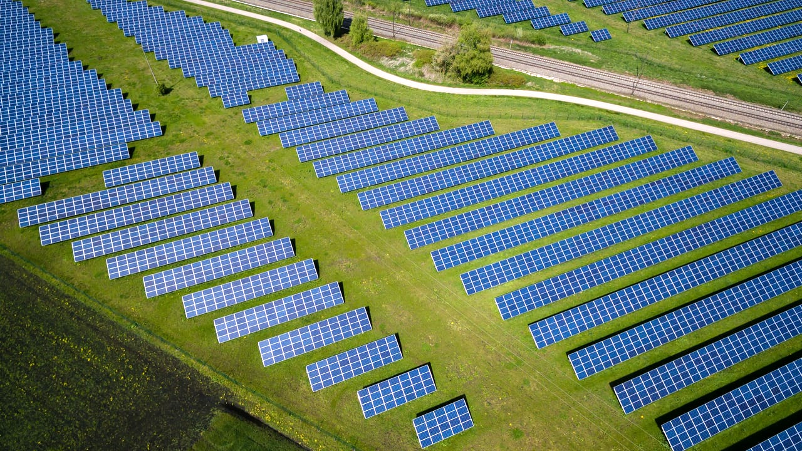
Job selection complete!
On the handout provided, write down the trade that you have selected for your business.

Slide 11
SWOT Analysis
STRENGTHS
What are your strengths that will transfer to your business?
WEAKNESSES
What are challenges of different industries? What are some weaknesses you should address/identify?
S
W
Based on your skills, your location, the market demands, etc., think about what opportunities exist.
OPPORTUNITIES
What threats exist that could affect your business being successful?
THREATS
O
T

Slide 12
What is the scope of your business?
Now that you have decided your industry, and completed a SWOT analysis, decide what service you will offer.
Keep it simple! Ideally, select ONE thing you will offer to your customers or clients.

Slide 13
BRAINSTORM
WHEN HAVE I SEEN A PERSON OR BUSINESS IN THIS FIELD IN MY LIFE?
HAVE MY PARENTS OR I EVER HIRED SOMEONE IN THIS FIELD?
HOW MUCH MONEY CAN I MAKE OFFERING THIS SERVICE?
WHAT KINDS OF JOBS DOES A PERSON IN THIS FIELD OFTEN PERFORM OR OFFER?
WHAT SKILLS WOULD ALIGN WITH MY PERSONAL STRENGTHS?
HOW EXPENSIVE ARE THE TOOLS OR MATERIALS FOR ME TO OFFER THIS SERVICE?
WHAT DO I ENJOY ABOUT THIS FIELD?
WHAT IS THE COOLEST JOB YOU CAN DO IN THIS FIELD?

Slide 14
SCOPE OF YOUR BUSINESS complete!
On the handout provided, write down the service you will offer your clients.
Photo by jesse orrico on Unsplash

Slide 15
Initial and upfront costs
How much will I need to get started?
2

Slide 16
Big concept
Now that you know what services you will offer, it’s time to look at how much it will cost to get started.

Slide 17
BREAKDOWN OF EXPENSES
Photo by Ashraf Ali on Unsplash

Slide 18
Registering a business
Click on the link below. Look through the sites to find how much it will cost you to register a business.
Register a Business in Ontario
Registering a sole proprietorship or partnership

Slide 19
Take some time to research
Photo by Jiyeon Park on Unsplash

Slide 20
YOU SHOULD HAVE FOUND:
$26 for a name search
$60 to register that name
$60 to renew every 5 years
$80 for new registration of your business
$40 for a records search
$210 for a limited partnership registration.

Slide 21
Registration costs
On the handout provided, write down the total cost to register a business based on your research and the previous slide. Ask for assistance from your teacher if necessary.
Photo by Steve Johnson on Unsplash

Slide 22
2. One-time startup costs
Computer and printer: $1,500
Primary trade tools (adjust this number if asked by your teacher to do so): $2,000
Furniture to set up your business space: $5,000

Slide 23
$8,500
In the space provided on your handout, write down this total for your upfront costs.

Slide 24
Module 2: total
In the space provided on your handout, add the cost of:
Registering a business
One-time startup costs
Photo by pina messina on Unsplash

Slide 25
Monthly expenses
Now that we have an idea of startup costs, we need to know how much money we need to be sustainable.
3

Slide 26
Big concept
Now you have an idea in mind of how much you need to save for the initial startup. But it’s important to know how much you will need on a regular basis. It isn’t a bad idea to save some extra money to help with these costs!

Slide 27
BREAKDOWN OF EXPENSES
Photo by Ashraf Ali on Unsplash

Slide 28
1. location
Will you need to purchase or rent a space to operate your business? What kind of space will you need? Different industries and businesses have very different requirements, so think about the needs specific to your business.

Slide 29
location
Things to consider:
Location:
Downtown? Suburbs? Industrial Park?
Developed ($$$) or less developed area ($)?
What city or town?
Indoor and/or outdoor space requirements?
Accessibility and visibility?

Slide 30
location
Things to consider:
Size:
How much room will you need?
Do you need room for customers or clients?
How much room do you need to do the work?
Do you need room for storage?
Is there several large items that need space (in length, width, height)?

Slide 31
location
Things to consider:
Type of rental space:
Do you need a garage, an office, a workshop, a kitchen, etc?
Do you need a street-level unit?
Do you need large or garage doors? A delivery entrance?

Slide 32
location
Things to consider:
What other factors may be important?
Is it set up for your business already?
Is it in a residential area?
Can you perform your selected scope in that space?

Slide 33
location
Take some time to find a suitable location on a real estate site. For example, realtor.ca, zolo.ca, etc.
Note: you can select a region in Ontario other than your own.

Slide 34
Take some time to research
Photo by Jiyeon Park on Unsplash

Slide 35
$______/month
In the space provided, write down the monthly cost of rent or monthly mortgage payments, based on your research.

Slide 36
2. Property insurance
The property you will be insuring will be at a higher rate than it would be for a residential space. We will assume an average amount for your calculations.

Slide 37
$200/month
In the space provided, write down the monthly cost of your property insurance.

Slide 38
3. Phone bill
Assume you have a business phone plan for only one phone.

Slide 39
$100/month
In the space provided, write down the monthly cost of your phone bill.

Slide 40
4. Automotive costs
You may not need a vehicle, but you will most likely need to pay for deliveries, meet clients, or other vehicle/gas expenses.

Slide 41
Automotive costs
Assume the following:
Monthly vehicle payments (finance or lease)
Gas
Vehicle insurance
Budget for service or repair

Slide 42
$1,000/month
In the space provided, write down the monthly automotive cost.

Slide 43
5. Liability insurance
Different businesses will have varying levels of danger or liability.
Generally, industries that can result in injuries or fatalities will cost more in insurance than other businesses.
Regardless of the business, you want to protect yourself from lawsuit.

Slide 44
$100/month
In the space provided, write down the assumed monthly cost of liability insurance.

Slide 45
6. Utilities
Depending on your business, this cost can vary, within a range of tens or hundreds of dollars. This number can be adjusted by your teacher.

Slide 46
$350/month
In the space provided, write down the monthly utility cost.

Slide 47
7. Tools and maintenance
Different businesses will have varying tool costs. Assume this is an average cost that includes replacing damaged tools, buying needed new tools, and maintenance and repair. This cost can be adjusted by your teacher.

Slide 48
$500/month
In the space provided, write down the monthly cost of tools and maintenance.

Slide 49
8. Advertising
Assume you will be spending some money to advertise your business.

Slide 50
$200/month
In the space provided, write down the monthly cost of advertising.

Slide 51
9. Consumable costs
Consumables are items that you require, that are used up and disposed of. They need to be constantly replenished.
Different businesses or industries will have different consumables required to do the work. Adjust the suggested amounts with your teacher if necessary.

Slide 52
Take a minute to brainstorm some likely consumable costs for your business
Photo by Jiyeon Park on Unsplash

Slide 53
8. Consumable costs
Some suggested consumable costs include:
Cleaning supplies
Paper and ink to print invoices
Bathroom supplies for you or clients
Pens and pencils
Safety gear

Slide 54
8. Consumable costs
Some suggested consumable costs include:
Industry specific materials such as:
Blades
Rags
Sandpaper
sprays

Slide 55
8. Consumable costs
Soaps
Paints
Oils
Etc.

Slide 56
$650/month
In the space provided, write down the monthly consumable cost.

Slide 57
salaries
You can’t sustain your business if you can’t pay yourself or your employees
4

Slide 58
Big concept
A company is only successful if the owner and employees can survive on their wages.

Slide 59
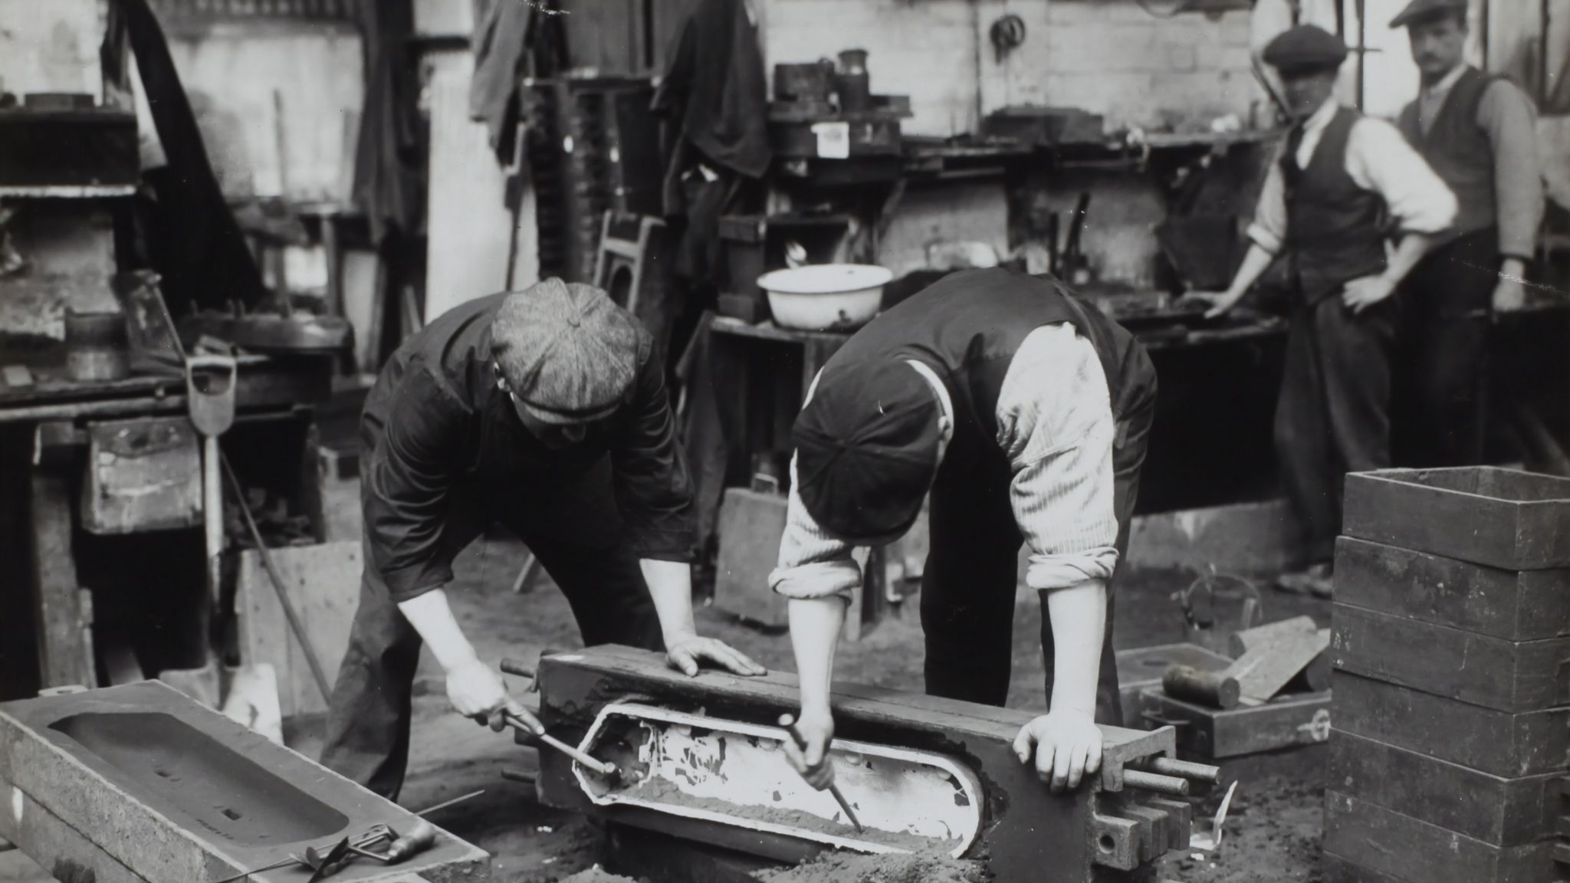
wages
To find the wages for yourself and your employees, use the following website:
https://www.jobbank.gc.ca/home
Photo by Museums Victoria on Unsplash

Slide 60
1. Your wage
The more you pay yourself, either:
the less you have to grow your company,
OR
the more expensive you will need to charge your clients.
Use the job bank website to find a realistic salary for your position.

Slide 61
1. Your wage
To calculate your salary:
Weekly Wage:
($/hr) x 40 = WW
Monthly Wage:
WW x (52 ÷ 12) = MW
Annual Wage:
MW x 12 = AW

Slide 62
$_____/month
In the space provided, write down your MONTHLY wages, assuming a 40 hour work week.

Slide 63
2. employees
You can select the roles of your TWO employees.
Ex. apprentices, journeymen, accountants, secretaries, administration, etc.
Use the job bank for appropriate salaries!!!
Remember:
Use the same formulas to calculate monthly wages as you used with your own!

Slide 64
$_____/month
In the space provided, write down your FIRST EMPLOYEE’S MONTHLY wages, assuming a 40 hour work week.

Slide 65
$_____/month
In the space provided, write down your SECOND EMPLOYEE’S MONTHLY wages, assuming a 40 hour work week.

Slide 66
3. wsib
Click on the following website:
WSIB
Do you need WSIB for your business?
Scan through the website to find if you need it!

Slide 67
3. wsib
If you need WSIB, to keep it simple, assume an average rate of $1.75
Take the total monthly salary of your two employees and multiply it by the wage above, divided by 100.
Ex. [$(wage 1) + $(wage 2)] x 1.75 ÷ 100 = Contribution

Slide 68
3. EI contributions
Take the total monthly salary of your two employees and multiply it by $1.58, divided by 100.
Ex. [$(wage 1) + $(wage 2)] x 1.58 ÷ 100

Slide 69
3. CPP contributions
Take the total ANNUAL salary of your two employees and multiply it by 5.45%.
Ex. [$(wage 1) + $(wage 2)] x 0.0545

Slide 70
$_____/month
In the space provided, write down your total monthly WSIB + E.I. + C.P.P. cost.

Slide 71
Reflection
Is my plan realistic?
5

Slide 72
Big concept
Now that you see the cost to sustain your business, let’s see if it’s realistic or if we need to make adjustments.

Slide 73
Recap your expenses and costs
Photo by Sanket Shah on Unsplash

Slide 74
Upfront costs
Based on your upfront costs, as well as at least three months of your total monthly costs, how much money will you need to save from now until you get your C of Q or Red Seal?

Slide 75
$_____
Write down how much you need to save just to start a business.

Slide 76
Monthly Expenses
Write down your total monthly expenses, including the salaries of your employees, as calculated above. Assume your employees are all working 40 hours a week.
Photo by NeONBRAND on Unsplash

Slide 77
$_____
Write down your TOTAL monthly expenses in the space provided, as calculated in the previous modules.

Slide 78
Pricing your job
Do some research and/or some calculations to determine a reasonable rate to charge customers for the service you offer.
Use google, ask your teacher, ask parents, stores (ex. Home Depot), etc.

Slide 79
Take a minute to figure out a reasonable rate for your service!
Photo by Jiyeon Park on Unsplash

Slide 80
$_____
Write down how much you will charge for completing ONE job.

Slide 81
Time to completion
Research how many hours will it take to complete ONE job?
** Do your best to research or make an educated guess.

Slide 82
Take some time to research and calculate
Photo by Jiyeon Park on Unsplash

Slide 83
Monthly project management
Based on how long it takes to perform that job, and assuming that you and your employees are working 40 hours a week, how many contracts can you complete in one month?
Note: keep the decimal if that is what you calculate.
Note: 52/12 give an average of number of weeks per month

Slide 84
Monthly JOB pricING
Example 1:
If you are a hairstylist and an average haircut takes one hour, you can do 1 x 40 = 40 cuts per employee per week.
Therefore, if you have two employees other than yourself, you three can do 40 x 3 x (52/12) = 520 haircuts in a month.

Slide 85
Monthly JOB pricING
Example 1:
40 x 3 x (52/12) = 520 haircuts in a month.
40 cuts per week
3 people doing the haircuts
52 weeks in a year
12 months in a year

Slide 86
Monthly job pricing
Example 2:
If you are a carpenter takes 3.5 hours to install a door.
Therefore, if you have two employees, you can do (40/3.5) x 3 x (52/12) = 148.57 doors in a month.

Slide 87
Monthly job pricing
Example 2:
(40/3.5) x 3 x (52/12) = 148.57 doors in a month.
40 hours of work per week, and it takes 3.5 hours to do one door. Therefore 40/3.5 = 11.429 doors a week per employee
3 employees
Average number of weeks per month

Slide 88
_____ hours
Write down how many hours it will take to complete ONE job.

Slide 89
Monthly Financial Forecast
Using the following equation, how much revenue can you bring in?
Monthly Revenue = (cost per job) x (number of jobs per month)
Write it down on your Data Sheet.

Slide 90
$_____
Write down your TOTAL monthly revenue.

Slide 91
Cost of Goods Sold
Of the above cost, how much DOES NOT go to your business.
Ex. If you charge $600 to install a window, but the window itself costs $350, then ONLY $250 goes toward paying employees, or your other monthly costs.

Slide 92
$_____
Write down your TOTAL Cost of goods and subtract it from your profit.

Slide 93
Break even Point
Is this enough to cover your monthly costs (overhead plus employee salaries)?
Is this enough to JUST pay your overhead?
How much will you be paid?
How much is left for the business?

Slide 94
Break Even Point
How many hours a week would you and your two employees need to work in order to bring in enough revenue to pay for your monthly costs?
Look back at your expenses. Where can you save some money? Where can you pay more?
EVALUATING Costs

Slide 95
Take some time to research and calculate where you can save money
Photo by Jiyeon Park on Unsplash

Slide 96
Write down your edited expenses and budget.
Repeat module 5 with your new monthly expenses.
Photo by Alexandre Debiève on Unsplash

Slide 97
Reflection: Now until you get your c of q
Are you able to save $20,000 a year? What about $5,000 a year? What is a realistic amount?
How many years will you need to work before you can start your company?

Slide 98
Reflection: Now until you get your c of q
What is your living situation going to be? Will you be living with your parents or paying rent?
Will you be paying your monthly bills yourself? Ex. food, clothing, transportation, etc.

Slide 99
Make an invoice
Now let’s learn how to make an invoice, based on your calculations in Module 5.
6

Slide 100
Here is the Clip which demonstrates how to create an invoice in the ACCOUNTING program WAVE.
Screencastify Clip
(5 mins.)

Slide 101
The game
Have fun beating your friends in a game of chance, such as operating a business. Each choice you make affects your business, as well as those around you! Are you the next Billionaire!!!
7

Slide 102
Thanks!
Any questions?
You can find me at:
@username
user@mail.me

Slide 103
Credits
Special thanks to all the people who made and released these awesome resources for free:
Presentation template by SlidesCarnival
Photographs by Unsplash

