Slide 1
ALLYSHIP AWARENESS
Informative training to understand what it means to be an Ally and the importance of being an Ally

Slide 2
STUDENT WORKBOOK
Allyship Training Student Workbook Link
Notes:
Ensure that students have either a print version or an editable PDF version of the student workbook.

Slide 3
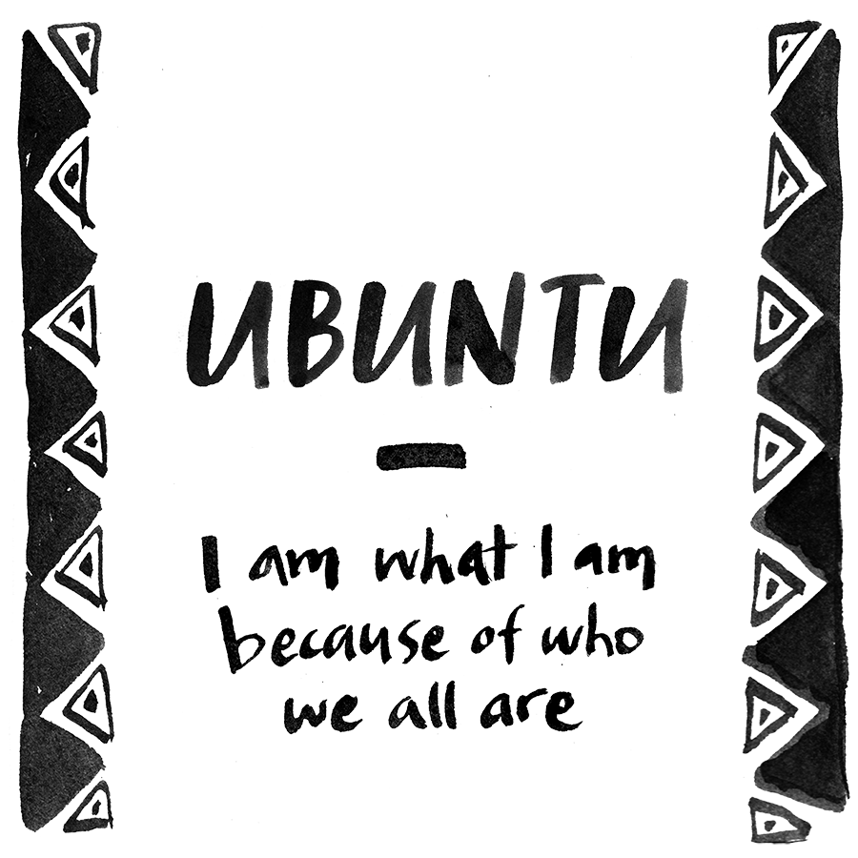
UBUNTU (n.)
A philosophy
A way of being that guides us
Pronunciation: oo-buhn-too
Origin: South African
Definition:
The belief that we are defined by our compassion and humanity towards others
Notes:
Creates an interconnectedness between everyone. Helps to show us that we are undeniably connected. UBUNTU allows for individuals to build relationships with one another and find a common ground between each other. Compassion and humanity are key to bettering and building upon our understanding of one another

Slide 4
IDENTITY
Identity is complex
Understanding someone’s identity is often limited to what we see on the surface - it doesn’t take the unseen aspects into account
Some aspects of identity are visible while others are invisible to others
It is important to avoid stereotypes and assumptions about an individual’s identity
“The qualities and beliefs that make a particular person or or group different from others” - can include: age, race, physical appearance, sex, religion, gender identity, sexual orientation, ethnicity, accessibility…
Notes:
Teachers: please go over this mini lesson for educators that further explains identity and the identity iceberg, which will make it easier to teach it to students and answer questions. If you want to, feel free to share parts of it with your students if it helps you to answer their questions:
https://adl.org/sites/default/files/identity-iceberg/story.html
Identity helps us to show who we are to one another. We are able to choose some items that we want others to know. While other items can be visibly seen. We will discuss this more on the next few slides.

Slide 5
There are different types of identity. The two that will be focused on for this training are:
PERSONAL IDENTITY
Are traits that make one different than others
This includes: your individual name, personality, history and unique characteristics of the individual and etc.
SOCIAL IDENTITY
This includes connections and affinities that an individual has with other people, values and norms that are accepted
This impacts the way that the individual behaves in that social setting with that affinity group
APPLICATION
In your own notes, write down the top 3 identities that you feel closest to
Next pick one item that you have (either with you or at home) and describe why it is important to you and why it best represents you. Share it with the people sitting around you.
Notes:
Our social identities and personal identities are relational. They both impact one another. The social groups that we belong to (and their identity) impact our own personal identity, while our own personal identities determine the social groups (and their identity) that we end up belonging to.
Notes for teacher about activity: the point of the activity is to create connectedness between the students to foster a positive, safe and brave space to talk about what is in this training. By students learning about themselves and each other, it will help build community. Begin this activity by modeling it with an item of your own so that students feel like you are open to discuss and participate as well.

Slide 6
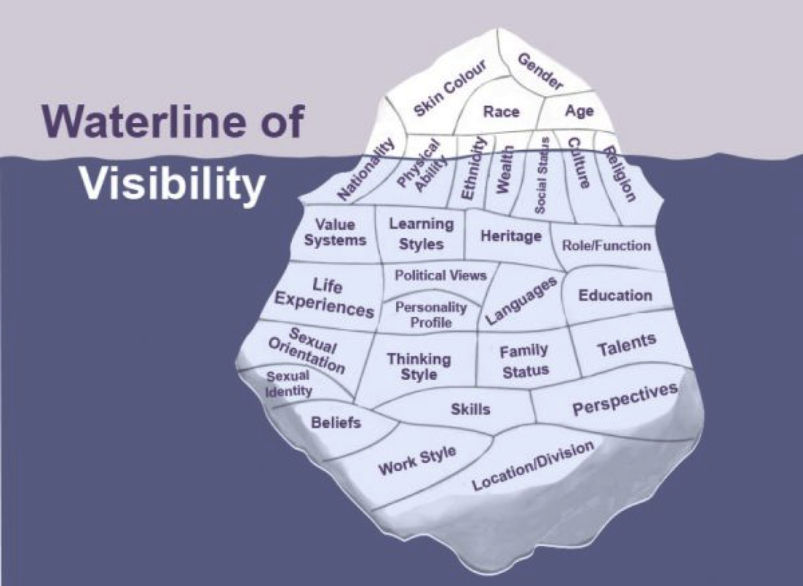
SELF REFLECTION
Review the image on the side and think about how it relates to yourself.
Reflect on the following and write down any thoughts in your own private notes:
What do you easily show to others around you?
Why do you choose to show those aspects of yourself to others?
Does your audience impact what you show of yourself that can not be physically seen?
How has the most visible aspects impacted you in your life?
Do you think anything listed as not being visible should be included in the visible section?
Notes:
This is a cultural iceberg that helps us realize what is actually seen by others in our own lives. We control what others see or know about the aspects of our own self that are under the waterline of visibility. We can choose to share the identities that are most hidden on the iceberg when we feel comfortable enough and safe enough to do so. However, our identities found at the top of the iceberg above water are visible to others whether we like it or not. This automatically places us in direct relation with those social identity groupings (intersectionalities) and the traits (both good and bad) associated with it. This can unfortunately lead to being labeled with stereotypes. A stereotype is a widely held belief or idea of a particular person or group (whether true or not).
Notes on reflection question: see if anyone would like to share their thoughts on question 5. Have them explain their thought process so everyone can understand how they got to they views.

Slide 7
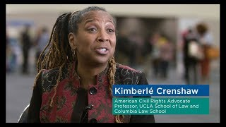
INTERSECTIONALITY
Intersectionality was first coined in 1989 by Kimberle Crenshaw
It connects to the facts that there can be multiple ways of discriminating a person based on aspect(s) of their identity
Different types of discrimination can intersect with each other to further discriminate a person and deepen the inequalities
It is a framework that states that overlapping social identities relate to social structures of racism and oppression
Intersectionality is directly linked to oppression
Notes:
Those who have more intersectionalities that are less powerful in society or are viewed in less regard in society (less privileged) are more likely to face systemic and intentional oppression. We will learn more about oppression later on in the training. A heterosexual white Christian male will have more opportunities in society, while a person who identifies as being black, homosexual, Islamic or a woman (for example) will face more oppression in society simply due to the intersectionalities they may identify as.

Slide 8
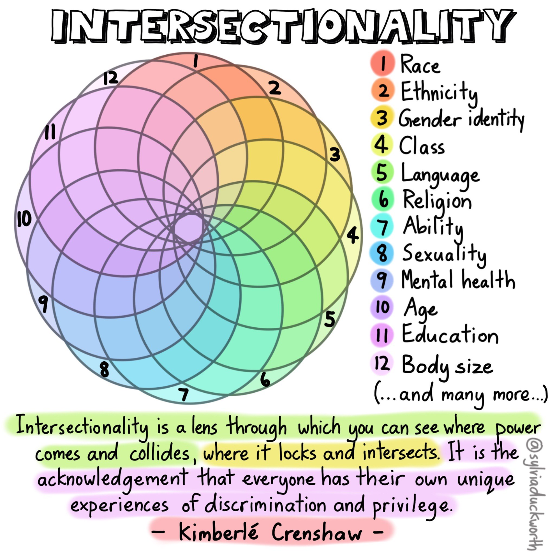
SELF REFLECTION
Identity and intersectionality are different. Review the image on the side and think about how it relates to yourself.
Reflect on the following and write down any thoughts in your own private notes:
What do you easily show to others around you?
Why do you choose to show those aspects of yourself to others?
Does your audience impact what you show of yourself that can not be physically seen?
How has the most visible aspects impacted you in your life?
Notes:
As our society has learned more, the types of intersectionalities have grown to meet the needs of society. These help shape us and how we identify as within the society and social group that we live in. These not only connect us with each other but unfortunately acts as ways that people can be discriminated against.
Activity: have students share if they want to or they can just write it down for their own notes. If they choose to share. Be sure to actively listen to them and engage with what they say, so they feel heard and valued.

Slide 9
BACKGROUND
Equality -> Equity -> Justice
Individuals and communities must be willing to move from thinking everyone requires the ‘same’ level of support (equality) to providing supports to overcome any barriers they encounter (equity) to have individuals and communities working to remove the barriers for those who are marginalized (justice).
Notes:
It is important to emphasize the big difference between equity and equality. They are not the same. Equality looks at everyone being seen as equal (equal treatment, equal outcomes). Equity looks at giving everyone the opportunities that they need to be able to attain similar outcomes. Justice is when we take the steps needed to ensure equity is being done for marginalized groups to be able to have opportunities to succeed.

Slide 10
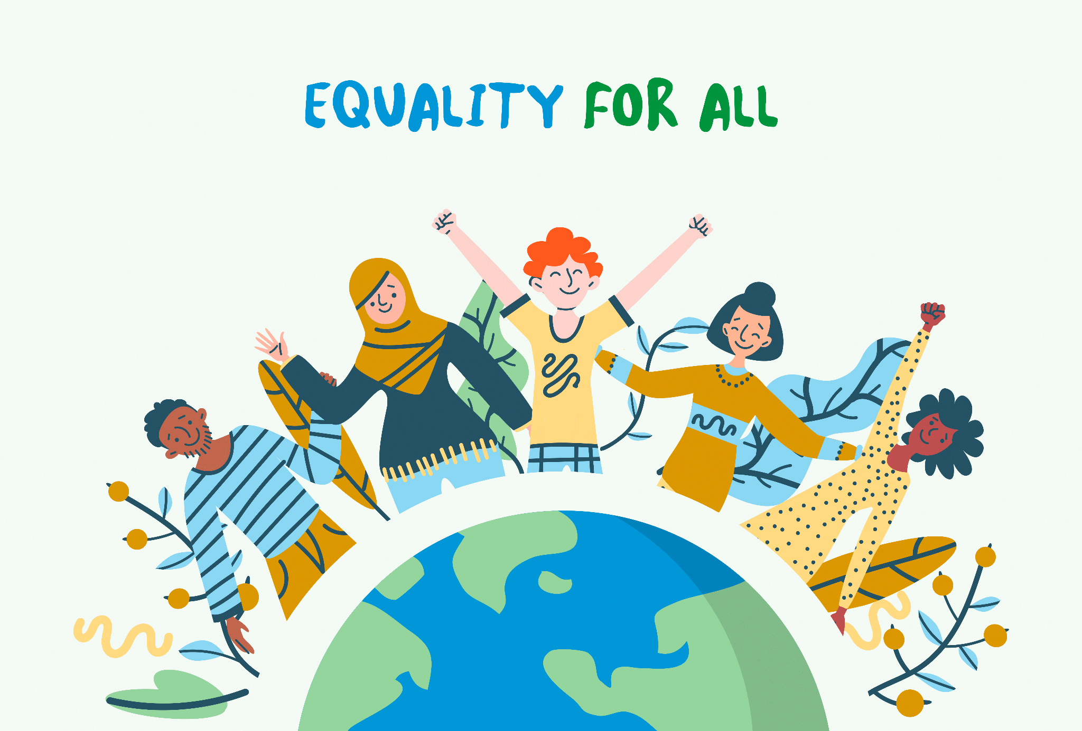
EQUALITY
(noun) The state or quality of being equal, especially in status, rights and opportunities
DISCUSS Why does a society need to have everyone measured to the same standard?
Is this the same in all societies or does it differ based on location?
APPLICATION Review the following slide and determine which animal is going to pass the test with no intervention and which animal will require the most interventions? An example intervention might be to provide stairs.
Notes:
Does Fair mean Equal? Why would someone think that everyone in society needs to receive the same level of supports? Giving everyone the same level of support/input does not necessarily allow everyone to reach the same goal/output. It only furthers the gap between those who are privileged and those who are not. We will talk more about this later on in the slides. On the next slide, what might the instructor do to show the strength of each creature?

Slide 11
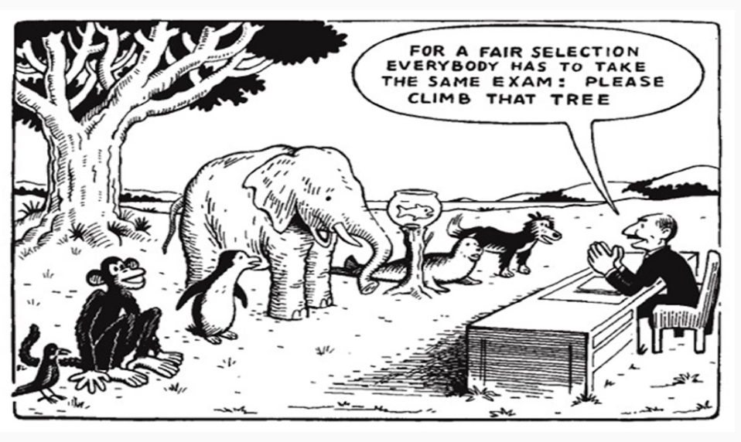
EQUALITY
Notes:
What could be done to ensure that all animals are given a fair chance to climb the tree?
What could you do to show the strength of each animal on this slide?
What interventions can be done to help each animal achieve the same goal?
Let’s discuss our answers and our reasonings.
Follow up question: How can you relate this slide to equity and equality? Explain.

Slide 12
EQUITY
(noun) The quality of being fair and impartial; takes into account a person’s unique circumstance and adjusts treatments accordingly so that the end result is equal. Closely linked to equality, diversity and inclusion.
DISCUSS In order to have an equitable society, every person or community must be provided the resources that will allow them to be successful. Equity refers to fairness and equality in outcomes, not just in supports and opportunity
APPLICATION Review the following slide and determine what resource was used to create the equity. Can you give other examples of resources from your community?
Notes:
Our federal and provincial taxes are done on a scale/ratio where those who make under a certain amount don’t need to pay tax/pay very little in comparison with those who make much more. That is an example of equitable government policies. In schools, students with Special Needs receive varying degrees of supports depending on their individual special need(s). In education the supports provided will allow most students to graduate. The input/supports are different but the goal for everyone to graduate is the same. These help show that different groups of people will require different supports in order for all of them to reach the same goals.
Society must provide supports to those groups who have been historically or systemically oppressed due to one or more of their intersectionalities. This is slowly starting to happen, but will take much more work to do so. We must advocate for these supports to be created/adapted so that all groups of people can have the opportunity to succeed in our society.

Slide 13
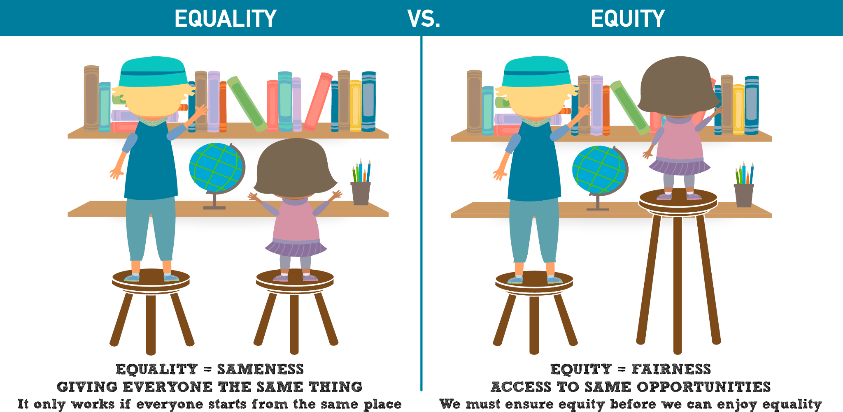
Notes:
What supports have been given here for both children to be able to receive the same outcome? Why was the support given to the child on the right? Explain your answers.
How might you respond to those who don’t think that giving the little girl a higher stool is OK? Explain.
Due to the the child on the right visually identifying as a girl who is racialized, we can see right off the bat that she is not as privileged as the visually identifying white male on the other side. This means that in society the white male will be systemically offered more opportunities than the black female who has been historically oppressed due to her race and sex. Therefore, more support is required to help her reach the same outcome (based on equity practices).

Slide 14
Notes:
Diversity, equity and inclusion all go hand in hand and are often linked with each other when doing this work. Over the past few years, DEI (diversity, equity and inclusion) training has started to occur wherein different aspects of society assess their own organizations to see how it includes and embeds DEI into their work, processes and such. This has sparked organizations to start reflecting on their own practices to ensure they are equitable and inclusive to all groups making for more healthier and positive working environments.

Slide 15
JUSTICE
DISCUSS In order to have a Just Society, every person or community must work at breaking down systematic barriers. What are examples of systematic barriers that lead to systemic racism and oppression?
APPLICATION Review the following slide and determine what was the barrier. Did a change to the barrier hurt or change anything with the outcome of the game? Can you give other examples of other barriers people from your community face?
Notes:
Injustice is when systemic barriers are set out policies, procedures, or practices that administered which unfairly discriminates and prevents individuals from participating fully in a situaion. Systemic barriers are often put into place unintentionally. They can be old policies/procedures/practices that have not been revised or adapted to meet the current needs of those groups in society. Examples of systemic barriers can range from - those living in poverty not able to access all levels of healthcare to Indigenous people making up about 32 per cent of the federal prison population, despite accounting for less than five per cent of the total population. Indigenous women, meanwhile, account for approx 50% per cent of the population in women's prisons. https://www.aptnnews.ca/national-news/canadas-prison-system-has-changed-little-for-indigenous-peoples-report/#:~:text=%E2%80%9CA%20corporate%20culture%20and%20a,made%20up%20of%20Indigenous%20peoples
Is this just? What do these facts tell us about how just our society is? How does this show systemic oppression (that discrimination and barriers that are built into the very systems that govern our society and benefit those who made them and those who are in power i.e. non-racialized groups of people)?

Slide 16
A JUST SOCIETY
Why it matters?
Individuals and communities must be willing to move from thinking everyone requires the ‘same’ level of support (equality) to providing supports to overcome any barriers they encounter (equity) to have individuals and communities working to remove the barriers for those who are marginalized (justice).
For those who believe they are marginalized live every day in a system predicted on injustice, no explanation is needed.
Notes:
This helps sum up the previous slide with the stark reality that so many in our country still live in an unjust environment. We see this everyday. Can you think of some times in the news, where you have seen marginalized groups of people being treated unjustly? What are your thoughts on how we can help change this? Explain.

Slide 17
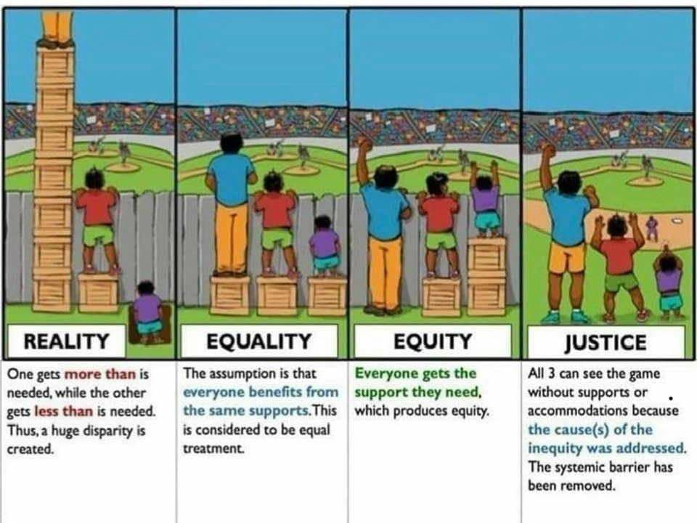
JUST SOCIETY
Notes:
Please read and discuss the descriptions under each picture. How does this image make you feel? Why do you think all 4 categories are important? Why is it important to strive for a just society? Where do you think our current society is based on the four categories when reflecting on your own beliefs, understanding and lived experiences? Explain.

Slide 18
SELF REFLECTION
Can you think of a time when you witnessed a situation that was inequitable, or not inclusive?
What happened?
How did you know it was inequitable?
How did it make you feel?
How did the people around handle the situation?
What might you do differently in the future?
Write down your thoughts in the student workbook. Feel free to discuss it in a class discussion now.
Notes:
Teacher note on slide: Have students share their information with three other people in the room in a small group format. Let students know that they can share if they feel comfortable otherwise they can choose to keep it to themselves and discuss something less personal.
Then, you can bring it back to a large group discussion and see if anyone feels comfortable sharing but be sure to bring it back to the concepts of equity, equality and justice.

Slide 19
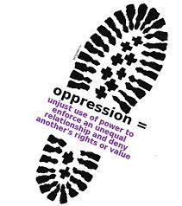
OPPRESSION (n.)
Definition:
The exercise of authority in an unjust manner;
A system of mistreatment, exploitation and/or abuse of marginalized group(s) for the benefit of a dominant group;
Benefit can be social, political or economic;
This would be based on the social identity that a person has;
It is institutionalized power that is perpetuated over time.
Prejudice + Power = Oppression
Notes:
Oppression is when a group of people are mistreated and or abused by a privileged group of people. It is important for those who are privileged to stand up for those who are being oppressed, becoming an ally, which we will discuss further on in the slides. In order to be oppressed, a person with a higher deemed social location must exert power, privilege and control over you due to prejudice (a preconceived opinion of a group not based on fact or reason). It is important to understand that prejudice plays an important role in oppression. Often times people exert power over others due to untrue reasonings.

Slide 20
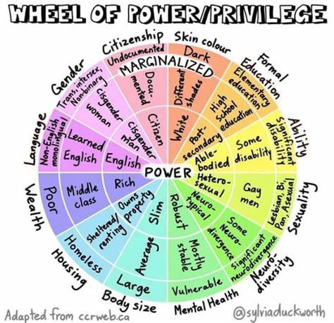
POWER
Definition:
The ability to influence (either directly or indirectly) the behavior of others or the events that may happen
Individuals can hold power over others for a multitude of reasons and can afford others with more advantages in society
Power goes hand in hand with privilege
Microaggressions
Notes:
The Wheel of Power/Privilege helps to give you a visual representation of the many factors that have an impact on the amount of power and privilege a person has based on how they choose (and are made) to identify. The closer to the middle of the wheel a person identifies as, the more power and privilege they would have as well. This clearly shows the interconnectedness of power, privilege, identity, social location, discrimination and oppression. How are all these terms connected - explain. What are your thoughts on this wheel?
Microaggressions are often used by those with power and privilege over someone with less power and privilege than them to ensure that they know the power imbalance. Microaggressions are backhanded comments that at first seem like a compliment but when further processed can be seen as an insult to the person due to their social location. An example of this could be: you are a pretty good driver even though you're a woman. Now let's unpack this. There are many stereotypes that state that women are bad drivers. This is not based on facts or reasonings. So when someone says you're a pretty good driver (that seems like a compliment) but then adds for a woman (this is the insulting comment). Essentially, they are putting down all women for not being able to drive as well as men, but that this specific person is better than those women. Have you ever heard any microaggressions based on a social identity of a person?

Slide 21
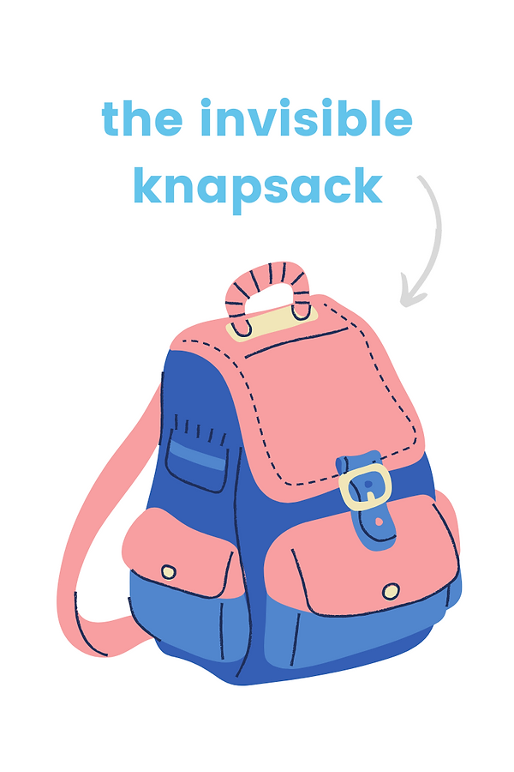
PRIVILEGE
Noun - the unearned advantage that an individual may have because they are apart of a social group that they are perceived to be apart of (that has power)
Advantages tend to be higher social status, income levels, positions of authority and greater control in the decision-making process in society
Usually occurs due to another social group being marginalized
This goes hand in hand with power
Notes:
It is important to note that when looking at privilege that one can be privileged in certain aspects of their social locations while they can be oppressed in other facets of their social identity. For example, a white identifying woman would be privileged in her race (white) but not privileged with her sex (woman). Being white in society comes with inherent power while being a woman in society is connected with less power and more oppression. Being an educated black male in society shows that he is privileged and powerful due to identifying as a an educated male (socioeconomic and sex) while being underprivileged as identifying as a person who is black (race). This is due to how society has systematically oppressed people who identify as being black over the many years and taken advantage of them by exerting their own power and privilege over them to keep them oppressed.

Slide 22
PRIVILEGE QUIZ
Complete the following quiz based on your own lived experiences. Once complete, tally up your marks to see how much “privilege” you have in society. Be understanding that this quiz was originally made in 1988 and some progress has been made on it, but much more is needed.
Privilege Quiz
Notes:
Peggy McIntosh had her findings published on the invisible backpack and white privilege in 1989. Peggy describes her connection with her unearned advantages because she identifies as a white woman. She explains power, privilege, oppression and white supremacy within this.
Within our own individual backpacks, we hold our own lived experiences and social identities, which can be heavy on our backs. We all walk around with these burdens day in and day out, and they have large impacts on our lives everyday. These challenges are seen as being invisible barriers that we must get through in order to succeed.
This activity helps students self-reflect on their own lives and lived experiences to see how much privilege they have and further their own understanding of white privilege. It will help them further understand how their own relationship and connection to whiteness both acts to benefit or disadvantage themselves in society.
This activity has been highly controversial over the many years - especially when it first came out. At the time, power and privilege was barely talked about in relation to equity and inclusion. This activity helped show people the inherent differences of treatment of those who identify as white and those who do not.
“Peggy McIntosh defines her white privilege ‘as an invisible package of unearned assets that I can count on cashing in each day, but about which I was ‘meant’ to remain oblivious. White privilege is like an invisible weightless knapsack of special provisions, maps, passports, codebooks, visas, clothes, tools and blank checks.’ Layla F. Saad describes the relationship between white privilege and white supremacy – white privilege is the “reward that white and white-passing people receive in exchange for participating in the system of white supremacy […] voluntarily or involuntarily. White persons cannot escape the benefits of white privilege and must be able to name and understand the benefits that such privilege confers to do any meaningful work in dismantling the systems of oppression that benefit whites and disadvantage racialized groups.”
This activity helps students engage in anti-racist pedagogy wherein they are able to analyze individuals and structured forms of racism, learn to disrupt/dismantle/interrupt oppression whenever and wherever they see it, and further their own understanding of positionality and power of everyone within a society.
Teacher: review the following website that has more information on the invisible backpack and teacher notes prior to teaching this part so you are more comfortable with these topics.
https://nationalseedproject.org/Key-SEED-Texts/white-privilege-unpacking-the-invisible-knapsack

Slide 23
ANTI-OPPRESSION
Are the theories, actions and practices that ACTIVELY challenge the systems of oppression in which the society operates in
It is meant to be challenged on an on-going basis - it should not just be a one time challenge
It seeks to call out the oppression that is being had in society and tries to limit the effects of it by lessening the power imbalances had within the society
ACTIVITY
In small groups, explain your full name (i.e. how to say it properly, how you got it, what it means, any stories around it and any additional information that you would like to share
Notes:
Anti-Oppression - requires active pushback on the systems of oppression that are currently had by people. Members in society must challenge these oppressive systems everyday in order to make change happen. When something is called out it means you publicly announce that the oppression is there and that it is wrong. When something is called in, it is a more one on one approach to talk to the person being oppressive to help them understand how they are being oppressive in order to facilitate change. Depending on the situation, one may choose to call out instead of call in someone, or vice versa. Ideally, you would try and figure out which approach would work best given the moment. For example, if you are having a conversation with another peer, you may choose to call in with them. However, if you in a group setting and harm has been done, calling out a person may work better in this situation.
Name Activity: when we learn how to properly say each other’s names, we give each other importance and acceptance of who they are. By saying someone’s name incorrectly, we further the oppression and diminish their own self-worth and identity. It is not difficult to learn how to properly say a person’s name - that is who they are. We must be accepting and understanding of our differences in order to build belonging and positivity.
In small groups, write out your fullest name and tell your story (name origin). Think about the following to help: who gave you your name? Why that name? Do you know the ethnic origins of your name? Does your name have a meaning? Do you have a nickname? What is it and how did you get it? What is your preferred name?
Them, each person will take turns sharing their name origin and any other details that they would like to share based on their self-reflection of their name.

Slide 24
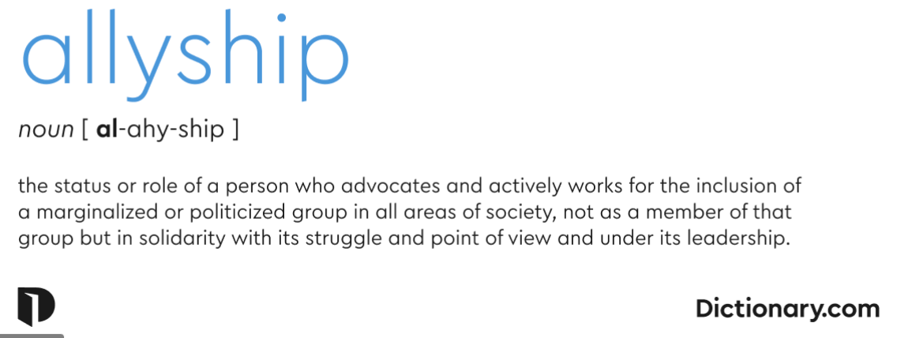
To create a just society - become an ALLY
Notes:
It is important to note that marginalized groups of people need the support of those who are privileged to speak out, interrupt, disrupt and dismantle the oppression that is happening within society. This is what makes someone truly an ally. An ally will advocate and actively work to eliminate the disadvantages faced by minority groups on a daily basis. They work to help to make sure the voices of minority groups are heard and valued by centering them whenever possible. They also work to change the attitudes/mindsets of those who are privileged to help eliminate some of the barriers and further the acceptance and understanding of minority groups within society.

Slide 25
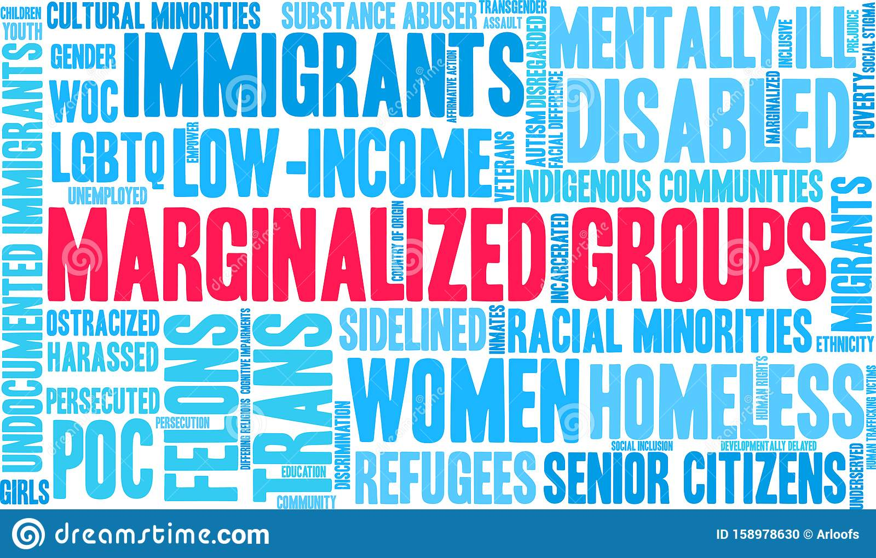
MARGINALIZED PEOPLE
Marginalized
adjective
(of a person, group, or concept) treated as insignificant or peripheral. "members of marginalized cultural groups"
DISCUSS
Reflect on your school community. What groups of people in your school or community do you believe are marginalized? Why?
Notes:
What makes a person or group marginalized? Is it race, gender, religion, etc. Who determines which race, gender, religion, etc is better than others? Minority groups are a group of people that do not fit into the mold of what society has predetermined them to be like based on stereotypes and prejudice.
Every group should have a shared working document to record their answers to the questions above. Explain the why to your answers as well. Share as a class.

Slide 26
ALLY
An ally is a trusted force for good.
The essential elements of that description are:
Willingness to learn
Trusted
Authentic
Notes:
Think about the elements listed above to be an ally. Discuss with your group what each aspect means to you. For example, what does it mean to be authentic? What would an authentic ally look/act like? Why is it important for an ally to be authentic? Analyze each element in this way to truly understand the role of an ally.

Slide 27
BECOMING AN ALLY
Fairness, justice, equity, opportunity and human dignity — that’s the work of allies.
It’s done for no personal glory or gain, although we all benefit when the work of allyship succeeds.
SELF REFLECTION
In your workbook, record your answers to the following questions:
What does an ally means to you?
Who has been an ally to you in your own life ot to society as a whole?
Explain how they were an ally?
Notes:
How does fairness, justice, equity, equality, inclusion, opportunity and human dignity play a role in being an ally? Take a few minutes now to write down what an ally means to you. Write down who has been an ally to you in your own life or to society as a whole and explain how they were an ally. This will help you to see the everyday allies that exist in society and within your life currently. An ally fights for what is right even when it is hard to do so and does it because it is the right thing to do.

Slide 28
The marginalized communities in society need us all to be an Ally.
Allies also show the marginalized group members that they are not alone in their struggle for a just society.
Allyship training can work with a marginalized person, group or community.
Let’s begin working through the Allyship steps.
Notes:
Being an ally means that you are willing to step up and fight for the just and fair treatment of all people even when it gets difficult. You are willing to carry the burden and hardship that may come your way because you know that those you are an ally for have had it much much worse in society.

Slide 29
STEP 1: Take Charge of your Learning and Unlearning
Confront your own prejudices and biases, even if it is uncomfortable to do; this is the first step in seeing things from the perspective of others.
Be willing to have your ideas about the history of the intersectionality(ies) that is challenged – these are social constructs and are constantly evolving (i.e. the history of Indigenous communities in Canada, slavery, homophobia, patriarchy and much more)
Determine if you must “Unlearn” or check on your Implicit Bias.
A lot of prejudice is biased in outdated ideals and ignorance about a specific group of people.
Notes:
What does it mean to unlearn? Is every child raised in an inclusive thinking home?
Everyone has the responsibility to assess their own implicit bias to “unlearn” in order to have a just society. What does it mean to unlearn something? It means that we need to let go of what we have learned in the past and re-learn in a new way. It is important to unlearn negative ways of thinking that can be detrimental. The term implicit bias is used to describe when we have attitudes towards people or associate specific stereotypes with them automatically or without our conscious knowledge which impacts our behaviour and actions towards them. Prejudice is the preconceived opinion that is not based on reason or actual experience and impacts our treatment of people based on it. For example, one can be prejudice against people who are from a different background than them.

Slide 30
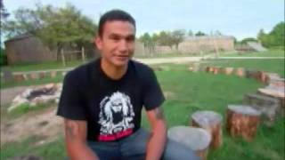
STEP 1: LEARNING EXAMPLE
Watch this video from CBC 8th Fire four-part Documentary. Wab Kinew, narrator and current Manitoba MLA, will bring you through 500 years of Indigenous History in Canada.
8TH FIRE EPISODE
Notes:
This video clip is only a small part of a great four part series. Take the time to watch the entire series. Link to CBC 8th Fire Documentary four part series. https://www.cbc.ca/firsthand/blog/8th-fire-wabs-walk-through-history Look below video clip to see the four part video series links on the web page. It is a four part series Part 1: Indigenous in the City, Part 2: It’s Time, Part 3: Whose Land is it Anyway? and Part 4: At the Crossroads.
After watching the video, ask students what they thought of it? Ask them what they learned from it?

Slide 31
STEP 2: TRUSTED
You can’t call yourself an ally. Others make that determination about you, one individual at a time.
To qualify, you must demonstrate trustworthiness.
Since we are defining our important terms, know that trust is confidence, in the face of risk, that another person will do the right thing.
Understandably, people who have historically faced injustice may have a higher threshold for extending trust.
Those who have experienced harassment, discrimination or incivility have every right to be cautious and skeptical.
Those who have harmed them (or still do) may be people they dared to trust. What makes you the person who will do the right thing?
Notes:
This is the background required to be an ally. Think about each point for your own learning and your growth as an Ally to be authentic. It is important to remember that our work should speak for ourselves when we are allies. We can not simply call ourselves allies - rather others must consider us allies by way of our work and actions.
At times the reasoning for ones work and actions may be questioned by the group, however as an ally it is important to explain why you are an ally and how you will continue to be an ally by way of your actions. If this does happened, it is important to not get defensive or upset as marginalized groups often times have had experiences with “allies” who are self-serving or performative and are not truly in it for the right reasons. If you truly are an ally, you will keep on pushing on to show marginalized groups that you are there to truly help end the oppression that they deal with.

Slide 32
STEP 3: LEARNING
The word “ally” is being thrown around a lot these days . . . mostly in labels that people apply to themselves, tied to a hashtag or an inspirational quote. It does not mean nothing, but it also does not hold the power it should. We are calling ourselves allies without going beyond words of solidarity.
Don’t be mistaken: Solidarity is better than silence, but on its own, it isn’t action that affects change. It won’t help win the war against systemic racism. To get there, we must truly align with this cause. We must believe this fight is ours and we must act with a commitment equivalent to that belief in order to be authentic and trusted.
DISCUSS
What does being trustworthy mean to you?
What actions make us trustworthy?
What does being authentic mean?
Notes:
Solidarity is when there is unity or agreement of feeling or action, especially among individuals based on a common interest had between members of the group. It includes having mutual support within a group for each other based on that common interest that connects members. It emphasizes the cohesive social bond that shares the same values and understanding.

Slide 33
STEP 4: AUTHENTICITY
Be authentic so do not rush your Allyship learning. Just as society will not change overnight, neither will you.
Here are some important do’s and don’ts to consider as you learn, grow, and step into the role of an ally.
The DO’S
• Do your research to learn more about the history of the struggle in which you are participating
• Do the outer work and figure out how to change the oppressive systems
• Do use your privilege to amplify (digitally and in-person) historically suppressed voices
• Do be open to listening
• Do be aware of your implicit biases
• Do the work every day to learn how to be a better ally
Notes:
A common example of implicit bias is favouring or being more receptive to familiar-sounding names than those from other cultural groups. Implicit bias doesn't mean that inclusivity is not one of our values. It means that we are not aware of how our own implicit bias can impact our actions and decisions, which ultimately acts to oppress a group of people.
It is important to amplify the voices of the group that you are being an ally for. By using your privilege to amplify the voices of those who have been suppressed, it allows them to have chance to truly have their voices heard. The work must be done everyday in everything that we do. We must live and breathe it and ensure that our actions are not seen to be a form of tokenism (doing something to appear to be fair and diverse, when in actuality it is not). An example of this is a work equity group having only one racialized member on it so that they look diverse but don't truly appreciate or take into account what that member has to say about equity issues or do not create a space for that racialized member to feel safe enough to bring up the issues that may be had.

Slide 34
STEP 4: AUTHENTICITY
THE DON’TS
• Do not expect to be taught or shown. Take it upon yourself to use the tools around you to learn and answer your questions
• Do not compare how your struggle is “just as bad as” a marginalized person
• Do not behave as though you know best
• Do not take credit for the labour of those who are marginalized and did the work
before you stepped into the picture
• Do not assume that every member of a marginalized community feels oppressed
DISCUSS
Which of the “don’ts” gave you an “aha” moment about yourself?
Notes:
When looking at allies - we are looking at those people that are privileged in a given situation. Hence, the don'ts are very important because it ensures that we are not perpetuating stereotypes and further oppression of the groups we are trying to be allies for. We must be sure that we are able to allow those minority groups to shine by giving them the audience and backing as an ally.

Slide 35
What is something we can do now in learning to be an Ally?
The following are some suggested ideas/projects/work that can be done within our schools, communities, province, country.
These are only suggestions and/or examples. You may know of an existing group or individual doing great Allyship work, ask if you can join with them.
If you know of where some Allyship work is required, ask those in leadership positions (Teacher, School Board Resource Teacher, Team Member, Principal, Mayor etc) to guide you in getting started on your Allyship journey.
Read through the following ideas to see where you might begin to be an Ally.
Notes:
All of the following SHSM Related activities and learning extensions are suggestions for you to be an ally. Remember when you are an ally, you have privilege in that social location and are able to fight for the just treatment of those who are being oppressed in that same social location.

Slide 36
CONNECTION TO OVIN
What is OVIN?
Is a flagship initiative in the automotive and transportation sector
Focused on building technologies that contribute to a lower environmental and carbon footprint
Looking for smart mobility solutions and advanced automotive technologies
Allyship Connection to OVIN & SHSM
Connection to women
Connection to minority groups who may not have been focused on
Retaining and leveraging highly skilled talent with skills and jobs
Becoming allies with all intersectionalities/social locations
Creating experiential learning opportunities to give to SHSM students to foster the growth of skilled talent so that an emphasis is had on the transportation sector and OVIN
Creating specific connections for every SHSM program linked to OVIN

Slide 37
SHSM Related ALLYSHIP
The following are project suggestions related to SHSM sectors to further Allyship with your students.
You can chose to complete just the activity or the activity and the extend your learning component.

Slide 38
ALLYSHIP LEARNING RELATED TO SHSM SECTORS IN ONTARIO
Notes:
Review your SHSM sector on the following slides and complete the activity listed in connection with anti-oppression and allyship.
Please note, the Extend your Learning shows another activity linked to OVIN with the SHSM sector that can also be completed.

Slide 39
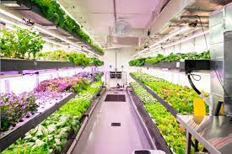
AGRICULTURE
Many Indigenous communities are far north and live in isolated areas.
Think about how an enhancement in transportation technologies can have a positive impact on maintaining sustainable agriculture in a community.
Activity: Research the company “GROWCER” Modular Food Solutions, Green Iglu - Strengthening food sovereignty in remote Indigenous communities.
Extend your Learning: Create an agricultural plan/idea for sustainable agriculture in your area.

Slide 40
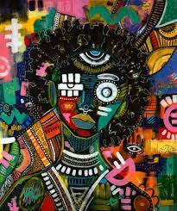
ARTS & CULTURE
Arts and culture is an important expression in our society. How can the learning of arts and culture impact the understanding of women and minority groups in the transportation industry?
Activity: Choose 4 artists or events and explain why you like these specific examples
Extend your Learning: Research a specific social location, create a video presentation showcasing your favorite artists or cultural events found within that social location and why you like them the most.
Charmaine Chanakira

Slide 41
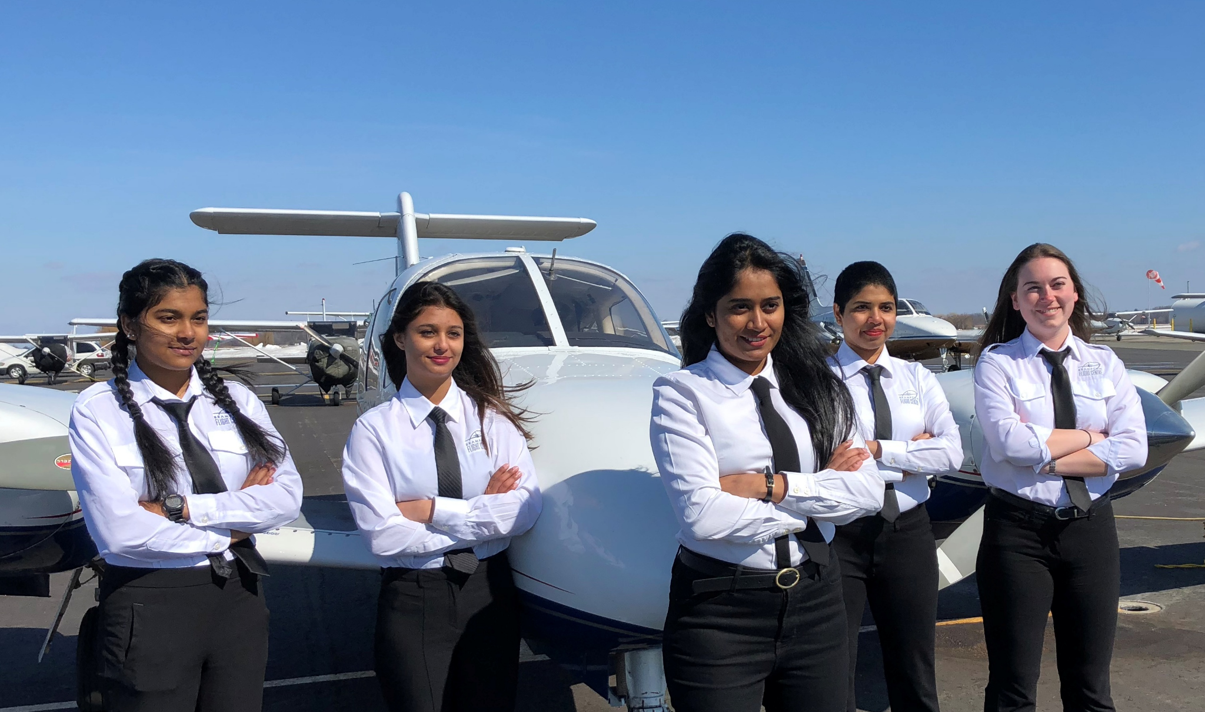
AVIATION/
AEROSPACE
Gender has always played a role when it comes to the stereotypes associated with the Aviation industry. In the field, women are still significantly underrepresented as pilots. Only 6% of private pilots are women, while only 4.5% of commercial pilots are women.
Activity: How can OVIN help to further the enhancement of women in the aviation industry by way of its technological advancements in the automotive industry?
Extend your Learning: Create a commercial (maximum length to 2 minutes) to advertise the aviation programs to women in Canada from all different backgrounds. The goal is to increase the number of women who enter pilot programs and sell the industry.

Slide 42
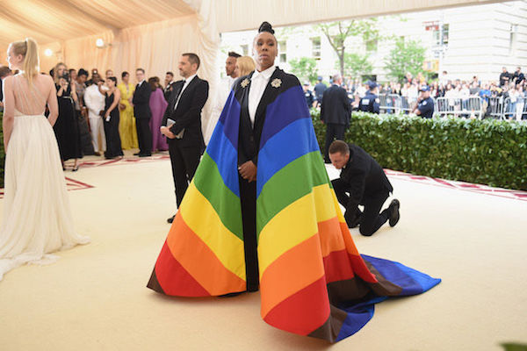
BUSINESS
Fashion is an important expression of one’s culture and personal identity.
Activity: How can we better understand minority groups by way of business and fashion? How can this impact their treatment in the transportation sector? How can this knowledge be leveraged to increase employee contentment in the automotive industry?
Research the fashion industry and showcase four of your favorite fashion designers/companies who identity in a different social location (ex. LGBTQ2+) and why you like them the most.
Extend your Learning: Design a logo, name of a company and an online brochure for a business run by and geared towards a minority group.

Slide 43
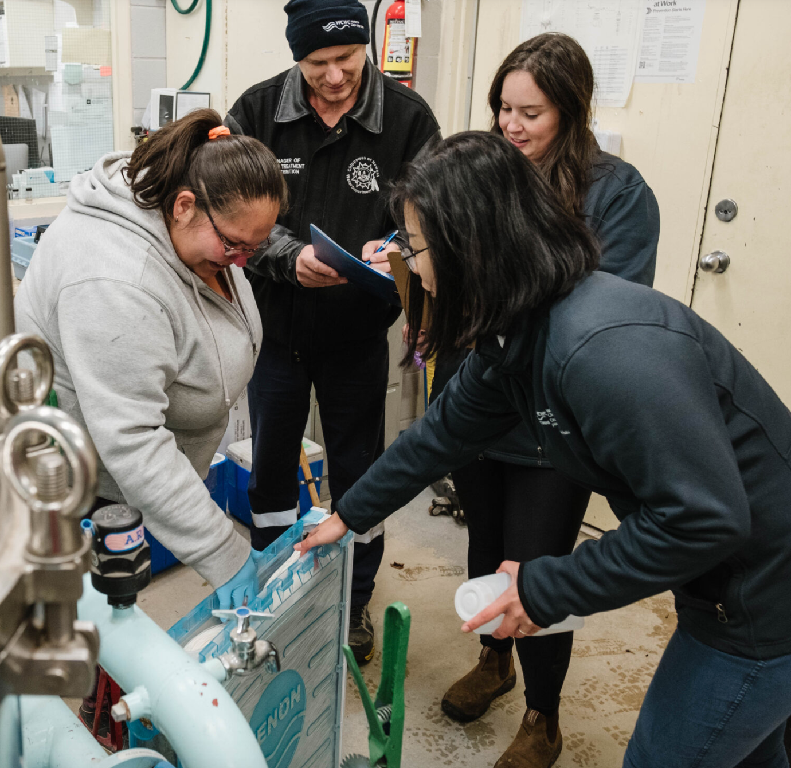
A single drinking water advisory can mean as many at 5,000 people lack access to safe, clean drinking water. 73 per cent of First Nations' water systems are at high or medium risk of contamination.
Activity: How can the projects and advancements within OVIN help bring fresh water to the reserves? What else can be done to lower the risk or contamination in the future? Review the following link discussing the four main types of water filtration from the Canadian Water Quality Association and complete one of the following: https://www.cwqa.com/page/TypesofTreatment
Extend your Learning: Select one of the following tasks.
Send a letter to the Minister of Indigenous Services Canada (ISC) and tell them it’s time to end drinking water advisories in Indigenous communities
Build a model of an Indigenous Filtration Station
Research Douglas Cardinal - Indigenous Architect and create a slideshow describing him and his creations https://www.mcgilldaily.com/2019/09/indigenous-architecture-with-douglas-cardinal/
CONSTRUCTION

Slide 44
In a recent article in The Toronto Star, it is suggested that Ontario will be facing a large energy crisis in the upcoming years. There is an urgent matter as by 2030 there could be “significant” shortages. The uincrease n demand that has occurred shown primarily through “green” power - carbon-emission-free electricity - seen mostly in the transportation and manufacturing industries.
Activity: Research the percentage of power in Ontario that is generated and compare it to the overall usage of energy by the province. The shift to electric vehicles will reduce the emissions, however it will cause a new strain on electric energy. Challenge: Think about how this burden can be lessened through new technological developments within the automotive industry and present it on a google slide presentation.
Extend your Learning: Think of up 5 realistic ways that we can lessen the looming energy crisis in the upcoming years. What renewable sources of energy do you think will help to alleviate some of the energy demands? Create a short Vlog to show your research and 5 ideas. Share it With your teacher.
ENERGY

Slide 45
ENVIRONMENT
The United Nations 17 Sustainable Development Goals are meant to have a positive impact on our society and environment, both locally and globally. It is meant to help us use our current resources sustainably while ensuring that our future generations will als be able to use the resources too. The SDG’s are considered urgent calls of action for all countries throughout the world to focus on fixing.
Activity: Review the goals at the following website: https://sdgs.un.org/goals What goals connect to the transportation industry and how that can be leveraged to benefit the environment and goal.
Extend your Learning: Choose a goal from the United Nations Sustainable Development Guide and create a project that would inspire your community to work towards the end goal. Examples: climate change, natural resource depletion, air and water pollution, and waste management. Create a 2 minute Podcast or film explaining the project and how you would implement the community project.

Slide 46
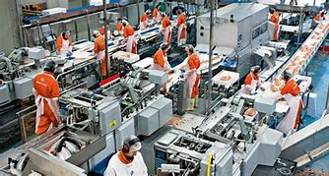
The Government of Canada reports that the Food Industry supplies 70% of all processed food and beverage products available in Canada. Processed food and beverages are exported to 192 countries worldwide, with the bulk of items going to the USA.
Activity: Read the following article: Emerging food products, processes and technologies 2020-21 - agriculture.canada.ca How can transportation and the advancements in that industry impact the import/export of processed food within and between countries?
Extend your Learning: Choose one of the types of enhancements that can occur within the food processing industry as discussed in the article. In google slides, summarize it and explain what the impact of it will be on the province if it is adapted into the industry. What impact will it have on the socio-economic classes in society? How can this then be linked to the other intersectionalities that we learned about?
FOOD PROCESSING

Slide 47
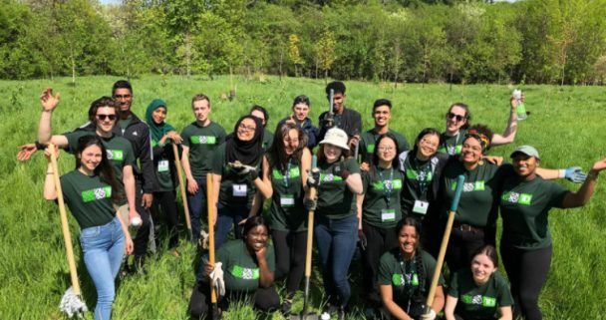
Sustainable Forestry Initiative SFI Community Grants are awarded for collaborative community-based projects, activities or events that support SFI’s efforts to connect communities to forests. Projects supported have included providing educators with tools to showcase green career pathways with students, educational field trips for underserved populations, programming focused on mass timber and education curriculum, and building youth engagement in outdoor education and conservation project.
Activity:How can the advancement of the technology in the automotive industry help support the forestry industry? How can these technological advancements in transportation reduce fire hazards in forests? Describe and research the types of trees in your area. What are they used for and who is responsible for maintaining them?
Extend your Learning: Create a Google Slide presentation on one of the following topics and explain the importance of forestry in regards to it:
FORESTRY
A community project that you are interested in starting https://forests.org/communitygrants/
A fuels planning managing forest structure to reduce fire hazard. Fuels planning: Managing forest structure to reduce fire hazard (usda.gov)

Slide 48
HEALTH & WELLNESS
Some well known barriers in the health and wellness industry are financial problems, work stress, unsupportive family/friends. There are many factors that influence wellness including (but not limited to) finances, family, diet, sleep and spiritual/religious beliefs. As you can see, these are directly linked to the many intersectionalities that we learned about in the training.
Activity: How can the advancements in technology within the automotive industry help to break down the barriers that might contributing to an individual having a low amount of wellness? Choose one of the factors an individual may be struggling with that can be connected to transportation.
Extend your Learning: Create a 5 day wellness plan for that individual that they can use to improve their wellness. Based on your own research, list any recommendations for them to do/try to help them achieve their own happiness.

Slide 49
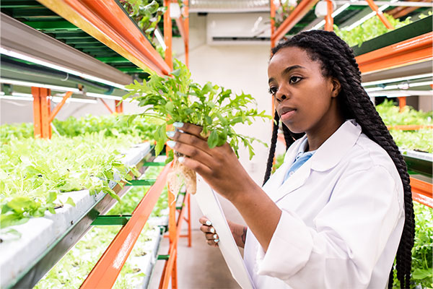
HORTICULTURE & LANDSCAPE
An important aspect of horticulture is health and productivity. Some issues within the industry include cap and trade, electricity rates and older/less up-to-date infrastructure to support operations. However, innovation is necessary in order to stay competitive in the market. In some horticulture businesses, manual labour is only used for packaging aspects, while all other aspects have been automated.
Activity: What are some ways that the same hardships can occur with the advancements of technology in the automotive industry in regards to OVIN? What are some of the challenges in community related to the Horticulture and Landscaping industry? How can you connect it with any of your learnings from this training? Think up 2 ways to make this industry more equitable and inclusive for all.
Extend your Learning: Create a vlog or blog that answers the questions above.

Slide 50
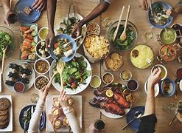
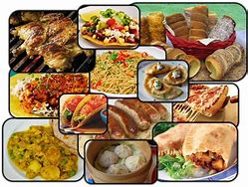
HOSPITALITY & TOURISM
Food is an important expression of culture and identity. Research a cuisine from a culture that you know only a little about.
Activity: How could the advancement of technology in the transportation industry further the positive impact on hospitality and tourism? Think of some ways this could benefit society? Research the local foods grown in your area.
Extend your Learning: Choose one of the following to complete:
Create a Google slide presentation showcasing four dishes (meals) and two of your favourite chefs from the cuisine of your choice. Be sure to explain why you like the meals and the chefs that you chose.
Select any recipe from the culture above and try your hand at cooking the recipe. Take a photo for a Culinary magazine. Maybe your photo could be on the cover!

Slide 51
INFORMATION & COMMUNICATION TECHNOLOGY
Internet service for remote regions in Ontario have had a difficult time receiving reliable internet. SpaceX has developed a low latency, broadband internet system to meet the needs of consumers across the globe. This latest internet service advancement might be exactly what Ontario’s remote communities require.
Activity: How can barriers in internet service in remote regions in Canada influence the advancements in technology for the automotive industry? How can ICT impact the goals of OVIN? Research the Starlink service map at starlink.com and confirm that all northern remote communities have access to this service.
Extend your Learning: Create a social media post asking the Federal Government of Canada to provide Starlink for all communities who currently can’t access reliable high speed internet, as it is seen a basic human right to be able to have freedom of expression

Slide 52
Communities rely on emergency services to help them when they are in need. At times, however, throughout the world we have seen a misuse of power at the hands of those with privilege. Often times, racialized communities are the ones who suffer with the injustices.
Activity: How can the transportation industry through OVIN leverage its relationships with those minority groups who are often the victims of injustices? How can OVIN and the transportation industry ensure that they are representing all intersectionalities in society, in order to have the most authentic products?
Research a case where this injustice has happened in Canada.
Extend your Learning: Create a podcast sharing the information of that case. At the end, discuss what you think can be done to ensure that the misuse of power can be erased, if not severely limited. How can we make those systems of oppression more equitable and inclusive? In the podcast, be sure that you have an intro and outro, and be at least three minutes in length.
JUSTICE, COMMUNITY SAFETY & EMERGENCY SERVICES

Slide 53
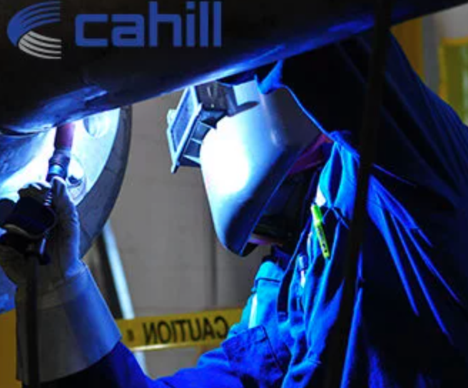
According to a Global News article, during COVID many Canadian manufacturers had been cutting capacity and focusing on key items to produce. This was due to labour shortages, shipping backlogs, delays in acquiring packaging or ingredients and high absenteeism. Since COVID, this has gotten better but some of these issues are still around and causing havoc. This has lead to many manufacturers having to reduce products and increase the price of selling, which has a direct impact on the consumers.
Activity: How can we learn from this experience to be better prepared to handle any issues that the industry may face so that the necessary items are always available at a reasonable price? For example - masks during COVID.
Extend your Learning: One of the biggest setbacks for manufacturers during the pandemic was the massive shortage of truck drivers that could import and export items to be used. How can new technological advancements benefit this industry so that transportation is not a setback and does not cause limitations?
MANUFACTURING

Slide 54
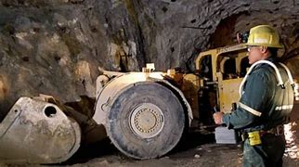
MINING
Activity: How can this equipment be adapted to further OVIN’s goals for clean and advanced technology for transportation? Research how many mining companies are conducting their operations in Ontario.
Extend your Learning: Pick one company and create a report on the reciprocal relationship in the areas of employment, supports, contracts, community supports, education, etc.

Slide 55
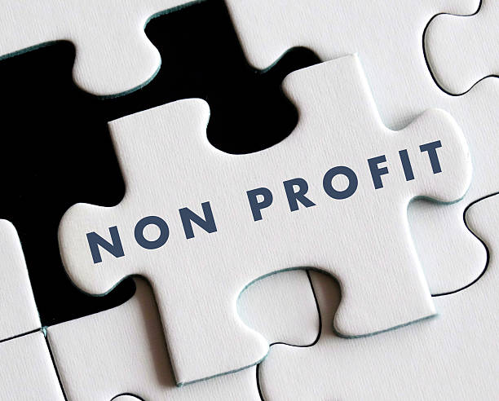
NON-PROFIT
Canada has over 170,000 non-profit organizations and charities that mostly focus on social and environmental issues in the country. Studies have found when reviewing this industry in Canada, women are seen to be more dominant in the workforce than men, T
Activity: How can OVIN’s goals be connected to the non-profit industry? How can OVIN ensure that it is furthering equitable hiring practices and meaningful employment that truly leverages the skill set of the most skilled workers regardless of their identities? ake a look at the infographics here and jot down some information that you found the most interesting about the non-profit industry: https://www.imaginecanada.ca/sites/default/files/Infographic-sector-stat-2021.pdf
https://www.imaginecanada.ca/sites/default/files/Datasheet-ON-2022.pdf
Extend your Learning: Choose any non-profit organization in Ontario that focuses on any of the intersectionalities learned about in this training and create a flyer/magazine article outlining what this Non-Profit fundraising organization is, the impact it is making, why it is important and how it is eliminating barriers.

Slide 56
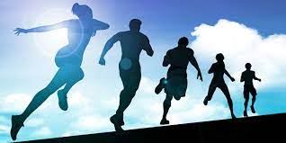
It has been reported that individuals with physical disabilities are less likely to engage in sports, exercise or outdoor activities due to inequitable access and participation in it. Often times those individuals will be made to participate in activities that are socially isolating - having a negative effect on their own mental health and well being. Also, due to the hardships individual’s face when participating in the sports industry, it acts to deter them from participating fully.
Activity: How can better access to transportation help eliminate some of the barriers that may be faced by individuals with varying abilities? Make a list of all the solutions you can think of.
Extend your Learning: How can the sports industry become more equitably inclusive for those individuals with varying abilities, so that everyone is able to play and enjoy sports related games, Using your knowledge of the sports industry, choose 2 sports and adapt them so that they can be modified for individuals with varying abilities can play them as well.
SPORTS

Slide 57
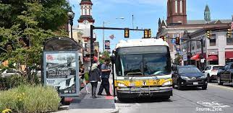
TRANSPORTATION
Transportation has changed widely due to the advancements in technology that have been occurring over time. Unfortunately, one’s socioeconomic status has a large impact on the type of transportation one uses on a daily basis/within their lives.
Activity: Think about new ideas from a technology standpoint for transportation that can be used to close the gap of disparities between the economic classes in society. Research and answer the question: What can be done to help everyone use affordable and clean energy transportation?
Extend your Learning: Compare the modes of transportation used by people throughout history on water, land and air. Complete a digital presentation on your findings. How has the affordability of and accessibility to transportation changed?

Slide 58
QUESTIONS?

Slide 59
Certificate
OCTE Allyship Training Certificate Template

Slide 60
ALLYSHIP TRAINING
Informative training to understand what it means to be an Ally and the importance of being an Ally

