Slide 1
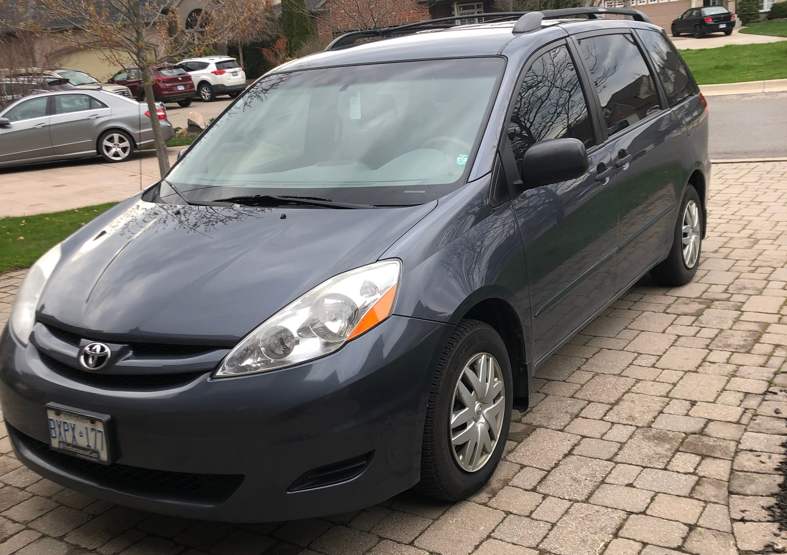
Vehicle presentation
Student's name
Toyota Sienna 2010
210 387 km (optional)

Slide 2
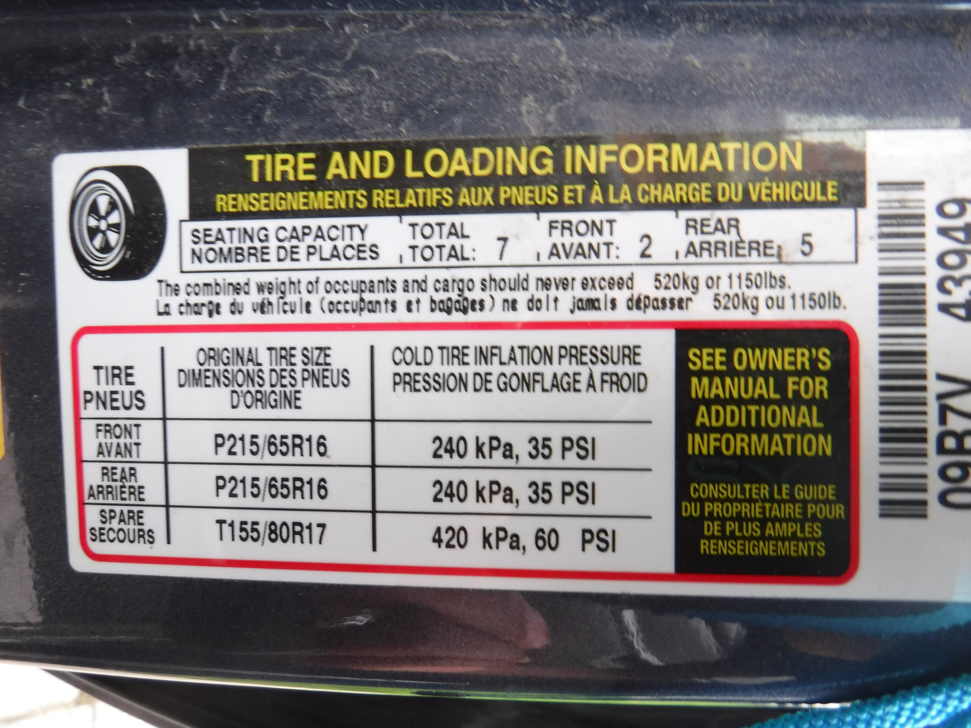
Recommended tire pressure
Front and rear tires should be inflated to 35 PSI.
Spare tire should be inflated to 60 PSI.

Slide 3
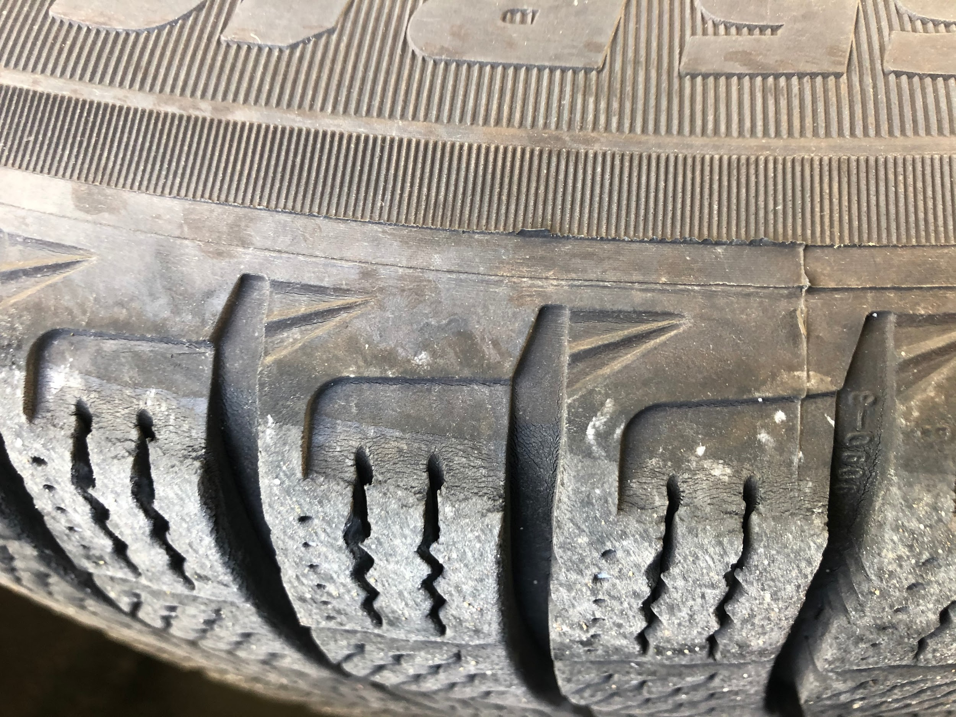
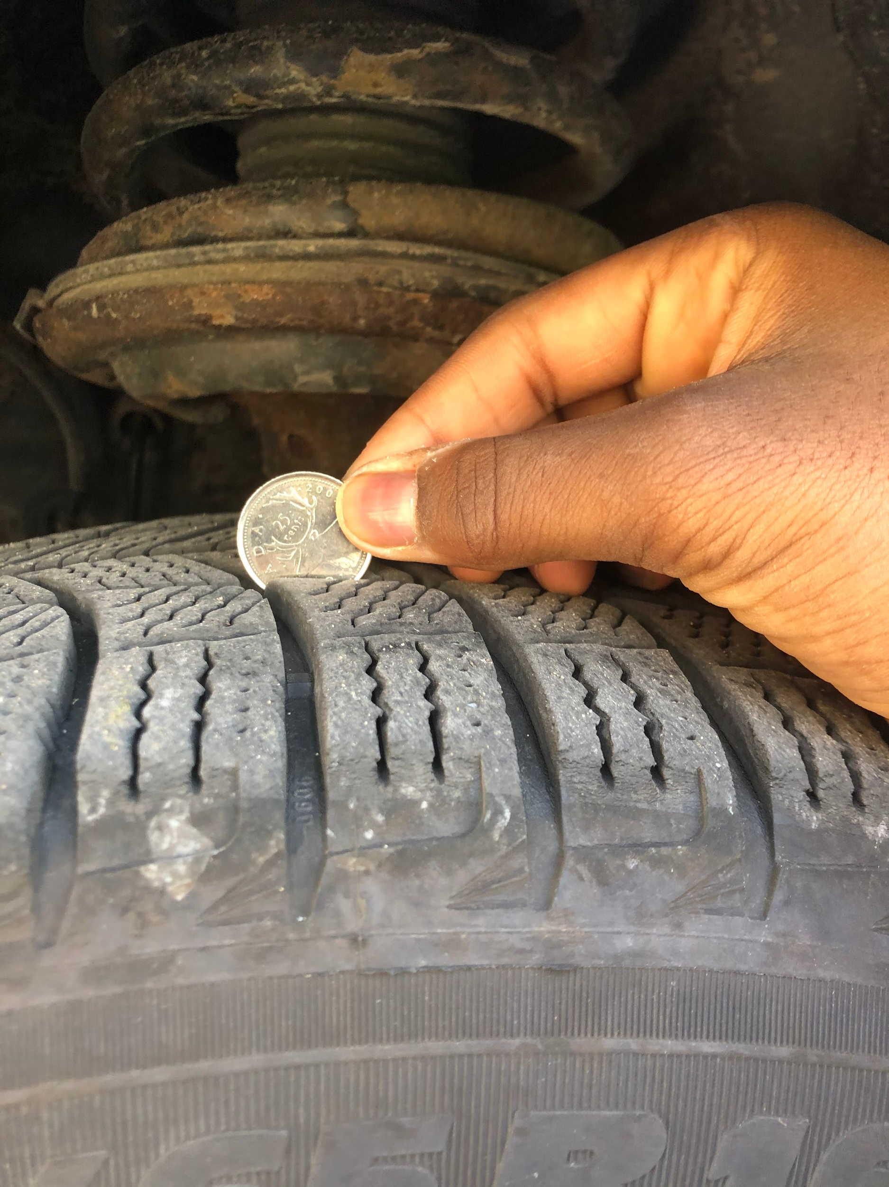
Driver's side front tire inspection
I observed a few small cracks.
I observed one or two small rocks in the tires.
The wear is uniform.
The tire is still good for one season.

Slide 4
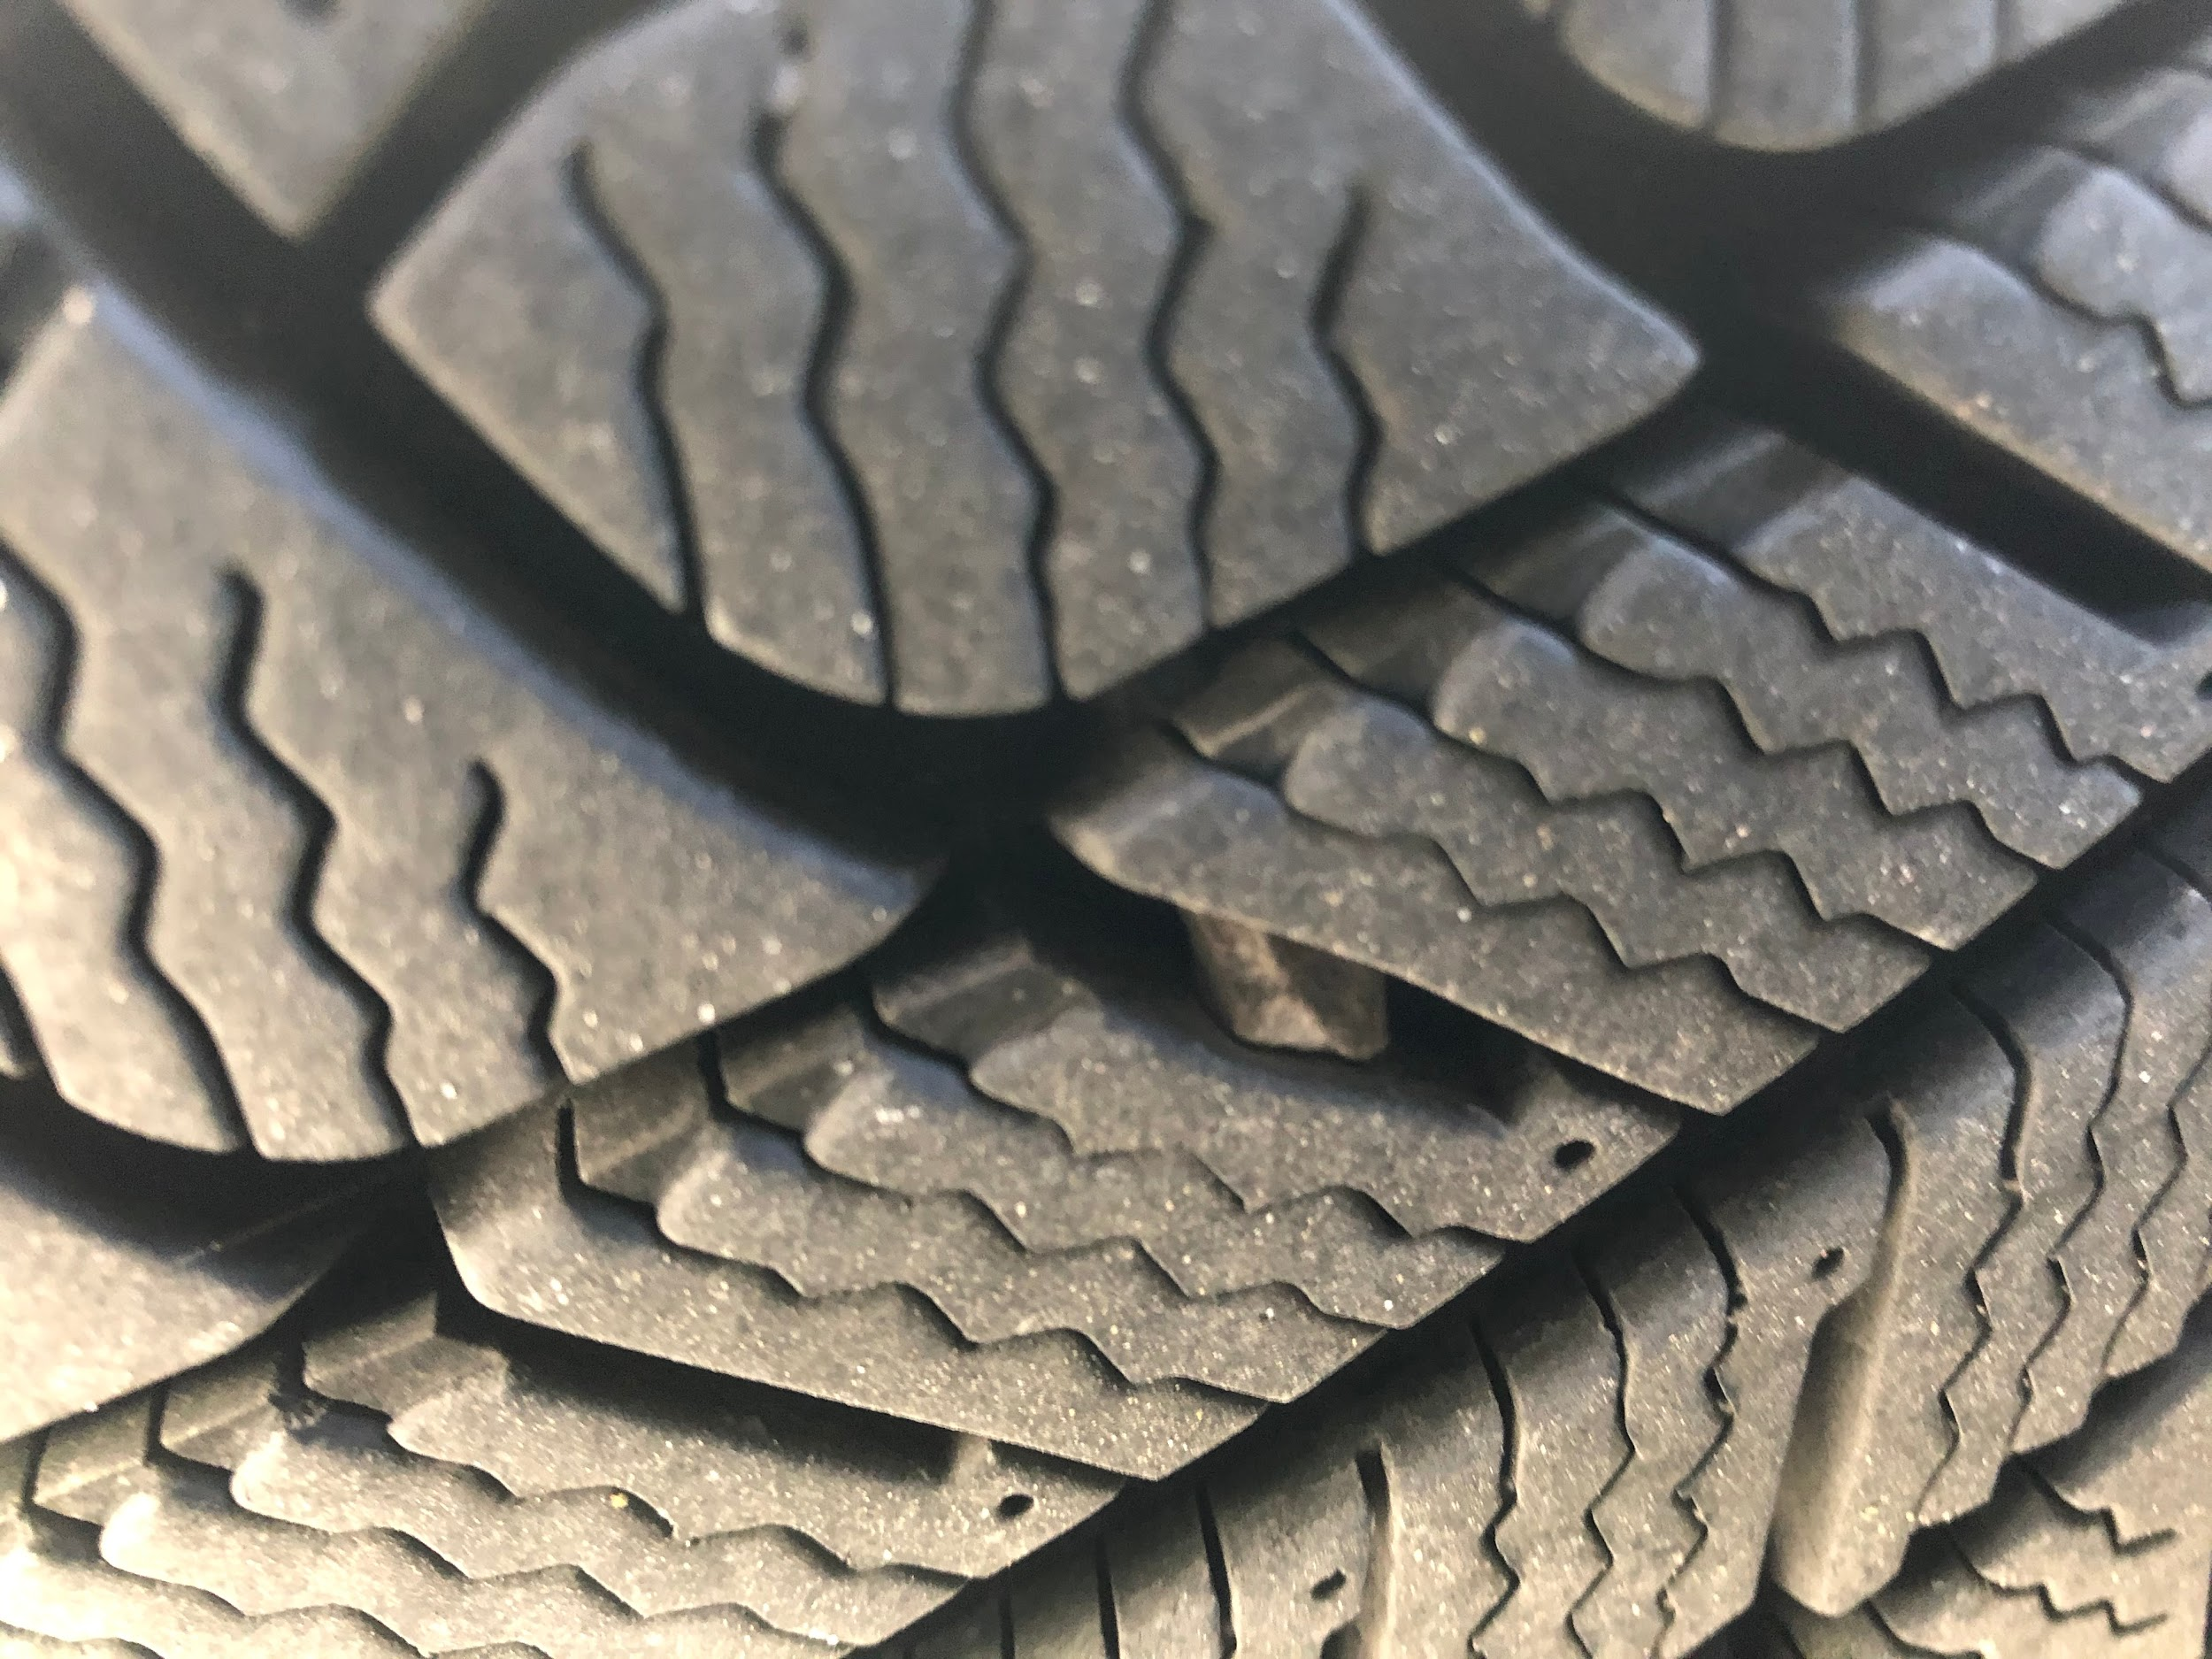
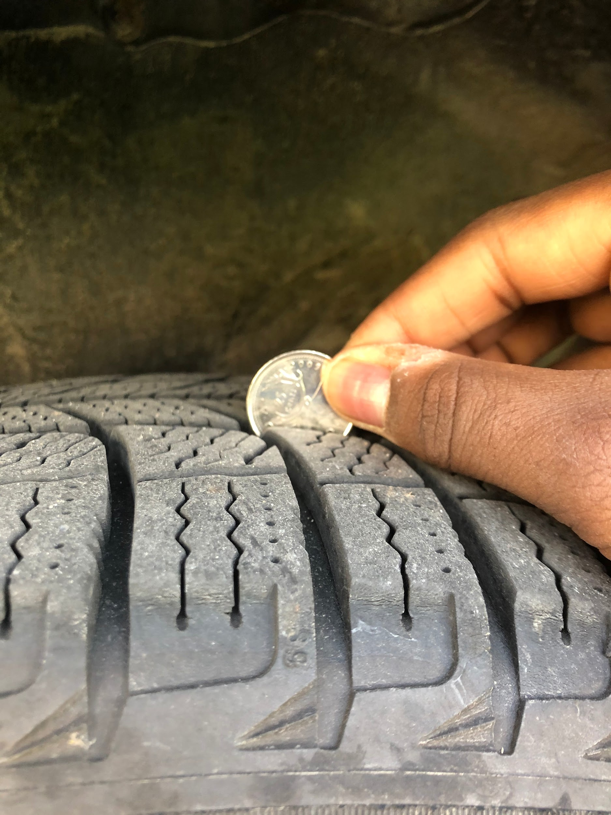
Front passenger tire inspection
I did not observe any uneven wear.
I did not observe any cracks in the tire.
There were about 5 small rocks in the tire.
The tire is still good for another season.

Slide 5
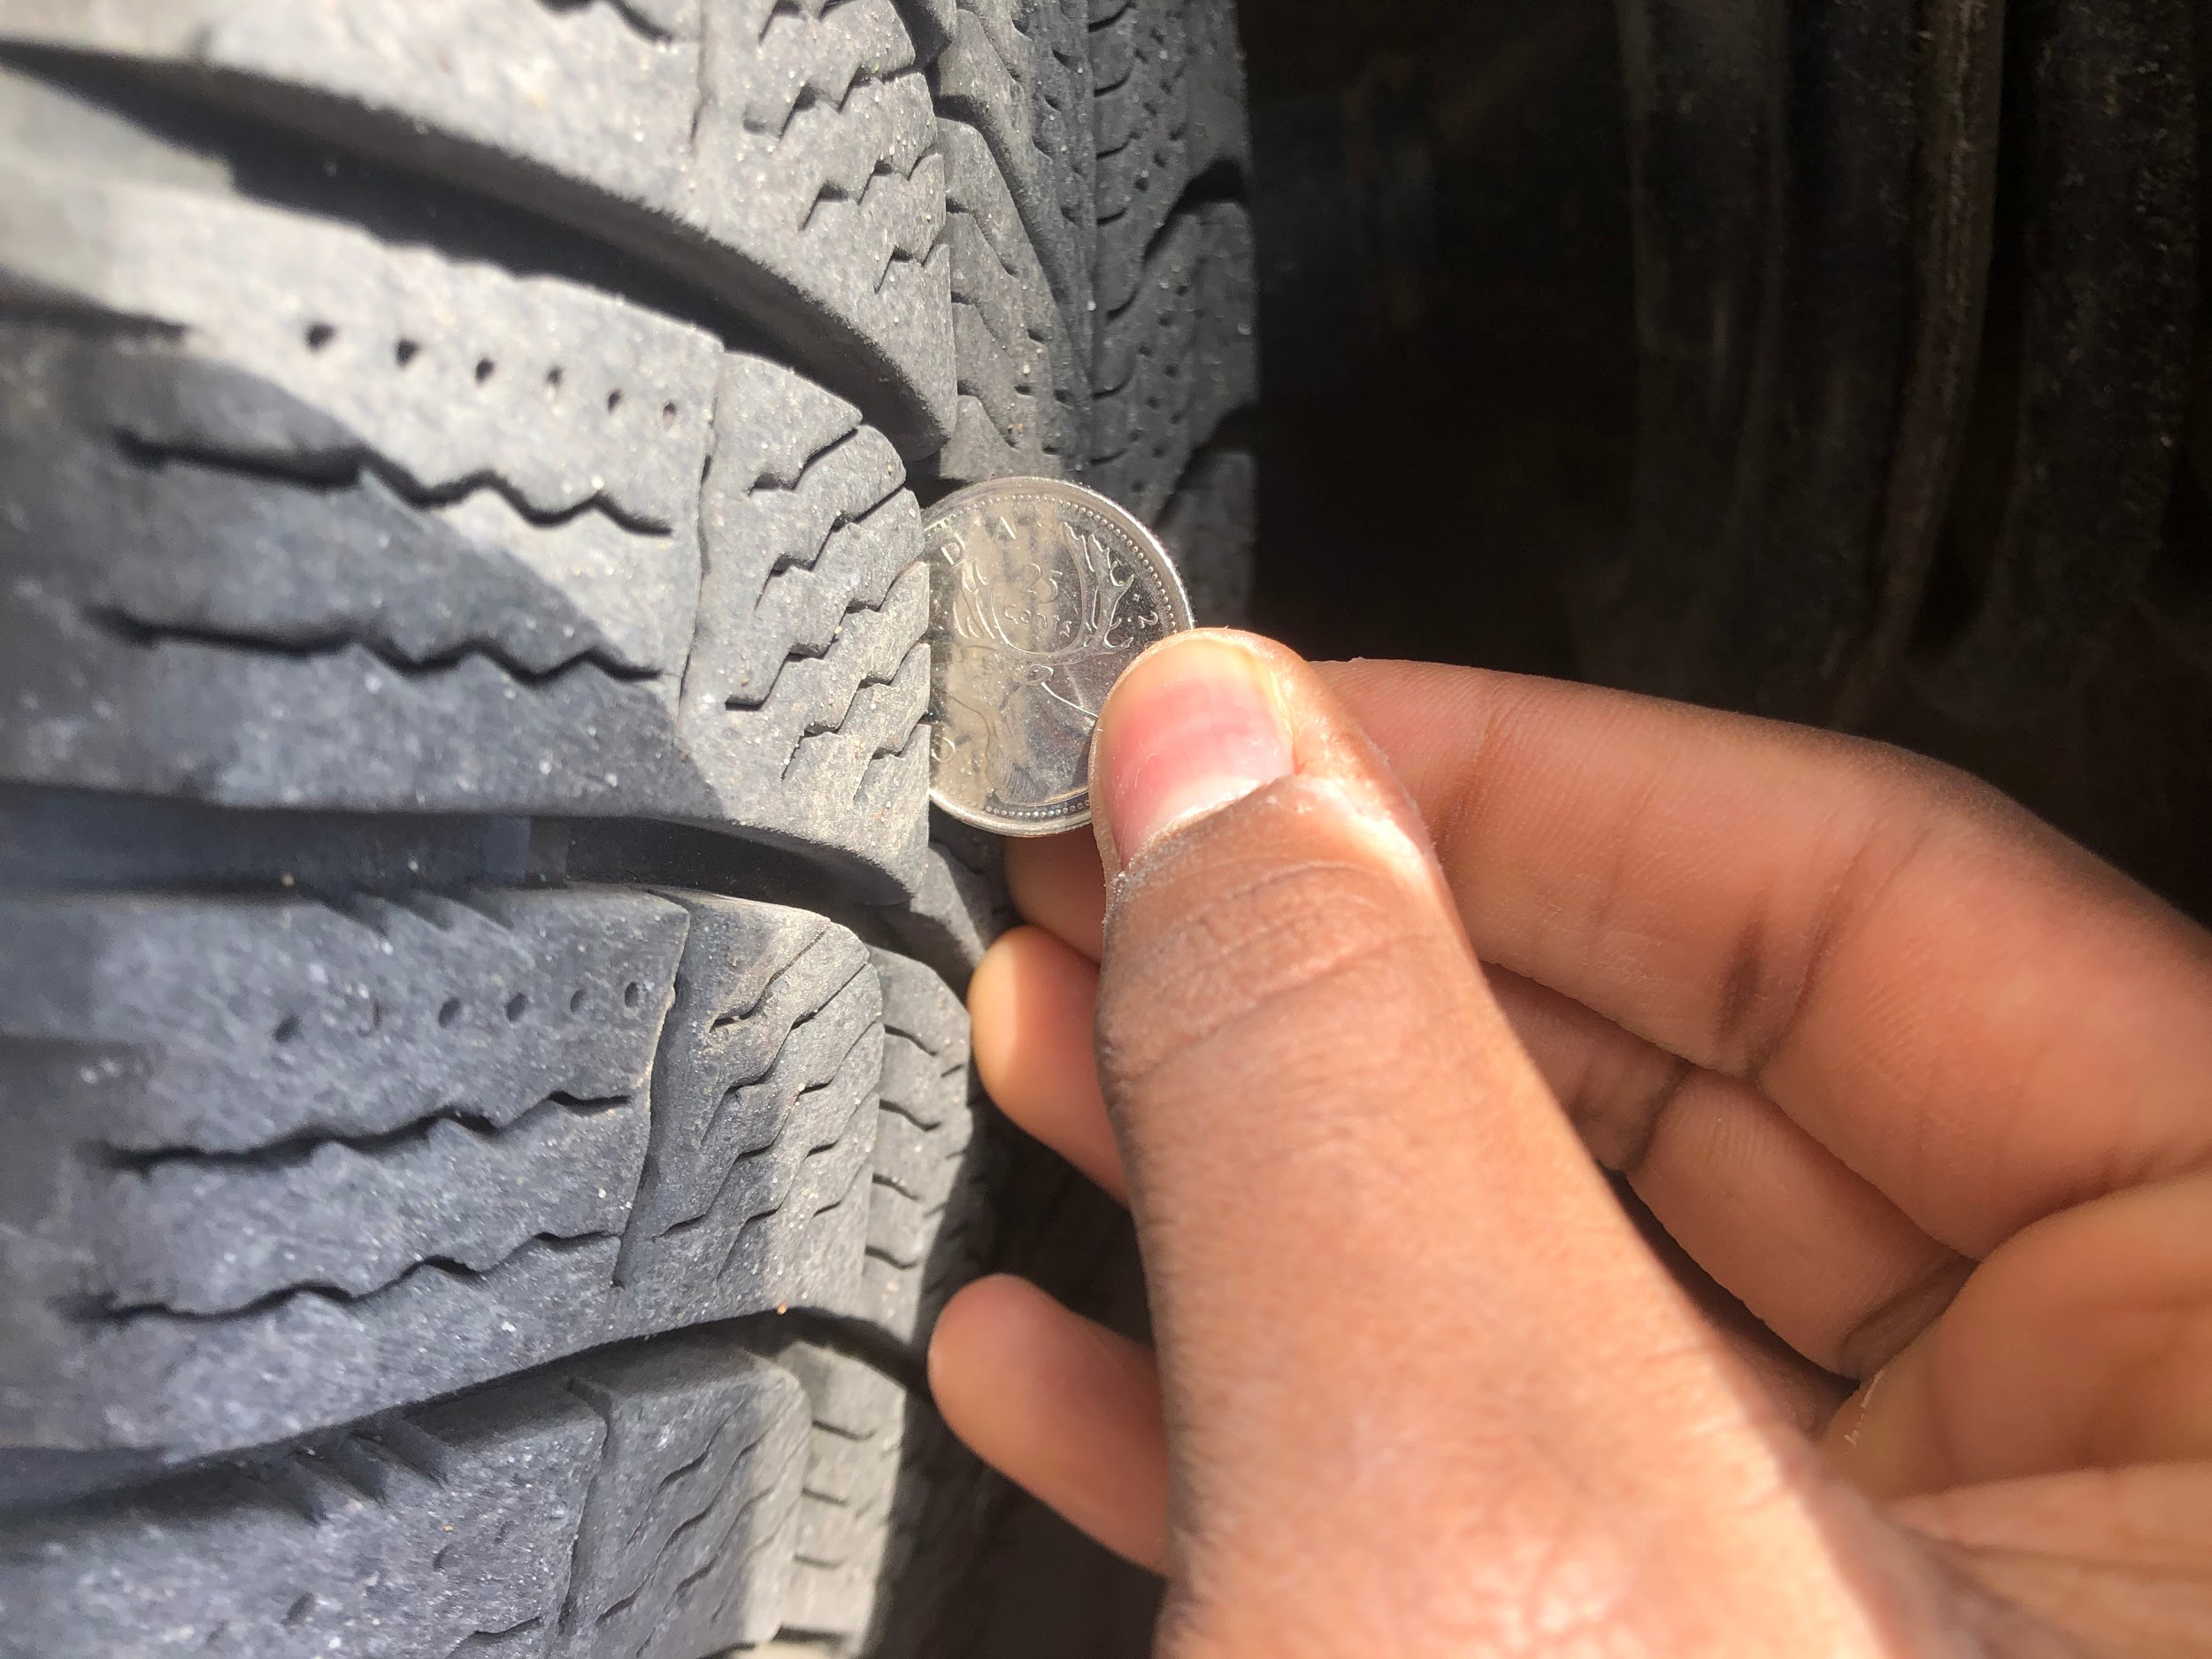
Driver's side rear tire inspection
I didn't see any uneven wear, but this tire was more worn than the other tires.
I did not observe any cracks in the tire.
I did not see any rocks in the tire.
The tire is still good for another season.

Slide 6
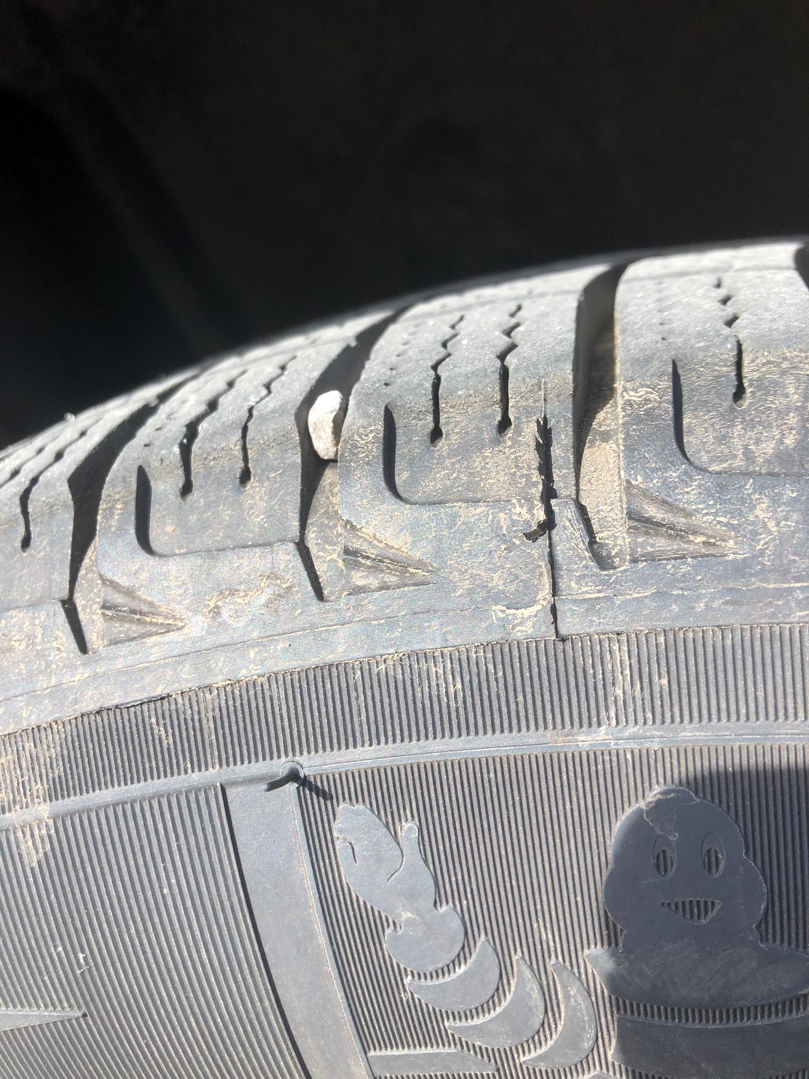
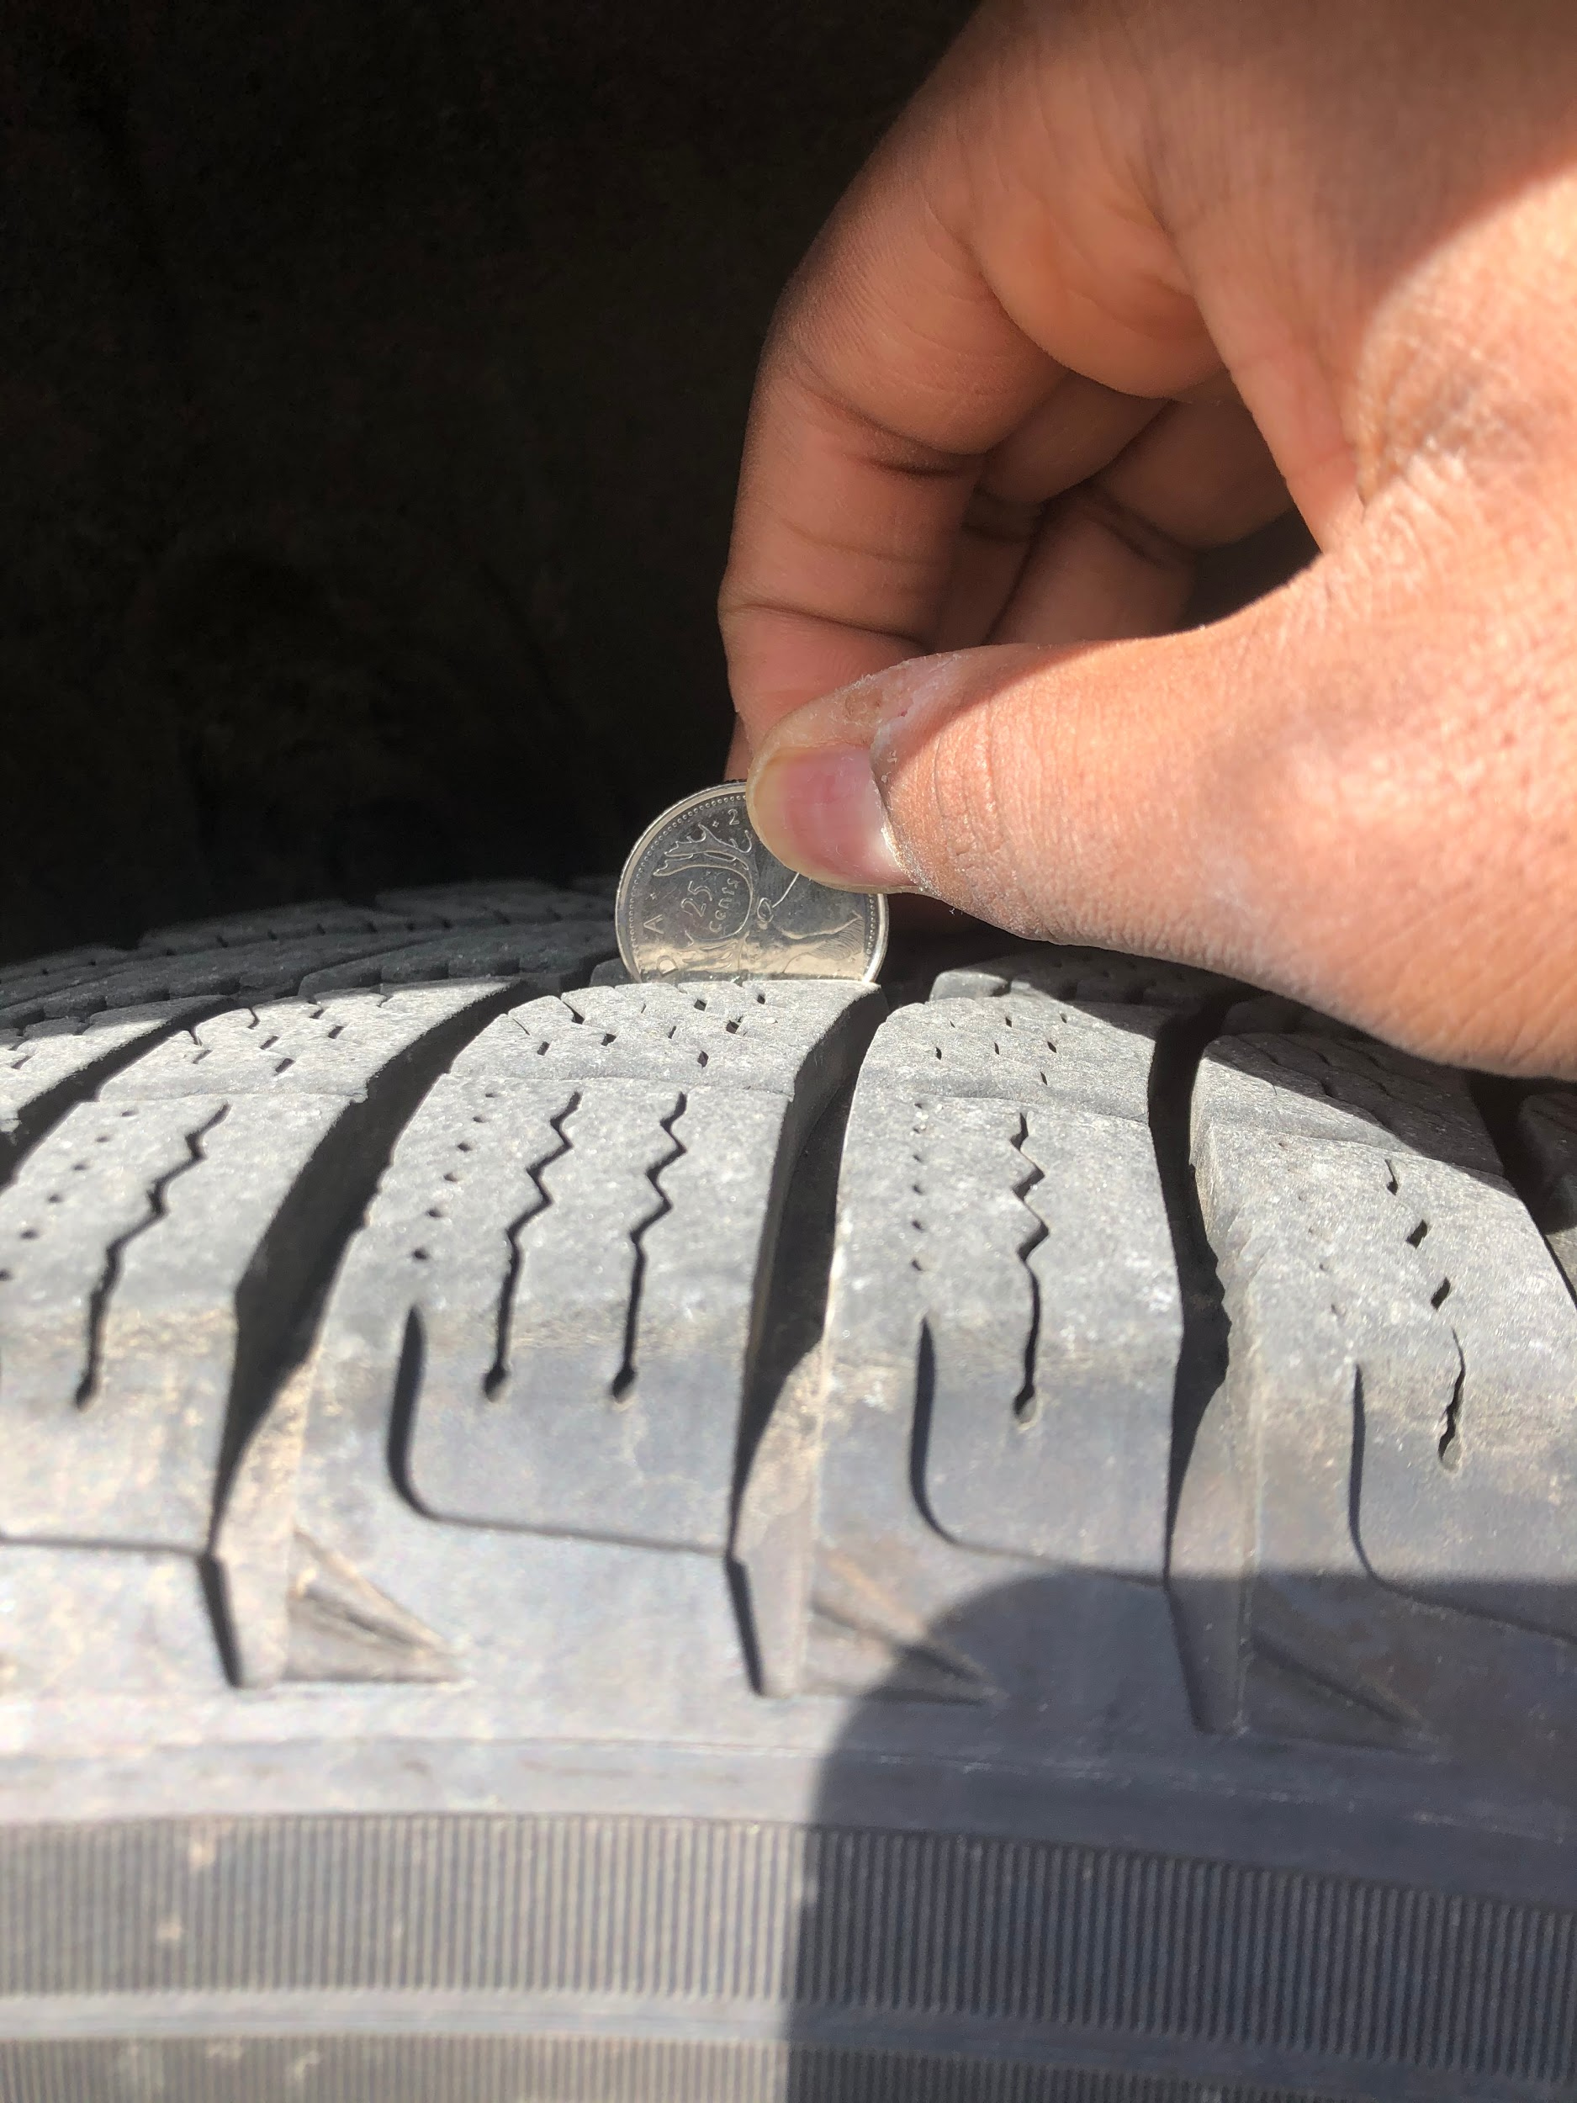
Passenger side rear tire inspection
I did not notice any uneven wear.
I did not observe any cracks in the tire.
There were about 8-10 rocks in the tire.
It is still good for another season.

Slide 7
Objectivation
Are my parents' tires safe for the next season?
Why should tires be inspected regularly?
I think my parents' tires are safe because I didn't really see any cracks, and there weren't really any big rocks. Also, according to my parents, the tires are fairly new. However, I don't have a way to check the tire pressure.
We need to inspect our tires regularly, because it's essential for your safety on the road. It also helps reduce your car's fuel consumption and exhaust emissions. And it makes your tires last longer.

