Slide 1
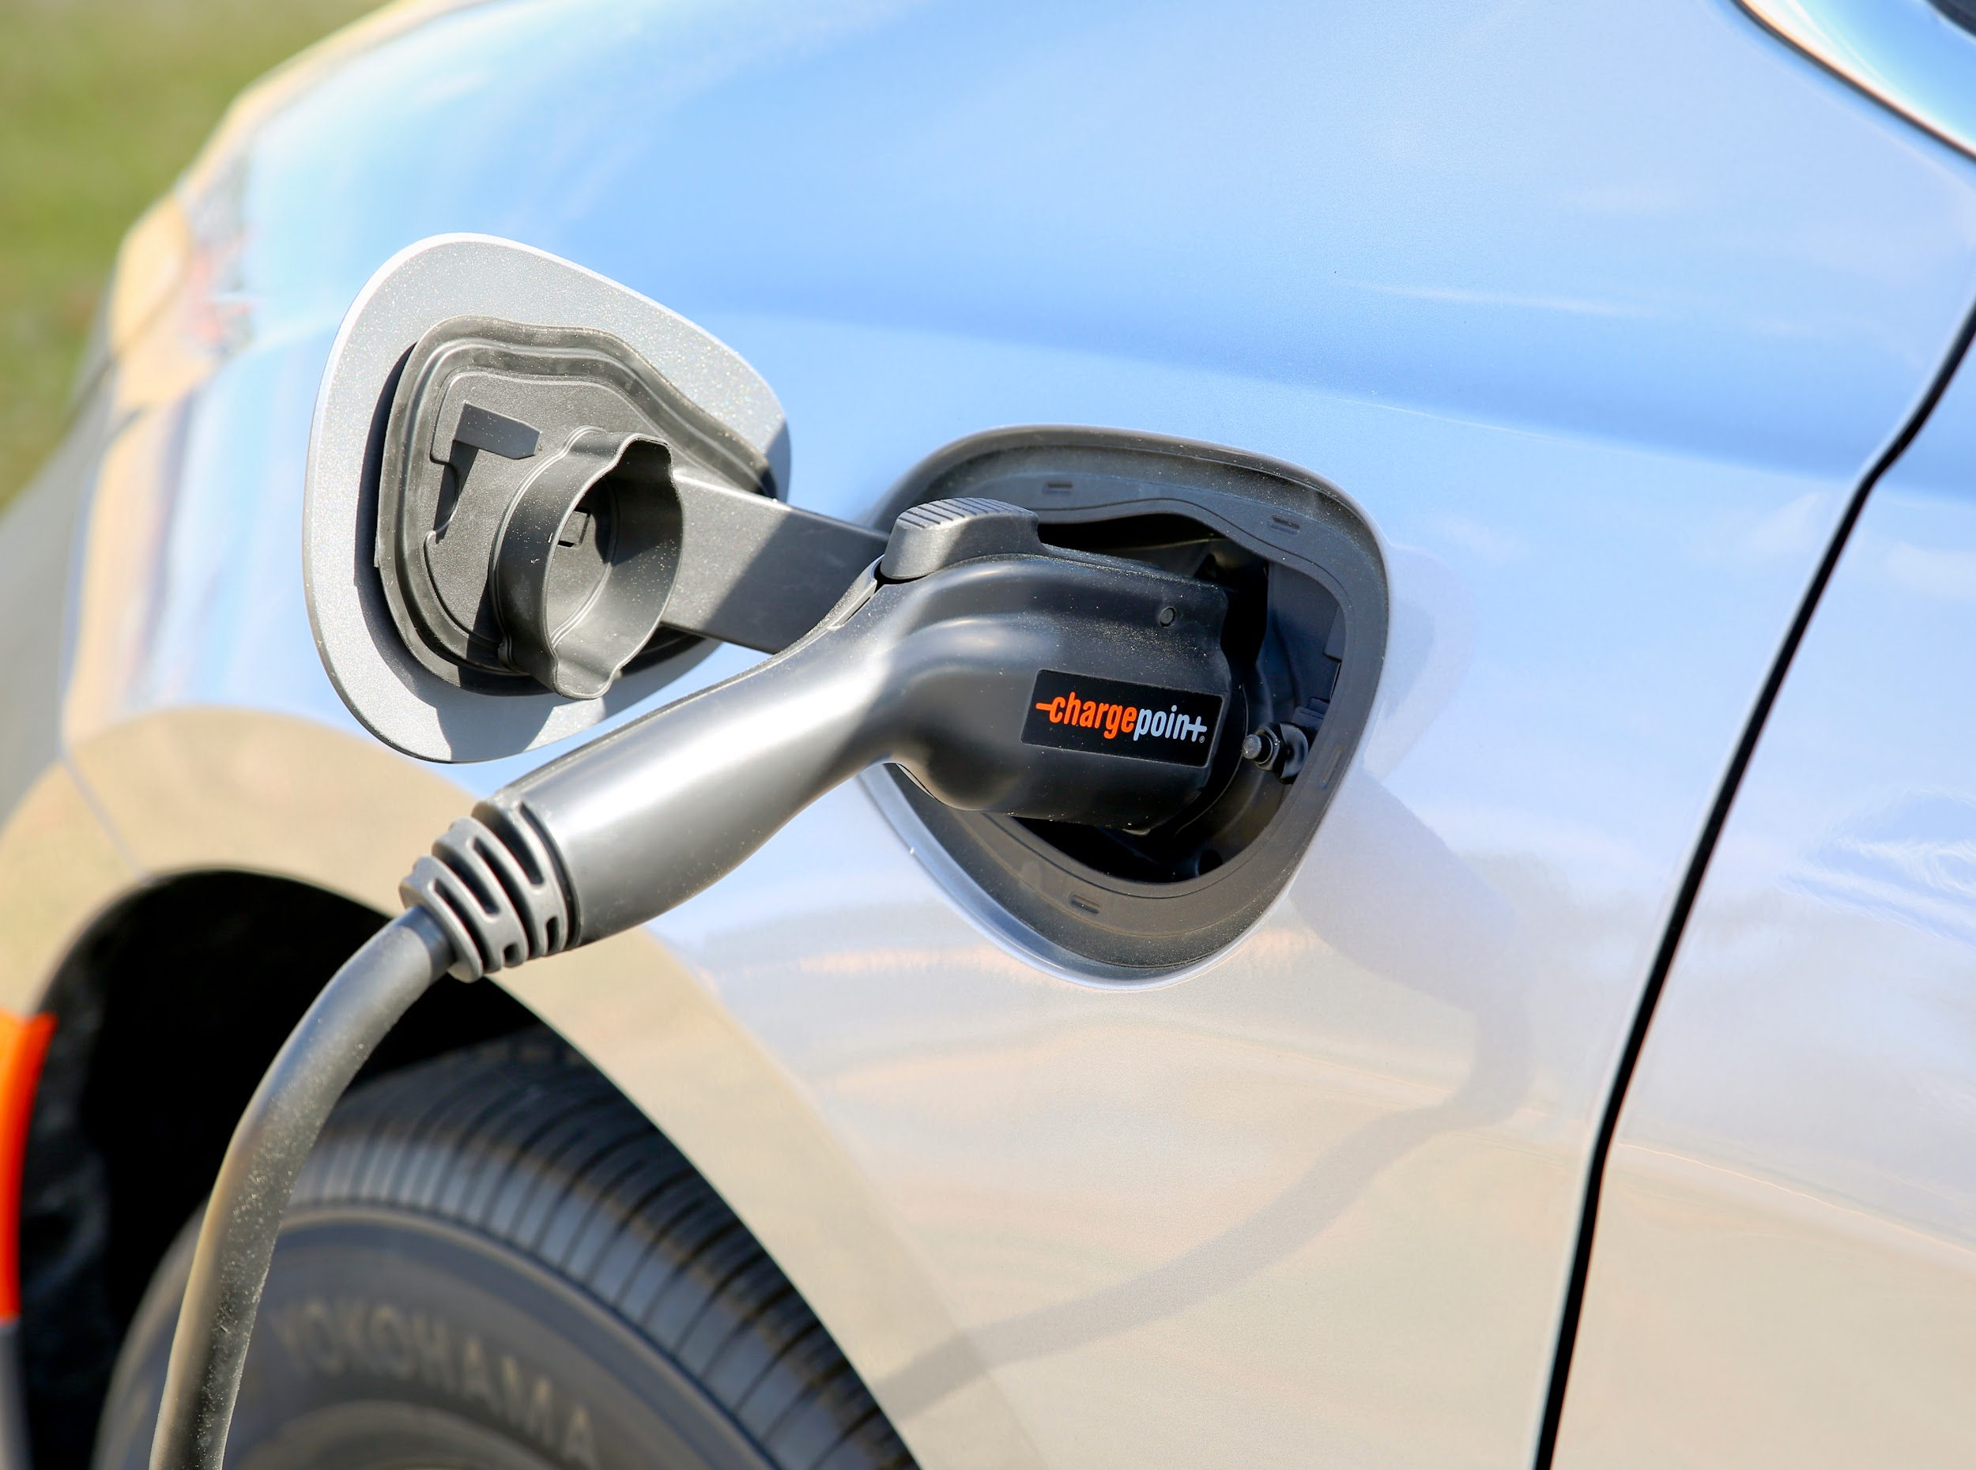
The Auto Industry
How can you contribute?
Notes:
Created by Melissa Oliver moliver@smcdsb.on.ca

Slide 2
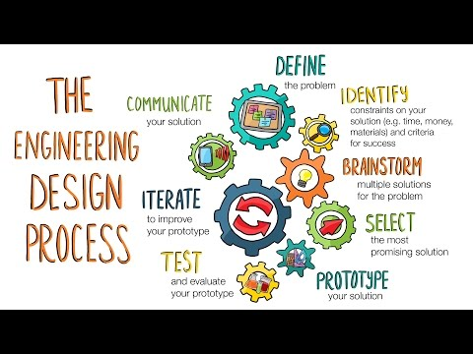
ovin-navigator.ca

Slide 3
Key components of the Engineering Design Process
Whatever you build with code should serve a purpose or fill a need.
Empathize
Define
Ideate
Prototype
Test
Learn about your target audience
Understand and identify your audience’s problem and need
Brainstorm several possible creative solutions
Construct rough drafts or sketches of your ideas
Test your prototype solutions and refine until you come up with the final version
ovin-navigator.ca
Notes:
In this activity, you’ll interview each other about your ideal pet. Be sure to take notes in your workbooks. The first step in coding by design involves understanding someone else’s need. Then, you can create prototypes that get you closer and closer to the best solution. Our prototypes will be simple drawings.

Slide 4
Empathize
Learn about your target audience
Questions to ponder…
What do you already know about electric vehicles?
What do you know about the interior of any vehicle?
What are some of the features you like in a vehicle?
ovin-navigator.ca

Slide 5
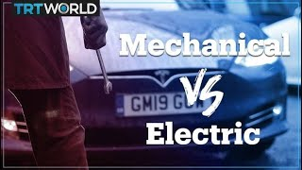
Define
Understand and identify your audience’s problem and need
The auto industry needs electrical engineers, have you thought about a career in the industry? They need you! But why? What are some of the issues facing the car industry today that you have heard about?
ovin-navigator.ca

Slide 6
Ideate
Brainstorm several possible creative solutions
Design process: Select 5 Features + 1 luxury for a total of 6, that you would want to put into your electric car. Make the 5 all connect to one of the following areas:
Weather
Daylight
Security
There must be one luxury item for your 6th feature
In the box snip photos or write out what features you plan on using
ovin-navigator.ca

Slide 7
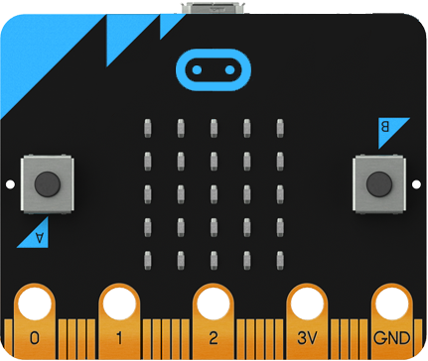
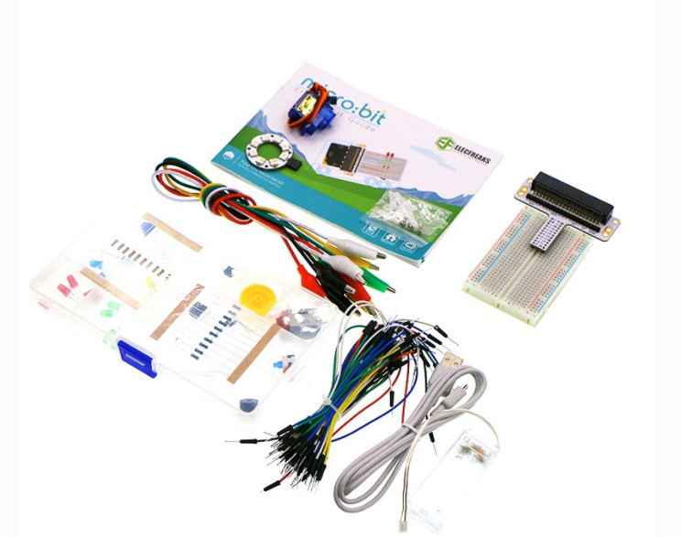
Features from the lessons are limited to the following that can be included for the MICRO:BIT and BREADBOARD
Micro:bit Items
Microbit controller
Acceleration
Light level
Button is pressed
Compass heading
Temperature
Running time
On shake
On button pressed
On logo down
On logo up
One pin pressed
On screen down
On screen up
Pin is pressed
Breadboard Items
Button
Trimpot
Photocell
RGB Light
Switch
Servo Motor
Buzzer
Motor
Accelerometer
Compass
Ambient Light
Temperature
Rainbow LED
You are not limited to the list above.
ovin-navigator.ca

Slide 8
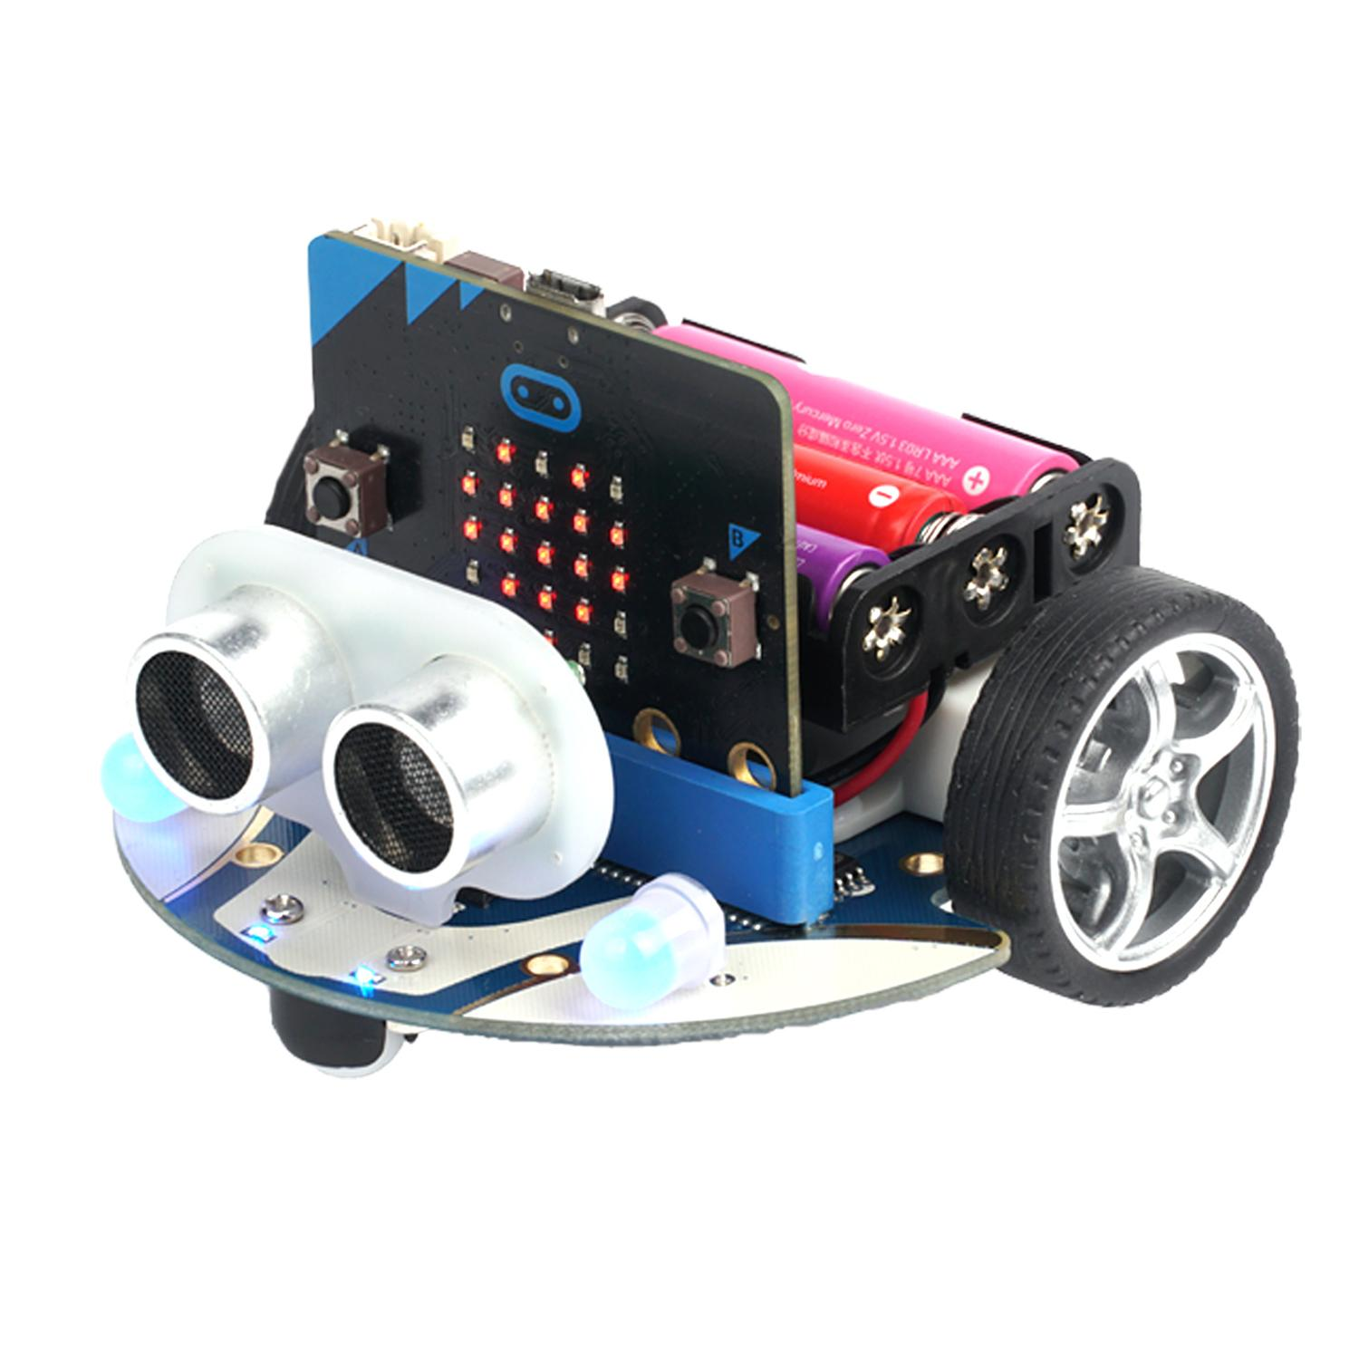
If you have SMART CUTEBOT the following can be considered.
SMART CUTEBOT RESOURCE
Speed (movement)
Following a Path
Move at Random
Automatic Lights
Steering
Fall- arrest
Autonomous Obstacles
Car following with a fixed distance
Remote control
Accelerometer
Extension activities available as well.
Python CODE
Block CODE
ovin-navigator.ca

Slide 9
Prototype
Construct rough drafts or sketches of your 6 ideas
ovin-navigator.ca

Slide 10
Test
Test your prototype solutions and refine until you come up with the final version
Keep track of all the things you have tried and either they work or they don’t work for you. List the process of testing this out!
ovin-navigator.ca

Slide 11
Showcase
ovin-navigator.ca

Slide 12
SHOWCASE: Presentation or Video your solution
Communicate
Pretend you are showing your creation to a board room of Electric Car manufacture executives. Now you have been give 5-10 mins max to convince them that this prototype is worth their time and investment.
Give a demo of how it works (simulator or actual device) Try and put 2-3 items together if you can of the 6.
Show how the code works (Explain the code with the language and terms you were taught in the slideshows)
Show how you assembled the physical/maker component
What was your biggest hurdle to get over?
What are you most proud of?
(this needs to be done in a video format or in a presentation so that I can see your code, your micro:bit and you can explain freely how the code works.) So you might be better off using your phone to do this.
ovin-navigator.ca

Slide 13
PASTE YOUR VIDEO HERE WITH YOUR PROTOTYPE AND YOUR VIDEO (Insert> Video> Google Drive> select your video that you put in google drive > then click SELECT) This will place the actual video in the slideshow.
ovin-navigator.ca

Slide 14
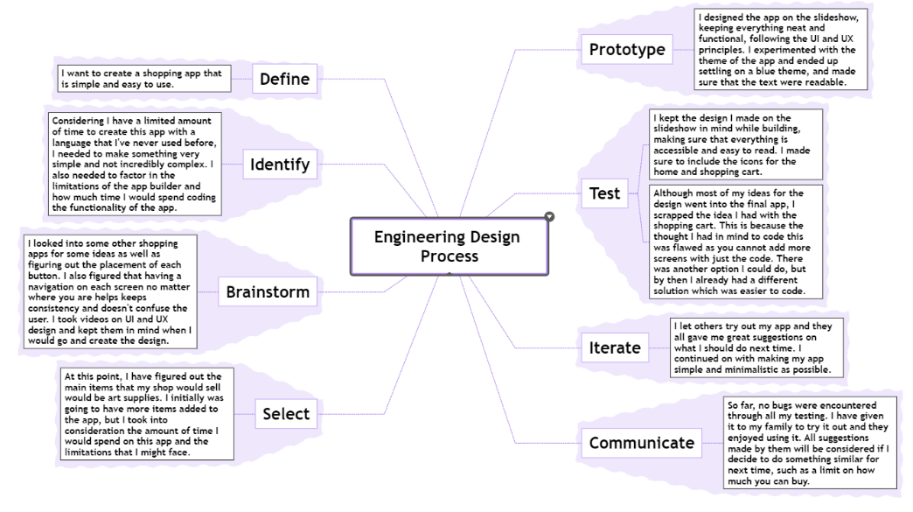
Once you are done your project create a mindmap to explain how you went through the Engineering design process. PASTE YOUR MIND MAP HERE (Screen snip your mindmap and paste it here.)
ovin-navigator.ca

Slide 15
Prototype RUBRIC for Automotive Industry
Assessment elements | R | 1 | 2 | 3 | 4
Code - Show what you know- Must have at least 3-4 /40 | Not enough evidence to show your understanding | Code does not demonstrate previous concepts, is not efficient, variable names not clear. | Code only partially demonstrates previous concepts, and/or is not efficient, variable names not clear. Is missing 2 of the 4 inputs or 3 outputs | Code only partially demonstrates previous concepts, and/or is not efficient. Is missing 1 of the 6 inputs. | Code very effectively demonstrates the use of concept(s). There were notes within the code that explain various parts and how they connect. Code uses a various elements. Able to Code is highly efficient and organized Demonstrated forward thinking of new concepts not taught in class.
Maker component of prototype /20 | No prototype was created | Breadboard was not utilized | Tangible component does not add to the functionality of the program. (meaning it could all run just on a breadboard without the microbit) | Tangible component is somewhat integrated with the micro:bit but is not essential. 3-4 components are tied to the theme and the industry. (Security, Weather or Time of Day | Tangible component is tightly integrated with the micro:bit and all 6 components tie into the Auto industry. Can see clearly how this could be effective prototype for a company to make in the auto industry. All components are necessary and connect to the overall global goal selected.
Prototype Design Process /10 | No design at all | Unable to clearly see the connection of the project to each of the parts of the Engineering design process. Very little detail. | The mindmap write up is too simplistic or is too confusing to understand as it does not follow the order. There is not enough detail or use of examples to explain an understanding of the process. | Mindmap needs a bit of refinement but was able to demonstrate some of the parts of the Engineering process | Clearly demonstrated the connection to the Automotive Industry and how the Micro:bit can help. The Mind Map demonstrates a high level of understanding of the problem and shows how the process of designing works. Reflection at each part shows insight and examples of the process.
Showcase /20 | No video was turned in | Code not seen but micro:bit simulator or physical microbit was. Questions were answered but showed limited understanding | Questions were answered somewhat. Very little detail was provided. Showed code but did not explain each part or did not show all of the circuit connections. | Questions were answered very casually. Professional language was not used. Limited terms were used to explain code. Automotive goal was not mentioned. | Video or presentation clearly explains the prototype to the Automotive Industry Committee. Demonstrates what was coded in MAKECODE. How each of the functions work on the circuit board. Uses the language that has been taught for this unit to explain the code. Responded to all questions clearly and demonstrated mastery of skill.
ovin-navigator.ca

Slide 16
Exemplars
ovin-navigator.ca

Slide 17
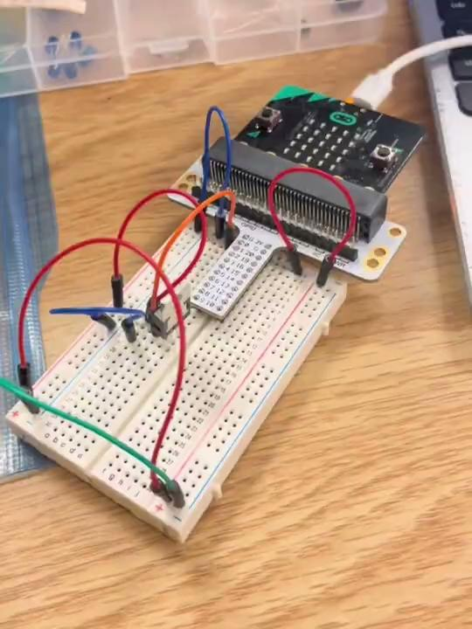
PASTE YOUR VIDEO HERE WITH YOUR PROTOTYPE AND YOUR VIDEO (Insert> Video> Google Drive> select your video that you put in google drive > then click SELECT) This will place the actual video in the slideshow.
Weather
ovin-navigator.ca

Slide 18
PASTE YOUR VIDEO HERE WITH YOUR PROTOTYPE AND YOUR VIDEO (Insert> Video> Google Drive> select your video that you put in google drive > then click SELECT) This will place the actual video in the slideshow.
Security
ovin-navigator.ca

