Slide 1
Injection mould Manufacturing
BBT Area: Manufacturing
Target Courses: TMJ3M TMJ4M
Explore more at ovin-navigator.ca

Slide 2
Section 1: Teacher Resources
Explore more at ovin-navigator.ca

Slide 3
Project Outline
This project will look at the automotive industries use of injection moulding to manufacture parts, with a focus on the electric vehicle manufacturing sector. The manufacturing courses TMJ3M/4M will guide the curriculum expectations. The project will design and machine basic injection moulding parts with options around machine setup and materials. Students will produce parts through different injection mould processes. This will include a mould design and build process to create a basic plastic washer. Students will create injection mould for a flat washer that can be used for the washer toss game. Injecting melted plastic will demonstrate the same principles that are used in the automotive industry. The washer toss box can be made using recycled materials.
ovin-navigator.ca

Slide 4
Related OVIN Sectors
Connected & Autonomous Vehicles (C/AV)
Auto & Parts Manufacturing
Tool, Die & mould
Aftermarket, Maintenance & Repair
ovin-navigator.ca

Slide 5
Prior Knowledge and Related Resources
Milling machine safety and operation
Basic milling tools
Basic lathe operations
Measurement with precision measuring tools
Safe shop practices
ovin-navigator.ca

Slide 6
Planning Notes and Teacher Guide
Teacher planning will start with the basic understanding of the automotive industry by showing students some of the videos about injection moulding and the EV industries use of the process.
Teacher will show the basic construction principles of two piece mould making.
Students will build their moulds.
Teacher will demonstrate how to use the plastic injection moulding machine.
Students will create eight injection moulded washers in two colours.
Students will build the washer game box using recycled materials
ovin-navigator.ca

Slide 7
Required Tools and Materials
Milling Machine (conventional or CNC)
Milling cutters
Drill bits and reamers
Lathe with 4-jaw chuck
Measuring tools
½” x 2 ½” x 8” 6061 Aluminum Flat
Hardened dowel pins
Plastic injection moulding machine or equivalent
Plastic pellets
Boxes and cardboard
ovin-navigator.ca

Slide 8
Safety Concerns
Risk
Milling operations
Lathe operations
Cutting oils and coolant
Sharp metal
Noise from machines
Fumes from injection moulding
Safety Equipment
Safety glasses
Hearing protection
Cut resistant gloves
Nitrile gloves
Mask/Respiratory protection
Ventilation
ovin-navigator.ca

Slide 9
Assessment and Evaluation
Assessment as learning
Self assessment tool for prior learning
Assessment for learning
Checklist for injection mould
Assessment of learning
Rubric for mould project
Rubric
Leveled Marking
Checklist
ovin-navigator.ca

Slide 10
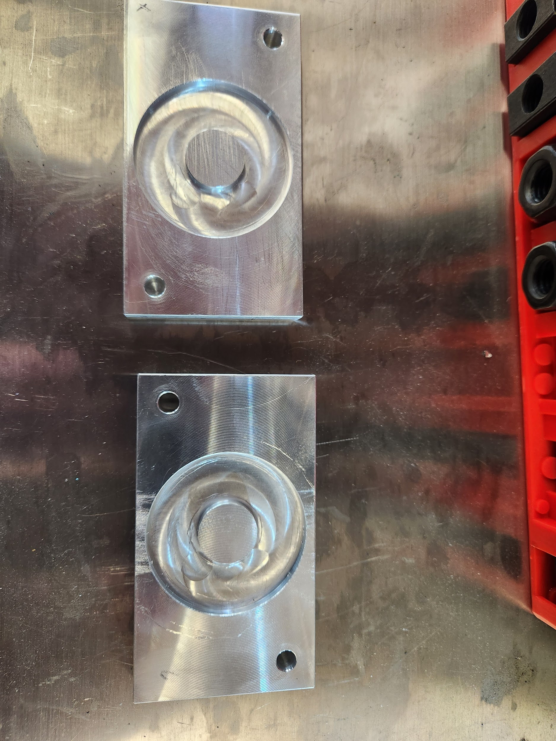
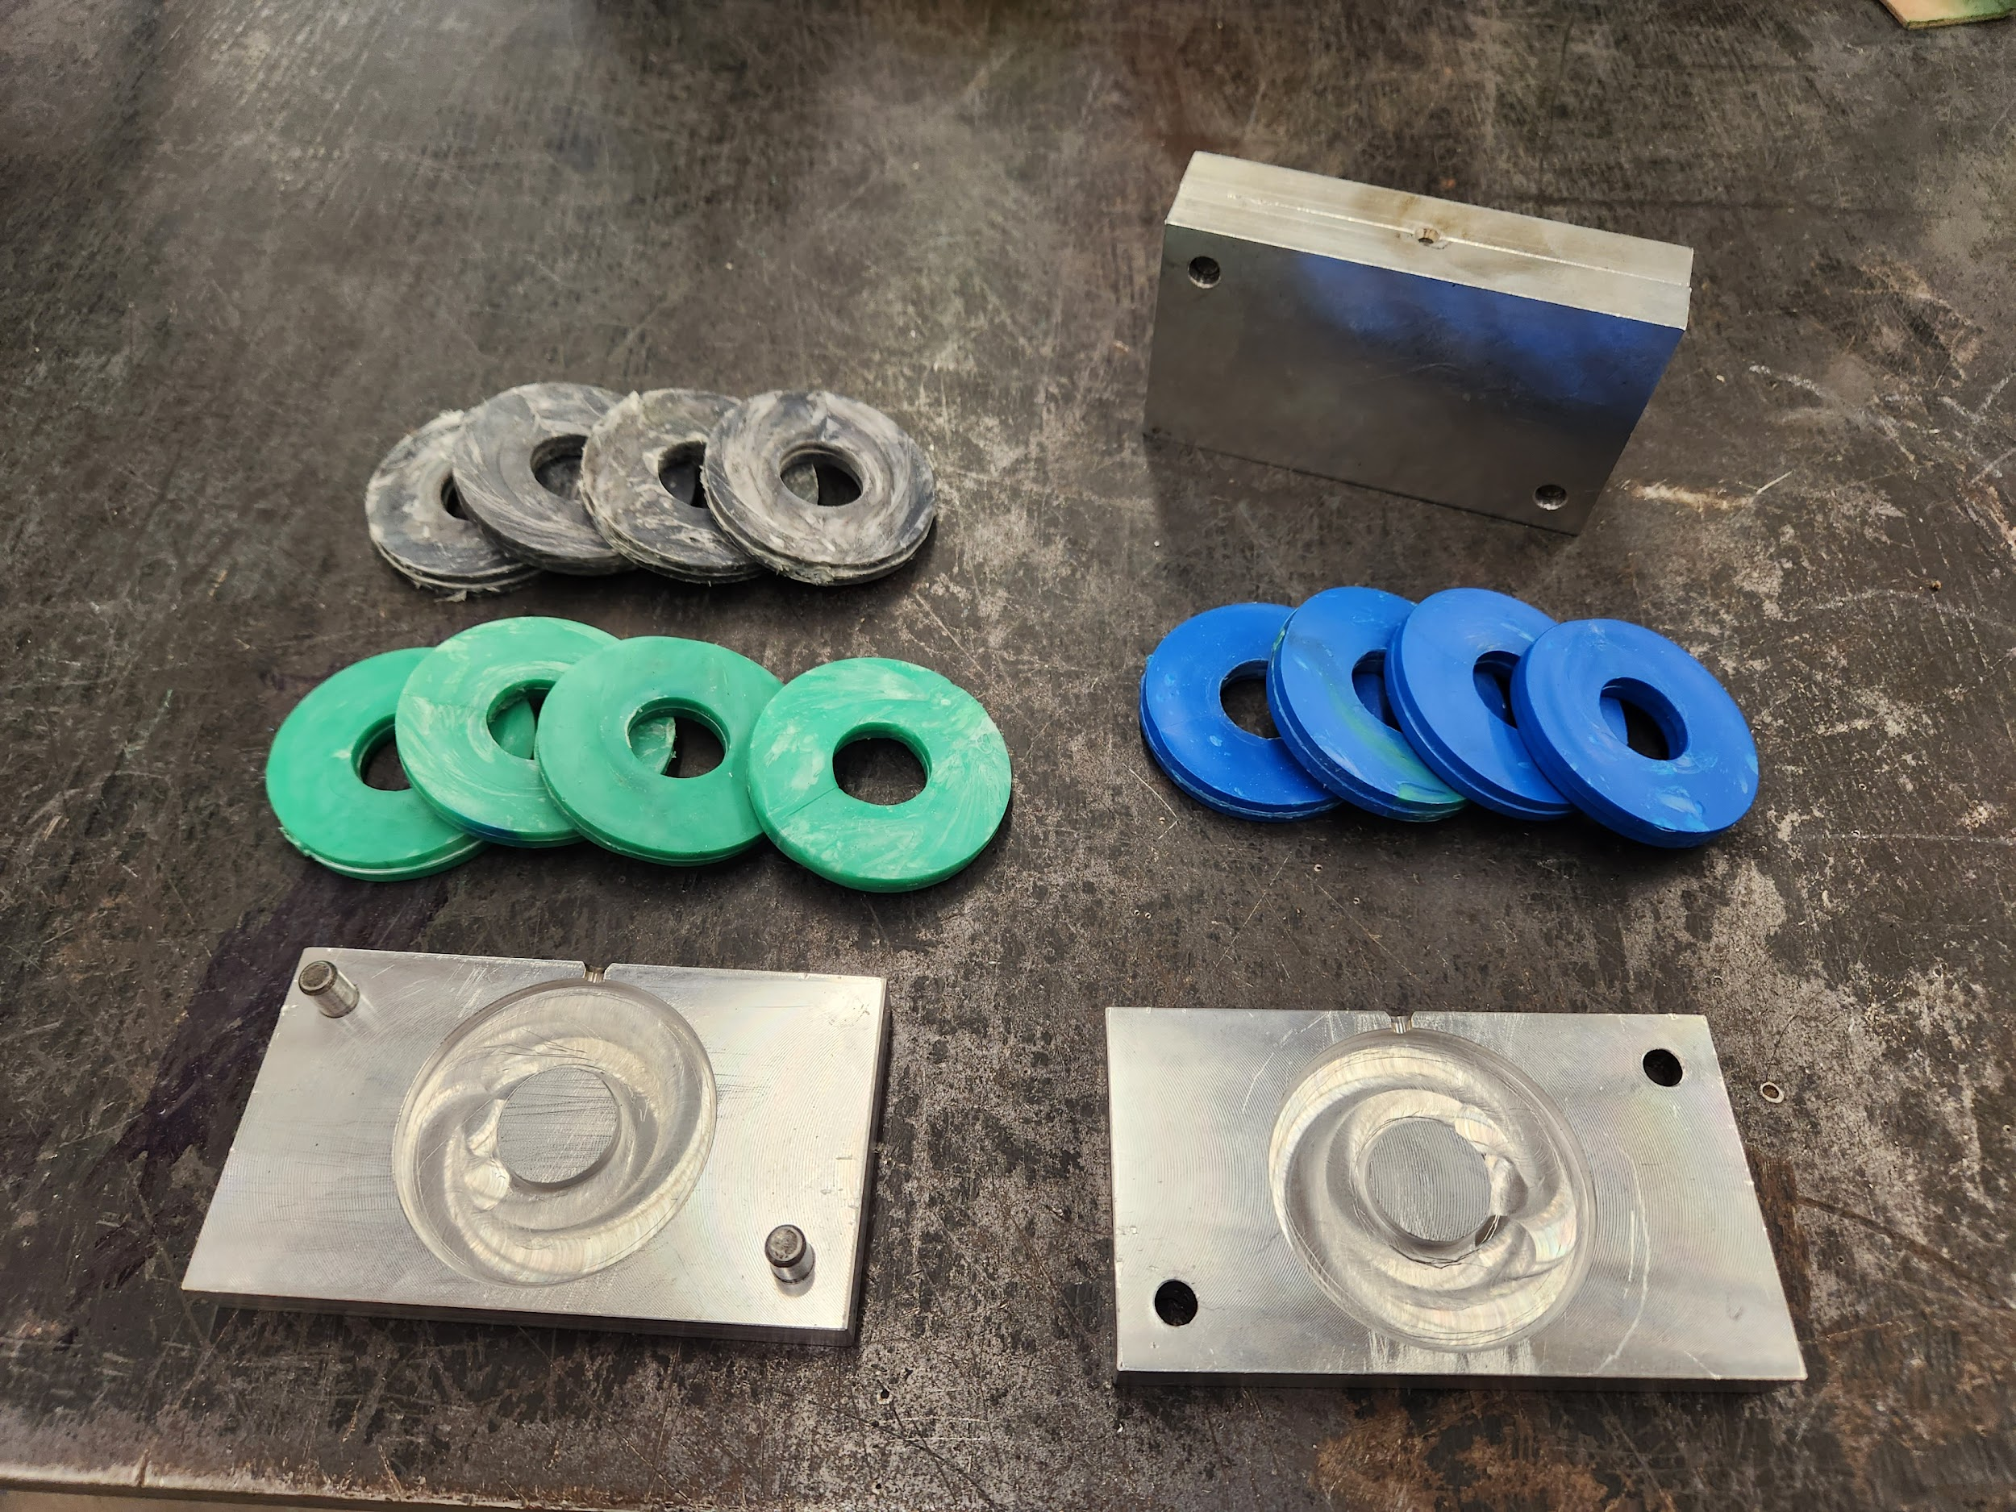
Project Exemplars
ovin-navigator.ca

Slide 11
Outside Resources and References
Electric and other car types
How Do All-Electric Cars Work?
Injection mould making 3D printing
https://formlabs.com/blog/diy-injection-moulding/
Injection moulding: mould Design & Making
https://www.youtube.com/watch?v=MhoAIDz4Bhw
Tesla Giga Press
The Incredible Logistics Of The Tesla Giga Press!
Titans of CNC
https://titansofcnc.com/
AutoDesk Fundamentals/ Titans
Fundamentals of CNC Machining
Technology Student
https://www.technologystudent.com/
Technology Student / Injection moulding
https://www.technologystudent.com/grp08/manu1.html
OCTE Manufacturing SafeDOC
https://www.octe.ca/en/resources/safety/safedocs
ovin-navigator.ca

Slide 12
Ontario Vehicle Innovation Network - Skills & Career Navigator
Check out this great resource to tie this project to the career and pathway opportunities available in Ontario.
OVIN's Skills & Career Navigator
Students Can:
Learn about automotive and mobility sector
Explore exciting jobs in automotive and mobility sector
Check out some of the learning programs that can prepare you for a job in automotive and mobility sector
ovin-navigator.ca

Slide 13
Section 2: Student Lesson
Explore more at ovin-navigator.ca

Slide 14
Injection mould Construction
BBT Area: Manufacturing
Target Courses:TMJ3M/TMJ4M
Explore more at ovin-navigator.ca

Slide 15
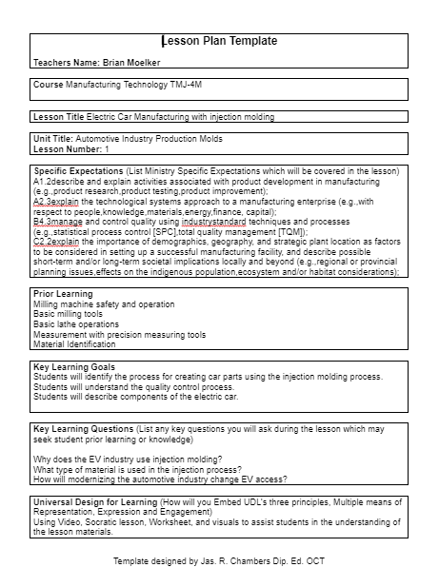
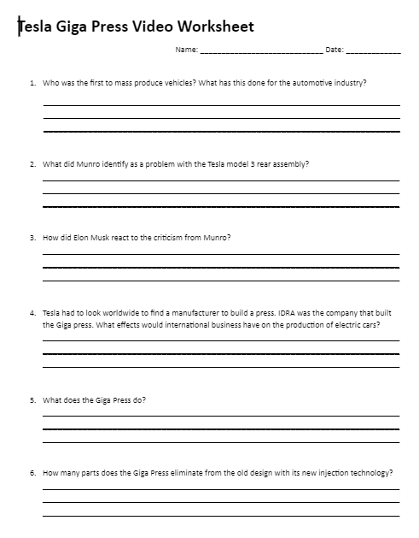
Lesson Plan 1: Electric Car Injection moulding
Lesson Plan Electric Car
Tesla Video Worksheet
ovin-navigator.ca

Slide 16
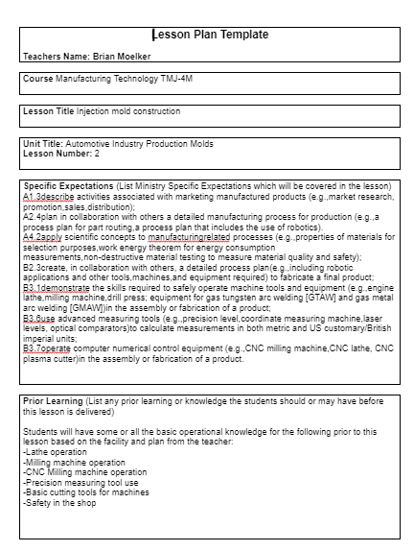
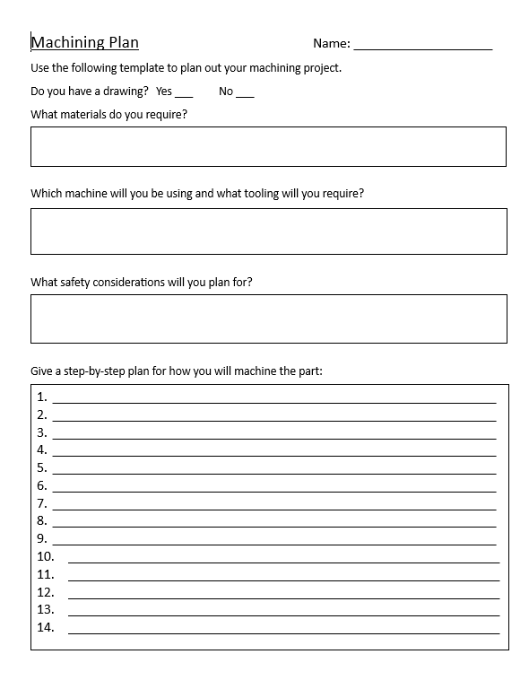
Lesson Plan 2: mould Building and Machining
Lesson Plan mould Building
Machining Plan Worksheet
ovin-navigator.ca

Slide 17
Section 3: Injection mould Project Instructions
Explore more at ovin-navigator.ca

Slide 18
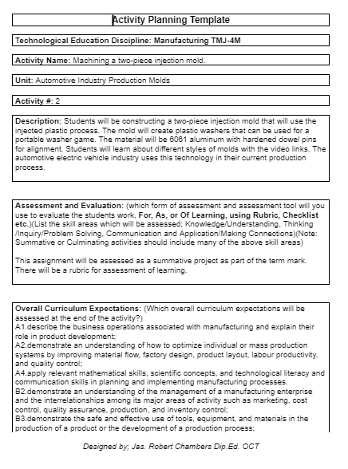
Injection mould Building Activity
Students will be constructing a two-piece injection mould that will use the injected plastic process. The mould will create plastic washers that can be used for a portable washer game. The material will be 6061 aluminum with hardened dowel pins for alignment. Students will learn about different styles of moulds with the video links. The automotive electric vehicle industry uses this technology in their current production process.
Activity Plan mould Building
ovin-navigator.ca

Slide 19
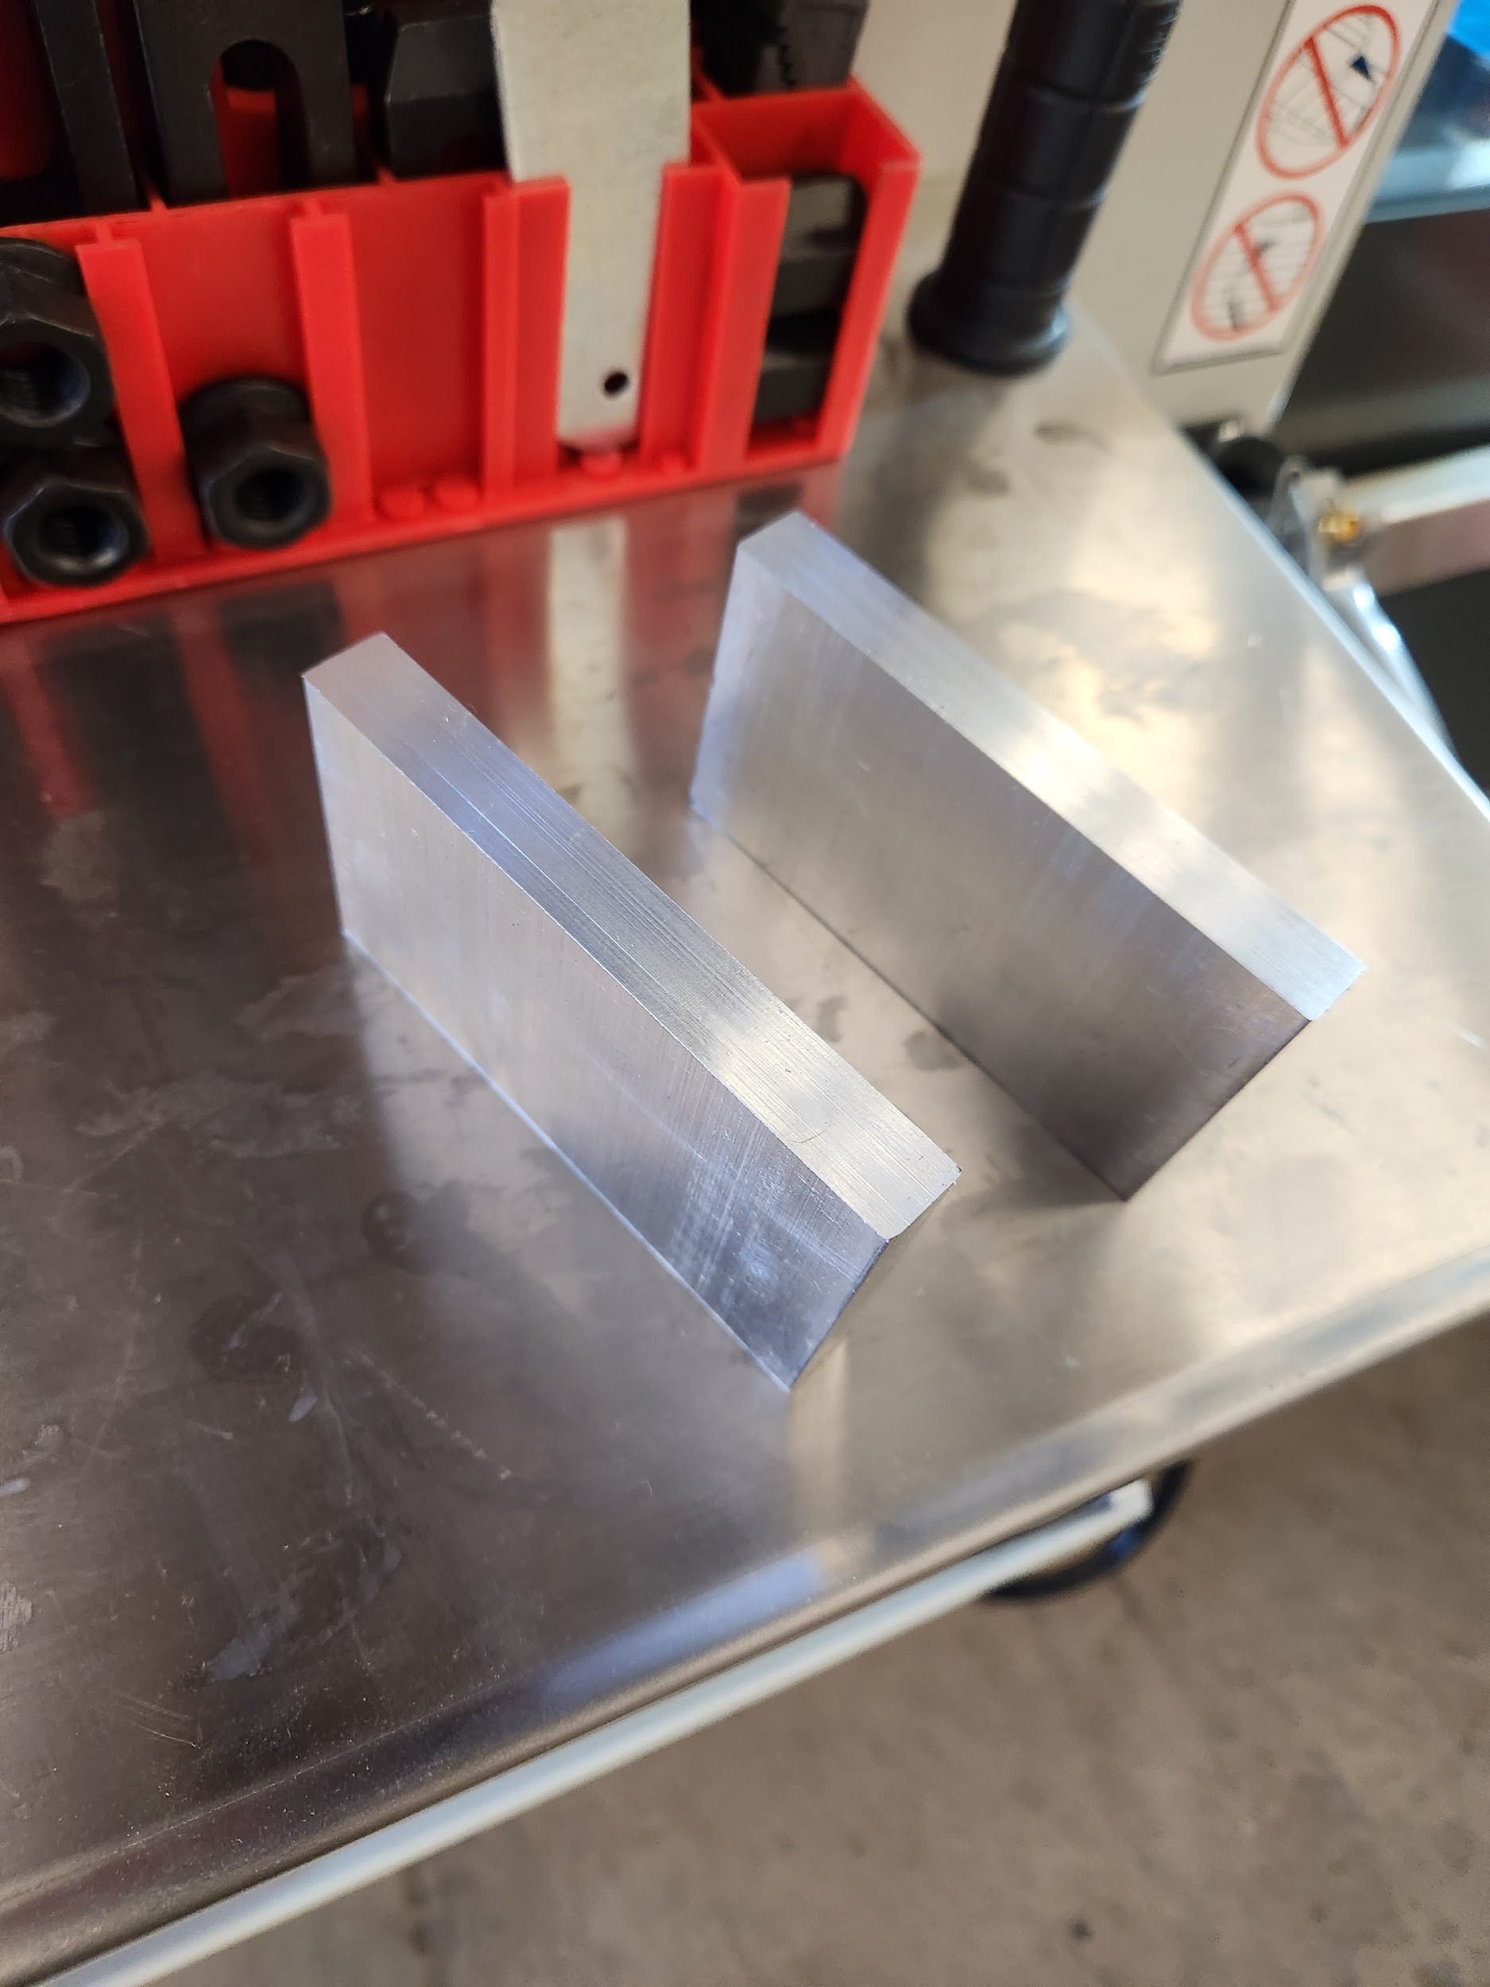
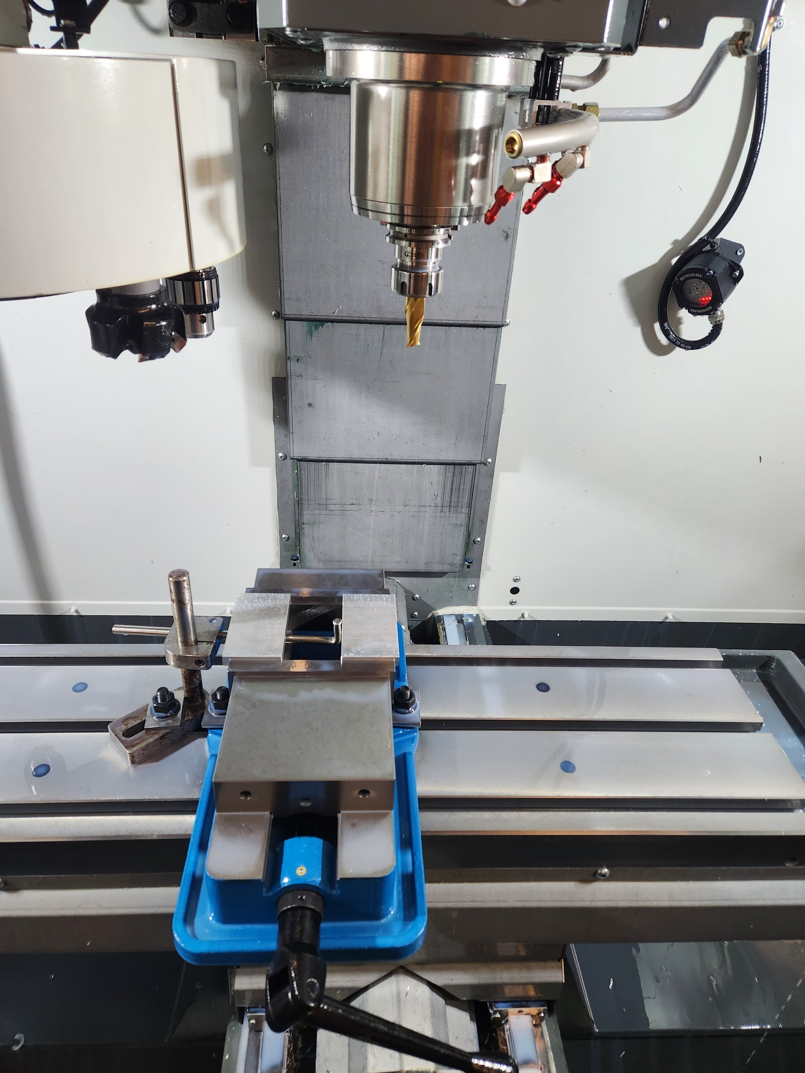
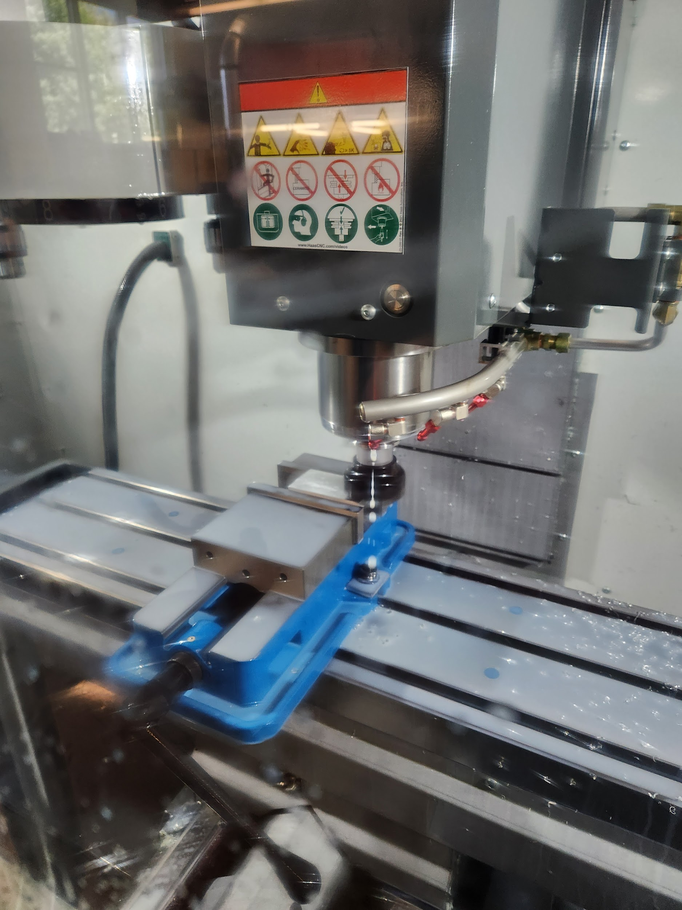
mould Machining
Cut material
Machine square
Face material
ovin-navigator.ca

Slide 20
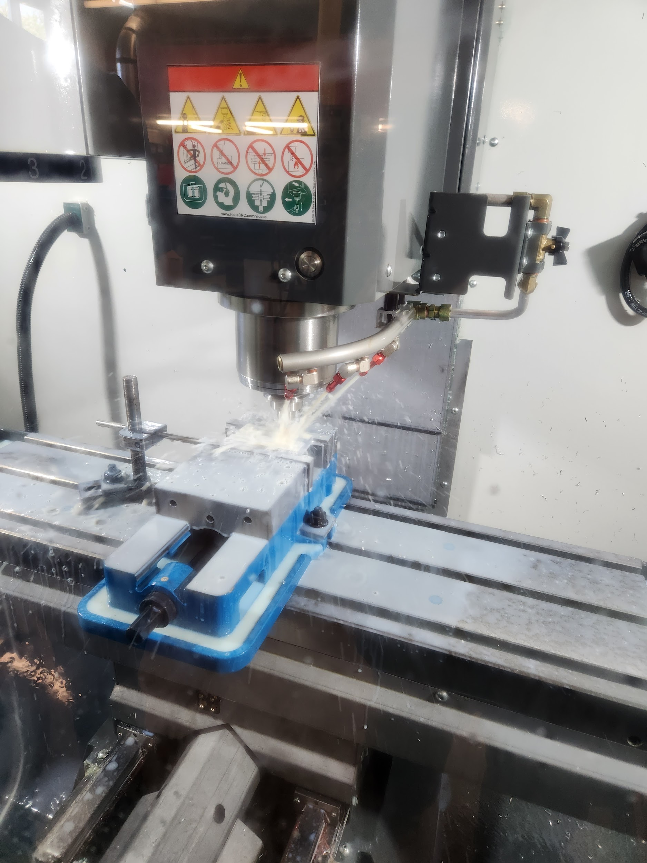
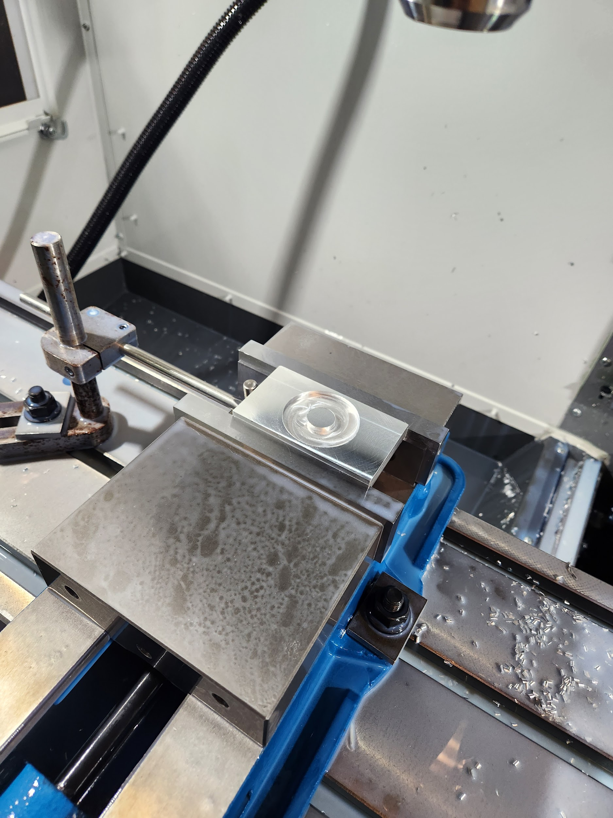
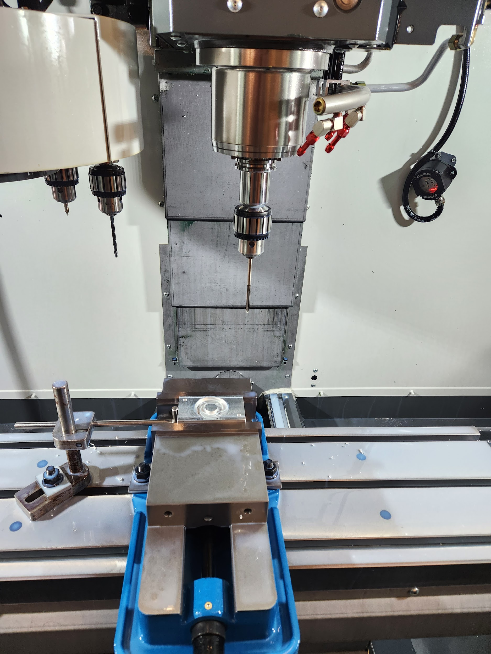
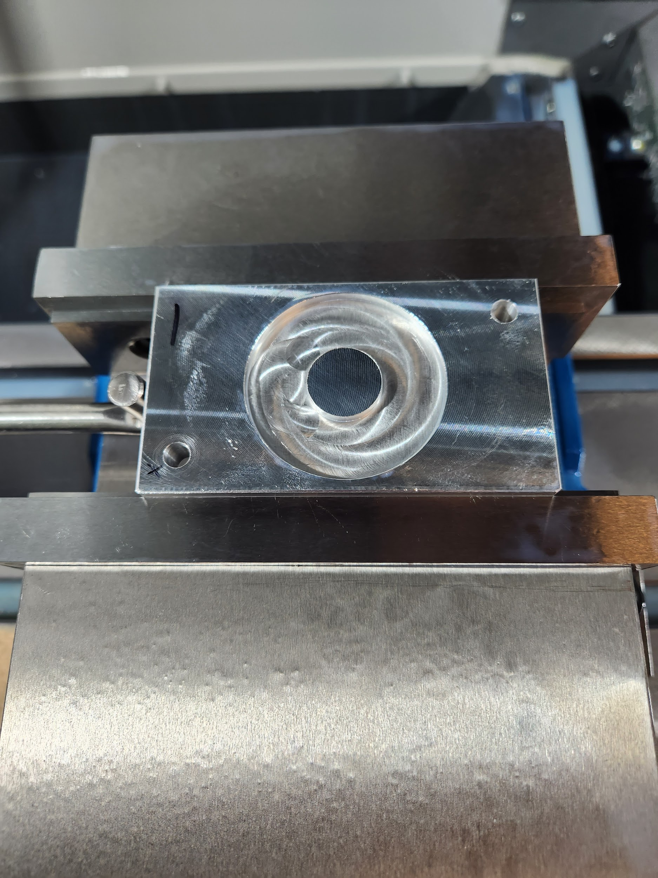
Machining / Drilling / Reaming
Machining the circular washer
Drilling and Reaming
ovin-navigator.ca

Slide 21
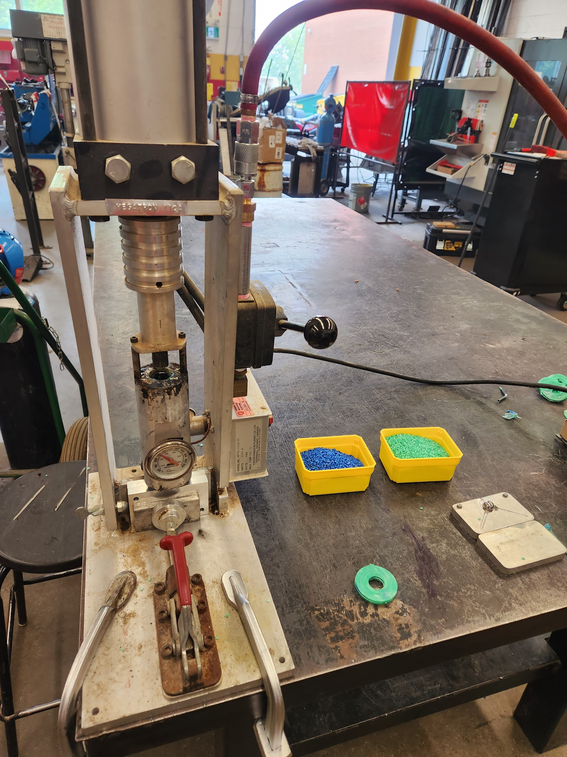
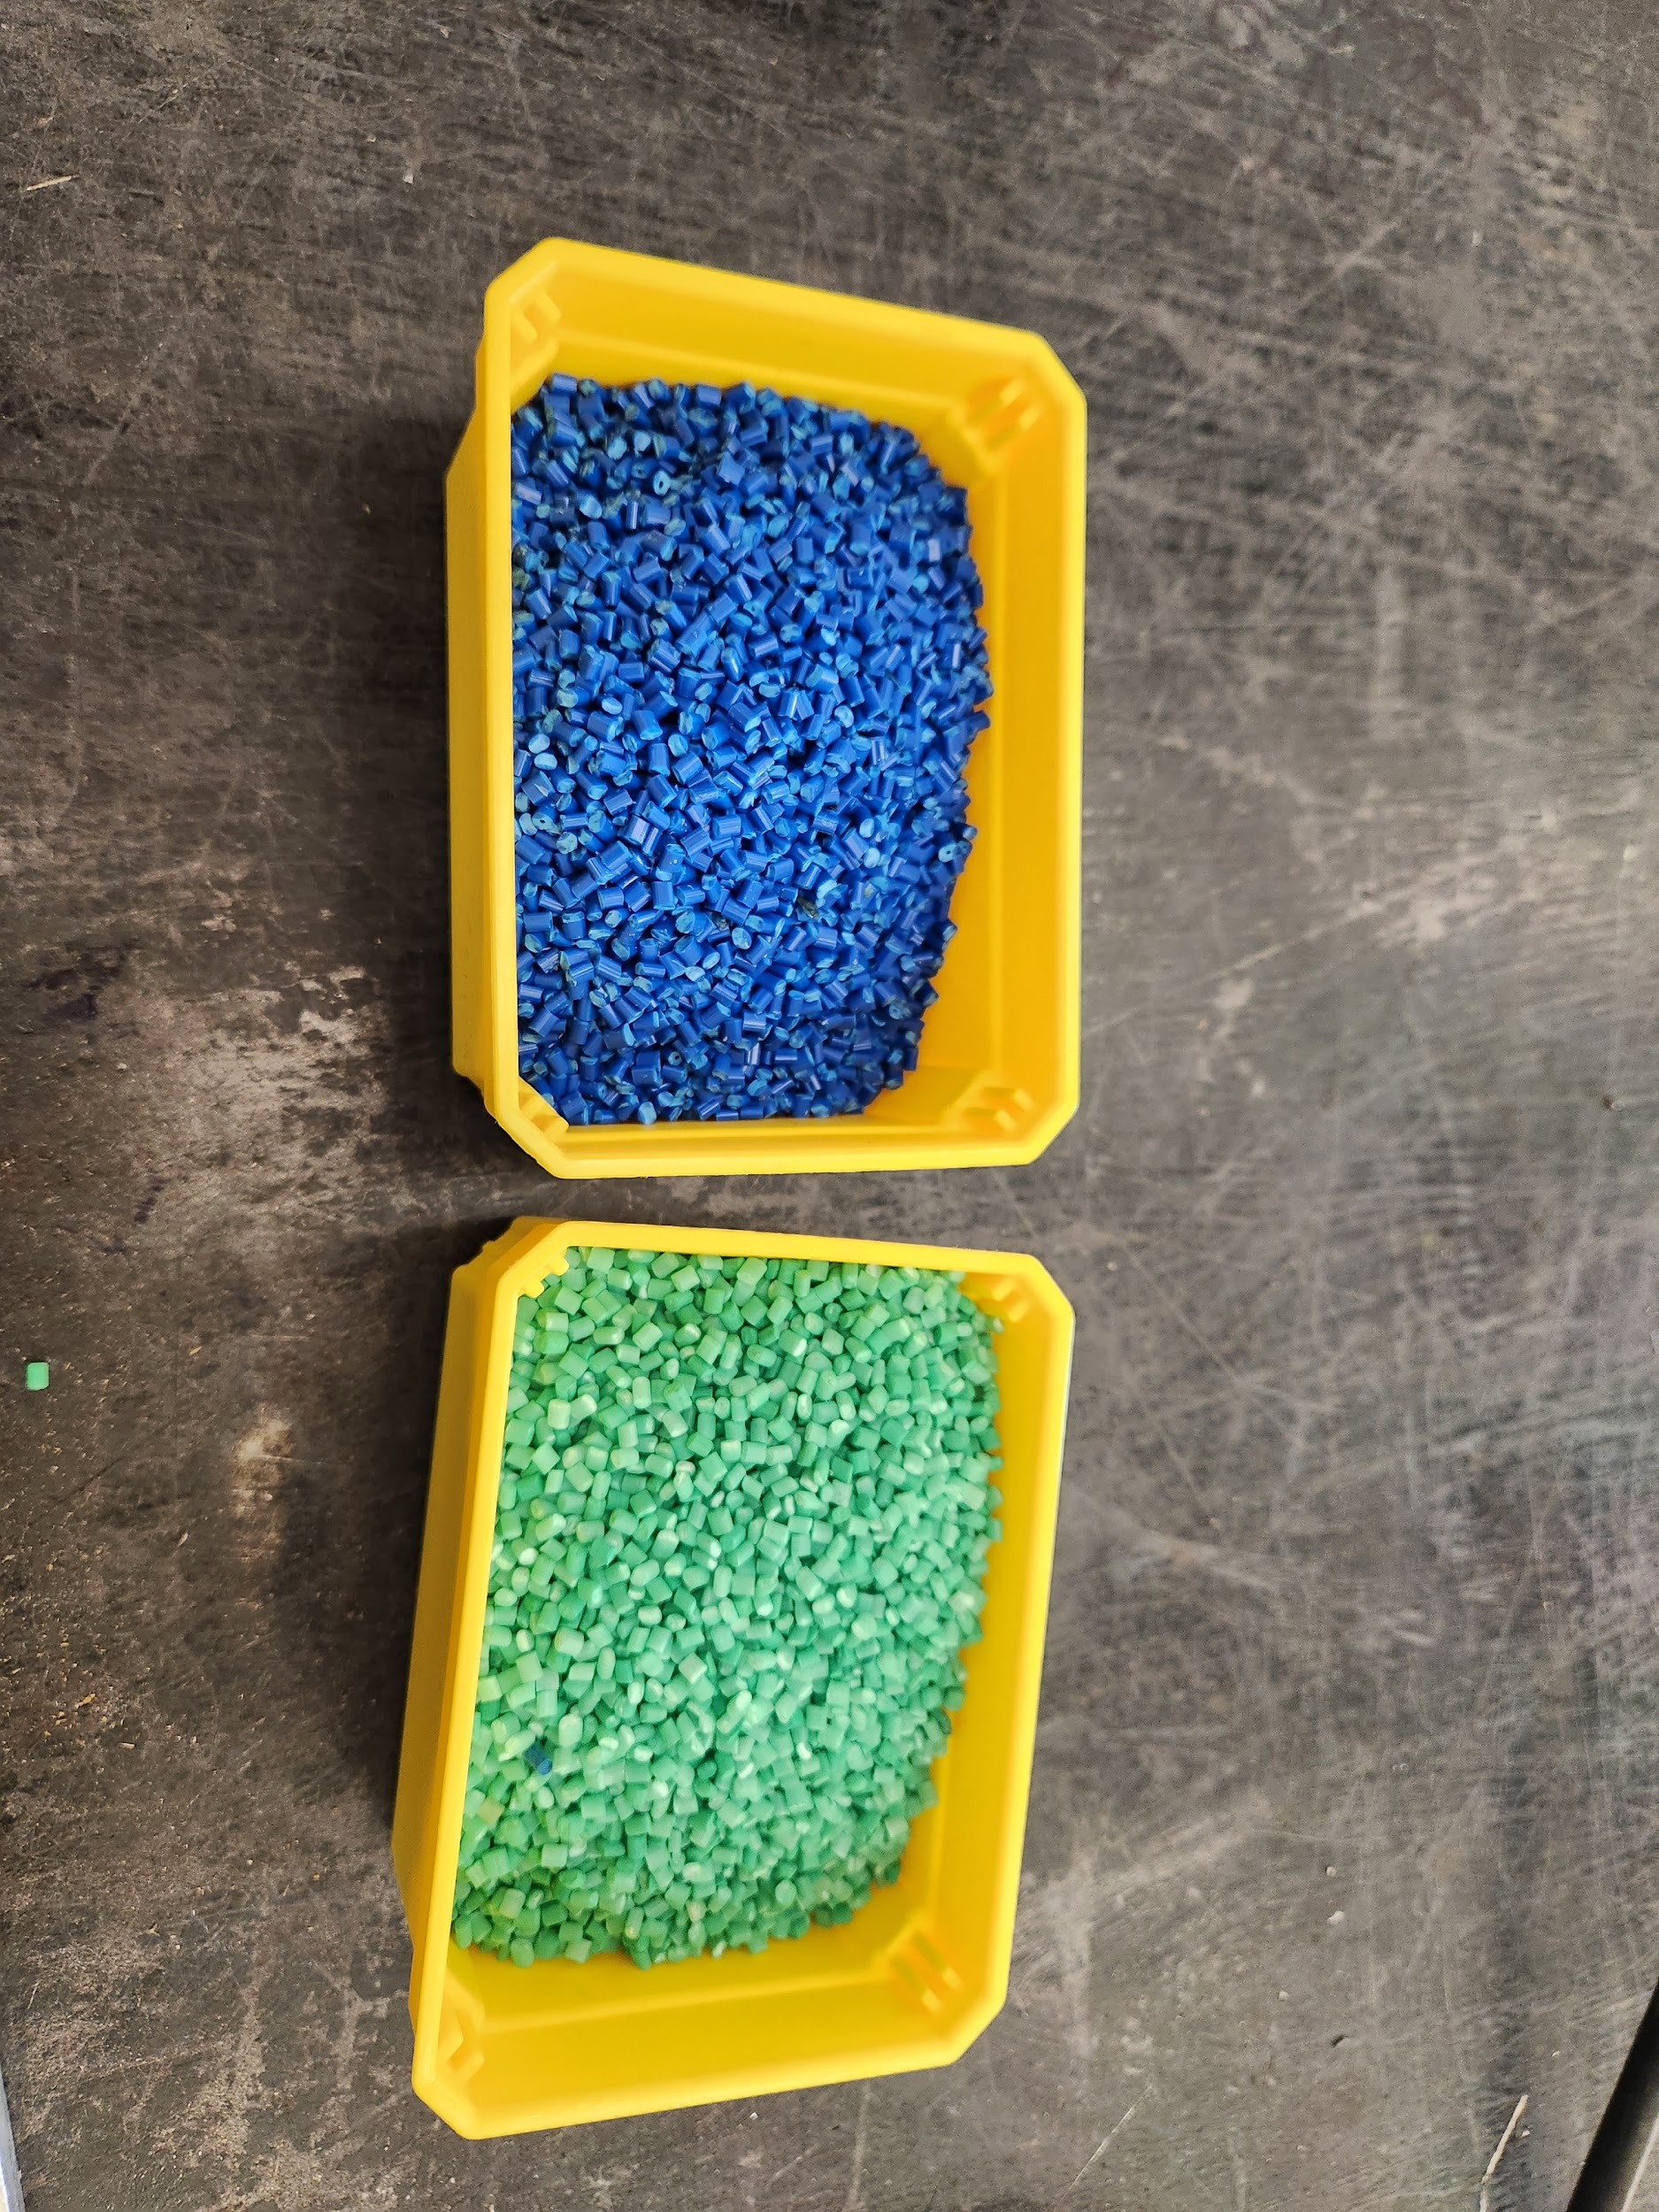
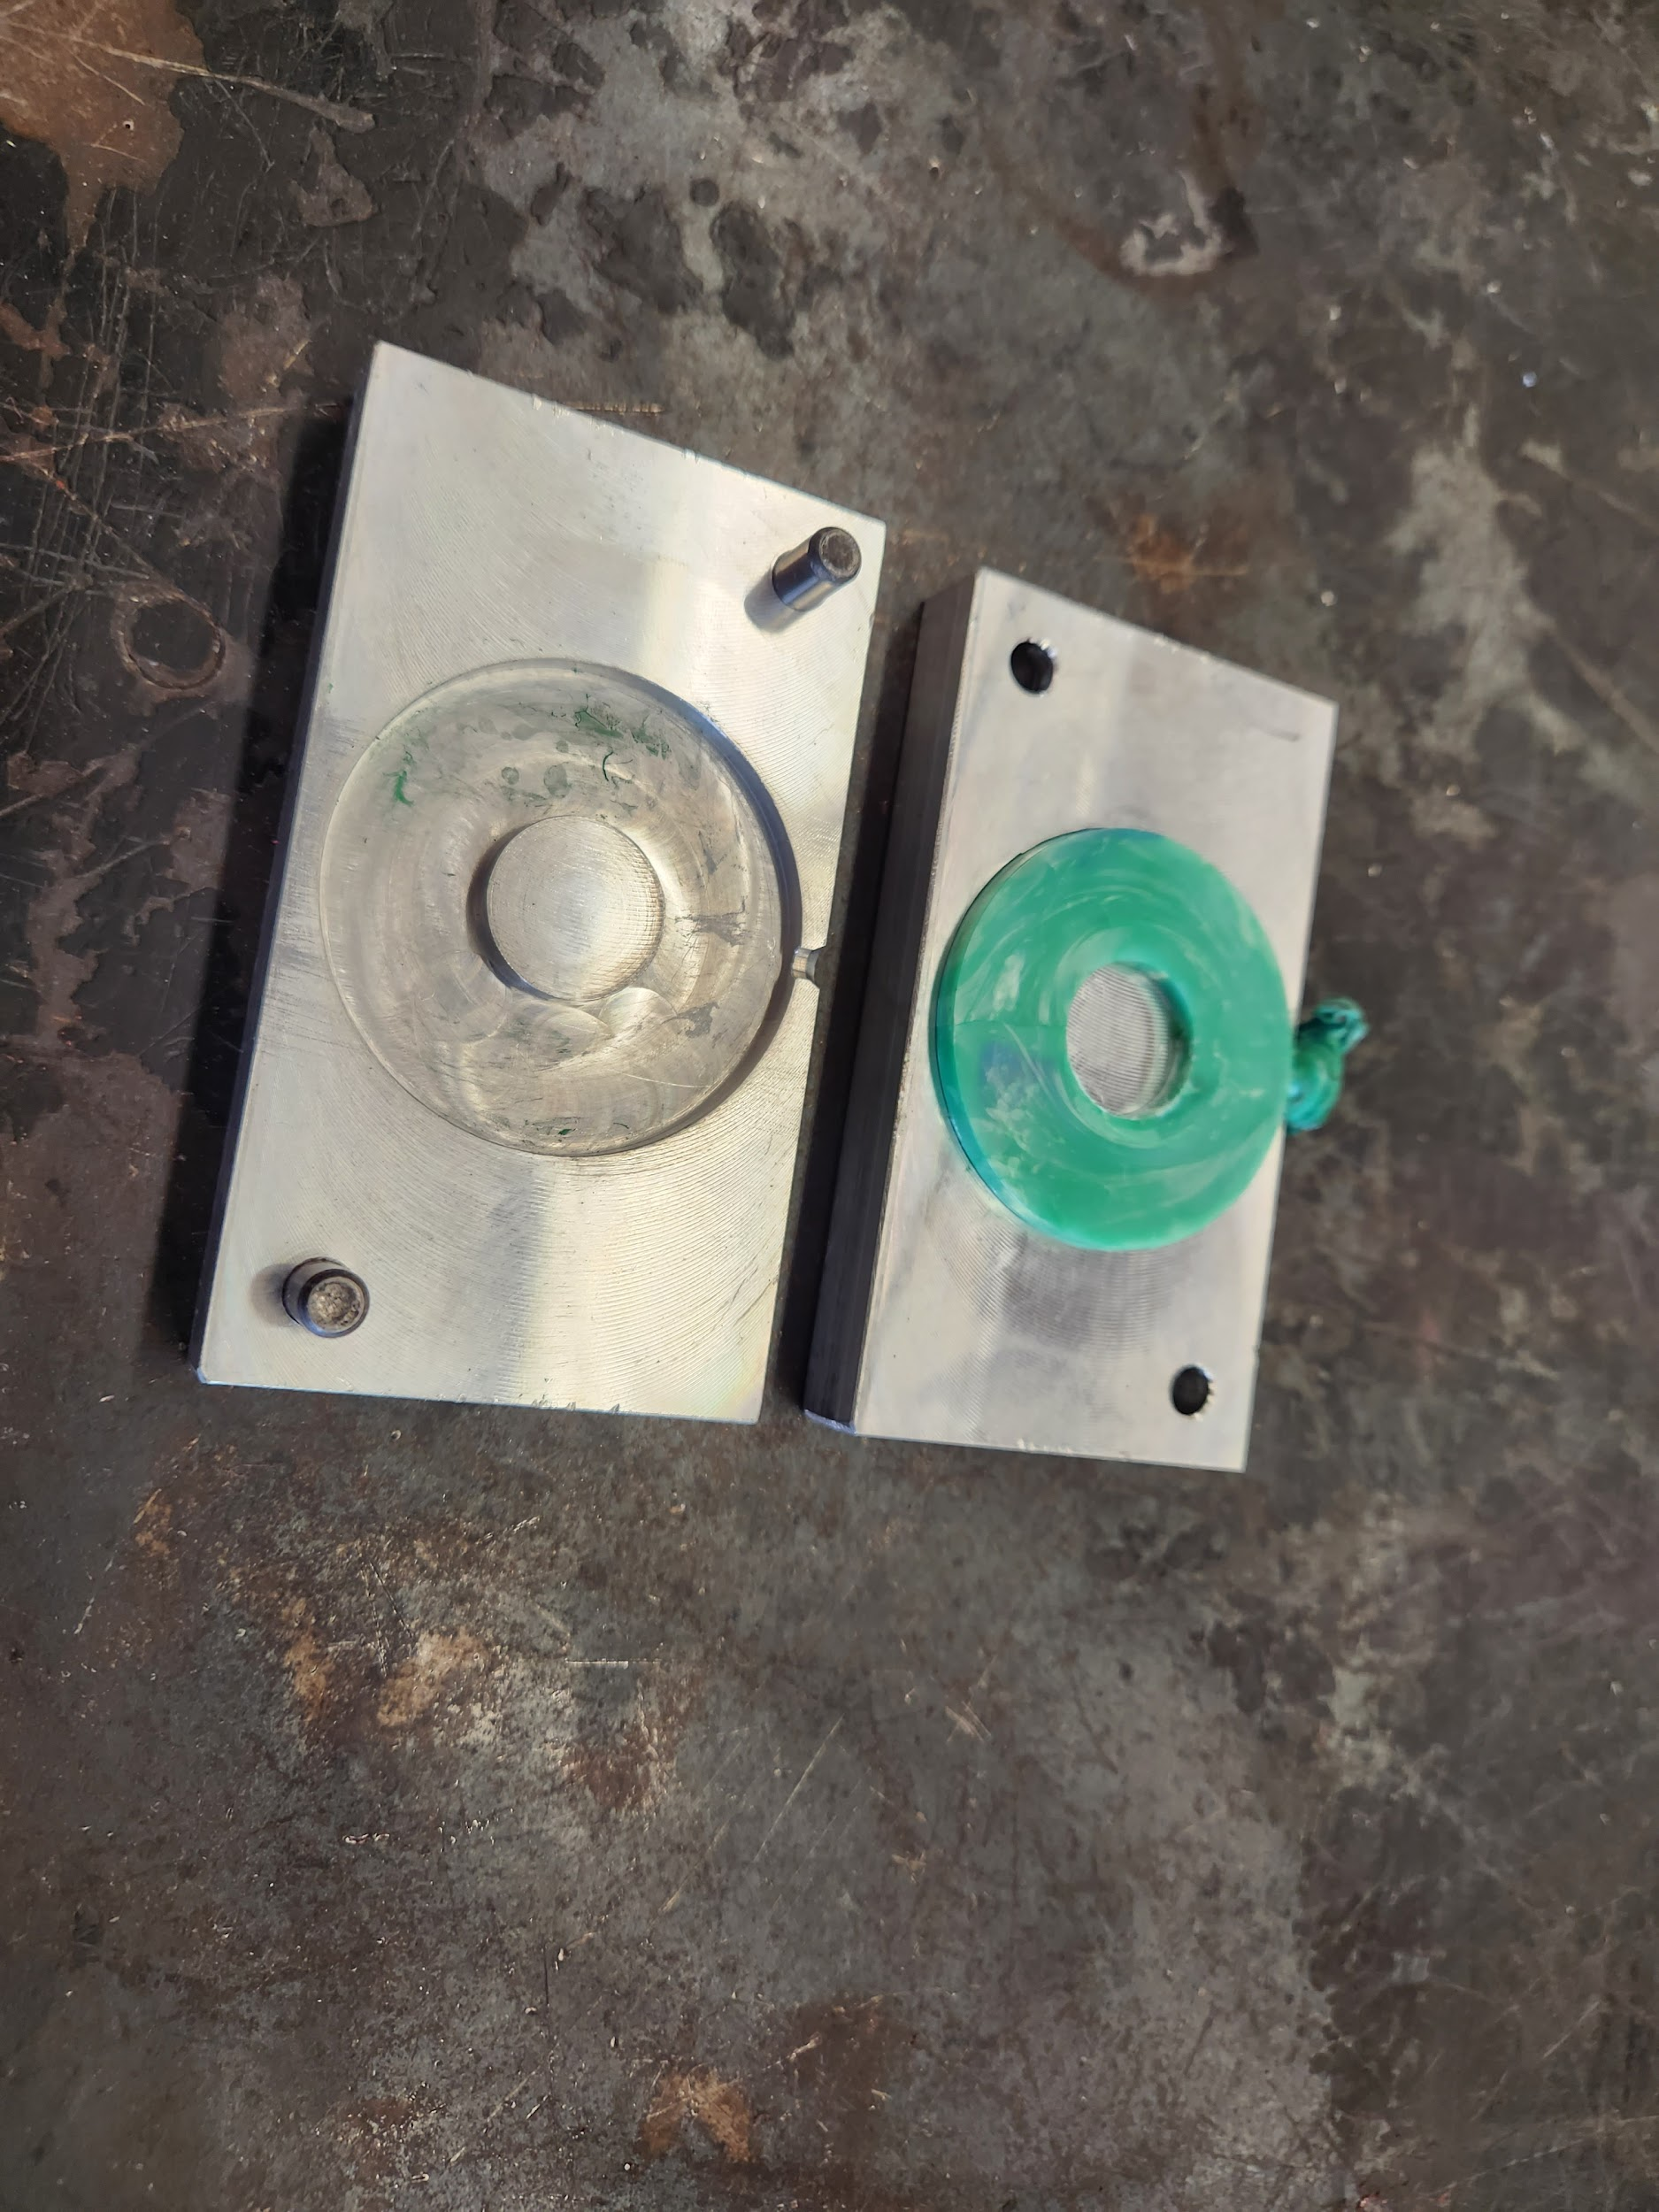
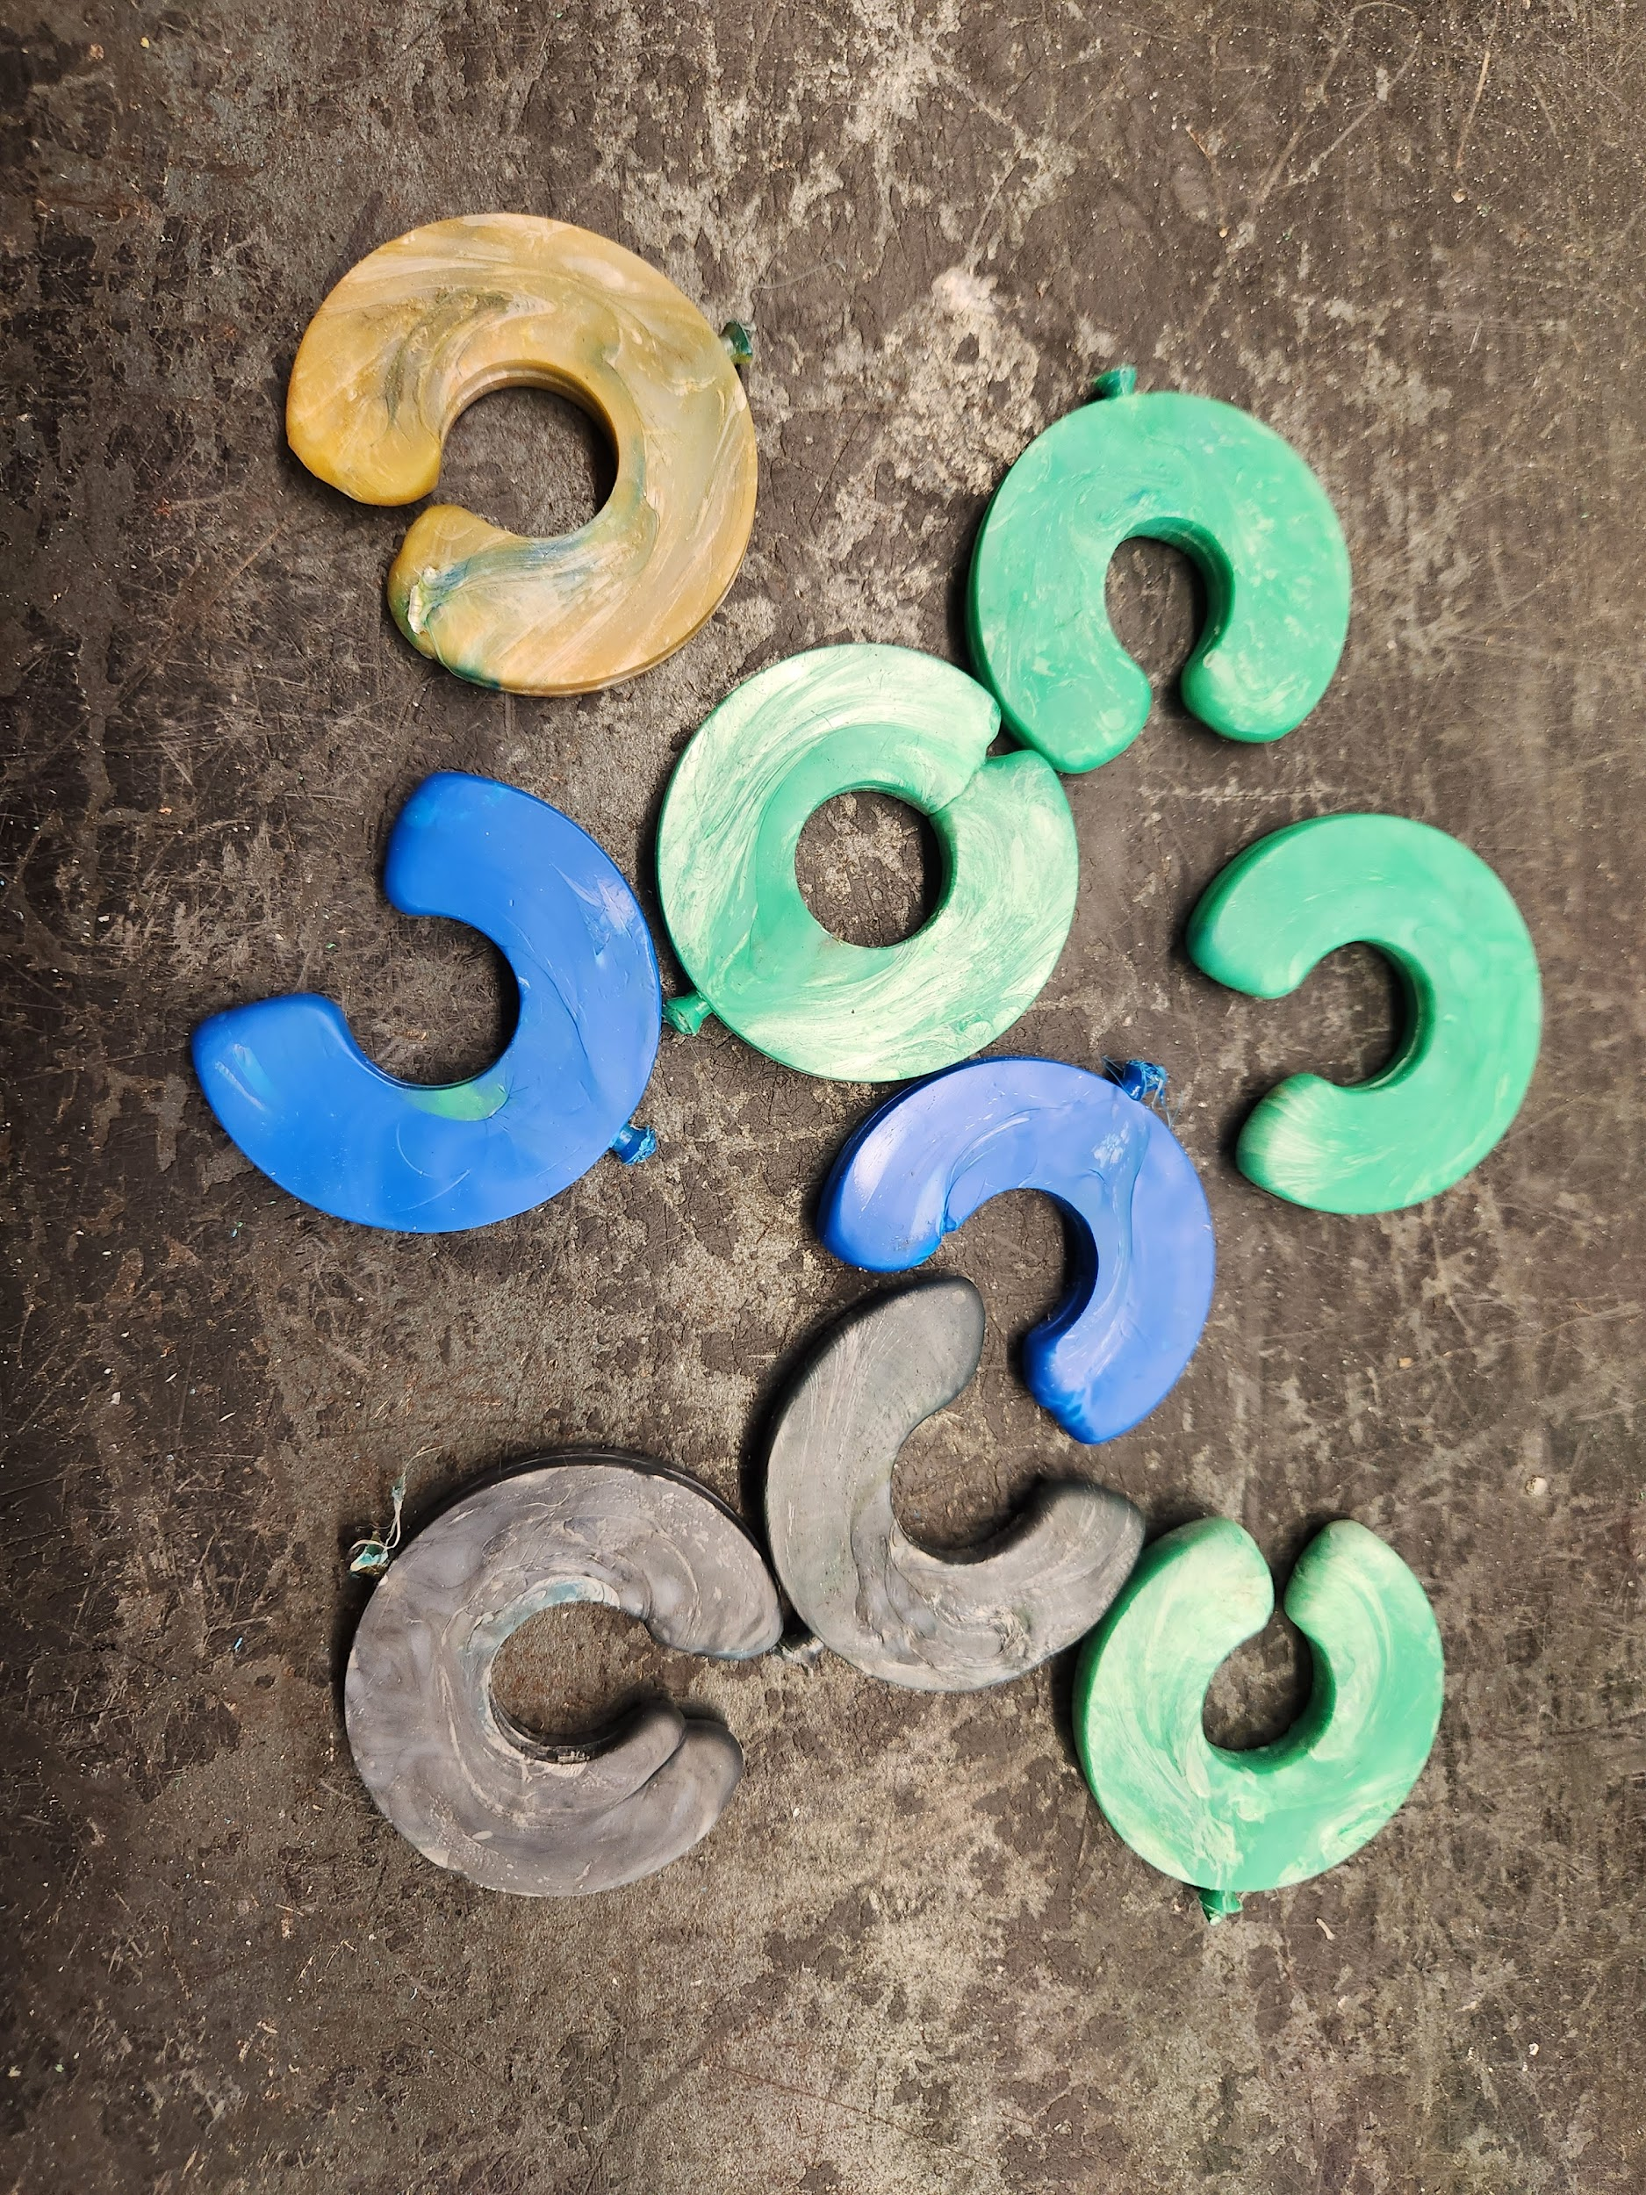
Injection moulding with Polystyrene
Injection Machine
Polystyrene Pellets
Finished Part
Production
Quality Control
ovin-navigator.ca

Slide 22
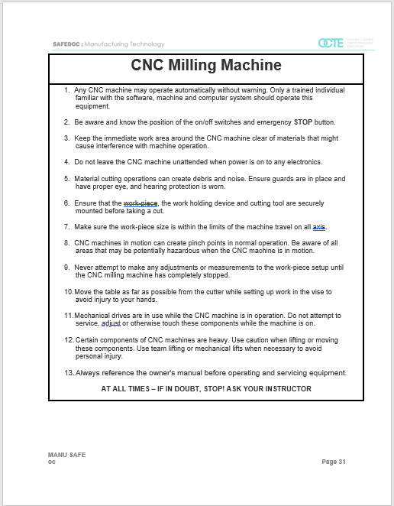
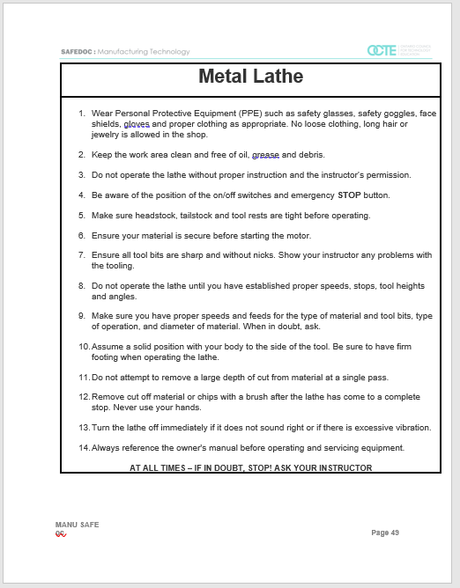
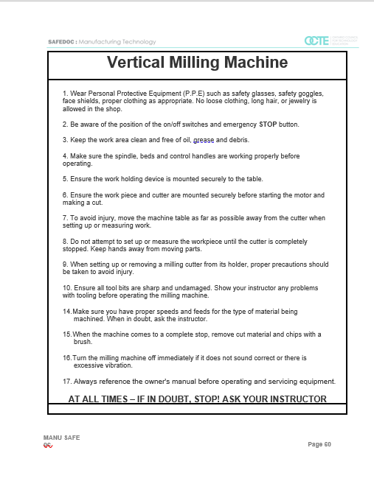
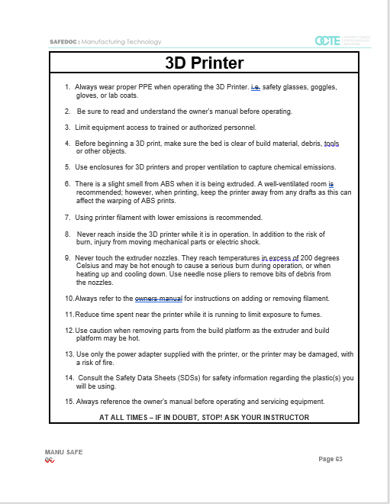
Student Safety Guidelines
CNC Milling Machine
Metal Lathe
Vertical Milling Machine
3D Printer
ovin-navigator.ca

Slide 23
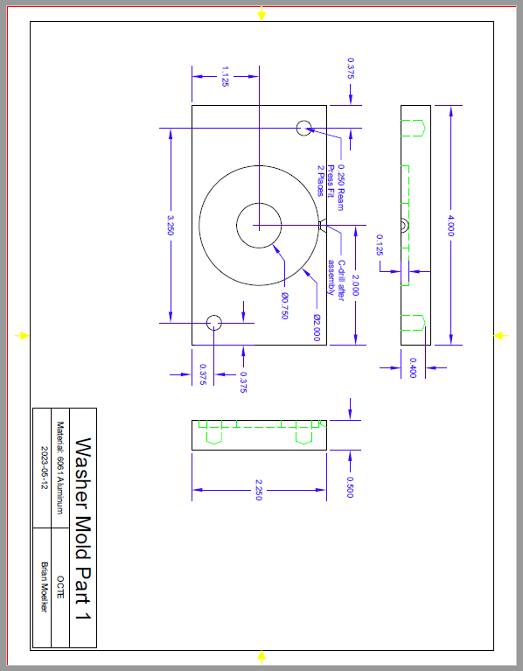
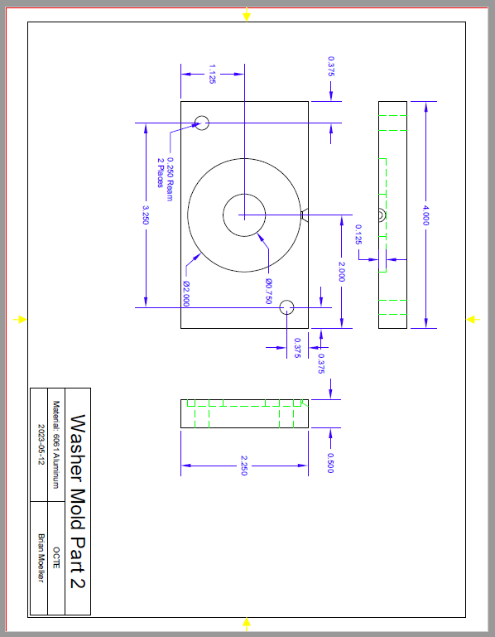
Injection mould Drawings
mould Drawing Part 1
mould Drawing Part 2
ovin-navigator.ca

Slide 24
Videos/Guides
Injection mould making 3D printing
https://formlabs.com/blog/diy-injection-moulding/
Injection moulding: mould Design & Making
https://www.youtube.com/watch?v=MhoAIDz4Bhw
Tesla Giga Press
The Incredible Logistics Of The Tesla Giga Press!
ovin-navigator.ca

Slide 25
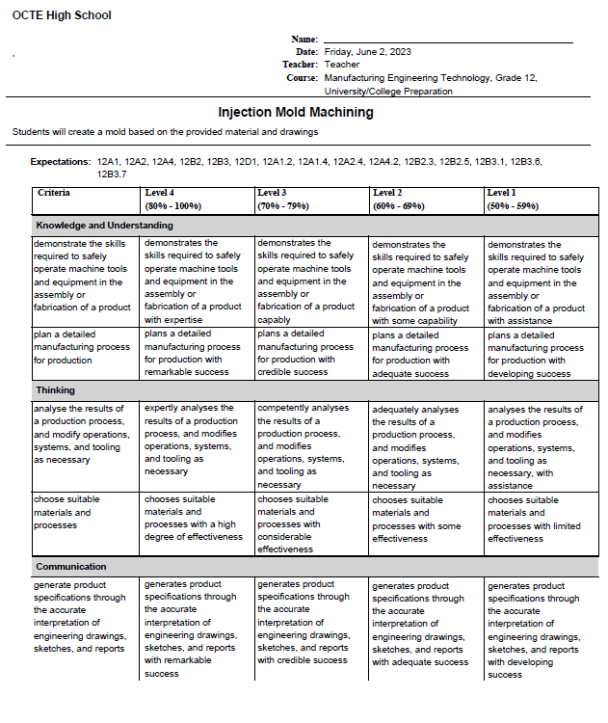
Injection mould Building Rubric
Injection mould Rubric PDF
ovin-navigator.ca

Slide 26
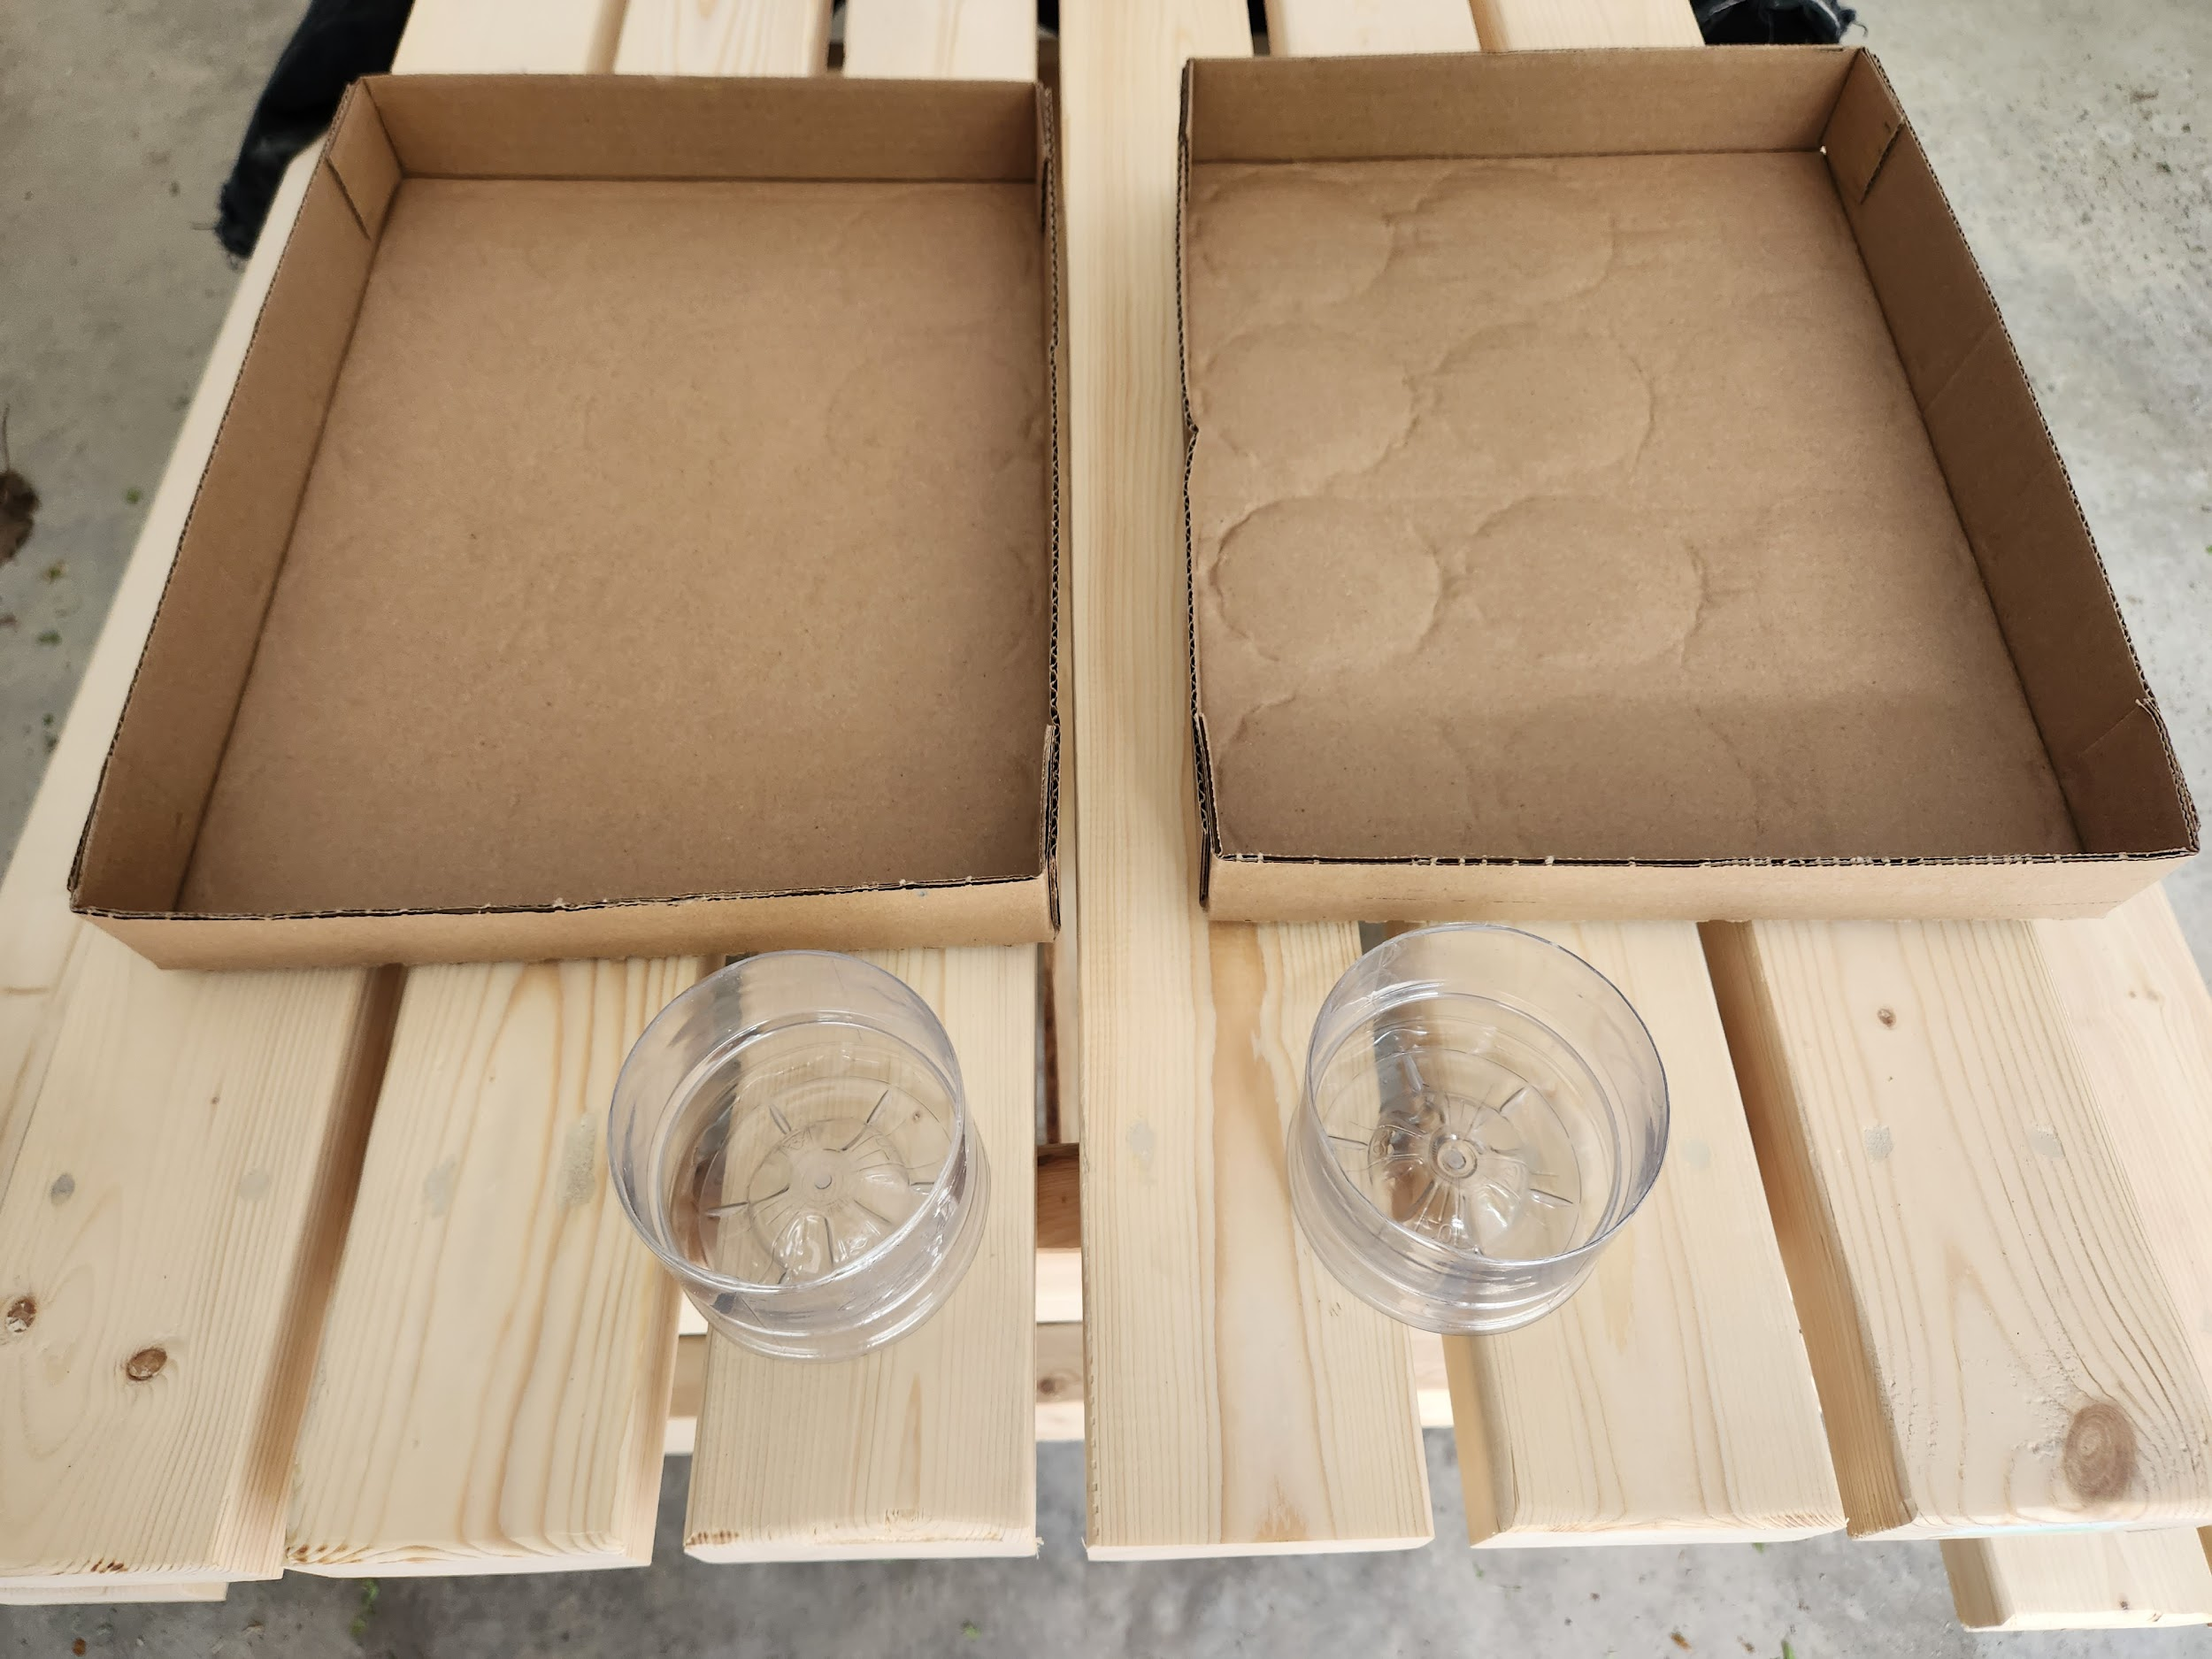
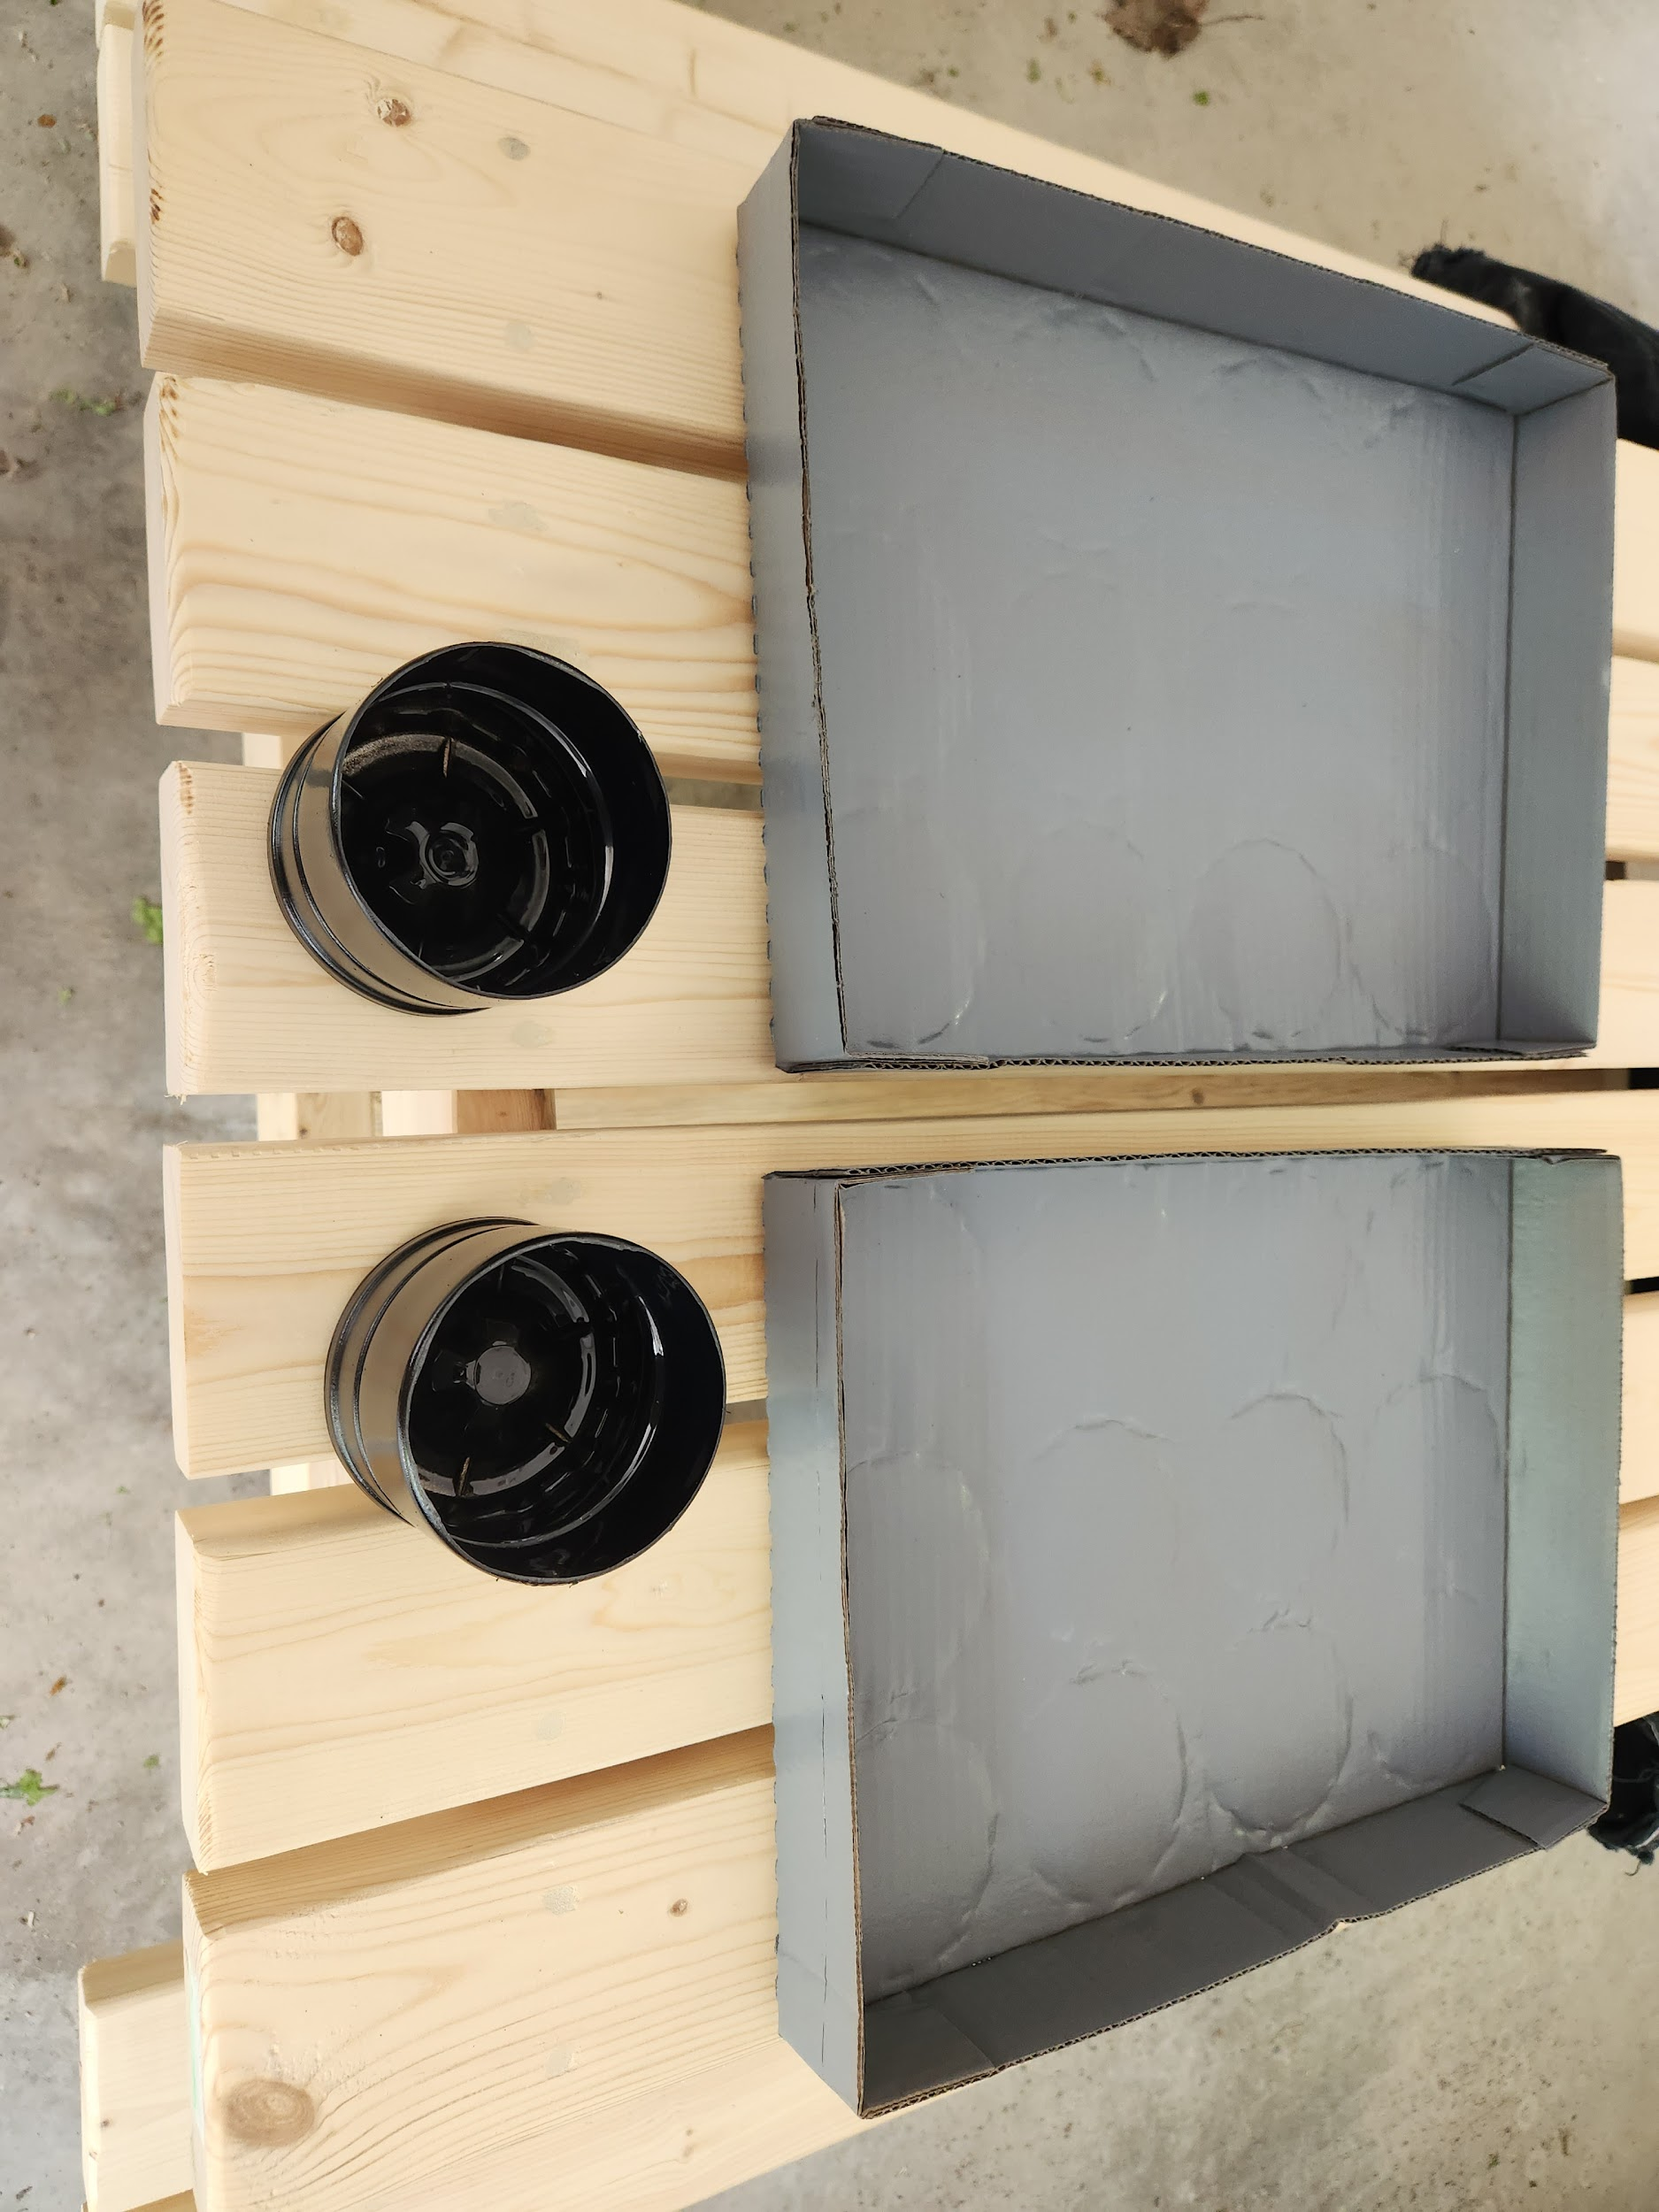
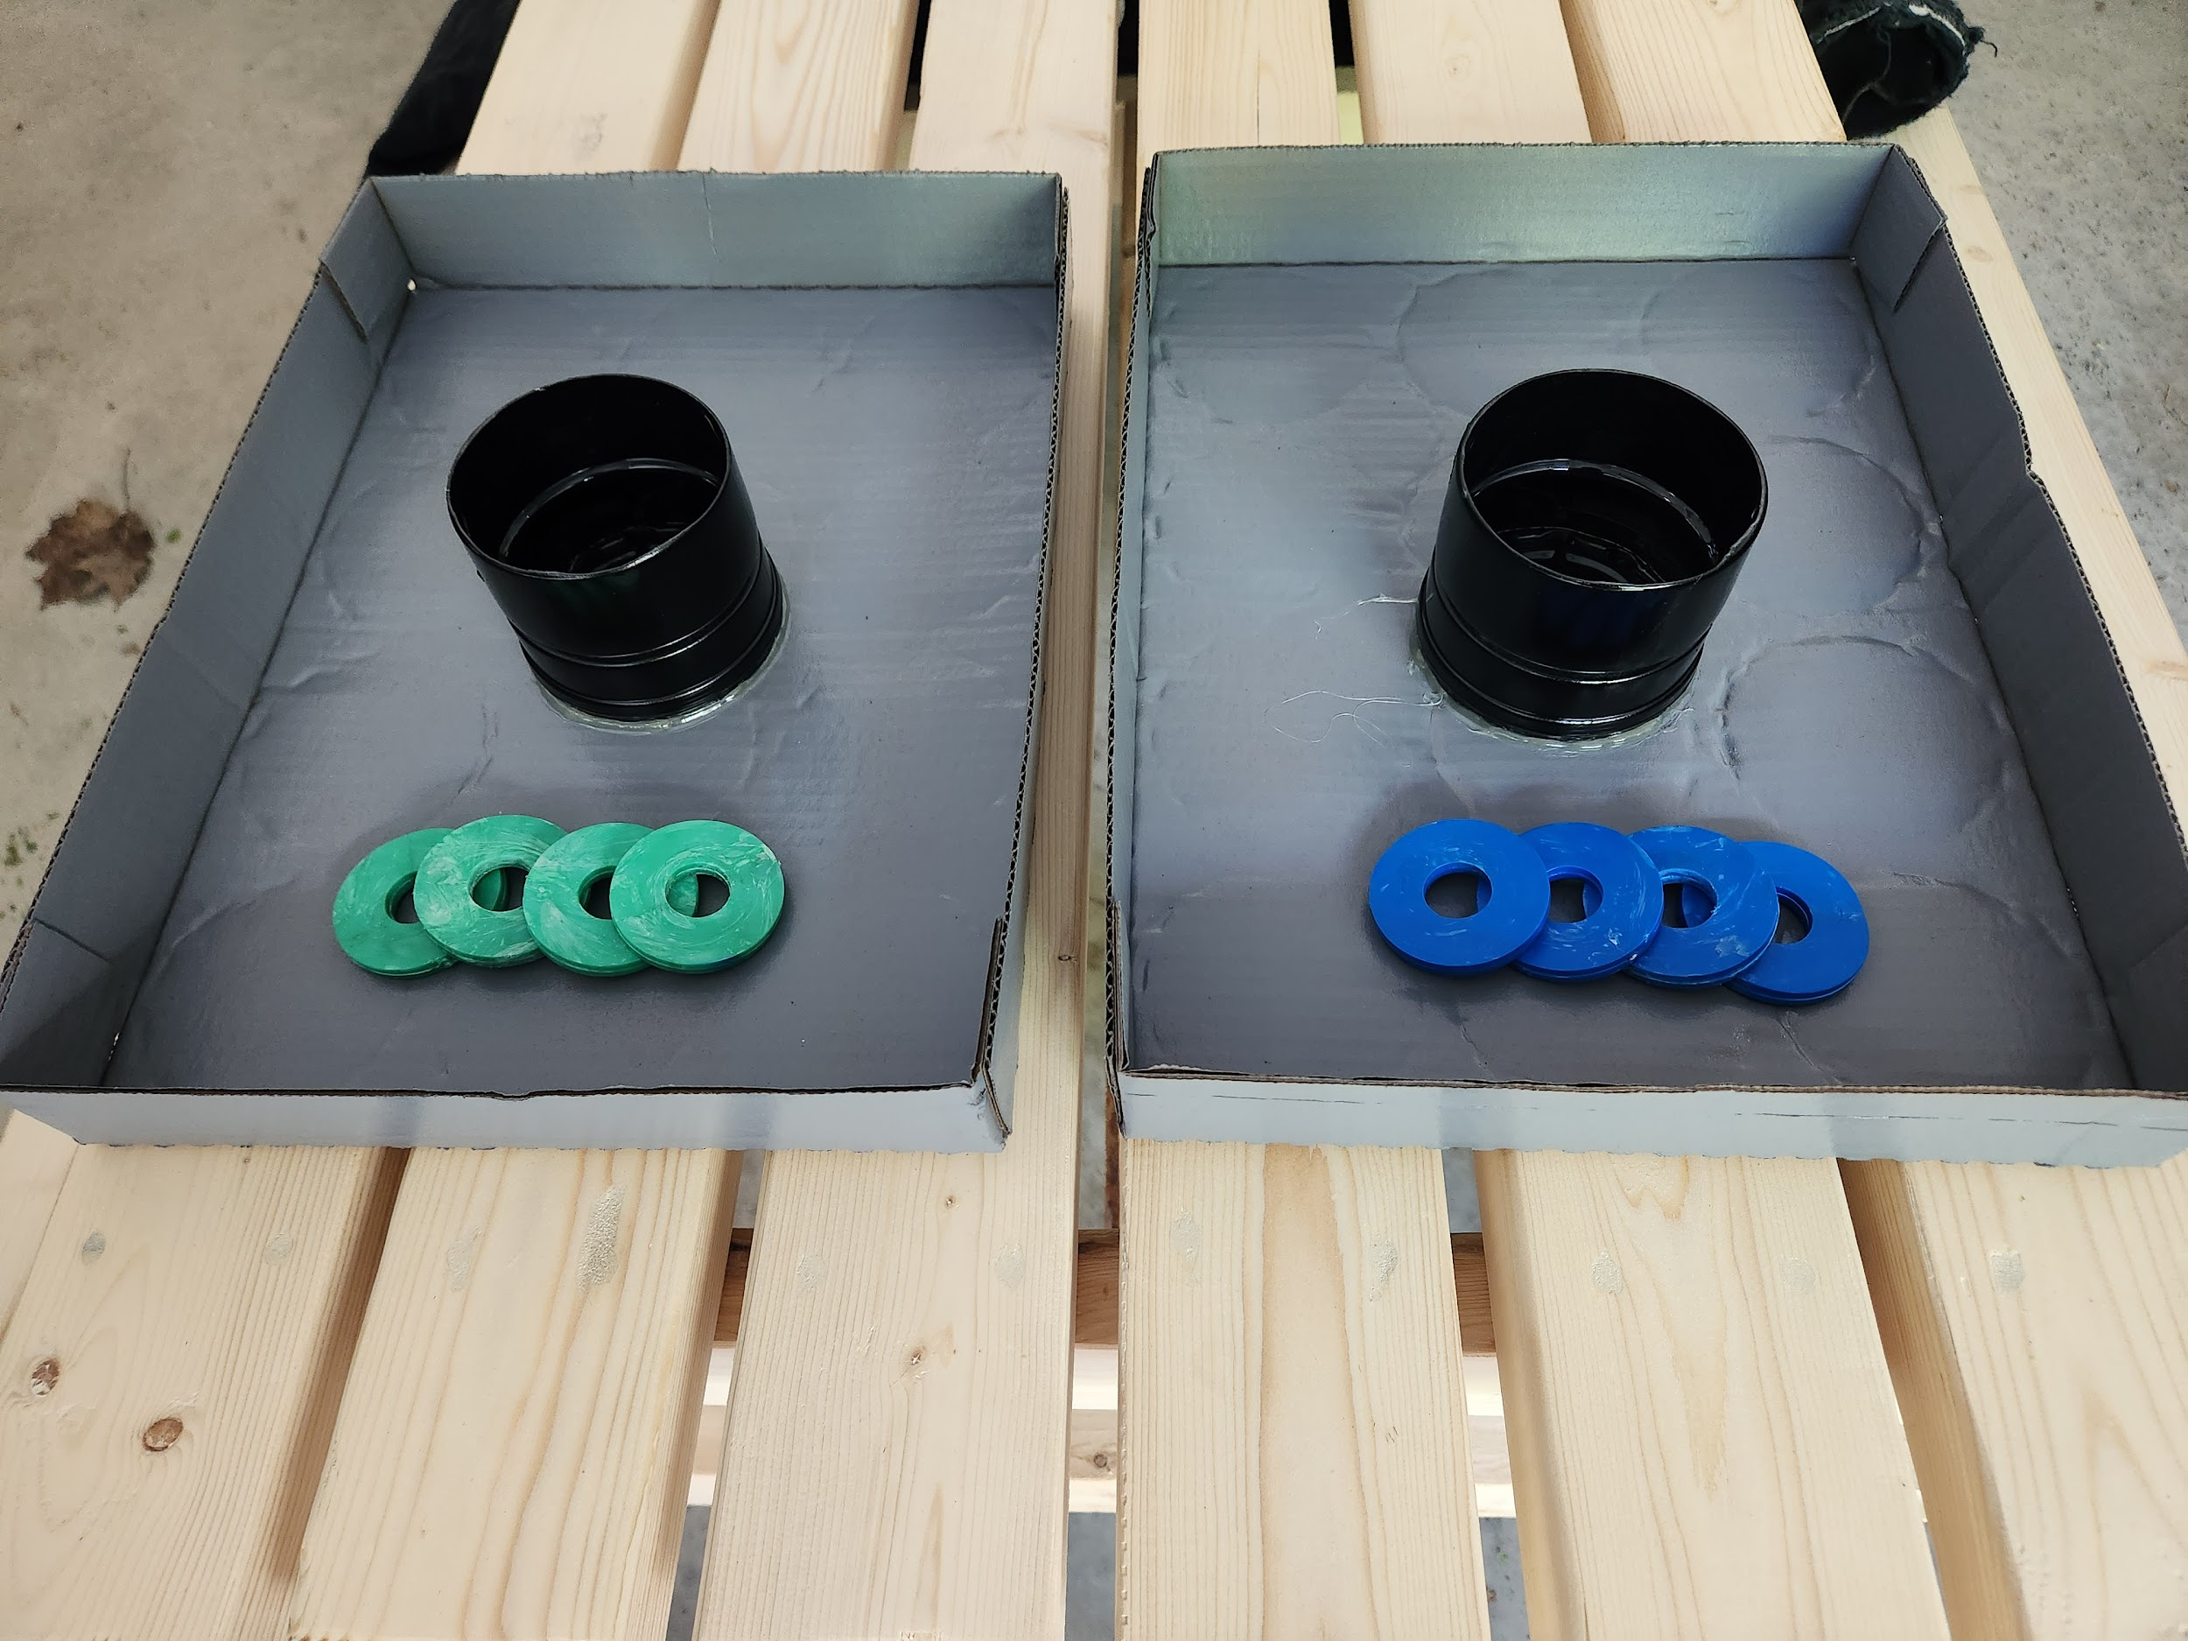
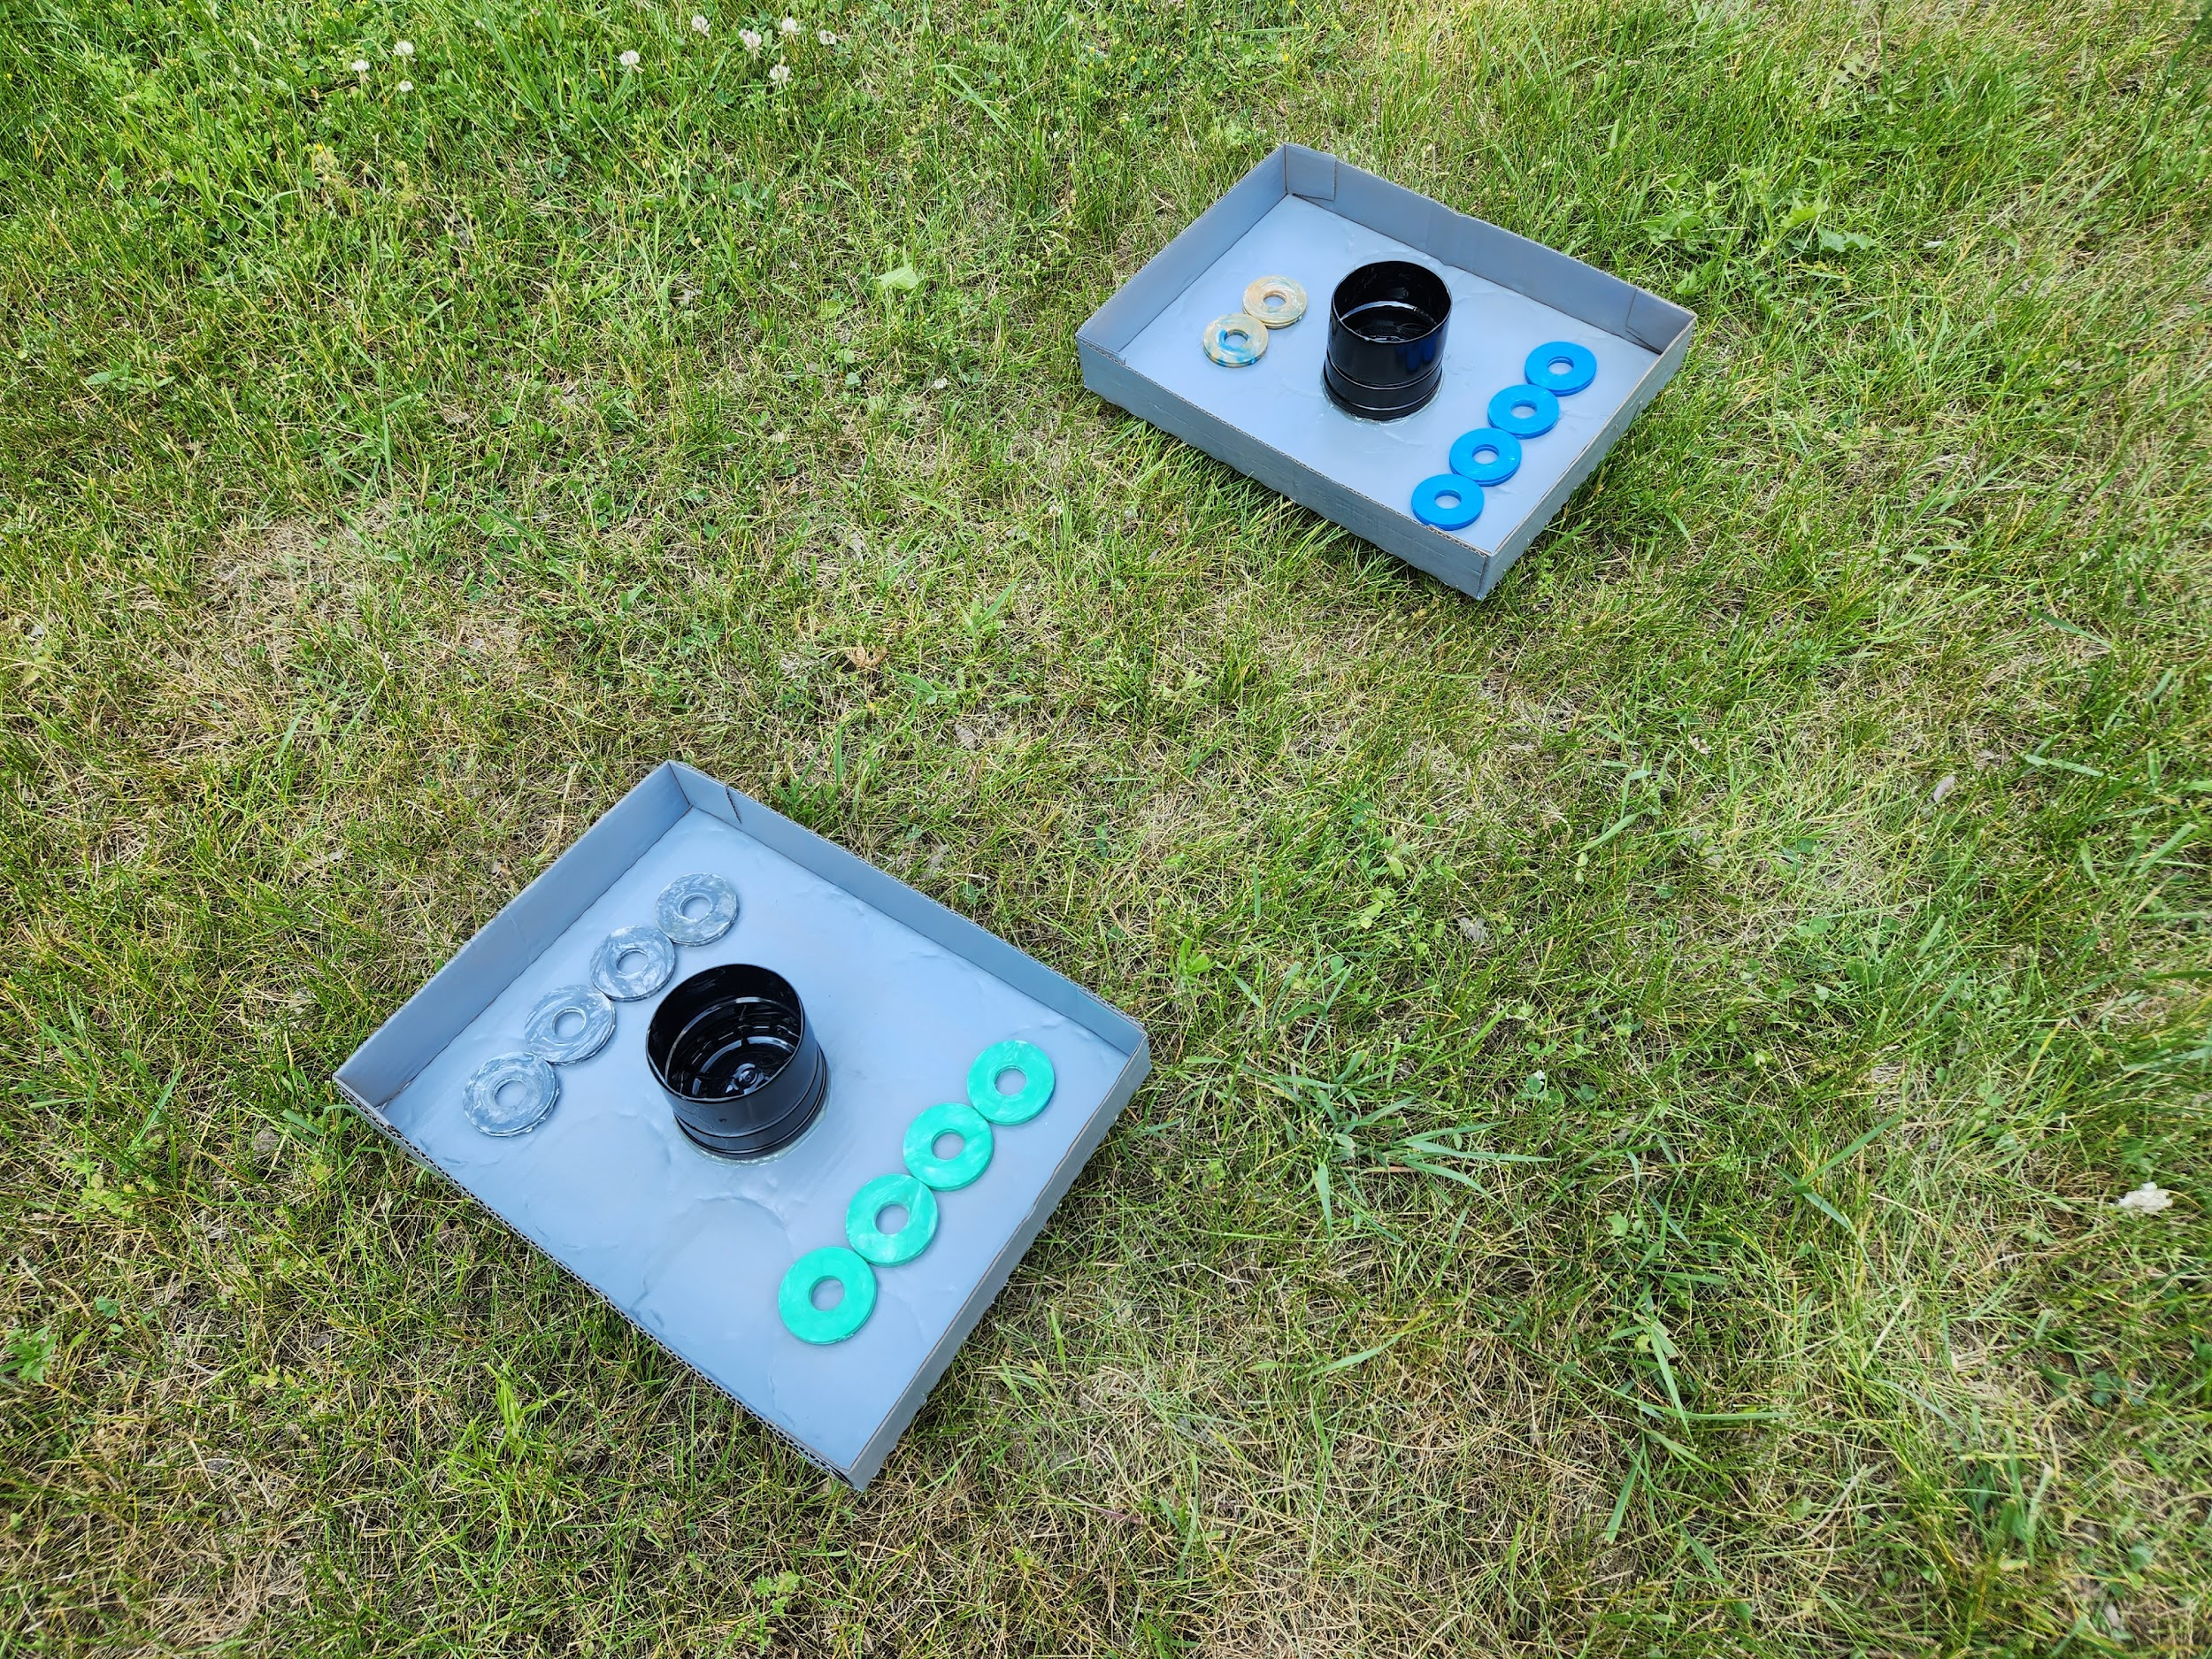
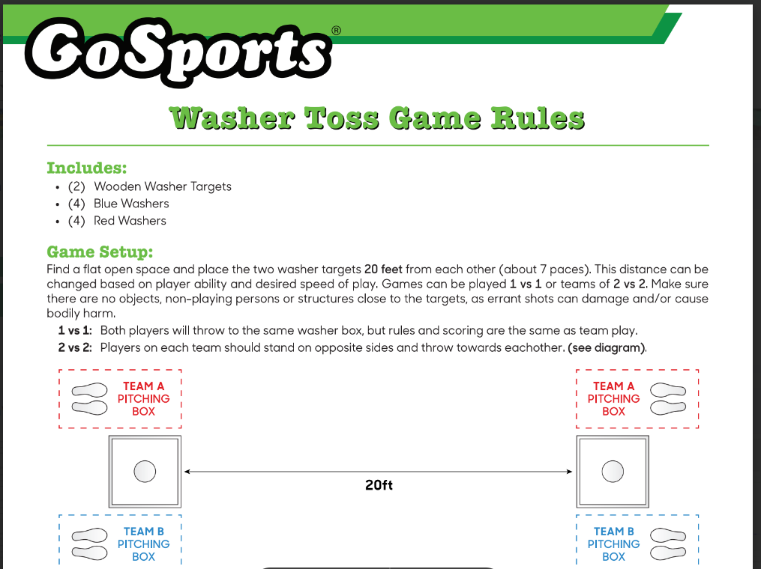
Washer Toss Game
Recycled Materials
Add some paint
Finished Product
Rules
The washer toss game can be made from and recycled materials that you feel fit. You can make connections to the environmental strands of the curriculum.
Rules Sheet
ovin-navigator.ca

Slide 27
Alternative Learning and Machining Options
Machining Options
Machine parts using a Metal Lathe and a four jaw chuck
Machine parts on a conventional milling machine with a boring head or a rotary table
3D printing moulds
Two part aluminum / 3D printed moulds
Injection moulding Options
Injecting soft plastic with plastisol
Injecting with two part plastics / silicone
Injecting with melted wax
Other Lesson Ideas
Quality control
Large Production Parts Run
Environmental Effects of Production
ovin-navigator.ca

