Slide 1
The 8 Sectors of Tourism

Slide 2
Why is Tourism Important in Ontario?
Every $1 million spent by visitors in Ontario generates 13 new jobs and $604, 800 in wages and salaries
Tourism contributes to the province’s economy and quality of life by creating jobs, promoting pride of place and celebrating diverse communities across the province
Tourism contributes more than $5 billion annually in tax revenue for the Ontario provincial government (Dec 2018)
Tourism is a growth market, projected to generate more than $31 billion in visitor spending in Ontario in 2019

Slide 3
The 8 Sectors of Tourism
The tourism industry has been divided into eight different sectors or areas. The following are the eight sectors of tourism:
Accommodation
Adventure Tourism and Recreation
Attractions
Events and Conferences
Food and Beverage
Tourism Services
Transportation
Travel Trade

Slide 4
Accommodation Sector
This sector includes businesses that provide short-term places for travelers, vacationers and others. In addition to lodging, a range of other services may be provided at these businesses.
Accommodation
Hotels
Campground
Hostels
Cabins, Cottages and Houseboats

Slide 5
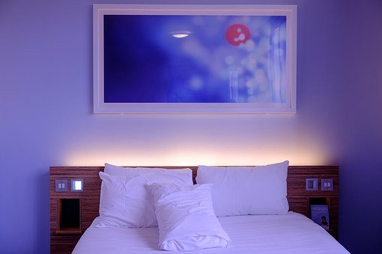
Accommodation Sector Various services and products offered
Single room: a room assigned to one person. My have one or more beds.
Double room: a room assigned to two people. May have one or more beds.
Triple rooms: a room that can accommodate three people and has been fitted with three twin beds, one double bed and one twin bed or two double beds.
Queen: a room with a queen-sized bed. May be occupied by one or more people.
King: a room with a king-sized bed. May be occupied by one or more people.
Suite: a room with one or more bedrooms and a separate living space.

Slide 6
Accommodation Sector Various services and products offered
Presidential Suite: the most expensive room provided by a hotel. This accommodation always has one or more bedrooms and a living space with a strong emphasis on grand in-room decoration, high-quality amenities and supplies, and tailor-made services (e.g., a personal butler or chef during the stay).
Connecting rooms: rooms with individual entrance doors from the outside and a connecting door in between. Guests can move between rooms without going through the hallway.
Acessible rooms: this room type is mainly designed for a guest with accessibility concerns and it is required by law that hotels must provide a certain number of accessible rooms.

Slide 7
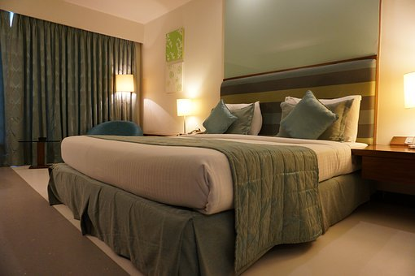
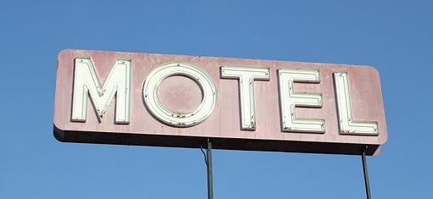
Accommodation Sector Various Types of Accommodation
Hotel: an enstablishment providing accommodations, meals, and other services for travelers and tourists
Motel: a roadside hotel designed primarily for motorists, typically having the rooms arranged in a low building with parking directly outside the door of your room
Bed and Breakfast: sleeping accommodations for a night and a morning meal, provided in guests houses and small hotels

Slide 8
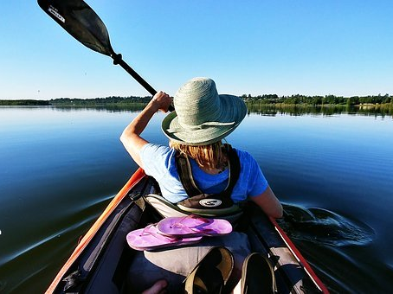
Adventure Tourism and Recreation Sector
This sector includes businesses that provide experiences where customers request active, recreational experiences or travel adventures where they can learn about nature and/or culture. This sector is growing fast because of changing trends and customer requests which continue to drive the growth of this sector.

Slide 9
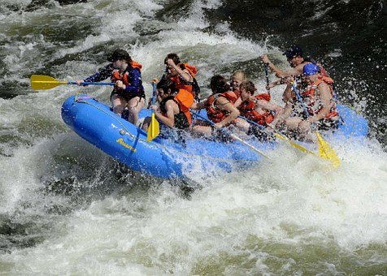
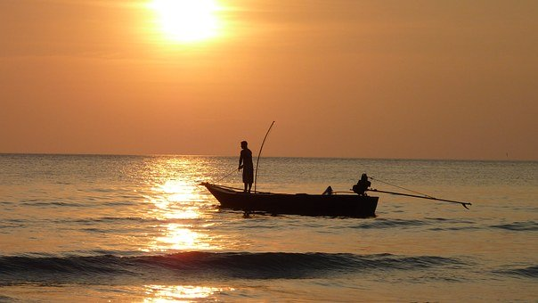
Adventure Tourism and Recreation Sector (continued)
This sector includes everything from bird watching to salmon fishing, horseback riding to white water rafting, and golf to wilderness trekking. Adventure tourism and recreation draws those who want to experience Canada as a place that is natural and unspoiled, and those who want active, unusual vacations. Because activities often mean clients need transportation, hotel rooms and restaurants, other tourism sectors also benefit.

Slide 10
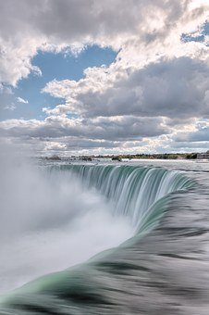
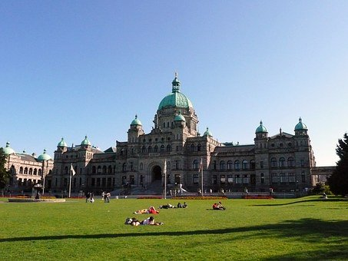
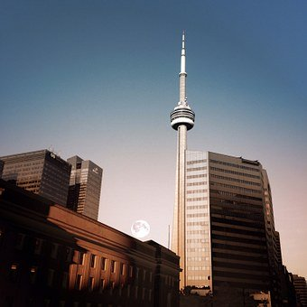
Attractions Sector
This sector includes historic sites, heritage homes, museums, halls of fame, art galleries, botanical gardens, aquariums, zoos, water parks, amusement parks, casinos and cultural attractions. Many attractions are educational in nature, others are solely for entertainment.

Slide 11
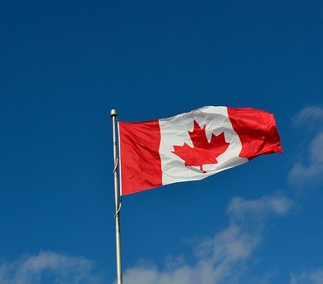
Attractions Sector (continued)
Every province and territory in Canada has major and minor attractions that attract visitors and generate tourism revenue. Canada has a wealth of cultural and heritage attractions: the Parliament Buildings and National Gallery in Ottawa, the Fortress of Louisbourg in Cape Breton, and Lower Fort Garry National Historic Site in Manitoba. There are heritage communities like
Vancouver's Gastown, natural resource attractions like the hot springs in Banff and Jasper National Parks, and the northern lights in the Northwest Territories. In addition, there are large amusement parks like Canada's Wonderland in Ontario, museums such as the Maritime Museum of the Atlantic in Halifax, and family attractions like Anne of Green Gables House on Prince Edward Island. Canada has a lot to offer.

Slide 12
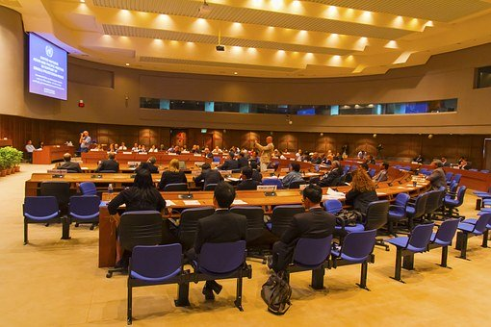
Events and Conferences Sector
Events and conferences bring people with a common interest together to learn about new things or share a common experience.
Events and conferences contribute dollars to communities. Not only do travellers spend money on the event or conference itself, but “spinoff dollars” are also spent on everything from accommodation to souvenirs. Travellers need to get to and from the event or conference site, so the transportation sector is also involved. They need to eat, so food and beverage outlets are visited. Conferences usually have social events or entertainment planned, so dollars are spent on tickets, admission, beverages and/or tips. Special events, such as festivals and sports events, may have formal or informal meetings that take place, so meeting space is rented, food and beverages are purchased, and/or local transportation is required. All of this means money is transferred from travellers to the local economy.

Slide 13
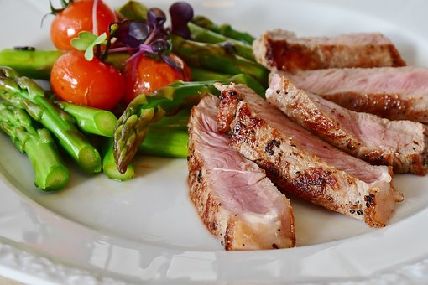
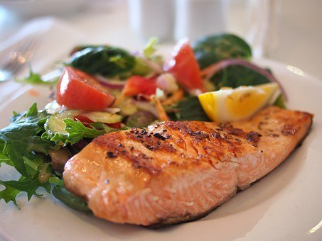
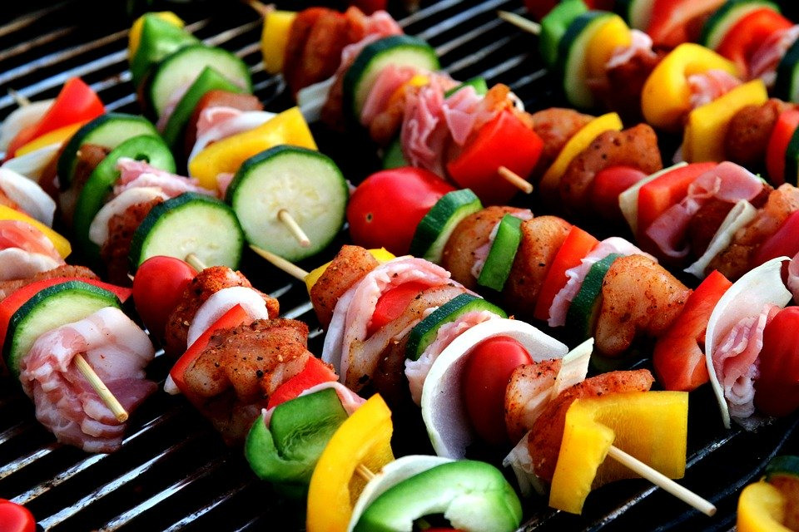
Food and Beverage Sector
This sector includes establishments primarily engaged in food services to customers who order and are served food and beverages. The food and beverage sector encompasses all types of establishments supplying food and beverages for consumption from fine dining and ethnic restaurants to institutional food outlets and catering firms, from pubs and bars to nightclubs and lounges.

Slide 14
Food and Beverage Sector (continued)
The food and beverage sector is also a major youth employer and a major training ground for many employees who are beginning their working careers.

Slide 15
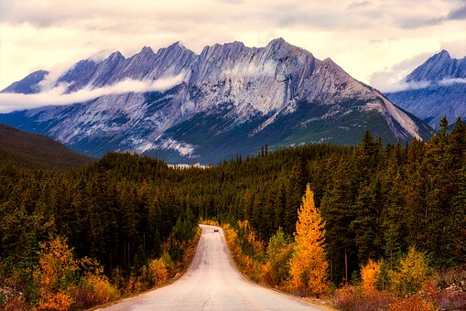
Tourism Services Sector
The tourism services sector is made up of the organizations, associations, government agencies and companies that specialize in serving the needs of the tourism industry as a whole rather than the needs of travellers specifically.
There are several areas that make up this sector:
Government
Industry Association
Marketing Services
Research
Retail

Slide 16
Tourism Services Sector (continued)
Government organizations encourage business by providing money, information and services. Government policies also affect tourism by building new airports, expanding a park system, improving a highway. The federal government focuses on promoting Canada as a tourist destination to international markets. Each province and territory has its own ministry, department or agency of tourism that recognizes the value of tourism and supports its growth.

Slide 17
Tourism Services Sector (continued)
Industry Associations have been established to serve either the entire industry or specific sectors. Some industry associations focus on marketing, e.g. Prince Edward Island Convention Bureau and the Canada West Ski Marketing Council. Other associations (such as the tourism education councils found in every Canadian province and territory) focus on education, training and professional development of those working in the tourism industry. There are also associations that concentrate on lobbying or advocacy. Examples include the Tourism Industry Association of Canada and the Canadian Restaurant and Foodservices Association.

Slide 18
Tourism Services Sector (continued)
Marketing Services is the promotion by an organization of the various services it has available for the purpose of attracting customers. Due to the amount of competition, consumers have a large variety of products and services from which to choose. Marketing is of primary importance to tourism, and many organizations have specialized marketing staff and services.

Slide 19
Tourism Services Sector (continued)
Research is essential in order to make informed plans and decisions. Information collected may be about an organization's own market and/or about competitors' markets. The reports that are generated from this research are useful in planning and decision-making. They measure the impact of tourism on the economy and find out what tourism consumers need and expect.

Slide 20
Tourism Services Sector (continued)
Retail businesses that benefit from tourism revenue are also part of the tourism services sector. Travellers who shop for the socks they forgot at home, or who get a hair cut while travelling, contribute dollars to the local economy. The World Tourism Organization defines tourism simply as the activities of those who travel outside their usual environments. This broad definition means that many businesses benefit from tourism dollars every day. Any businesses that are retail in nature are part of the tourism services sector.

Slide 21
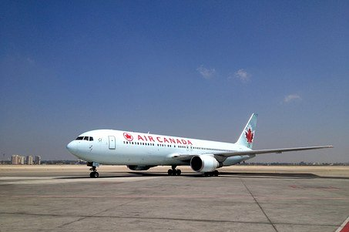
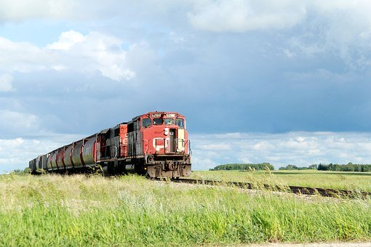
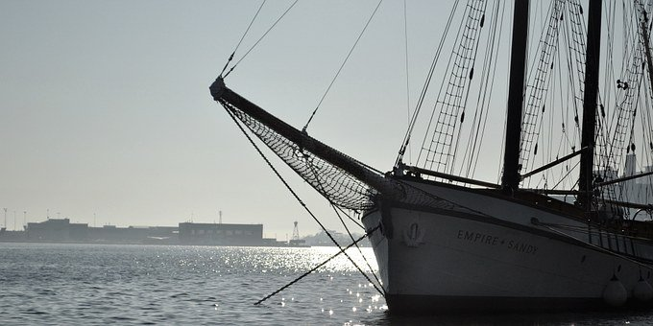
Transportation Sector
This sector provides the movement while people are travelling.
The sector is divided into four categories:
Air
Railway
Water
Ground transport

Slide 22
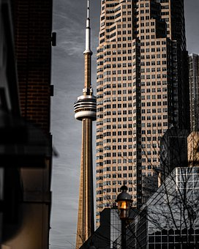
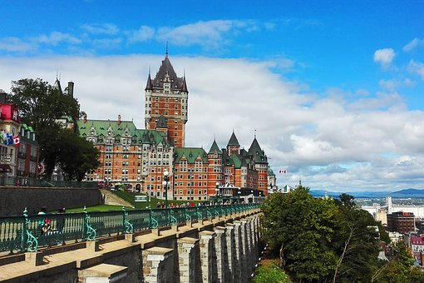
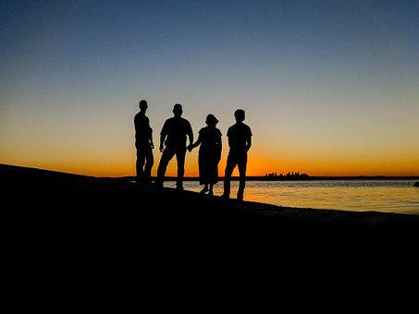
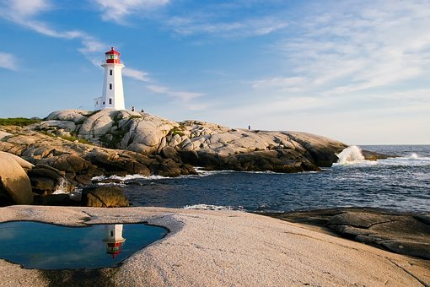
Travel Trade Sector
The travel trade sector supports the bookings and sales in other sectors. The people that work in the travel trade make reservations for accommodations, tours, transportation, food and beverage and/or for attractions. These bookings can be in the form of an all-encompassing tour package or a single booking for a single traveller.

Slide 23
Resources
Tourism Industry Association of Ontario
Websites
http://fopl.ca/
https://www.investinontario.com/tourism#domestic
https://www.ic.gc.ca/app/scr/app/cis/search-recherche#brwseinds
www.cthrc.ca
www.pixabay.com
https://setupmyhotel.com

