Slide 1
Lean Manufacturing: 5S System
BBT Area: Construction Technology & Manufacturing
Target Course(s): TIJ10

Slide 2
Section 1: Teacher Resources
Explore more at ovin-navigator.ca

Slide 3
What is OVIN?
The automotive industry is undergoing a significant shift, with technological advances and evolving mobility preferences redefining its future. Through the Ontario Vehicle Innovation Network (OVIN), Ontario is at the forefront of this transformation. OVIN capitalizes on the economic potential of advanced automotive technologies and smart mobility solutions such as connected and autonomous vehicles (C/AVs), and electric and low-carbon vehicle technologies, while enabling the province’s transportation and infrastructure networks to plan for and adapt to this evolution.
OVIN’s Talent Strategy and Roadmap - Please Watch with your students.
Ontario Government news Release introducing OVIN
Who is OVIN - Click here to read about the five main objectives of ovin and who they are!
Key facts and segments of of OVIN as well as interesting stats on careers.

Slide 4
Lesson Plan and Teacher Resources
Use this LINK to navigate this lesson, materials, and instructions.

Slide 5
Assessment and Evaluation
Rubric for Lean Pizza Shop Project & Justification Journal
Brainstorm: Applying Lean into our School and Community

Slide 6
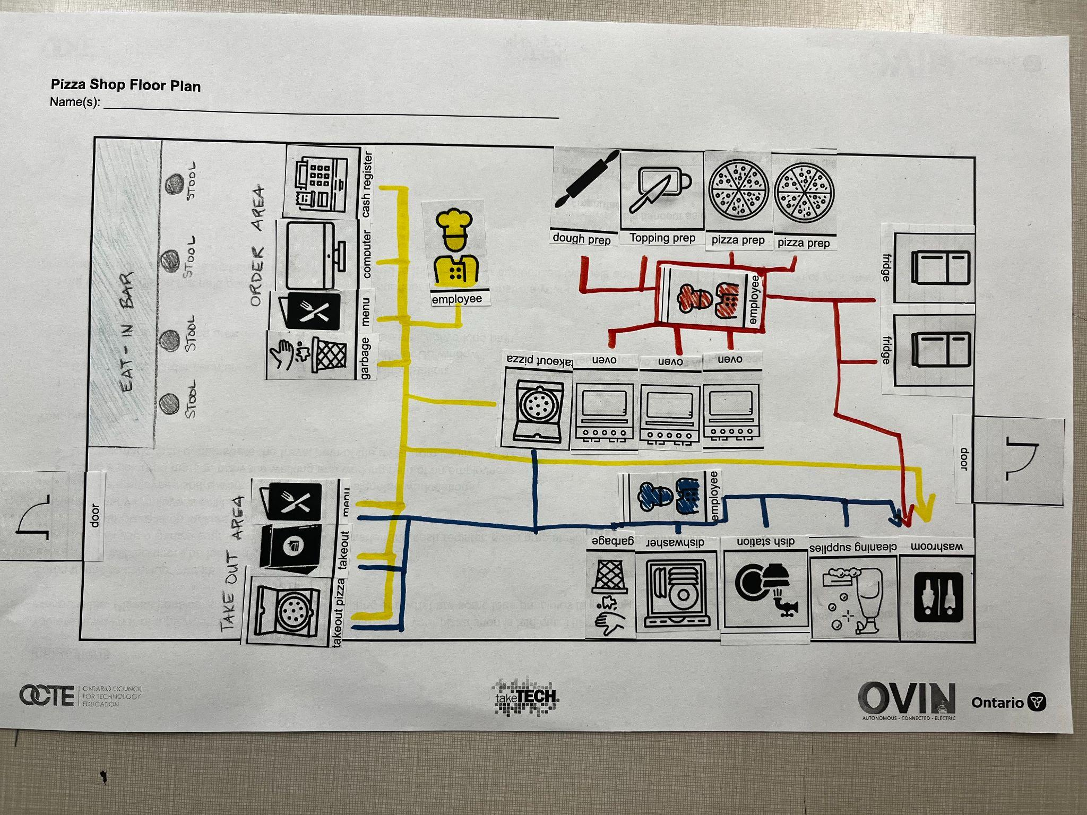
Project Exemplars

Slide 7
Outside Resources and References
21st Century Competencies: Foundation Document for Discussion. Phase 1: Towards Defining 21st Century Competencies for Ontario, Winter 2016 Edition, 2016
Growing Success: Assessment, Evaluation, and Reporting in Ontario Schools, First Edition, Covering Grades 1 to 12, 2010
The Ontario Curriculum, Grades 9 and 10: Technological Education, 2009 (revised)

Slide 8
Section 2: Student Lesson
Explore more at ovin-navigator.ca

Slide 9
Activity 1 - Lean Manufacturing Intro Slideshow
Together as a class go through the introductory slideshow. Use this slideshow to introduce and cue discussions around manufacturing and the development of Lean Manufacturing with the aid of the slides and supplementary videos.
At the end of the slideshow, have students break into 5 groups. Assign each group one of the 5S’ (Sort, Set in Order, Shine, Standardize, and Sustain). Each group should research and define what their ‘S’ means and examples of how/where it has been incorporated in manufacturing. Each group should write their research on a poster to display around the class for the duration of this project and share/present their findings with their classmates.
Time required: 50-100 minutes
Materials/equipment needed: Projector, poster board/paper, and markers

Slide 10
Activity 2: Lean Pizza Shop Project Materials
Working in groups (or on their own), students will design a pizza shop that incorporates Lean practices and the 5S principles. They will be asked to consider and include a number of factors into their designs. After completing their layout they will be asked to fill in the justification journal worksheet.
Option: Have each group or individual share their project and reasoning to the class in a gallery-walk activity
Time Required: 50-120 minutes
Materials Needed: Project handouts printed, markers, scissors, glue sticks/tape, pencils

Slide 11
Activity 3: Applying Lean Principles into our School/Community
Using what you have learned about Lean manufacturing, is there anything in the school community that could be improved using the principles of Lean? Students/Groups should use the Lean Brainstorm handout to identify inefficiencies that exist in your school/community. What are the possible solutions to improve them? How can you incorporate them to make change? Set the plan in motion and make it happen..
Here are some ideas that could spark the brainstorm:
Problem: Bottlenecked traffic in staircases and doorways or cafeteria
Solution: Clearly labeled in/out doors or arrows to assist in the flow of traffic
Problem: Unable to find tools easily in class shop
Solution: Clean and obvious work stations with colour coordinated tools
Time Required: 50 mins - ongoing
Materials Needed: Printed brainstorm handout, pencils

Slide 12
Rubric/Assessment
Rubric for Lean Pizza Shop Project & Justification Journal
Brainstorm: Applying Lean into our School and Community

Slide 13
Videos
What is Manufacturing (LINK)
History of Manufacturing (LINK)
New Trends in Manufacturing (Lean Manufacturing) (LINK)
Toyota Kaizen Video (LINK)

