Slide 1
COMMON SYMBOLS USED FOR CLASSIFICATION IN THE TOURISM INDUSTRY
Forbes Travel Guide
Michelin Guide
CAA/AAA
The 8 Sectors of Tourism

Slide 2
CLASSIFICATIONS IN THE TOURISM INDUSTRY
This presentation will cover common symbols used for classification purposes in the tourism sector.
The three award systems that will be introduced are:
Five-diamond award system (Canadian & American Automobile Association)
Three-star award system (Michelin Guide)
Five-star award system (Forbes Travel Guide)

Slide 3
FIVE-DIAMOND AWARD SYSTEM by Canadian and American Automobile Association CAA/AAA
The CAA/AAA Diamond-Rating Program is a system used by American and Canadian auto clubs that award one to five diamonds to restaurants and hotels based on certain guidelines. An establishment has to meet high standards to be awarded even one diamond. The more diamonds, the more added luxuries you will find.

Slide 4
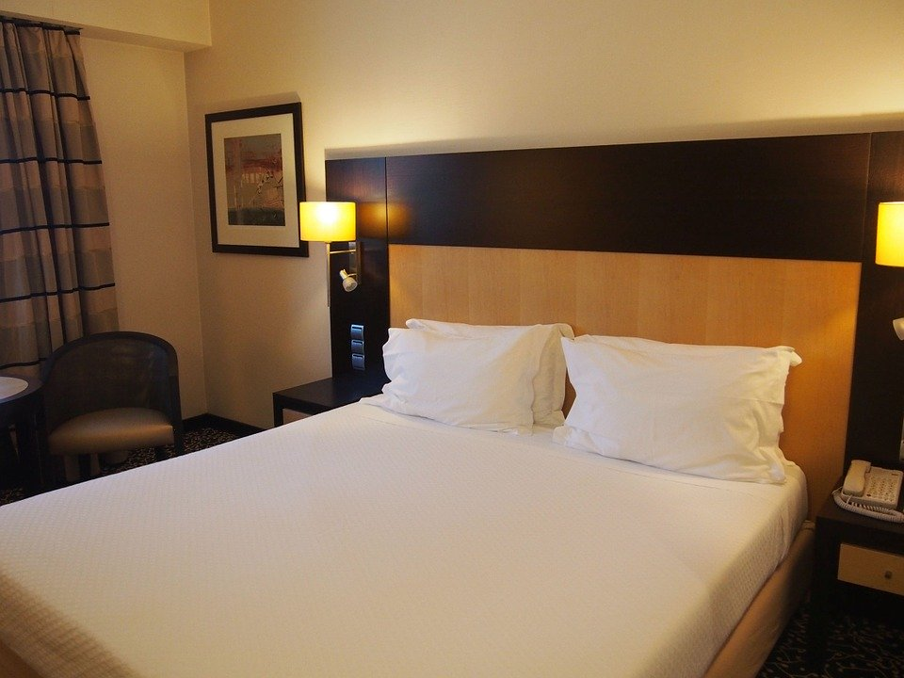
FIVE DIAMOND AWARD SYSTEM FOR HOTELS
CAA/AAA Diamond designations for hotels represent the overall quality, range of facilities and level of hospitality offered.
Approved Noteworthy by meeting the industry-leading standards of CAA/AAA inspections
Three Diamonds Comprehensive amenities, style and comfort level
Four Diamonds Upscale style and amenities with the right touch of service
Five Diamonds World-class luxury, amenities and indulgence for a once-in-a-lifetime experience

Slide 5
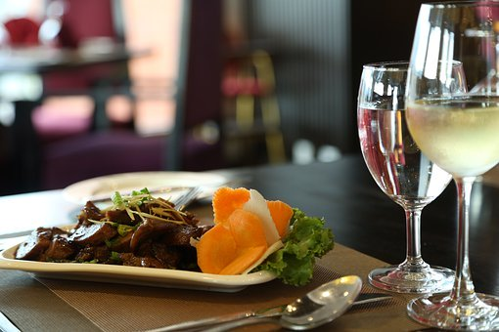
FIVE DIAMOND AWARD SYSTEM FOR RESTAURANTS
CAA/AAA Diamond designations for restaurants represents the overall food, service and vibe offered.
Approved Noteworthy by meeting the industry-leading standards of CAA/AAA inspections
Three Diamonds Trendy food skillfully presented in a remarkable setting
Four Diamonds Distinctive fine dining, well-served amide upscale ambience
Five Diamonds Leading-edge cuisine, ingredients and preparation with extraordinary service and surroundings

Slide 6
THE VALUE OF THE CAA/AAA DIAMOND REWARD PROGRAM
Hyatt Centric South Beach Miami
Ritz-Carlton, Cancun

Slide 7
THE IMPRESSIVE MICHELIN STAR
The first Michelin star ratings were given in 1926 – restaurants in France were awarded a single star if they were considered to be “fine dining establishments”.
In 1931 the rating system was expanded to become the Michelin three-star rating.
1 Star: A very good restaurant in its category
2 Stars: Excellent cooking, worth a detour
3 Starts: Exceptional cuisine, worth a special journey

Slide 8
THE IMPRESSIVE MICHELIN STAR

Slide 9
MICHELIN STAR
Coveted by many chefs, but given only to an excellent few. Getting a star (or three) could change the fate of a restaurant.

Slide 10
MICHELIN 1 STAR MEANING
High quality cooking.
Worth a stop!

Slide 11
MICHELIN 2 STAR MEANING
Excellent cooking.
Worth a detour!

Slide 12
MICHELIN 3 STAR MEANING
Exceptional cuisine, worth a special journey.

Slide 13
MICHELIN SYMBOLS
COMFORT AND QUALITY
(Restaurants)

Slide 14
MICHELIN SYMBOLS
COMFORT AND QUALITY
(Hotels or Accommodations)

Slide 15
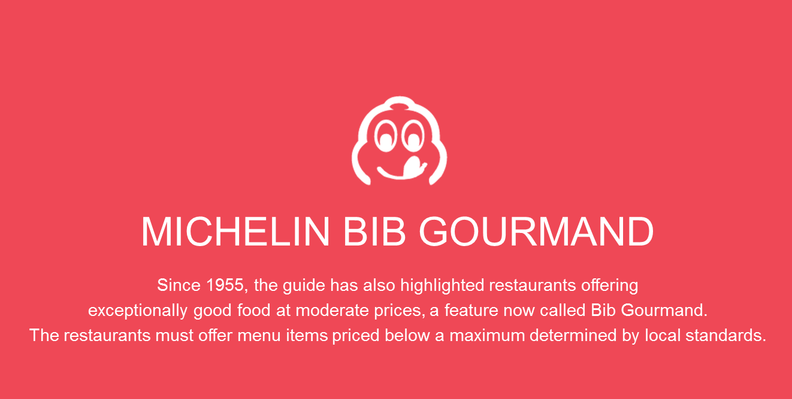
MICHELIN SYMBOLS

Slide 16
MICHELIN SYMBOLS
Street Food
The best way to experience the heart of Thai food cultures is to savour hawker fare. For that, there’s the symbol of a two-wheeled cart with a little roof. This denotes the physical characteristics of the establishment rather than the quality of the food.

Slide 17
MICHELIN SYMBOLS
Interesting Wine List
If you are looking for establishments with an excellent wine list, keep an eye out for this symbol. It covers a spectrum ranging from lists presented by sommeliers in luxury restaurants to simple spaces with a passion for wine.

Slide 18
MICHELIN SYMBOLS
Interesting View
These three crimson rays indicate particular breathtaking sceneries for diners to enjoy while tucking into their food.

Slide 19
MICHELIN SYMBOLS
Terrace Dining
The patio parasol represents the option of terrace dining for the diners, or a relaxing meal in an open-air environment.

Slide 20
MICHELIN SYMBOLS
Simple Shop
Simple shops that offer great food despite their casual environment are to be found everywhere and that’s no different from the MICHELIN Guide. Not to be confused with the street food category (reserved mostly for hawker stalls), it denotes a humble space where the service and physical aspects are unfussy.

Slide 21
MICHELIN SYMBOLS
Counter dining
The counter symbol denotes the dining option in an open kitchen concept, where chefs are observed up close from the counters; a full view of the chefs in full action.

Slide 22
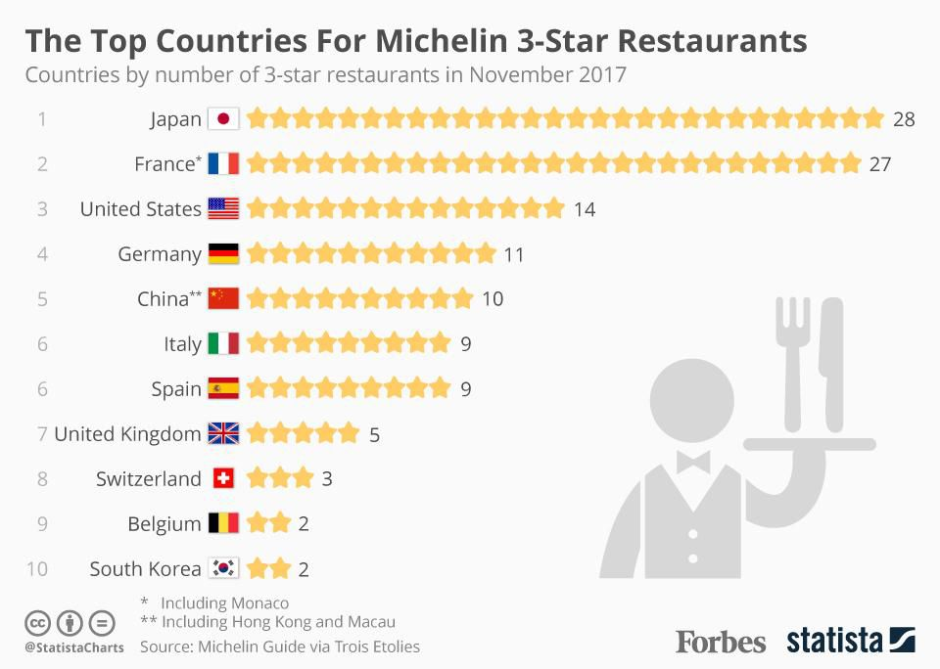
TOP COUNTRIES FOR MICHELIN 3-STAR RESTAURANTS
Notice that Canada is not included in the top countries for Michelin Stars. As of July 2020, Canada does not have any restaurants with any Michelin Stars despite the incredibly talented chefs in Canada. Definitely food for thought!

Slide 23
FIVE STAR AWARD SYSTEM Forbes Travel Guide
The Forbes Travel Guide verifies luxury. Their highly trained inspectors visit every property they rate, evaluating properties based on up to 900 objective sets of criteria. The inspectors stay a minimum of two nights, are anonymous and pay their own way so they will have the same experience as a typical guest. All ratings are earned through an objective inspection process.

Slide 24
FIVE STAR AWARD SYSTEM Forbes Travel Guide
Inspectors inspect both service and facility, the Star Rating system emphasizes service because the experience at a hotel, restaurant or spa goes beyond looks – how it makes you feel is what guests will remember the most.

Slide 25
FIVE STAR AWARD SYSTEM Forbes Travel Guide
Five-Star
These are outstanding, often iconic properties with virtually flawless services and amazing facilities.
Four-Star
These are exceptional properties, offering high levels of service and quality of facility to match.
Recommended
These are excellent properties with consistently good services and facilities.
Soon to be Rated
As the highly trained, anonymous inspectors work to assess properties, our editors check them out ahead of time and provide a sneak preview of what to expect.
Years ago, Forbes had 1 and 2 stars as well, but they dropped those categories when the company decided to focus their efforts on verifying luxury properties only.

Slide 26
COMMON SYMBOLS USED FOR CLASSIFICATION IN THE TOURISM INDUSTRY
STOP
for Assignment
Forbes Travel Guide
Michelin Guide
CAA/AAA
Time to take a closer look at the symbols used for classifying purposes in the tourism industry by Forbes Travel Guide, the Michelin Guide and CAA/AAA. Please refer to the Assignment for the Tourism Services Sector.
The 8 Sectors of Tourism

Slide 27
RESOURCES
https://www.aaa.com/diamonds/diamond-awards
https://www.escoffier.edu/blog/world-food-drink/a-brief-history-of-the-michelin-guide/
https://www.forbes.com/
https://guide.michelin.com/
https://www.forbestravelguide.com/award-winners

