Slide 1
Building an Autonomous Search and Rescue Craft
BBT Area: Exploring Technologies, Computer Technology,Transportation Technology
Target Courses: TIJ1O, TEJ2O, TTJ2O
Explore more at ovin-navigator.ca

Slide 2
Section 1: Teacher Resources
Explore more at ovin-navigator.ca

Slide 3
Project Outline
This project will guide students through the process of building a model autonomous search and rescue craft.
The ASR (Autonomous Search and Rescue) Craft is based on a “Springer” model tug boat, although any model wooden boat that has (or can be modified to have) 2 propellers would be appropriate.
The craft is fitted with a series of sensors that detect body heat. Once the ASR Craft detects heat, an Arduino will assess the information from the sensors and power 2 small electric motors that are attached to propellers to turn towards the target. Once the target is directly in front of the ASR Craft it will navigate straight forward to it.
ovin-navigator.ca

Slide 4
Related OVIN Sectors
Connected & Autonomous Vehicles (C/AV)
Mobility Planning & Infrastructure
ovin-navigator.ca

Slide 5
Prior Knowledge and Related Resources
Skills required:
Basic woodworking skills to build the craft and apply finish
Basic electrical and soldering skills for wiring the craft
Very basic coding skills to install provided code onto the Arduino
Basic “tinkering” skills to adjust sensors
Optional skills to enhance the project:
Advanced coding skills if choosing to alter the provided code to enhance the ASR Craft’s performance
ovin-navigator.ca

Slide 6
Planning Notes and Teacher Guide
Building of the craft is fairly straightforward and is detailed in section 2. It is suggested that room be left on the sensor deck for modification and expansion so different sensors can be used.
Lessons in section 2 range from basic electricity up to coding. It is suggested to consider your audience and the level of complexity they are comfortable with. The coding section could be a good introduction to programming, but might overwhelm some students.
Note that extensive adjustments and tinkering with the sensors will be necessary. Try and limit any motion or interference within the area that the craft is operating.
ovin-navigator.ca

Slide 7
Required Tools
Woodworking tools:
Hand saws or band saw, measuring tape, glue, clamps, paint brushes
Electronic tools:
Variety of small screwdrivers, soldering tools, wire strippers, pliers
Programming tools:
Laptop with internet access, cable to connect to Arduino
ovin-navigator.ca

Slide 8
Required Materials
Construction materials (available at any home improvement center):
Approx 3 feet 1x6 pine
2’ x 4’ sheet ¼ plywood
Spar urethane finish
Paint as desired
Silicone sealant
Wood glue
Six inches 1” angle aluminum
12” x 18” balsa wood 1/16” thick
Three ½” hinges
Various fasteners
2 part epoxy
Masking tape
ovin-navigator.ca

Slide 9
Required Materials
Electronics and Miscellaneous (available on Amazon):
Arduino 2560 or equivalent
4 channel relay shield with optocoupler
3 PIR motion sensors
Breadboard jumper wires
7.2 - 12v R/C battery and charger
Propeller shafts and propellers (consider having these machined by a Manufacturing program within the school)
On / off switch
2 surplus brushed motors
16 gauge automotive type wire (2 colours)
Solder
Automotive vacuum line
ovin-navigator.ca

Slide 10
Required Materials
Programming:
Laptop with internet access
USB 2.0 cable type A/B - typically supplied with Arduino
Arduino environment (free to download)
ovin-navigator.ca

Slide 11
Safety Concerns (including PPE if required)
Safety concerns include:
Moderate risks having students near water, have personal floatation devices nearby, assess students’ swimming ability, or consider building an 8x8 “pool” using 2x6 and plastic sheeting
Moderate risks of eye injury throughout build, provide students with safety glasses
Moderate burn risks from soldering electrical connections
Low fume inhalation risks from soldering electrical connections, complete task in well ventilated area using non-lead based solder
Low injury risks from spinning propellers, consider wearing gloves
ovin-navigator.ca

Slide 12
Assessment and Evaluation
Consider evaluating students based on the performance of their ASR Craft. Criteria could include:
How quickly the craft detected and reached its target
How accurately the craft maneuvered while navigating towards its target
Overall performance of the craft
Appearance of the craft
Fit and finish of the craft
If building multiple crafts, consider holding a competition to see which craft reaches its target the fastest.
ovin-navigator.ca

Slide 13
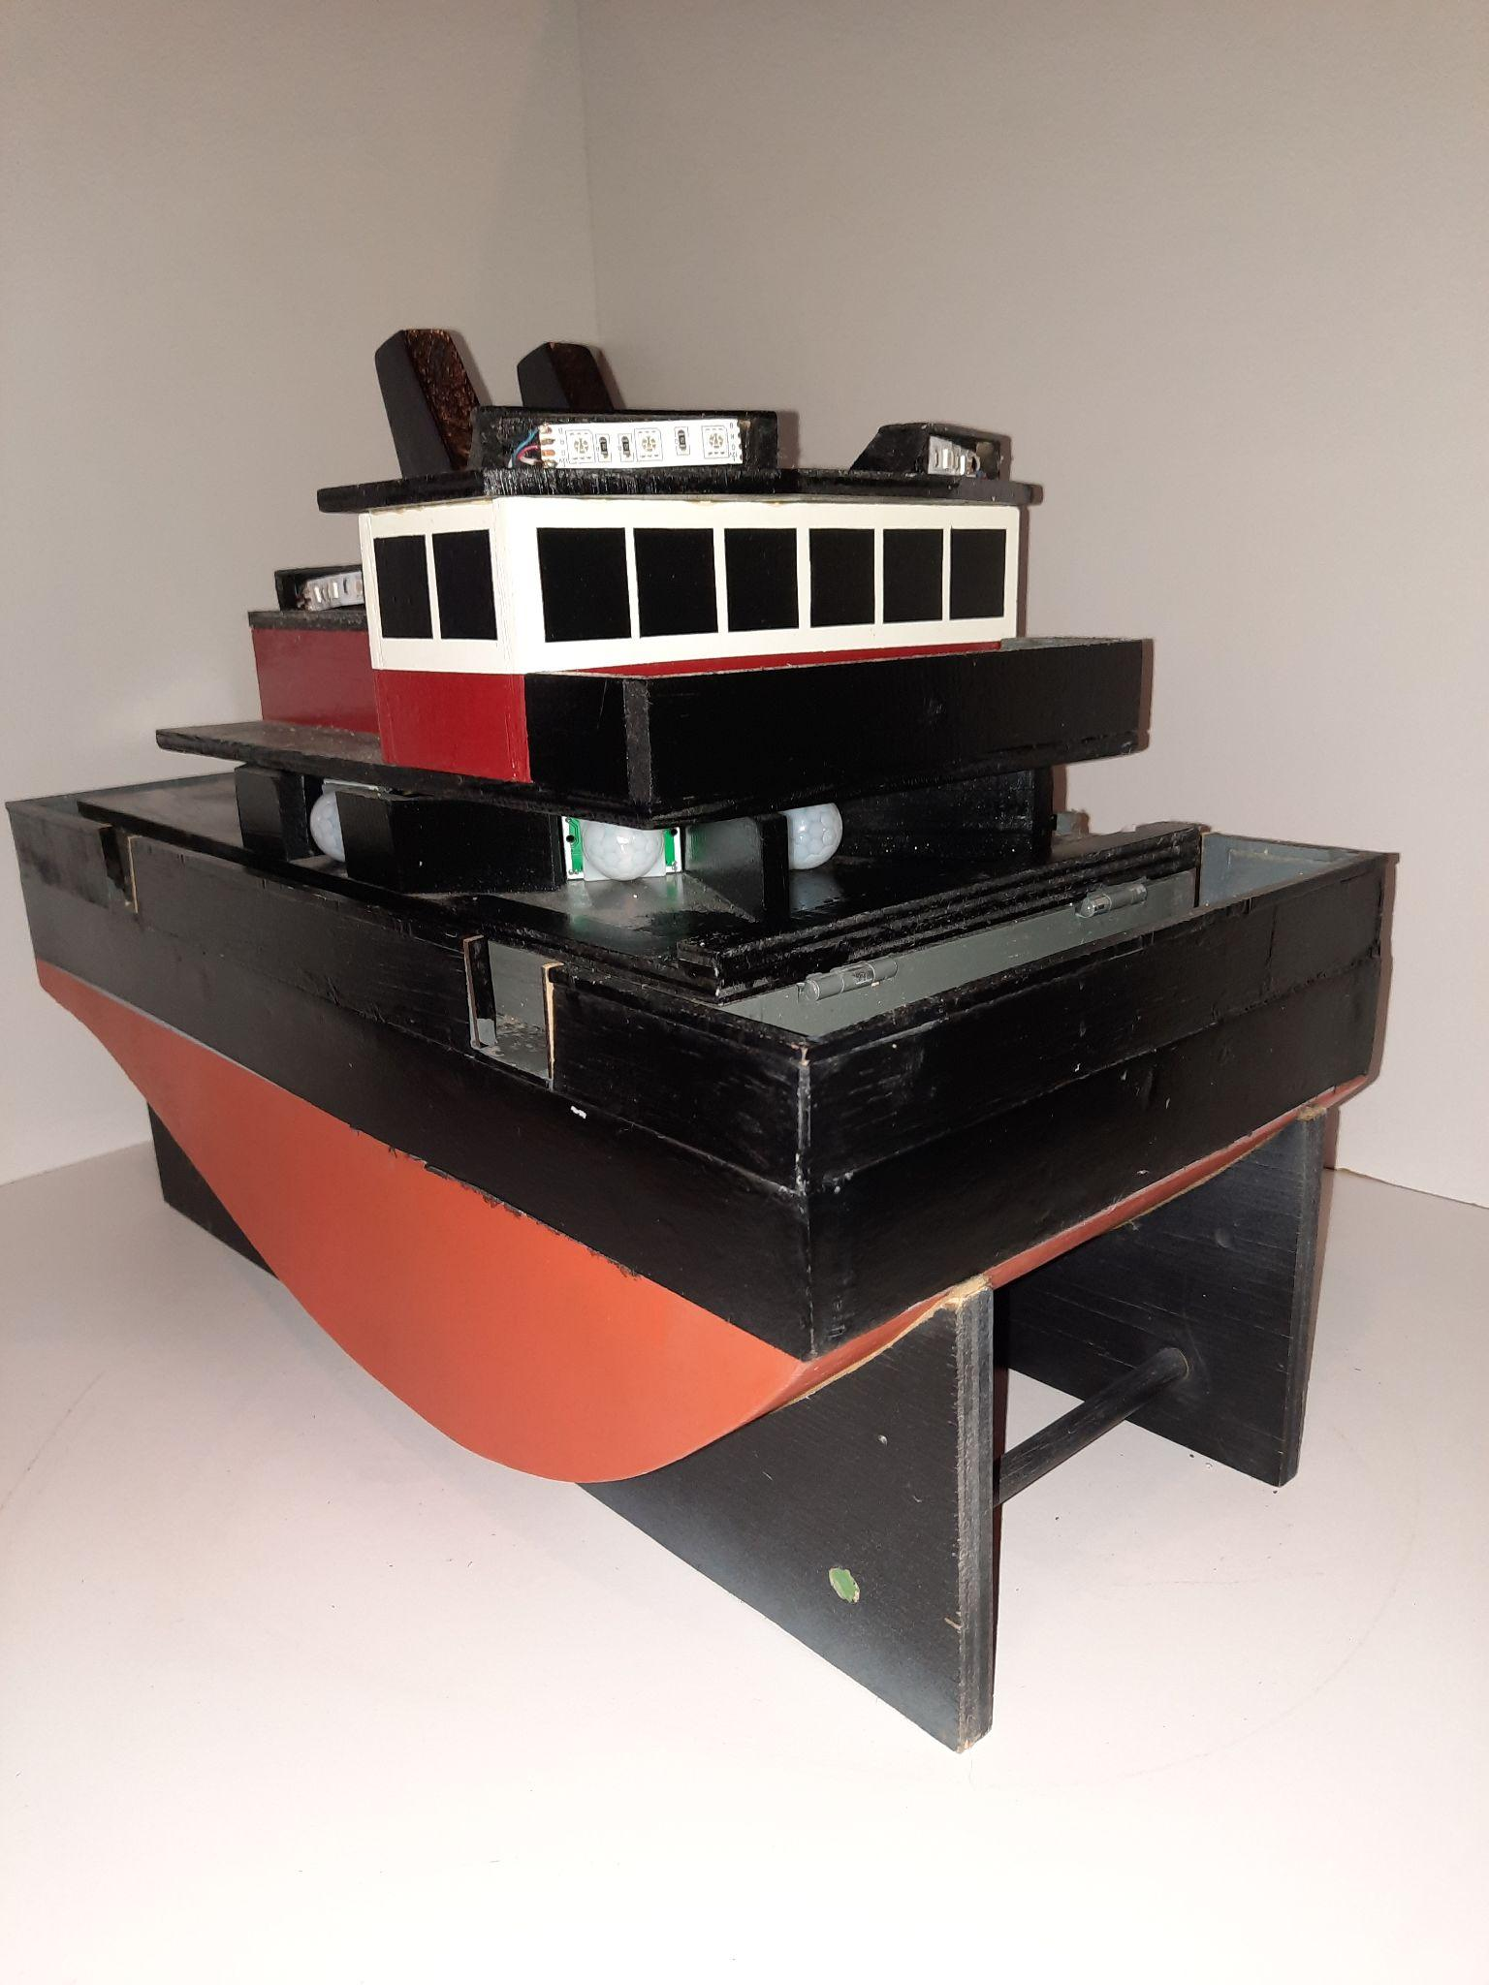
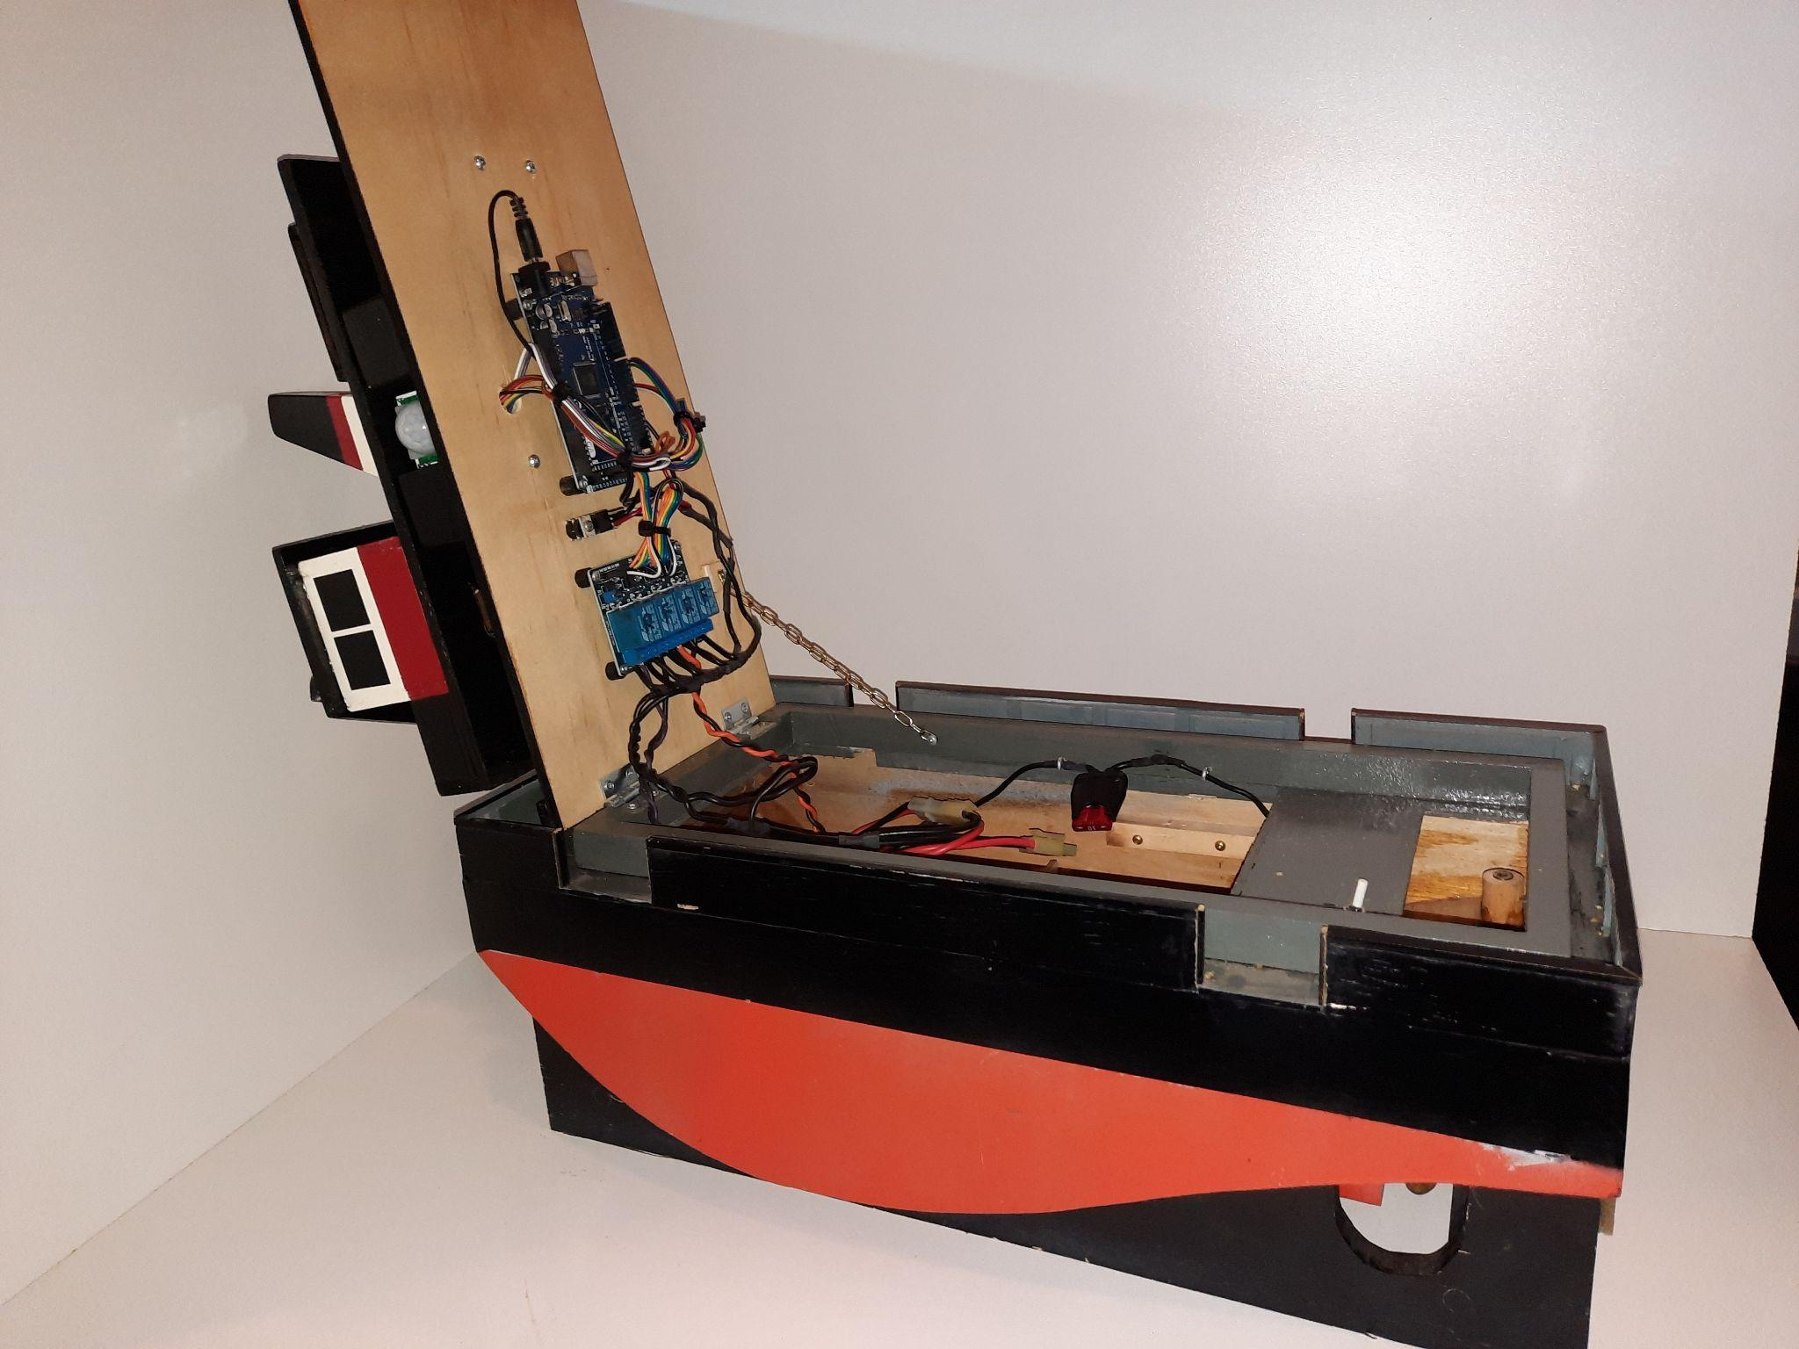
Project Exemplars
ovin-navigator.ca

Slide 14
Outside Resources and References
Basic description of model Springer Tug boats: Pusher Tug - Build Features
Boat design and building resources: SSMBC's Springer Tugs
ovin-navigator.ca

Slide 15
Ontario Vehicle Innovation Network - Skills & Career Navigator
Check out this great resource to tie this project to the career and pathway opportunities available in Ontario.
OVIN's Skills & Career Navigator
Students Can:
Learn about automotive and mobility sector
Explore exciting jobs in automotive and mobility sector
Check out some of the learning programs that can prepare you for a job in automotive and mobility sector
ovin-navigator.ca

Slide 16
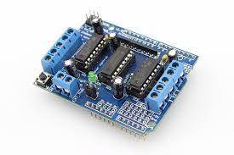
Modifications, Tinkering, and Tweaks
In this project relays were used to illustrate basic electrical circuits, however consider substituting an Arduino motor driver shield.
Consider adding an ultrasonic sensor that can measure distance. By adding this sensor and altering the code the ASR craft can be programmed to stop once close to its target.
ovin-navigator.ca

Slide 17
Modifications, Tinkering, and Tweaks
Consider replacing PIR sensors with ultrasonic sensors and altering the code so the craft can navigate an obstacle course.
ovin-navigator.ca

Slide 18
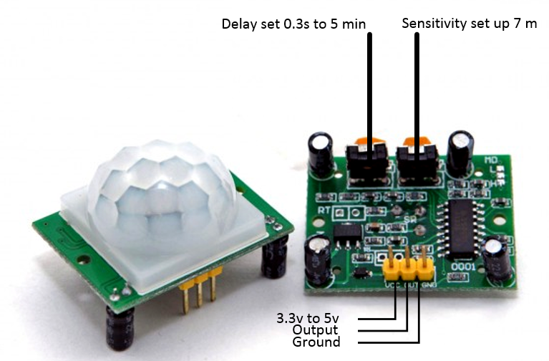
Modifications, Tinkering, and Tweaks
The PIR sensor has adjustments for both delay and sensitivity. It will be necessary to play with these adjustments.
The sensors can be moved within the craft to alter their field of view. Consider doing this and even building small shields to adjust what the sensors can see.
ovin-navigator.ca

Slide 19
Modifications, Tinkering, and Tweaks
Consider altering the size of the propellers to adjust the crafts speed.
Consider using counter rotating propellers to enhance accurate navigation.
Consider adding LEDs on the exterior of the craft that will indicate the crafts intended direction of travel - this could be very useful while making other adjustments.
ovin-navigator.ca

Slide 20
Modifications, Tinkering, and Tweaks
Consider altering the code. Customizations that could be made include:
Altering the distance and direction of travel during the initial deployment
Altering how long the craft will travel before re-reading the sensors
ovin-navigator.ca

Slide 21
Modifications, Tinkering, and Tweaks
Consider building the craft to simply patrol the waters without running into anything. This can be done by altering the code and replacing the PIR sensors with proximity sensors.
ovin-navigator.ca

Slide 22
Section 2: Building the ASR Craft
Explore more at ovin-navigator.ca

Slide 23
Project Introduction (and hook)
Building the Autonomous Search and Rescue craft will touch on several different broad based technology areas including Construction, Computer Engineering, Transportation, and even Manufacturing if students build the propeller shafts themselves. By teaching a broad range of skills from different areas, students will be more likely to find something that appeals to them and become engaged.
While the base construction of the ASR Craft should remain the same, students should be encouraged to custom paint the craft so they can see themselves in the project.
ovin-navigator.ca

Slide 24
Project Introduction (and hook)
Once the project is complete, teachers are encouraged to hold a competition to see which craft can navigate towards its target the fastest.
Even if only one craft is built, students can modify their own individual code to power the craft. The code can be easily loaded into one craft in a few seconds, and teachers can cycle through all of the students’ codes to see which makes the craft navigate the best. By choosing this option the culminating competition can remain the same, and determining factor will be just the code instead of the entire craft.
ovin-navigator.ca

Slide 25
Building Part 1 Building the Boat
Explore more at ovin-navigator.ca

Slide 26
Building the ASR Craft
The boat itself is modeled on the “Springer” model tug boat.
The Suncoast Scale Model Boat Club has numerous resources to assist in building this base boat platform. The shape of the hull is the only standardized part of the boat, from the deck up is open to modification and creativity. Scale drawings for the hull can be found on the SSMBC website linked below.
SSMBC Website
ovin-navigator.ca

Slide 27
Building the ASR Craft
The hull sides are constructed from ½ inch (13mm) thick pine, although plywood could be substituted. Cut two pieces of pine that are 18 inches (457mm) long by 6 inches (152mm).
ovin-navigator.ca

Slide 28
Building the ASR Craft
Mark 1 inch increments across the wood. At the 0 inch increment, draw a 1 5/16 inch long vertical line. At the 1 inch increment draw a 2 ¼ long vertical line. Continue doing this until you have drawn all of the vertical lines as shown below. Next, draw a line that connects the ends of all the lines.
ovin-navigator.ca

Slide 29
Building the ASR Craft
Use a saw to cut out one hull side. Once cut, the hull side can be used as a template for the second side.
ovin-navigator.ca

Slide 30
Building the ASR Craft
Connect the off cuts from the hull using 3 pieces of pine 2” long by 2” wide by ½” thick as shown to make a stand for the craft. Note the cut outs at the rear of the stand: these will have to be custom cut to allow room for the crafts propellers.
ovin-navigator.ca

Slide 31
Building the ASR Craft
Cut 2 pieces of pine 8” long. One should be 1 5/16 wide, the other should be 1 ¾ inches wide. Use the narrow piece to glue the two hull sides together at the front. Use the wide piece to glue the two hull sides together at the back.
ovin-navigator.ca

Slide 32
Building the ASR Craft
Cut a ¼ piece of plywood to the dimensions below to make the deck of the craft. Glue deck on top of hull sides once cut.
ovin-navigator.ca

Slide 33
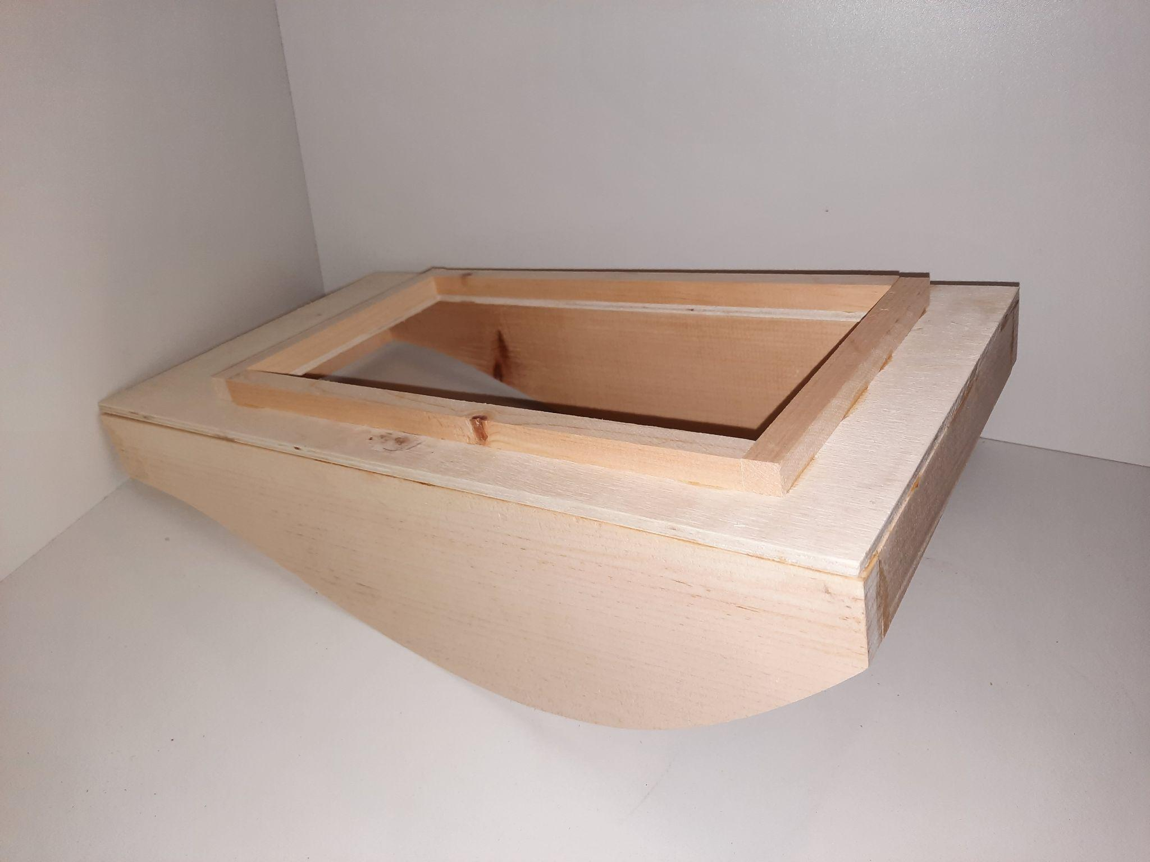
Building the ASR Craft
Surround the opening on the deck with ½” x ½” pine. If any water happens to get on the deck this will prevent it from getting into the hull of the craft.
ovin-navigator.ca

Slide 34
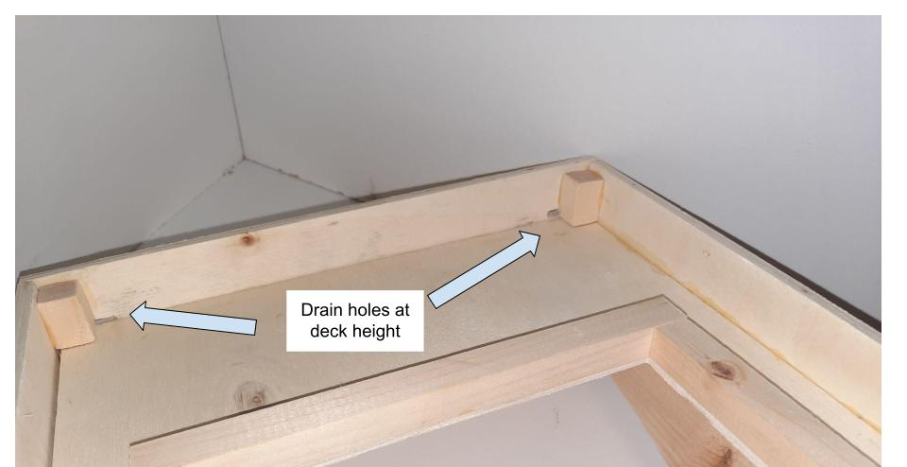
Building the ASR Craft
Surround the entire craft with ¼ plywood cut to 1 ½” wide. When attaching the plywood be sure it is exactly 1” higher than the deck of the craft so any future sensors won’t get blocked. The plywood will help prevent water from getting on the deck.
When cutting the plywood leave drain holes as shown to allow any water that does get on the deck to drain off.
ovin-navigator.ca

Slide 35
Building the ASR Craft
Once dry, the bottom of the hull can be fitted and glued in place. Use a thin flexible material such as ⅛ inch balsa wood or another suitable thin board. Add silicone to the seams to keep water out. Once this is attached the hull will be complete. To help waterproof the hull is should be sealed with 2 coats of spar urethane or shellac followed by two coats of paint.
ovin-navigator.ca

Slide 36
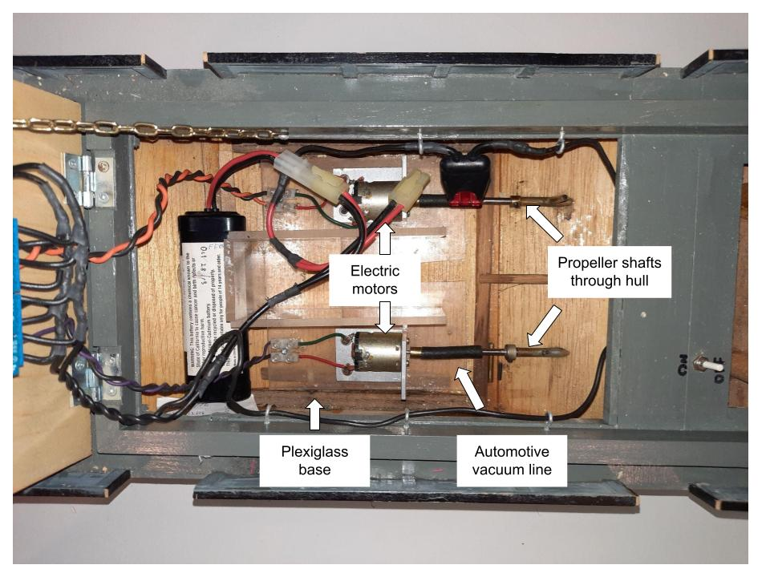
Building the ASR Craft
To install the propeller shafts, cut 2 slots in the bottom of the hull for the shafts to exit the hull. These slots should be as close to the sides of the craft as is practical.
ovin-navigator.ca

Slide 37
Building the ASR Craft
Build a small platform out of wood or plexiglass for the electric motors. The motors should be attached to the platform using a small piece of angle iron and screws.
ovin-navigator.ca

Slide 38
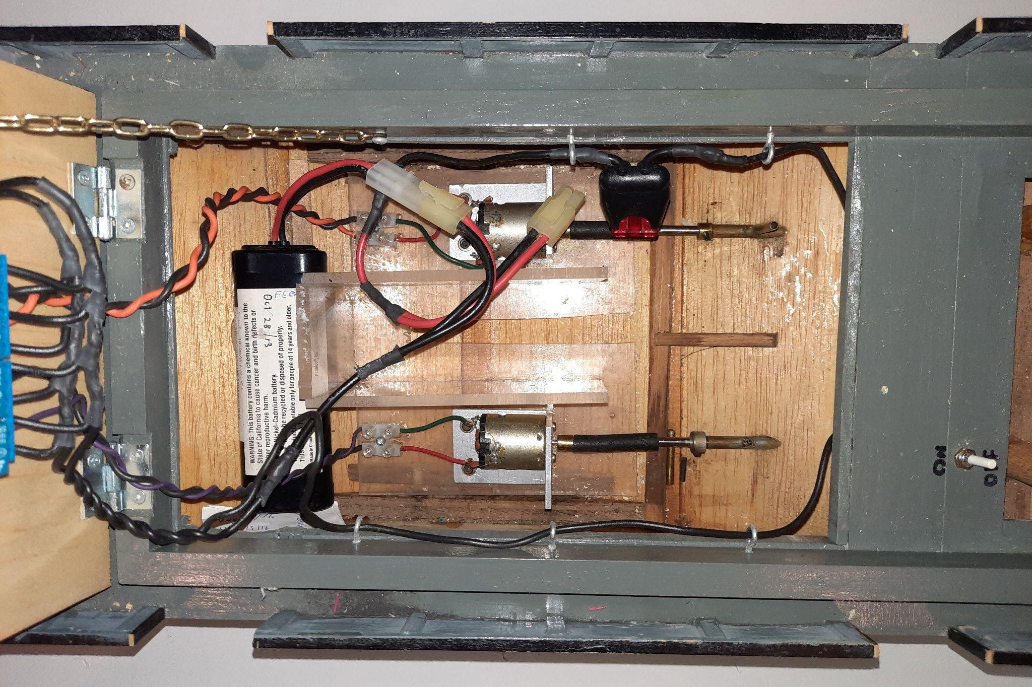
Building the ASR Craft
Slip the propeller shaft into the slots and attach to the electric motors using a small piece of automotive vacuum line. It is best to keep the angle between the motor and the propeller shaft as straight as possible. Once everything is roughly in place, use masking tape to block off the open space around the propeller shafts and fill the void with 2 part epoxy.
ovin-navigator.ca

Slide 39
Building the ASR Craft
Cut a piece of ¼ plywood to cover the opening in the main deck. Attach it to the main deck using a ½ hinge at the front. This will be the basis of the sensor deck. The electronics get mounted on the underside of the sensor deck to keep them away from water.
ovin-navigator.ca

Slide 40
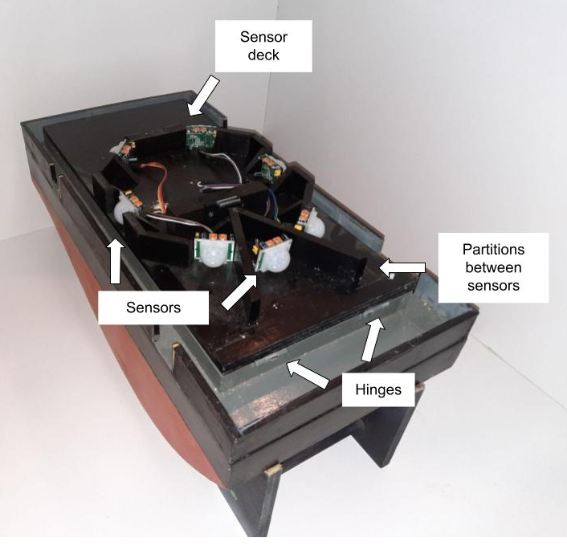
Building the ASR Craft
The top side of the sensor deck will need to be custom built to house sensors. See the suggested layout. Note: only front and side sensors will be used for this project.
ovin-navigator.ca

Slide 41
Building the ASR Craft
Cut another piece of ¼ plywood to cover the sensors and attach using a hinge at the back. This will form the base of the navigation deck. The navigation deck is built from ¼ plywood but is for aesthetic purposes only. A suggested configuration is shown.
ovin-navigator.ca

Slide 42
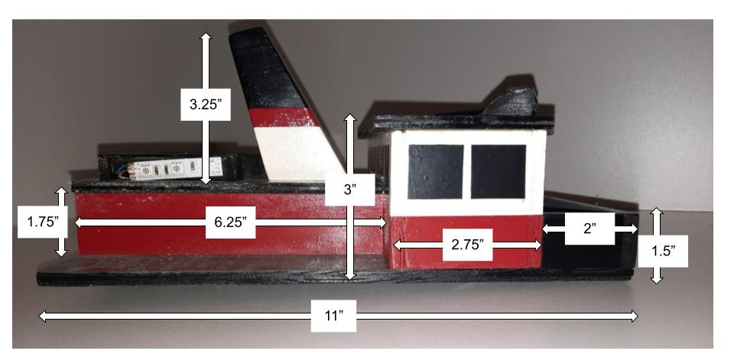
Building the ASR Craft
ovin-navigator.ca

Slide 43
Building the ASR Craft
ovin-navigator.ca

Slide 44
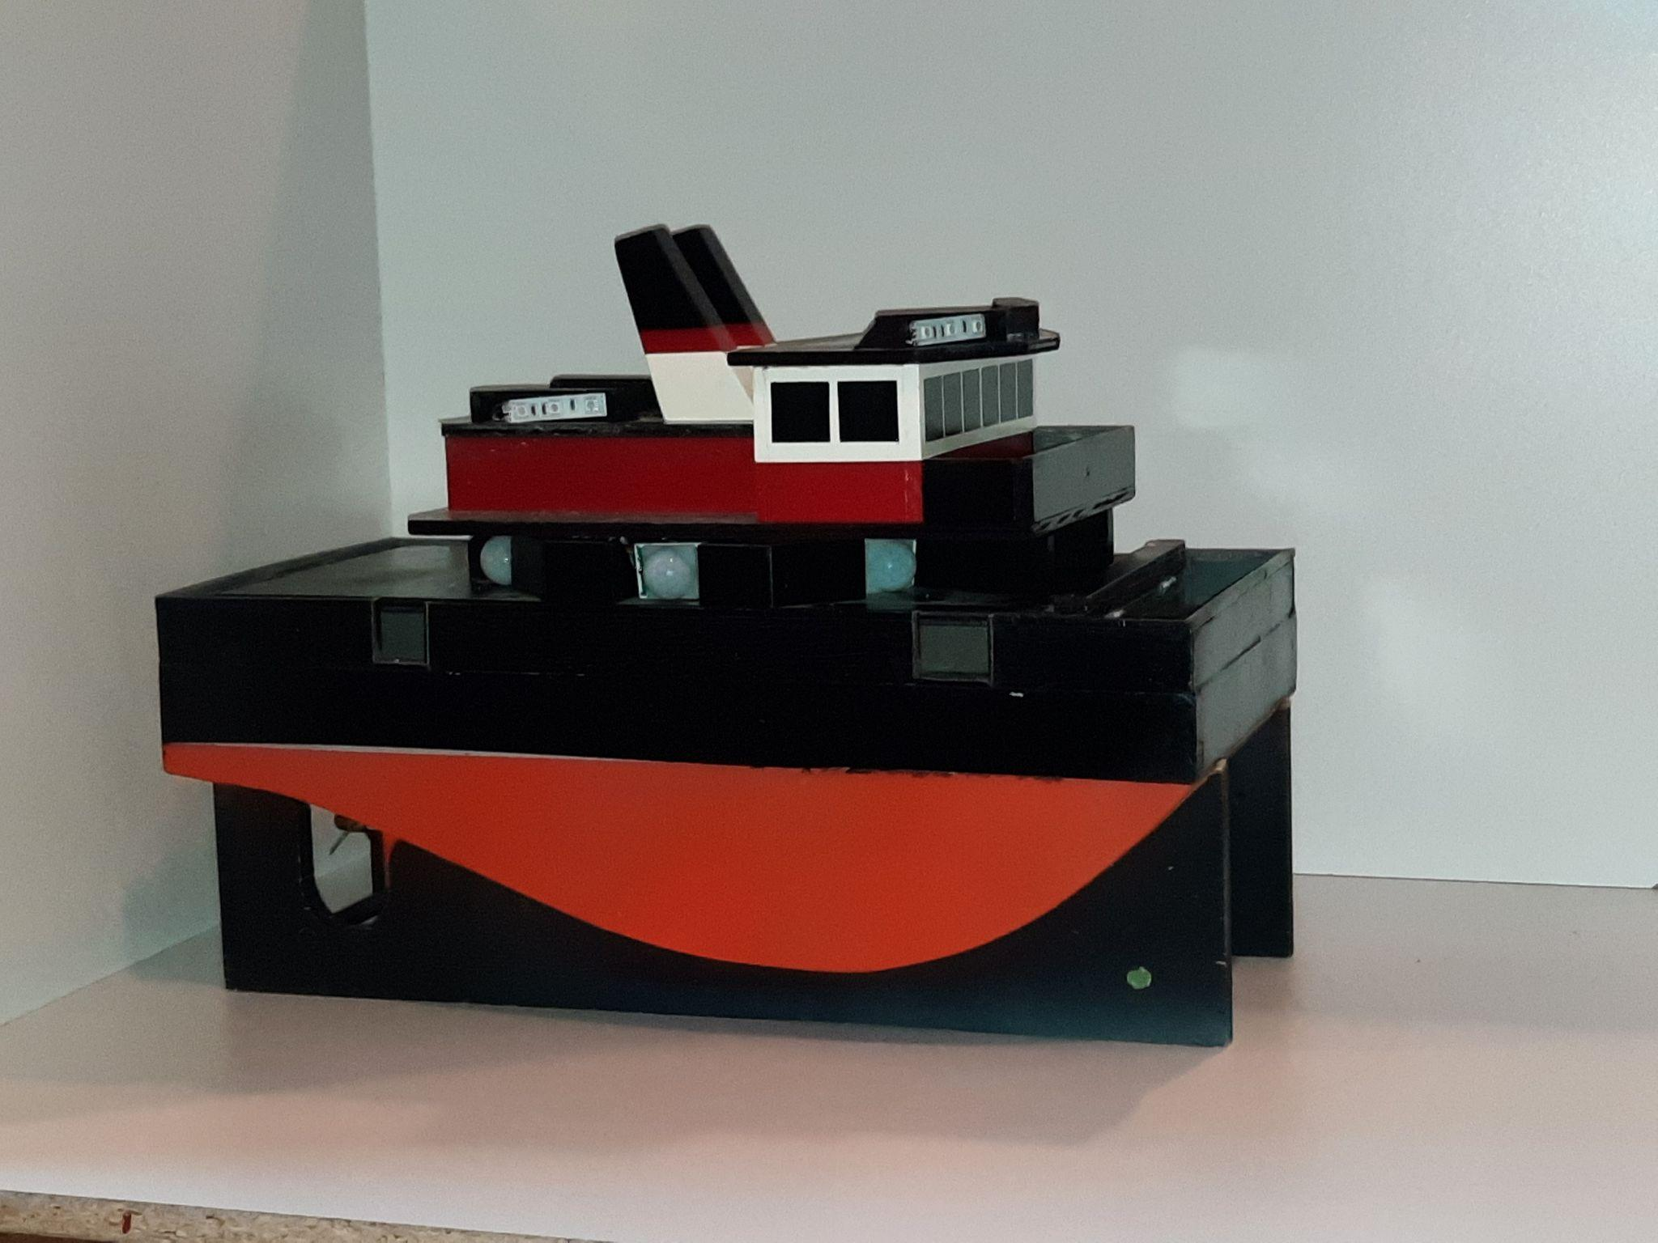
Building the ASR Craft
Up next: Wiring the boat
ovin-navigator.ca

Slide 45
Building Part 2 Wiring the Boat
Explore more at ovin-navigator.ca

Slide 46
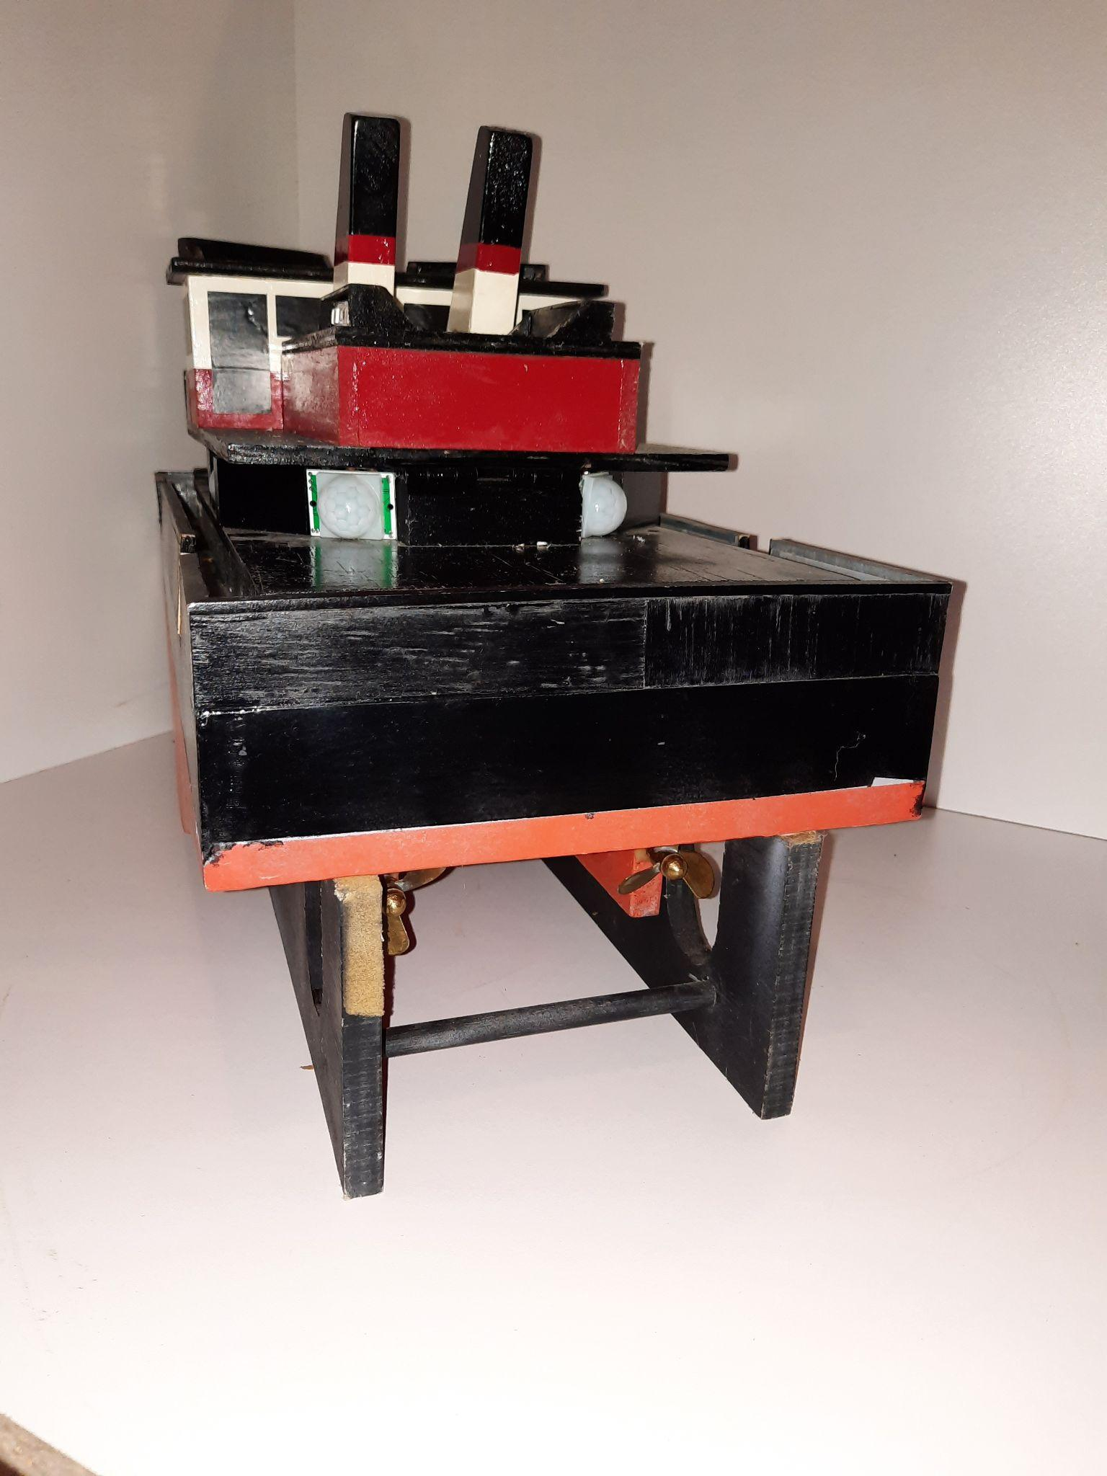
Build Part 2: Wiring the Boat
The ASR Craft runs on a standard battery pack for radio controlled model cars and boats. Any voltage between 7.2 - 12 volts will be appropriate.
The craft will require a fuse and an on / off switch.
ovin-navigator.ca

Slide 47
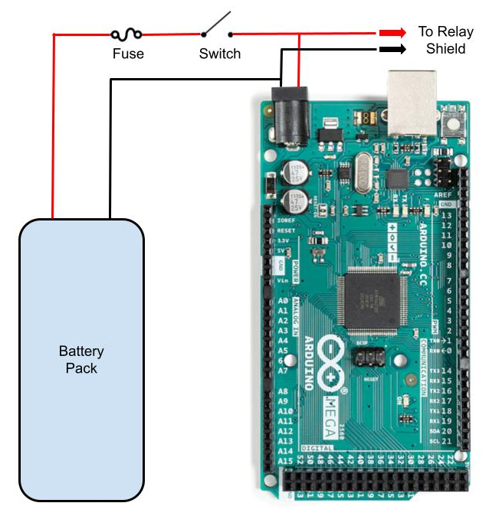
Build Part 2: Wiring the Boat
All wires are common 16 gauge automotive type wires.
As shown on the right, the 10 amp fuse will protect the craft by opening the circuit if something goes wrong.
The switch will provide a means of turning the craft on and off.
Note the two wires that split off to feed the relay shield. More about this when we wire the Arduino in the next section.
ovin-navigator.ca

Slide 48
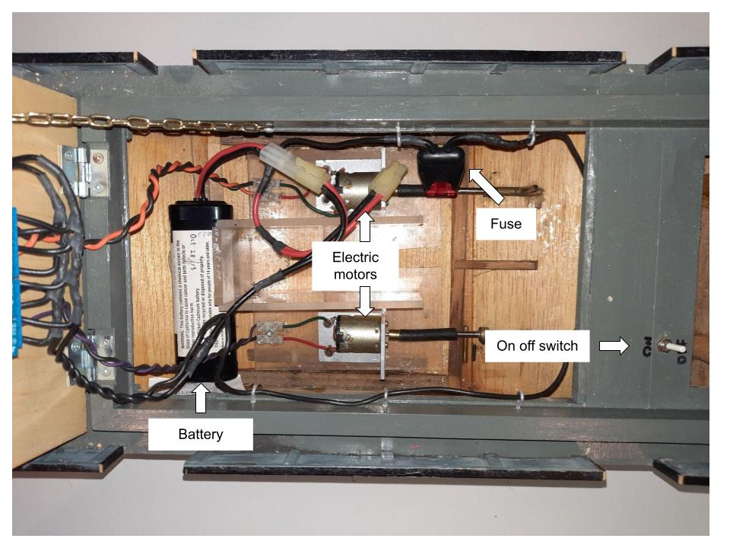
Build Part 2: Wiring the Boat
ovin-navigator.ca

Slide 49
Build Part 2: Wiring the Boat
Up next: Wiring the Arduino
ovin-navigator.ca

Slide 50
Building Part 3 Wiring the Arduino
Explore more at ovin-navigator.ca

Slide 51
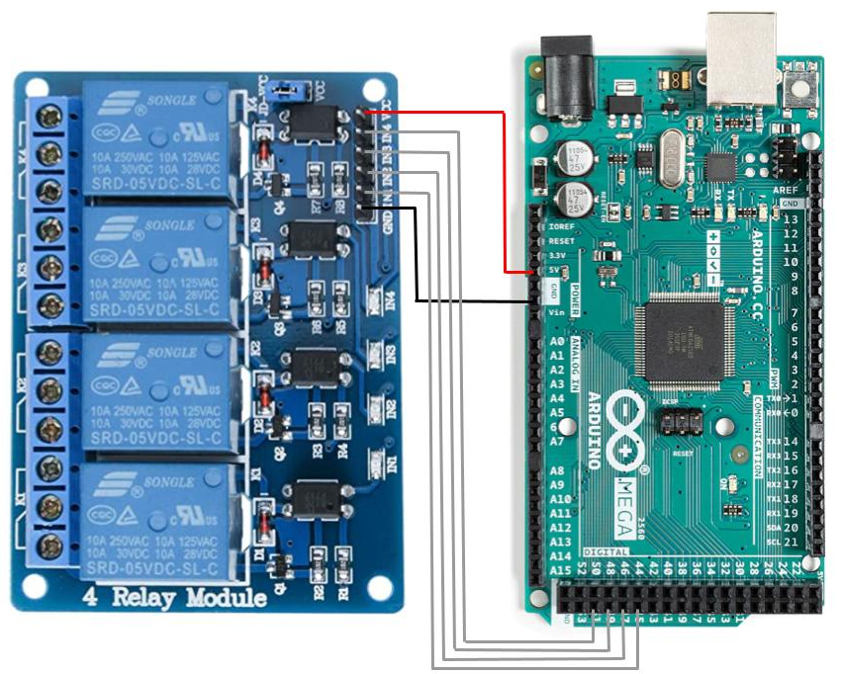
Build Part 3: Wiring the Arduino
Using jumper wires make the following connections from the Arduino to the relay shield
VCC pin on relay shield to 5V pin on Arduino - this powers the relay shield
GND pin on relay shield to GND pin on Arduino - this grounds the relay shield
ovin-navigator.ca

Slide 52
Build Part 3: Wiring the Arduino
Using jumper wires make the following connections from the Arduino to the relay shield
IN1 pin on relay shield to pin 45 on Arduino - this is how Arduino will turn on right motor forward relay
IN2 pin on relay shield to pin 47 on Arduino - this is how Arduino will turn on right motor reverse relay
ovin-navigator.ca

Slide 53
Build Part 3: Wiring the Arduino
Using jumper wires make the following connections from the Arduino to the relay shield
IN3 pin on relay shield to pin 49 on Arduino - this is how Arduino will turn on left motor forward relay
IN4 pin on relay shield to pin 51 on Arduino - this is how Arduino will turn on left motor reverse relay
ovin-navigator.ca

Slide 54
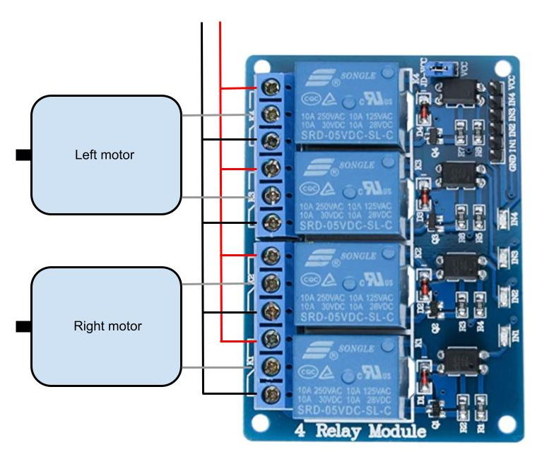
Build Part 3: Wiring the Arduino
Using standard 16 gauge automotive wire, connect the center terminal of the bottom relay to one side of the right motor.
Connect the center terminal of the second from bottom relay to the other side of the right motor.
ovin-navigator.ca

Slide 55
Build Part 3: Wiring the Arduino
Connect the center terminal of the top relay to one side of the left motor.
Connect the center terminal of the second from top relay to the other side of the left motor.
ovin-navigator.ca

Slide 56
Build Part 3: Wiring the Arduino
Connect the top terminal on each individual relay to battery+ as shown
Connect the bottom terminal of each individual relay battery- as shown
ovin-navigator.ca

Slide 57
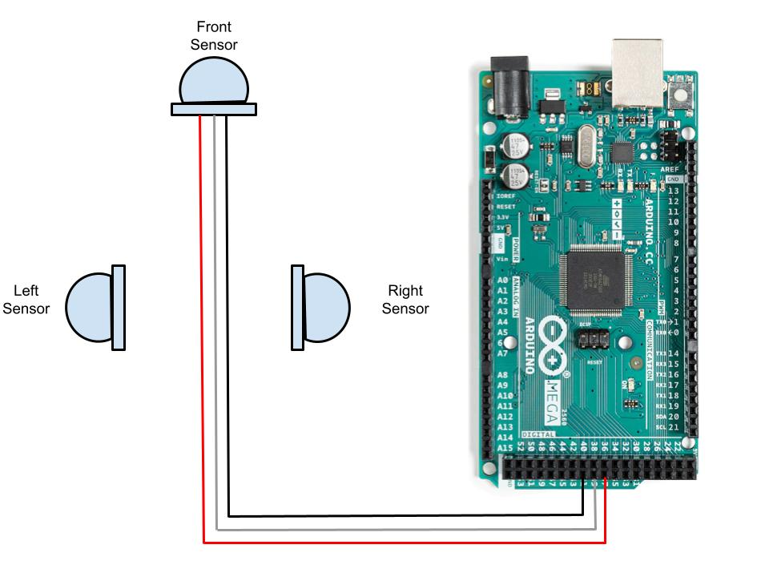
Build Part 3: Wiring the Arduino
Next we have to connect the sensors
Using jumper wires make the following connections from the Arduino to the front sensor
Arduino pin 37 to front sensor + pin - this is how Arduino power sensor
Arduino pin 39 to front sensor signal pin - this is how Arduino receive signal from the sensor
Arduino pin 41 to front sensor - pin - this is how Arduino ground sensor
ovin-navigator.ca

Slide 58
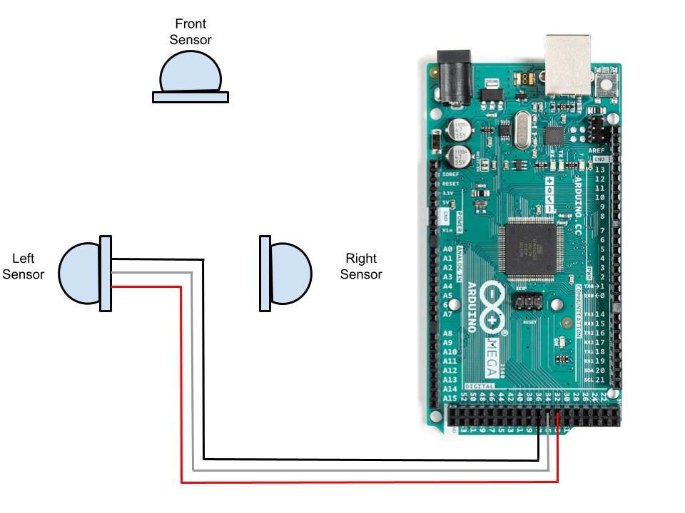
Build Part 3: Wiring the Arduino
Using jumper wires make the following connections from the Arduino to the left front sensor
Arduino pin 32 to front sensor + pin - this is how Arduino power sensor
Arduino pin 34 to front sensor signal pin - this is how Arduino receive signal from the sensor
Arduino pin 36 to front sensor - pin - this is how Arduino ground sensor
ovin-navigator.ca

Slide 59
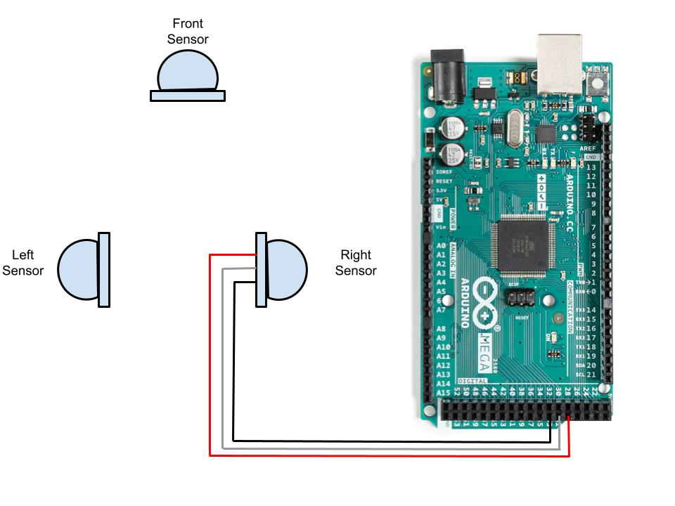
Build Part 3: Wiring the Arduino
Continue making connections to sensors as shown
Arduino pin 29 to R sensor for power
Arduino pin 31 to R sensor for signal
Arduino pin 33 to R sensor for ground
ovin-navigator.ca

Slide 60
Build Part 3: Wiring the Arduino
Up next: Uploading the code
ovin-navigator.ca

Slide 61
Building Part 4 Uploading the Code
Explore more at ovin-navigator.ca

Slide 62
Part 4: Uploading the Code
You will need the Arduino environment on your computer. Instructions on how to install it and the environment itself can be found at:
https://www.arduino.cc/en/Guide
Next you will need to copy the code from this Google Doc:
Programmable Model Boat Code
Finally, paste the code into the Arduino environment and save it as PMB Code
ovin-navigator.ca

Slide 63
Part 4: Uploading the Code
Under “Tools” you must select the type of Arduino that is being used. This project used an Arduino Mega 2560 or equivalent.
ovin-navigator.ca

Slide 64
Part 4: Uploading the Code
Next you must verify the code to make sure there are no syntax errors. This is done by clicking on the checkmark on the top left in the Arduino environment.
It will take a few seconds for the verification process to complete.
ovin-navigator.ca

Slide 65
Part 4: Uploading the Code
Using the cable that came with your Arduino, connect it to a USB port on your computer.
Under “Tools” you must select the port that the Arduino is connected to. The Arduino should show up at the top of the list.
ovin-navigator.ca

Slide 66
Part 4: Uploading the Code
Finally, you can upload the code to your Arduino by clicking on the right arrow at the top of the Arduino environment.
A progress bar will appear and the RX and TX LEDs on the Arduino will flash rapidly.
A message will appear to let you know the code is done uploading
ovin-navigator.ca

Slide 67
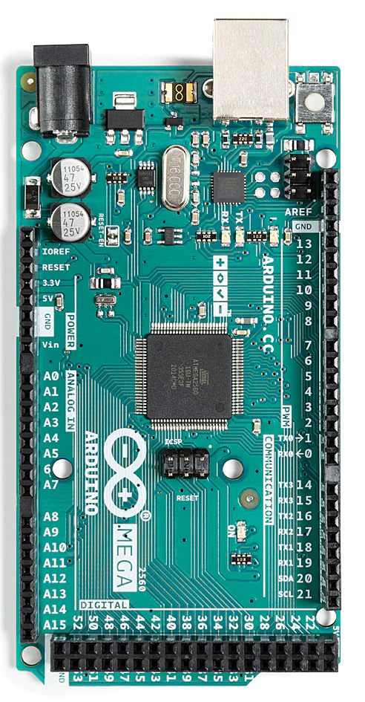
Part 4: Uploading the Code
Once the Arduino is installed in the ASR Craft and powered up, the program will automatically start.
The program begins with a short delay to allow time put the craft in the water, but it should soon navigate away.
Students are encouraged to alter the program to try and find navigational efficiencies!
ovin-navigator.ca

Slide 68
Section 3: Student Lesson
Explore more at ovin-navigator.ca

Slide 69
Lesson 1 Basic Electricity and Moving the ASR Craft
Explore more at ovin-navigator.ca

Slide 70
Lesson 1: Basic Electricity and Moving the ASR Craft
In this lesson students will learn:
Basic electricity and how to make a motor spin
How to change the direction of the motor by reversing polarity
How to incorporate relays to drive the motor
ovin-navigator.ca

Slide 71
Lesson 1: Basic Electricity and Moving the ASR Craft
The ASR Craft will use a small electric motor attached to a propeller to power move craft
If the battery is connected to the motor as shown, the motor will rotate in one direction, presumably driving the ASR Craft forward
ovin-navigator.ca

Slide 72
Lesson 1: Basic Electricity and Moving the ASR Craft
If the battery is connected to the motor as shown, the motor will rotate in the other direction, presumably driving the ASR Craft backwards
Commonly called “Switching or reversing polarity”
ovin-navigator.ca

Slide 73
Lesson 1: Basic Electricity and Moving the ASR Craft
Next we need to install a device that will allow the small current available from an Arduino to control the larger current going to the motor.
ovin-navigator.ca

Slide 74
Lesson 1: Basic Electricity and Moving the ASR Craft
A relay is an electrically controlled switch
When “at rest” a spring holds the switch contacts to the right as shown in the top Diagram
When power is applied to the coil it produces a magnetic field which physically pulls the switch contacts to the left as shown in the bottom diagram
Important to note that the magnetic coil and switch portions of the relay are electrically isolated from each other, they do not touch
ovin-navigator.ca

Slide 75
Lesson 1: Basic Electricity and Moving the ASR Craft
Relays can seem complex, however if you follow the path of current flow from the positive side of the battery through the circuit and back to the negative side of the battery we can understand how (and if) the circuit is working.
The next slide will illustrate how we can use two relays to easily control one motor
ovin-navigator.ca

Slide 76
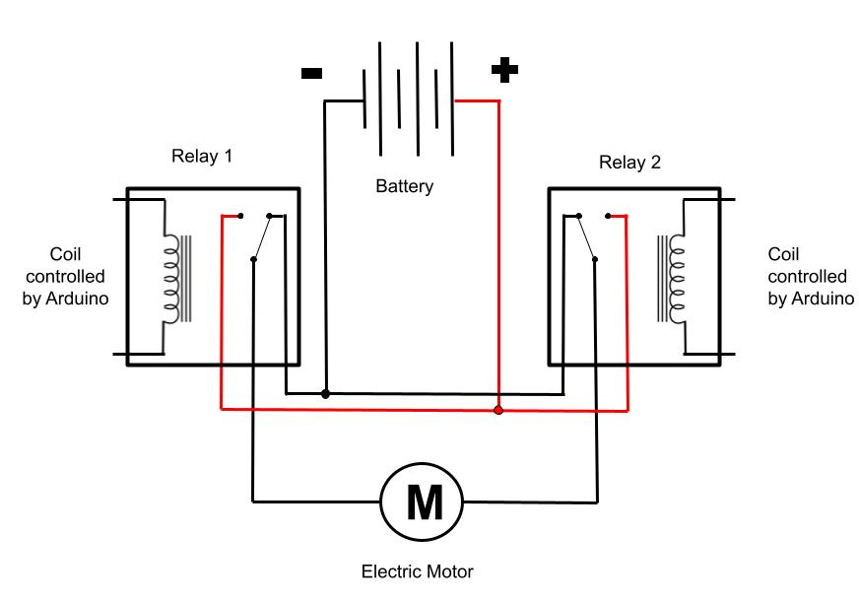
Lesson 1: Basic Electricity and Moving the ASR Craft
In the diagram to the right we can see the relays are fed both battery + and battery -
The switch part of both relays are aligned to feed battery - to the motor
Since the motor has battery - on both sides it will not turn
ovin-navigator.ca

Slide 77
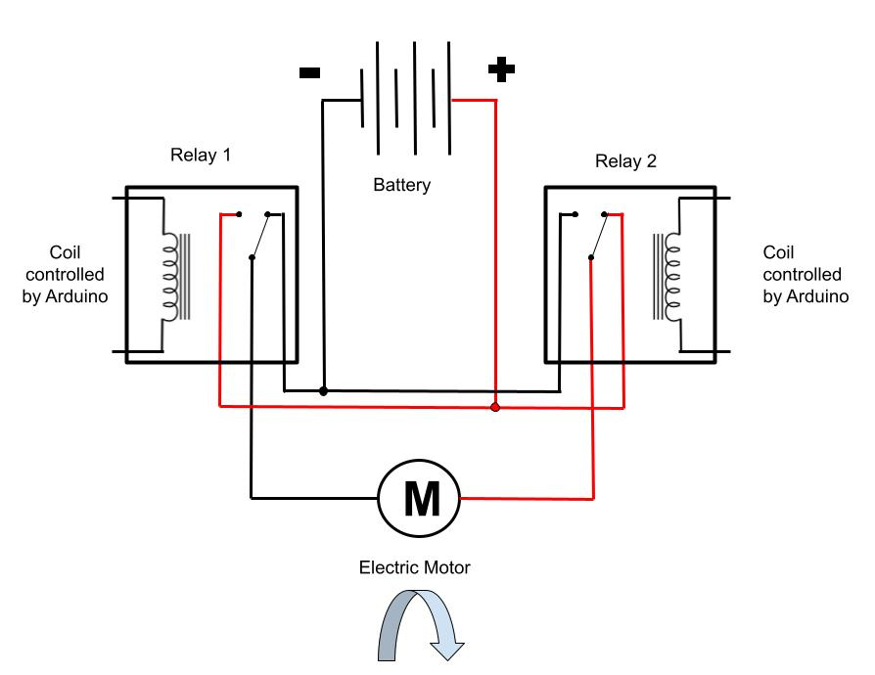
Lesson 1: Basic Electricity and Moving the ASR Craft
In the diagram to the right relay 2 has been energized and the switch inside has flipped
This is now feeding battery+ to one side of the motor
Relay #1 is not energized so it continues to feed battery- to the other side of the motor
Since the motor has battery+ on one side and battery- on the other side it will rotate in one direction
ovin-navigator.ca

Slide 78
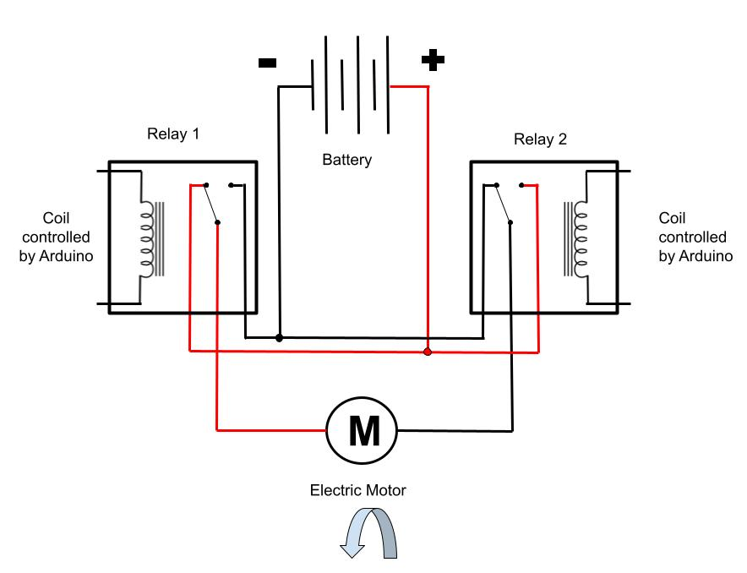
Lesson 1: Basic Electricity and Moving the ASR Craft
In the diagram to the right relay #1 has been energized and the switch inside has flipped
This is now feeding battery+ to the other side of the motor
Relay #2 is not energized so it continues to feed battery- to the other side of the motor
Since the motor has battery+ on one side and battery- on the other side it will rotate, but this time in the opposite direction
ovin-navigator.ca

Slide 79
Lesson 1: Basic Electricity and Moving the ASR Craft
By turning the relays on or off we can make the motor spin in one direction, or the other direction
Once the motor is connected to a propeller, this will give us the ability to drive the craft forwards or backwards
However, we still need to steer the craft
ovin-navigator.ca

Slide 80
Lesson 1: Basic Electricity and Moving the ASR Craft
Up next: Basic electricity and steering the ASR Craft
ovin-navigator.ca

Slide 81
Lesson 2 Basic Electricity and Steering the ASR Craft
Explore more at ovin-navigator.ca

Slide 82
Lesson 2: Basic Electricity and Steering the ASR Craft
In this lesson students will learn:
How to use 2 electric motors to drive the craft forwards
How to steer the craft left and right
How to spin the craft on its own axis
ovin-navigator.ca

Slide 83
Lesson 2: Basic Electricity and Steering the ASR Craft
The ASR craft has been constructed with 2 motors and 2 propellers
One motor / propeller is on the left side of the craft
One motor / propeller is on the right side of the craft
ovin-navigator.ca

Slide 84
Lesson 2: Basic Electricity and Steering the ASR Craft
If we power both motors as shown on the top right, the craft will move forward
If we power both motors as shown on the bottom right, the craft will move backwards
We still need to add steering
ovin-navigator.ca

Slide 85
Lesson 2: Basic Electricity and Steering the ASR Craft
If we only power the motor on the right, it will gently turn the craft to the left
If we only power the motor on the left, it will gently turn the craft to the right
This is how we can make the craft complete gentle turns
However, there is a way to make it turn more abruptly
ovin-navigator.ca

Slide 86
Lesson 2: Basic Electricity and Steering the ASR Craft
If we power the left motor in the forward direction, and the right motor in the backward direction, the craft will spin clockwise
If we power the left motor in the backward direction, and the right motor in the forward direction, the craft will spin counter clockwise
ovin-navigator.ca

Slide 87
Lesson 2: Basic Electricity and Steering the ASR Craft
Up next: Sensing hardware and Logic for the ASR Craft
ovin-navigator.ca

Slide 88
Lesson 3 Sensing Hardware and Logic for the ASR Craft
Explore more at ovin-navigator.ca

Slide 89
Lesson 3: Sensing Hardware and Logic for the ASR Craft
In this lesson students will learn:
How to interpret sensors
How to apply basic logic
How to implement this into the craft
ovin-navigator.ca

Slide 90
Lesson 3: Sensing Hardware and Logic for the ASR Craft
Warm blooded animals - including humans - radiate heat
A PIR sensor can detect warm blooded animals and movement
When this is detected it can send a signal to an Arduino to let it know it “sees” something
ovin-navigator.ca

Slide 91
Lesson 3: Sensing Hardware and Logic for the ASR Craft
For the PIR sensor to function we need to supply it with 3.3 - 5 volts of power from a battery
We also need to supply a path back to the negative side of the battery
The sensor will require a short warm up period
Once functional, if the sensor “sees” something it will send a 5 volt signal out on the output terminal
ovin-navigator.ca

Slide 92
Lesson 3: Sensing Hardware and Logic for the ASR Craft
The sensor has 2 adjustments
One adjustment will set a delay, meaning if it “sees” something we can set the time it takes to generate the 5 volt signal from .3 seconds to 5 minutes
The other adjustment will adjust how far the sensor can see
Extensive “tinkering” with these adjustments will be needed to fine tune the ASR craft
ovin-navigator.ca

Slide 93
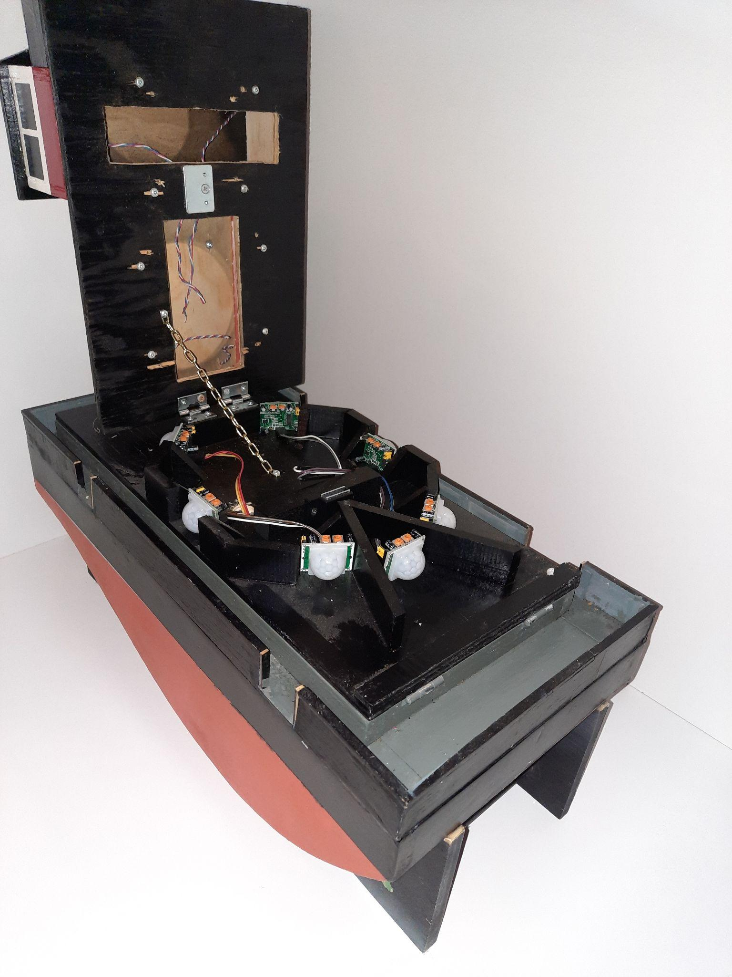
Lesson 3: Sensing Hardware and Logic for the ASR Craft
One front and 2 side sensors will be used for this project (other sensors in picture are for future expansion)
This will allow the craft to “see” in all directions except directly back
Sensors should be mounted with the adjustments facing up for easy tuning
Sensors should not be permanently affixed to the craft so they can be moved for fine tuning
ovin-navigator.ca

Slide 94
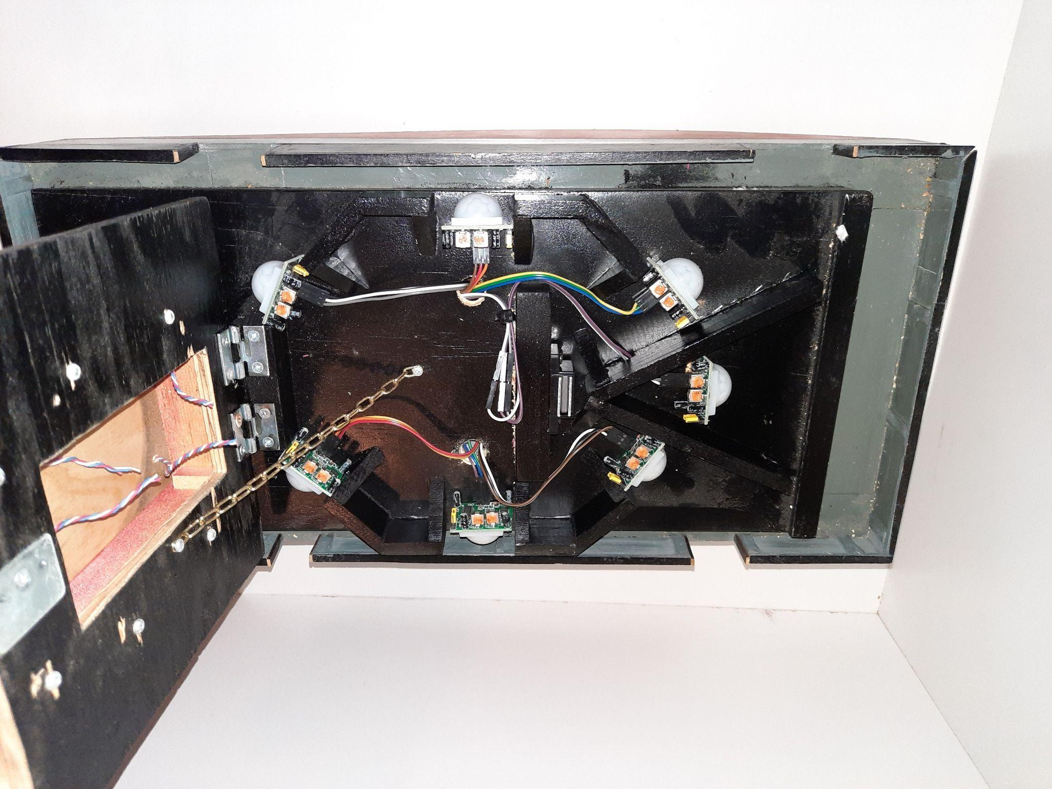
Lesson 3: Sensing Hardware and Logic for the ASR Craft
Note that barriers have been built into the craft that limit how far sensor can see side to side
This will help prevent overlap of the sensors readings
The hinged upper deck of the craft will limit how far up the sensors can see
This will prevent the sensors for seeing things above the water such as birds
All of these will require “tinkering and tweaking”
ovin-navigator.ca

Slide 95
Lesson 3: Sensing Hardware and Logic for the ASR Craft
If the front sensor sees something, we will program the craft to power both motors and drive straight forward
Since something directly in front of the craft will be our priority, we will program the craft to ignore the other sensors for now
ovin-navigator.ca

Slide 96
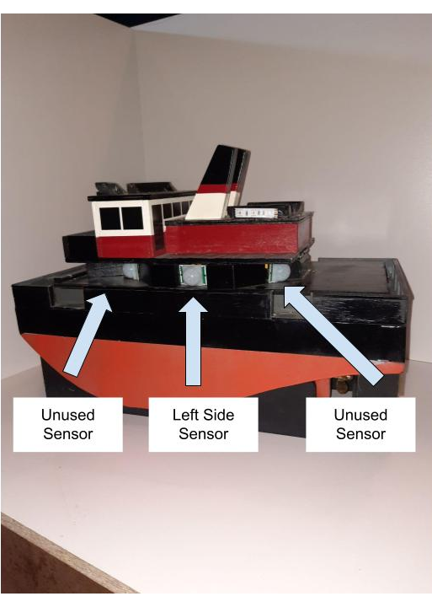
Lesson 3: Sensing Hardware and Logic for the ASR Craft
If the front sensor doesn’t see anything, but the left side sensor does, we will program the craft to pivot on its axis towards the target
We will do this by commanding one motor to drive forwards and the other motor to drive backwards
We will program the craft to do this until the target become visible to one of the front sensors
Once visible to the front sensors, the craft will drive towards the target as previously discussed
ovin-navigator.ca

Slide 97
Lesson 3: Sensing Hardware and Logic for the ASR Craft
If the front and left side sensors don’t see anything, but the right side sensor does, we will program the craft to pivot on its axis towards the target
We will do this by commanding one motor to drive backwards and the other motor to drive forwards
We will program the craft to do this until the target become visible to one of the front sensors
Once visible to the front sensors, the craft will steer towards the target as previously discussed
ovin-navigator.ca

Slide 98
Lesson 3: Sensing Hardware and Logic for the ASR Craft
Up next: Programming the ASR Craft
ovin-navigator.ca

Slide 99
Lesson 4 Programming the ASR Craft
The Set Up
Explore more at ovin-navigator.ca

Slide 100
Lesson 4: Programming the ASR Craft
In this lesson students will learn:
The basics of setting up an Arduino sketch
How to declare variables and assign pins
How to move the craft forward
How delays work
ovin-navigator.ca

Slide 101
Lesson 4: ASR Programming - The Set Up
Once the ASR craft is built and wired we have to program it
An Arduino program is called a sketch
A base sketch has been provided that will drive the Autonomous Search and Rescue Craft
Students are encouraged to modify this sketch to fine tune navigation
First we must understand how a few things work
ovin-navigator.ca

Slide 102
Lesson 4: ASR Programming - The Set Up
We must name the pins that we plan to use on the Arduino
First we will name the pins that we are going to use to send power to the relays that control the motors
These pins will be used as an output only
We will declare them as outputs later
ovin-navigator.ca

Slide 103
Lesson 4: ASR Programming - The Set Up
We will use pin 45 on the Arduino to turn on the relay that will turn on the right motor in the reverse direction
Using the int command we will name pin 45 “rmr” for Right Motor Reverse
This will be done using the following line of code:
int rmr = 45;
ovin-navigator.ca

Slide 104
Lesson 4: ASR Programming - The Set Up
We will name all of the other pins in a similar manner
Since we will use pin 47 to turn on the relay that drives the right motor forward, we will call it “rmf”
int rmf = 47;
ovin-navigator.ca

Slide 105
Lesson 4: ASR Programming - The Set Up
Pin 49 will control the relay that drives the left motor in reverse
We will name it “lmr”
Pin 51 will control the relay that drives the left motor forwards
We will name it “lmf”
int lmr = 49;
Int lmf = 51;
ovin-navigator.ca

Slide 106
Lesson 4: ASR Programming - The Set Up
Next we must let the Arduino know that the pins we just named will be used as outputs only
We will do this using the pinmode command
The following line of code will set pin 45, which we named “rmr”, as an output
pinMode(rmr, OUTPUT);
ovin-navigator.ca

Slide 107
Lesson 4: ASR Programming - The Set Up
Similarly we will set rmf (pin 47), lmr (pin 49), and lmf (pin 51) as outputs
Once again, this will be done using the pinMode command
ovin-navigator.ca

Slide 108
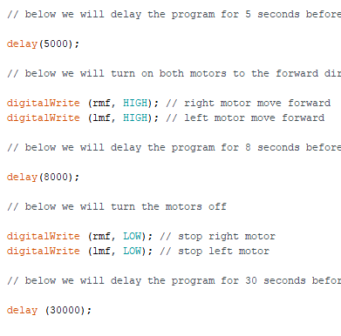
Lesson 4: ASR Programming - The Set Up
Next, let's do the following:
Build in a 5 second delay that will allow us some time to turn the craft on and place it in the water without is starting up
delay(5000);
ovin-navigator.ca

Slide 109
Lesson 4: ASR Programming - The Set Up
Following the delay we will:
Turn both motors in the forward direction to drive the craft out in the water
Build in an 8 second delay
Turn both motors off
Once the craft is in place we will have a 30 second delay to allow the sensors to warm up
ovin-navigator.ca

Slide 110
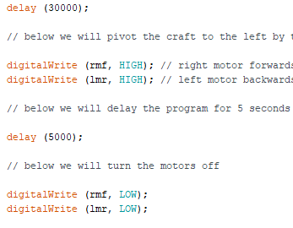
Lesson 4: ASR Programming - The Set Up
Finally, to let us know the craft is ready and about to enter the monitoring loop we will briefly pivot the craft to the left by:
Turning the right motor in the forward direction
Turning the left motor in the reverse direction
Delaying for 5 seconds
Turning both motors off
ovin-navigator.ca

Slide 111
Lesson 4: ASR Programming - The Set Up
Up next: The Monitoring Loop
ovin-navigator.ca

Slide 112
Lesson 5 Programming the ASR Craft
The Monitoring Loop
Explore more at ovin-navigator.ca

Slide 113
Lesson 5: ASR Programming: The Main Monitoring Loop
In this lesson students will learn:
How to set up and read sensors
How to use “if” and “else” statements
How to take a sensor reading and program an appropriate reaction
How a loop works
ovin-navigator.ca

Slide 114
Lesson 5: ASR Programming: The Main Monitoring Loop
The main monitoring loop will consist of:
Reading the sensors
Deciding what action to take based on the information from the sensors
Turning the motors in the appropriate direction
Delaying for one second
Turning the motors off and starting the process over again
ovin-navigator.ca

Slide 115
Lesson 5: ASR Programming - The Main Monitoring Loop
Just like we did in the set up, we must declare names again
First we will name the pins that we are going to use to send power to the relays that control the motors
These pins will be used as an output only
Just as before, we will declare them as outputs later
ovin-navigator.ca

Slide 116
Lesson 5: ASR Programming - The Main Monitoring Loop
Using the int command we will name Pin 45 rmr since it will control the relay that drives the right motor in reverse
We will name Pin 47 rmf since it will control the relay that drives the right motor forwards
We will name Pin 49 lmr since it will control the relay that drives the left motor in reverse
We will name Pin 51 lmf since it will control the relay that drives the left motor forwards
ovin-navigator.ca

Slide 117
Lesson 5: ASR Programming - The Main Monitoring Loop
Just as before we will set rmr (pin45), rmf (pin 47), lmr (pin 49), and lmf (pin 51) as outputs
This will be done using the pinMode command
ovin-navigator.ca

Slide 118
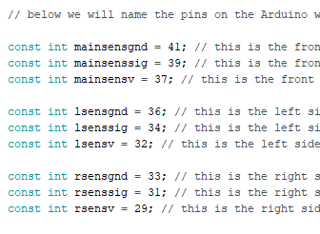
Lesson 5: ASR Programming - The Main Monitoring Loop
Next, using the int command, we have to name the pins that we will use for all 3 PIR sensors
Each PIR sensor has 3 pins, one for battery+, one for battery-, and one to send a signal back to the Arduino when is “sees” something
ovin-navigator.ca

Slide 119
Lesson 5: ASR Programming - The Main Monitoring Loop
The most important sensor is the one on the very front of the craft
We will use pin 41 to provide battery- to the sensor, we will call this “mainsensgnd” as shown
We will use pin 39 to receive the signal from the sensor, we will call this “mainsenssig” as shown
We will use pin 37 to provide battery+ to the sensor, we will call this “mainsensv” as shown
ovin-navigator.ca

Slide 120
Lesson 5: ASR Programming - The Main Monitoring Loop
We will name all of the pins in a similar fashion
“lsens…” will refer to left side sensor
“rsens…” will refer to the right side sensor
ovin-navigator.ca

Slide 121
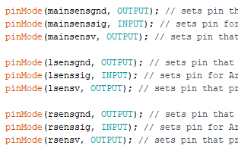
Lesson 5: ASR Programming - The Main Monitoring Loop
Exactly as we did with the motor pins we named, we must state if each pin will be used either as an input or an output
This must be done for every sensor pin we named!
The pins that provide battery+ and battery- to the sensors will both be outputs, since they are sending something to the sensors
The pins that receive information back from the sensors will be inputs
ovin-navigator.ca

Slide 122
Lesson 5: ASR Programming - The Main Monitoring Loop
To set the “mainsensgnd” pin as an output we will use the following line if code
pinMode (manisensgnd, OUTPUT);
Similarly, to set the “mainsensv” pin as an output we will use the following line of code
pinMode (manisensv, OUTPUT);
To set the “mainsenssig” pin as an input we will use the following line if code
pinMode (manisensv, INPUT);
ovin-navigator.ca

Slide 123
Lesson 5: ASR Programming - The Main Monitoring Loop
We must continue declare if each sensor pin is an input or an output for all of the remaining sensors
3 sensors, with 3 pins each = 9 pins we must set!
ovin-navigator.ca

Slide 124
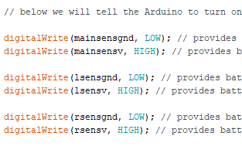
Lesson 5: ASR Programming - The Main Monitoring Loop
We must power up all 7 sensors in a similar fashion using the digitalWrite command
Pins that provide battery + will be set “high”
Pins that provide battery - will be set “low”
ovin-navigator.ca

Slide 125
Lesson 5: ASR Programming: The Main Monitoring Loop
First we will get a snapshot of all the sensors to determine if they “see” anything.
To start, we will use the following code to read the front sensor
digitalRead(mainsenssig)
If the front sensor sees something it will read as “high”
If the front sensor sees nothing it will read as “low”
ovin-navigator.ca

Slide 126
Lesson 5: ASR Programming: The Main Monitoring Loop
Using the digitalRead command, we read all of the sensor the same way.
We will store what we find under the names ssm, ssl, and ssr
Next we must decide what to do based on this information.
Some logic must be involved.
ovin-navigator.ca

Slide 127
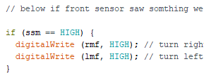
Lesson 5: ASR Programming: The Main Monitoring Loop
The front sensor is our priority, so we will consider it first, followed by the other sensors.
In the code an “if” statement will be used
The program will do whatever is in the brackets following the “if” statement if the condition is true
If the front sensor saw something, then we will drive the craft forward towards it.
We will ignore the other sensors since the target appears to be directly in front of the craft
ovin-navigator.ca

Slide 128
Lesson 5: ASR Programming: The Main Monitoring Loop
If the main sensor signal (ssm) is high, meaning it saw something, then we will use the digitalWrite command to do the following:
Turn the right motor in the forward direction
Turn the left motor in the forward direction
This will navigate the craft forward towards what the front sensor saw.
If the main sensor is low, meaning it saw nothing, then nothing will happen and the loop will move on to the next step.
ovin-navigator.ca

Slide 129
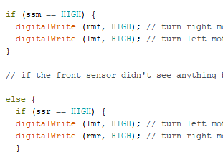
Lesson 5: ASR Programming: The Main Monitoring Loop
Next we will use and else statement
If the reading from the front sensor was high it will move the craft forward, else, meaning otherwise, it will look at the right sensor
If the right sensor signal is high, meaning it saw something, then we will use the digitalWrite command to turn the left motor in the forward direction and the right motor in the reverse direction to navigate the craft to the right.
ovin-navigator.ca

Slide 130
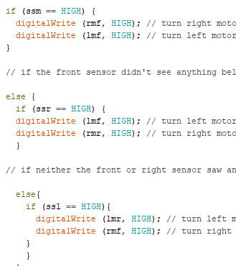
Lesson 5: ASR Programming: The Main Monitoring Loop
Now we will use a second else statement
If the right side sensor saw something the code will navigate to the right
Else, meaning otherwise, we will check the left sensor
If the left side sensor signal is high, meaning it saw something, then we will use the digitalWrite command to turn the right motor in the forward direction and left motor in the reverse direction to pivot the craft to the left.
ovin-navigator.ca

Slide 131
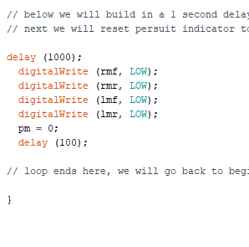
Lesson 5: ASR Programming: The Main Monitoring Loop
Using the delay command, we will build in a delay to allow whatever action is currently happening to continue for 1 second.
After the delay, we will turn off any motor that may be running using the digitalWrite command.
Finally we will end the loop and go back to the beginning of the loop and starting the entire process over again.
This loop will continue to run until the craft is shut off at the main power switch. In the process, craft should navigate to the target.
ovin-navigator.ca

Slide 132
Pictures/Project Diagrams
ovin-navigator.ca

