Slide 1
Understanding What the Micro:bit can Drive
BBT Area: Computer Technology
Target Course(s): TIJ10

Slide 2
Section 1: Teacher Resources
Explore more at ovin-navigator.ca

Slide 3
Project Outline
With the way of electric cars becoming more of a norm, the industry of transportation will be in need of various jobs within this industry. The Ontario Vehicle Innovation Network (OVIN) is seeing to fill these areas with Ontarians who are highly skilled to be able to help our future in the automotive and mobility sectors.
By being able to introduce a connection to the automotive industry in computer technology the hope is that we might be able to open the doors to allow students to see that they have more opportunities in their future.
Using the Micro:bit will allow students to see how simple parts of a car are created and allow them the creativity to be able to engineer perhaps new ways of helping the automotive industry. This will also connect to the UNs Global Goals of sustainability. Students will connect their project to either #9 Industry, Innovation and Infrastructure or #11 Sustainable cities and communities. At the core the micro:bit will teach students the intricacies of basic features of an electric dashboard inside an automotive and perhaps gain an awareness of computer/ electrical engineers that are needed in the automotive and mobility sectors.

Slide 4
Related OVIN Sectors
Connected & Autonomous Vehicles (C/AV)
Auto & Parts Manufacturing
Tool, Die & Mold
Aftermarket, Maintenance & Repair
Freight & Goods Movement

Slide 5
Prior Knowledge and Related Resources
Students Prior Knowledge:
Understand how to plug in a USB
Able to plug in adapters for battery use in the microbit
Open up website: makecode.microbit.org
Able to use a mouse to drag and drop on the screen.
Students who do not know the above should be taught prior to starting in to the lessons.
Teacher Prior Knowledge:
Able to upload/download files.
Able to discuss various options of a car dashboard (air conditioning, lights, radio, buttons, windshield wipers, and temperature)

Slide 6
Planning Notes and Teacher Guide
The lessons are set up to guide both teacher and student through the project. Each lesson is set up for approximately 60 mins.
Students are introduced to the Engineering design process.
They will create something that is connected to the UN Global goals as part of our connection to the curriculum (Section C: Technology, the Environment and Society)
They will gather a bases behind the need for people to fill jobs in the electrical fields related to the automotive industry.
They will be able to code in block code and see physically how that code responses in their microcontroller.
Their end task is to combine items they have coded on the micro:bit to react based on user input.
Ultimately to have a narrative that outlines the connection between the Global goals and the automotive industry.

Slide 7
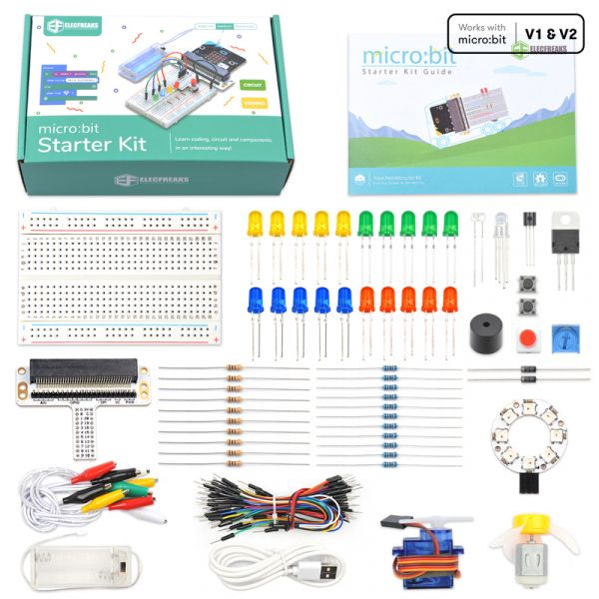
Required Tools and Materials
Micro:bit (gen 1 or gen 2) -- all of these options here are able to be completed by the gen 1.
ElecFreaks Micro:bit Starter kit with breadboard
Batteries
Access to the internet to code on https://makecode.microbit.org/
Optional ability to see dashboards of various vehicles (electric vs gas, luxury vs economical vehicles, this could be done via video or a walk in the parking lot at school perhaps, or set up a viewing with staff)

Slide 8
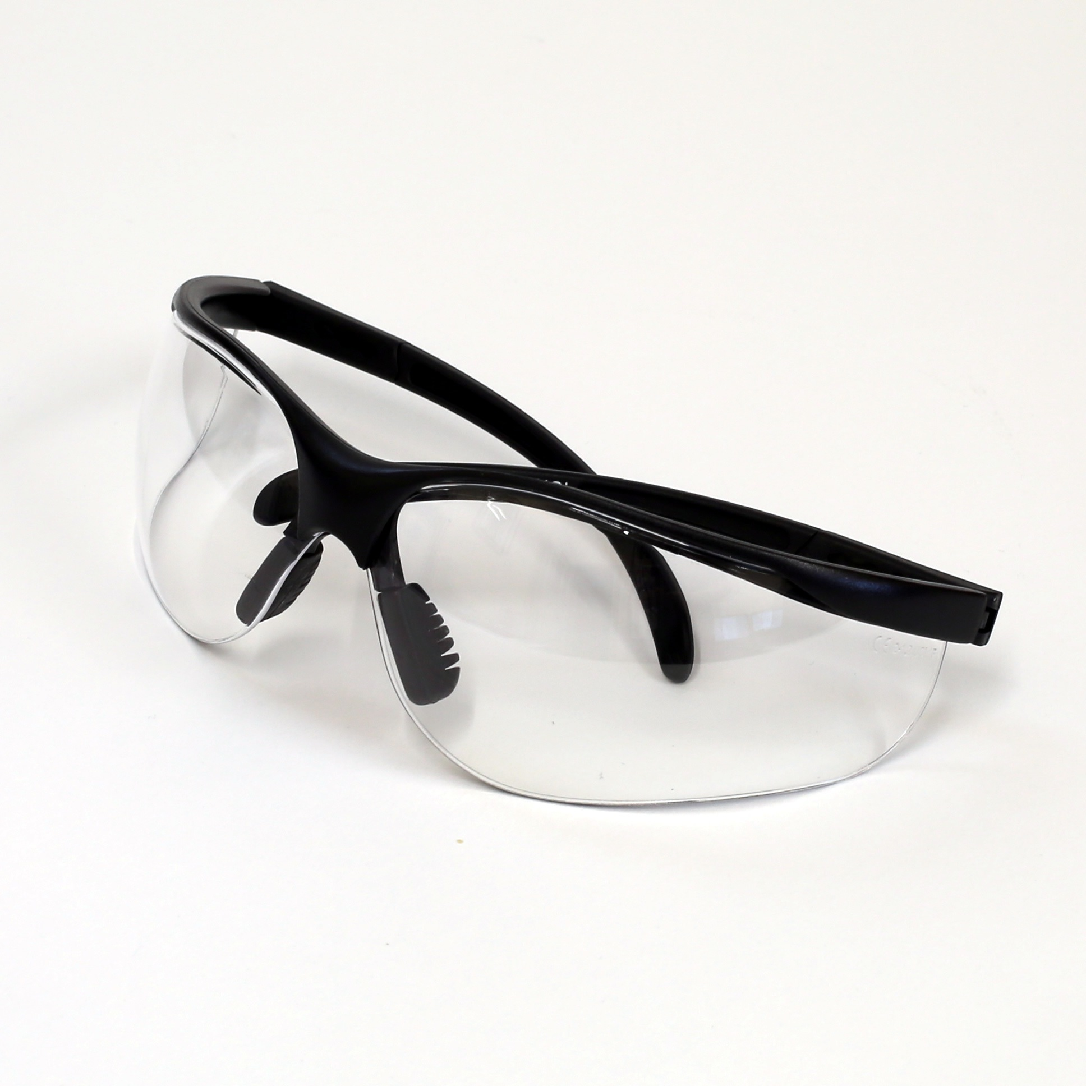
Safety Concerns (including PPE if required)
Safety glasses are suggested.
No food or liquids should be near the micro:bit and breadboard.

Slide 9
Assessment and Evaluation
End goal is for students to be able to program a minimum of 3 functions on the microbit that have a narrative that connects the automotive industry to the sustainable goals of #9 industry, innovation and infrastructure and #11 Sustainable cities and communities. This would be to show their understanding of what is already in existence in the electric automobile sector.
Higher level students can seek to provide innovative solutions to problems that are connected to the sustainable goals as well as have 4 functions working simultaneously with the micro:bit.
See RUBRIC for more details.

Slide 10
Assessment and Evaluation
SHOWCASE QUESTIONS:
Students are to pretend they are showing their creation to connect to the SUSTAINABLE GOALS. They have been given 5-10 mins max to convince them that this prototype is worth their time and investment.
Give a demo of how it works (simulator or actual device) Try and put 2-3 items together
Show how the code works (Explain the code with the language and terms you were taught in the slideshows)
Show how you assembled the physical/maker component
What was your biggest hurdle to get over?
What are you most proud of?
(OPTION to do this in video format to see the code, the micro:bit and student can explain freely how the code works.)

Slide 11
Prototype RUBRIC for Automotive Industry
Assessment elements | R | 1 | 2 | 3 | 4
Code - Show what you know- Must have at least 2-3 functions /40 | Not enough evidence to show your understanding | Code does not demonstrate previous concepts, is not efficient, variable names not clear. | Code only partially demonstrates previous concepts, and/or is not efficient, variable names not clear. Is missing 2 of the 4 inputs or 3 outputs | Code only partially demonstrates previous concepts, and/or is not efficient. Is missing 1 of the 3 inputs. | Code very effectively demonstrates the use of concept(s). There were notes within the code that explain various parts and how they connect. Code uses a various elements. Able to Code is highly efficient and organized Demonstrated forward thinking of new concepts not taught in class.
Maker component of prototype /20 | No prototype was created | Breadboard was not utilized | Tangible component does not add to the functionality of the program. (meaning it could all run just on a breadboard without the microbit) | Tangible component is somewhat integrated with the micro:bit but is not essential. 2-3 components are tied to the theme and the industry. | Tangible component is tightly integrated with the micro:bit and all 3-4 components tie into the Auto industry and a narrative that demonstrates an understanding of the global goals.. Can see clearly how this could be effective prototype for a company to make in the auto industry. All components are necessary and connect to the overall global goal selected.
Prototype Design /10 | No design at all | The design or concept is not really there. Missed the point of the project theme and just coded what you want. | There are some items on the prototype that do not help with the theme. The design is too simplistic or is too confusing to work for the set goal. | There are some items on the prototype that do not connect to one of the themes of: Security, Weather or Time of Day. The design needs a bit of refinement but clearly functions well for the set goal | Clearly demonstrated the connection to the Automotive Industry and how the Micro:bit can help. The Prototype has integrated design elements as well as functionality and purpose for the set goal.
Showcase /20 | No video was turned in and no presentation was seen | Code not seen but microbit simulator or physical microbit was. Questions were answered but showed limited understanding | Questions were answered somewhat. Very little detail was provided. Showed code but did not explain each part or did not show all of the circuit connections. | Questions were answered very casually. Professional language was not used. Limited terms were used to explain code. Automotive goal was not mentioned. | Video or presentation, clearly explains the prototype to the Automotive Industry Committee. Demonstrates what was coded in MAKECODE. How each of the functions work on the circuit board. Uses the language that has been taught for this unit to explain the code. Responded to all questions clearly and demonstrated mastery of skill.

Slide 12
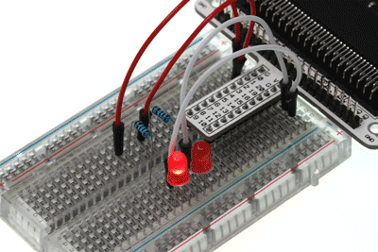
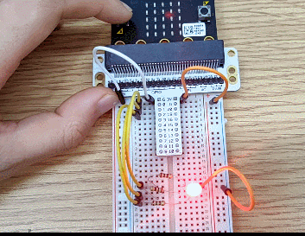
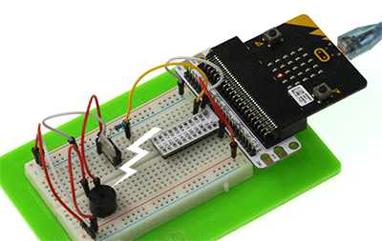
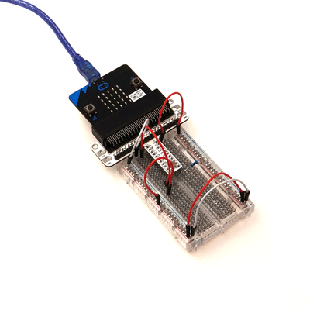
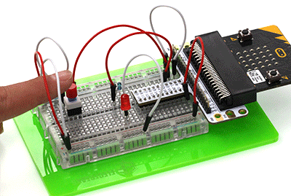
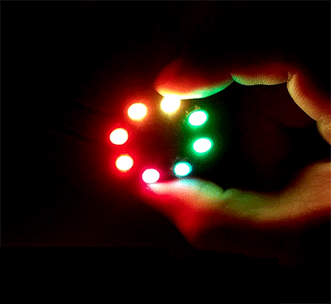
Project Exemplars (Videos/Pictures)
Various options for what students can connect with the breadboard and microbit.

Slide 13
Outside Resources and References
Resources:
ElecFreaks Micro:bit starter lessons (This is the site where all of the introductory lessons can be found the student handbook that was created has clips from this site to be able to chunk the information differently for some students)
Curriculum expectations: https://www.edu.gov.on.ca/eng/curriculum/secondary/teched910curr09.pdf
Micro:bit coding platform: https://makecode.microbit.org/
Code.org Micro:bit online platform extension https://studio.code.org/s/microbit-2023

Slide 14
Section 2: Student Lesson
Explore more at ovin-navigator.ca

Slide 15
Printable Student Resources (if required)
Feel free to use the slide deck as handouts.
Option to use the slidedeck as lesson plans and populate as a class to go through.
Rubric can be separate

Slide 16
Understanding What the Micro:bit can Drive
BBT Area: Computer Technology
Target Course(s): TIJ10
Explore more at ovin-navigator.ca

Slide 17
Project Introduction (and hook)
Students should be introduced to the automotive sector by accessing prior knowledge of vehicles.
General interest questions: What car would you like to own? What transportation do you take? Have you ever been on any mode of transportation that is electric?
Ways to gather information: Class discussion, parking lot of sticky notes, jamboard, etc.
As a class can you go out and visit the inside of a car in the parking lot?

Slide 18
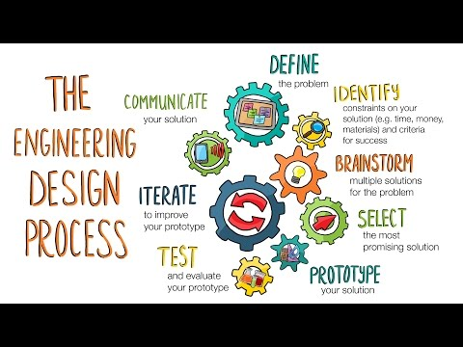
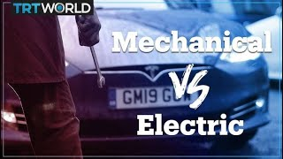
Project Introduction (and hook)

Slide 19
Understanding the ENGINEER Design Thinking Process
Whatever you build with code should serve a purpose or fill a need.
Empathize
Define
Ideate
Prototype
Test
Learn about your target audience
Understand and identify your audience’s problem and need
Brainstorm several possible creative solutions
Construct rough drafts or sketches of your ideas
Test your prototype solutions and refine until you come up with the final version

Slide 20
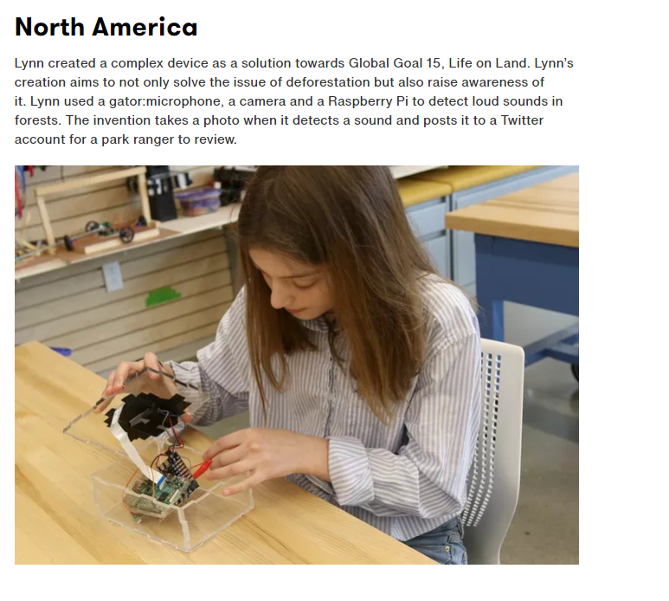
Curriculum Expectation: Students will develop an awareness of related environmental and societal issues, and will begin to explore secondary and postsecondary pathways leading to careers in the field.¹
Global Goals
Our focus

Slide 21
Student Lesson:
See the following RESOURCE to be used as the lesson plans for the UNIT
ENGINEER NOTEBOOK
Please note that this notebook is extensive, and not necessary to complete the whole project. Select what you would like to try with your students based on the time allotment you have. The attachment is meant as an entire unit of study.

