Slide 1
Future Forward Careers:
Future-Proof Your Career With Transferable Skills
GLC2O - Career Studies

Slide 2
What are
‘Transferable Skills’?
Brainstorm a definition and examples.

Slide 3
Definition
An essential skill that can be transferred from one situation to another.
Updated Government of Canada Skills for Success Website

Slide 4
Transferable Skills (Skills for Success)
Also known as
‘soft skills’
Notes:
See HANDOUT 3c. Future-Proof Your Career With Transferable Skills: https://docs.google.com/document/d/1RqgV5TyZR9a4SjJUVyAIoyNYap_mNMlHGg6eZOwa0kk/edit#

Slide 5
Collaboration
Work with and supporting others to reach a common goal.

Slide 6
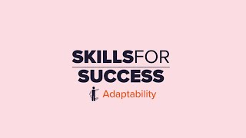
Adaptability
Being able to adjust and continually learn when something unexpected occurs or the workplace changes.

Slide 7
Writing
Being able to share information with words, symbols, and images.

Slide 8
Reading
Be able to find, understand, and use information.

Slide 9
Problem Solving
Being able to identify, analyze, propose solutions, and make decisions.

Slide 10
Numeracy
Being able to understand and work with mathematical information.

Slide 11
Digital
Being able to effectively use computers and other digital technology to find, manage, apply, create and share information and content.

Slide 12
Creativity and Innovation
Being able to imagine, develop, express, encourage, and apply ideas in new ways.

Slide 13
Communication
Being able to receive, understand, consider, and share information and ideas through speaking, listening, and interacting with others.

Slide 14
Collaborative Work - Human Knot
Let’s do the Human Knot Activity!!

Slide 15
Collaborative Work
Collaboration is key within all industries including the automotive industry.
Watch this video to learn more.
Notes:
See HANDOUT 3c. Future-Proof Your Career With Transferable Skills: https://docs.google.com/document/d/1RqgV5TyZR9a4SjJUVyAIoyNYap_mNMlHGg6eZOwa0kk/edit
Collaboration - Auto Industry Example (https://www.cbc.ca/player/play/2054967875869)

Slide 16
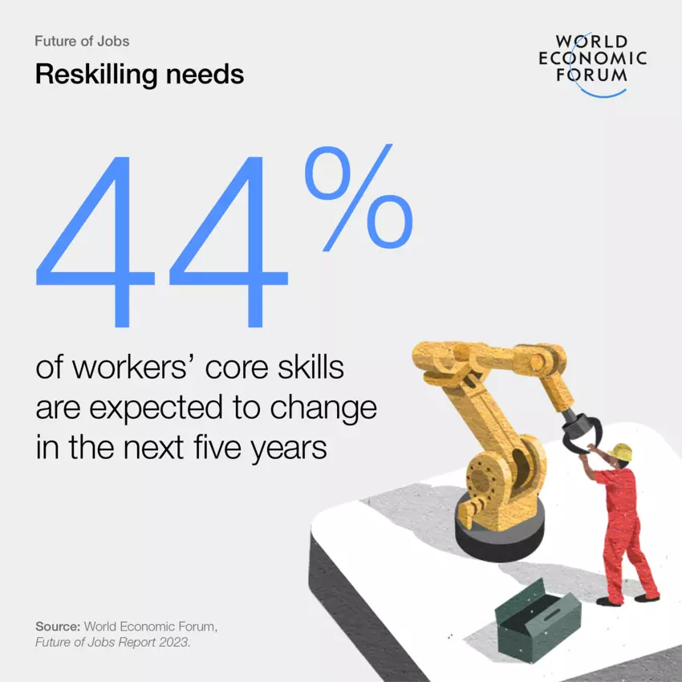
Adaptability (Upskilling
and Reskilling)
Adaptability is key in all industries including the automotive industry.
Reskilling is learning something outside of your existing skill set.
(E.g. A car assembler is replaced by a robot so they learn how to maintain the robot.)

Slide 17
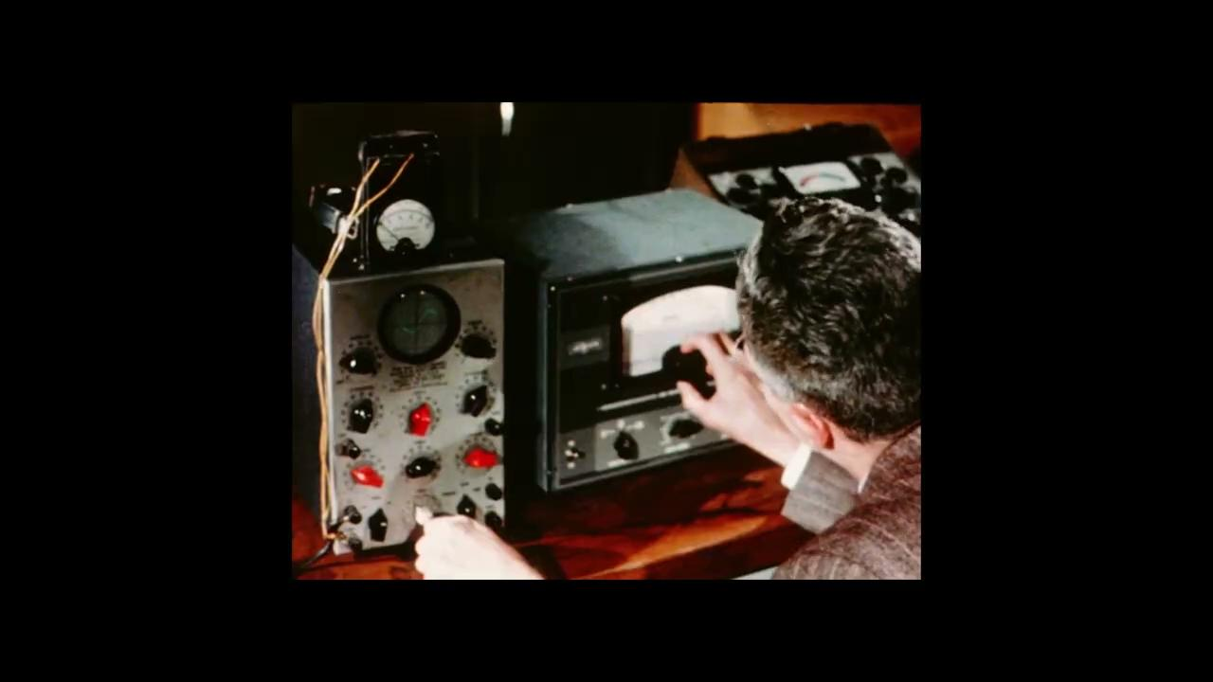
Adaptability (Upskilling and Reskilling)
Upskilling is learning something to expand your existing skill set.
(E.g. A car painter learning a new technique to paint more efficiently.)
Optional: Test your Adaptability (upskill and reskill) skills.

Slide 18
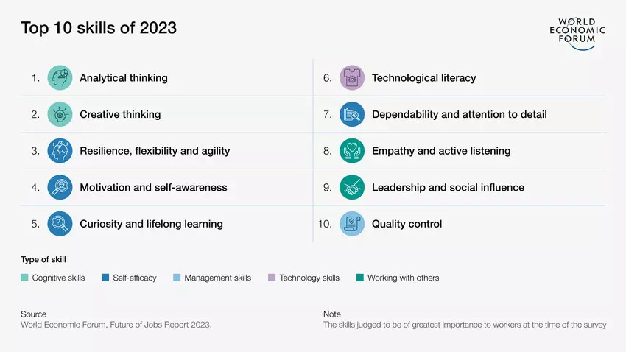
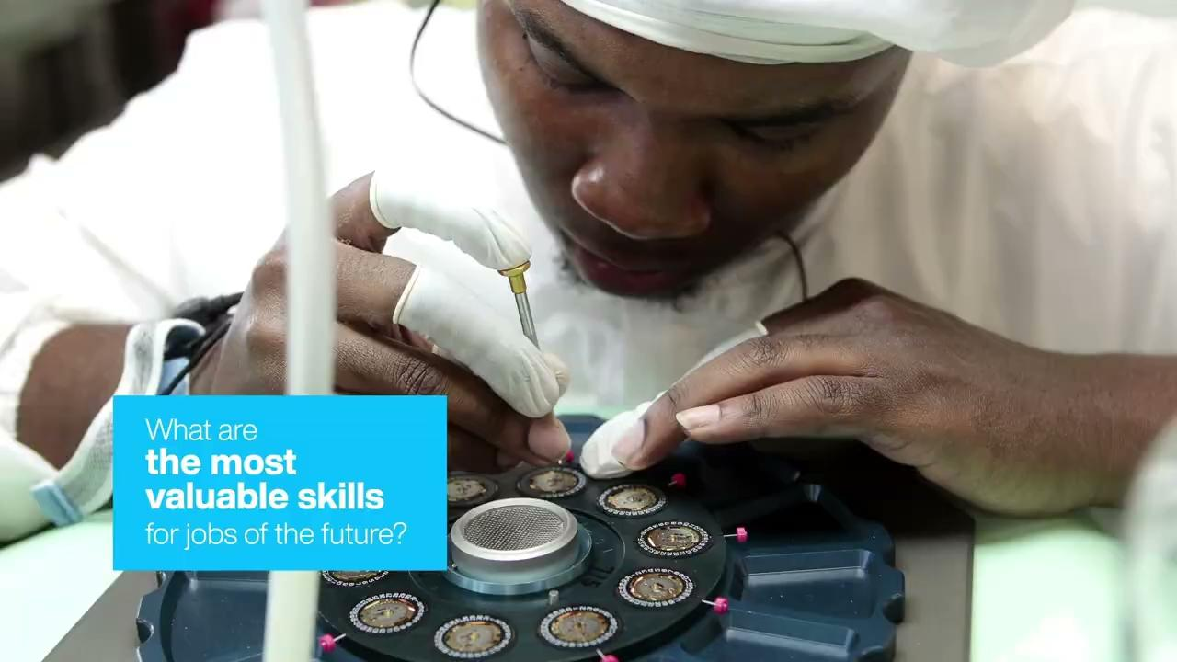
Skills Today vs. Skills 5 Years From Now

Slide 19
Transferable (Essential) Skills in the Automotive Industry

Slide 20
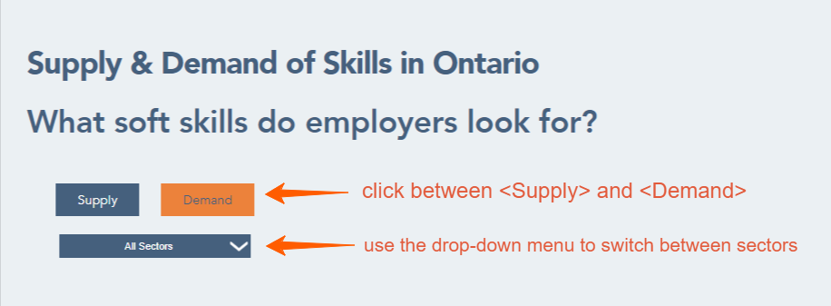
Supply and Demand of Skills in Ontario
Go to OVIN - Labour Market as a class.
Scroll down to the “Supply and Demand of Skills in Ontario” section.
Notes:
See HANDOUT 3c. Soft Skills in the Automotive Industry: https://docs.google.com/document/d/1_4EQu8kL7DEshjvWEYKPXvwrPyBWoG_kCq-w7rg7E_c/edit?usp=share_link

Slide 21
Supply and Demand of Skills in Ontario
You will see the supply of soft skills (transferable skills) applicants bring.
After viewing, click on the demand button.
Use the drop down menu to look closely at each sector.
What differences did you notice?
Why do you think these differences exist?
What could be done to help fill the skill gap?

Slide 22
Conclusion and Wrap Up
Think: What did I learn today?
Add some of the observations you have made about your transferable skills to your Individual Pathways Plan or your portfolio for this course.
Consider spending more time on the OVIN Career Navigator on your own time, to consider if you are a fit for a career in the automotive and mobility sector.

Slide 23
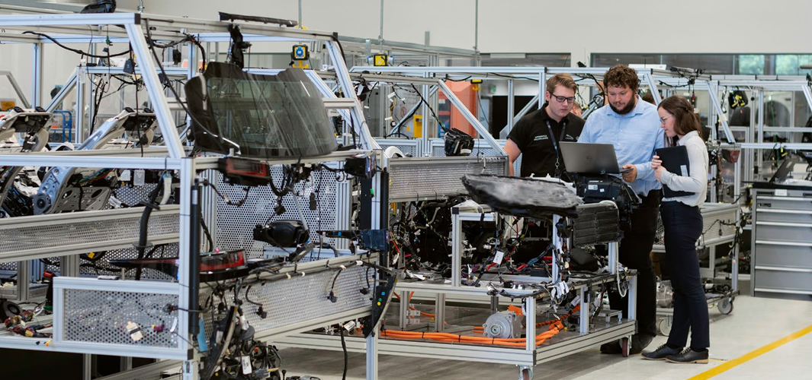
Optional Extension # 1
Go back to the “Adaptability (Upskill and Reskill) slide (slide 18) and click on the Optional link to complete the assessments.
Test all your other essential skills as well.

Slide 24
Optional Extension # 2
Students can go to the Government of Canada Skills for Success website and complete the skills assessment and skills training tool for further exploration. https://www.canada.ca/en/services/jobs/training/initiatives/skills-success/tools.html?category=Individual&type=Training

Slide 25
Optional Extension # 3
Students can go back to the OVIN Career Pathways website and explore other career options in the automotive industry. https://ovin-navigator.ca/skills-career-pathway/career-pathways/teens-select-segment-of-the-sector/

