Slide 1
Microbit Challenge
BBT Area: Computer Technology
Target Course(s): TEJ2O

Slide 2
Section 1: Teacher Resources
Explore more at ovin-navigator.ca

Slide 3
Project Outline
The project that students will embark on is allow them to gather insight into the automotive industry especially when it comes to electrical circuits. The hope is that by bringing awareness that these simple circuits are the foundation of what they see sitting in the front seat as they take the wheel for the first time is comprised of small circuits like that found in the microprocessor of the micro:bit.
Students will practice their problem solving, communication and technology skills as they learn how to program for the micro:bit using a breadboard starter kit and optional expansions such as the Smart Cutebot.

Slide 4
Related OVIN Sectors (remove those that don’t apply)
Connected & Autonomous Vehicles (C/AV)
Auto & Parts Manufacturing
Aftermarket, Maintenance & Repair
Freight & Goods Movement

Slide 5
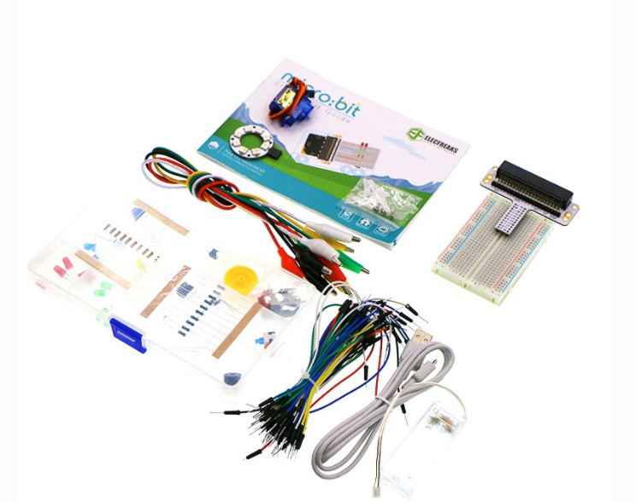
Related Resources
Microbit with STARTER KIT (If you do not have the starter kit then you will be doing everything we do in TINKERCAD or NEW CODE.org software of coding with the mico:bit has a great online course to walk students through)

Slide 6
Prior Knowledge and Related Resources
If students have not had experience with the Micro:bit and breadboard it is encouraged that a brief introduction take place with a few small activities that can be found in the following guide used in the TIJ10 Computer Technology resource from OCTE. Here is a condensed version of that resource to use in class LINK.
Students should have understanding of the following:
How the breadboard and micro:bit work in conjunction with each other
How to use wires, alligator clips and download the programs to the micro:bit

Slide 7
Planning Notes and Teacher Guide
Have students in a similar comfort zone with how the breadboard and micro:bit work together
Attached are two ways of delivering roughly the same project. Depending on your learners one might be a better fit.
The first one is very open ended and allows for creativity and student choice to drive the project
The second one was based off of a level schematic to allow students to see what level they would like to try first and the if they choose they can adapt their project to fit the next level.
Once you have selected the assignment have students review the Engineering Design Process as they will be required to fill in a mindmap to show how they engineered their design.
Having students enter into the class with varying levels of ability in an open class is always a challenge, so with this in mind the the project based learning can start where they are at and move them forward. Simultaneously allowing students who are just starting to see where they can go if they enjoy this project.

Slide 8
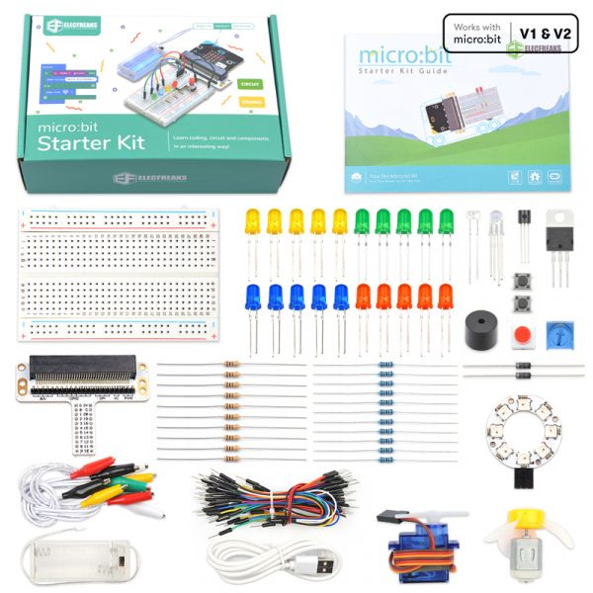
Required Tools and Materials
Micro:bit (gen 1 or gen 2) -- all of these options here are able to be completed by the gen 1.
ElecFreaks Micro:bit Starter kit with breadboard
Batteries
Access to the internet to code on https://makecode.microbit.org/
Mindmap software: Mindomo for example
Optional ability to see dashboards of various vehicles (electric vs gas, luxury vs economical vehicles, this could be done via video or a walk in the parking lot at school perhaps, or set up a viewing with staff)

Slide 9
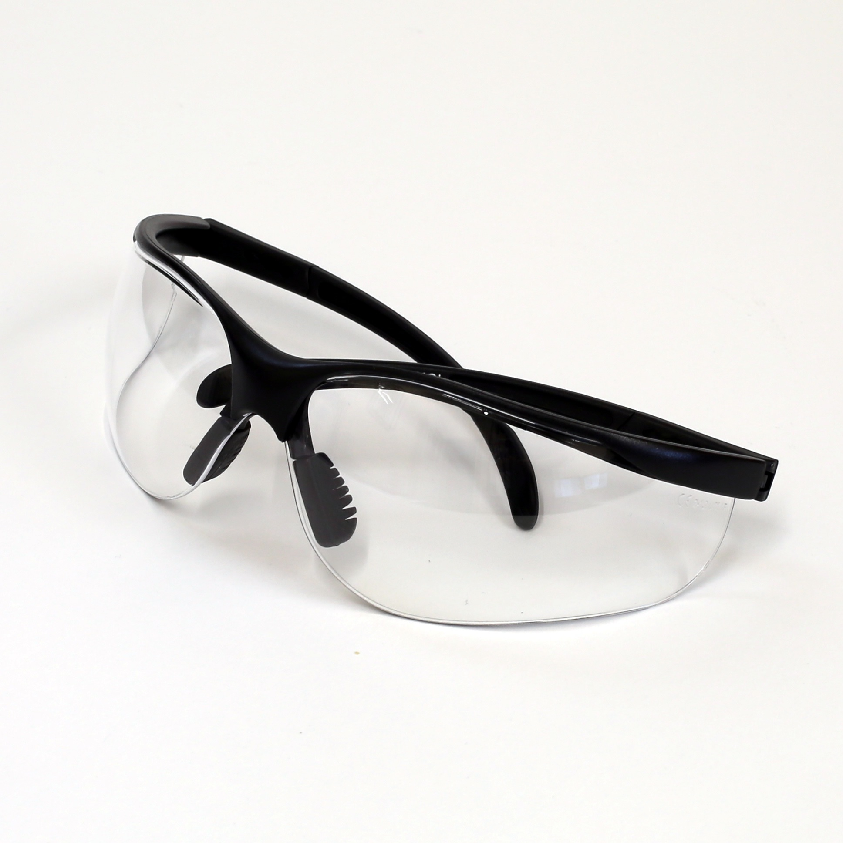
Safety Concerns (including PPE if required)
Safety glasses are suggested.
No food or liquids should be near the micro:bit and breadboard.

Slide 10
Assessment and Evaluation
Microbit Resource
Creative Assignment
Scaffolding Assignment
Smart Cutebot Resource
Rubric for Assignment
MINDOMO

Slide 11
Outside Resources and References
Article is a great resource for TEJ courses as it highlights the areas this course can specialize in with the Automotive industry: LINK

