Slide 1
Tire size and age.
P205/65R17 89V DOT 0818
What do these letters and numbers mean?

Slide 2
Why know the meaning of these letters and numbers?
You will own a vehicle one day and you will be responsible for having the right tire size on your vehicle.
You will need to buy tires for your vehicle and you will need to know the right size to buy.
You will also need to make sure that your tires are not too old, as they could blow out on the road.

Slide 3
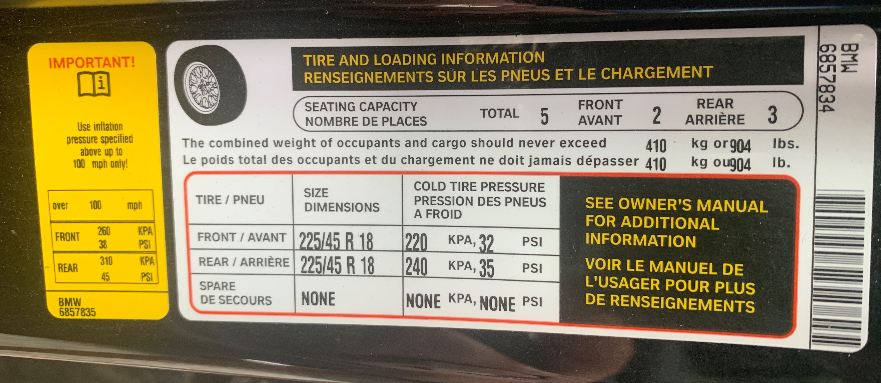
You can find the recommended tire size on the sticker in the driver’s door or in the owner's manual :
Front tire size
Rear tire size
Spare tire size (if applicable)

Slide 4
Tires come in different sizes and have different characteristics
You should never install tires of different sizes or types on a vehicle.
Each tire has specific handling characteristics.

Slide 5
In addition to the model and manufacturer's names, each tire is characterized by a coded sequence moulded into its sidewall. For example, a tire with the following designation P215/65R15 89H can be described as follows :
P: It is designed for a passenger vehicle L: Light truck
215: its width is 215 mm
65: it has a 65% profile - the height of the tire is 65 percent of its width (65% of 215 = 140 mm height)
R: it is a Radial tire
15: this tire is suitable for 15-inch wheels
89 is the load capacity index of the tire; 89 corresponds to 1279 lbs.
H is the speed code which indicates the maximum speed allowed for the tire; for example, the code H corresponds to 210 km / h maximum.

Slide 6
Date of manufacture
The date of manufacture of the tire is also written on the inside edge of the tire, near the rim. The last 4 digits of the serial number (called DOT) indicate the week and year of manufacture: for example, 0818 means that the tire was manufactured in the 08th week of the year 2018.
Note that the life of a tire is 6 to 7 years. It is recommended that you check these numbers on any tire you purchase to make sure it is not too old. Tires begin to deteriorate after 6 years, even if they have never been mounted on a vehicle.

