Slide 1
Autonomous Taxi Design
BBT Area:
Target Course(s): Technological Design
Explore more at ovin-navigator.ca

Slide 2
Section 1: Teacher Resources
Explore more at ovin-navigator.ca

Slide 3
Project Outline
By the end of this project students will be able to understand and work through the stages of the design process, researching, sketching, assessing and evaluating design criterias when choosing a design concept and then create a model of their design. This project can be used in a TIJ Grade 9 course in as a technological design unit or in a TDJ9/10 Course.

Slide 4
Related OVIN Sectors (remove those that don’t apply)
Connected & Autonomous Vehicles (C/AV)
Auto & Parts Manufacturing

Slide 5
Prior Knowledge and Related Resources
Prior Knowledge
How to setup and print using a 3D printer
How to use a CAD program to design the base structure of the model
Optional
If using tools to create the base structure, tool use and safety will need to be covered.

Slide 6
Planning Notes and Teacher Guide
Steps in the Project in order
1. Introduction to the project, using project introduction slide & hook.
2. Lesson #1 - What is an Autonomous Taxi?
3. Activity - Cabin Layout activity Sheet
4. Activity - What do Taxi’s look like around the world?
5. Lesson #2 - What is a sample board?
6. Lesson #3 - Sketching Concepts.
7. Lesson #4 – Choosing a Design
8. Activity - Create a base structure.
9. Activity - Apply Clay, paint, add-ons like wheels, lights etc
10. Optional next step, create a one-page advertisement showing off the features and design elements

Slide 7
Required Tools and Materials
Pen
Pencil
Markers
blank paper
3d printer
Clear Laminate paper
Wheel and axle
Modeling clay
Modeling Tools
Optional Equipment & Materials
High Density styrofoam, foam core or lego
3D printed wheels and axle
Canva, Photoshop or Illustrator for a one page advertisement

Slide 8
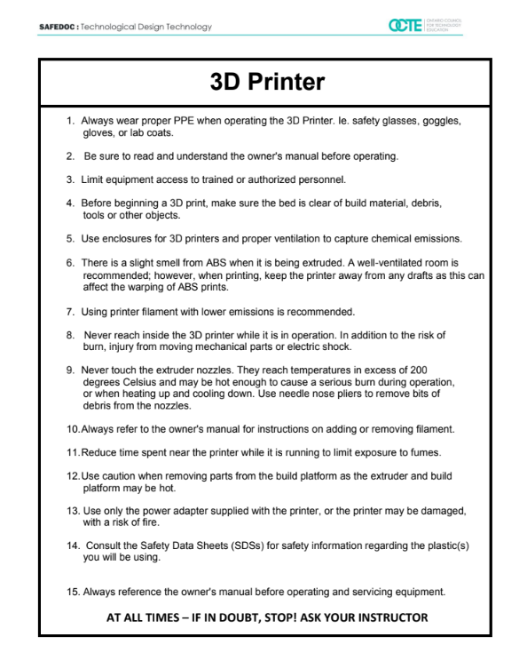
Safety Concerns (including PPE if required)
Risk
If the base structure is 3D printed
Fumes from 3D printing
3D printer, pinch points, burns from extruder tip if not enclosed
Fumes from painting model
If the base structure is cut with wood (Optional)
Bandsaw
Table saw
Scroll saw
Drill press
Wood glue
PPE
Proper footwear, eye protection, and hearing protection will be needed when using machines.
3D Printer SafeDoc

Slide 9
Assessment and Evaluation
Rubric at two stages, One after sketch and choosing a design focus on communication and knowledge and understanding, another after clay model focus on application.

Slide 10
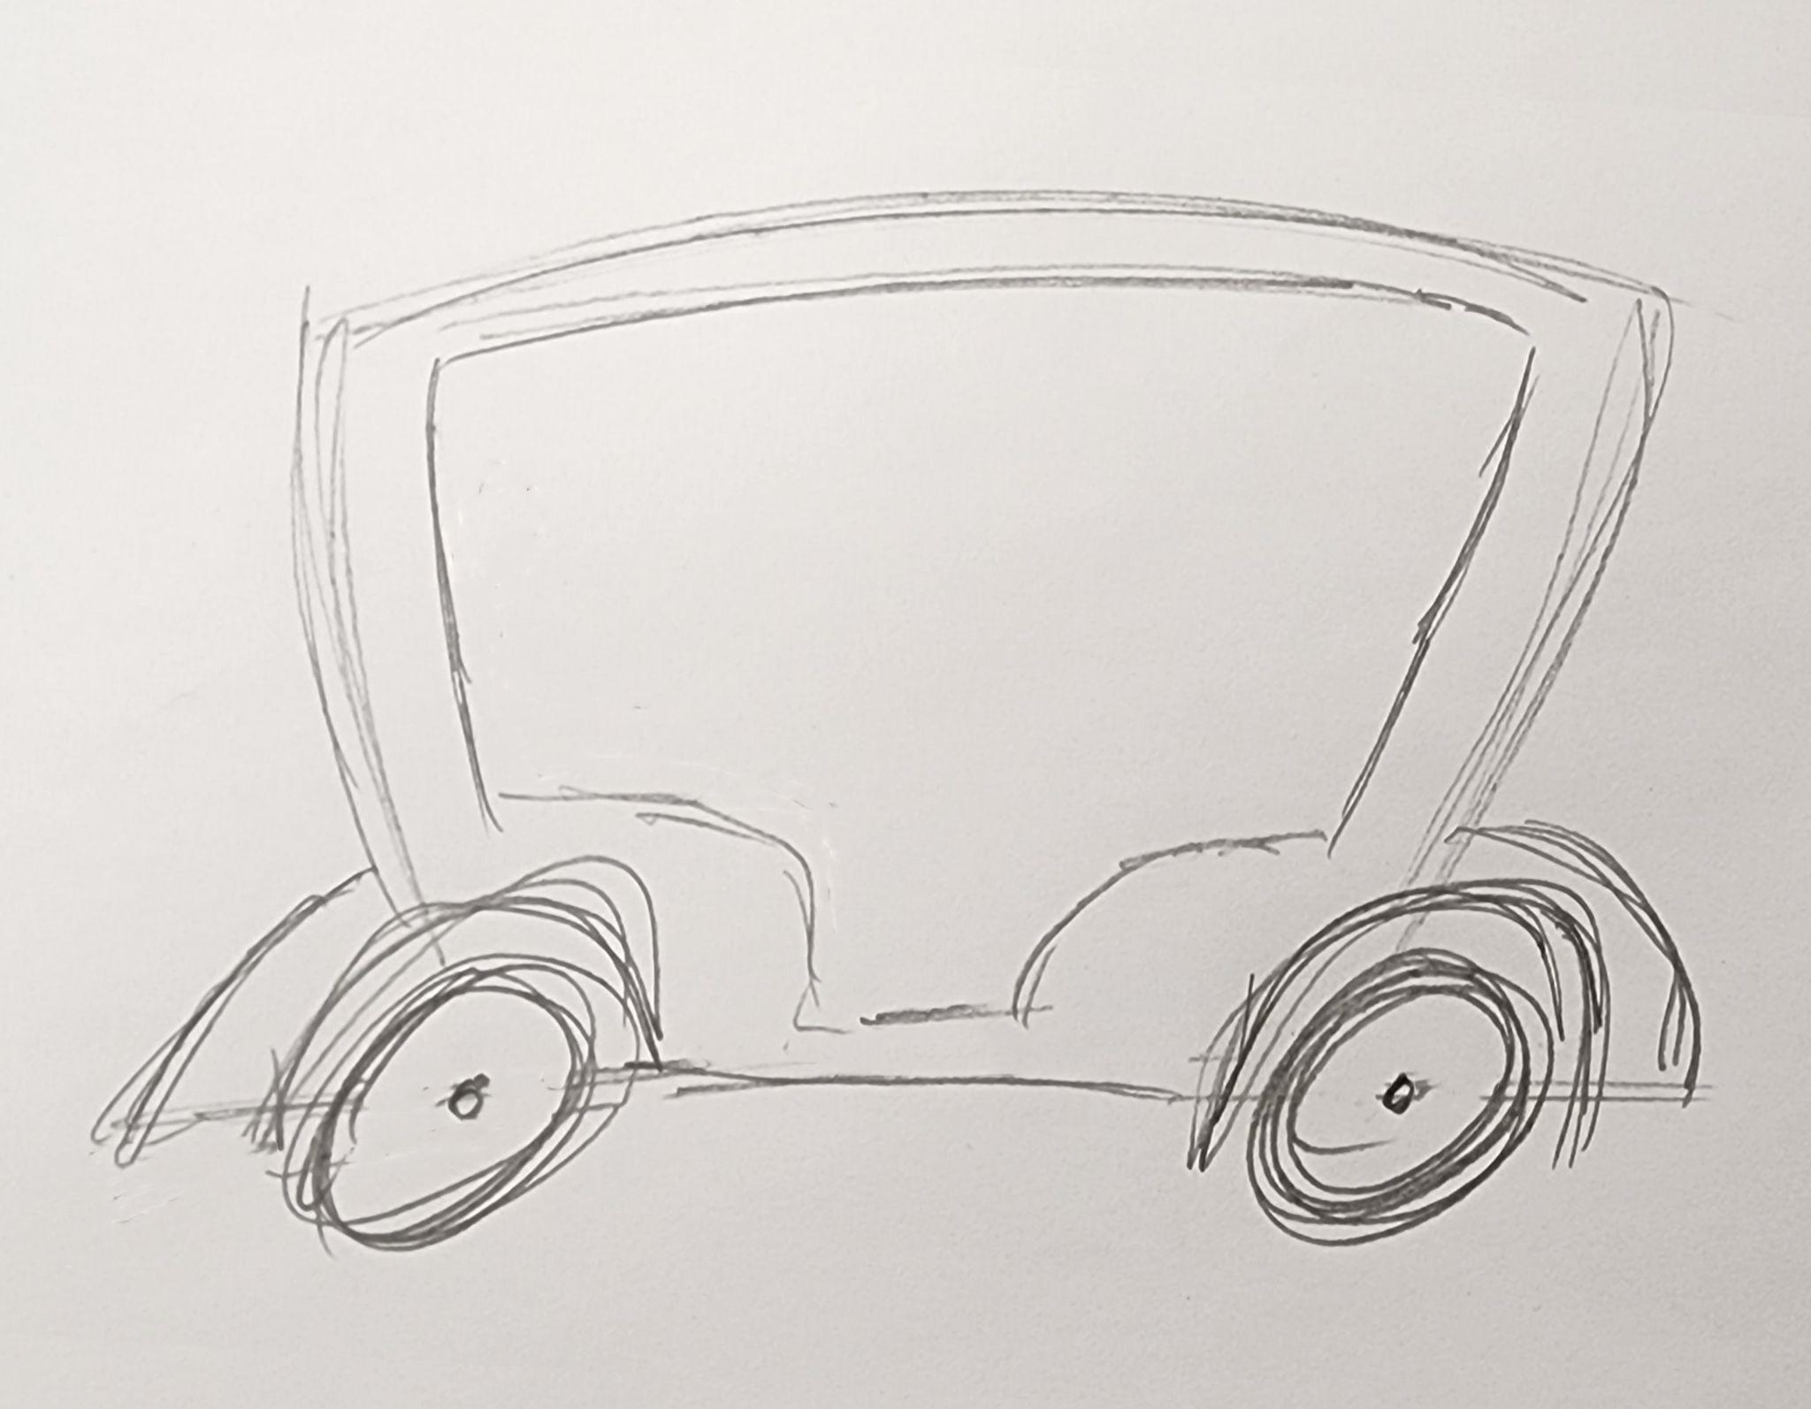
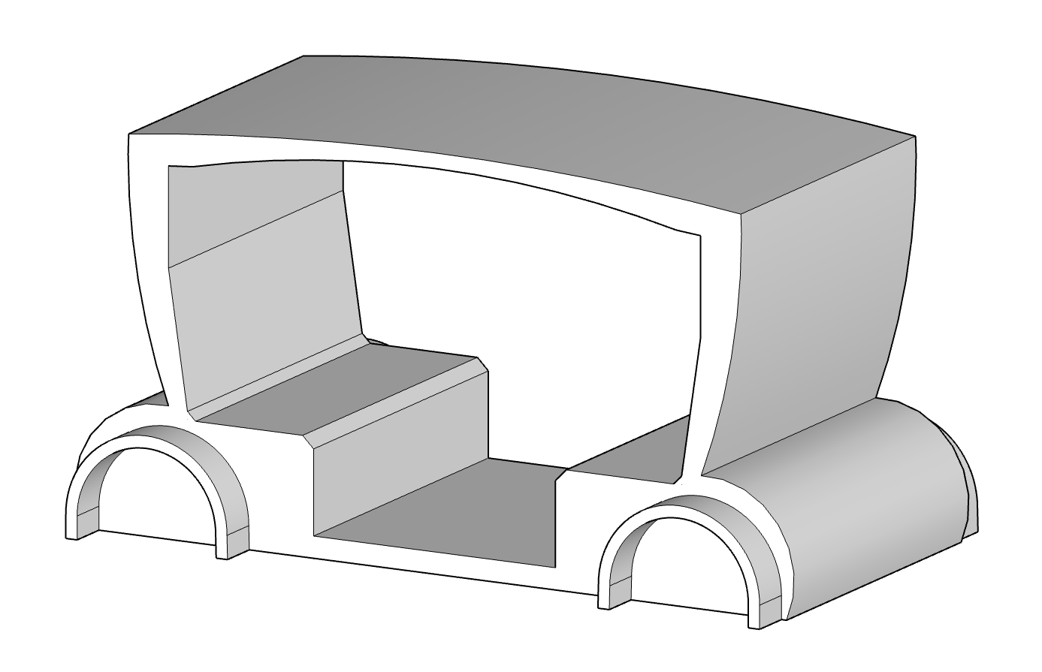
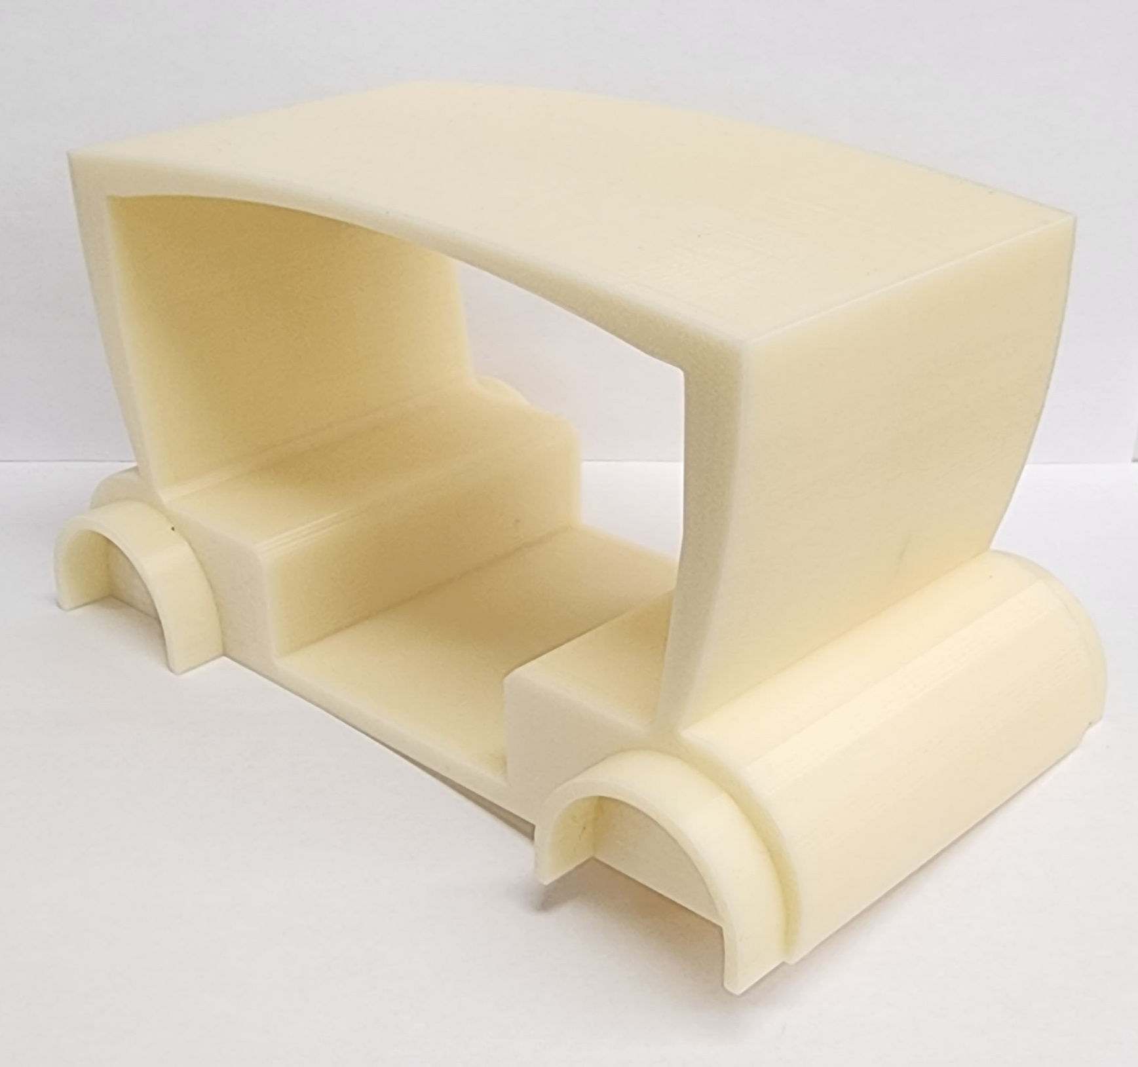
Project Exemplars (Videos/Pictures)
Concept Sketch
CAD Model
3D Printed Model

Slide 11
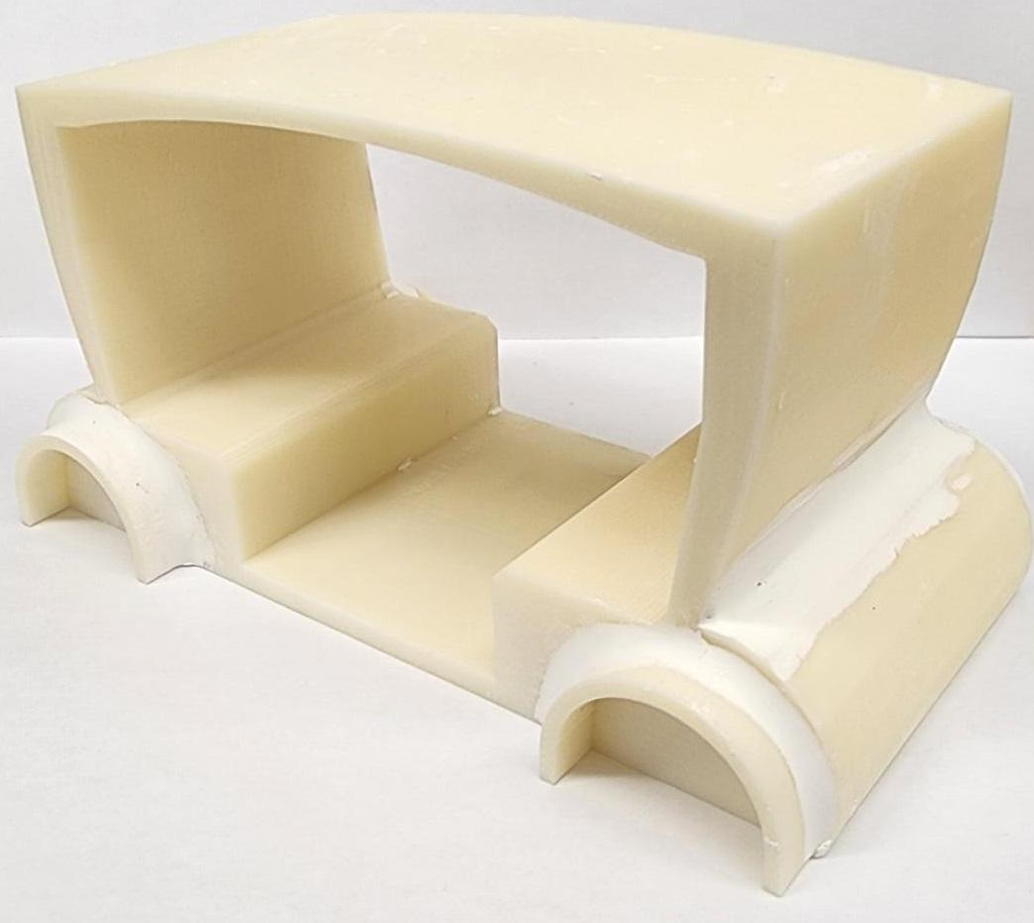
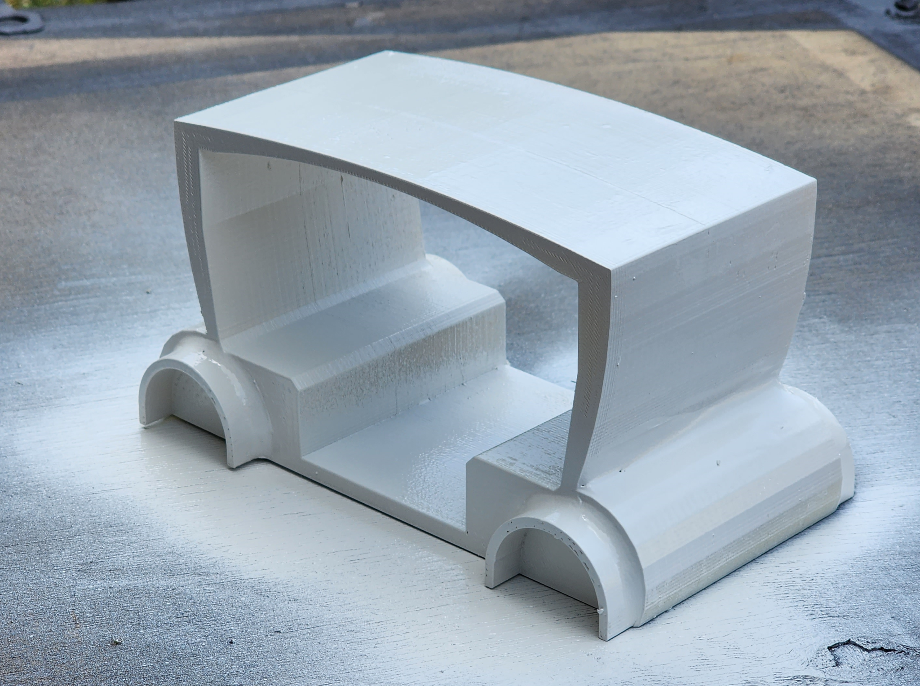
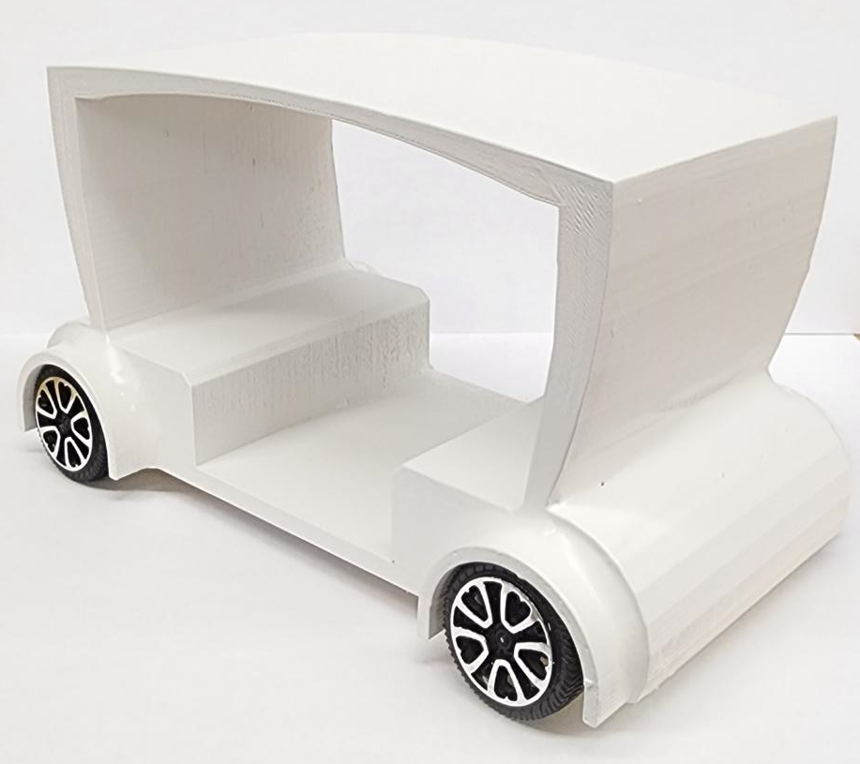
Project Exemplars (Videos/Pictures)
Clay Added
Painted
Finished Model
Optional, add doors, windows, lights, colour, 3D printed and designed wheels

Slide 12
Outside Resources and References
How to Design Your Own Car
The Future of autonomous Vehicles
Is This What Car Interiors Will Look Like In 10 Years!?
Designing an autonomous car interior for endless possibilities
Nine weird in-car seating arrangements
Taking a Diamond Cab Why Car Companies Still Use Clay
Example of Clay for modeling
Taxi’s in London England
Taxi’s in New York City USA
Taxi’s in Mumbai India
Rickshaw Taxi’s
Sample Boards
Mood/Conceptual Boards
How to sketch a car interior using markers
Car Design 101: Side View Proportions
Presentation Boards

Slide 13
Section 2: Student Lessons
And Activities
Explore more at ovin-navigator.ca

Slide 14
Autonomous Taxi
BBT Area: Technological Design
Target Course(s): TIJ
Explore more at ovin-navigator.ca

Slide 15
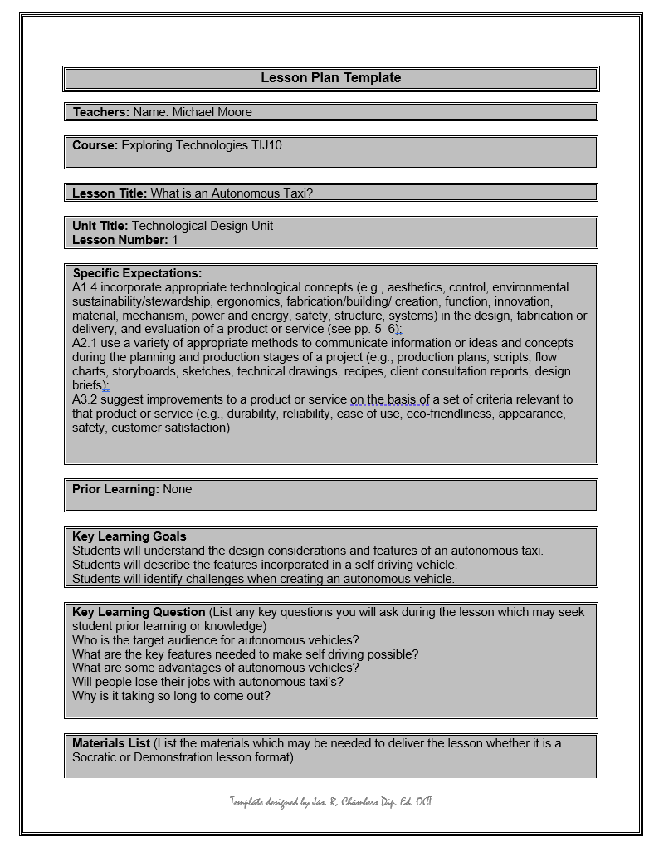
Lesson Slide 1 - What is an Autonomous Taxi?
Lesson Plan on “What is an autonomous taxi?” and article questions.
What is an Autonomous taxi Discussion questions and literacy component
Lesson Plan Link

Slide 16
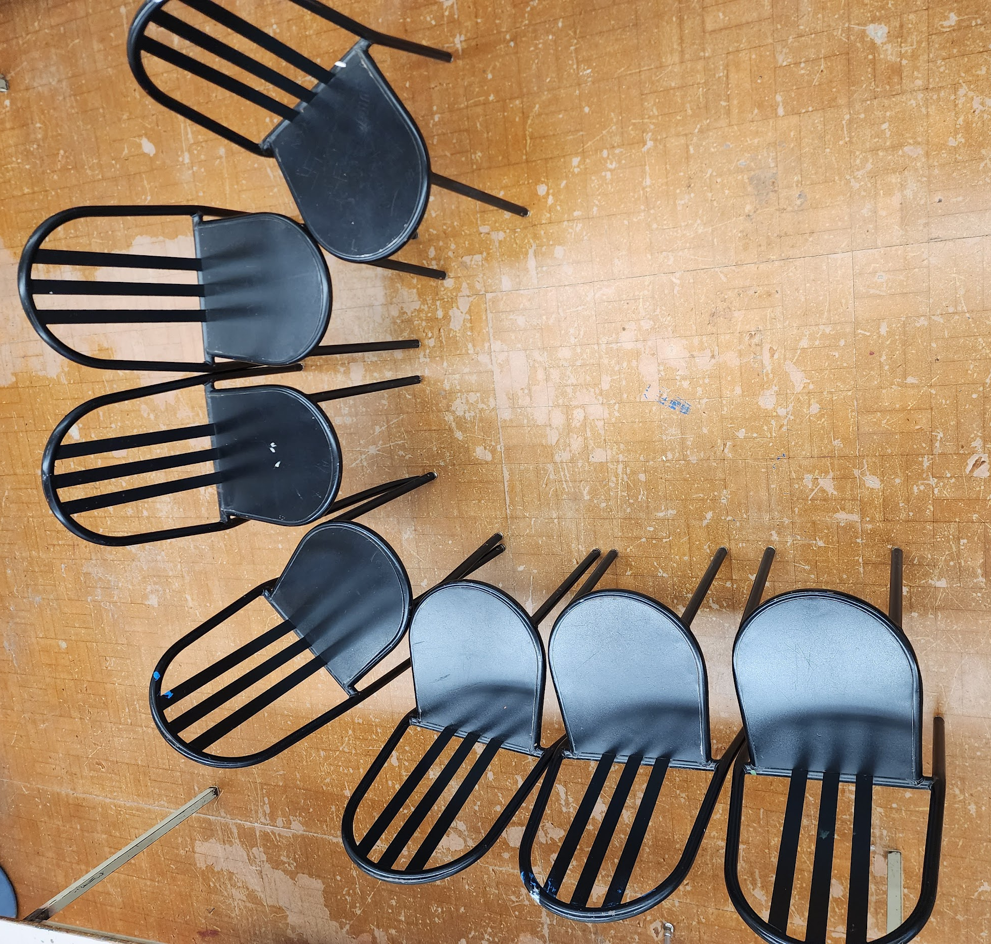
Activity Slide 2 - Cabin Layout
Activity on Cabin layout, what different cabins look like and layout of seating task.
J Style Seating

Slide 17
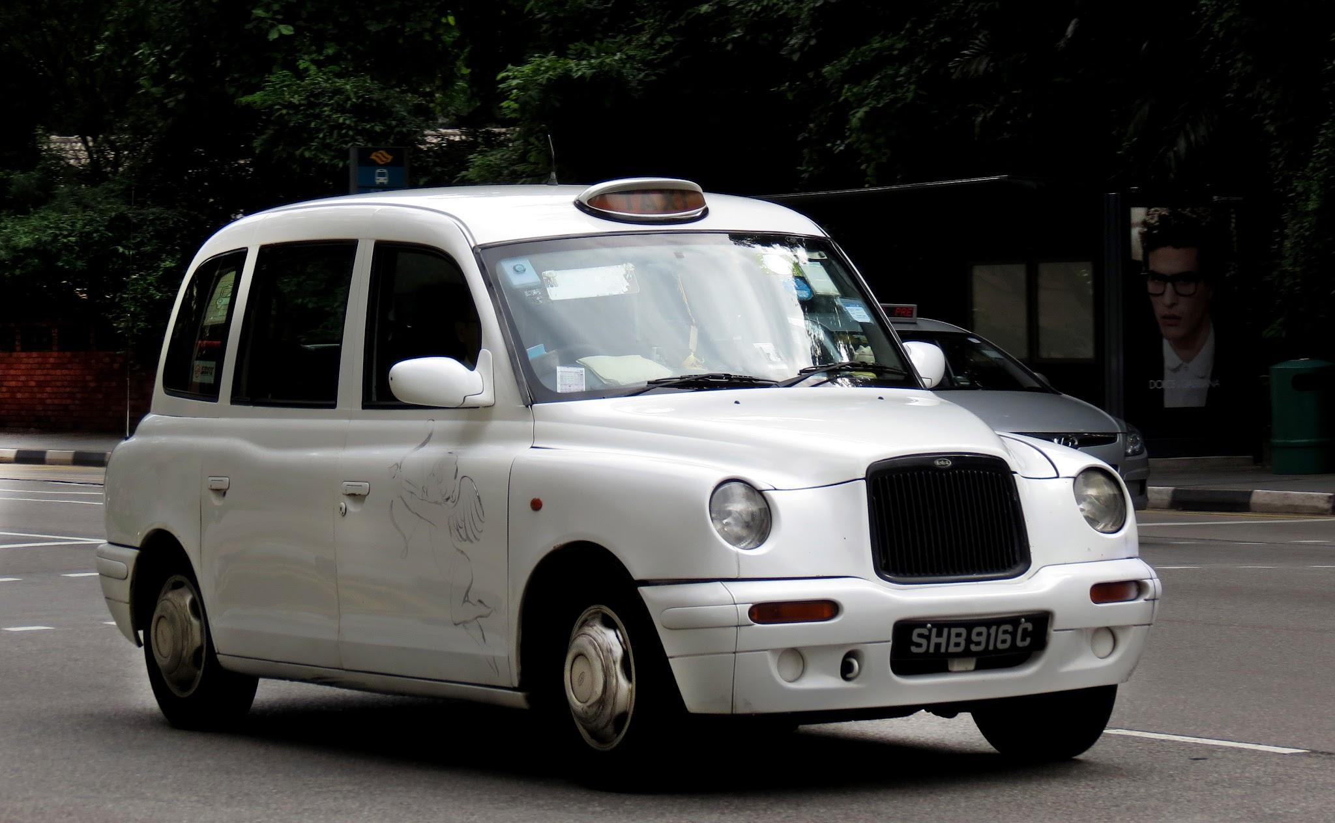
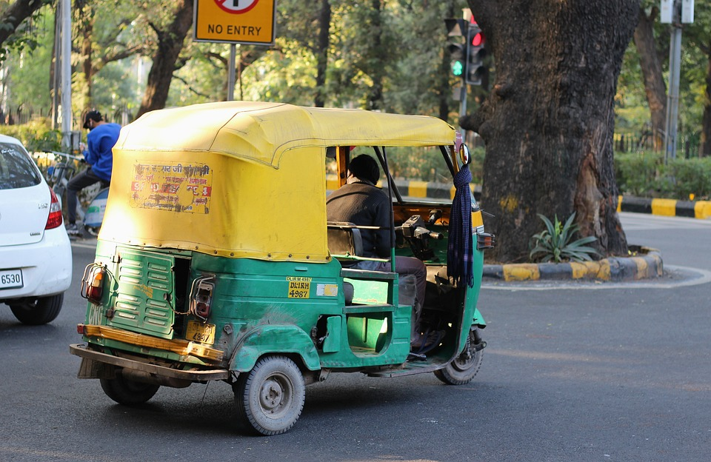
Activity Slide 3 - What do taxi’s look like around the world?
Review taxi’s from different countries like London England, New York City, Mumbai India, and or others
Review regular 4 door sedan taxis, vans, or even open door Rickshaw style taxi’s.
Task - Have student research then discuss the different style of taxi’s, possible issues with each, seating location, doors or no doors, consider weather and location being used, and pros and cons for each.

Slide 19
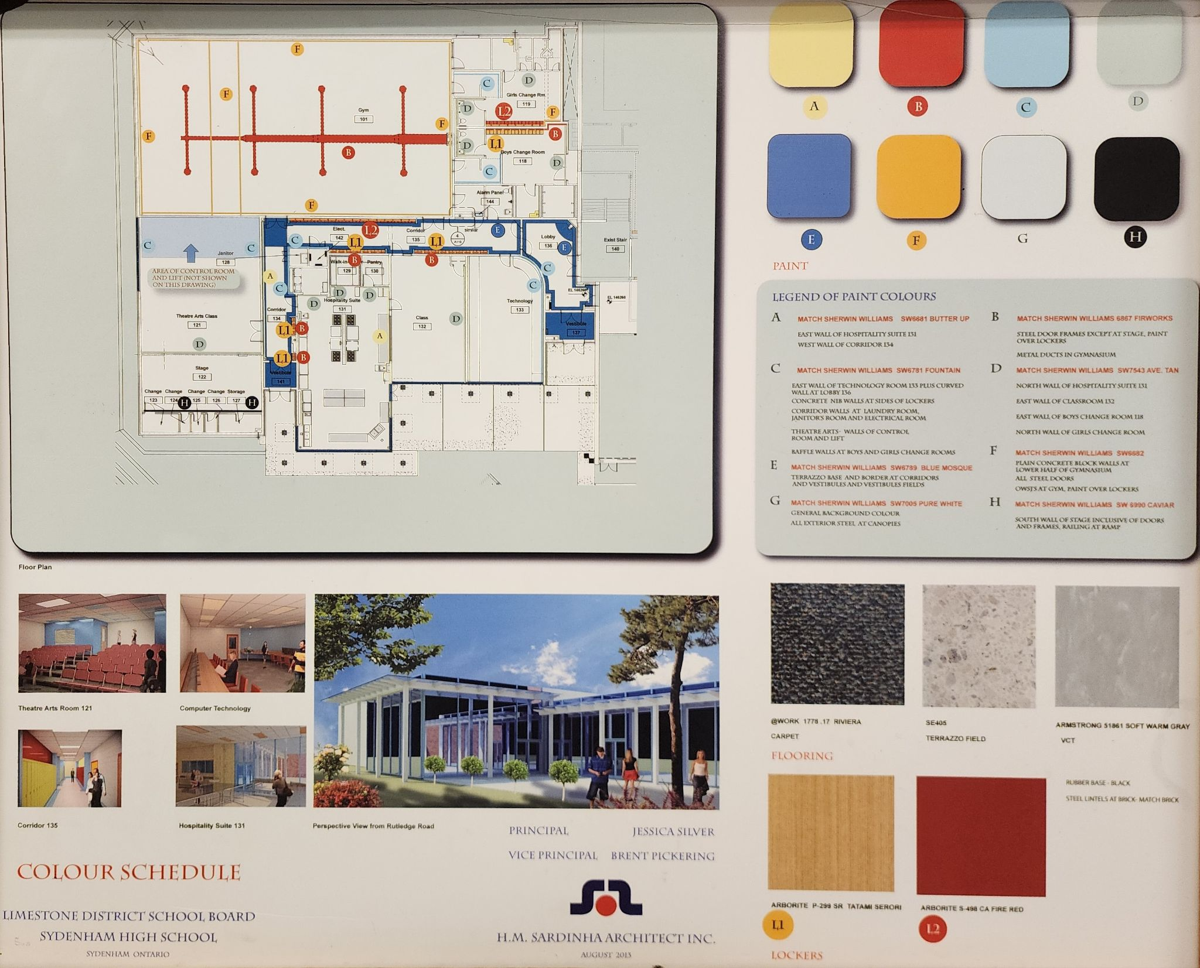
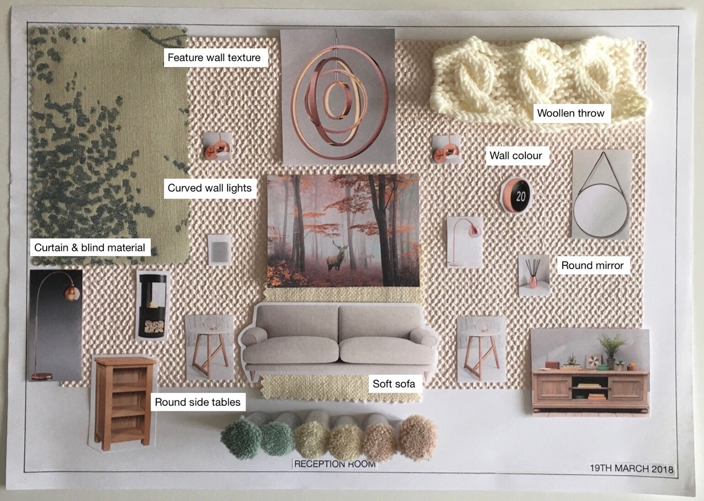
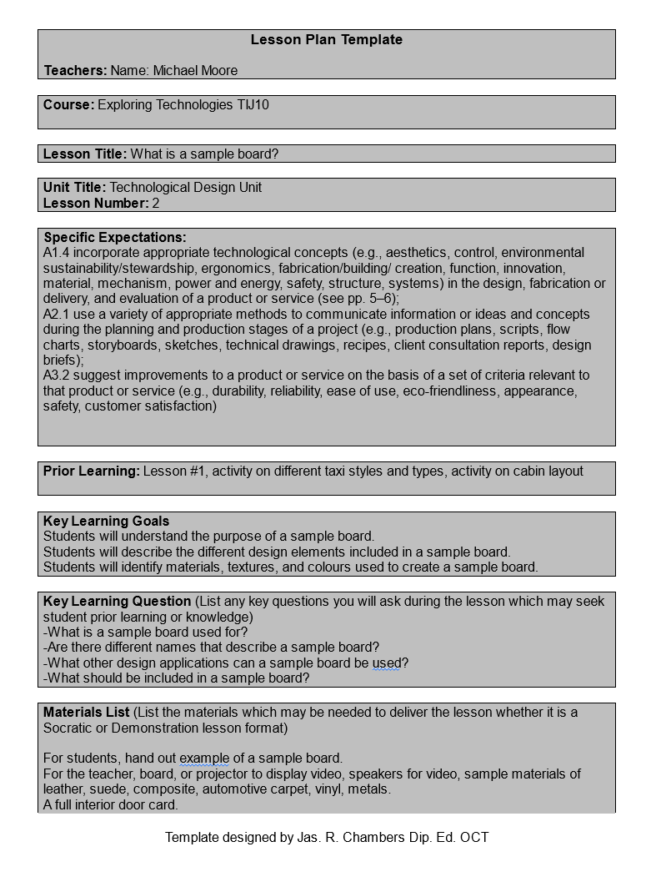
Lesson Slide 4 - What is a sample board?
Review example of sample board, mood boards and conceptual boards.
Sampleboard
Mood/Conceptual
Presentation Boards
Sample Board Example
Task Create a sample board
School Sample Board
Interior Design Sample Board
Lesson Plan

Slide 20
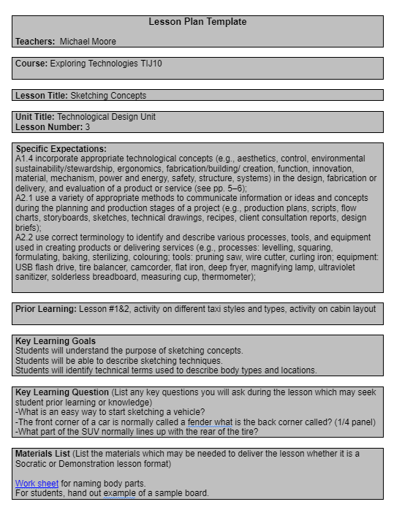
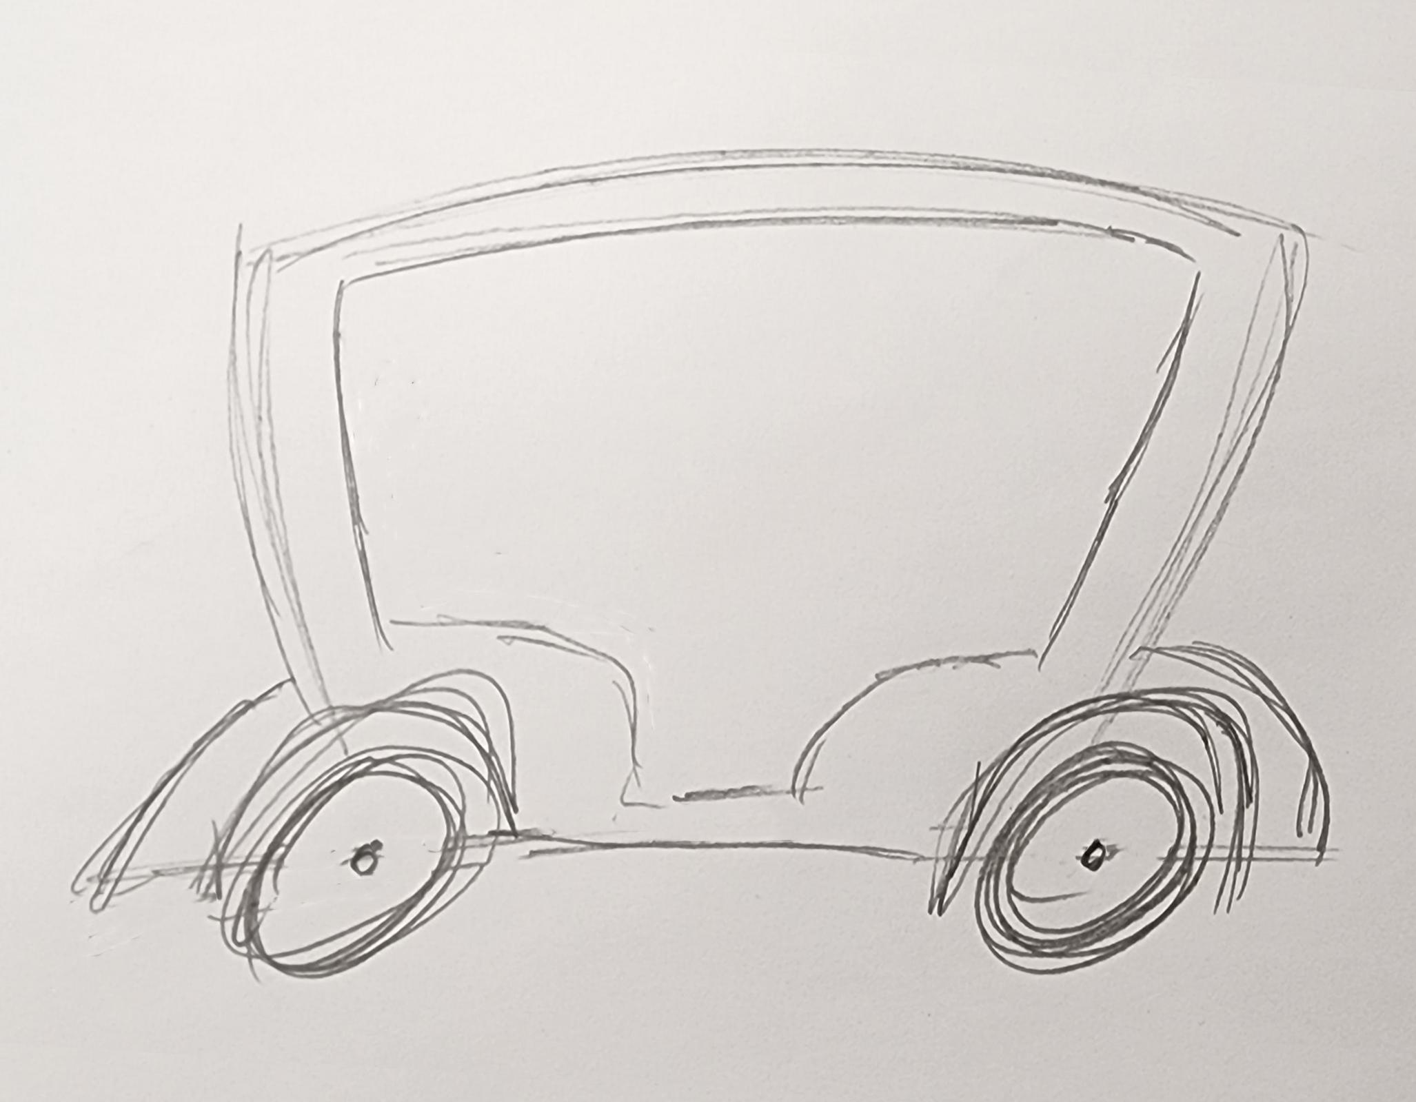
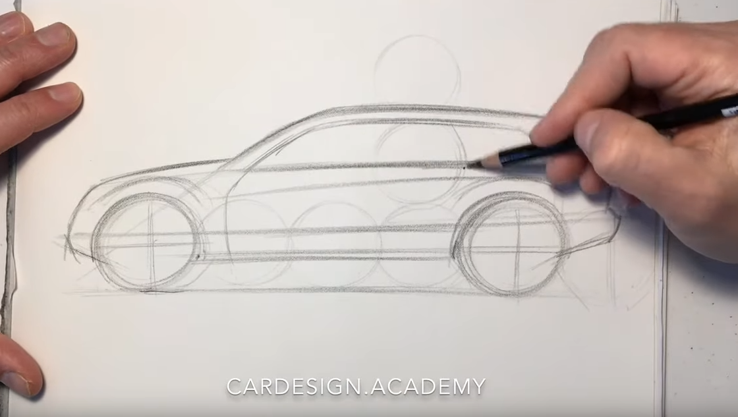
Lesson Slide 5 - Sketching Concepts
Lesson Plan on how to sketch, techniques needed and how to start
Sketch concept task and videos
Worksheet for body naming body parts of a car.
Lesson Plan

Slide 21
Rating System Slide 6 - Choosing a design
Optional step
Students can go through a choosing process using the “Rating System for choosing a design”
This step can be added if they have enough different designs to choose from.
It could be applied to different steps in the design process such as cabin layout or exterior style, or just over all design.

Slide 22
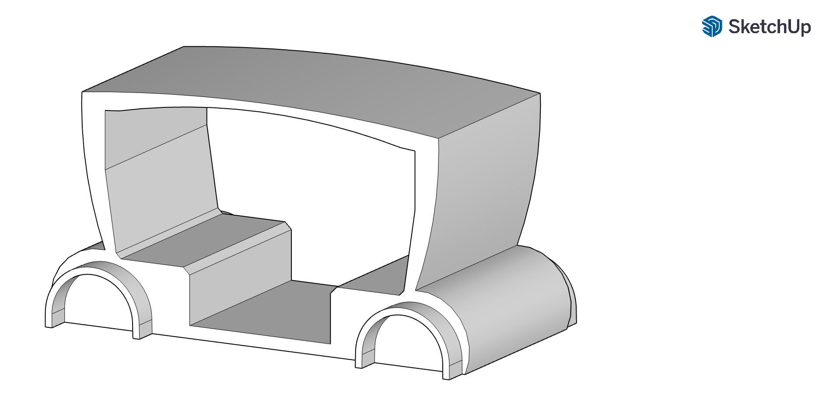
Activity Slide 7 - Create a Base Structure
CAD Model
Based on prior 3D CAD knowledge, have the students create a 3D model of their sketch. Focus on proportions, adding as much detail as possible. Remind students details can be added after using Clay, compound curves, colour etc.
Optional 3D add-ons, wheels, lights, windows, doors can be added if time permits.
Optional, if a 3D printer is not available, the design part of the project can end here and the design can be communicated through a presentation or a presentation board.
Optional, If CAD software is not available, base structure can be made out of wood, foam core, HD styrofoam, note different safety concerns and lessons around using power tools will need to be reviewed.
3D Printed Model

Slide 23
Activity Slide 8 - Finish Model using Clay & Paint
Based on prior 3D CAD knowledge, have the students create a 3D model of their sketch. Focus on proportions, adding as much detail as possible. Remind students details can be added after using Clay, compound curves, colour etc.
Optional 3D add-ons, wheels, lights, windows, doors can be added if time permits.
Optional, if a 3D printer is not available, the design part of the project can end here and the design can be communicated through a presentation or a presentation board.
Optional, If CAD software is not available, base structure can be made out of wood, foam core, HD styrofoam, note different safety concerns and lessons around using power tools will need to be reviewed.

Slide 24
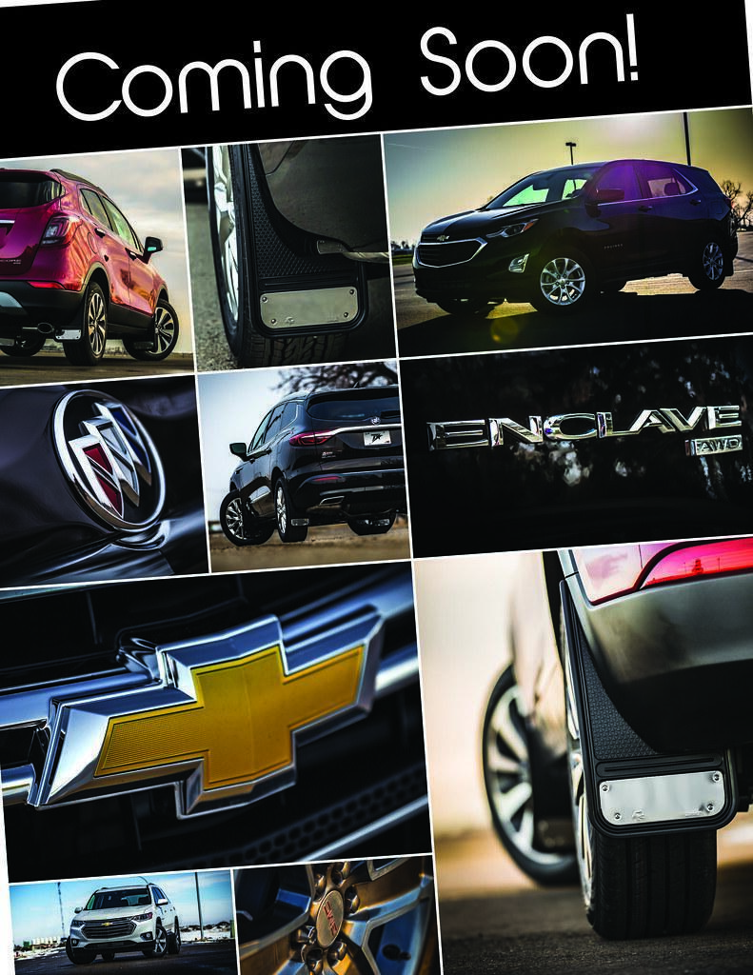
Activity Slide 9 - Optional Next Step
Create a one page advertisement showing off the different features and design elements of the model.
Computers would be needed. Canva is a suggested as its a free online program.

Slide 25
Section 3: Project Instructions
Explore more at ovin-navigator.ca

Slide 26
Project Introduction (and hook)
The future is changing faster than it ever has. Get ready to drive into the future of AI and autonomous vehicles. But wait is AI going to design the vehicles we use as well as drive them? Not this time, let's show off what we can do and put a personal human touch into the design of an autonomous driven taxi, something that shows off what is possible now or in the future.

Slide 27
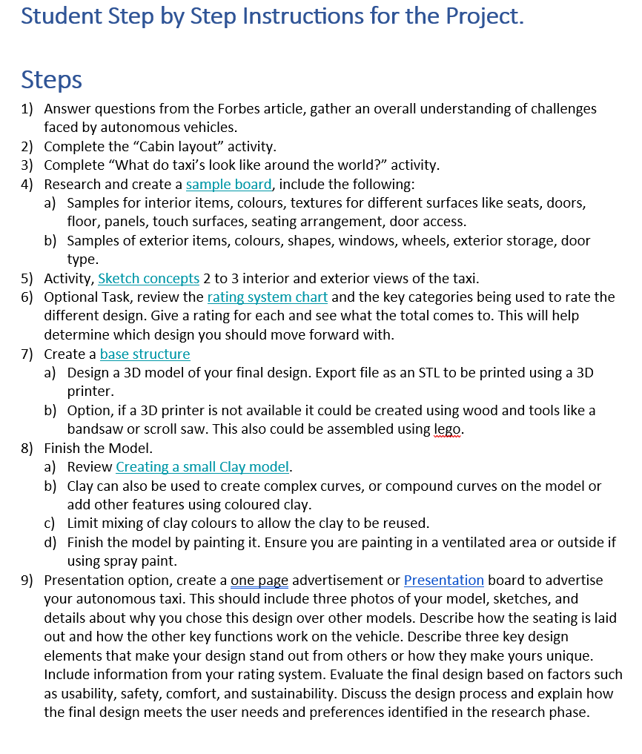
Student Instructions and Tasks
Student Instructions
Step by Step instructions for the student with options.

Slide 28
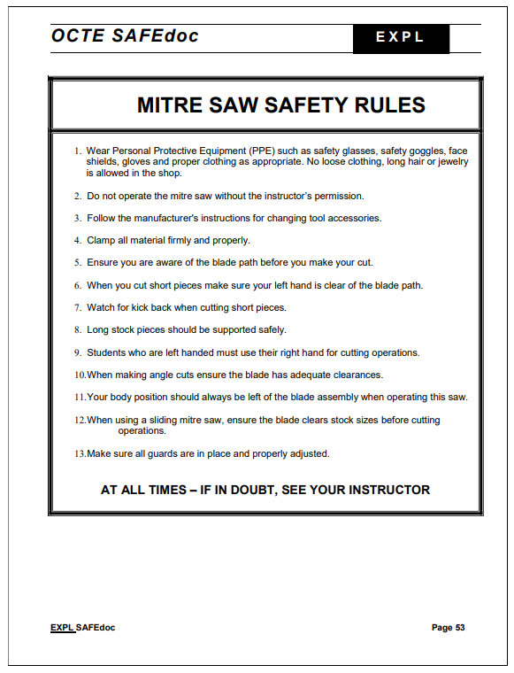
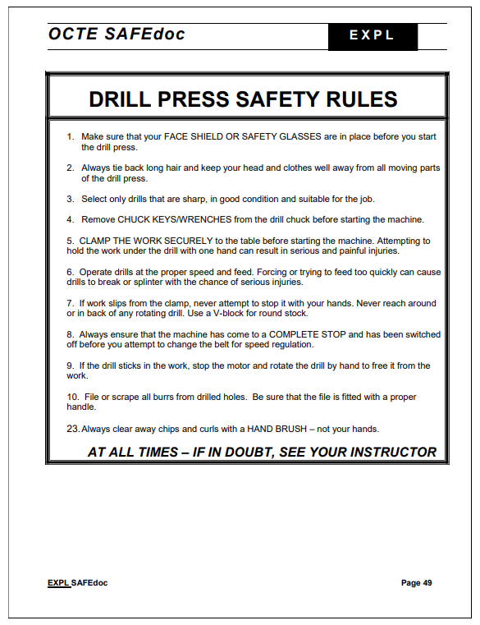
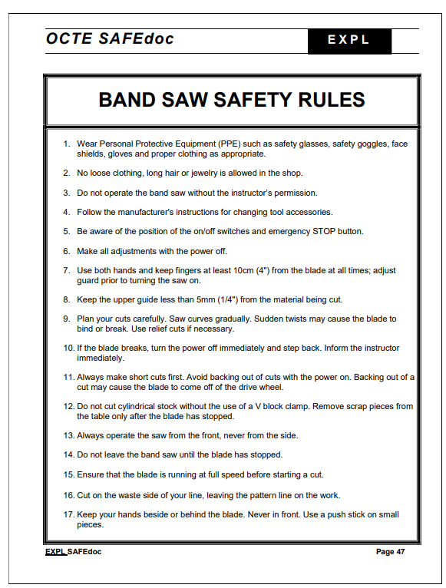
Student Safety Guidelines
OCTE SAFEdoc

Slide 29
Pictures/Project Diagrams
Project options
Add laminate doors, Clay lights, Laminate windows, Toy wheels (seen in photo)
Design options
3D print wheels (seen in photo)
Doors, windows, lights

Slide 30
Videos/Guides
https://www.youtube.com/watch?v=rzuemoK21EM

Slide 31
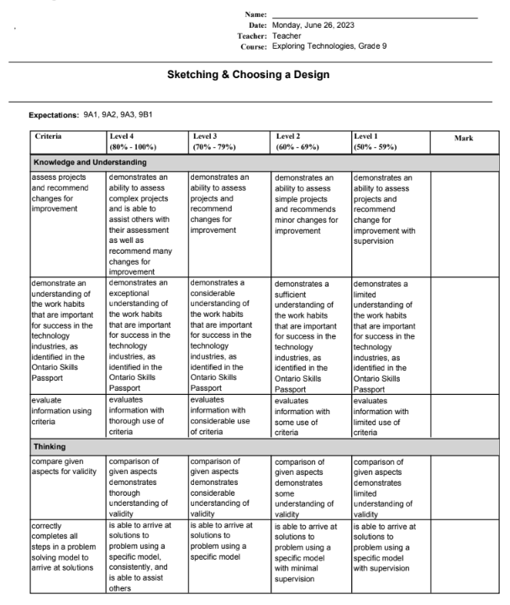
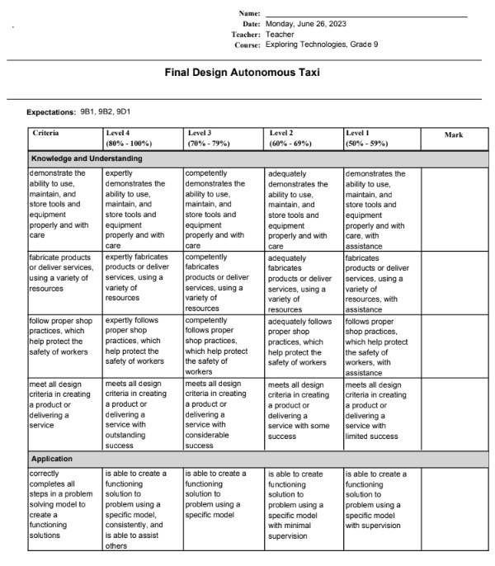
Rubric/Assessment
Sketching and Choosing a Design Rubric
Sketching and Choosing a design
Rubric
Teaching Companion information sheet
Leveled Marking Sheet
Check List Marking Sheet
Final Design Rubric
Final Design
Rubric
Teaching Companion information sheet
Leveled Marking Sheet
Check List Marking Sheet

