Slide 1
CAD - Sketchup
https://www.sketchup.com/plans-and-pricing/sketchup-free
Interactive training to help students learn and understand the basic concepts and capabilities of CAD software.

Slide 3
Learning Goals
Confidently navigate and identify tools and menus
Properly sketch, draw and extrude objects
Utilize various tools to manipulate the size and shape of objects
Effectively apply correct measurements
Administer various finishing techniques
Ability to apply skills learned into personal projects

Slide 4
Key Terminology
Views (Orbit/Pan/Zoom)
Line (Draw)
Shape (Rectangle, Circle, Arc etc.)
Offset/Flip/Mirror
Measure/Scale/Dimension
Push/Pull
Paint/Finish

Slide 5
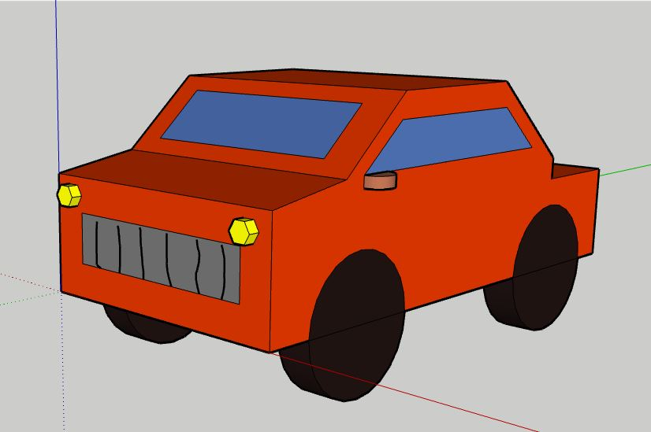
Final Product

Slide 6
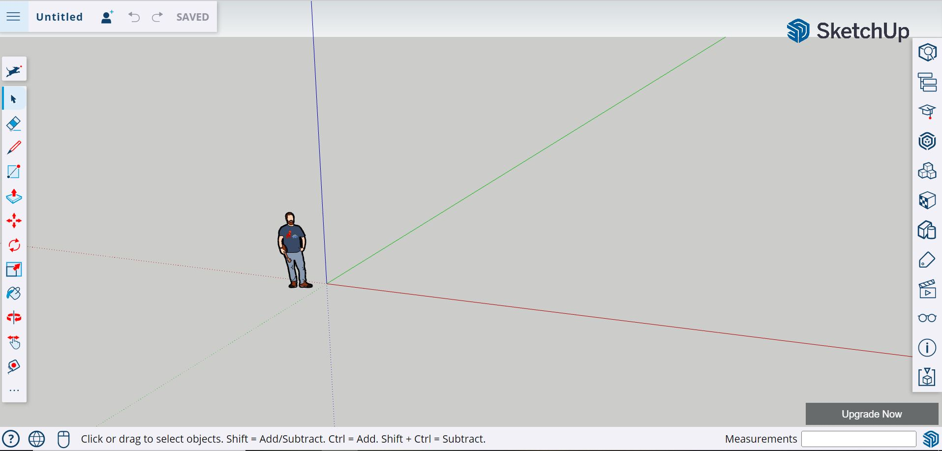
Getting Started
Go to SketchUp.com and Click "Start Modeling”
Select “Create New” and you should see the screen below:

Slide 7
Views/Axis
The center point of our work area will be where all three axis meet.
The “X” (red), “Y” (green) and “Z” (Blue) axis.
The viewing tools (shown below) allow you to move, rotate and pan. Try it out!
You can use the touchpad (or mouse) to zoom in and out.

Slide 8
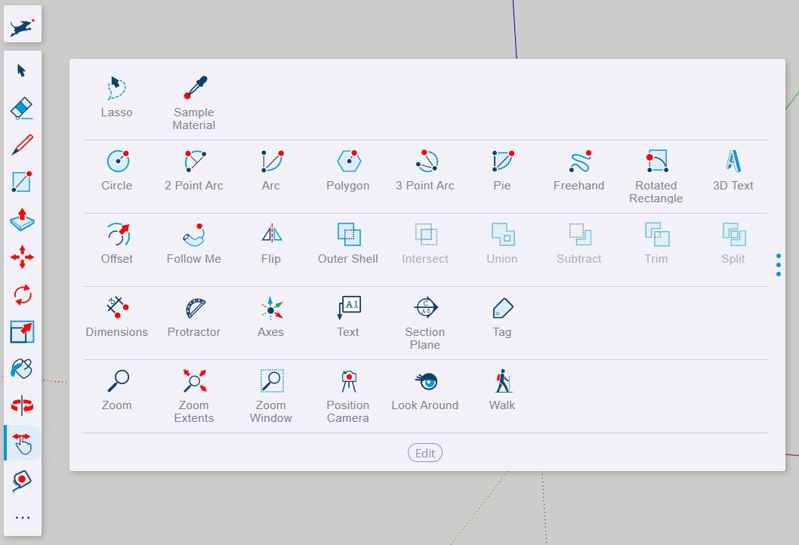
Extra Tools
Clicking the three dots at the bottom of the toolbar will open up a larger toolbar with various extra tools.
Play around with a few of them!

Slide 9
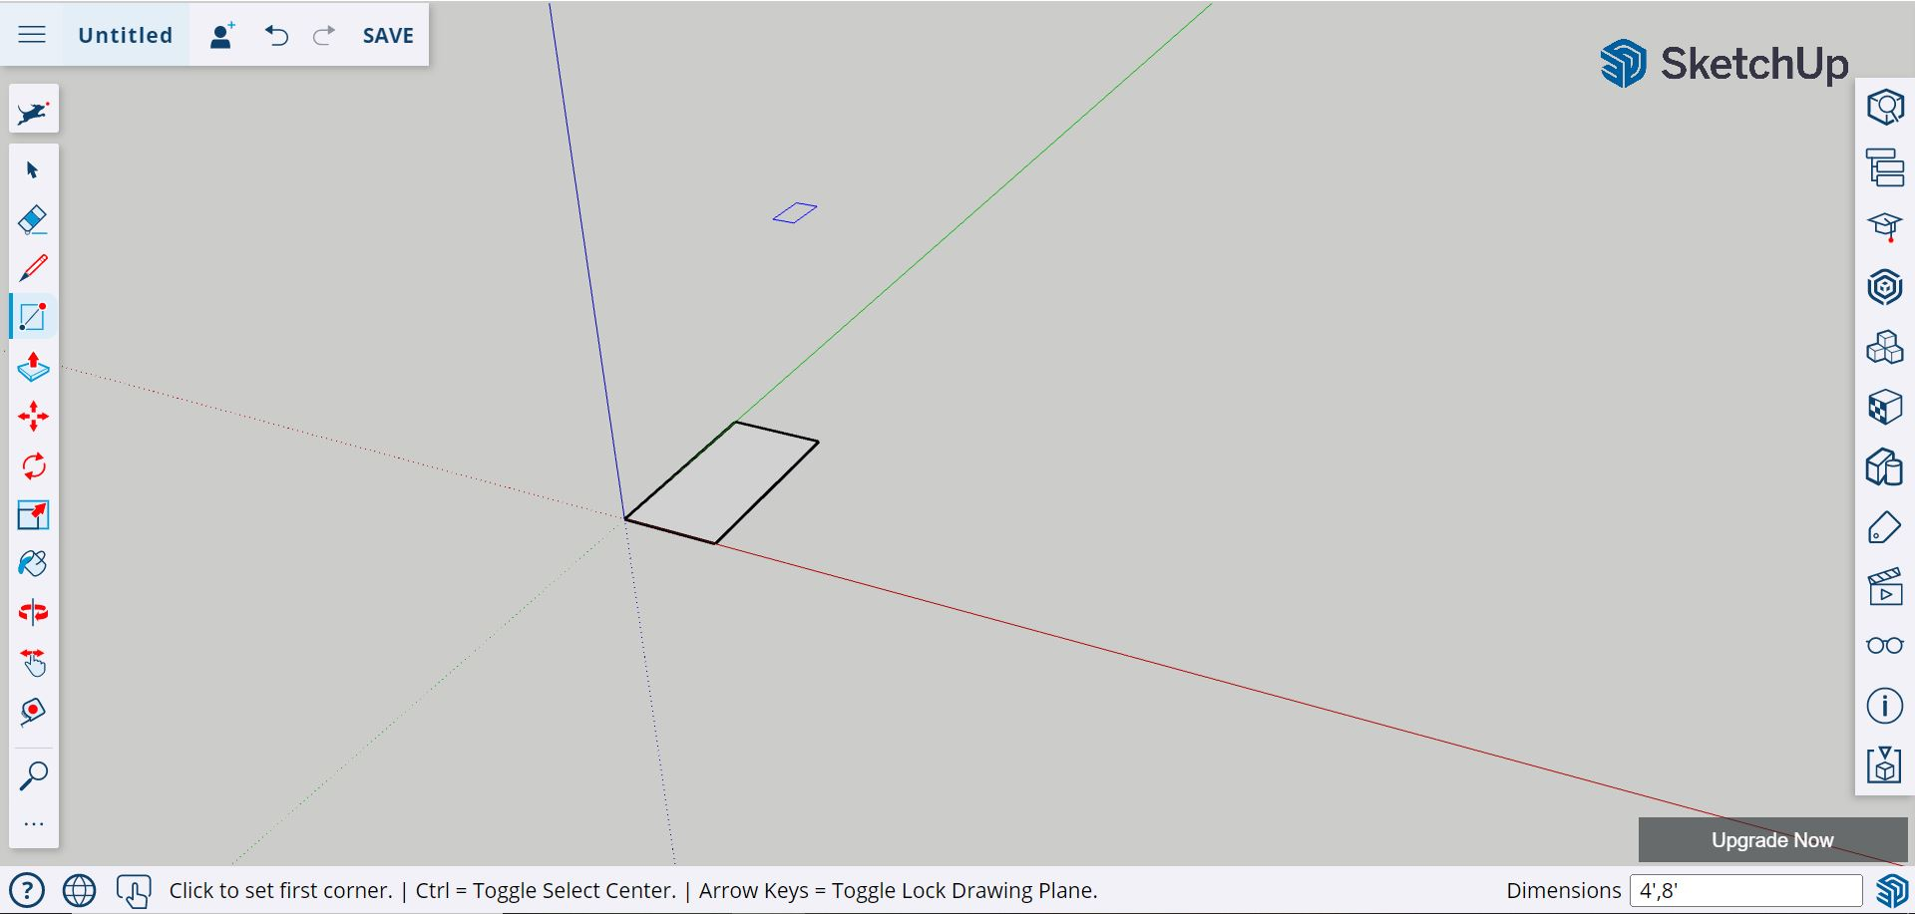
Rectangle
Select the rectangle tool, click the center point and pull to the top right corner.
Type 4’, 8’ in the dimensions box (located in the bottom right corner) and click Enter.

Slide 10
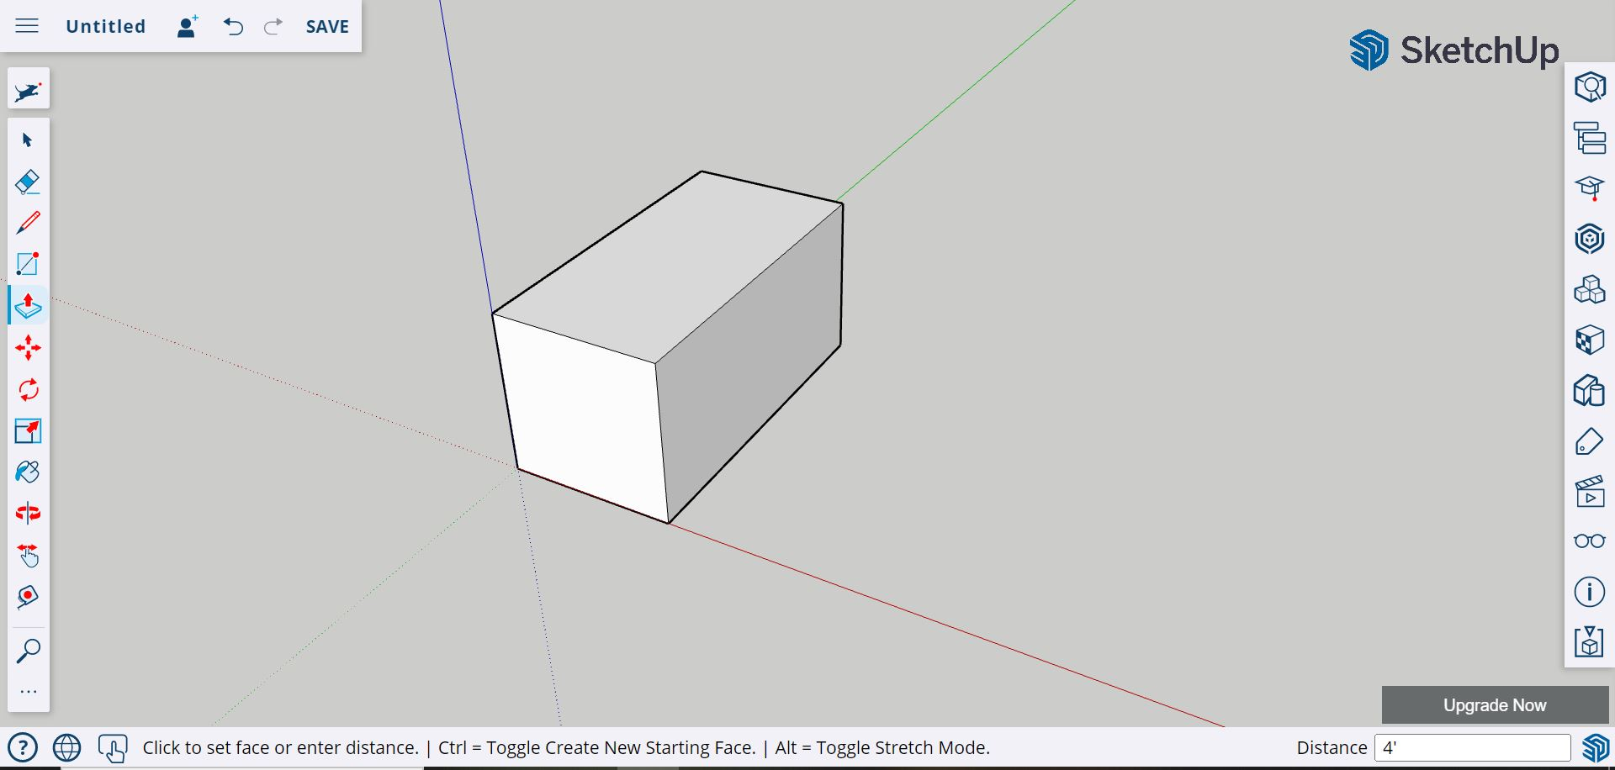
Rectangular Prism
Select the push/pull tool, click the center of the rectangle and pull the object upward.
Type 4’ in the dimensions box (located in the bottom right corner) and click Enter.

Slide 11
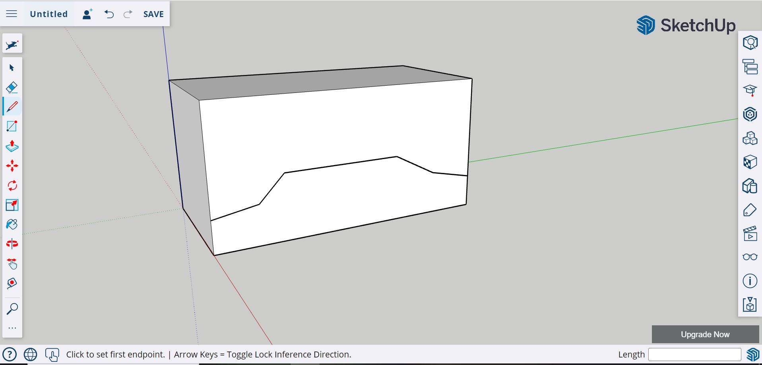
Drawing
Select the line tool.
Sketch the side profile of the vehicle you would like to create.

Slide 12
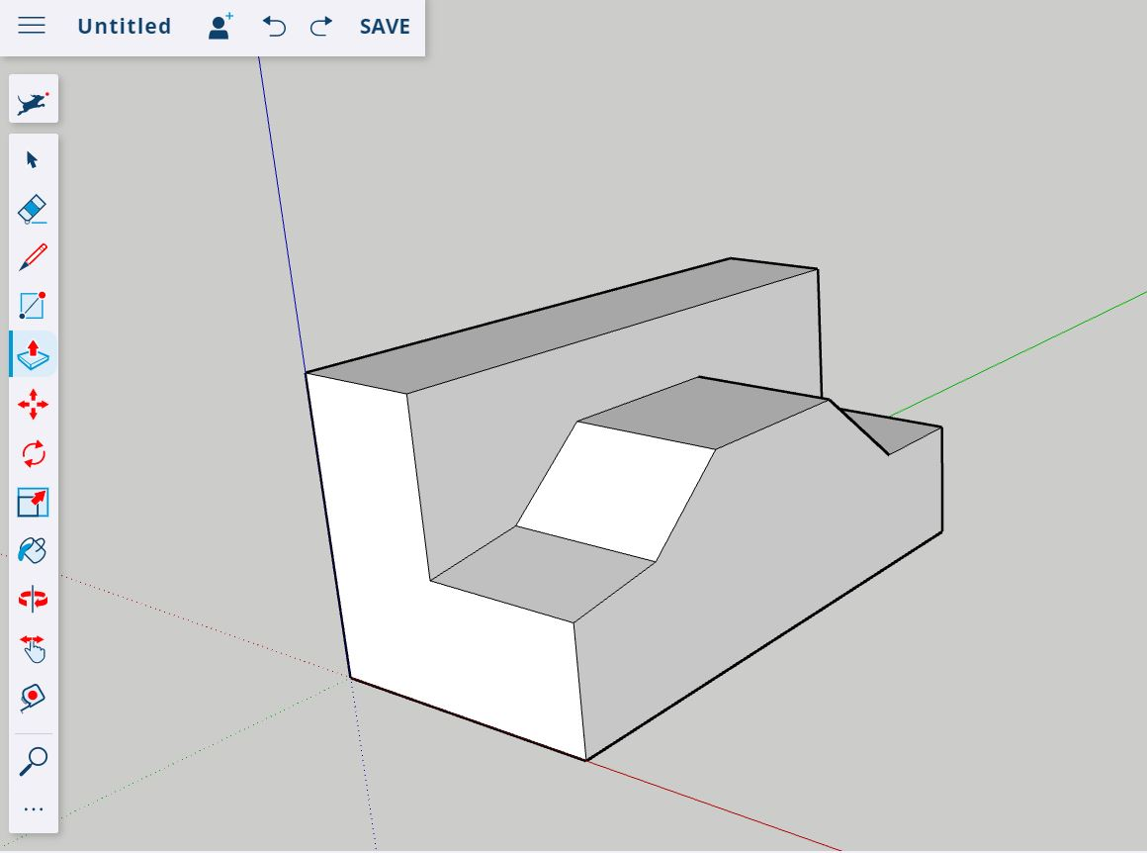
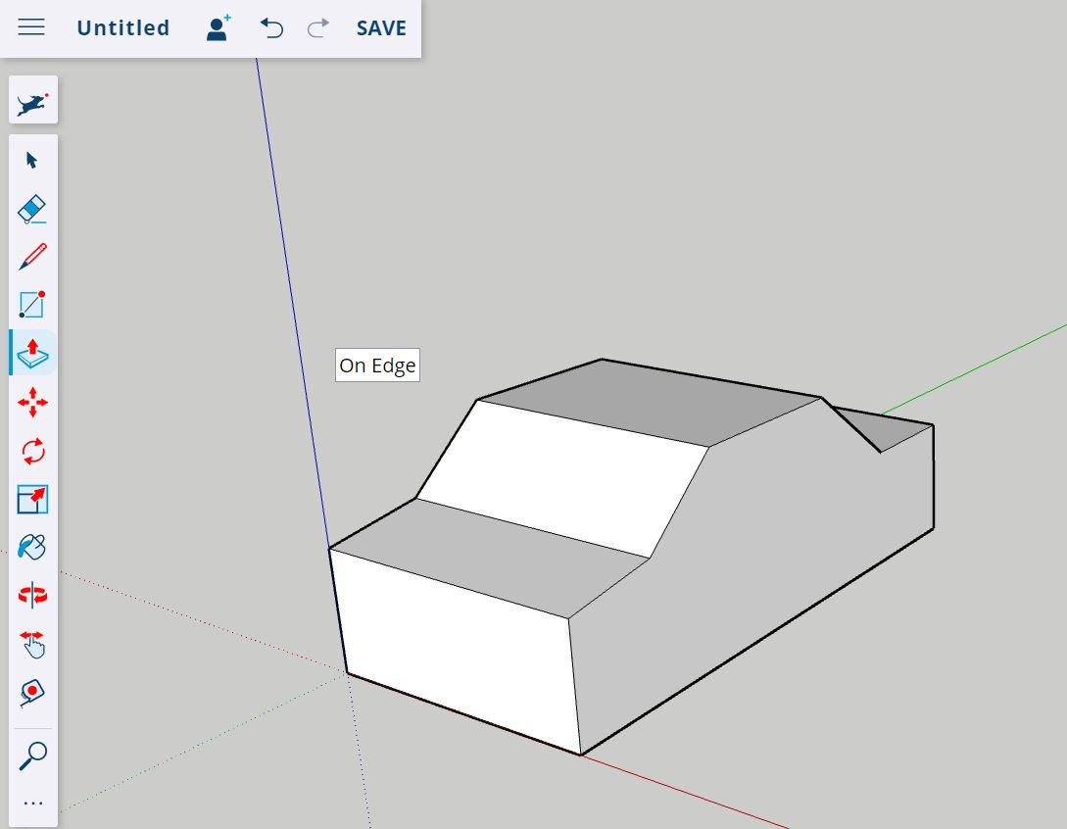
Extruding
Select the push/pull tool.
Push the profile above your sketch line to the blue axis until your vehicle is visible.

Slide 13
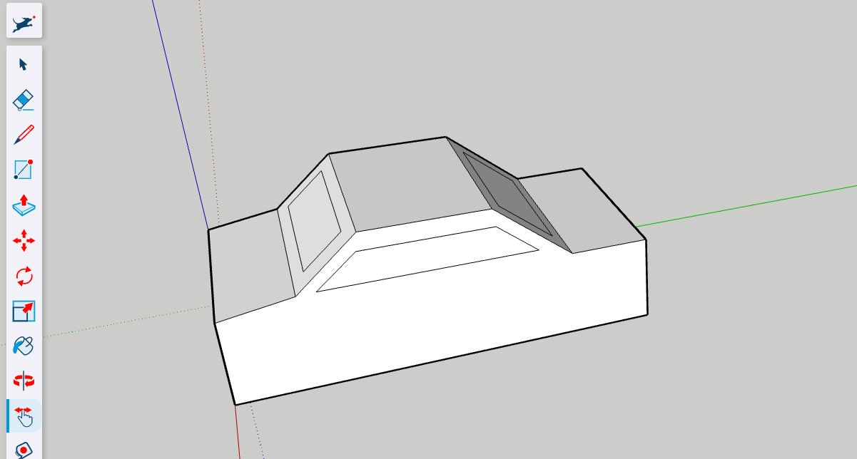
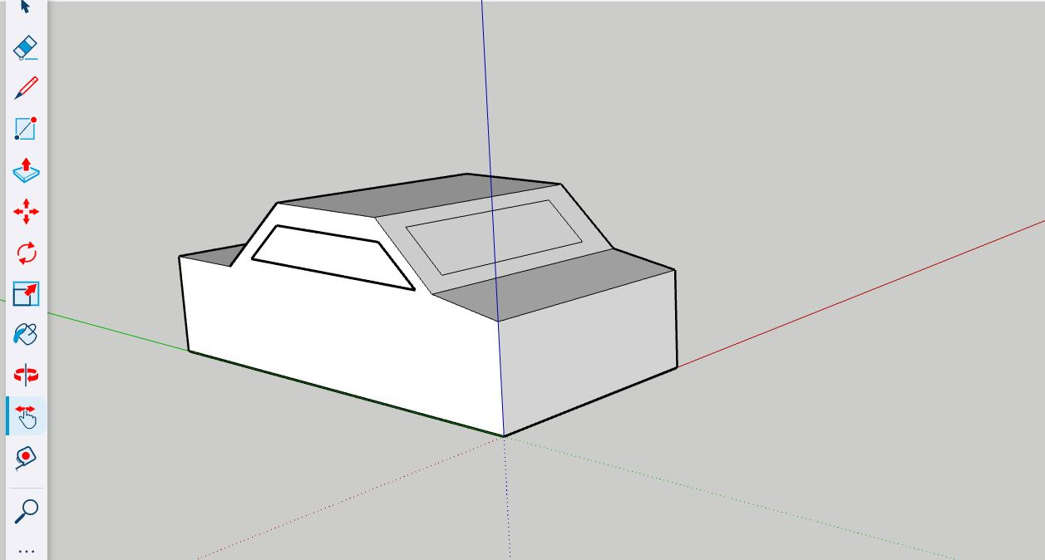
Copy Tool
Select the rectangle tool to create your front and back windows.
Sketch a side window profile using the line tool.
Select all 4 lines on the side window and click CTRL “C”.
Rotate the vehicle and select the opposite side. Click CTRL “V” to paste the copied window. Move the window copy into place.
Use the line tool to trace the outline of your copy. This will make it a solid object.

Slide 14
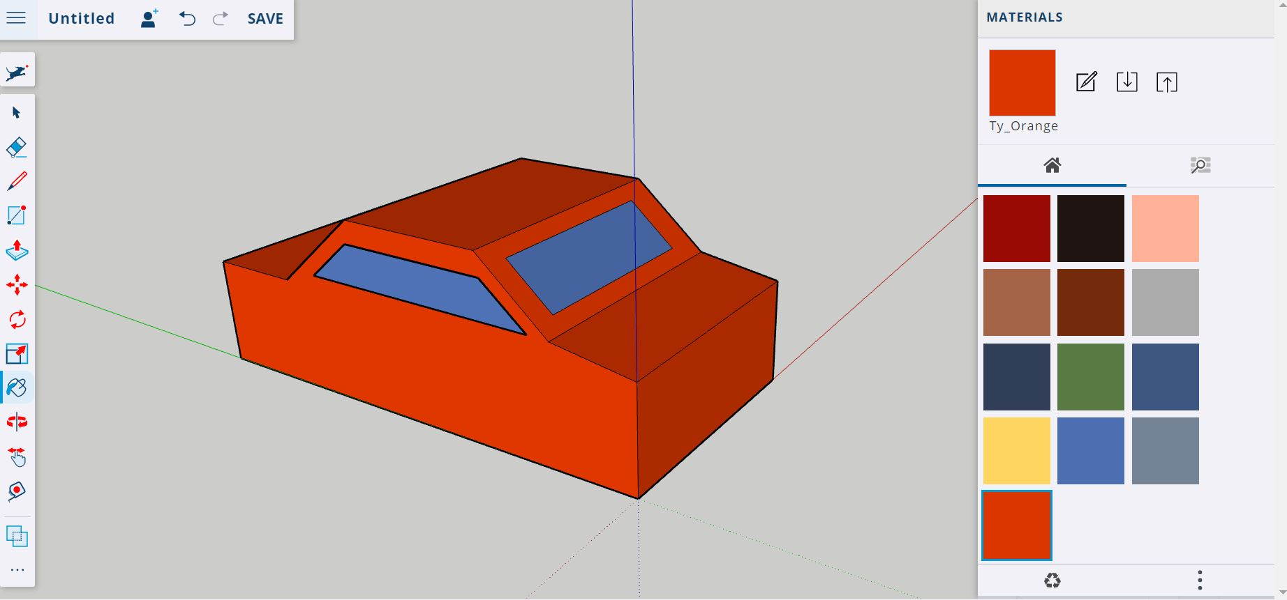
Painting
Select the paint tool.
Select your colour preference and fill in each section by clicking the desired area.

Slide 15
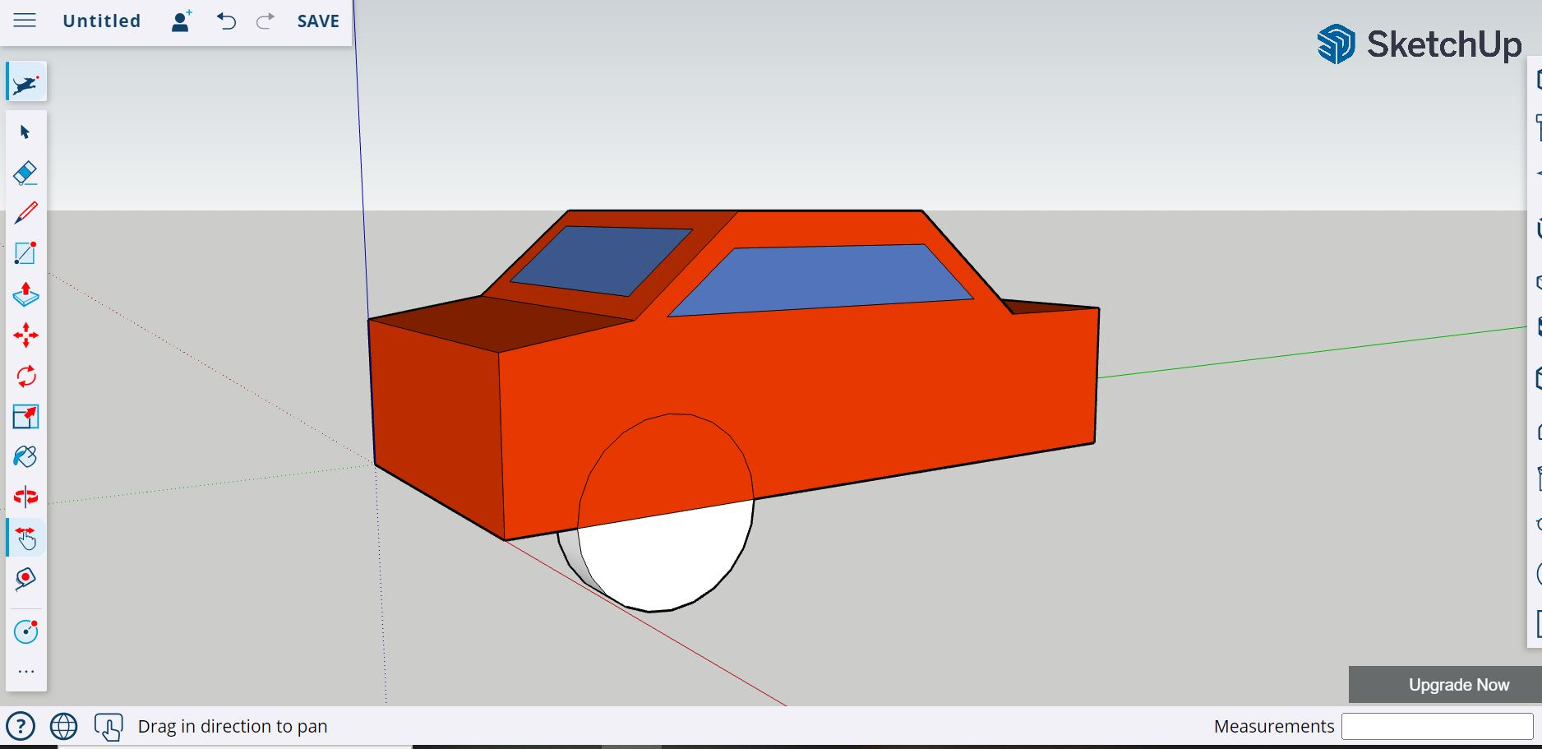
Reference Points
Select the line tool, click the front corner, input 2’ in the dimension box, click Enter.
Select the circle tool, click the point you just created, input 12” in the dimension box, click Enter.
Select the push/pull tool, click the circle, input 6” in the dimension box, click Enter.

Slide 16
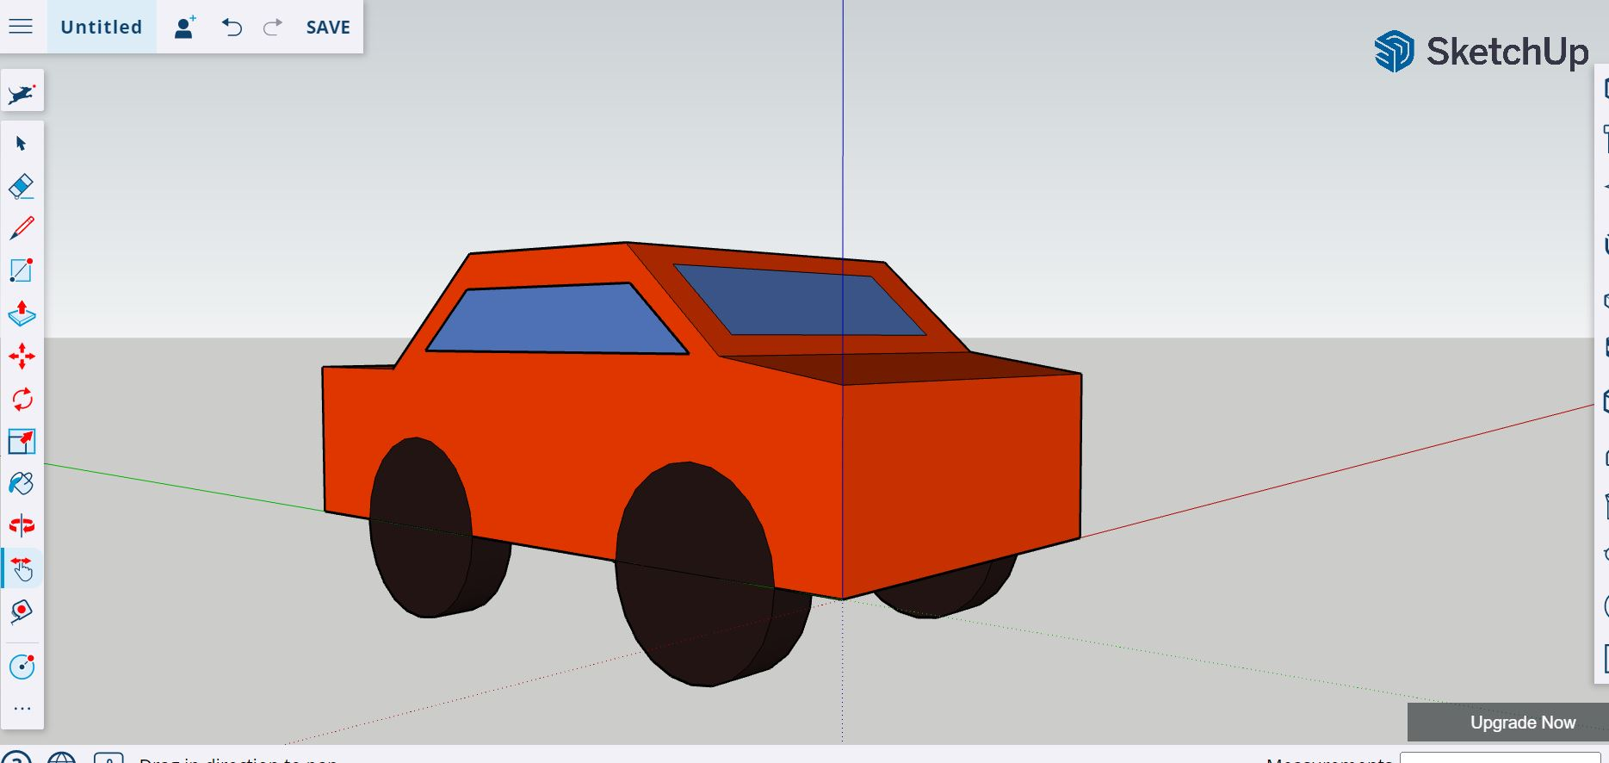
Repeating Steps
Repeat the steps outlined on slide 15 to create the remaining three tires. Your starting point for each tire is its respective corner.
Select the paint tool to fill in each face on your tires (see Slide 14 for reference).

Slide 17
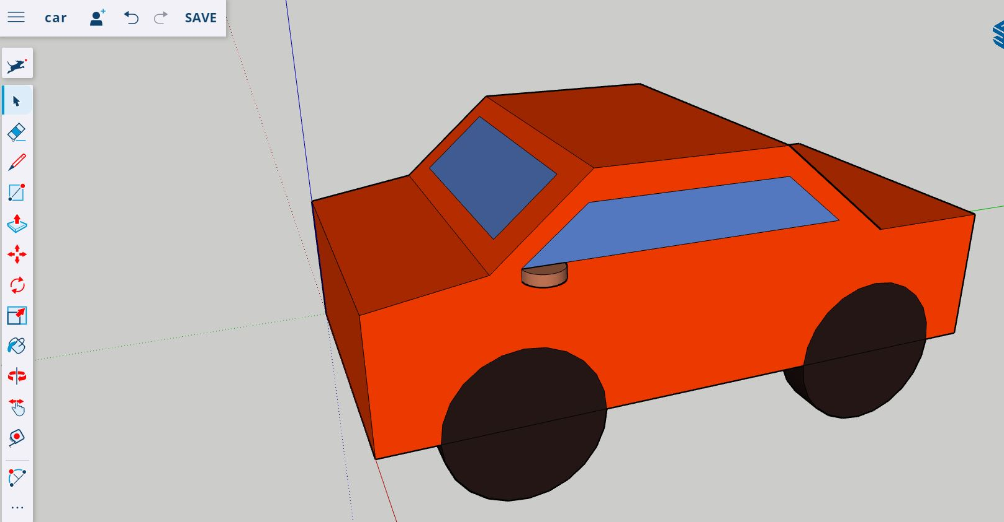
Arc Tool
Select the 2 point arc tool and click the front corner of your side window.
Type 6” in the dimension box and click enter, to move your second point along the base of the window.
Pull the arc away from the car, input 3” into the dimension box and click Enter.
Pull your handle down 2” and paint it (see slides 13, 14 & 15 for reference).

Slide 18
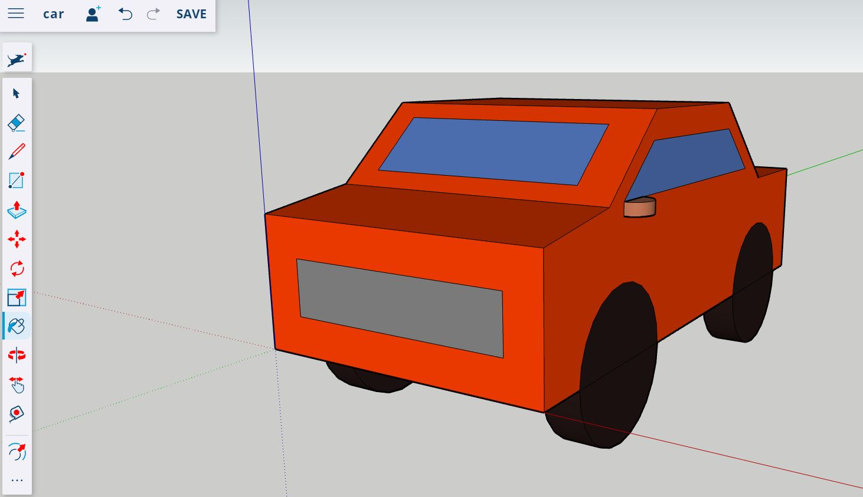
Offset Tool
Select the offset tool and click the front right corner of the car.
Type your desired dimension of the grill into the dimension box and click Enter.
Paint your grill.

Slide 19
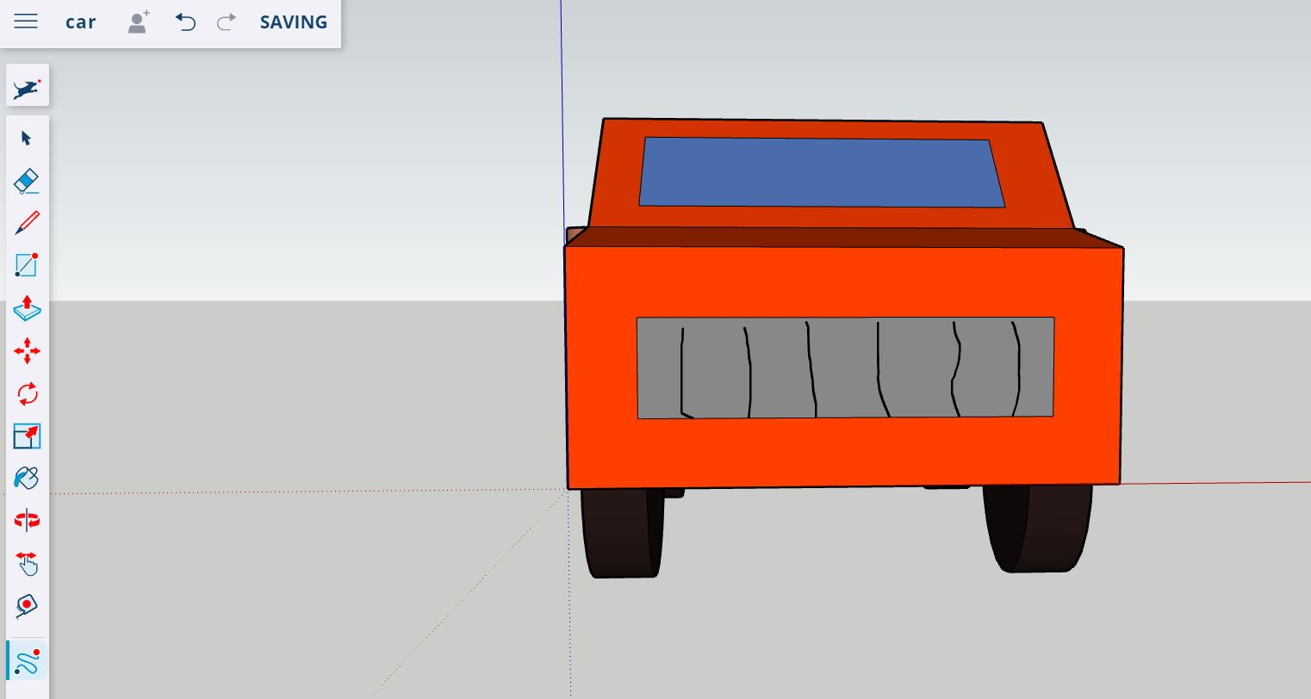
Freehand Tool
Select the freehand tool.
Draw the grill pattern of your choice by clicking and dragging your lines.

Slide 20
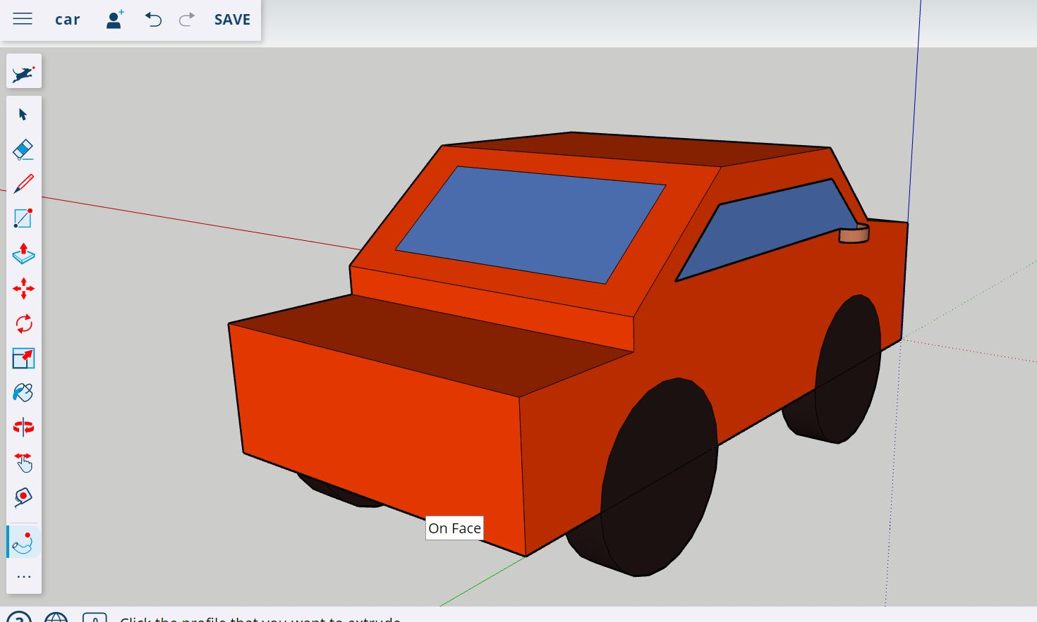
Follow Me Tool
Select the follow me tool and click the top of the back portion of the car.
Pull the face down to create a trunk size of your choice.

Slide 21
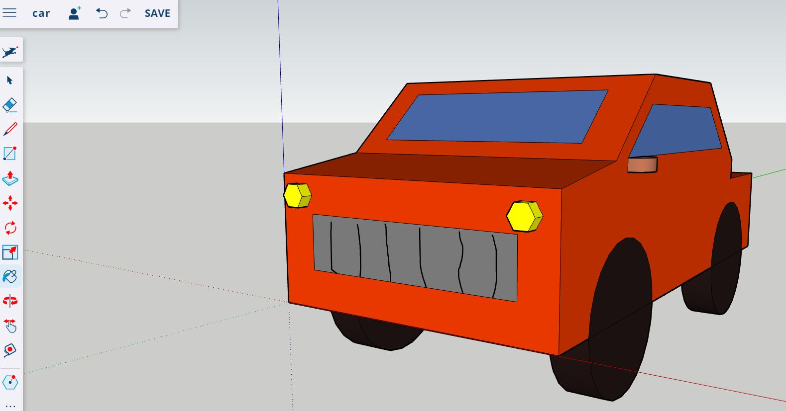
Polygon Tool
Select the Polygon tool and create a 2” polygon, that is 4” in and 4” down from each corner.
Pull your polygon out 2”.
Paint your lights a colour of your choice.

Slide 22
Personal Model
Choose ONE of the drawings provided to create a model using Sketchup.
If applicable, keep your school’s CNC machines and CAM software capabilities in mind when choosing your drawing.
Utilize the skills and tools form the slides in this deck, to help you create your model, following the specifications of the drawing.
Pay close attention to all dimensions and notes provided.

Slide 23
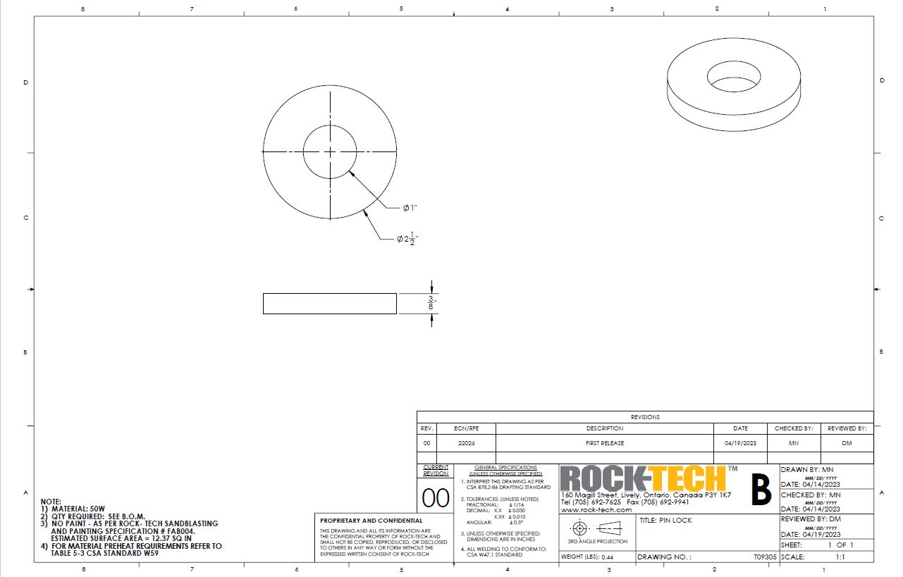
Drawing One - .375” Bushing

Slide 24
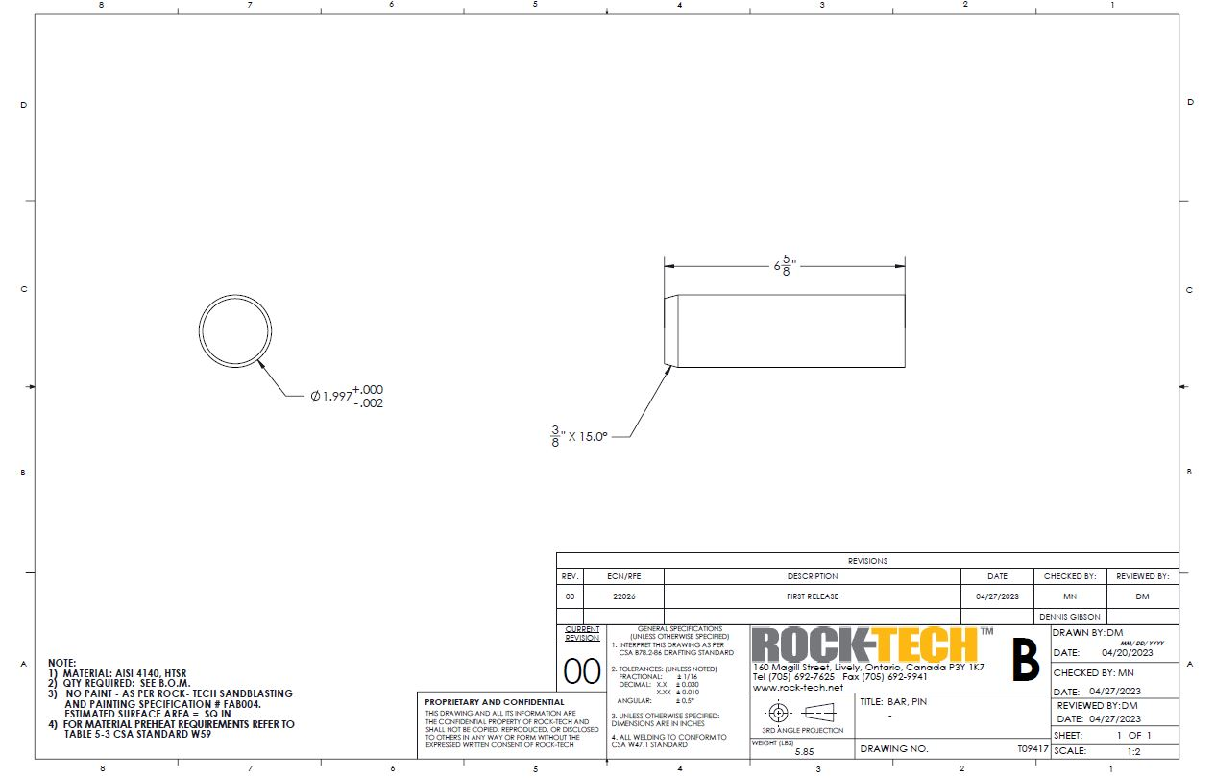
Drawing Two - 6.675” Pin

Slide 25
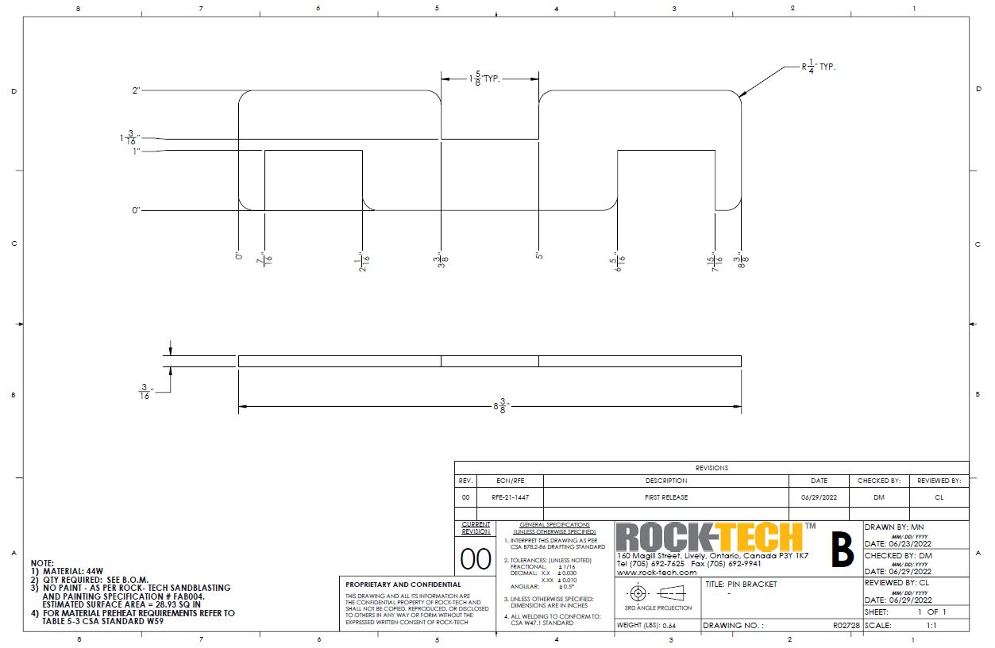
Drawing Three - Pin Bracket

Slide 26
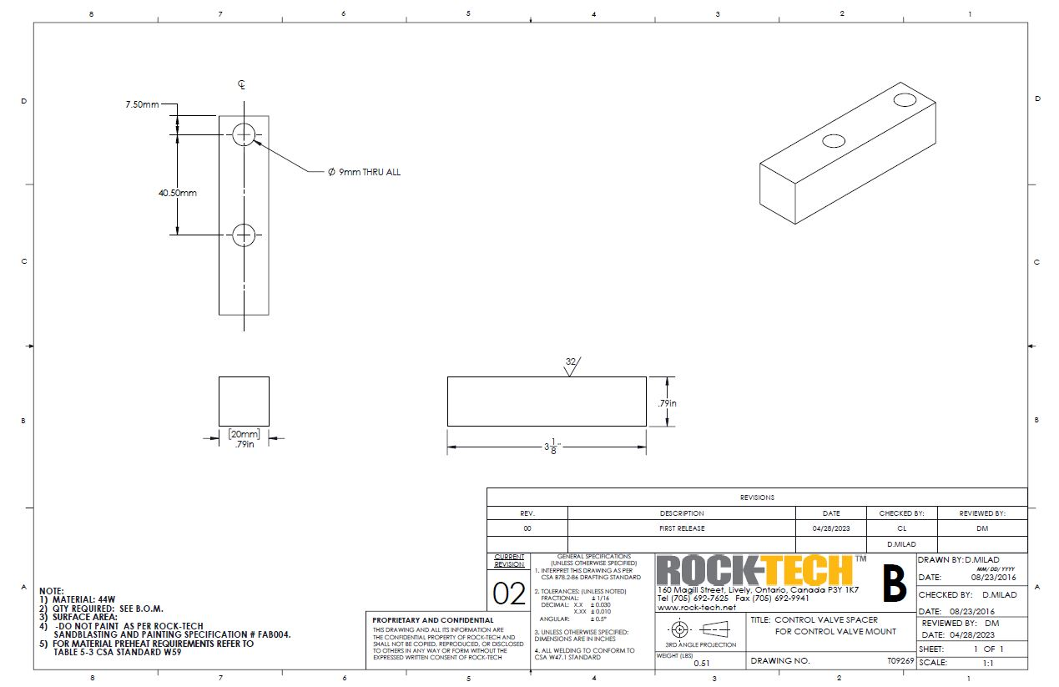
Drawing Four - Valve Spacer

Slide 27
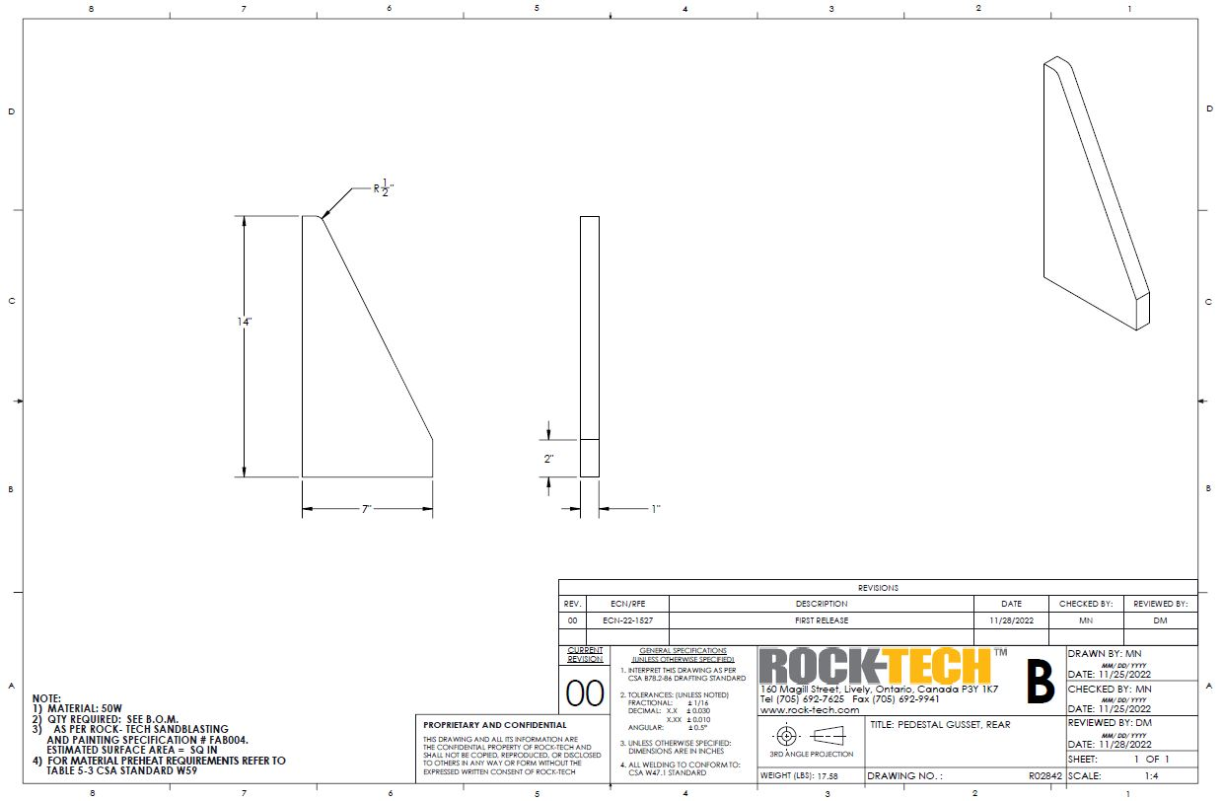
Drawing Five - Welding Gusset

Slide 28
Teacher Resource
Enhancement Training Video Explanation
Enhancement Training Written Explanation
Written Handout
Digital handout
Certificate Sample
Certificate Template

