Slide 1
Time to Customize -
3D Modeling
BBT Area: Technological Design
Target Course: TDJ4, TDA4,TDM4

Slide 2
Section 1: Teacher Resources
Explore more at ovin-navigator.ca

Slide 3
Project Outline
Students will be asked to design/model a custom car accessory.
OPTION to test the aredomanics in a classroom made windtunnel.
Students are welcome to use whichever 3D modeling software that is available.
Students will also learn how to create multi part assemblies.
Students can then explore their design work into technical drawing formats, like exploded view parts, drawings, and orthographic projection technical drawings for manufacturing.
Skills that will develop during this small units are as follows:
Procedure thinking
Design problem solving
Introduction to Transportation Technology terminology
Additional careers and post secondary pathways involving the transportation sector, Automotive engineering sector

Slide 4
Related OVIN Sectors
Auto & Parts Manufacturing
Tool, Die & Mold
Aftermarket, Maintenance & Repair

Slide 5
Prior Knowledge and Related Resources
Students should be familiar with:
design process steps (research, imagine possible solutions, concept sketch, choose the best design, build a prototype, test prototype).
concept sketches, isometric drawings, and orthographic projections.
basic CAD commands terminology, exposures to apps like TinkerCAD, INVENTOR, Solidworks or Solid Edge, Fusion 360.
Students should have:
basic understanding of math skills (measuring, units, multiplication).
basic research skills.
ability to use basic computing tools, mice, saving to your school server or cloud, basic google suite applications.
basic understanding of how to use 3D modelling software such as TinkerCAD, Inventor, etc.

Slide 6
Planning Notes and Teacher Guide
Make sure your classroom licence is up to date and active.
Familiarize yourself with the softwares that are available and or being asked to use by your students.
Have a projector available for showing the software.
Print or post the tutorial.
Allow for 5+ days for this unit.
Consider the Part 2 to this unit. Included in this unit is a “how to” build a classroom small wind tunnel to test aerodynamics of the part.
Allow an additional 1 week+ to build and test.

Slide 7
Required Tools and Materials
Part 1 - Aftermarket Parts Design
Laptop or desktop computer
Mouse
Larger monitor if possible
Sketch paper should you have the students design their own as a “testing your knowledge” activity
3D printer for parts
Part 2 - Wind Tunnel
Please see slide 19 for further information

Slide 8
Safety Concerns (including PPE if required)
Make sure your computer area is clear of school bags, food and drinks.
Position your body in the correct ergonomic position for your working area.
Use a external mouse not the touch pad where possible.
Use a bluelight filter on your screen to protect your eyesight extended use exposure.
Well vented room for 3D printer off gassing.
Safety glasses.
Small hand tools to help remove the 3D model supports like:
Dremel, pliers, dental picks, 3D model support baths/ chemicals.

Slide 9
Assessment and Evaluation
In this project, the instructor should be looking for your students to be able to identify and apply the following MoE curricular over all looks fors: (TDJ4M)
A1. demonstrate an understanding of criteria, relationships, and other factors that affect technological design and the design process;
A3. demonstrate an understanding of drafting standards, drawing types, conventions, and guidelines used when representing design ideas graphically;
A4. demonstrate an understanding of various types of models and prototypes, and describe the tools, materials, equipment, and processes for building, testing, and evaluating them;
A5. use appropriate technical language and communications methods to document, report, present, and market design ideas and results.
B1. use appropriate resources, methods, and tools to research and manage design projects and related activities;
B2. apply appropriate methods for generating and graphically representing complex design ideas and solutions;
B3. create, test, and analyse models and/or prototypes, using a variety of techniques, tools, and materials;
B4. use a variety of formats and tools to create and present reports summarizing and evaluating the design process, to analyse decisions made during the process, and to advocate the final design.

Slide 10
Assessment and Evaluation
Continued
C2. analyse the relationship between society and technological development.
D2. compare a variety of careers related to technological design, as well as the training and educational requirements for them, and maintain a portfolio of their work as evidence of their qualifications for future education and employment.

Slide 11
Project Exemplars (Videos/Pictures)
Low Speed Wind Tunnel - how it works - YouTube
Everything you need to know about Wind Tunnels - F1 explained - YouTube
Using Fusion 360 to match Car Parts to Car Bodies - YouTube
Any software is applicable with this concept

Slide 12
Outside Resources and References
Modelling Tools toolSAFE resources
The Ontario Curriculum, Grades 11 and 12 : Technological Education, 2009 (revised)
The focus & future of the Automotive Aftermarket - Article

Slide 13
Section 2: Student Lesson
Explore more at ovin-navigator.ca

Slide 14
Printable Student Resources (if required)
Student Assignment with Assessment rubric - Aftermarket Parts Design

Slide 15
Aftermarket Parts Design
BBT Area: Technological Design
Target Course: TDJ4, TDA4, TDM4
Explore more at ovin-navigator.ca

Slide 16
Section 3: Project Instructions
Explore more at ovin-navigator.ca

Slide 17
Project Introduction (and hook)
Did you Know?
The automotive aftermarket can be broadly divided into two segments: replacement parts and accessories. The size of the global automotive aftermarket was estimated to be around 265 billion U.S. dollars. The United States is the largest market for automotive aftermarket products and services, followed by Europe and China. The automotive aftermarket is a highly competitive industry. In order to succeed, companies must offer products that are high quality, reasonably priced, and appealing to consumers.
Are car parts in demand?
This sector of the vehicle industry has been steadily on the rise in recent years. The leading automotive parts in the market are vehicle batteries, cooling systems, underbody parts, engine components, filters, lighting such as headlights and taillights, electrical components and more!
What is Sema? - YouTube

Slide 18
Student Safety Guidelines
Students should be aware of basic online safety and identity protection strategies.
Students should be seated in an ergonomic way at their desk.
Allow for body movement breaks if seated and working for more than 30mins.
Students should not be seated in proximity to the 3D printer while in use.
3D printer should be in a well ventilated space.
PPE like safety glasses should be used when removing and working with the 3D prints.

Slide 19
Part 1: Aftermarket Parts Design
Student Assignment with Assessment rubric - Aftermarket Parts Design

Slide 20
Part 2: Classroom Windtunnel
Thank you Jamesabt007 on the Instructables website for this wonderful and easy step by step on How to make a classroom windtunnel - Instructables website.
Materials
-Cardboard
-Toilet Paper rolls/ Used paper towel rolls
-Sheet of Lexan (Might be a tad expensive but does not shatter when cutting with a jigsaw)
-Fan
-Duct Tape
-Masking Tape
Tools
-Hobby Knife
-Scissor
-JigSaw
-Ruler
-Measuring tape/long straight edge
-Pen/Pencil
-Sand Paper/ Dremmel
-Hot Glue/ Waterproof adhesive
-90 degree angle tool
-Gloves
-Safety Glasses

Slide 21
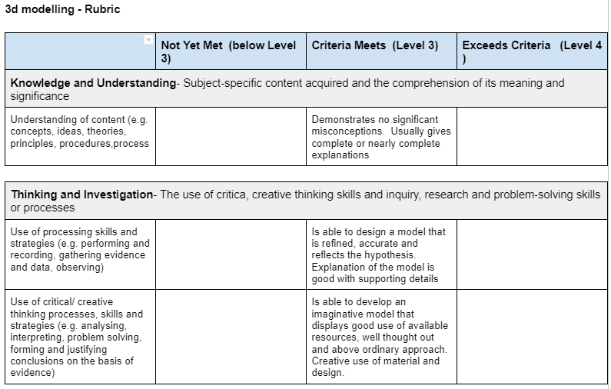
Rubric/Assessment

Slide 22
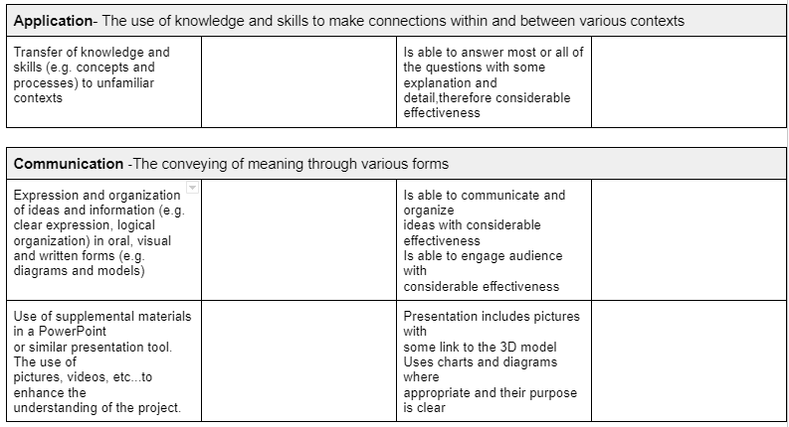
Rubric/Assessment continued

