Slide 1
Lean Manufacturing
Did you ever consider why things cost what they cost?

Slide 2
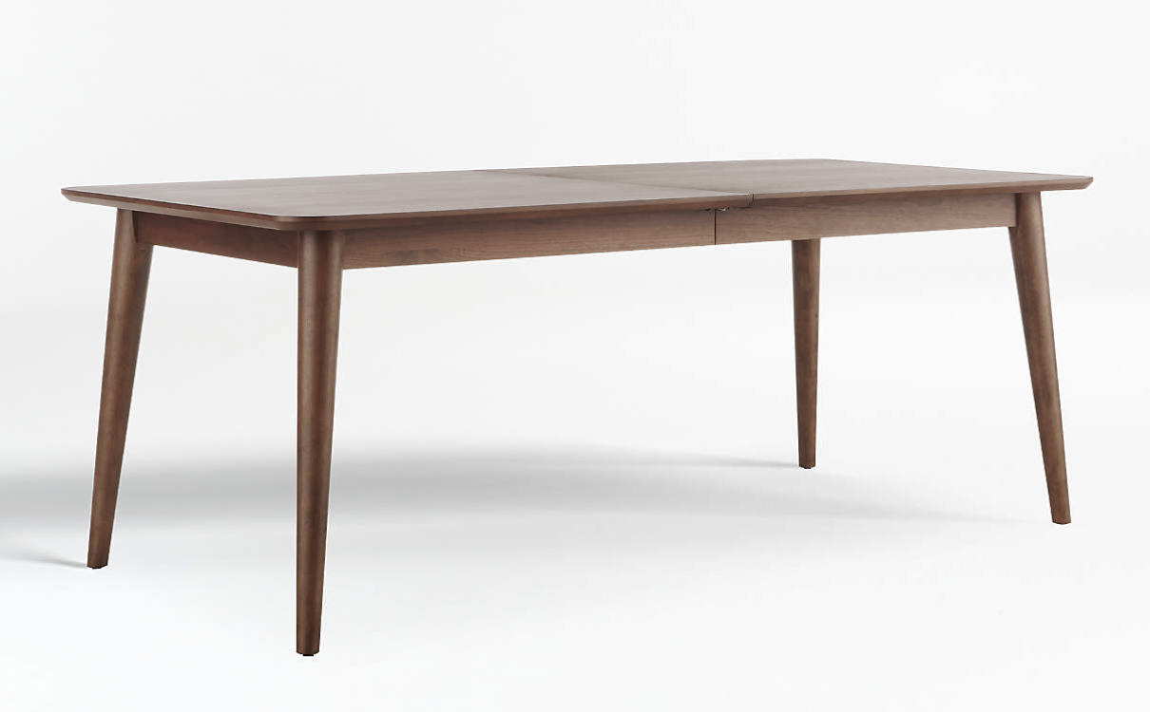
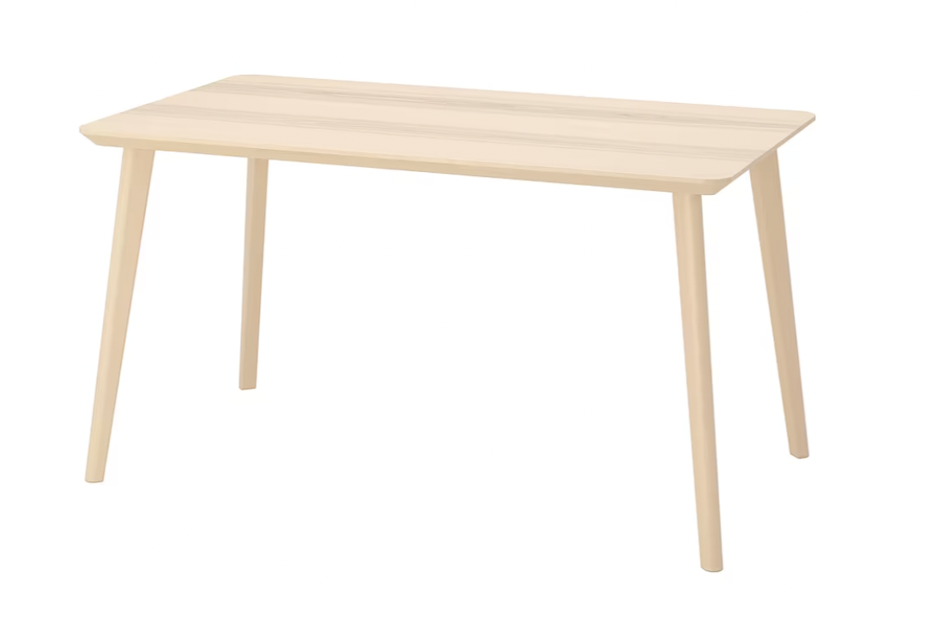
Take these two tables for example:
Left table: a modern dark brown table
Right table: a modern light brown table
Both tables are similar sizes and made out of similar materials
The table on the left is $2099.00
The table on the right is $299.00
Discuss what contributes to this cost difference

Slide 3
One of the main reasons these two tables differ in cost is because of how they were made.
Their means of production.
We call the production of goods manufacturing
Factory illustration

Slide 4
Exploring Manufacturing
Watch these 3 short video segments:
What is Manufacturing?
History of Manufacturing
New Trends in Manufacturing (Lean Manufacturing)
Discuss:
What are the important points that you saw in the videos?
What did you learn about manufacturing processes that you didn’t know before?

Slide 5
Manufacturing is when a company builds new products by using raw materials or components (parts).
-Automotive manufacturers make cars
-Bakeries manufacture bread and pastries
-Phone companies manufacture cell phones using mined metals and developed technology.
-Builders and contractors manufacture homes
Can you think of other products that are manufactured?
Are there any that are manufactured specifically in your community?
Bread illustration

Slide 6
Aspects of Lean Manufacturing
Just-in-time Production
Only makes products once they have been purchased or ordered
Saves time, effort, materials, and money
Only produces what can be sold
Alarm clock illustration

Slide 7
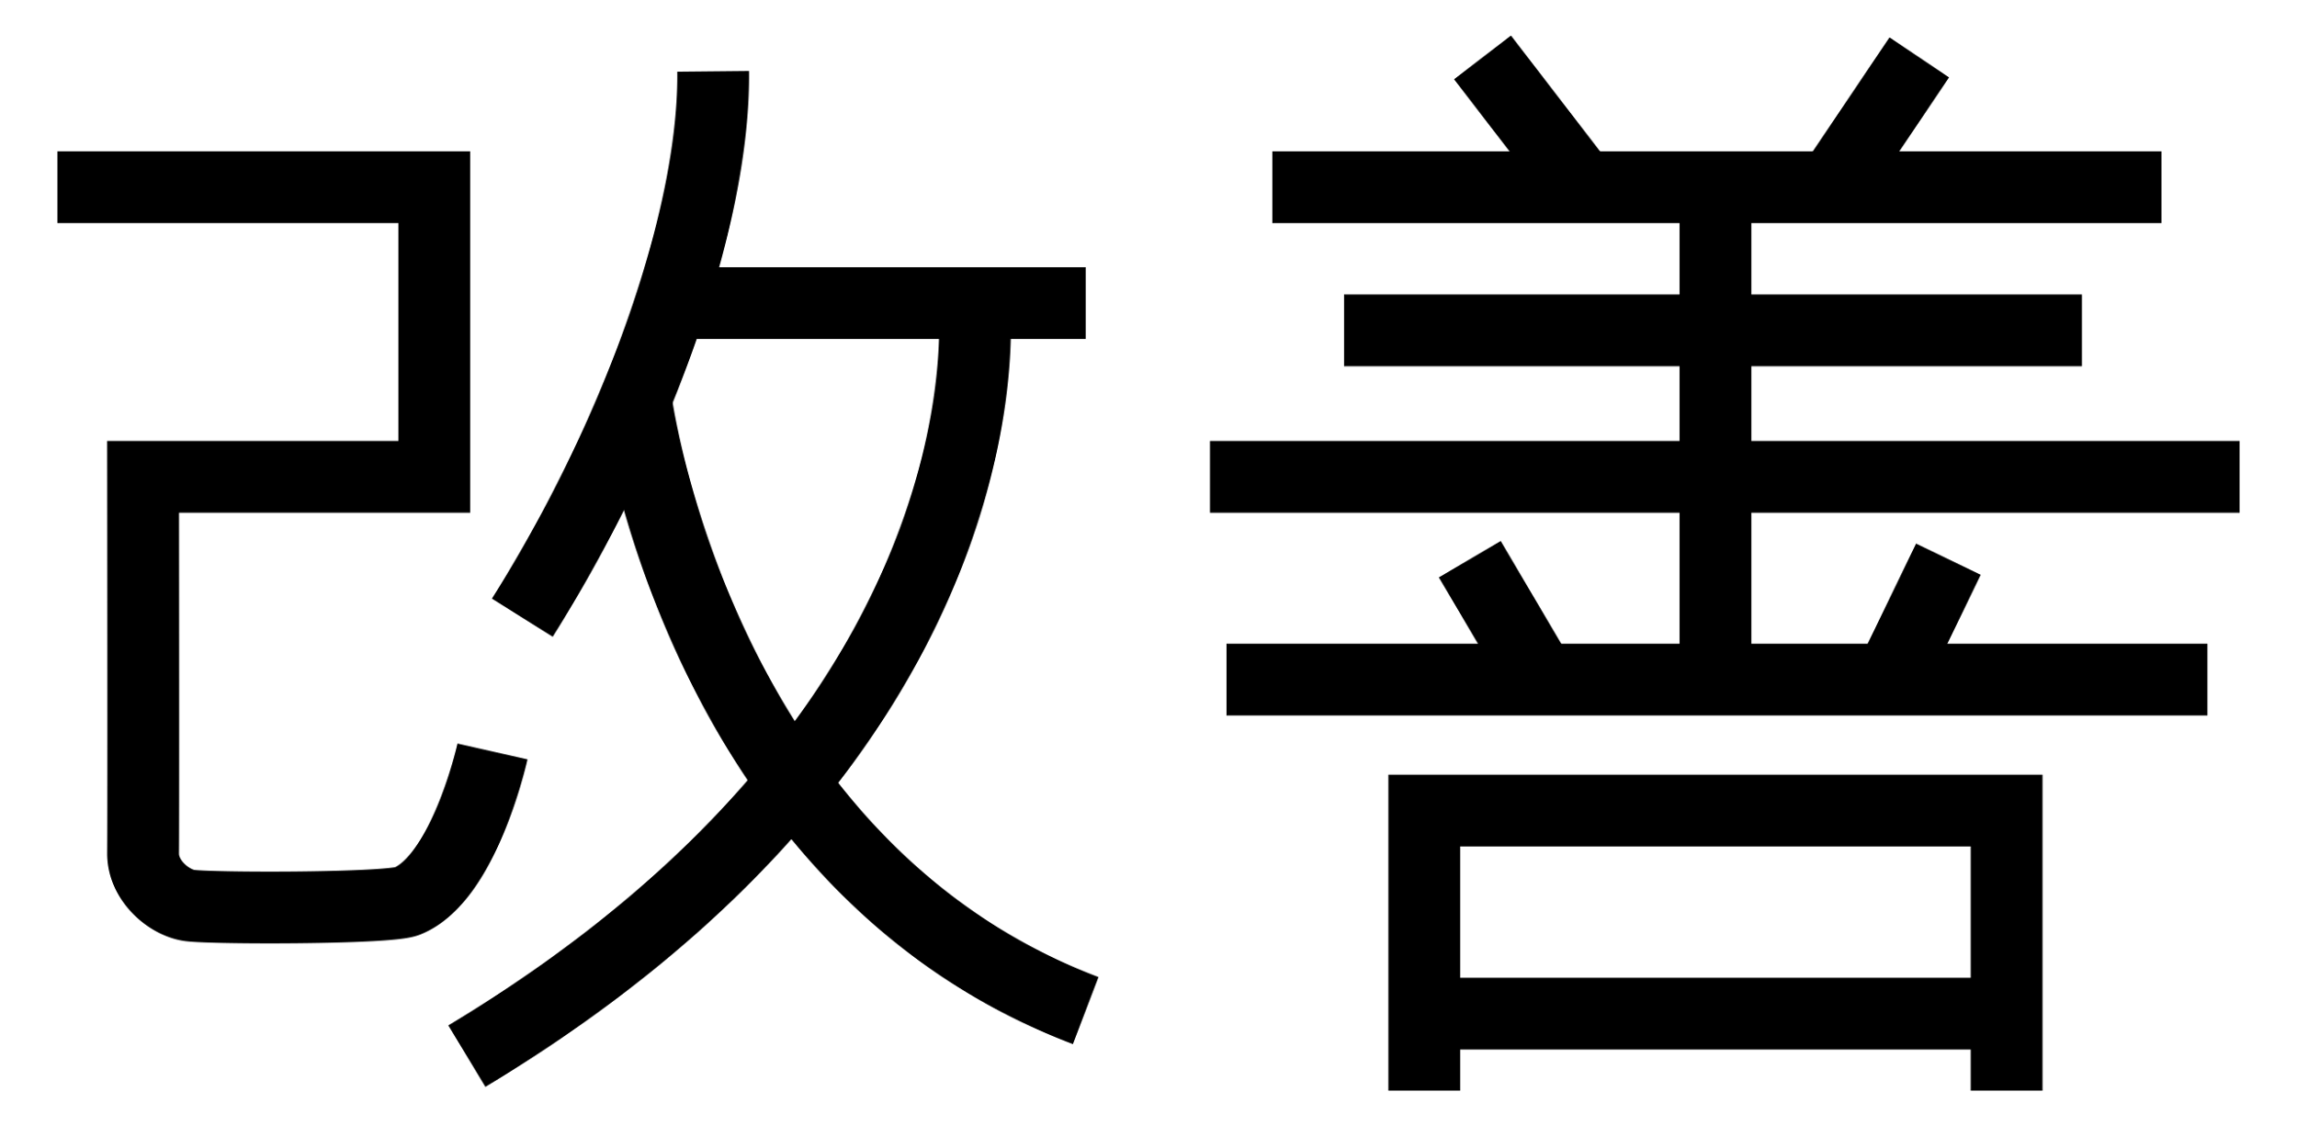
Aspects of Lean Manufacturing
Kaizen
Kaizen is a Japanese word that means “continuous improvement”. This philosophy implies that small, incremental changes routinely applied and sustained over a long period result in significant improvements.
Empowers workers to contribute to better systems of production
Improves product quality and creates a happier workforce

Slide 8
Watch this video on How Toyota Changed the Way We Make Things
It was the car company Toyota who designed the concept of “lean manufacturing”. They learned a lot from what the Ford company did wrong.
Toyota recognized that the inventory was a major cost factor for production. Consequently, they reduced waste, and the largest waste of them all was excess material. By optimizing this excess, Toyota developed Lean production. Many different influences shaped the Toyota Production System. For one, culturally, the Japanese have a very strong work ethic and a respect for system design and the importance of the group and final product are prioritized.
Toyota - Inventors of Lean Production

Slide 9
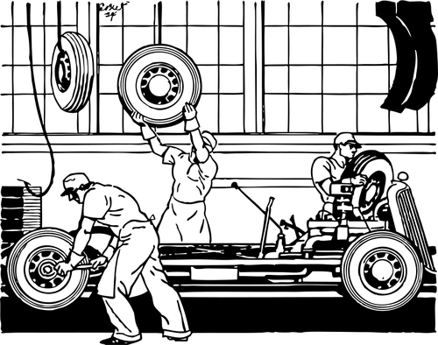
A Further Look at Toyota’s Kaizen
Toyota Kaizen Video
Car factory illustration

Slide 10
Let’s Explore Further - 5S Pillars
5S is a system to reduce waste and optimize productivity through maintaining an orderly workplace and using visual cues to achieve more consistent operational results. Implementation of this method "cleans up" and organizes the workplace in its existing configuration, and it is typically the first Lean method which organizations implement.
The 5 S’ are:
1.Sort (Seiri) 2. Set in Order 3. Shine 4. Standardize 5. Sustain
Divide into 5 groups. Each group will be assigned one of the S’. Research what your groups S means and record your information on a large poster board. You should be able to share your findings with the other groups and explain its meaning and give examples of how it might be used in manufacturing.
Keep these on display as it will help with the next portion of the assignment

Slide 11
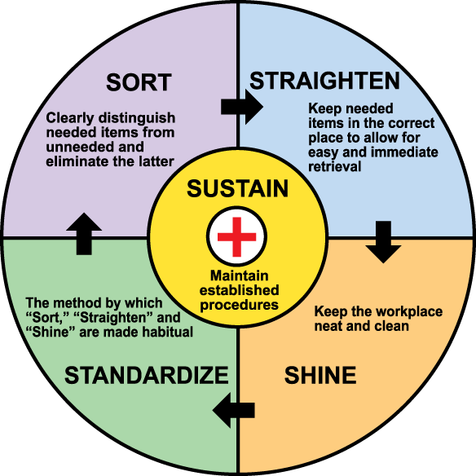
5S Diagram

Slide 12
Once you have an understanding on Lean Manufacturing you are going to work alone, in pairs, or in groups to apply these practices to the pizza shop that you own.
Make sure that you are keeping in mind the principles that you have learned and incorporate them into your project: Just-in-time production, Kaizen, and the 5S’

