Slide 1
EV Safety
BBT Area:
Target Course(s): TTJ

Slide 2
Project Outline
The difference between an Electric Vehicle (EV) or a Hybrid Vehicle (HEV) is the drive train and power source.
EV and HEV vehicles use the same brake, steering, suspension, lighting systems as an internal combustion engine (ICE) vehicle to operate.
Outlined in this safety awareness lesson are the precautions and hazards related to working on an electric vehicle.

Slide 3
Related OVIN Sectors (remove those that don’t apply)
Connected & Autonomous Vehicles (C/AV)
Auto & Parts Manufacturing
Aftermarket, Maintenance & Repair

Slide 4
Prior Knowledge and Related Resources
Students should understand and identify the differences between electric, hybrid and internal combustion engine driven vehicles
Resources in this lesson will assist in identifying vehicles and safety precautions related to different repairs
The safety precautions identified are related to regular maintenance and repair
In a high school classroom, the high voltage systems should never be serviced or repaired without manufacturers’ specific training.

Slide 5
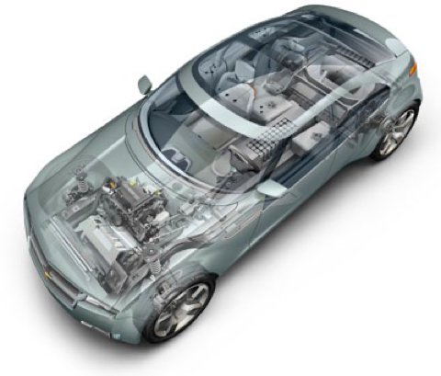
What is an EV?
What is the main difference between an EV and a Hybrid?
A Electric Vehicle (EV) is battery powered
A Hybrid (HEV) has an internal combustion engine (ICE) and a battery.

Slide 6
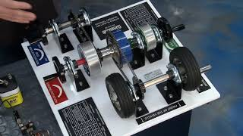

Slide 7
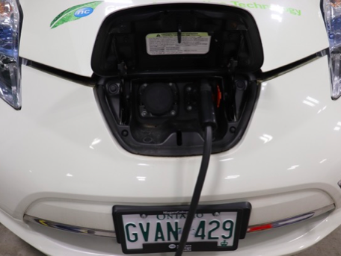
How to tell if a vehicle is an EV or HEV
The easiest way is by the model name or badging on the exterior of the vehicle (E or H suffix following standard model designation) and the presence of an exterior vehicle charging port
Not all EVs and HEVs have identifying badging

Slide 8
What is High Voltage?
High voltage is any part of the vehicle system that is greater than 60 Volts
Low voltage is any part of the vehicle system lower than 60 volts
Most components of a vehicle are 12.6 Volts to 14.9 Volts and safe to repair

Slide 9
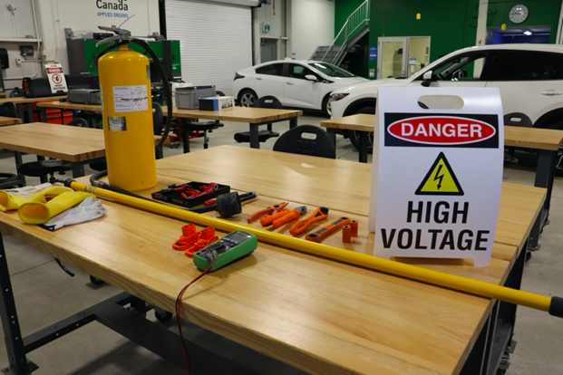
Hazards while working on an EV
Orange colored cables and wires identify the high voltage system (HV)
Never perform any tasks where orange wires are indicated.
Treat all parts as if they are HV parts until they are confirmed to be low voltage

Slide 10
Safety Precautions working on an EV
While working on electric vehicles, avoid contact with high-voltage cables.
The only time when it is safe to work on the high voltage system is when the high-voltage battery has been completely disconnected.
Always ensure that the right PPE is worn when working on EV vehicles.

Slide 11
Safety Precautions working on an EV
Safety Glasses
Safety glasses protect the wearer from hazards to the eyes and should be a standard part of every technician’s work uniform. It is always a good idea to confirm that the glasses comply with ANSI Z87+ standards: They must provide protection from impact and chemical exposure, and they must protect peripheral vision
Lineman Gloves
Commonly called hybrid or EV gloves, lineman gloves are designed to prevent the wearer from becoming part of an electrical circuit. You should wear them any time you are working with the high-voltage system, whether that is the battery or the energized components of the vehicle. Gloves must be certified every 6 months

Slide 12
Safety Precautions working on an EV
Inspect and Air Test Before Each Use
Physically inspect and air test the gloves using an air testing kit before each use. You’re looking to identify tears, holes, ozone cuts, defects, or material swelling or thinning. Perform air testing in compliance with the glove manufacturer’s recommendations and glove type requirements.
Wear with Leather Gloves
Never use lineman gloves without a pair of leather protector gloves over top. They are designed to protect the insulated gloves from wear and tear, such as cuts, abrasions, and punctures. There are limited exceptions to this requirement, but considering the high voltage of electric vehicle batteries, leather protectors are required.

Slide 13
General Safety Rules
Hybrid (HEV) and Electric Vehicles (EVs) are automobiles which do not rely solely on an Internal Combustion Engine as the main power source for the vehicle
Avoid all Orange Coloured Cables and wires as they are the main parts of the High Voltage System
WEAR PERSONAL PROTECTIVE EQUIPMENT INCLUDING SAFETY GLASSES and use rubber gloves with no path through your heart when working on a Hybrid or EV
Careless handling of components can cause serious injury or death
Always ensure the system that is being worked on is low voltage

Slide 14
General Safety Rules
Treat all High Voltage parts as if they have High Voltage until you have tested them with your Digital Volt Meter (DVOM) and are sure they are at zero or close to zero volts
Remember the Internal Combustion Engine can start up at any time
READY means the car is ON and it may move, engine on or not!
Do not wear watches, jewelry or any metal
If you have a pacemaker stay away from the drive motor magnets
Always follow proper manufactures procedures for servicing components that are not connected to the High Voltage System

Slide 15
Battery Disconnect Procedures
Disconnect 12 volt battery. (Same procedure as an ICE vehicle)
Every EV and HEV has a master disconnect switch.
The disconnect switch may be located in the cabin, truck or frunck.
To locate and follow disconnect procedures, refer to manufacturers instructions as there is no standard location of the disconnect switch

Slide 17
General - Lifting an EV-HEV
Due to their drivetrains and suspension, some HEVs and EVs may need the service or tow mode to be engaged to be able to roll the vehicle. This mode will also prevent damage to the air suspension components when lifted
Some GM EV models, like the Hummer, will call it immobilization mode. Refer to the manufacturers guide prior to lifting
Some EVs require specialized lifting pads to prevent battery damage

Slide 18
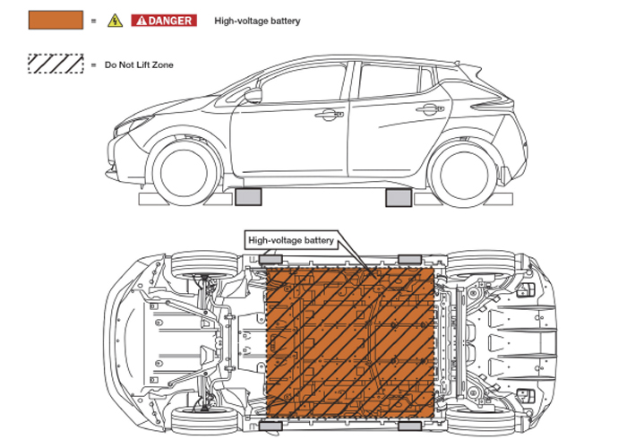
Lifting using a 2 post hoist
You need to find the lift points to lift any vehicle. Most EVs and HEVs have specific lift points stamped into the unibody. Some EVs might require special blocks inserted into holes on the lift points. Some manufacturers recommend blocks or pucks that slide over the pinch welds on the rockers

Slide 19
Lifting with a 2 post hoist - Center of Gravity
If you are using any type of two-post lift, you need to be aware of the center of gravity. EVs and HEVs can have a different center of gravity compared to a vehicle with an internal combustion engine
Battery packs, inverters and motors can move the center of gravity to the rear
The old rule that front-wheel-drive vehicles have the center of gravity at the side view mirrors and that a rear-wheel-drive vehicle’s center of gravity is below the driver’s seat does not apply for EVs and some HEVs
Refer to the service information for where to spot the vehicle

Slide 20
Lifting with a 2 Post Hoist - Considerations
Battery damage - Lifting in the wrong location or lifting a vehicle that is not allowed to be jacked up may cause serious damage to the battery pack itself.
Weight - Vehicles with HV batteries may weigh more than those using standard combustion engines. Because of this extra weight from the battery, certain jacks, jack stands, and lifts may not be able to hold the vehicle safely, which in turn could cause injury to a technician as well as damage to the vehicle.

Slide 21
Lifting with a 2 Post Hoist - Considerations
Damage to related components - Even if you are careful not to place the lift or jacks on the battery itself, there could be other HV components in the area that may get damaged during the lifting and supporting process. It is important to familiarize yourself with the location of HV components. Additional items like exhaust heat exchangers and associated cooling system lines and hoses also need to be protected from damage.
Special tools and equipment - Some service information procedures require that lift hoist pads/adapters be properly placed in the designated areas to prevent damage while lifting the vehicle.

Slide 22
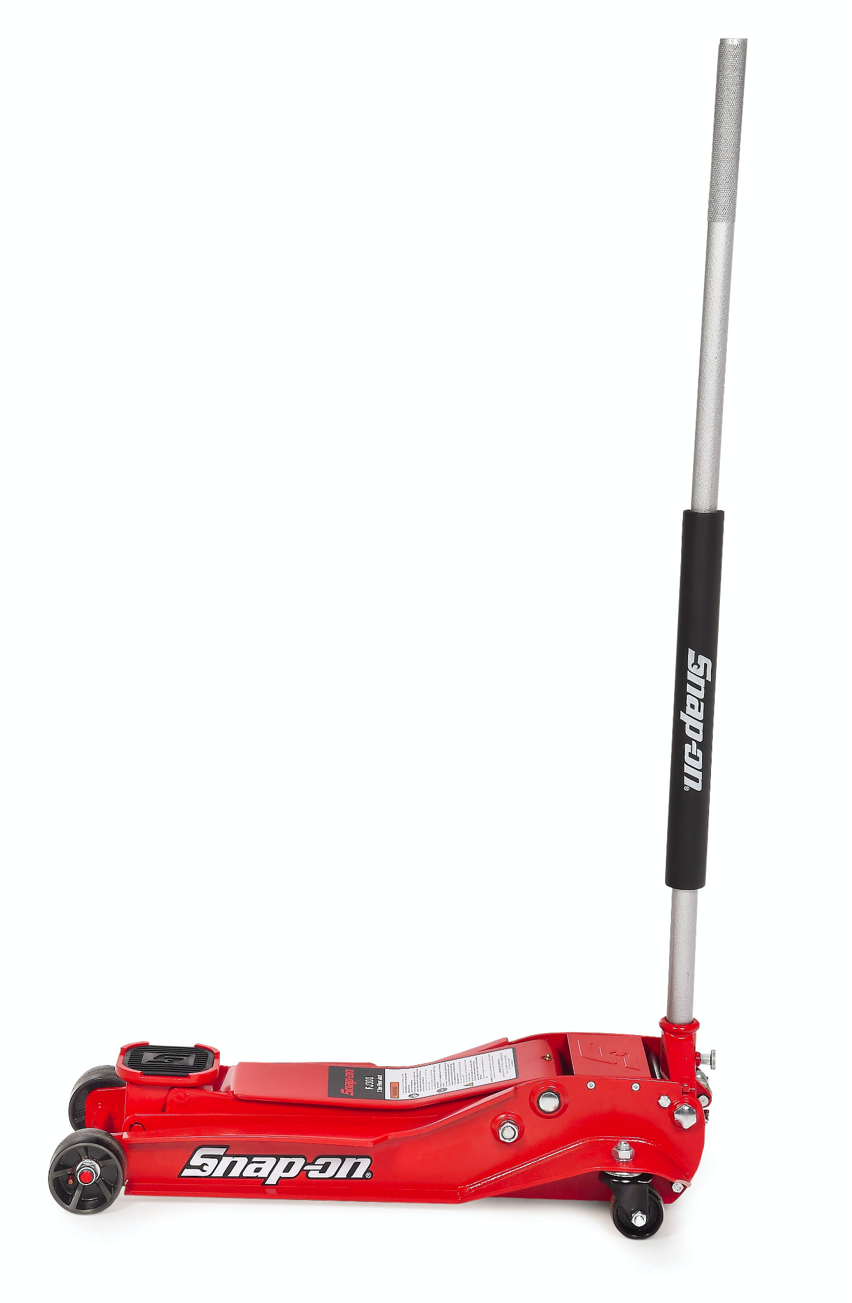
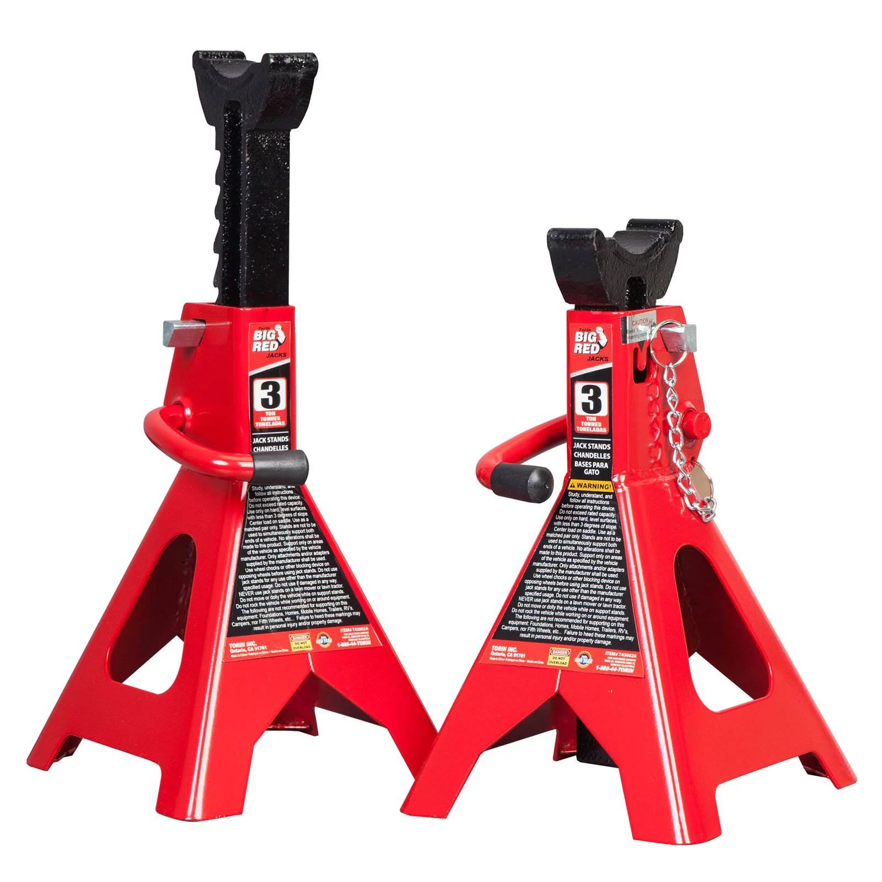
Lifting using a floor jack
You need to find the lift points to lift any vehicle
Most EVs and HEVs have specific lift points stamped into the unibody
Some EVs might require special blocks inserted into holes on the lift points
Some manufacturers recommend blocks or pucks that slide over the pinch welds on the rockers.

Slide 23
Drive on Automotive Lift
When you first pull the car into the bay, the basic rules of spotting the vehicle remain the same. Always make sure the vehicle is straight and positioned in the centerline of the lift
A roll-on or runway lift used for alignments or oil changes can be a safe bet for EVs and HEVs. But, these lifts can block access to some components under the vehicle
If you use the rolling jacks, you need to use the correct adapters and lift points.

Slide 24
Drive on Automotive Lift
The last part can be difficult for some HEVs and EVs due to their drivetrains. You might have to engage a service or tow mode to be able to roll the vehicle. On some models with air suspension, this mode will also prevent damage to the air suspension components when lifted
Some GM EV and HEV models, like the Hummer, will call it immobilization mode
Always place wheel chocks in front and behind the wheels to prevent the vehicle from rolling in service mode

Slide 25
Engine Service
Most vehicles have an "idle stop" mode that shuts the gasoline engine off when the vehicle rolls to a stop - such as at a traffic light. The vehicle will then initially move under power from the electric motor when the accelerator is depressed, much like an electric golf cart. Shortly thereafter, the gasoline engine will restart and power the vehicle under normal driving conditions.

Slide 26
Engine Service
A problem could occur in the shop if a hybrid vehicle is brought to a stop and the ignition key is left in the on position. A technician about to service the vehicle might think the engine is shut off and therefore safe to work on. Touching the accelerator may cause the motor to restart
The key must be placed out of range of the vehicle and vehicle turned off
Always follow manufacturers instructions and precautions
After following manufacturers precautions, servicing an engine is identical to a non-electrical vehicle

Slide 27
Body Panel Repair Precautions
The vehicle cannot be towed or moved on its road wheels to prevent possible HV system damage and to reduce the potential shock hazard.
All HV system components must be initially located and inspected for signs of damage.
All service requirements for the various systems must first be fully understood, for example the engine cooling system.
Damaged body panel(s) must be checked behind for any HV system wires, connectors, modules or batteries that might have also sustained damage.

Slide 28
Body Panel Repair, Welding Precautions
When welding on a HEV or EV, follow the same precautions with the 12-volt system as when welding on a conventional vehicle. In addition, there are precautions to take with the high-voltage battery.
Disconnect both the 12-volt battery and the high-voltage battery service disconnect. (Note: always disable the high-voltage battery following the automaker’s repair information and follow all safety precautions.)
Keep in mind that there is typically more than one method available for disabling the high-voltage system
The preferred disabling method for technicians would be to remove the hybrid battery service disconnect

Slide 29
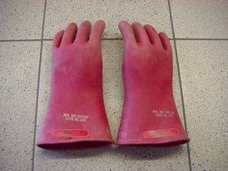
Required Tools and Materials
Engine service
Certified Lineman's rubber gloves with no path through your heart (hand in pocket)
60 v at 1 amp is lethal

Slide 30
Required Tools and Materials
Engine service
Leather over gloves to protect rubber gloves from being damaged

Slide 31
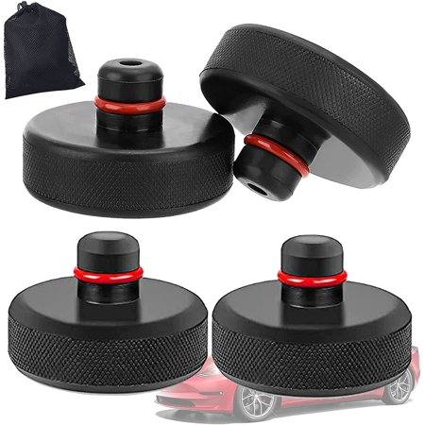
Required Tools and Materials
Engine service
EV and Hybrid lifting adapters must be used to prevent battery damage. Below is an example used by Tesla

Slide 32
Safety Concerns (including PPE if required)
The high voltage battery may be damaged by lifting the vehicle incorrectly. Always follow manufacturers lifting instructions
Always refer to manufacturers instructions whenever performing any task on a EV or HEV
All orange wires are high voltage. Never perform any tasks on any component of the high voltage system
HEVs engine may start at any time. Ensure the ignition is off and key is not within range to connect with the vehicle
Always wear the appropriate PPE

Slide 33
Safety Quiz
What colour wires indicate high voltage? _________________
What is the maximum voltage is safe without special protection? _________________
Where should the ignition keys be when performing any work on an EV/HEV? _______________________________________________________________________________
How would you identify an EV or HEV in the shop? _______________________________________________________________________________
What 2 precautions should you take when lifting an EV or HEV? ______________________________________________________________________________
What PPE should be worn when working near high voltage wires or batteries? _______________________________________________________________________________
What does ICE ___________________________________________________________________
How should all electrical parts be treated on an EV or HEV until tested with a DVOM? _______________________________________________________________________________
Any non conductive gloves can be used while working on HEV and EVs. True False
There are no special precautions when an EV or HEV is placed on a drive on lift. True False

Slide 34
Safety Quiz Answers
What colour wires indicate high voltage? Orange
What is the maximum voltage is safe without special protection? 60 Volts
Where should the ignition keys be when performing any work on an EV/HEV? Outside of the communication range of the vehicle
How would you identify an EV or HEV in the shop? The model name or badging on the exterior of the vehicle (E or H suffix following standard model designation) and the presence of an exterior vehicle charging port
What 2 precautions should you take when lifting an EV or HEV? Caution must be taken to prevent battery damage using proper lift points and pads. The centre of gravity changes depending on battery placement.
What PPE should be worn when working near high voltage wires or batteries? Safety glasses, Safety boots, Certified Lineman's Gloves, Leather gloves
What does ICE Internal Combustion Engine
How should all electrical parts be treated on an EV or HEV until tested with a DVOM? Treat all parts as high voltage until tested.
Any non conductive gloves can be used while working on HEV and EVs. True False
There are no special precautions when an EV or HEV is placed on a drive on lift. True False

Slide 35
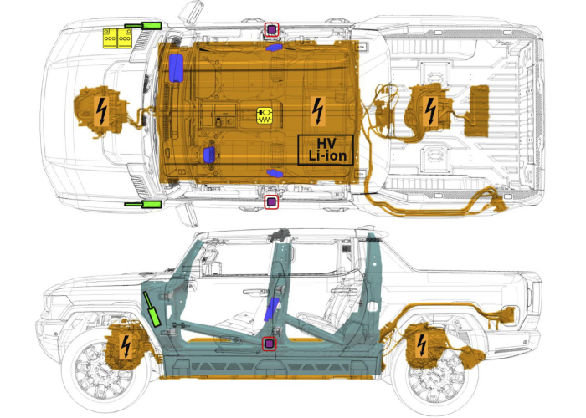
Outside Resources and References
Tech Garage
Garage Gurus
OVIN
Plug & Drive
Underhood Service/EV Lifting
Vehicle Service Pros
Department of Energy

