Slide 1
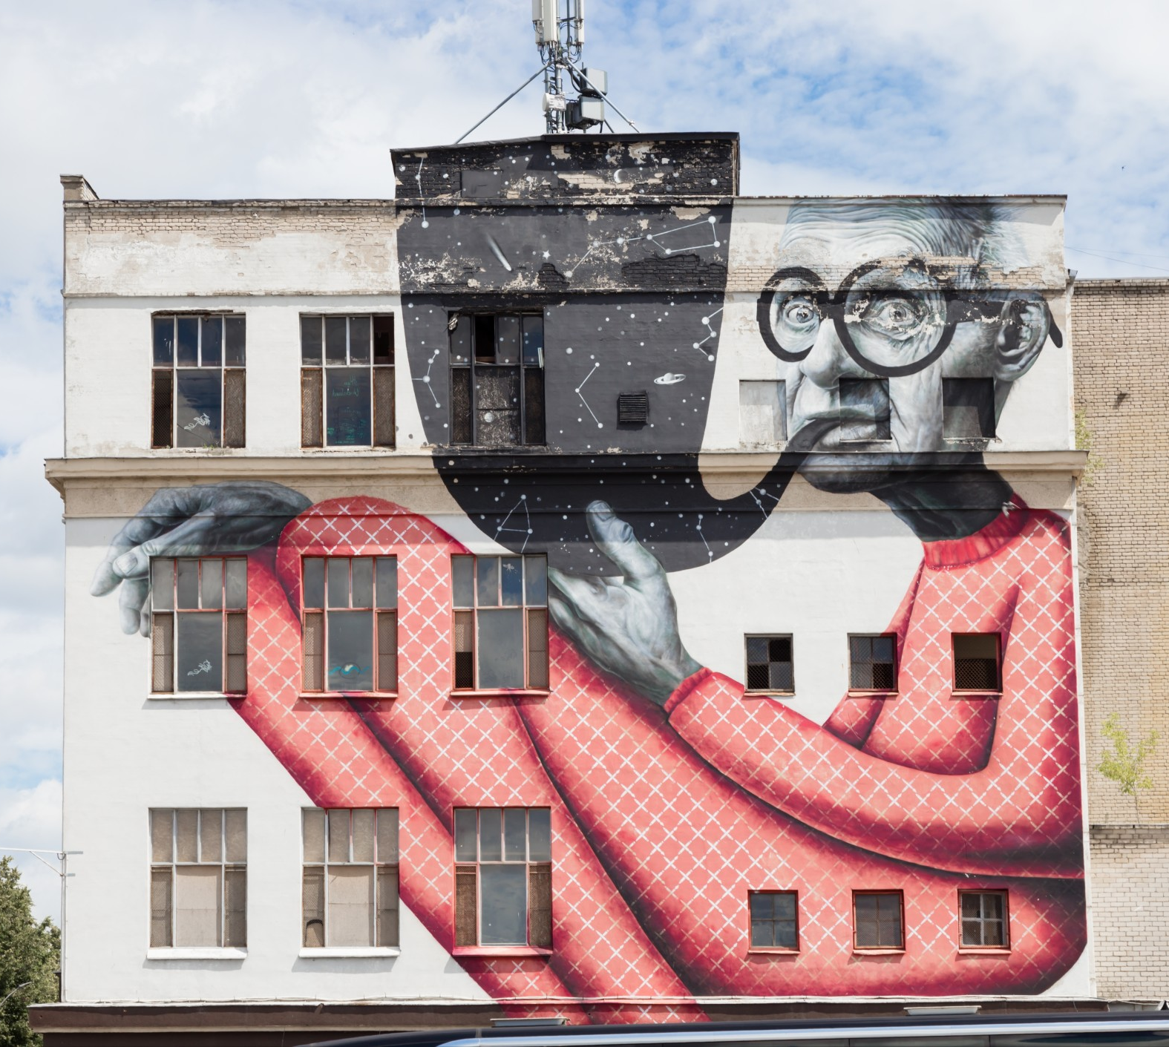
Graphic Design
Lesson and Activity 4

Slide 2
Activities &
Assignment
Activity 1 – Explore the role of a Graphic Designer
Activity 2 – Elements of Graphic Design
Activity 3 – Exploring Colour
Activity 4 – Create a simple vector image
Assignment – Create a sticker

Slide 3
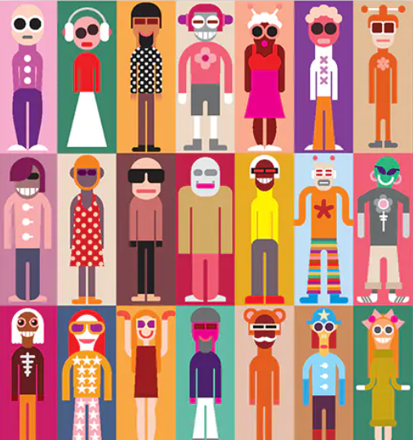
Create Vector Images
Question: What is a Vector Image?
Answer: Vectors create graphic design images made up of lines, points, curves, and basic shapes that are based on mathematical equations.
Watch @ Learn – Vector Graphics
  What are Vector and Raster Graphics
Watch @ Learn – Buddy Media
  Raster and Vector Graphics
Note: You may sometimes hear Raster graphics called by their other name Bitmap
Create Vector Images
Explore the role of a Graphic Designer
Elements of Graphic Design
The Power of Colour

Slide 4

Create Vector Images
Question: What programs/application can I use to create Vector Images
Answer: There are many applications that allow you to create Vector Graphics they include:
  Adobe Illustrator
  Inkscape
  Vectr
  Corel Draw
  Affinity Designer
  Vecteezy
You will can choose any vector program; we will look at three options you may wish to try.
Create Vector Images
Explore the role of a Graphic Designer
Elements of Graphic Design
The Power of Colour

Slide 5

Adobe Illustrator PC or Mac
Adobe Illustrator is the industry standard and is used by graphic designers of all types to create illustrations and typography for all kinds of media
Getting Started Tutorials:
Create an Icon
Create a Digital Badge
Create a Graphic Portrait (Part 1)
Create a Graphic Portrait (Part 2)
Note: Illustrator is a paid program check with your school to see if they have access
Create Vector Images
Explore the role of a Graphic Designer
Elements of Graphic Design
The Power of Colour

Slide 6

Inkscape – PC, Linux, or Mac
A FREE and open-source vector graphics editor. Inkscape is full-featured and is used by industry professionals.
Getting Started Tutorials:
Lesson 1 – Interface and Basic Drawing
Lesson 2 – Shape Tools and Options
Lesson 3 – Fill and Stroke Settings
Lesson 4 – Groups, Levels, and Selection
Lesson 5 – Exporting Images
Lesson 6 – Text and Fonts
To Download Inkscape Click Here
Create Vector Images
Explore the role of a Graphic Designer
Elements of Graphic Design
The Power of Colour

Slide 7

Vectr – Web-Based
A FREE web-based vector graphic design application, with a simple and intuitive interface and lots of features
Getting Started Tutorials:
Lesson 1 – Getting Started
Lesson 2 – Sharing/Exporting Your Work
Lesson 3 – Create a simple poster
Lesson 4 – Create a logo
Lesson 5 – Create a Typographic Logo
To Access Vectr Click Here
Create Vector Images
Explore the role of a Graphic Designer
Elements of Graphic Design
The Power of Colour

Slide 8

Create!
Now it is your turn, choose a Vector Image Program or Application that works for you! You can choose from one of the three applications that have detailed descriptions or select one from the list or your search.
Task: Follow two or more step by step tutorials and submit your final work as a .png file
Note: PNG (Portable Network Graphics) is a file format used for lossless image compression
Create Vector Images
Explore the role of a Graphic Designer
Elements of Graphic Design
The Power of Colour

