Slide 1
Building a Programmable Model Boat
BBT Area: Exploring Technologies, Computer Technology,Transportation Technology
Target Courses: TIJ1O, TEJ2O, TTJ2O
Explore more at ovin-navigator.ca

Slide 2
Section 1: Teacher Resources
Explore more at ovin-navigator.ca

Slide 3
Project Outline
This project will guide students through the process of building a model boat that can be programmed to navigate forwards, backwards, or steer left and right.
The model boat is based on a “Springer” model tug boat, although any model wooden boat that has (or can be modified to have) 2 propellers would be appropriate.
The craft is fitted with an Arduino that students will program to power 2 small electric motors that are attached to propellers.
ovin-navigator.ca

Slide 4
Related OVIN Sectors
Mobility Planning & Infrastructure
ovin-navigator.ca

Slide 5
Prior Knowledge and Related Resources
Skills required:
Basic woodworking skills to build the craft and apply finish
Basic electrical and soldering skills for wiring the craft
Very basic coding skills to install provided code onto the Arduino, and to modify the code to adjust navigation as desired
Basic “tinkering” skills
Optional skills to enhance the project:
Adding sensors to make the craft autonomous - see “ASR Search and Rescue Craft” project
ovin-navigator.ca

Slide 6
Planning Notes and Teacher Guide
Building of the craft is fairly straightforward and is detailed in section 3. It is suggested that room be left on the sensor deck for modification and expansion so different sensors can be used.
Lessons in section 2 range from basic electricity up to coding. It is suggested to consider your audience and the level of complexity they are comfortable with. The coding section could be a good introduction to programming, but might overwhelm some students.
ovin-navigator.ca

Slide 7
Required Tools
Woodworking tools:
Hand saws or band saw, measuring tape, glue, clamps, paint brushes
Electronic tools:
Variety of small screwdrivers, soldering tools, wire strippers, pliers
Programming tools:
Laptop with internet access, cable to connect to Arduino
ovin-navigator.ca

Slide 8
Required Materials
Construction materials (available at any home improvement center):
Approx 3 feet 1x6 pine
2’ x 4’ sheet ¼ plywood
Spar urethane finish
Paint as desired
Silicone sealant
Wood glue
Six inches 1” angle aluminum
12 x 18 balsa wood 1/16” thick
Three ½” hinges
Various fasteners
2 part epoxy
Masking tape
ovin-navigator.ca

Slide 9
Required Materials
Electronics and Miscellaneous (available on Amazon) :
Arduino 2560 or equivalent
4 channel relay shield with optocoupler
Breadboard jumper wires
7.2 - 12v R/C battery and charger
Propeller shaft and propellers (consider having these machined by a Manufacturing program within the school
On / off switch
2 surplus brushed motors
16 gauge automotive type wire (2 colours)
Solder
Automotive vacuum line
ovin-navigator.ca

Slide 10
Required Materials
Programming:
Laptop with internet access
USB 2.0 cable type A/B - typically supplied with Arduino
Arduino environment (free to download)
ovin-navigator.ca

Slide 11
Safety Concerns (including PPE if required)
Safety concerns include:
Moderate risks having students near water, have personal floatation devices nearby, assess students’ swimming ability, or consider building an 8x8 “pool” using 2x6 and plastic sheeting
Moderate risks of eye injury throughout build, provide students with safety glasses
Moderate burn risks from soldering electrical connections
Low fume inhalation risks from soldering electrical connections, complete task in well ventilated area using non-lead based solder
Low injury risks from spinning propellers, consider wearing gloves
ovin-navigator.ca

Slide 12
Assessment and Evaluation
Consider evaluating students based on the performance of their model boat. Criteria could include:
Complexity of the navigation that students programmed into the boat
How accurately the craft maneuvered while navigating
Overall performance of the craft
Appearance of the craft
Fit and finish of the craft
If building multiple crafts, consider holding a competition to see which boat can navigate and obstacle course the best.
ovin-navigator.ca

Slide 13
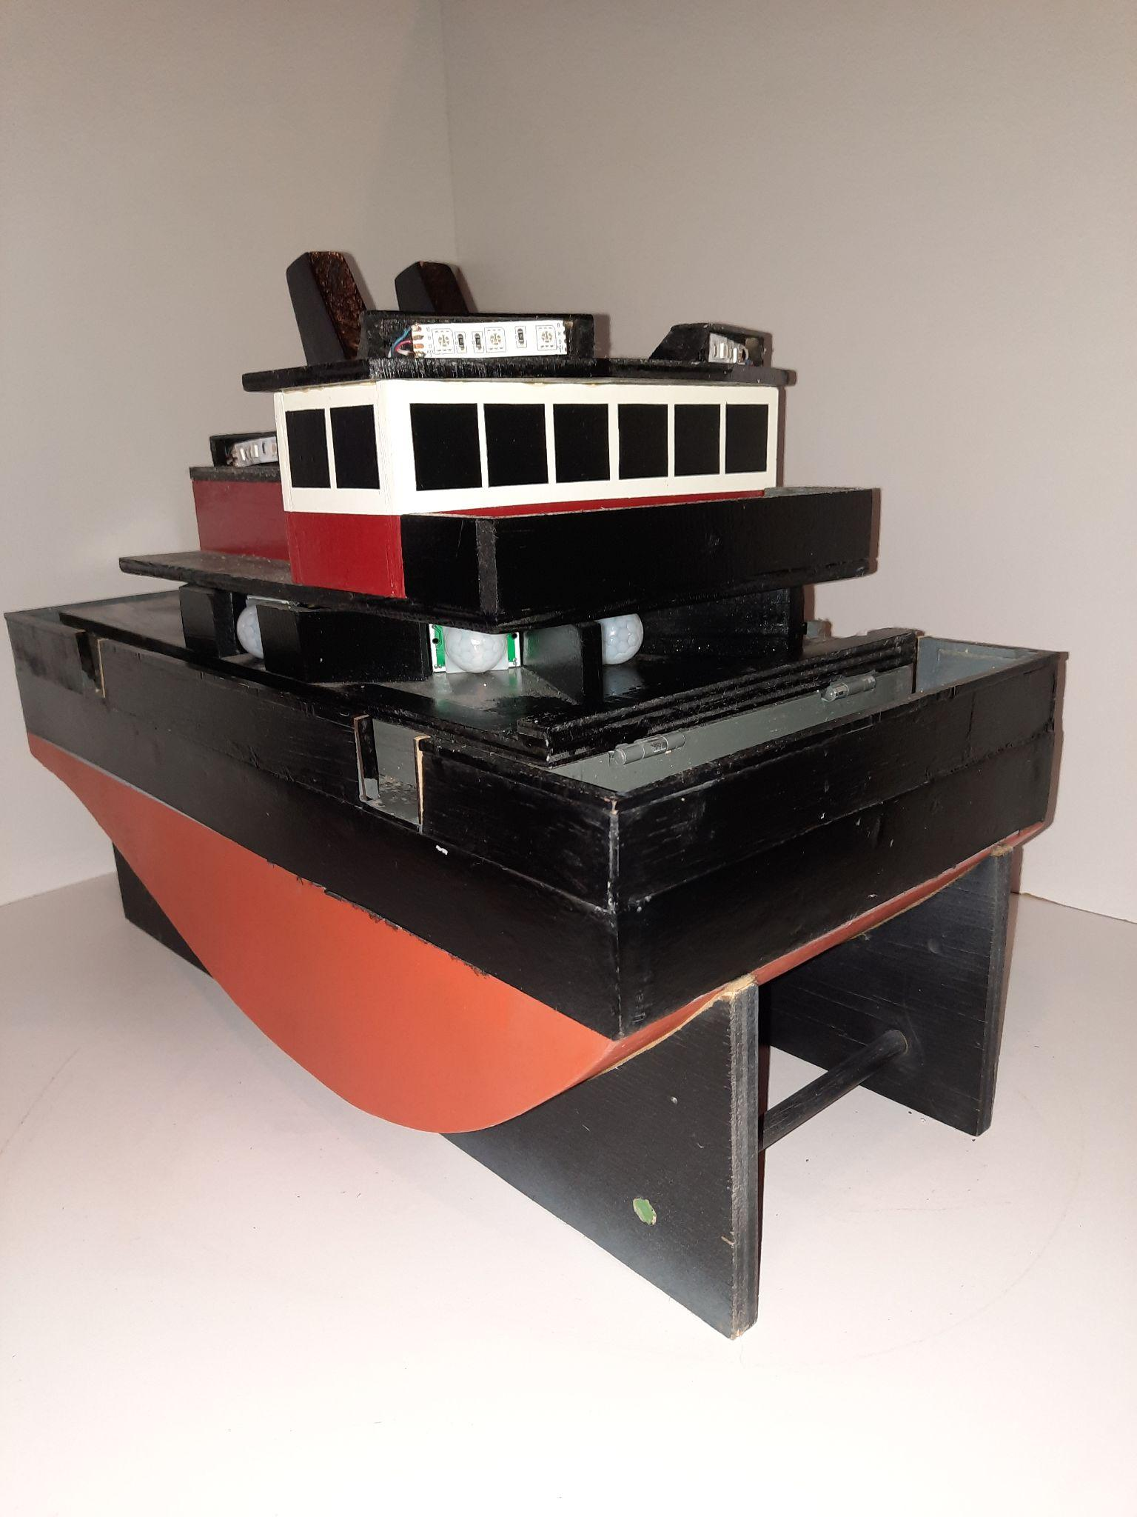
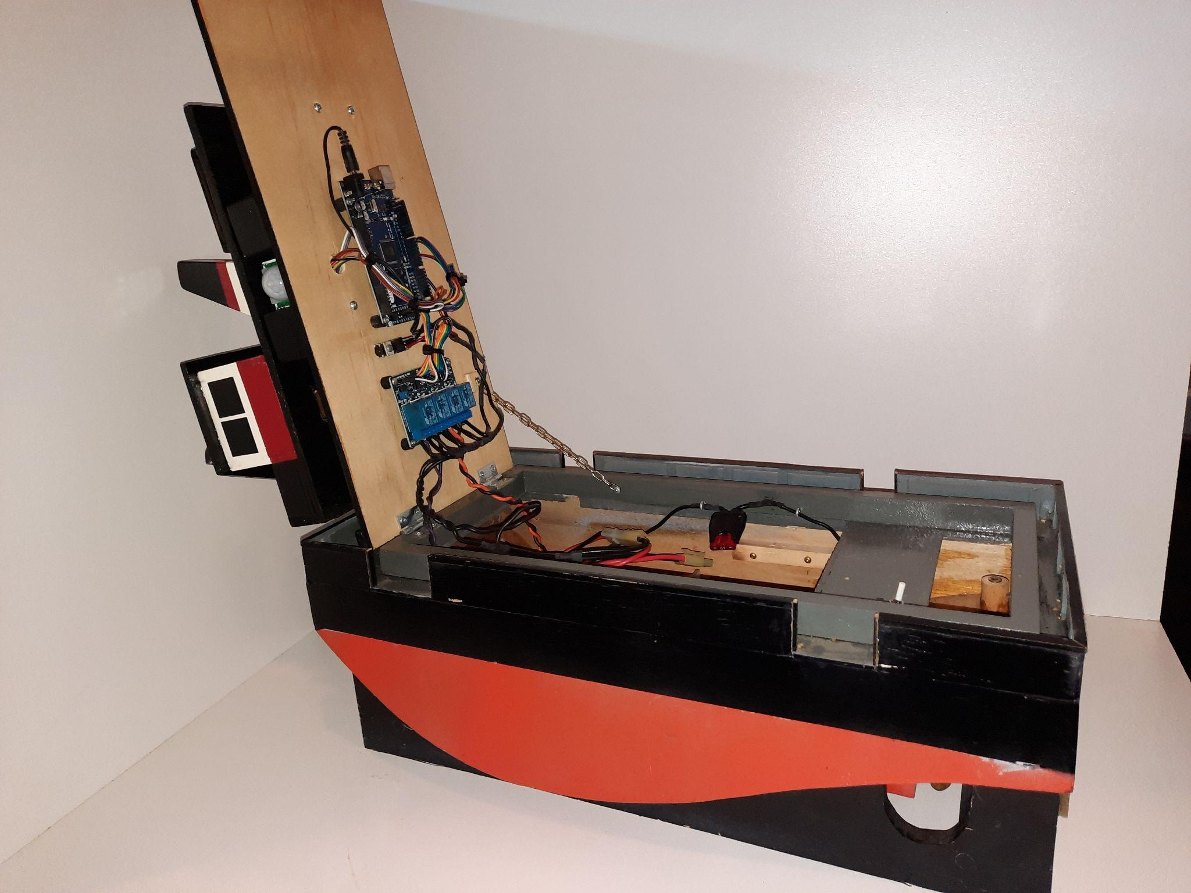
Project Exemplars
ovin-navigator.ca

Slide 14
Outside Resources and References
Basic description of model Springer Tug boats: https://www.modelboats.co.uk/news/article/pusher-tug/21652
Boat design and building resources: SSMBC's Springer Tugs
Book - Arduino for Dummies ISBN# 978-1-118-44637-9
Arduino official website: Arduino
ovin-navigator.ca

Slide 15
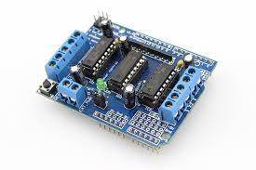
Modifications, Tinkering, and Tweaks
In this project relays were used to illustrate basic electrical circuits, however consider substituting an Arduino motor driver shield.
Consider adding additional sensors to make the boat autonomous. See “ASR Search and Rescue Craft” project. This boat shares the same platform as the autonomous craft, and can be upgraded once built.
Consider adding a distance sensor that can be used to stop the craft if it gets too close to an object
ovin-navigator.ca

Slide 16
Modifications, Tinkering, and Tweaks
Consider altering the size of the propellers to adjust the crafts speed.
Consider using counter rotating propellers to enhance accurate navigation.
Consider adding LEDs on the exterior of the craft that will indicate the crafts intended direction of travel - this could be very useful while making other adjustments to the code.
ovin-navigator.ca

Slide 17
Modifications, Tinkering, and Tweaks
Alter the code! Customizations that could be made include:
Altering the distance and direction of travel during the initial deployment
Programming the boat to steer left or right
Programming the boat to spin left or right
Programming the boat to navigate an obstacle course
ovin-navigator.ca

Slide 18
Section 2: Building the Programmable Model Boat
Explore more at ovin-navigator.ca

Slide 19
Project Introduction (and hook)
Building the Programmable Model Boat will touch on several different broad based technology areas including Construction, Computer Engineering, Transportation, and even Manufacturing if students build the propeller shafts themselves. By teaching a broad range of skills from different areas, students will be more likely to find something that appeals to them and become engaged.
While the base construction of the Programmable Model Boat should remain the same, students should be encouraged to custom paint the craft so they can see themselves in the project.
ovin-navigator.ca

Slide 20
Project Introduction (and hook)
Once the project is complete, teachers are encouraged to hold a competition to see which craft can navigate an obstacle course the most effectively.
Even if only one craft is built, students can modify their own individual code to power the craft. The code can be easily loaded into one craft in a few seconds, and teachers can cycle through all of the students’ codes to see which makes the craft navigate the best. By choosing this option the culminating competition can remain the same, and determining factor will be just the code instead of the entire craft.
ovin-navigator.ca

Slide 21
Building Part 1 Building the Boat
Explore more at ovin-navigator.ca

Slide 22
Building the PMB Boat
The boat itself is modeled on the “Springer” model tug boat.
The Suncoast Scale Model Boat Club has numerous resources to assist in building this base boat platform. The shape of the hull is the only standardized part of the boat, from the deck up is open to modification and creativity. Scale drawings for the hull can be found on the SSMBC website linked below.
SSMBC Website
ovin-navigator.ca

Slide 23
Building the PMB Boat
The hull sides are constructed from ½ inch (13mm) thick pine, although plywood could be substituted. Cut two pieces of pine that are 18 inches (457mm) long by 6 inches (152mm).
ovin-navigator.ca

Slide 24
Building the PMB Boat
Mark 1 inch increments across the wood. At the 0 inch increment, draw a 1 5/16 inch long vertical line. At the 1 inch increment draw a 2 ¼ long vertical line. Continue doing this until you have drawn all of the vertical lines as shown below. Next, draw a line that connects the ends of all the lines.
ovin-navigator.ca

Slide 25
Building the PMB Boat
Use a saw to cut out one hull side. Once cut, the hull side can be used as a template for the second side.
ovin-navigator.ca

Slide 26
Building the PMB Boat
Connect the off cuts from the hull using 3 pieces of pine 2” long by 2” wide by ½” thick as shown to make a stand for the craft. Note the cut outs at the rear of the stand: these will have to be custom cut to allow room for the crafts propellers.
ovin-navigator.ca

Slide 27
Building the PMB Boat
Cut 2 pieces of pine 8” long. One should be 1 5/16 wide, the other should be 1 ¾ inches wide. Use the narrow piece to glue the two hull sides together at the front. Use the wide piece to glue the two hull sides together at the back.
ovin-navigator.ca

Slide 28
Building the PMB Boat
Cut a ¼ piece of plywood to the dimensions below to make the deck of the craft. Glue deck on top of hull sides once cut.
ovin-navigator.ca

Slide 29
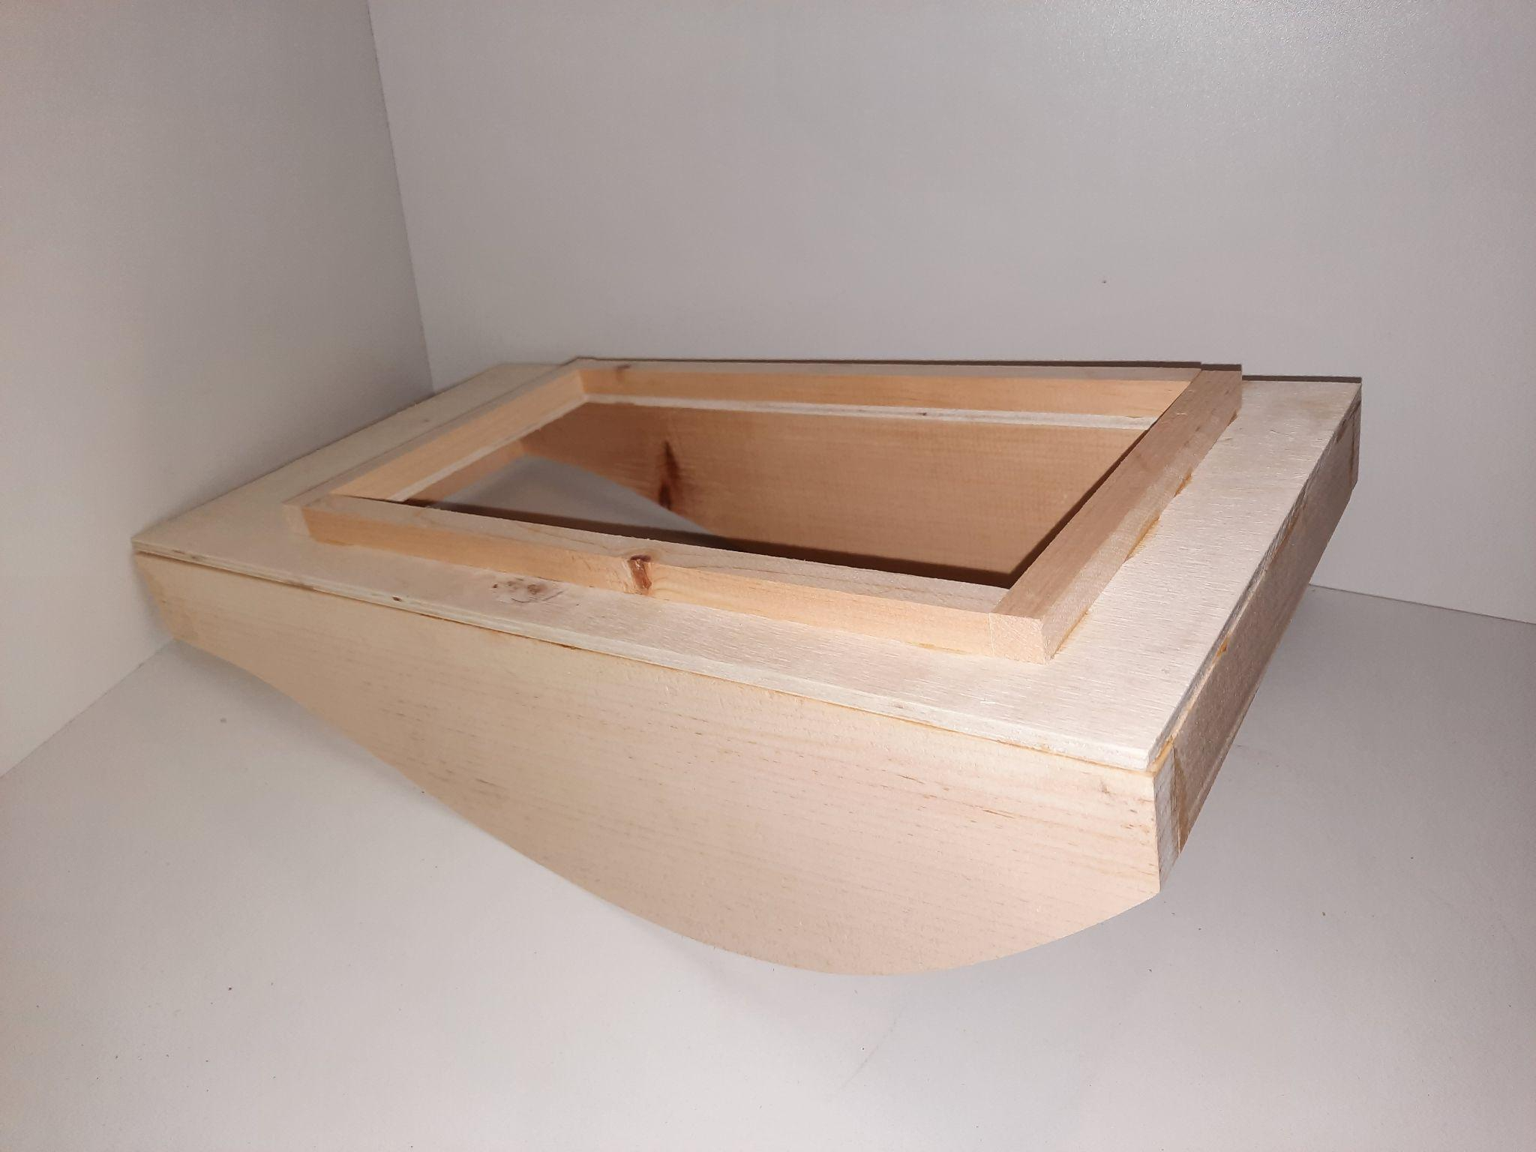
Building the PMB Boat
Surround the opening on the deck with ½” x ½” pine. If any water happens to get on the deck this will prevent it from getting into the hull of the craft.
ovin-navigator.ca

Slide 30
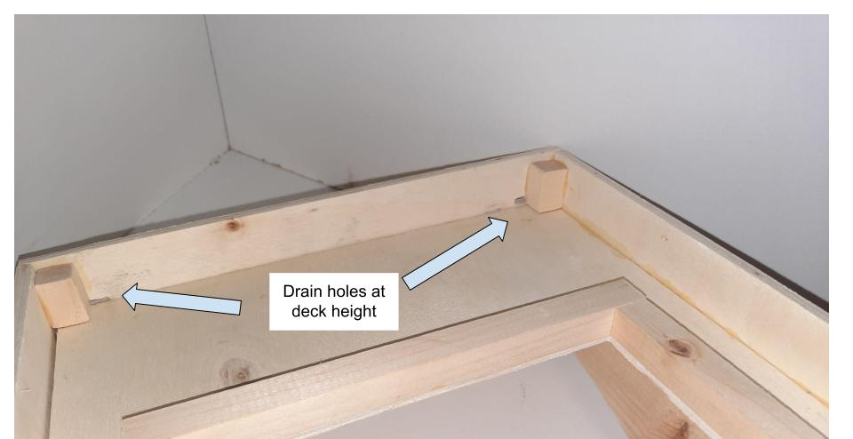
Building the PMB Boat
Surround the entire craft with ¼ plywood cut to 1 ½” wide. When attaching the plywood be sure it is exactly 1” higher than the deck of the craft so any future sensors won’t get blocked. The plywood will help prevent water from getting on the deck.
When cutting the plywood leave drain holes as shown to allow any water that does get on the deck to drain off.
ovin-navigator.ca

Slide 31
Building the PMB Boat
Once dry, the bottom of the hull can be fitted and glued in place. Use a thin flexible material such as ⅛ inch balsa wood or another suitable thin board. Add silicone to the seams to keep water out. Once this is attached the hull will be complete. To help waterproof the hull is should be sealed with 2 coats of spar urethane or shellac followed by two coats of paint.
ovin-navigator.ca

Slide 32
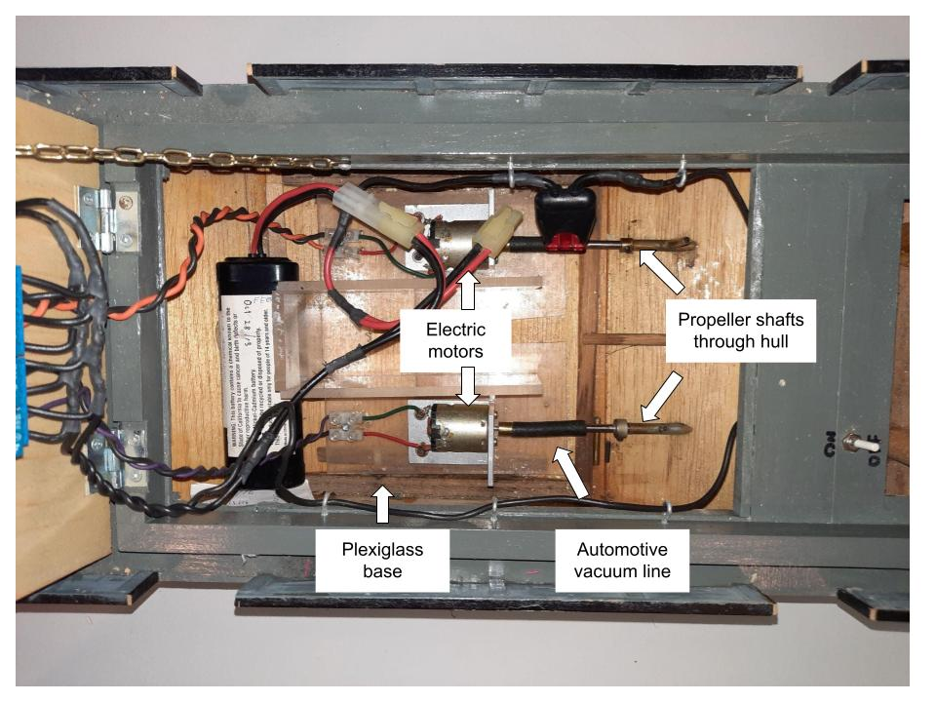
Building the PMB Boat
To install the propeller shafts, cut 2 slots in the bottom of the hull for the shafts to exit the hull. These slots should be as close to the sides of the craft as is practical.
ovin-navigator.ca

Slide 33
Building the PMB Boat
Build a small platform out of wood or plexiglass for the electric motors. The motors should be attached to the platform using a small piece of angle iron and screws.
ovin-navigator.ca

Slide 34
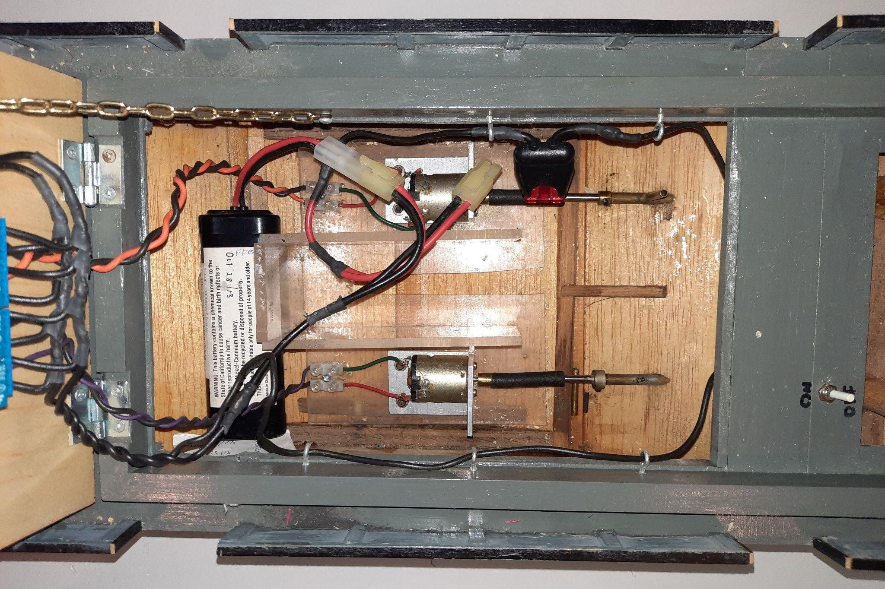
Building the PMB Boat
Slip the propeller shaft into the slots and attach to the electric motors using a small piece of automotive vacuum line. It is best to keep the angle between the motor and the propeller shaft as straight as possible. Once everything is roughly in place, use masking tape to block off the open space around the propeller shafts and fill the void with 2 part epoxy.
ovin-navigator.ca

Slide 35
Building the PMB Boat
Cut a piece of ¼ plywood to cover the opening in the main deck. Attach it to the main deck using a ½ hinge at the front. This will be the basis of the sensor deck for the upgraded autonomous version of the craft. The electronics get mounted on the underside of the sensor deck to keep them away from water.
ovin-navigator.ca

Slide 36
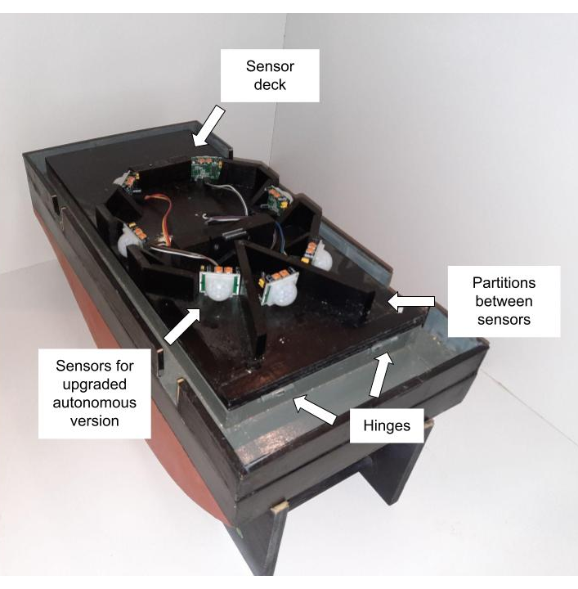
Building the PMB Boat
The top side of the sensor deck will need to be custom built to house sensors for the upgraded autonomous version of the craft. See the suggested layout.
ovin-navigator.ca

Slide 37
Building the PMB Boat
Cut another piece of ¼ plywood to cover the sensors and attach using a hinge at the back. This will form the base of the navigation deck. The navigation deck is built from ¼ plywood but is for aesthetic purposes only. A suggested configuration is shown.
ovin-navigator.ca

Slide 38
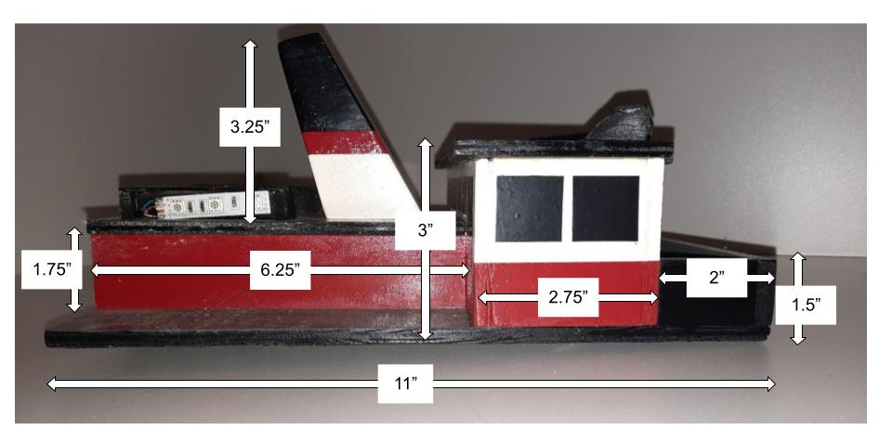
Building the PMB Boat
ovin-navigator.ca

Slide 39
Building the PMB Boat
ovin-navigator.ca

Slide 40
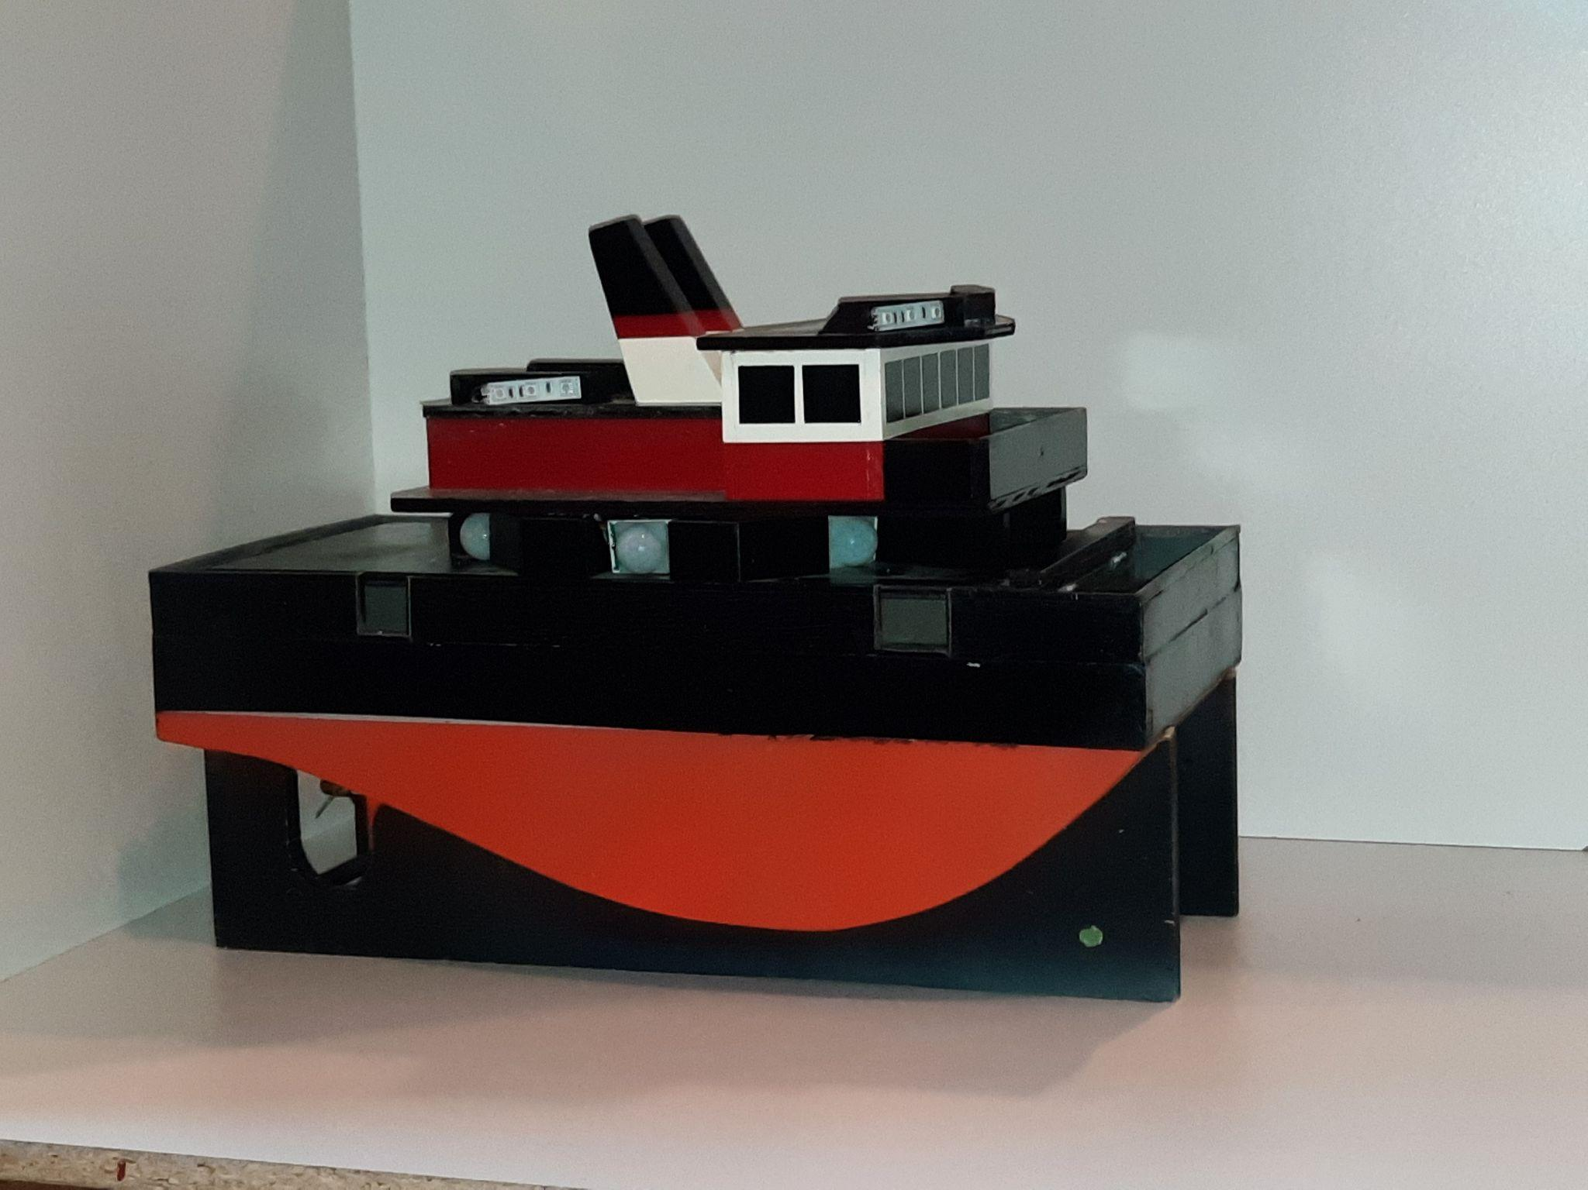
Building the PMB Boat
Up next: Wiring the boat
ovin-navigator.ca

Slide 41
Building Part 2 Wiring the Boat
Explore more at ovin-navigator.ca

Slide 42
Build Part 2: Wiring the Boat
The PMB Craft runs on a standard battery pack for radio controlled model cars and boats. Any voltage between 7.2 - 12 volts will be appropriate.
The craft will require a fuse and an on / off switch.
ovin-navigator.ca

Slide 43
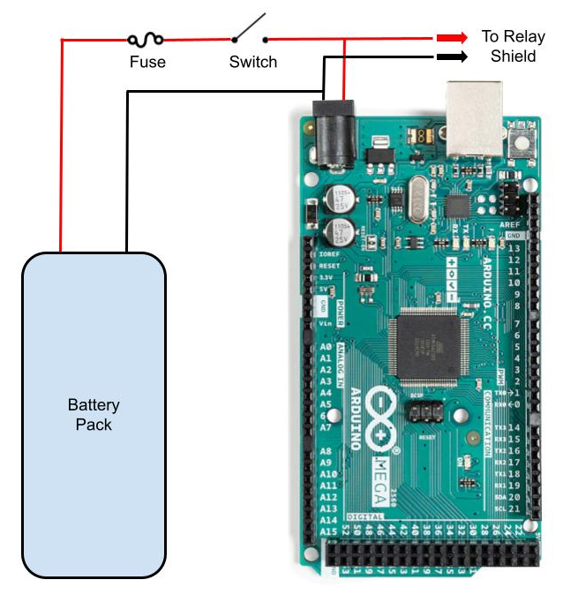
Build Part 2: Wiring the Boat
All wires are common 16 gauge automotive type wires.
As shown on the right, the 10 amp fuse will protect the craft by opening the circuit if something goes wrong.
The switch will provide a means of turning the craft on and off.
Note the two wires that split off to feed the relay shield. More about this when we wire the Arduino in the next section.
ovin-navigator.ca

Slide 44
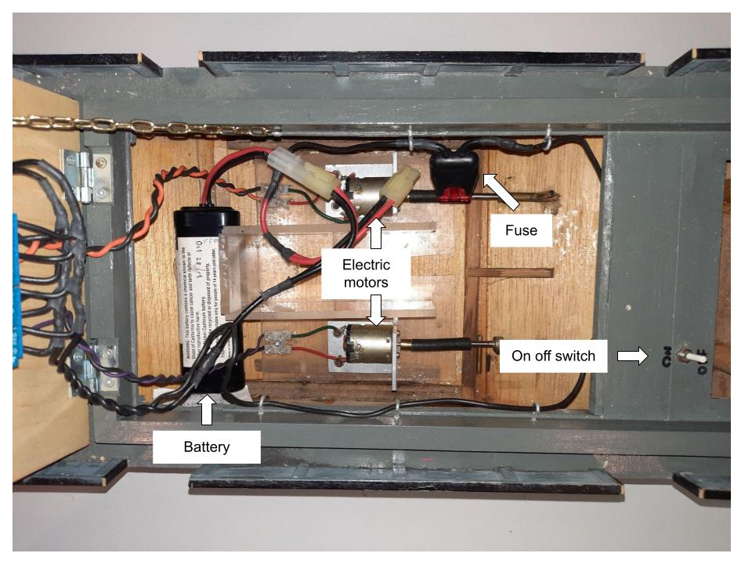
Build Part 2: Wiring the Boat
ovin-navigator.ca

Slide 45
Build Part 2: Wiring the Boat
Up next: Wiring the Arduino
ovin-navigator.ca

Slide 46
Building Part 3 Wiring the Arduino
Explore more at ovin-navigator.ca

Slide 47
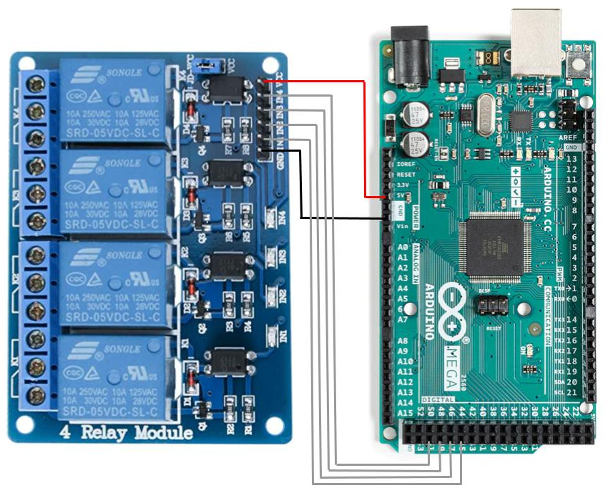
Part 3: Wiring the Arduino
Using jumper wires make the following connections from the Arduino to the relay shield
VCC pin on relay shield to 5V pin on Arduino - this powers the relay shield
GND pin on relay shield to GND pin on Arduino - this grounds the relay shield
ovin-navigator.ca

Slide 48
Part 3: Wiring the Arduino
Using jumper wires make the following connections from the Arduino to the relay shield
IN1 pin on relay shield to pin 45 on Arduino - this is how Arduino will turn on right motor forward relay
IN2 pin on relay shield to pin 47 on Arduino - this is how Arduino will turn on right motor reverse relay
ovin-navigator.ca

Slide 49
Part 3: Wiring the Arduino
Using jumper wires make the following connections from the Arduino to the relay shield
IN3 pin on relay shield to pin 49 on Arduino - this is how Arduino will turn on left motor forward relay
IN4 pin on relay shield to pin 51 on Arduino - this is how Arduino will turn on left motor reverse relay
ovin-navigator.ca

Slide 50
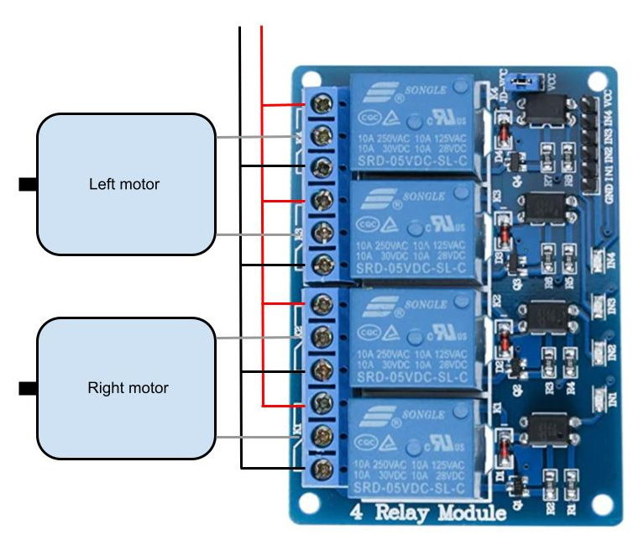
Part 3: Wiring the Arduino
Using standard 16 gauge automotive wire, connect the center terminal of the bottom relay to one side of the right motor.
Connect the center terminal of the second from bottom relay to the other side of the right motor.
ovin-navigator.ca

Slide 51
Part 3: Wiring the Arduino
Connect the center terminal of the top relay to one side of the left motor.
Connect the center terminal of the second from top relay to the other side of the left motor.
ovin-navigator.ca

Slide 52
Part 3: Wiring the Arduino
Connect the top terminal on each individual relay to battery + as shown
Connect the bottom terminal of each individual relay battery- as shown
ovin-navigator.ca

Slide 53
Build Part 3: Wiring the Arduino
Up next: Uploading the code
ovin-navigator.ca

Slide 54
Building Part 4 Uploading the Code
Explore more at ovin-navigator.ca

Slide 55
Part 4: Uploading the Code
You will need the Arduino environment on your computer. Instructions on how to install it and the environment itself can be found at:
https://www.arduino.cc/en/Guide
Next you will need to copy the code from this Google Doc:
Programmable Model Boat Code
Finally, paste the code into the Arduino environment and save it as PMB Code
ovin-navigator.ca

Slide 56
Part 4: Uploading the Code
Under “Tools” you must select the type of Arduino that is being used. This project used an Arduino Mega 2560 or equivalent.
ovin-navigator.ca

Slide 57
Part 4: Uploading the Code
Next you must verify the code to make sure there are no syntax errors. This is done by clicking on the checkmark on the top left in the Arduino environment.
It will take a few seconds for the verification process to complete.
ovin-navigator.ca

Slide 58
Part 4: Uploading the Code
Using the cable that came with your Arduino, connect it to a USB port on your computer.
Under “Tools” you must select the port that the Arduino is connected to. The Arduino should show up at the top of the list.
ovin-navigator.ca

Slide 59
Part 4: Uploading the Code
Finally, you can upload the code to your Arduino by clicking on the right arrow at the top of the Arduino environment.
A progress bar will appear and the RX and TX LEDs on the Arduino will flash rapidly.
A message will appear to let you know the code is done uploading
ovin-navigator.ca

Slide 60
Part 4: Uploading the Code
Once the Arduino is installed in the PMB Craft and powered up, the program will automatically start.
The program begins with a short delay to allow time put the craft in the water, but it should soon navigate away.
Students are encouraged to alter the program to make it navigate however they like!
ovin-navigator.ca

Slide 61
Section 3: Student Lesson
Explore more at ovin-navigator.ca

Slide 62
Lesson 1 Basic Electricity and Moving the Boat
Explore more at ovin-navigator.ca

Slide 63
Lesson 1: Basic Electricity and Moving the Boat
In this lesson students will learn:
Basic electricity and how to make a motor spin
How to change the direction of the motor by reversing polarity
How to incorporate relays to drive the motor
ovin-navigator.ca

Slide 64
Lesson 1: Basic Electricity and Moving the Boat
The ASR Craft will use a small electric motor attached to a propeller to power move craft
If the battery is connected to the motor as shown, the motor will rotate in one direction, presumably driving the ASR Craft forward
ovin-navigator.ca

Slide 65
Lesson 1: Basic Electricity and Moving the Boat
If the battery is connected to the motor as shown, the motor will rotate in the other direction, presumably driving the ASR Craft backwards
Commonly called “Switching or reversing polarity”
ovin-navigator.ca

Slide 66
Lesson 1: Basic Electricity and Moving the Boat
Next we need to install a device that will allow the small current available from an Arduino to control the larger current going to the motor.
ovin-navigator.ca

Slide 67
Lesson 1: Basic Electricity and Moving the Boat
A relay is an electrically controlled switch
When “at rest” a spring holds the switch contacts to the right as shown in the top Diagram
When power is applied to the coil it produces a magnetic field which physically pulls the switch contacts to the left as shown in the bottom diagram
Important to note that the magnetic coil and switch portions of the relay are electrically isolated from each other, they do not touch
ovin-navigator.ca

Slide 68
Lesson 1: Basic Electricity and Moving the Boat
Relays can seem complex, however if you follow the path of current flow from the positive side of the battery through the circuit and back to the negative side of the battery we can understand how (and if) the circuit is working.
The next slide will illustrate how we can use two relays to easily control one motor
ovin-navigator.ca

Slide 69
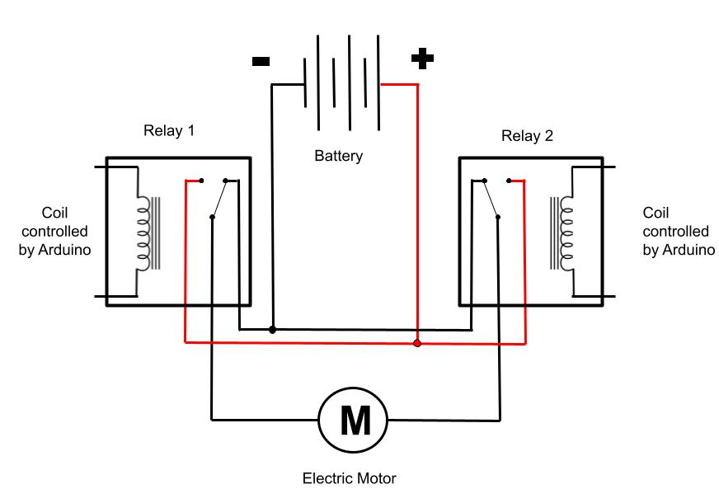
Lesson 1: Basic Electricity and Moving the Boat
In the diagram to the right we can see the relays are fed both battery + and battery -
The switch part of both relays are aligned to feed battery - to the motor
Since the motor has battery - on both sides it will not turn
ovin-navigator.ca

Slide 70
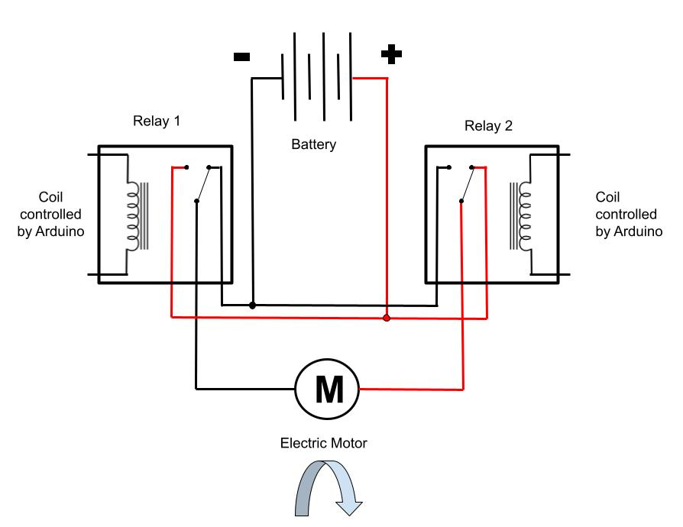
Lesson 1: Basic Electricity and Moving the Boat
In the diagram to the right relay 2 has been energized and the switch inside has flipped
This is now feeding battery+ to one side of the motor
Relay #1 is not energized so it continues to feed battery- to the other side of the motor
Since the motor has battery+ on one side and battery- on the other side it will rotate in one direction
ovin-navigator.ca

Slide 71
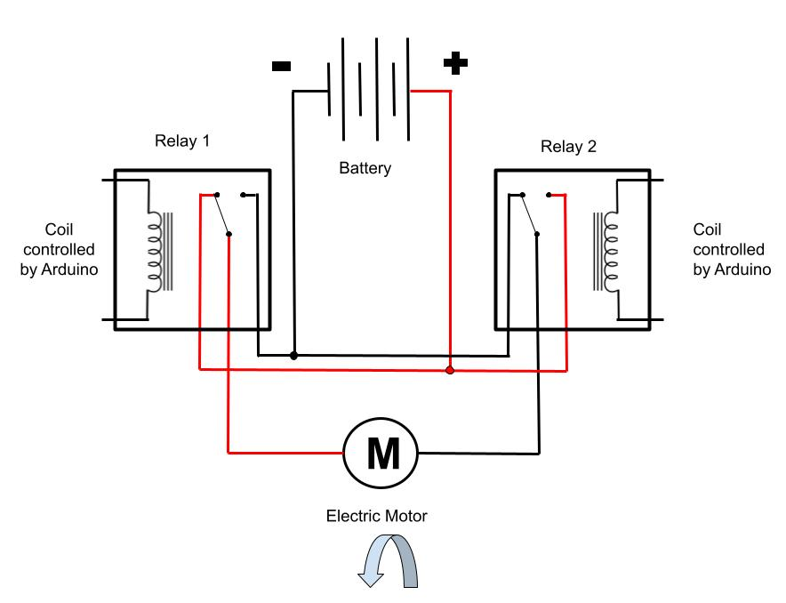
Lesson 1: Basic Electricity and Moving the Boat
In the diagram to the right relay #1 has been energized and the switch inside has flipped
This is now feeding battery+ to the other side of the motor
Relay #2 is not energized so it continues to feed battery- to the other side of the motor
Since the motor has battery+ on one side and battery- on the other side it will rotate, but this time in the opposite direction
ovin-navigator.ca

Slide 72
Lesson 1: Basic Electricity and Moving the Boat
By turning the relays on or off we can make the motor spin in one direction, or the other direction
Once the motor is connected to a propeller, this will give us the ability to drive the craft forwards or backwards
However, we still need to steer the craft
ovin-navigator.ca

Slide 73
Lesson 1: Basic Electricity and Moving the Boat
Up next: Basic electricity and steering the boat
ovin-navigator.ca

Slide 74
Lesson 2 Basic Electricity and Steering the Boat
Explore more at ovin-navigator.ca

Slide 75
Lesson 2: Basic Electricity and Steering the Boat
In this lesson students will learn:
How to use 2 electric motors to drive the craft forwards
How to steer the craft left and right
How to spin the craft on its own axis
ovin-navigator.ca

Slide 76
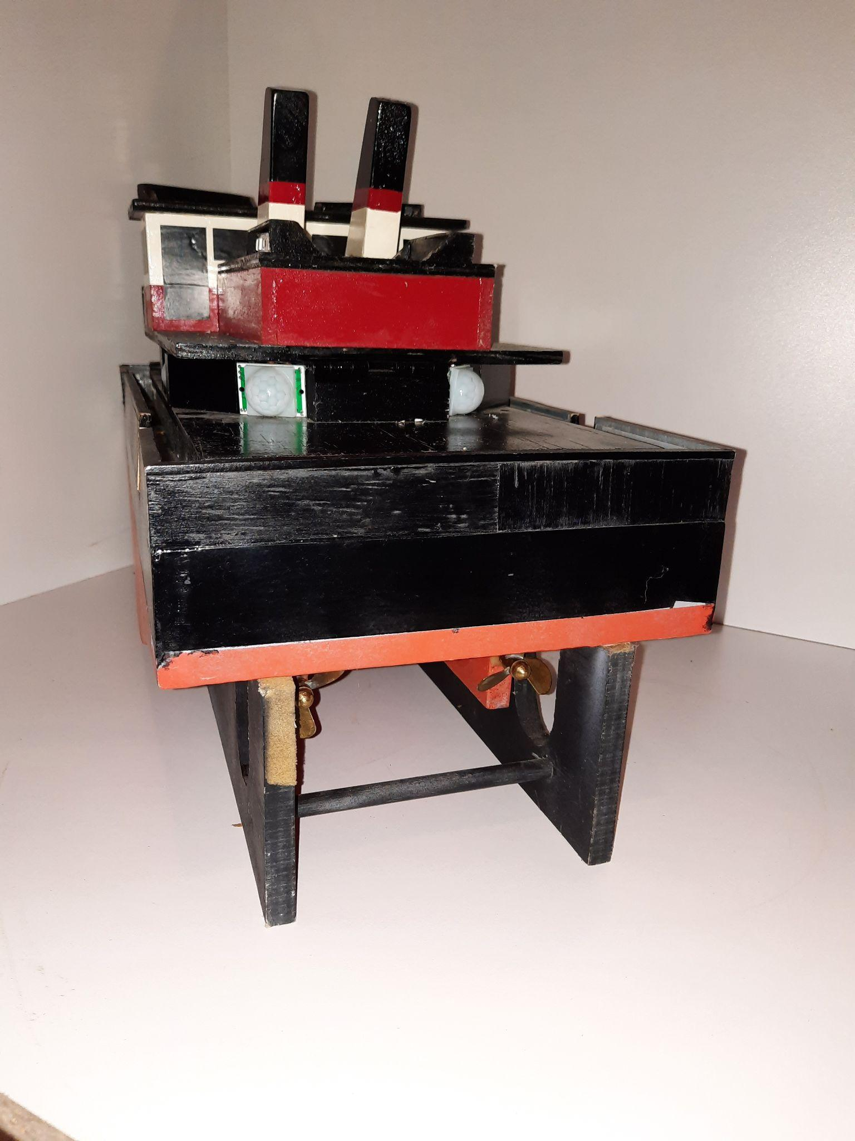
Lesson 2: Basic Electricity and Steering the Boat
The ASR craft has been constructed with 2 motors and 2 propellers
One motor / propeller is on the left side of the craft
One motor / propeller is on the right side of the craft
ovin-navigator.ca

Slide 77
Lesson 2: Basic Electricity and Steering the Boat
If we power both motors as shown on the top right, the craft will move forward
If we power both motors as shown on the bottom right, the craft will move backwards
We still need to add steering
ovin-navigator.ca

Slide 78
Lesson 2: Basic Electricity and Steering the Boat
If we only power the motor on the right, it will gently turn the craft to the left
If we only power the motor on the left, it will gently turn the craft to the right
This is how we can make the craft complete gentle turns
However, there is a way to make it turn more abruptly
ovin-navigator.ca

Slide 79
Lesson 2: Basic Electricity and Steering the Boat
If we power the left motor in the forward direction, and the right motor in the backward direction, the craft will spin clockwise
If we power the left motor in the backward direction, and the right motor in the forward direction, the craft will spin counter clockwise
ovin-navigator.ca

Slide 80
Lesson 2: Basic Electricity and Steering the Boat
Up next: Programming the Boat
ovin-navigator.ca

Slide 81
Lesson 3 Programming the Boat
Explore more at ovin-navigator.ca

Slide 82
Lesson 3: Programming the Boat
In this lesson students will learn:
How to set which pins on the Arduino will be used for what
How to set a pin to act as either an input or output
How to use simple commands to ask the Arduino to turn motors on or off
How to delay the program to allow the motors to run for a set time
ovin-navigator.ca

Slide 83
Lesson 3: Programming the Boat
Once the PMB is built and wired we have to program it
An Arduino program is called a sketch
A base sketch has been provided that will drive the Programmable Model Boat forward, spin it to the left, and the drive it forward again
Students are encouraged to modify this sketch and program the PMB to do something different
First we must understand how a few things work
ovin-navigator.ca

Slide 84
Lesson 3: Programming the Boat
We must name the pins on the Arduino that we are going to use to send power to the relays that control the motors
These pins will be used as an output only
We will declare them as outputs later
ovin-navigator.ca

Slide 85
Lesson 3: Programming the Boat
We will use pin 45 on the Arduino to turn on the relay that will turn on the right motor in the reverse direction
We will name pin 45 “rmr” for Right Motor Reverse
This will be done using the following line of code:
int rmr = 45;
ovin-navigator.ca

Slide 86
Lesson 3: Programming the Boat
We will name all of the other pins in a similar manner
Since we will use pin 47 to turn on the relay that drives the right motor forward, we will call it “rmf”
int rmf = 47;
ovin-navigator.ca

Slide 87
Lesson 3: Programming the Boat
Pin 49 will control the relay that drives the left motor in reverse
We will name it “lmr”
Pin 51 will control the relay that drives the left motor forwards
We will name it “lmf”
int lmr = 49;
Int lmf = 51;
ovin-navigator.ca

Slide 88
Lesson 3: Programming the Boat
Next we must let the Arduino know that the pins we just named will be used as outputs only
We will do this using the “pinmode” command
The following line of code will set pin 45, which we named “rmr”, as an output
pinMode(rmr, OUTPUT);
ovin-navigator.ca

Slide 89
Lesson 3: Programming the Boat
We will set the other pins we just named as outputs as well
pinMode(rmf, OUTPUT);
pinMode(lmr, OUTPUT);
pinMode(lmf, OUTPUT);
ovin-navigator.ca

Slide 90
Lesson 3: Programming the Boat
The first thing we will do is build in a 5 second delay
This will give us time to put the boat in the water after we turn it on
This will be done with the following line of code:
delay(5000);
ovin-navigator.ca

Slide 91
Lesson 3: Programming the Boat
Next it is time to move the boat by telling the Arduino to send battery+ to the relay that will move the right motor forward
This is done using the following line of code:
digitalWrite (rmf, HIGH);
In the next line of code we will ask the Arduino to do the same thing with the left motor
The craft should now be moving
ovin-navigator.ca

Slide 92
Lesson 3: Programming the Boat
We will then delay the program for 5 seconds using the delay command
The motors will remain running for this amount of time
Finally we will shut the motors off using the following code:
digitalWrite (rmf, LOW);
digitalWrite (lmf, LOW);
The motors will now shut off
ovin-navigator.ca

Slide 93
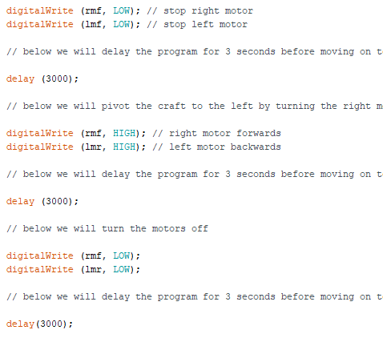
Lesson 3: Programming the Boat
Just as before, we will delay the program 3 seconds using the delay command
Next we will ask the Arduino to move the right motor forward and the left motor in reverse to spin the boat
This will be done using the digitalWrite command as shown
ovin-navigator.ca

Slide 94
Lesson 3: Programming the Boat
We will now delay the program for 3 seconds so the boat can spin, this is done using the delay command as shown
Then we will shut the motors off by setting “rmf” and “lmr” to low using the digitalWrite command
This will be followed by another 3 second delay
ovin-navigator.ca

Slide 95
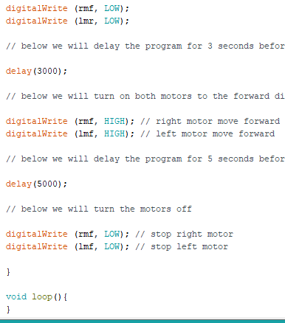
Lesson 3: Programming the Boat
Finally, we will ask the Arduino to move the boat forward again by setting “rmf” and “lmf” high
We will allow this to happen for 5 seconds by delaying the program with the delay command before setting “rmf” and “lmf” back low
The program will then end
ovin-navigator.ca

Slide 96
Lesson 3: Programming the Boat
Once students understand how the program works they are encouraged to alter the delay times to keep the boat running shorter or longer
Also consider adding code lines that will steer the boat left or right, make it spin in a different direction, or make it go through a routine
There are no limits!!!
ovin-navigator.ca

Slide 97
Lesson 3: Programming the Boat
Other lines of code that may be useful:
digitalWrite (rmf, HIGH); will turn on the right motor causing the boat to steer left
digitalWrite (lmf, HIGH); will turn on the left motor causing the boat to steer right
Or adding these two lines together will spin the boat to the right:
digitalWrite (lmf, HIGH);
digitalWrite (rmr, HIGH);
ovin-navigator.ca

Slide 98
Lesson 3: Programming the Boat
Remember once the motors are on you will have to add a delay before turning them off! Example below:
delay (5000);
The following lines of code will turn the motors off
digitalWrite (lmf, LOW);
digitalWrite (rmr, LOW);
ovin-navigator.ca

Slide 99
Pictures/Project Diagrams
ovin-navigator.ca

