Slide 1
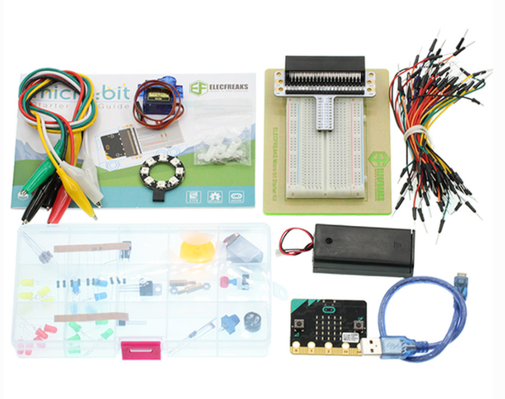
1.0 MICRO:BIT
Understanding what can drive the Micro:bit
V.1 Micro:bit & Starter Kit
TIJ10
ovin-navigator.ca
Notes:
Created by Melissa Oliver moliver@smcdsb.on.ca

Slide 2
PRIOR LEARNING
Before taking the TIJ10 course
Students Prior Knowledge:
Understand how to plug in a USB
Able to plug in adapters for battery use in the microbit
Open up website: makecode.microbit.org
Able to use a mouse to drag and drop on the screen.
Students who do not know the above should be taught prior to starting in to the lessons.
ovin-navigator.ca

Slide 3
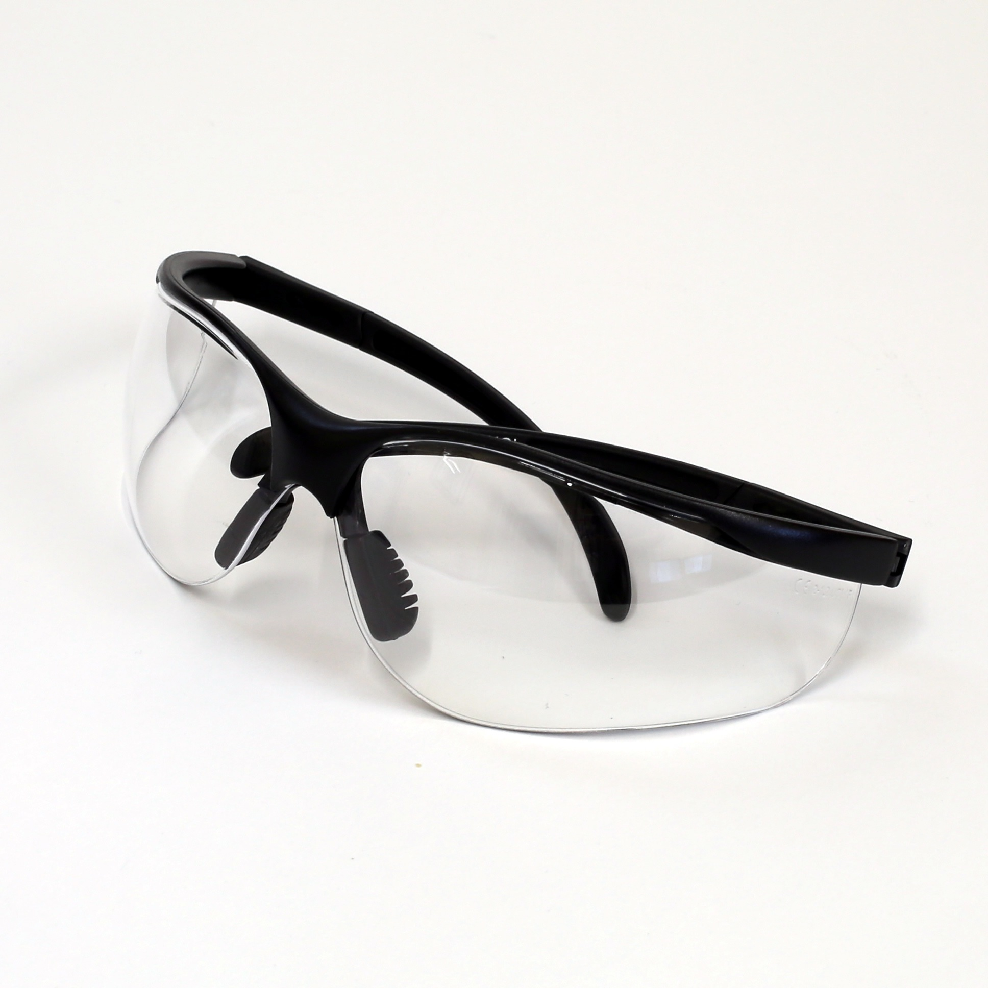
Safety Concerns (including PPE if required)
Safety glasses are suggested.
No food or liquids should be near the micro:bit and breadboard.
ovin-navigator.ca

Slide 4
Day 1
ovin-navigator.ca

Slide 5
ovin-navigator.ca

Slide 6
ovin-navigator.ca

Slide 7
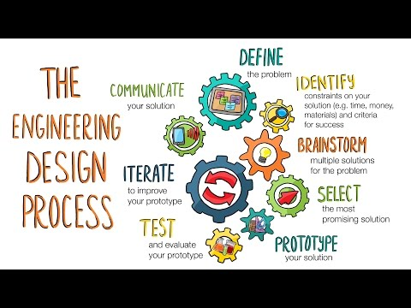
The design process that engineers use is close to the one we are using!
ovin-navigator.ca

Slide 8
Design thinking process
Whatever you build with code should serve a purpose or fill a need.
Empathize
Define
Ideate
Prototype
Test
Learn about your target audience
Understand and identify your audience’s problem and need
Brainstorm several possible creative solutions
Construct rough drafts or sketches of your ideas
Test your prototype solutions and refine until you come up with the final version
ovin-navigator.ca
Notes:
In this activity, you’ll interview each other about your ideal pet. Be sure to take notes in your workbooks. The first step in coding by design involves understanding someone else’s need. Then, you can create prototypes that get you closer and closer to the best solution. Our prototypes will be simple drawings.

Slide 9
Interview your partner about their ideal car
JAMBOARD
Suggested questions:
General interest questions:
What car would you like to own? why?
What transportation do you take? why?
Have you ever been on any mode of transportation that is electric? When? What were you doing?
Why do you think everyone wants to go to electric cars?
The goal is to find out more about your partner by asking questions. Try to ask “Why?” as much as possible. Your partner will tell you about his or her ideal pet, but you are really finding out more about your partner’s likes and dislikes. When we design, we create real things for real people. So we need to start with understanding them first.
ovin-navigator.ca
Notes:
TEACHERS: You can link your JAMBOARD to the button. Other ways to gather information: Class discussion, parking lot of sticky notes, jamboard, etc.

Slide 10
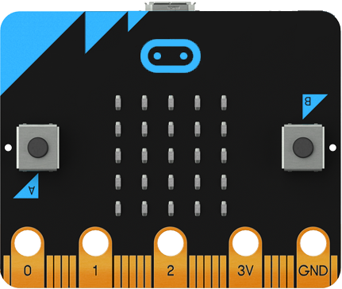
Design process:
Now that you have discussed with your partner items about electric vehicles. Think of what matters most in an electric vehicle. Select 3 features that you would want to make sure your electric car had?
ENGINEER NOTEBOOK
Item #1
Item #2
Item #3
ovin-navigator.ca

Slide 11
END TASK IN MIND
For the next few days we will be learning about circuits and how they work with different lights, sensors and even a small motor. But we want to connect this all to something we can make change with. Connecting the auto industry and the Global Goals can create change and meaning to our project.
What could you create?
https://microbit.org/projects/do-your-bit/

Slide 12
ovin-navigator.ca

Slide 13
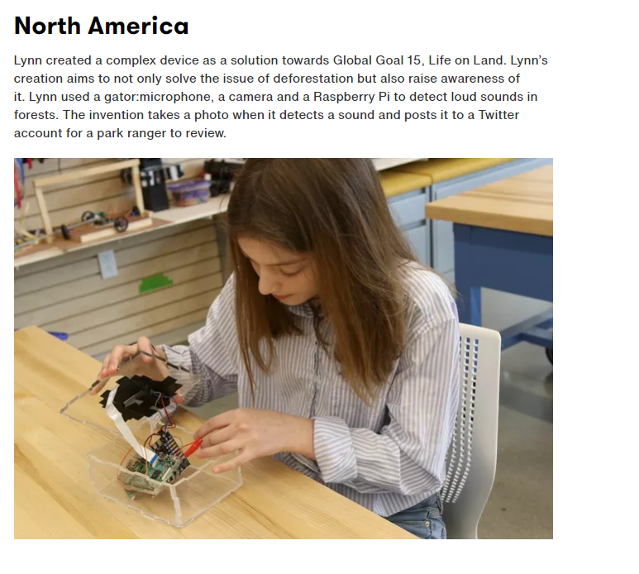
Curriculum Expectation: Students will develop an awareness of related environmental and societal issues, and will begin to explore secondary and postsecondary pathways leading to careers in the field.¹
Global Goals
Our focus
ovin-navigator.ca
‹#›
Notes:
The Ontario Curriculum, Grades 9 and 10: Technological Education, 2009 https://www.edu.gov.on.ca/eng/curriculum/secondary/teched910curr09.pdf

Slide 14
Design process:
Looking at the Global goals of #9 and #11 what are some problems what are some problems the Automotive industry faces?
ENGINEER NOTEBOOK
Problem #1
Problem #2
Problem #3
ovin-navigator.ca

Slide 15
Now let’s see if the microbit can solve one of those problems.

Slide 16
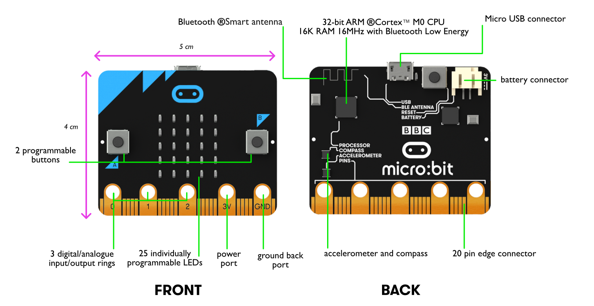
The micro:bit is a computer
Move the arrow to the processor and label it.
ovin-navigator.ca
Notes:
TEACHERS: Have students go over the parts and find the parts of the Micro:bit
Using the arrow have the students drag the point to the processor and label it.

Slide 17
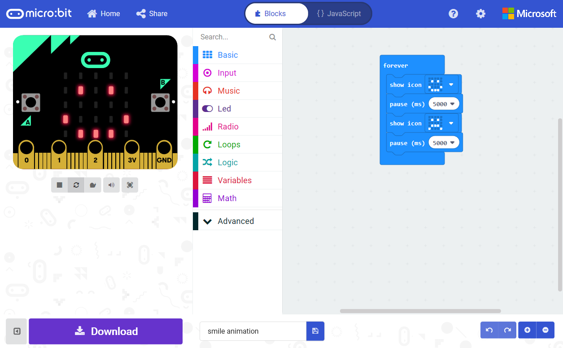
Using the makecode website here is what you will see once you make your first file.
Share your Project
Go back to Home Page
Program in either Blocks or JavaScript
Block Toolbox
Simulator shows what your program will look like running on a micro:bit
Programming Workspace where you will build your program
Simulator Toolbar
Undo/Redo and
Zoom Workspace
Download your Project to the micro:bit
Name your Project and Save it on your computer
ovin-navigator.ca
Notes:
TEACHERS: Using the software that goes with the micro:bit to go over the parts that students will be using. Perhaps printing this slide out and having it as a resource near students would be good.

Slide 18
MAKECODE WEBSITE
LINK
ovin-navigator.ca

Slide 19
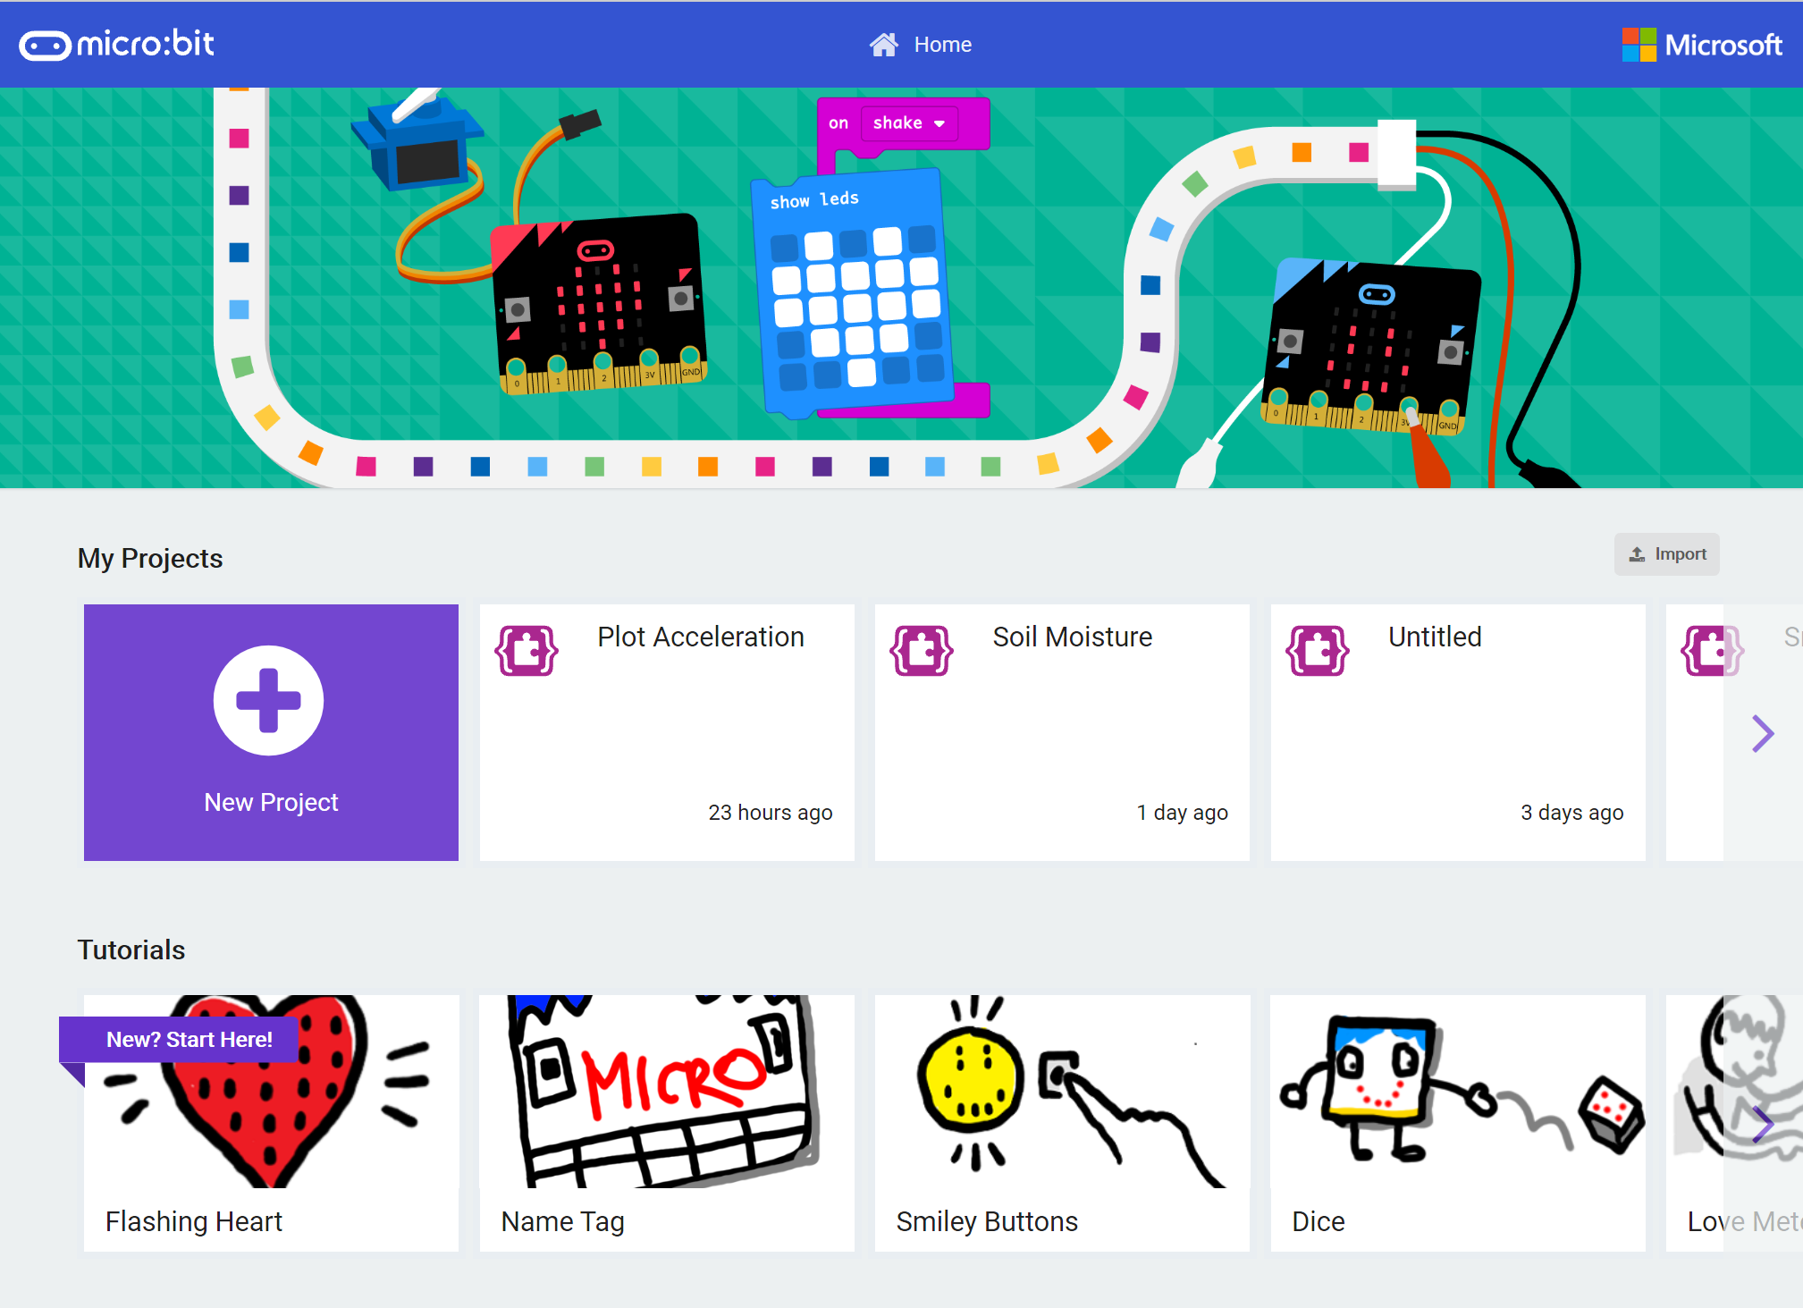
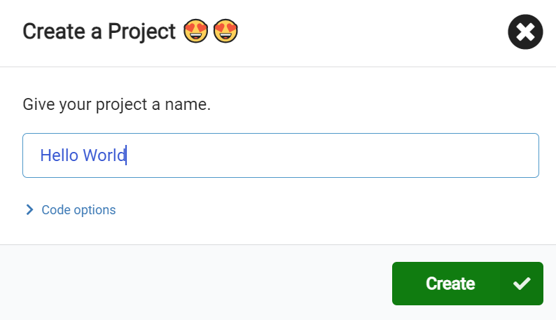
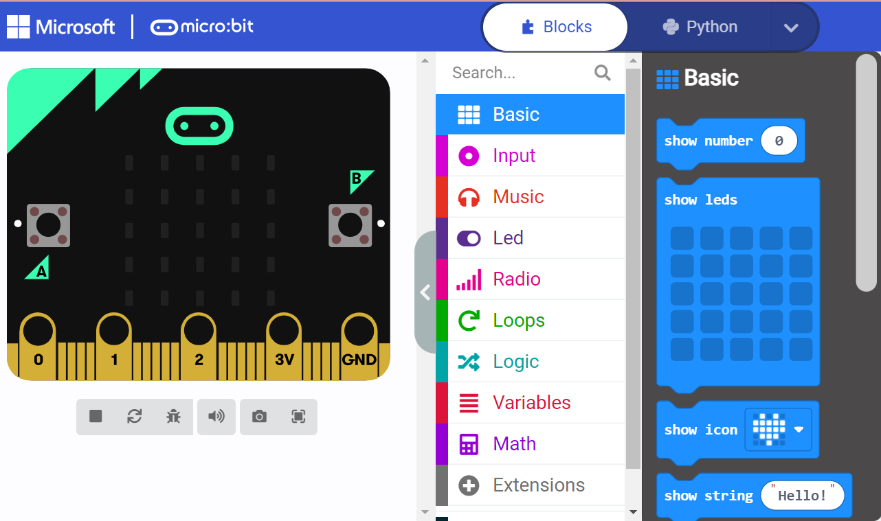
In MakeCode, create a New Project
Click on
“Show String “Hello”
ovin-navigator.ca

Slide 20
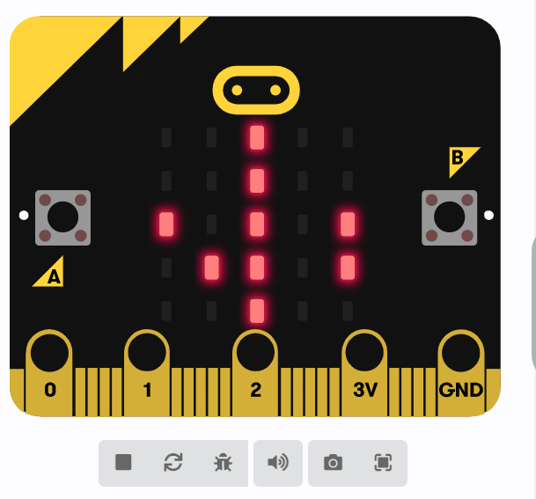
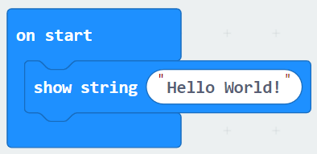
Change the text to read Hello World! (this is a famous way coders start coding in a new language they always write Hello World as their first line of code.)

Slide 21
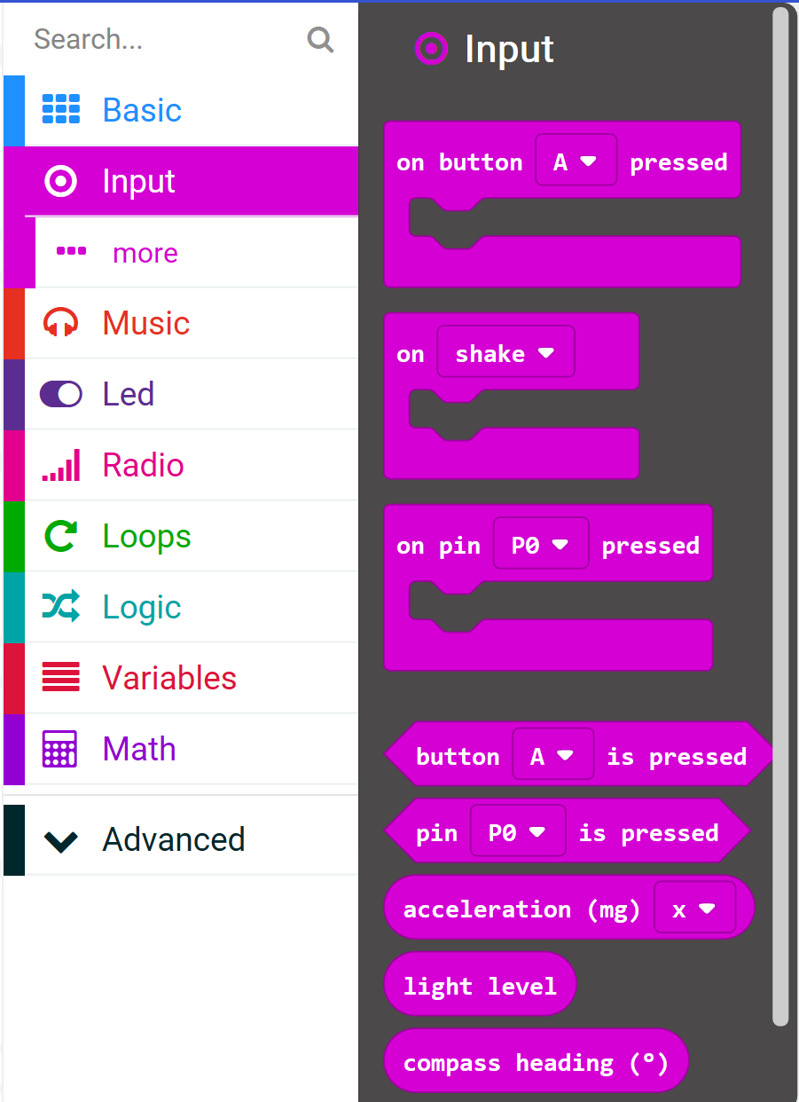
Take a look through all of the side panel to see what you might recognize or what might spark your interest.
Can you figure out how to make music?
Available Inputs v.1
Acceleration
Light level
Button is pressed
Compass heading
Temperature
Running time
On shake
On button pressed
On logo down
On logo up
One pin pressed
On screen down
On screen up
Pin is pressed
ovin-navigator.ca

Slide 22
Day 2
ovin-navigator.ca

Slide 23
MAKECODE WEBSITE
LINK
ovin-navigator.ca

Slide 24
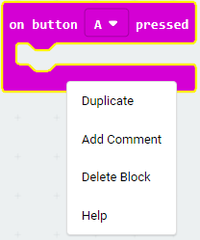
Adding Comments to your code
Right click on a block and you get even more features! Add a comments to your Code: Using a #and then the text is the way coders tell other coders what their codes is about.
(and reminds you too!)
Notes:
TEACHERS: Having students write comments in their code can show you their thinking and understanding of what the code is doing. Similarly you could write coding questions for students to answer as they work through their code challenge.

Slide 25
Let’s look at LED lights
ovin-navigator.ca

Slide 26
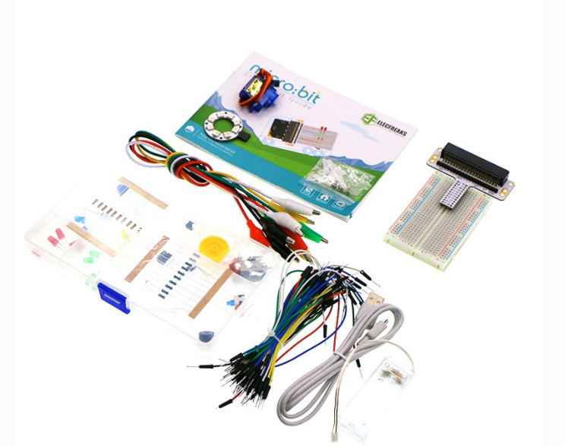
Microbit with STARTER KIT (If you do not have the starter kit then you will be doing everything we do in TINKERCAD. Makecode does have some options to use external extensions like this as well for beginners.)
ovin-navigator.ca
Notes:
Screen snips have been adapted to a slidedeck from Elecfreaks site for the introduction to the microbit https://wiki.elecfreaks.com/en/microbit/circuit-design/microbit-starter-kit/starter_kit_case_01

Slide 27
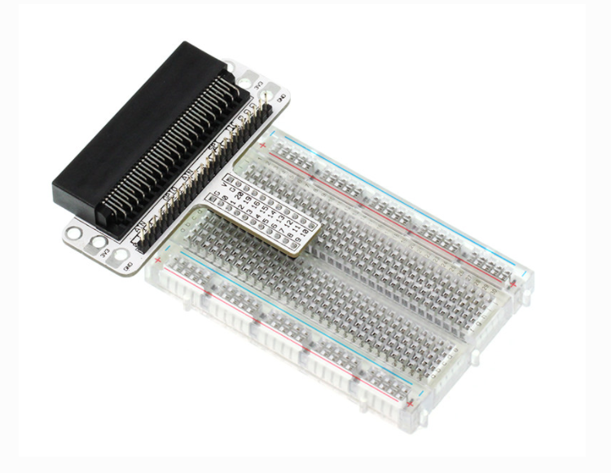
Connect the Micro:bit Breadboard Adapter to the breadboard
ovin-navigator.ca

Slide 28
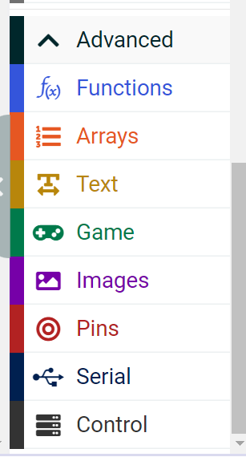
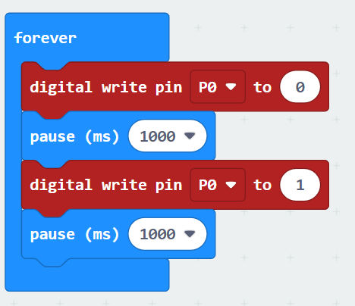
Next go into makecode and copy the code below.
The “Forever” block is a blok that loops any other command block inserted into it over and over again… forever
What do you think this code would do?
Watch the video on the next slide to find out.
ovin-navigator.ca

Slide 29
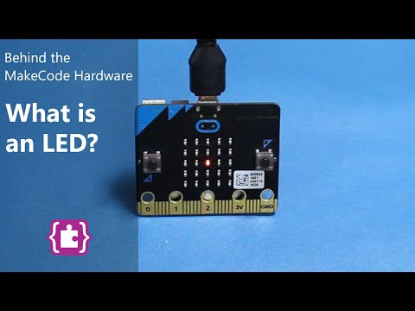
What is an LED?
ovin-navigator.ca

Slide 30
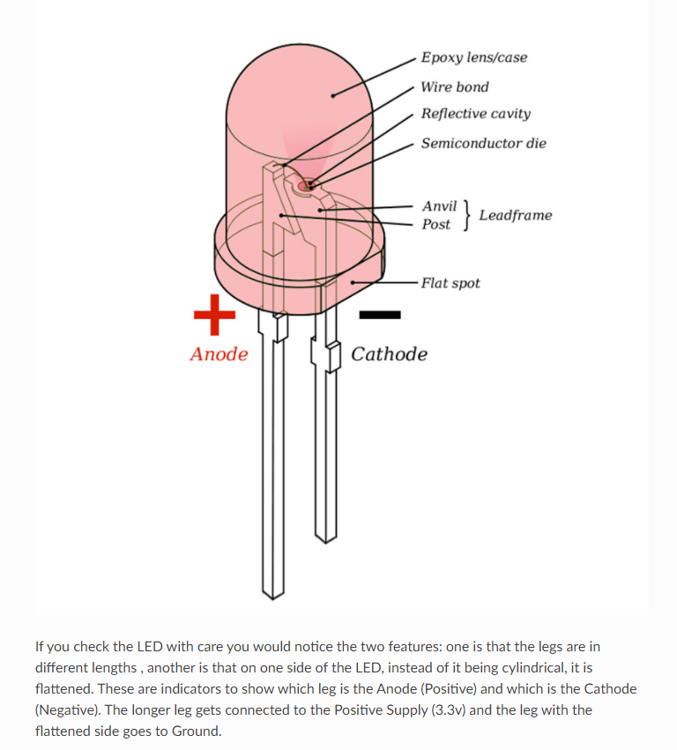
LED Light (Light Emitting Diodes)
ovin-navigator.ca

Slide 31
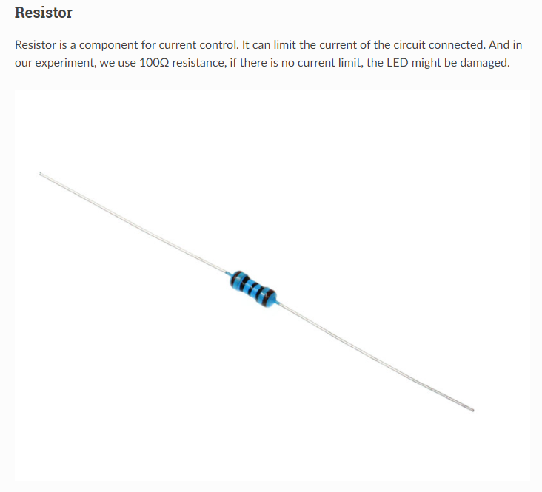
Resistor
ovin-navigator.ca

Slide 32
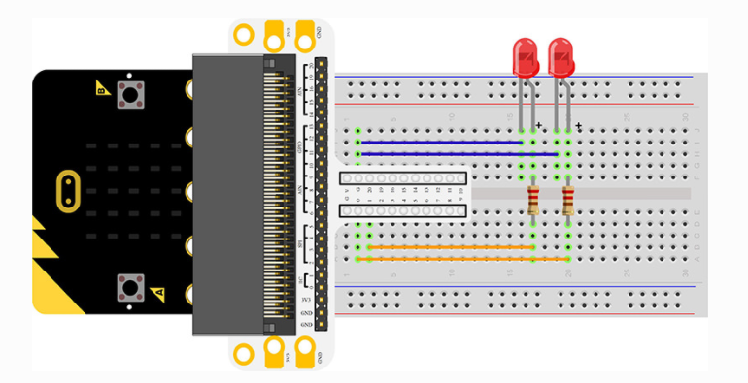
Connecting your components
Connect your components according to the picture below:
Connect the shorter leg with the GND
Connect the longer leg with the P0 and P1 ports through the resistor.
(NOTE: This photo shows the light in the wrong order)
ovin-navigator.ca

Slide 33
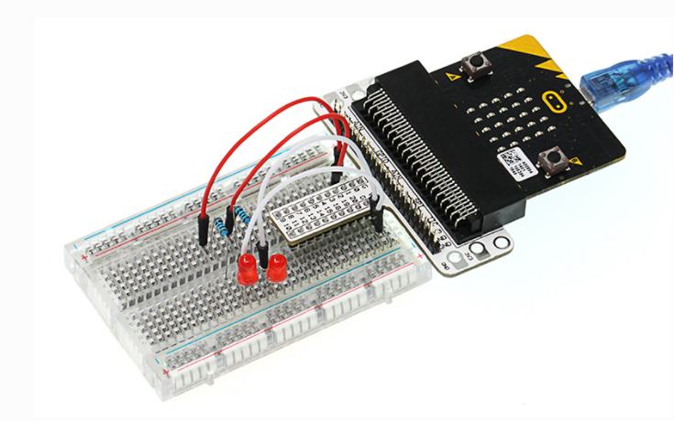
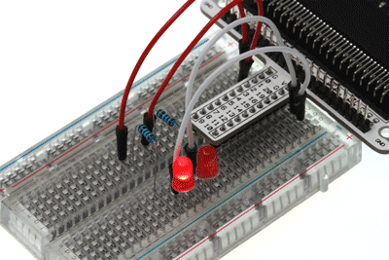
Physically what your breadboard should look like
ovin-navigator.ca

Slide 34
Task A:
If we want to control 4 LEDs and make them illuminated in turns, how can we design the circuit and code?
Challenge Time
OR
Task B:
How can we make an RGB traffic light?

Slide 35
Paste your ideas for what your group came up with for code:
Did it work?
If not where did you go wrong?
ovin-navigator.ca

Slide 36
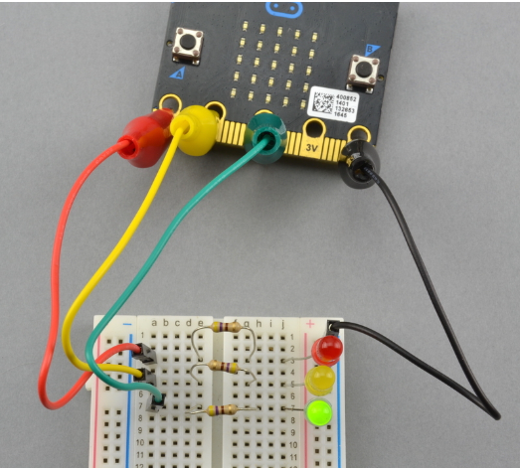
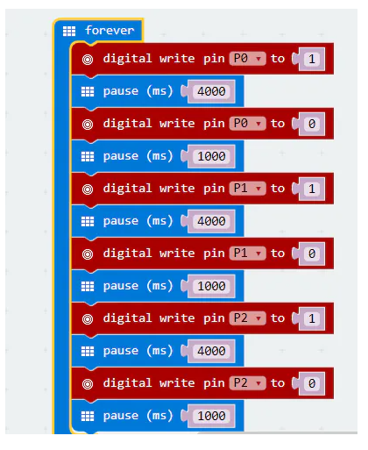
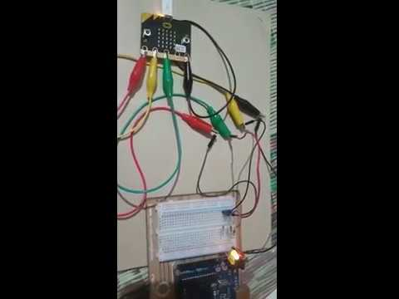
TEACHER:
Code for Traffic Light
LINK TO VIDEO
ovin-navigator.ca

Slide 37
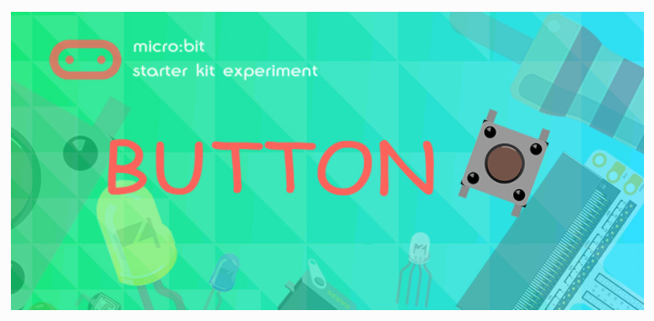
Let’s look at making a button work
ovin-navigator.ca

Slide 38
What is a button?

Slide 39
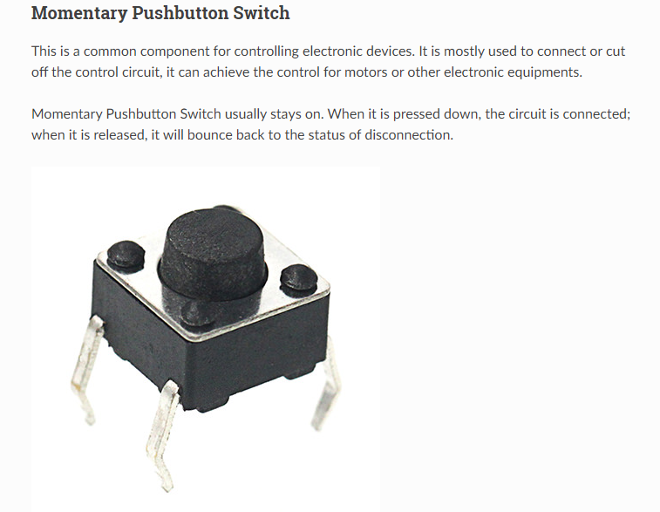
Buttons or Pushbuttons
ovin-navigator.ca

Slide 40
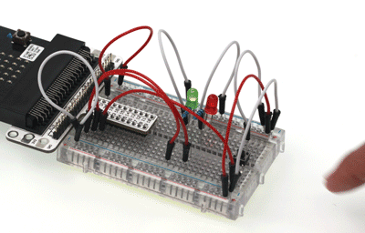
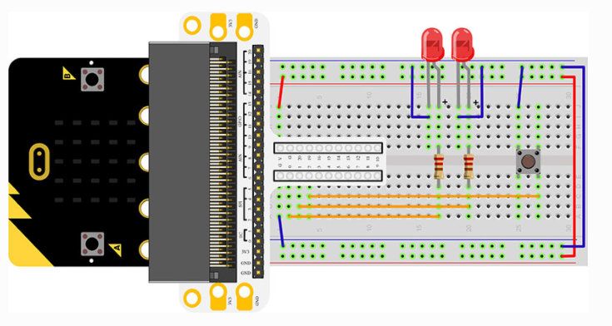
Hardware Connection for button
Connect your components according to the picture.
Connect the longer leg with the GND
Connect the shorter leg with the P0 and P1 ports through the resistor
Connect the Momentary pushbutton to P2 port
ovin-navigator.ca

Slide 41
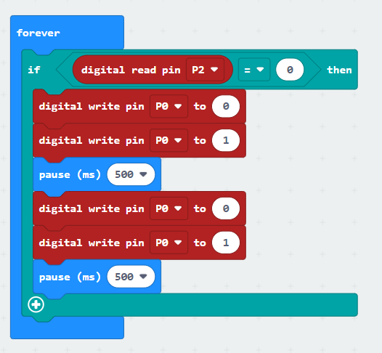
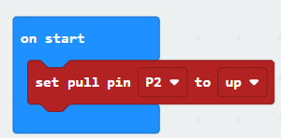
Code for the button
Read the status from P2 to chekc if the button is pressed, if yes, digital write signal 0 to P0 port to turn off the LED; digital write signal 1 to P1 prot to turn on the LED, then set the pause in 500ms; digital write signal 1 to P0 port to turn on the LED; digital write signal 0 to P1 port to turn off the LED, then set the pause to 500ms.
ovin-navigator.ca

Slide 42
Challenge Time
BREAK OUT INTO PAIRS To try this challenge
If we want to light on the red LED when press the button and the light on the green LED when release the button, how can we program that?

Slide 43
Paste your ideas for what your group came up with for code:
Did it work?
If not where did you go wrong?

Slide 44
ovin-navigator.ca

Slide 45
TRIMPOT
ovin-navigator.ca

Slide 46
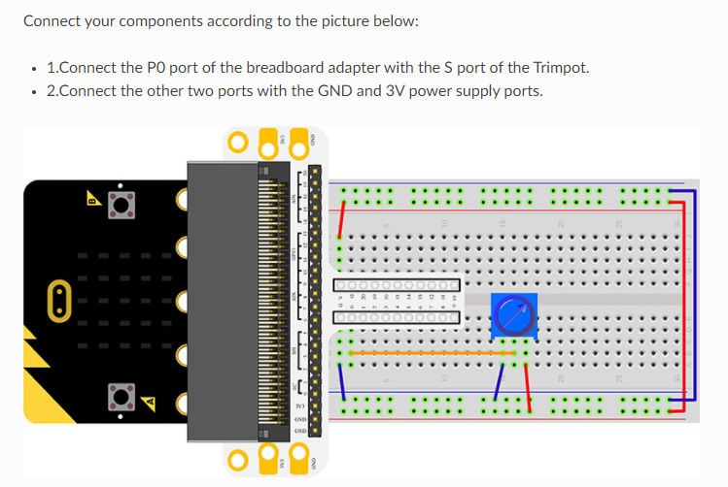
ovin-navigator.ca

Slide 47
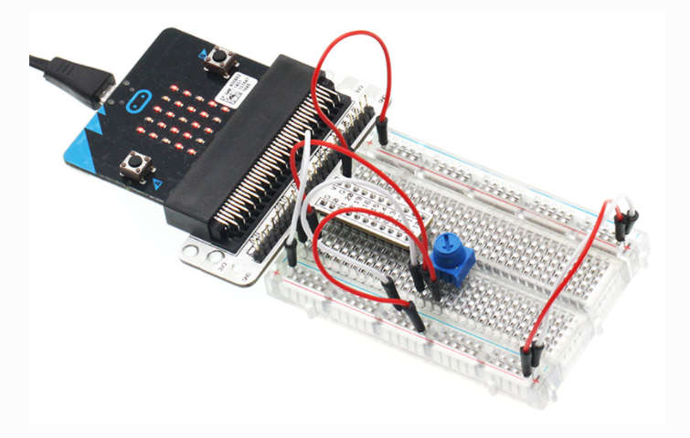
What it looks like connected
ovin-navigator.ca

Slide 48
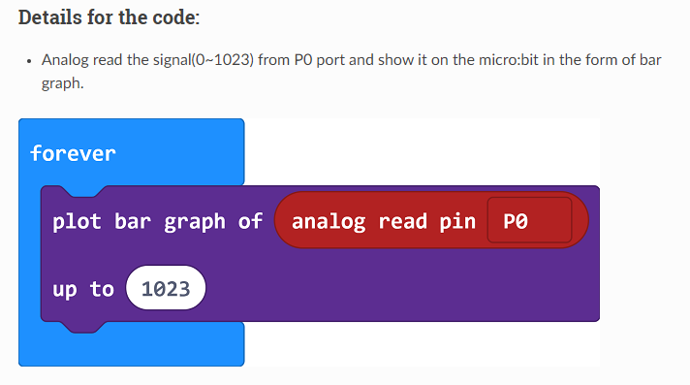
CODE
ovin-navigator.ca

Slide 49
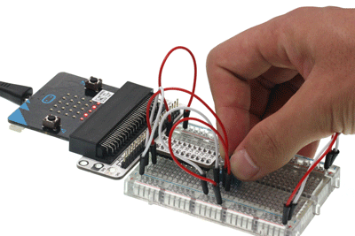
TRIMPOT
How do we adjust the brightness of a LED, how can we design the circuit and program?
ovin-navigator.ca

Slide 50
Day 3
ovin-navigator.ca

Slide 51
Let’s try the next one as a whole class
ovin-navigator.ca

Slide 52
ovin-navigator.ca

Slide 53
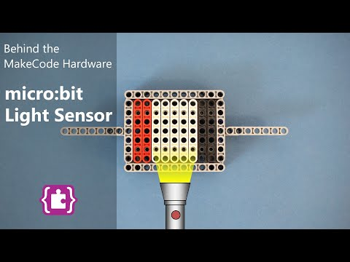
What is a light sensor
(Warning beginning is a bit cheesy! lol) Watch till 3:36
Do you have a night light still?
YES?
NO?
ovin-navigator.ca

Slide 54
Photocell
ovin-navigator.ca

Slide 55
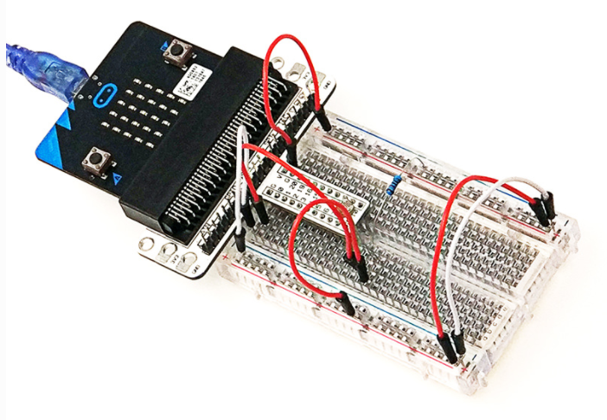
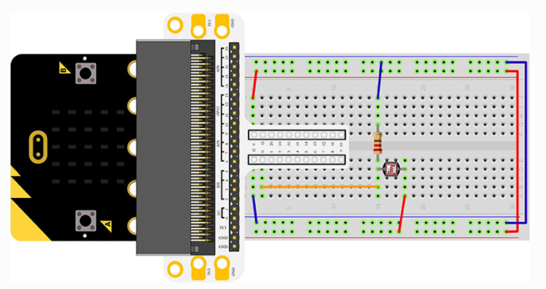
What it looks like connected
Connect your components according to the photo below:
Connect the photocell to P0 port
Connect the brown resistor with the photocell
ovin-navigator.ca

Slide 56
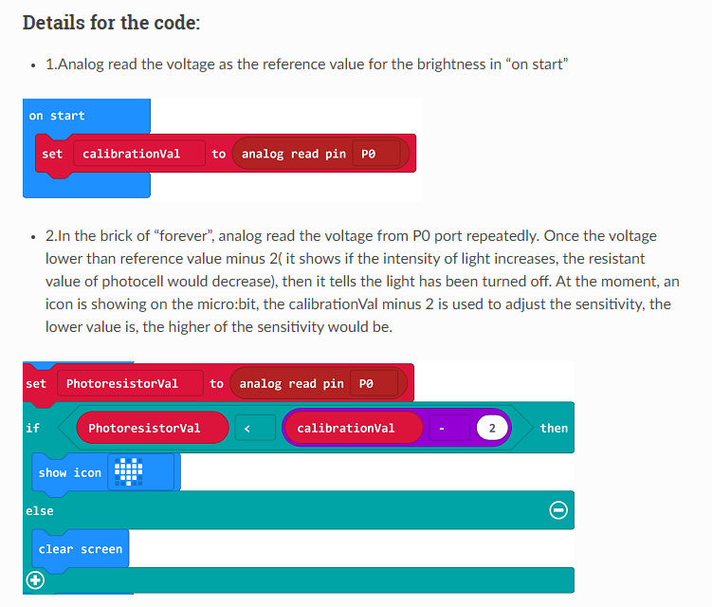
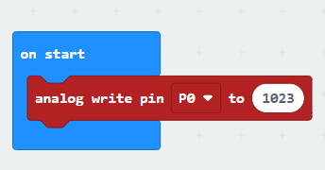
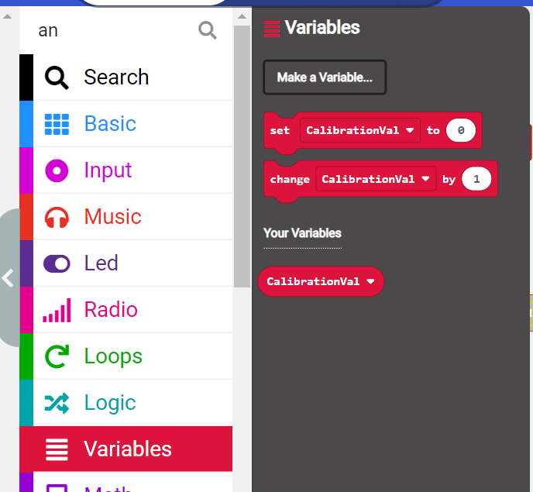
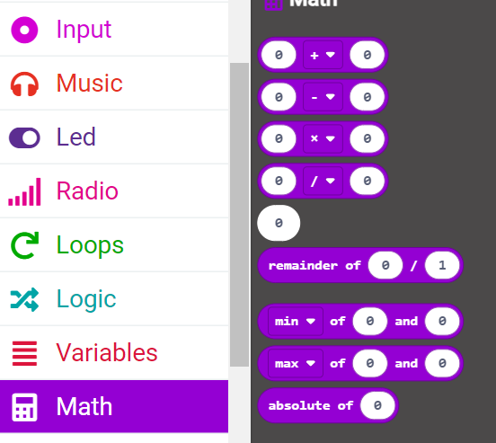
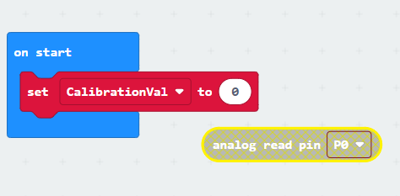
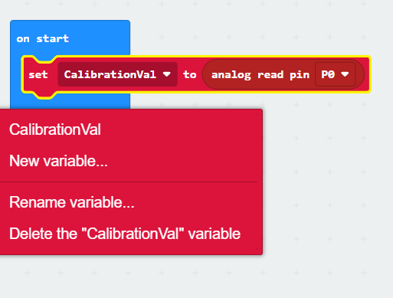
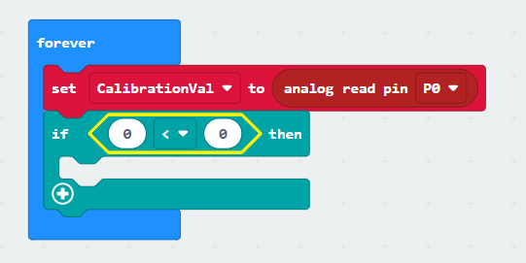
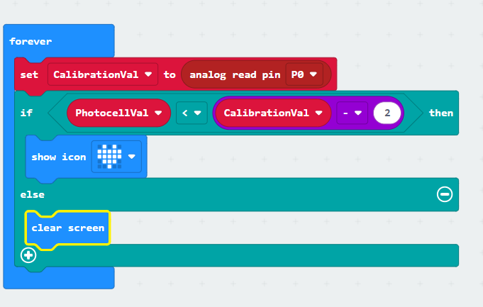
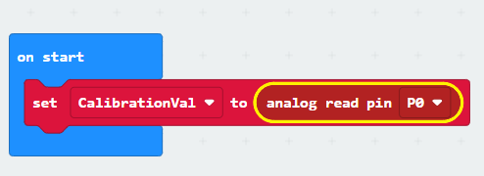
CODE: The reasoning behind what we are doing
In the brick of “forever”, analog read the voltage from P0 port repeatedly. Once the voltage lower than reference value minus 2 (it shows if the intensity of light increases, the resistant value of photocell would decrease), then it tells the light has been turned off. At the moment, an icon is showing on the micro:bit the calibrationVal minus 2 is used to adjust the sensitivity, the lower value is, the higher of the sensitivity would be.
Click on each screen snip below and enlarge the photo to see your next step. (there are 8 total photos)
ovin-navigator.ca

Slide 57
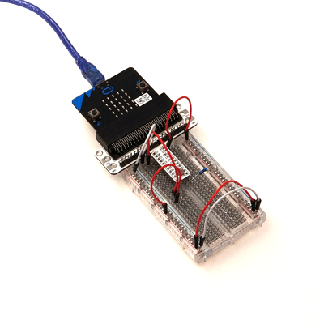
Photocell at work
ovin-navigator.ca

Slide 58
SElect one of the following to complete on your own
ovin-navigator.ca

Slide 59
ovin-navigator.ca

Slide 60
RGB LED
ovin-navigator.ca

Slide 61
RGB LED Set up

Slide 62
What it looks like connected
ovin-navigator.ca

Slide 63
Code for RGB light
ovin-navigator.ca

Slide 64
What it looks like connected
ovin-navigator.ca

Slide 65
ovin-navigator.ca

Slide 66
Self- lock Switch
ovin-navigator.ca

Slide 67
Self-Lock switch set up
ovin-navigator.ca

Slide 68
What it looks like connected
ovin-navigator.ca

Slide 69
How to set up the code
ovin-navigator.ca

Slide 70
What it looks like connected
ovin-navigator.ca

Slide 71
ovin-navigator.ca

Slide 72
ovin-navigator.ca

Slide 73
The Servo motor
ovin-navigator.ca

Slide 74
Set up of the servo motor
ovin-navigator.ca

Slide 75
Day 4
ovin-navigator.ca

Slide 76
SElect Three of the following to show the teacher or attach a video of your code and your micro:bit breadboard
ovin-navigator.ca

Slide 77
ovin-navigator.ca

Slide 78
The Buzzer
ovin-navigator.ca

Slide 79
The Buzzer
ovin-navigator.ca

Slide 80
The Transistor
ovin-navigator.ca

Slide 81
Set up of the Buzzer
ovin-navigator.ca

Slide 82
How it looks set up and the code
ovin-navigator.ca

Slide 83
ovin-navigator.ca

Slide 84
The Motor
ovin-navigator.ca

Slide 85
Alligator Clips and Diodes
ovin-navigator.ca

Slide 86
How to connect the alligator clips
ovin-navigator.ca

Slide 87
How the set- up looks
ovin-navigator.ca

Slide 88
The physical set up
ovin-navigator.ca

Slide 89
The code
ovin-navigator.ca

Slide 90
How it should work
ovin-navigator.ca

Slide 91
Find different ones to try out below
ovin-navigator.ca

Slide 92
Click on the picture to get to the instructions and the code
ovin-navigator.ca

Slide 93
Click on the picture to get to the instructions and the code
ovin-navigator.ca

Slide 94
Click on the picture to get to the instructions and the code
ovin-navigator.ca

Slide 95
Click on the picture to get to the instructions and the code
ovin-navigator.ca

Slide 96
Click on the picture to get to the instructions and the code
ovin-navigator.ca

Slide 97
Final PROJECT

Slide 98
ovin-navigator.ca

Slide 99
Design thinking process
Whatever you build with code should serve a purpose or fill a need.
Empathize
Define
Ideate
Prototype
Test
Learn about your target audience
Understand and identify your audience’s problem and need
Brainstorm several possible creative solutions
Construct rough drafts or sketches of your ideas
Test your prototype solutions and refine until you come up with the final version
ovin-navigator.ca
Notes:
In this activity, you’ll interview each other about your ideal pet. Be sure to take notes in your workbooks. The first step in coding by design involves understanding someone else’s need. Then, you can create prototypes that get you closer and closer to the best solution. Our prototypes will be simple drawings.

Slide 100
Empathize
Which area did you pick?
Think about who the group of #9 or #11 GLOBAL GOALs are being affected. What is causing them problems? Think about the auto industry and how is the auto industry responding to the issues in #9 and #11?.
LIst what you already know about the answers.
ovin-navigator.ca

Slide 101
Define
Using a mind map software like MINDOMO
1. Create a mindomo map like the tree in the video and in the centre write in a problem related to the goal you have picked, that you would like to solve.
2. Write in 5 main causes as the first set of roots under the tree.
3. Then pick one of those causes and write down 4-6 reasons for why this may be the case.
ovin-navigator.ca
Notes:
What are the causes of the problems would be in the roots of the tree.

Slide 102
IDEATE
Brainstorm solutions for the problems that you have identified using your reasoning so far to help with the process.
ovin-navigator.ca

Slide 103
Prototype
From the ideas you came up with draw out what your micro:bit prototype could be in order to address an aspect of one of the goals selected. Be sure to label
What lessons would you incorporate into your prototype:
Just a note: You want to try to have at least 3 of the lessons we did in class demonstrated here. We will code them in MICRO: BIT

Slide 104
CODE
Write out the code in micro:bit or in tinkercad to see if it will work virtually. Screenshot your code here once you have it working the way you want.
ovin-navigator.ca

Slide 105
Showcase

Slide 106
SHOWCASE Questions to be answered in VIDEO or in class presentation
Pretend you are showing your creation to a board room of Microsoft and Apple executives. Now you have been give 5-10 mins max to convince them that this prototype is worth their time and investment.
Give a demo of how it works (simulator or actual device)
Show how the code works (Explain the code with the language and terms you were taught in the slideshows)
Show how you assembled the physical/maker component
Tell us how you used one concept you already knew
Tell us how you learned something new
What was your biggest hurdle to get over?
What are you most proud of?
(this needs to be done in a video format so that I can see your code, your micro:bit and you can explain freely how the code works.)

Slide 107
Day 1 Photo of PROTOTYPING

Slide 108
Day 2 Photo of PROTOTYPING

Slide 109
Day 3 Photo of PROTOTYPING

Slide 110
TEST
PASTE YOUR VIDEO HERE WITH YOUR PROTOTYPE AND YOUR VIDEO (Insert> Video> Google Drive> select your video that you put in google drive > then click SELECT) This will place the actual video in the slideshow.
ovin-navigator.ca

Slide 111
Prototype RUBRIC for connecting the Automotive sector with the Global Goals of 9 and 11
PRINT VERSION
Assessment elements | R | 1 | 2 | 3 | 4
Code - Show what you know- Must have at least 2-3 functions /40 | Not enough evidence to show your understanding | Code does not demonstrate previous concepts, is not efficient, variable names not clear. | Code only partially demonstrates previous concepts, and/or is not efficient, variable names not clear. Is missing 2 of the 4 inputs or 3 outputs | Code only partially demonstrates previous concepts, and/or is not efficient. Is missing 1 of the 3 inputs. | Code very effectively demonstrates the use of concept(s). There were notes within the code that explain various parts and how they connect. Code uses a various elements. Able to Code is highly efficient and organized Demonstrated forward thinking of new concepts not taught in class.
Maker component of prototype /20 | No prototype was created | Breadboard was not utilized | Tangible component does not add to the functionality of the program. (meaning it could all run just on a breadboard without the microbit) | Tangible component is somewhat integrated with the micro:bit but is not essential. 2-3 components are tied to the theme and the industry. | Tangible component is tightly integrated with the micro:bit and all 3-4 components tie into the Auto industry and a narrative that demonstrates an understanding of the global goals.. Can see clearly how this could be effective prototype for a company to make in the auto industry. All components are necessary and connect to the overall global goal selected.
Prototype Design /10 | No design at all | The design or concept is not really there. Missed the point of the project theme and just coded what you want. | There are some items on the prototype that do not help with the theme. The design is too simplistic or is too confusing to work for the set goal. | There are some items on the prototype that do not connect to one of the themes of: Security, Weather or Time of Day. The design needs a bit of refinement but clearly functions well for the set goal | Clearly demonstrated the connection to the Automotive Industry and how the Micro:bit can help. The Prototype has integrated design elements as well as functionality and purpose for the set goal.
Showcase /20 | No video was turned in and no presentation was seen | Code not seen but microbit simulator or physical microbit was. Questions were answered but showed limited understanding | Questions were answered somewhat. Very little detail was provided. Showed code but did not explain each part or did not show all of the circuit connections. | Questions were answered very casually. Professional language was not used. Limited terms were used to explain code. Automotive goal was not mentioned. | Video or presentation, clearly explains the prototype to the Automotive Industry Committee. Demonstrates what was coded in MAKECODE. How each of the functions work on the circuit board. Uses the language that has been taught for this unit to explain the code. Responded to all questions clearly and demonstrated mastery of skill.
ovin-navigator.ca
Notes:
Printer Friendly version of this available.

