Slide 1
Micro:bit Resource
BBT Area: Computer Technology
Target Course(s):TIJ10 and TEJ20
Explore more at ovin-navigator.ca
Notes:
Adapted by Melissa Oliver moliver@smcdsb.on.ca from http://wiki.elecfreaks.com/en/microbit/circuit-design/microbit-starter-kit/starter_kit_case_01/

Slide 2
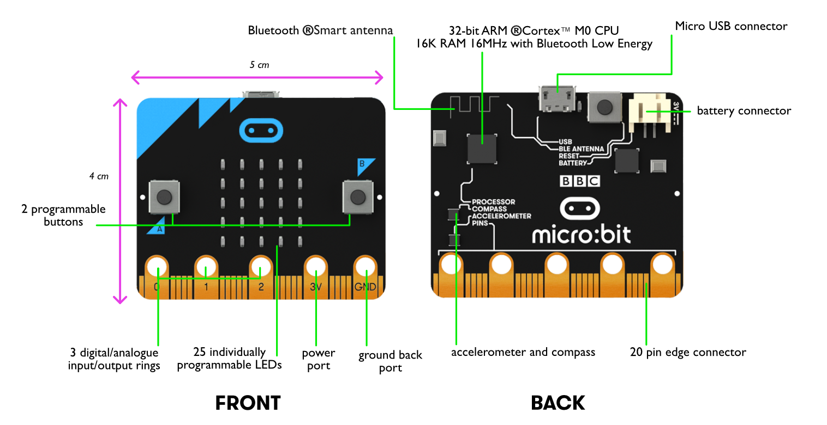
The micro:bit is a computer
Move the arrow to the processor and label it.
ovin-navigator.ca
Notes:
TEACHERS: Have students go over the parts and find the parts of the Micro:bit
Using the arrow have the students drag the point to the processor and label it.

Slide 3
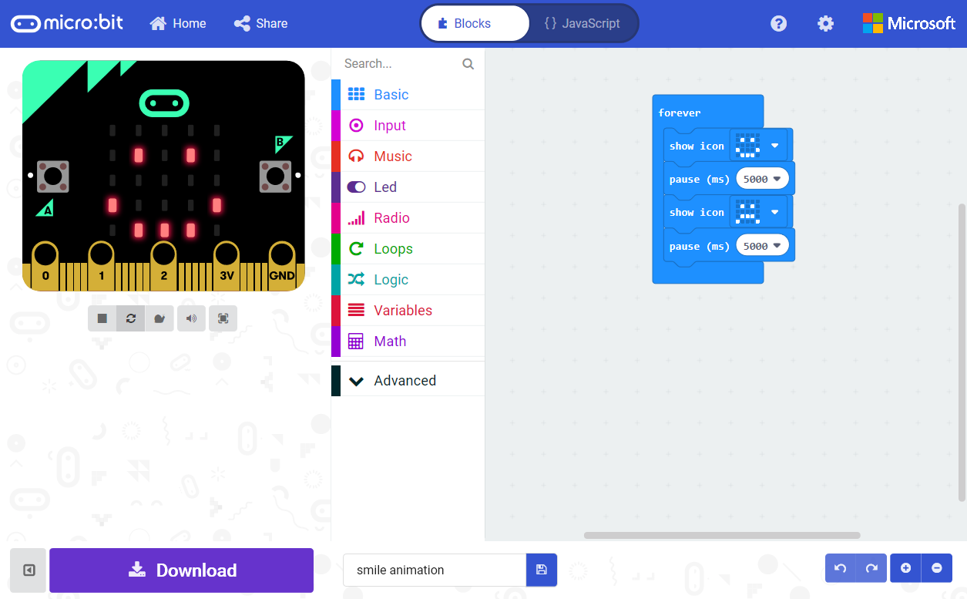
Using the makecode website here is what you will see once you make your first file.
Share your Project
Go back to Home Page
Program in either Blocks or JavaScript
Block Toolbox
Simulator shows what your program will look like running on a micro:bit
Programming Workspace where you will build your program
Simulator Toolbar
Undo/Redo and
Zoom Workspace
Download your Project to the micro:bit
Name your Project and Save it on your computer
ovin-navigator.ca
Notes:
TEACHERS: Using the software that goes with the micro:bit to go over the parts that students will be using. Perhaps printing this slide out and having it as a resource near students would be good.

Slide 4
MAKECODE WEBSITE
LINK
ovin-navigator.ca

Slide 5
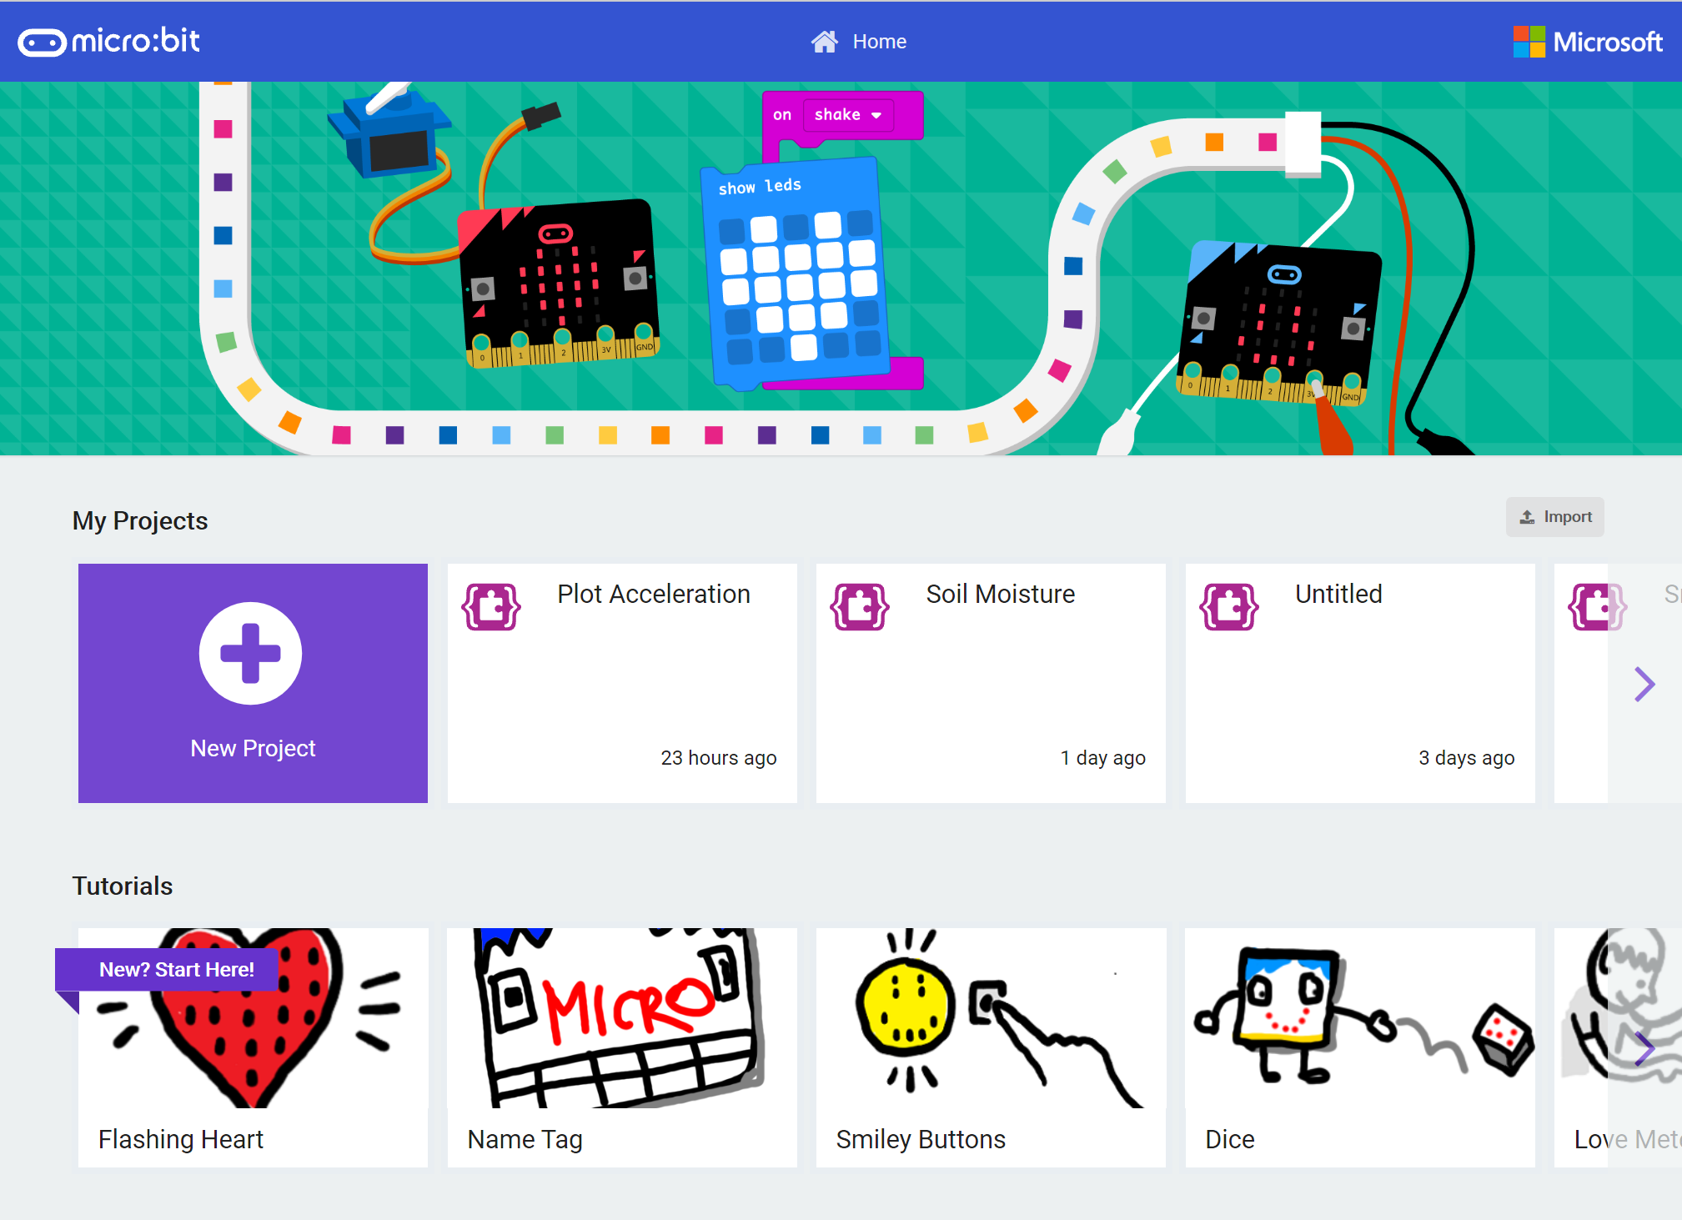
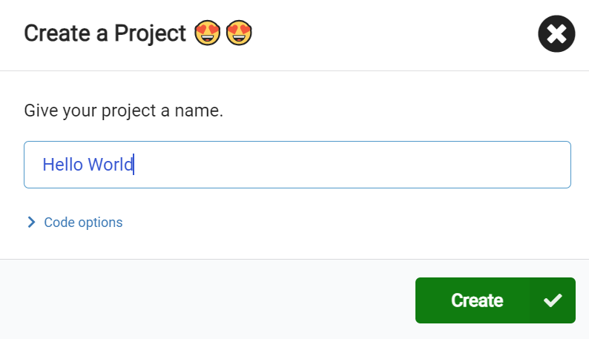
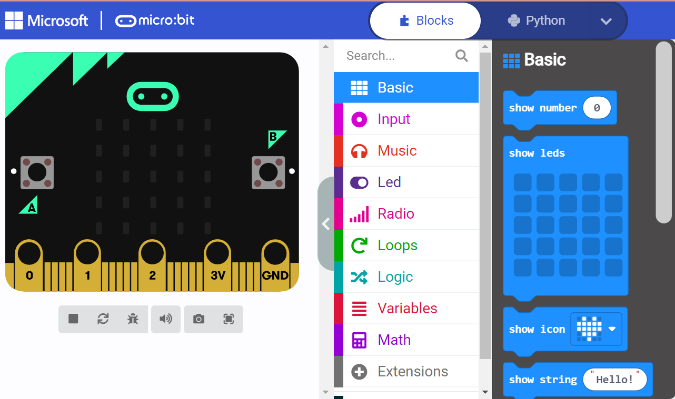
In MakeCode, create a New Project
Click on
“Show String “Hello”
ovin-navigator.ca

Slide 6
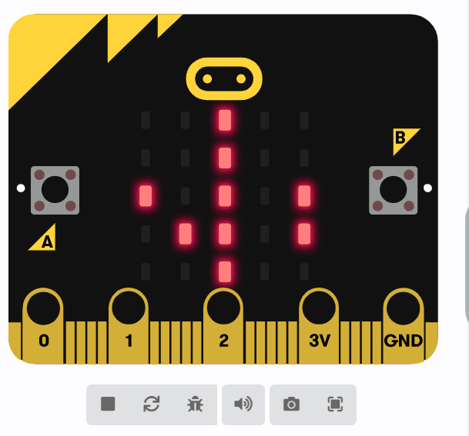
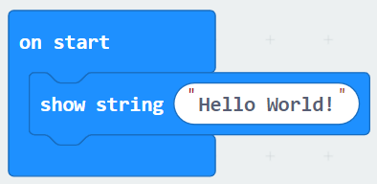
Change the text to read Hello World! (this is a famous way coders start coding in a new language they always write Hello World as their first line of code.)

Slide 7
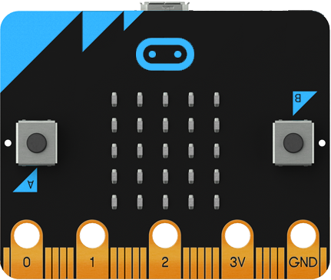
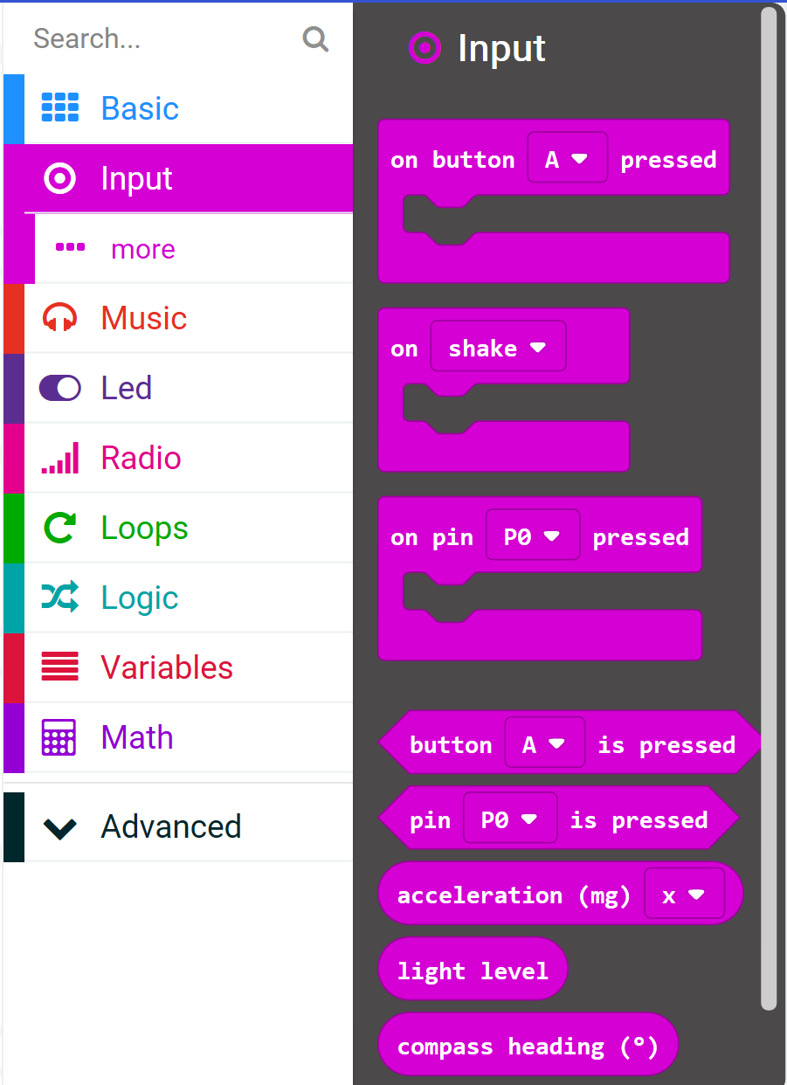
Take a look through all of the side panel to see what you might recognize or what might spark your interest.
Can you figure out how to make music?
Available Inputs v.1
Acceleration
Light level
Button is pressed
Compass heading
Temperature
Running time
On shake
On button pressed
On logo down
On logo up
One pin pressed
On screen down
On screen up
Pin is pressed
ovin-navigator.ca

Slide 8
Day 2
ovin-navigator.ca

Slide 9
MAKECODE WEBSITE
LINK
ovin-navigator.ca

Slide 10
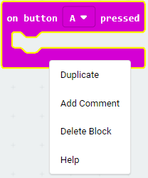
Adding Comments to your code
Right click on a block and you get even more features! Add a comments to your Code: Using a #and then the text is the way coders tell other coders what their codes is about.
(and reminds you too!)
Notes:
TEACHERS: Having students write comments in their code can show you their thinking and understanding of what the code is doing. Similarly you could write coding questions for students to answer as they work through their code challenge.

Slide 11
Let’s look at LED lights
ovin-navigator.ca

Slide 12
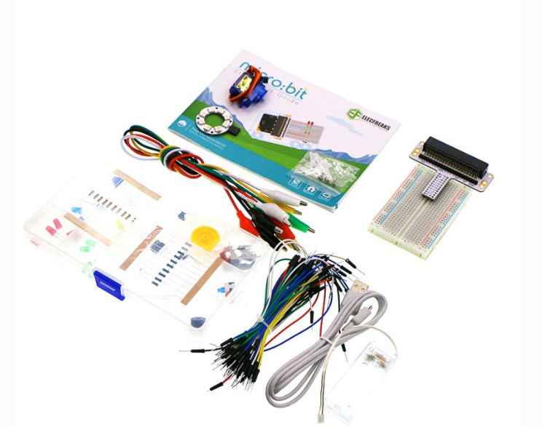
Microbit with STARTER KIT (If you do not have the starter kit then you will be doing everything we do in TINKERCAD. Makecode does have some options to use external extensions like this as well for beginners.)
ovin-navigator.ca
Notes:
Screen snips have been adapted to a slidedeck from Elecfreaks site for the introduction to the microbit https://wiki.elecfreaks.com/en/microbit/circuit-design/microbit-starter-kit/starter_kit_case_01

Slide 13
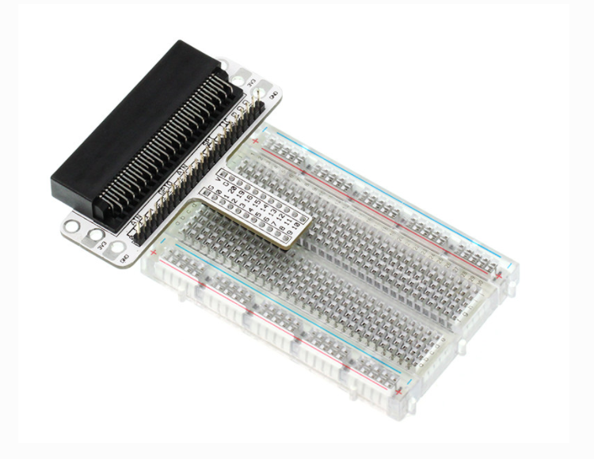
Connect the Micro:bit Breadboard Adapter to the breadboard
ovin-navigator.ca

Slide 14
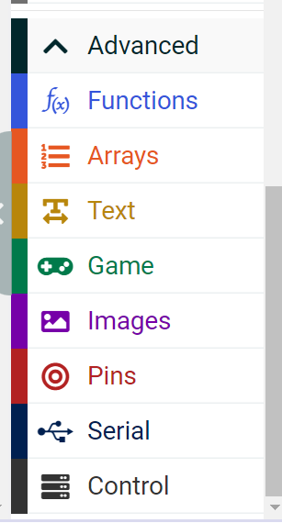
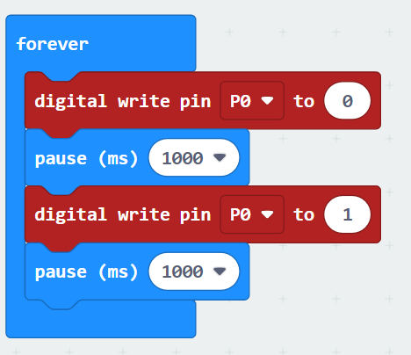
Next go into makecode and copy the code below.
The “Forever” block is a blok that loops any other command block inserted into it over and over again… forever
What do you think this code would do?
Watch the video on the next slide to find out.
ovin-navigator.ca

Slide 15
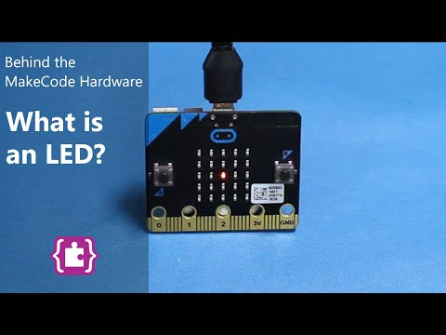
What is an LED?
ovin-navigator.ca

Slide 16
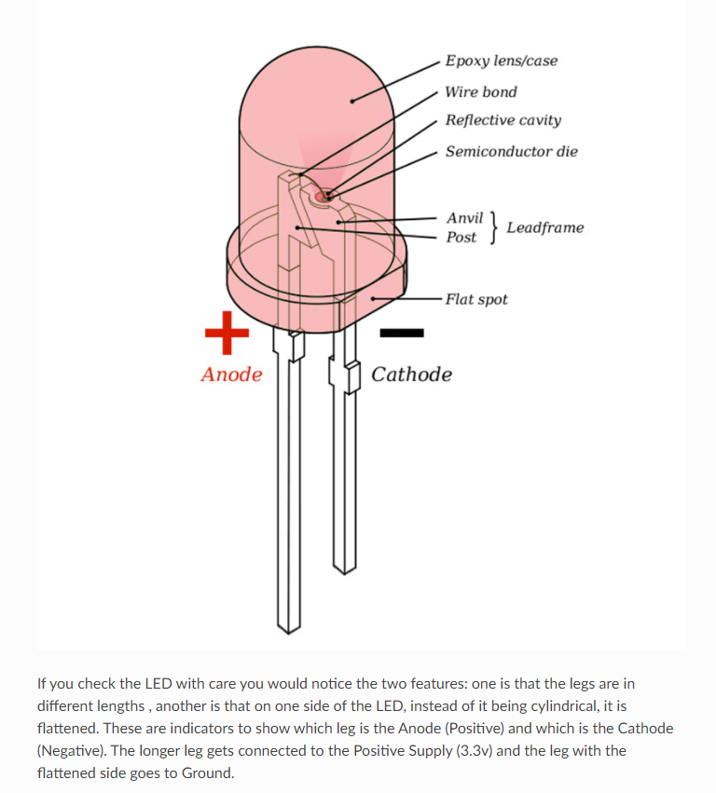
LED Light (Light Emitting Diodes)
ovin-navigator.ca

Slide 17
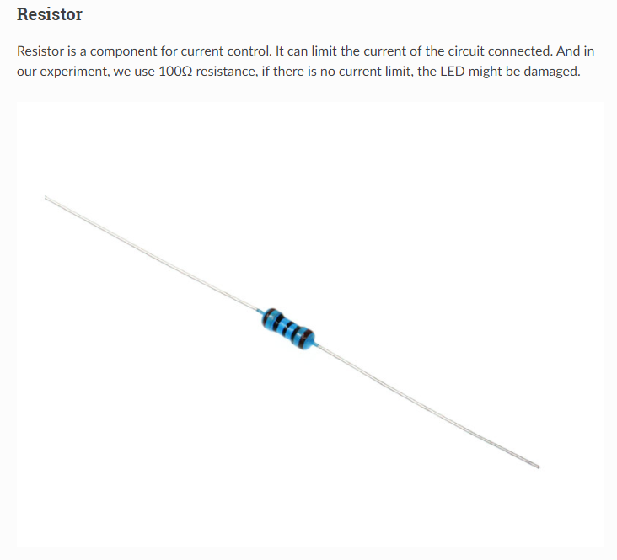
Resistor
ovin-navigator.ca

Slide 18
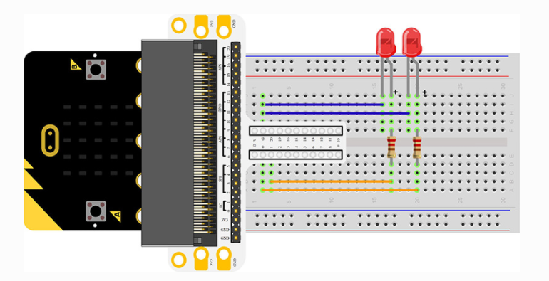
Connecting your components
Connect your components according to the picture below:
Connect the shorter leg with the GND
Connect the longer leg with the P0 and P1 ports through the resistor.
(NOTE: This photo shows the light in the wrong order)
ovin-navigator.ca

Slide 19
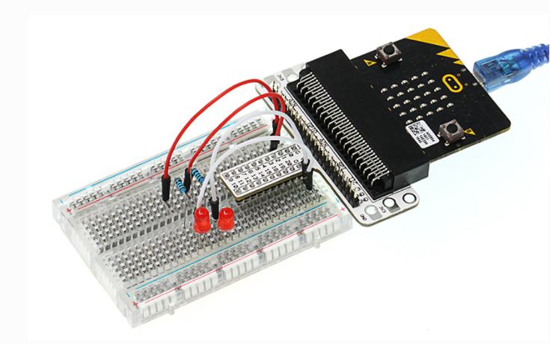
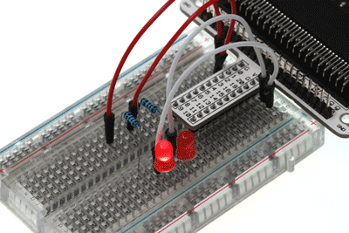
Physically what your breadboard should look like
ovin-navigator.ca

Slide 20
Task A:
If we want to control 4 LEDs and make them illuminated in turns, how can we design the circuit and code?
Challenge Time
OR
Task B:
How can we make an RGB traffic light?

Slide 21
Paste your ideas for what your group came up with for code:
Did it work?
If not where did you go wrong?
ovin-navigator.ca

Slide 22
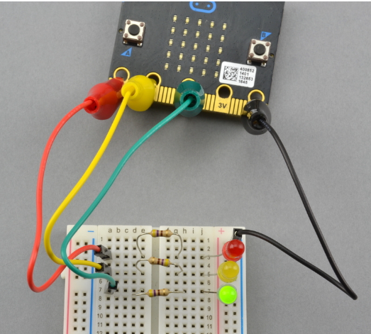
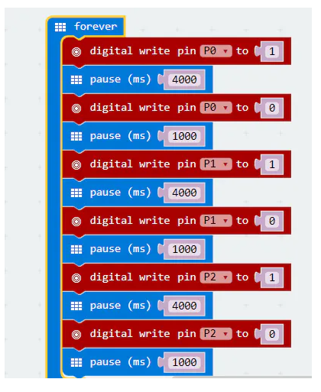
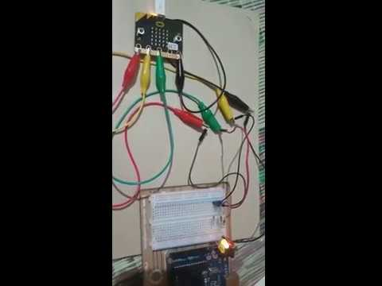
TEACHER:
Code for Traffic Light
LINK TO VIDEO
ovin-navigator.ca

Slide 23
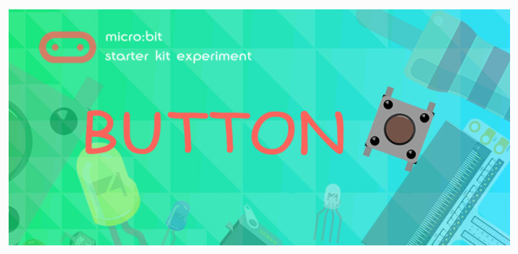
Let’s look at making a button work
ovin-navigator.ca

Slide 24
What is a button?

Slide 25
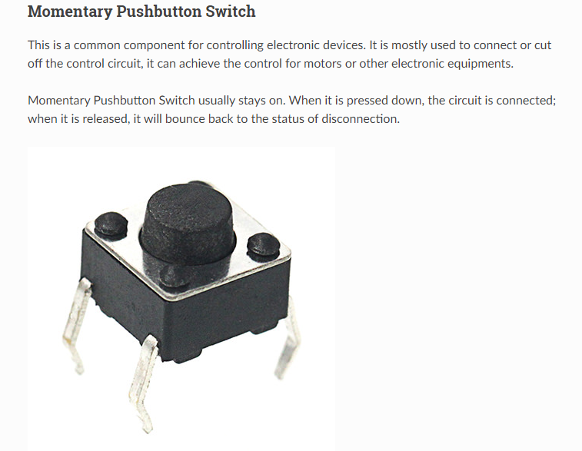
Buttons or Pushbuttons
ovin-navigator.ca

Slide 26
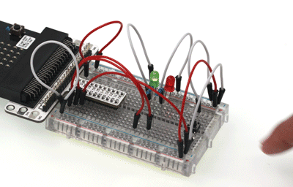
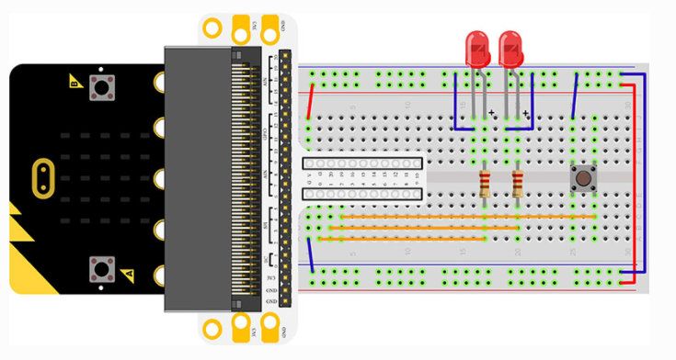
Hardware Connection for button
Connect your components according to the picture.
Connect the longer leg with the GND
Connect the shorter leg with the P0 and P1 ports through the resistor
Connect the Momentary pushbutton to P2 port
ovin-navigator.ca

Slide 27
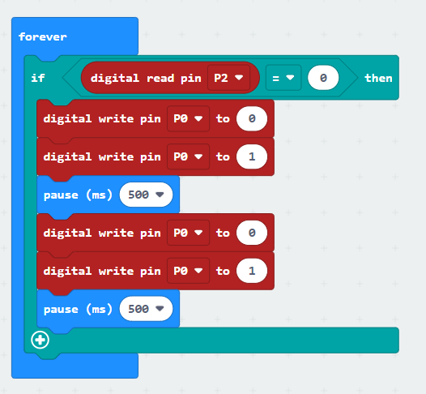
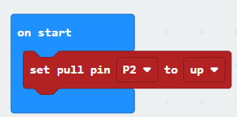
Code for the button
Read the status from P2 to chekc if the button is pressed, if yes, digital write signal 0 to P0 port to turn off the LED; digital write signal 1 to P1 prot to turn on the LED, then set the pause in 500ms; digital write signal 1 to P0 port to turn on the LED; digital write signal 0 to P1 port to turn off the LED, then set the pause to 500ms.
ovin-navigator.ca

Slide 28
Challenge Time
BREAK OUT INTO PAIRS To try this challenge
If we want to light on the red LED when press the button and the light on the green LED when release the button, how can we program that?

Slide 29
Paste your ideas for what your group came up with for code:
Did it work?
If not where did you go wrong?

Slide 30
ovin-navigator.ca

Slide 31
TRIMPOT
ovin-navigator.ca

Slide 32
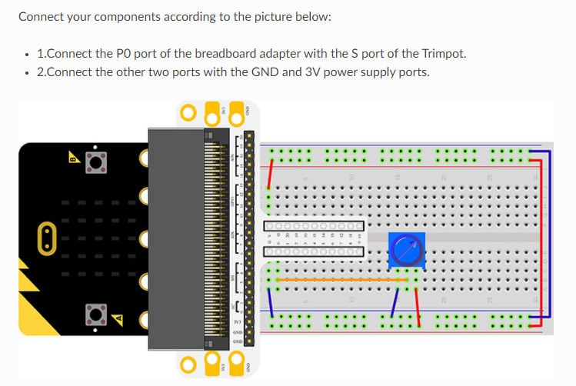
ovin-navigator.ca

Slide 33
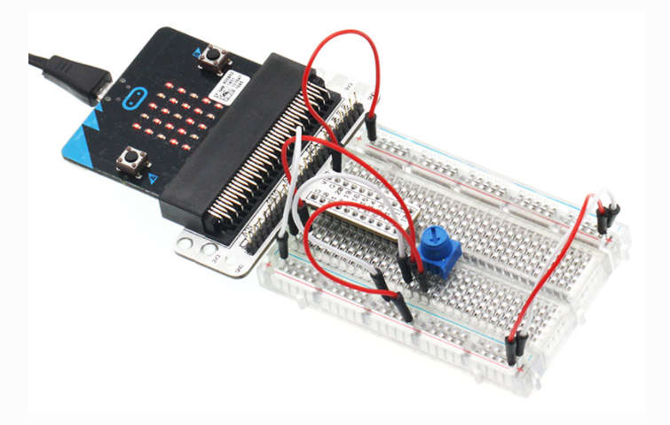
What it looks like connected
ovin-navigator.ca

Slide 34
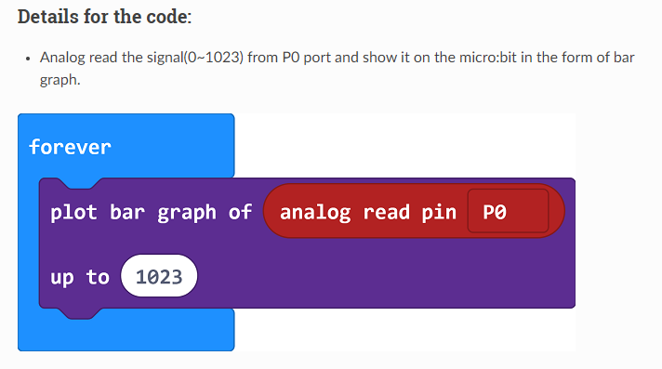
CODE
ovin-navigator.ca

Slide 35
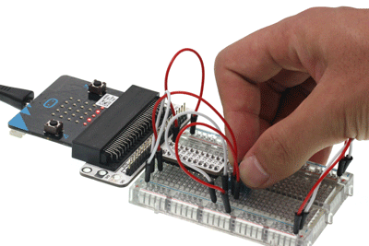
TRIMPOT
How do we adjust the brightness of a LED, how can we design the circuit and program?
ovin-navigator.ca

Slide 36
Day 3
ovin-navigator.ca

Slide 37
Let’s try the next one as a whole class
ovin-navigator.ca

Slide 38
ovin-navigator.ca

Slide 39
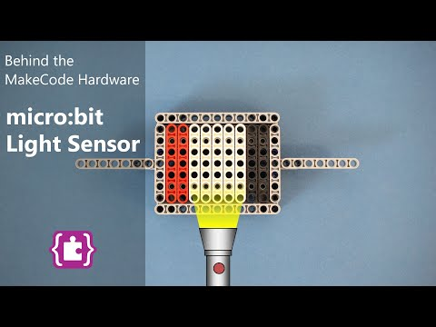
What is a light sensor
(Warning beginning is a bit cheesy! lol) Watch till 3:36
Do you have a night light still?
YES?
NO?
ovin-navigator.ca

Slide 40
Photocell
ovin-navigator.ca

Slide 41
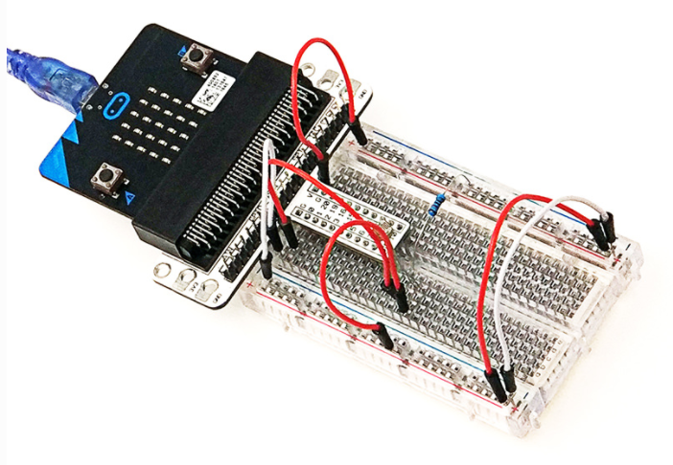
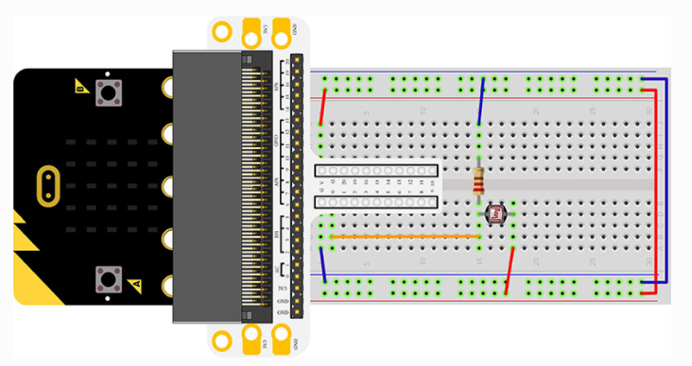
What it looks like connected
Connect your components according to the photo below:
Connect the photocell to P0 port
Connect the brown resistor with the photocell
ovin-navigator.ca

Slide 42
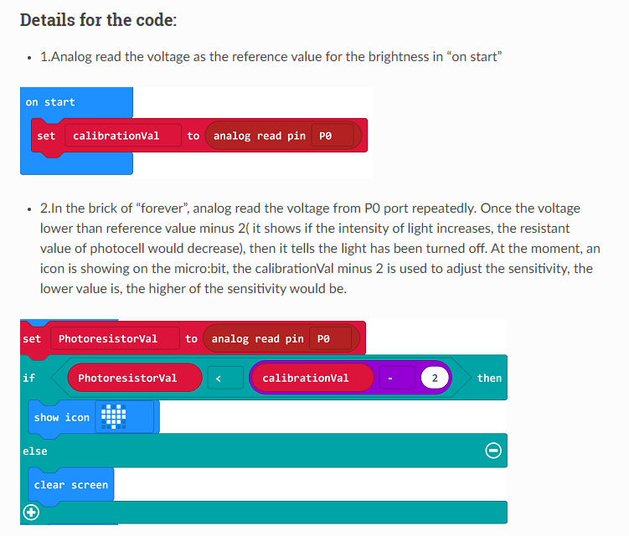
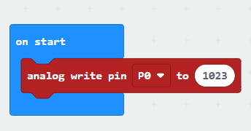
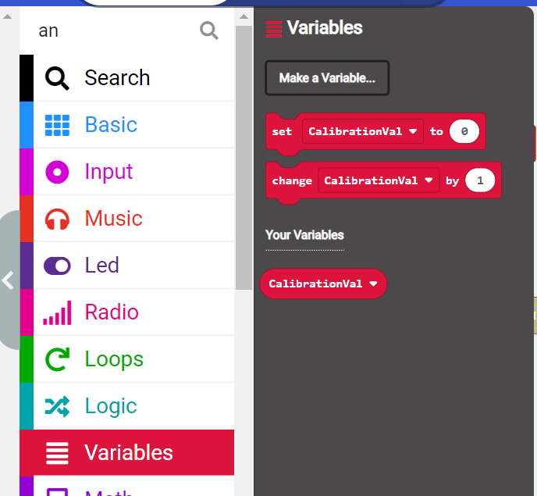
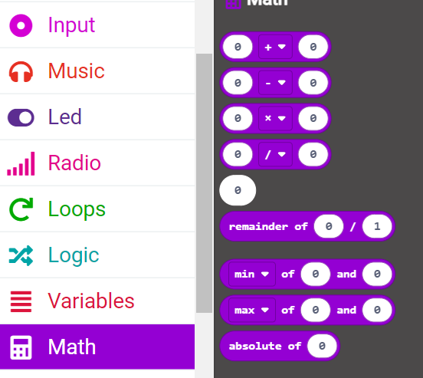
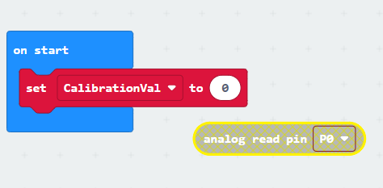
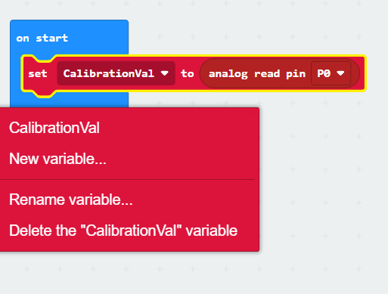
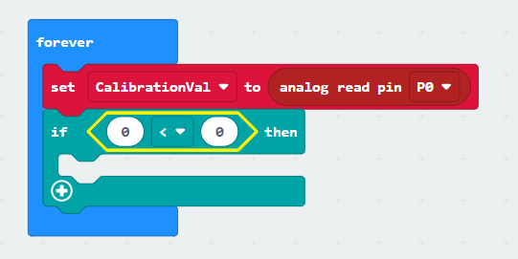
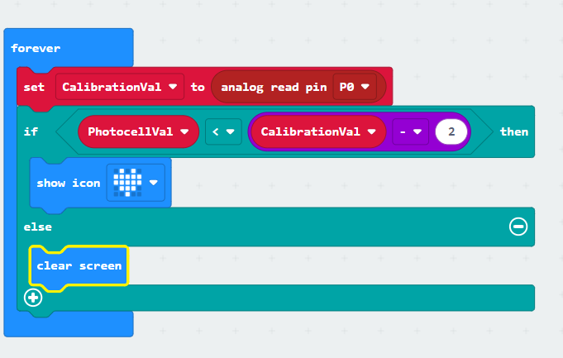
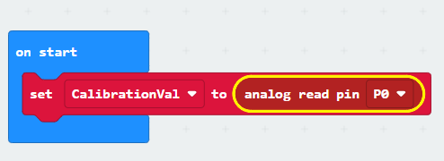
CODE: The reasoning behind what we are doing
In the brick of “forever”, analog read the voltage from P0 port repeatedly. Once the voltage lower than reference value minus 2 (it shows if the intensity of light increases, the resistant value of photocell would decrease), then it tells the light has been turned off. At the moment, an icon is showing on the micro:bit the calibrationVal minus 2 is used to adjust the sensitivity, the lower value is, the higher of the sensitivity would be.
Click on each screen snip below and enlarge the photo to see your next step. (there are 8 total photos)
ovin-navigator.ca

Slide 43
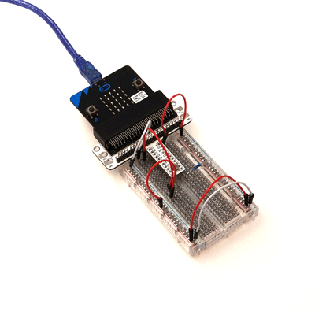
Photocell at work
ovin-navigator.ca

Slide 44
SElect one of the following to complete on your own
ovin-navigator.ca

Slide 45
ovin-navigator.ca

Slide 46
RGB LED
ovin-navigator.ca

Slide 47
RGB LED Set up

Slide 48
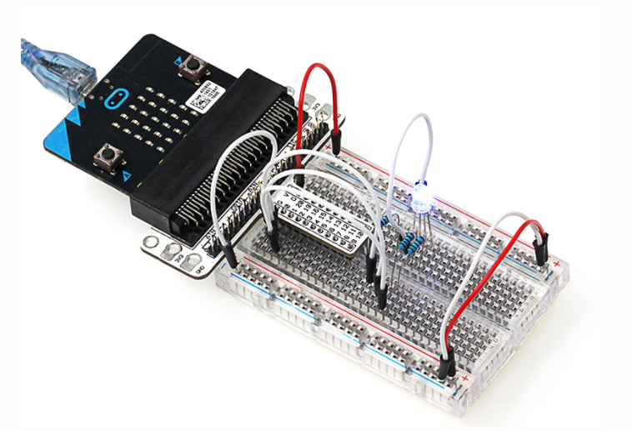
What it looks like connected
ovin-navigator.ca

Slide 49
Code for RGB light
ovin-navigator.ca

Slide 50
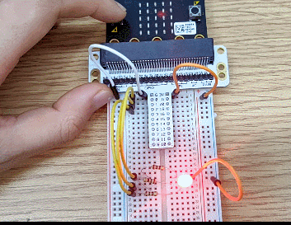
What it looks like connected
ovin-navigator.ca

Slide 51
ovin-navigator.ca

Slide 52
Self- lock Switch
ovin-navigator.ca

Slide 53
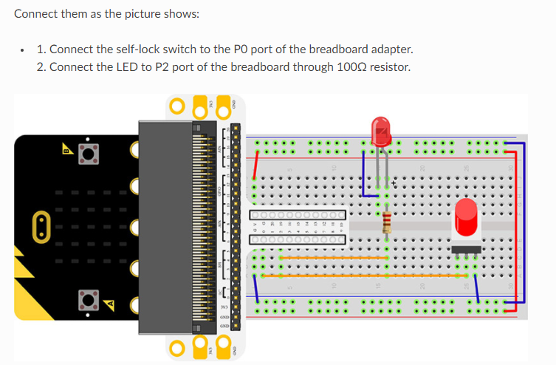
Self-Lock switch set up
ovin-navigator.ca

Slide 54
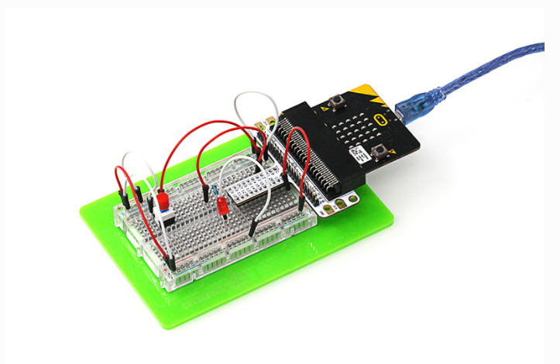
What it looks like connected
ovin-navigator.ca

Slide 55
How to set up the code
ovin-navigator.ca

Slide 56
What it looks like connected
ovin-navigator.ca

Slide 57
ovin-navigator.ca

Slide 58
ovin-navigator.ca

Slide 59
The Servo motor
ovin-navigator.ca

Slide 60
Set up of the servo motor
ovin-navigator.ca

Slide 61
Day 4
ovin-navigator.ca

Slide 62
SElect Three of the following to show the teacher or attach a video of your code and your micro:bit breadboard
ovin-navigator.ca

Slide 63
ovin-navigator.ca

Slide 64
The Buzzer
ovin-navigator.ca

Slide 65
The Buzzer
ovin-navigator.ca

Slide 66
The Transistor
ovin-navigator.ca

Slide 67
Set up of the Buzzer
ovin-navigator.ca

Slide 68
How it looks set up and the code
ovin-navigator.ca

Slide 69
ovin-navigator.ca

Slide 70
The Motor
ovin-navigator.ca

Slide 71
Alligator Clips and Diodes
ovin-navigator.ca

Slide 72
How to connect the alligator clips
ovin-navigator.ca

Slide 73
How the set- up looks
ovin-navigator.ca

Slide 74
The physical set up
ovin-navigator.ca

Slide 75
The code
ovin-navigator.ca

Slide 76
How it should work
ovin-navigator.ca

Slide 77
Find different ones to try out below
ovin-navigator.ca

Slide 78
Click on the picture to get to the instructions and the code
ovin-navigator.ca

Slide 79
Click on the picture to get to the instructions and the code
ovin-navigator.ca

Slide 80
Click on the picture to get to the instructions and the code
ovin-navigator.ca

Slide 81
Click on the picture to get to the instructions and the code
ovin-navigator.ca

Slide 82
Click on the picture to get to the instructions and the code
ovin-navigator.ca

