Slide 1
Tire pressure and wear.
220 kPa/2,2 BAR / 32 psi
What do these letters and numbers mean?

Slide 2
Why know the meaning of these letters and numbers?
You will probably own a vehicle one day and will be responsible for checking and adjusting the tire pressure on your vehicle.
You will also need to make sure for your own safety and the safety of your passengers that your tires are safe in terms of tread wear.
You will also have to make sure that your tires have an even wear pattern so that you are always safe on the road.

Slide 3
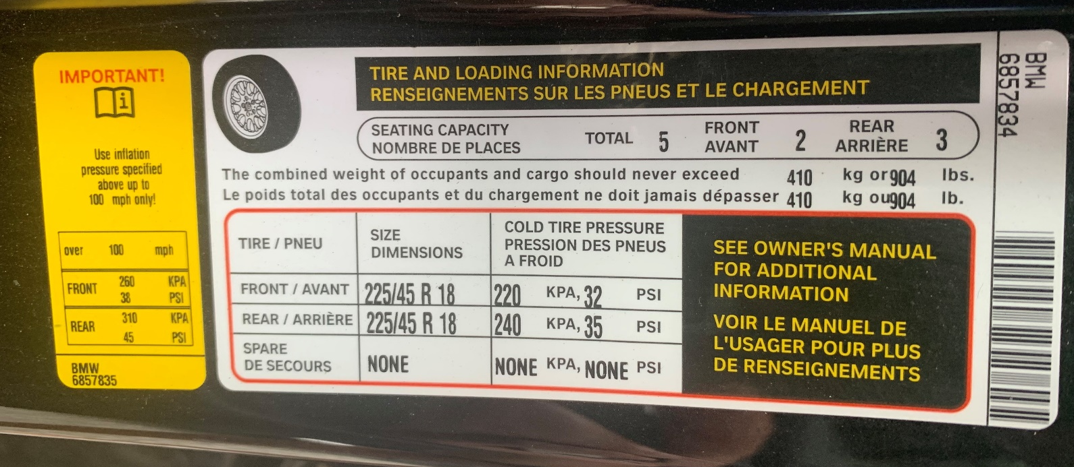
You can find the recommended tire pressure on the sticker of the driver’s door or in the owner's manual :
Front tire pressure
Rear tire pressure
Spare tire pressure (if applicable)

Slide 4
Tire pressure
Tires must be inflated to the pressure recommended by the manufacturer.
Tires have a maximum pressure marked on the sidewall of the tire. This pressure indicates the maximum pressure to which the tire can be safely inflated.

Slide 5
Tire pressure
Tire pressure is usually measured in Psi and kPa.
PSI (pound per square inch) is an Anglo-Saxon unit of pressure.
The kPa is a metric unit of measurement that indicates kilo Pascal.
The measuring tool used by the technician is the pressure gauge.

Slide 6
An under-inflated tire
An under-inflated tire causes several problems such as
Increased fuel consumption.
Increased tire heat and risk of a blowout.
Risk of tire deformation due to premature wear.
Premature wear on the sidewalls of the tire.

Slide 7
An overinflated tire
An overinflated tire causes several problems such as
Decreased contact area between the tread and the road. (less traction)
Compromised handling at cruising speeds, in curves and during braking.
Premature wear in the centre of the tread.

Slide 8
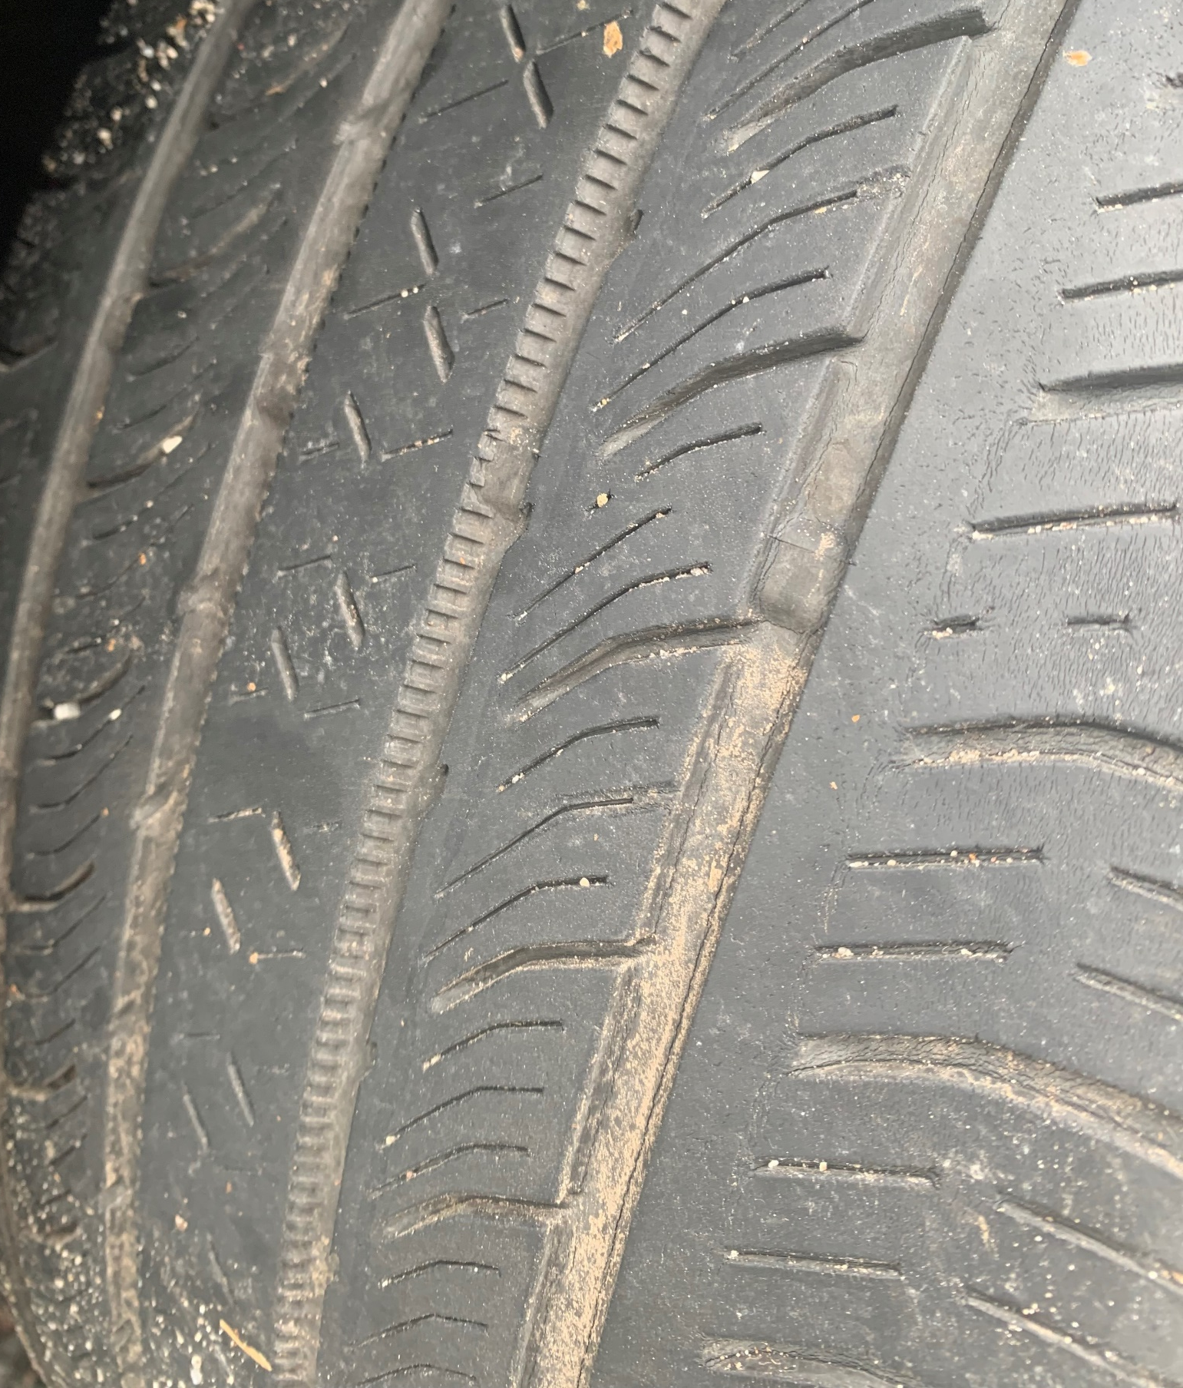
The wear indicator on the tread
A tire has six wear indicators evenly distributed on the tire.
This indicator shows the minimum depth of the tire. This wear represents 2/32 of an inch or 1.59 mm.
The tire has lost 80% of its efficiency on water when the wear indicators are equal to the tread.
Wear indicators :

Slide 9
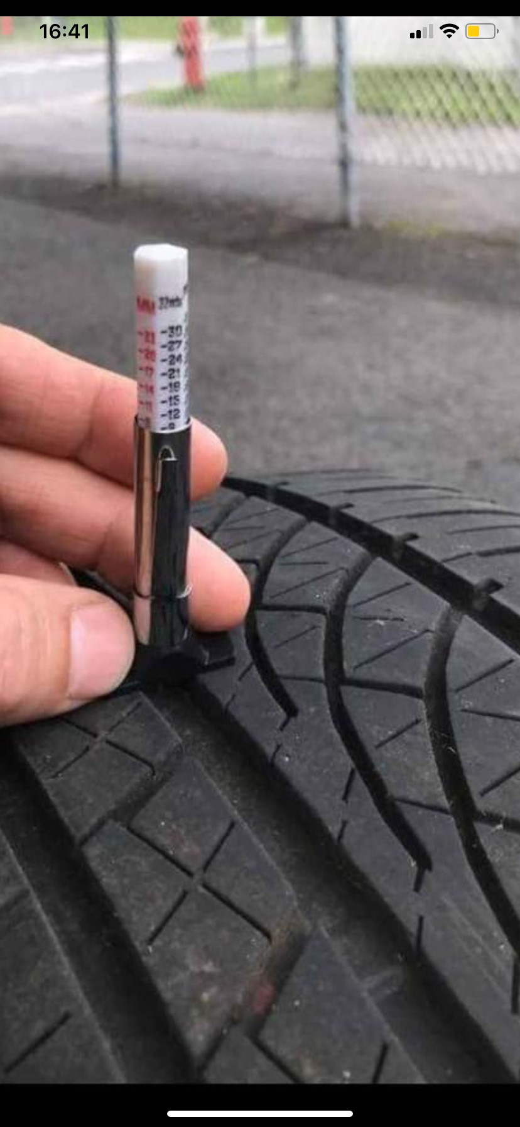
Checking tire wear
The tool for checking tire wear is called a depth gauge.
A quarter will check if the tire has a minimum of 4/32 or 3.175 mm. If you can see the moose’s nose tip, then the tire needs to be replaced.

Slide 10
Non-uniform wear
Uneven tire wear may indicate:
A problem with the steering geometry.
A problem with the suspension.
A problem with the wheel balance.
Insert your picture here
Insert your picture here
Insert your picture here

