Slide 1
Introduction to AutoDesk INVENTOR
BBT Area: Technological Design
Target Course: TDJ2O

Slide 2
Section 1: Teacher Resources
Explore more at ovin-navigator.ca

Slide 3
Project Outline
Students will become familiar with the basic CAD/INVENTOR commands, AutoDESK interface and basic design theory used to create features in 3D.
Students will also learn how to create multi part assemblies.
Students can then expand their design work into technical drawing formats, like exploded view parts, drawings, and orthographic projection technical drawings for manufacturing.
Skills that will develop during this small units are as follows:
Procedure thinking
Design problem solving
Introduction to Transportation Technology terminology
Additional careers and post secondary pathways involving the transportation sector/Automotive engineering sector

Slide 4
Related OVIN Sectors
Auto & Parts Manufacturing
Tool, Die & Mold

Slide 5
Prior Knowledge and Related Resources
Students should be familiar with:
design process steps (research, imagine possible solutions, concept sketch, choose the best design, build a prototype, test prototype).
concept sketches, isometric drawings, and orthographic projections.
basic CAD commands terminology, exposures to apps like TinkerCAD.
Students should have:
basic understanding of math skills (measuring, units, multiplication).
basic research skills.
ability to use basic computing tools, mice, saving to your school server or cloud, basic google suite applications.
basic understanding of how to use 3D modelling software such as TinkerCAD.

Slide 6
Planning Notes and Teacher Guide
Make sure your classroom licence is up to date and active.
Read through the step by step tutorial.
Familiarize yourself with the software.
Do a dry run, yourself of the tutorial.
Have a projector available for showing the software.
Print or post the tutorial.
Allow for 3-5 days for this unit.

Slide 7
Required Tools and Materials
Laptop or desktop computer
Mouse
Larger monitor if possible
Sketch paper should you have the students design their own as a “testing your knowledge” activity

Slide 8
Safety Concerns (including PPE if required)
Make sure your computer area is clear of school bags, food and drinks.
Position your body in the correct ergonomic position for your working area.
Use a external mouse not the touch pad where possible.
Use a bluelight filter on your screen to protect your eyesight extended use exposure.

Slide 9
Assessment and Evaluation
In this project, the instructor should be looking for your students to be able to identify and apply the following MoE curricular looks fors:
A3. demonstrate an understanding of how design ideas are represented graphically;
A4. explain the purpose of building models and prototypes, and identify tools, materials, and methods for building and testing them;
A5. demonstrate an understanding of communications methods used in the design process.
A3.2 correctly use drafting standards, conventions (e.g., line types and weights, dimensioning, title block information, labelling), and tools (e.g., drafting curves, protractors, computer-aided design [CAD] or sketching software, templates);
A3.3 identify various types of technical drawings (e.g., orthographic, pictorial, detail, and rendered drawings; floor plans; elevations; sections).
B3. create and test models using a variety of techniques, tools, and materials;
B2.2 apply mathematical and scientific concepts and skills as required in the course of designing various products and/or processes;
B2.3 produce hand-drafted and/or computer based technical drawings of design solutions, using standard drafting tools and conventions
B3.2 use appropriate measuring methods and scales (e.g., metric: 1:10, 1 cm:1 m or 1:100, 1:500; imperial: 1 /2":1’ or 1:24) when creating models and prototypes;

Slide 10
Assessment and Evaluation
Continued
B3.3 assess models and/or prototypes on the basis of prescribed criteria (e.g., aesthetics, ergonomics, safety, efficiency, environmental impact).
C2. describe how society influences technological innovation and how technology affects society.
C2.2 describe how various technological innovations have affected quality of life (e.g., pesticides, internal combustion engines, plastics, on-demand water heaters, catalytic converters, nanotechnology, wireless communication).
D2. identify careers related to technological design, and the education and training required for them
D2.3 identify groups and programs that are available to support students who are interested in pursuing non-traditional career choices in the technological design industry (e.g., mentoring programs, virtual networking/support groups, specialized postsecondary programs, relevant trade/industry associations);
D2.5 demonstrate an understanding of the work habits that are important for success in the technological design industry, as identified in the Ontario Skills Passport (e.g., working safely, teamwork, reliability, initiative, customer service, entrepreneurship);
D2.6 develop and/or select pieces of work and other materials that provide evidence of their skills and achievements in technological design, for inclusion in a portfolio (e.g., work logs, skills checklist, sketches, drawings, photographs of models and prototypes, virtual models).
D2.1 identify a variety of career opportunities related to technological design (e.g., engineer, architect, engineering technician, industrial designer, landscape designer, fashion designer, interior designer);
D2.2 identify and compare the education and/or training required for various careers in technological design (e.g., degree, diploma, certificate, apprenticeship);

Slide 11
Project Exemplars
Wheels- How they work - YouTube
Understanding Wheels - YouTube

Slide 12
Outside Resources and References
Modelling Tools toolSAFE resources
The Ontario Curriculum, Grades 9 and 10: Technological Education, 2009 (revised)
How Rims Work and Why They Matter - Article

Slide 13
Section 2: Student Lesson
Explore more at ovin-navigator.ca

Slide 14
Printable Student Resources
Introduction to AutoDESK INVENTOR - Tire and Wheel Assembly Unit

Slide 15
Basic Interface of INVENTOR
BBT Area: Technological Design
Target Course: TDJ2O
Explore more at ovin-navigator.ca

Slide 16
Lesson Slide 1
How to open and start at 2D sketch in INVENTOR -
New interface INVENTOR start up

Slide 17
Tire and Rim Assembly in INVENTOR: Project Instructions
Explore more at ovin-navigator.ca

Slide 18
Project Introduction (and hook)
Did you know:
3D Modeling Accelerates the Development of Product Design
3D Modeling Simplifies the Prototyping Process
Product 3D Modeling is Perfect for Approving Intermediate Stages of Product Design Development
3D Modeling Helps to Improve Communication Between Developing Teams
Motive Careers connected to 3D Modeling:
Car accessory designer - Top Earners $74,500 $36/hr
Automotive Exterior Designer & Interior Designer - Top Earners $97,000 $48/hr
Digital sculptor - Top Earners $63,000 $32.74/hr
UX Designer - Top Earners $82,000 $42.62/hr
UX Engineer - Top Earners $125,000 $65/hr
Virtual Reality Designer - Top Earners $101,000 $50.50/hr

Slide 19
Student Safety Guidelines
Students should be aware of basic online safety and identity protection strategies.
Students should be seated in an ergonomic way at their desk.
Allow for body movement breaks if seated and working for more than 30mins.

Slide 20
Guides / Tutorials
Introduction to AutoDESK INVENTOR - Tire and Wheel Assembly Unit

Slide 21
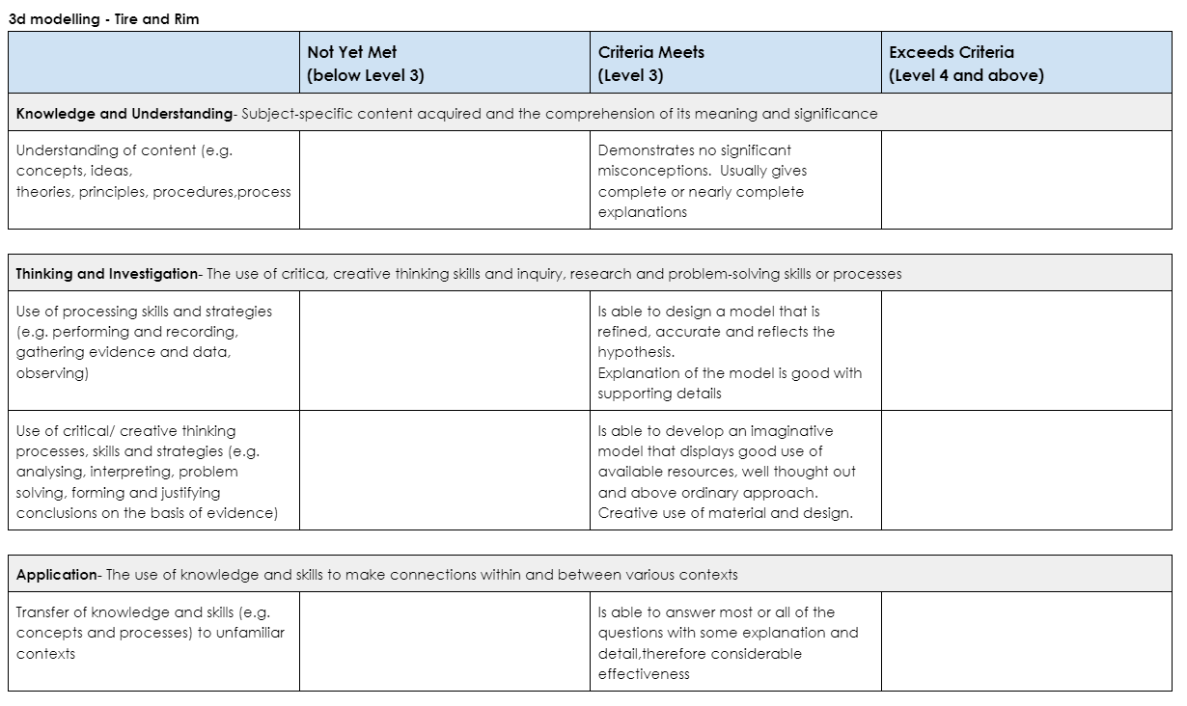
Rubric/Assessment

