Slide 1
OCTE -
Customer Service Certification

Slide 2
Customer Service Certification Roadmap
Extensions:
Lean Six Sigma
OVIN
Module 1:
Definition and Relevance
Module 3:
Surprise and Delight!
Module 5:
Customer Service in your SHSM Sector/ at Co-op
1
3
5
2
4
6
Module 2:
Essential Skills and Traits
Module 4:
Typical Customer Scenarios
Module 6:
Optional:
Sector Partner Experience
Customer Experience
Notes:
Module 6 is OPTIONAL. Teachers can arrange the Sector Partner Experience – ICE with a local company that has a customer service problem that the ICE model can be applied to by the SHSM students. The resources for this are found in a separate slide deck.

Slide 3
Table of Contents
Introduction
Module 1: Definition and Relevance
Module 2: Essential Skills and Traits
Module 3: Surprise and Delight!
Module 4: Typical Customer Scenarios
Module 5: Customer Service in your SHSM Sector/at Co-op
Module 6: Customer Experience
Extension Module: Lean Six Sigma
Extension Module: OVIN

Slide 4
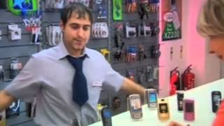
Have you ever experienced Customer Service like this?
Notes:
Video: Customer Service Compilation
https://www.youtube.com/watch?v=9oywp2qRRyc
Note – after watching the video, discuss what the employees could have done to improve the situation.

Slide 5
Warm-up: The Good and the Bad and Ugly Customer Experiences
Think about the best experience you have had when dealing with a customer service representative.
What did the employee do to create such a positive experience?
Think about the worst experience you have had when dealing with a customer service representative.
What aspects made this experience so poor for you?
Notes:
Note: If delivering this certification in-person, students can discuss these scenarios in small groups. Ask for volunteers to tell their Good and Bad and Ugly customer experience stories.
If using sticky notes, students can jot down the positive and negative aspects (one sticky note per experience). In their groups, students can organize the notes, looking for common points.

Slide 6
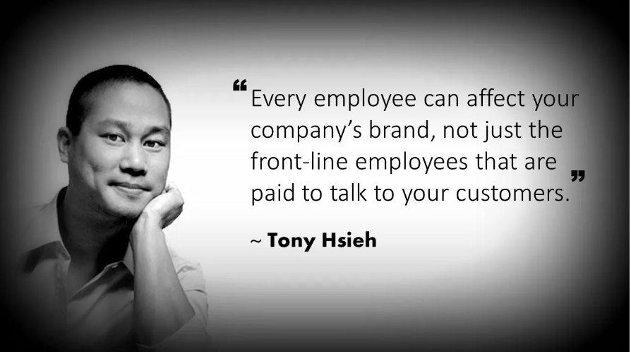
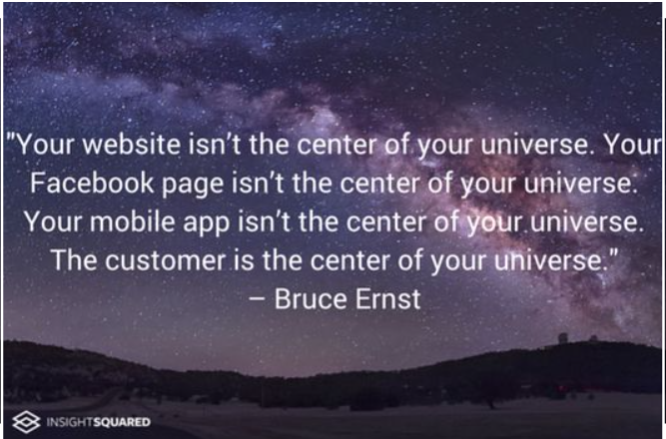
American Internet Entrepreneur and Venture Capitalist
Chief Product Officer of WorkplaceDynamics

Slide 7
Definition & Relevance
1
Module
Table of Contents

Slide 8
How you think about your customers influences how you respond to them.
Marilyn Suttle,
Customer Service consultant, speaker and author

Slide 9
Minds On
How would you define and describe “customer service”
Discuss with other students or think about it on your own. Add your thoughts to your copy of the student workbook.

Slide 10
Customer Service is..
...the assistance and advice provided by a business to existing customers who buy or use its products or services and to consumers considering a purchase.
Effective customer service needs to be provided to the customer before, during and after the purchase.
Wikipedia and Oxford Languages
Notes:
There are many different definitions of customer service; different sources and different sectors will have specific areas and focus around customer service.
This simple definition has been created from many sources, primarily Wikipedia and Oxford Languages.

Slide 11
Is your definition similar to this one?
Add additional points to your definition
in the student workbook.

Slide 12
Great companies realize that no matter what you sell, whether it’s a product or a service, what you are actually selling is an experience.
Marilyn Suttle,
Customer Service consultant, speaker and author

Slide 13
Why is Customer Service so important to a business?
It makes a customer happy!
Happy customers means increased loyalty to the business:
Customers will purchase more often
Amount purchased per visit typically increases
Positive word-of-mouth marketing and reputation
Will attract new customers to the business
Notes:
Related resources:
https://www.abetteranswer.com/blog/5-reasons-customer-service-is-important-to-the-growth-of-small-companies
https://www.acu-data78.com/the-importance-of-customer-service-in-small-business-relationships/
https://www.benchmarkone.com/blog/small-business-customer-service/
https://www.groovehq.com/blog/why-customer-service-is-important
https://www.ameritasinsight.com/employee-benefits/industry-buzz/why-good-customer-service-is-important
https://www.momentcrm.com/blog/why-customer-service-important/
https://www.performanceinpeople.co.uk/blog/why-is-customer-service-important/
https://www.indeed.com/career-advice/career-development/why-is-customer-service-important

Slide 14
Video: I Was “Seduced” by Exceptional Customer Service (8:20)
Notes:
Video: I was seduced by exceptional customer service (8:20)
John Boccuzzi Jr., TEDxBryantU
https://www.youtube.com/watch?v=GH1TXfQSwUQ
Key Take-Aways:
Exceptional Customer Service will change a casual customer into a brand loyal ambassador
The companies that stand out and succeed are those that focus on exceptional customer service
They don’t necessarily have big, multi-media marketing campaigns
They are not typically big box/large companies
Not necessarily offering the lowest prices
(4:42) “The customer experience is not about the product you offered, it is about how you make someone feel during the buying journey and frankly, after the purchase has been made.”
According to the John Boccuzzi Jr, successful businesses all focus on delivering exceptional customer experiences each and every day
(7:00 – 7:34) “Delivering customer experience isn’t just good for the customer, it actually good for business.”

Slide 15
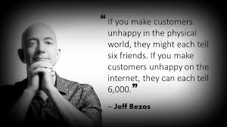
The Power of Word-of-Mouth
Founder and executive chairperson of Amazon.
Notes:
Jeff Bezos – founder and chairperson of Amazon

Slide 16
Reflect and Connect
Why are the quotations from Marilyn Suttle and Jeff Bezos in this module so relevant to the importance of effective customer service, in-person and online?
Discuss with other students or think about it on your own. Add your thoughts to your student workbook.

Slide 17
Essential Skills and Traits
Module
2
Table of Contents

Slide 18
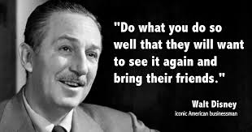

Slide 19
Minds On
How does the video clip, “Be Our Guest” from Disney’s Beauty and the Beast demonstrate Walt Disney’s idea of customer service?
Discuss with other students or think about it on your own. Add your thoughts to your copy of the student workbook.

Slide 20
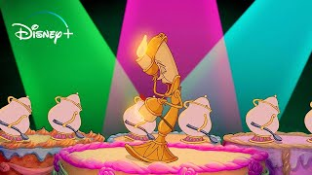
Disney’s Beauty and the Beast – Be Our Guest
Notes:
Beauty and the Beast – Be Our Guest
Video: https://www.youtube.com/watch?v=afzmwAKUppU

Slide 21
The “Disney Way” of Customer Service is recognized around the world!
The Disney Institute teaches other businesses about leadership and customer service.
The book, “Be Our Guest, Perfecting the Art of Customer Service” gives insights into Disney’s success.
Notes:
Disney Institute: https://www.disneyinstitute.com/
Additional Resources for the “Disney Way” of Customer Service:
Video: A Lesson in Customer Service from Disney
https://www.youtube.com/watch?v=_QD0PvjxXY0
Article: Forbes – Five Lessons from Disney’s Magical Customer Experience
https://www.forbes.com/sites/blakemorgan/2020/01/23/5-lessons-from-disneys-magical-customer-experience/?sh=28c381987555
Article: How Disney Beats All Others in Customer Service
https://www.wdwinfo.com/disneylandcalifornia/how-disney-beats-all-others-in-customer-service/
Article: Customer Service the Disney Way
https://www.forbes.com/sites/carminegallo/2011/04/14/customer-service-the-disney-way/?sh=13cffa5878f8

Slide 22
Disney has 5 Keys for the Guest Experience:
Notes:
Additional resource:
http://disneyatwork.com/disneys-four-keys-to-a-great-guest-experience/

Slide 23
To All Who Come to this Happy Place: Welcome
Notes:
Video: To All Who Come to this Happy Place: Welcome
https://www.youtube.com/watch?v=QQTij9Rghls&list=RDCMUC1xwwLwm6WSMbUn_Tp597hQ

Slide 24
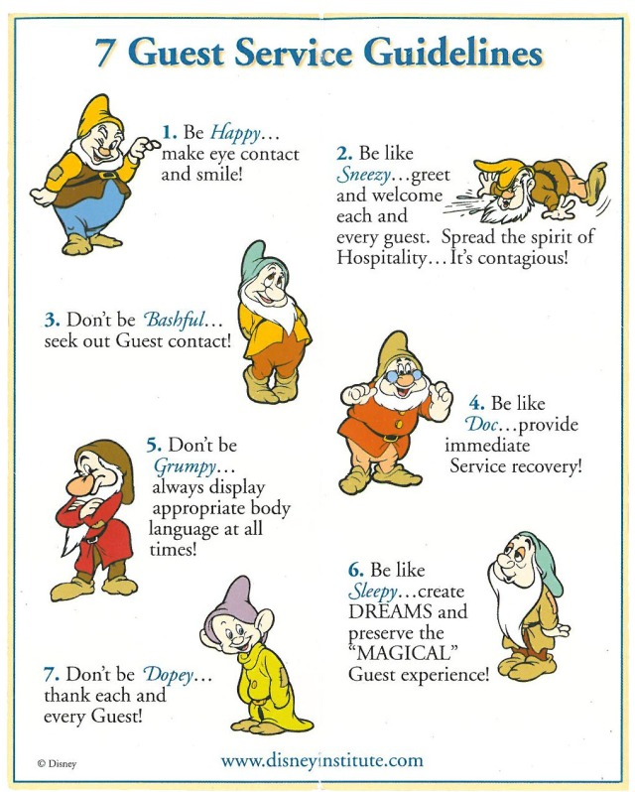
Disney’s 7 Guest Service Guidelines have been adapted over the years to align with their 5 Keys, but their commitment to exceptional guest experiences remains the same!
These guidelines are the essential skills of customer service for any employee in any business!
Be like the Seven Dwarfs!

Slide 25
Reflect and Connect
In the student workbook, summarize Disney’s 7 Guest Guidelines
Why are these guidelines useful for skills for all employees working in any company?
Discuss with other students or think about it on your own.
Notes:
Note: If the videos do not work, or other examples are needed, there are many online articles and resources for other examples:
https://www.inc.com/molly-reynolds/9-companies-that-nailed-the-whole-surprise-and-del.html
https://www.oberlo.ca/blog/customer-service
https://www.teamoutpost.com/blog/customer-care-methods/

Slide 26
Investigate and Describe
Watch video, “How to Approach Customer Service Like Disney”
Alternative: Read the corresponding blog post:
https://blog.hubspot.com/service/disney-customer-service-model
In the student workbook, describe three to five different methods Disney uses to provide outstanding customer service.
Discuss with other SHSM students or think about it on your own.
Notes:
Note: If the videos do not work, or other examples are needed, there are many online articles and resources for other examples:
https://www.inc.com/molly-reynolds/9-companies-that-nailed-the-whole-surprise-and-del.html
https://www.oberlo.ca/blog/customer-service
https://www.teamoutpost.com/blog/customer-care-methods/

Slide 27
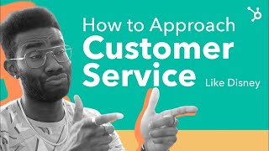
How to Approach Customer Service Like Disney
Notes:
Video: How to Approach Customer Service Like Disney
https://www.youtube.com/watch?v=dXz99gxUguk&t=302shubspot.com/service/disney-customer-service-model
Supporting online resource:
https://blog.

Slide 28
Video: Be a Hospitalian (7:52)
Notes:
Video: Be a Hospitalian (7:52)
https://www.youtube.com/watch?v=TH2L_uNkt-Y
Bobby Stuckey, TEDxBoulder
This video would be a good option to use along with the Disney resources or as a substitution.
Key Take-Aways:
The notion of hospitality can be applied to businesses beyond restaurants, hotels, attractions, travel and tourism; it is method of providing an exceptional customer experience
(1:39) “Hospitality Intervention” – staff member shifting the mood of an upset customer by using hospitality
“A hospitalian” – someone who provides the authentic act of hospitality; thinks of others instead of themselves and focuses on making the customer feel great
(2:04 – 2:50) Difference between Customer Service and Hospitality
Service🡪 What you do to/provide for someone
Hospitality 🡪 How you make someone feel, looking outward instead of inward
(5:03 – 5:44) Importance of Hospitality between the traditional hospitality-based businesses
Application/Thinking for SHSM students:
In your SHSM sector, how can you provide hospitality over service?

Slide 29
“Customer Service is not a department, it is an attitude”
David Forman, Internet Entrepreneur
Successful companies make a commitment to providing excellent customer service from ALL employees
Regular training and coaching for staff help further develop their customer service traits and skills
Employees will often develop an Action Plan to further develop their Customer Service skills

Slide 30
Your Customer Service Skills Action Plan
Refer to your student workbook
Read through the list of customer service skills and list of customer service traits
Use the organizer in the student handout to indicate which skills and traits are Super Star, So-So and Need to Develop
Identify one skill and one trait in the So-So and Need to Develop that you want to improve
Describe at least one strategy to improve for each of the identified skill and trait.
Notes:
Adapted from:
Carlaw, P., & Deming, V. K. (1999). The big book of customer service training games: Quick, fun activities for training customer service reps, salespeople, and anyone else who deals with customers. McGraw-Hill.

Slide 31
Employees who stand out in their work have these Customer Service SKILLS:
Friendly
Quick
Efficient
Eager to please
Knowledgeable
Optimistic
Diligent
Attentive
Creatively helpful
Empathetic
Poised
Upbeat
Honest and fair
Solution-oriented
Able to understand customers’ requests
Notes:
Source:
Carlaw, P., & Deming, V. K. (1999). The big book of customer service training games: Quick, fun activities for training customer service reps, salespeople, and anyone else who deals with customers. McGraw-Hill.

Slide 32
Employees who stand in their work have these Customer Service TRAITS:
Listen attentively
Maintain a positive attitude
Speak clearly
Avoid technical terms or fancy words
Give customers a feeling of confidence in them, the information they give and the company
Make every customer feel important
Calm customers that are annoyed, frustrated, upset
Notes:
Source:
Carlaw, P., & Deming, V. K. (1999). The big book of customer service training games: Quick, fun activities for training customer service reps, salespeople, and anyone else who deals with customers. McGraw-Hill.

Slide 33
Module
3
Table of Contents
Notes:
Additional Resource:
https://www.inc.com/molly-reynolds/9-companies-that-nailed-the-whole-surprise-and-del.html

Slide 34
“Surprise & Delight doesn’t refer to special promotions or exclusive deals… there is no “catch”. Customers are simply treated to something of value, completely out of the blue, with no strings attached.”
Resource: https://stampme.com/what-is-surprise-and-delight-and-why-is-it-so-effective/.
Notes:
Supporting article:
Davis, B. (2020, July 30). What is "surprise and delight" and why is it so effective? - stamp me. Stamp Me Loyalty Card App. https://stampme.com/what-is-surprise-and-delight-and-why-is-it-so-effective/.

Slide 35
Minds On
How does the restaurant featured in the video “surprise and delight” their customer?
Notes:
If delivering the certification in-person, teachers can facilitate a discussion after watching the video.

Slide 36
Notes:
Video: Blind Woman Gets Chocolate Braille Birthday Surprise
https://www.youtube.com/watch?v=6hu0uyw0UG0
A restaurant created a birthday dessert with braille for a blind customer by using melted chocolate on a plate to write “Happy Birthday” in braille.

Slide 37
Surprise and Delight
“Surprise and Delight” customer service goes above and beyond the typical customer experience
The gestures can be small and inexpensive :
Thank you cards, birthday acknowledgements, a giveaway, company swag
Some companies, like WestJet, make it an annual event that goes viral
Notes:
Supporting article:
https://stampme.com/what-is-surprise-and-delight-and-why-is-it-so-effective/

Slide 38
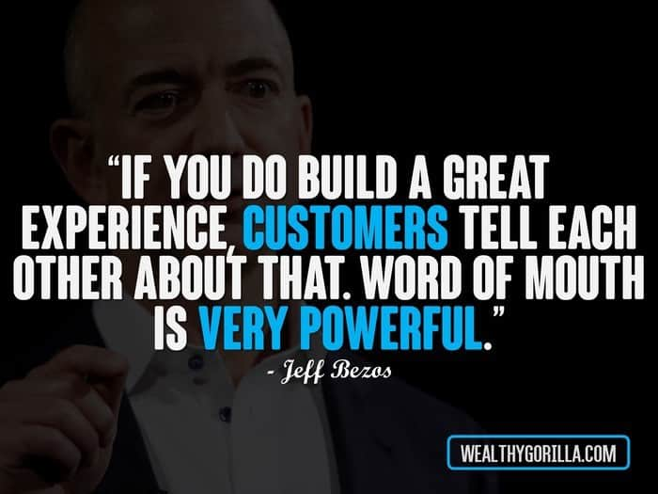
Notes:
Jeff Bezos, founder and executive chairperson of Amazon.

Slide 39
Benefits of Surprise and Delight
A very effective method of thanking and appreciating customers
Creates connections with customers
Builds long-term relationships with customers
Builds further loyalty with existing customers
Creates positive word-of-mouth
A very effective marketing strategy as well
All of these benefits creates more business for the business!

Slide 40
Notes:
Seth Godin is an entrepreneur, best-selling author, and speaker.
https://www.sethgodin.com/

Slide 41
Investigate and Describe
Watch one (or all!) of the videos that show a company surprising and delighting their customers.
In the student workbook, describe the surprise and delight strategy for one of the companies.
Discuss with other students or think about it on your own.
Explain the way in which the surprise and delight strategy creates a connection with the customer
Notes:
Note: If the videos do not work, or other examples are needed, there are many online articles and resources for other examples:
https://www.inc.com/molly-reynolds/9-companies-that-nailed-the-whole-surprise-and-del.html
https://www.oberlo.ca/blog/customer-service
https://www.teamoutpost.com/blog/customer-care-methods/

Slide 42
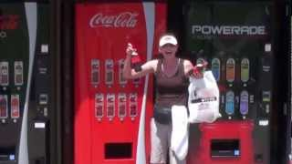
Coca Cola Happiness Machine
Notes:
Video: Coca Cola Happiness Machine at the World of Coca Cola, Atlanta
https://www.youtube.com/watch?v=qI_L7dF3OdY

Slide 43
Coke Happiness Truck, Poland
Notes:
Coke Happiness Truck, Poland
https://www.youtube.com/watch?v=KhJP5dtC81g

Slide 44
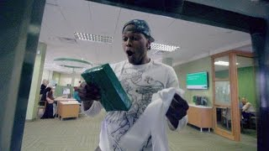
TD Bank – ATM (Automated Thank You Machine) #tdthanksyou
Notes:
TD Bank - Sometimes you just want to say Thank You
https://www.youtube.com/watch?v=bUkN7g_bEAI
#tdthanksyou

Slide 45
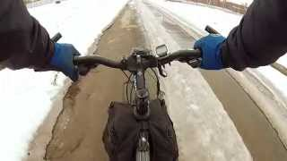
Kleenex – #sharekleenexcare
Notes:
Kleenex – Share Kleenex Care with Someone
https://www.youtube.com/watch?v=AaWzTf81aws

Slide 46
Brainstorm
Think about a local small business that is related to your SHSM sector or coop placement; identify it on your student workbook
In your student workbook, list two to four “surprise and delight” strategies that the business could use.
They can be inexpensive ideas or a larger in scale
Use the internet to help you come up with some ideas!
(Discuss with other students or think about it on your own.)

Slide 47
Video: Popsicle Moments: Finding a New Flavour of Customer Service (15:03)
Notes:
Video: Popsicle Moments: Finding a New Flavour of Customer Service
https://www.youtube.com/watch?v=CfZrqej03As&t=738s
Darren Ross, TEDxSantaBarbara
(0:00 – 2:19) “Create a moment, earn a memory.”
Take an ordinary setting, create an elevated experience
Slow down the process and focus on the customer, creating a moment
(6:43) – Would I return, based on their service?
Customer Service versus “Nothing” Service
(10:25 – 15:03) Creating a “Customer Service Reflex”
Listen carefully to respond creatively
Companies slowing down for us, to take care of us

Slide 48
Typical Customer Scenarios
4
Module
Table of Contents

Slide 49
It takes months to find a customer…and seconds to lose one.
Vince Lombardi,
American football coach and executive in the NFL.
Notes:
Vince Lombardi – American football coach and executive in the NFL

Slide 50
Watch the following three videos, keeping in mind the customer service skills and traits being demonstrated. (Or not being demonstrated!)

Slide 51
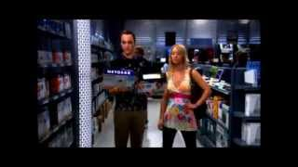
Big Bang Theory: Sheldon Shopping for Electronics
In what ways is Sheldon providing excellent customer service?
How does this clip demonstrate an issue with the customer service being provided by the store?
Notes:
Video: Sheldon Shopping for Electronics
https://www.youtube.com/watch?v=gORmiX-5PWU

Slide 52
Love Actually – Gift Wrapping Scene
How is the employee providing excellent customer service?
How is the employee not providing excellent customer service?
Notes:
Video: Love Actually – Gift Wrapping Scene
https://www.youtube.com/watch?v=XUBeW_NFggM

Slide 53
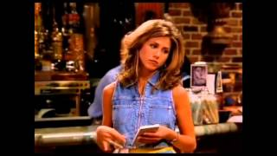
Friends – Rachel as a Server
In what ways does Rachel not provide excellent customer service?
Notes:
Friends – Rachel as a waitress
https://www.youtube.com/watch?v=b30evnsHJ_U

Slide 54
What would YOU do in the following situations when a customer…
…arrives ten minutes before closing time wanting to purchase several items.
What will you say or do?
…interrupts you while you are helping another customer.
What will you say or do?
…asks a question about a product that you do not know how to answer.
How will you respond?
Notes:
Instructor notes – students can work on these scenarios independently or in small groups. If working in small groups, encourage each group to present their scenario and customer service solution to the rest of the group.

Slide 55
What would YOU do in the following situations when a customer…
...asks your opinion about a product that you know has had some quality issues.
How will you balance being honest and trying to make a sale?
...is very upset about an unpleasant experience with someone you work with.
What will you say and do?
…calls your place of business with a question about the hours of business.
How will you answer the phone? Respond to the question?

Slide 56
Your most unhappy customers are your greatest source of learning.
Bill Gates,
Co-founder of Microsoft

Slide 57
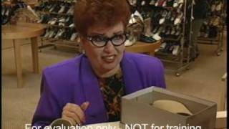
Helping Unhappy Customers
Assisting clients with complaints, issues and concerns is a part of every job, regardless of the industry
Helping an unhappy, angry, upset customer can be intimidating and challenging
Customer complaints can help companies figure out areas of improvement in their business
ACTION: Watch the video, “Dealing with Angry Customers,” to learn some pro tips!

Slide 58
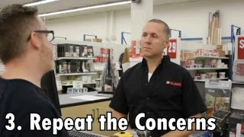
Dealing with an Angry Customer
Notes:
Corporate Video – Dealing with an Angry Customer
Video: https://www.youtube.com/watch?v=T20hV4ynU7o&t=19s

Slide 59
Steps in Assisting an Angry Customer
Stay Calm
Actively Listen
Repeat the Concerns
Actively Sympathize
Apologize
Find a Solution

Slide 60
Reflect, Connect, Demonstrate
Task: Create an upset customer scenario. It can be based on an experience you have had in a workplace. Try to connect the scenario to your SHSM sector or Co-op placement.
Apply the six steps in dealing with the customer.
Can you also “surprise and delight” the customer?
Your scenario can be written as a script, acted out,
recorded or completed as a video.
Remember to share it with your teacher!

Slide 61
Customer Service in your SHSM or Co-op Sector
5
Module
Table of Contents

Slide 62
Customer Service is the new marketing, it’s what differentiates one business from another.
Jay Baer,
Entrepreneur,
consultant and author
Instead of focusing on the competition,
focus on the customer.
Scott Cook,
co-founder of Intuit

Slide 63
Minds On
Why are these two quotations important for a small business owner to keep in mind?
Add your explanation to your student workbook.

Slide 64
Investigate and Describe
What are some common customer service issues related to your SHSM sector or Coop placement?
In your student workbook, identify and describe two to four customer service issues.
Tips!
Brainstorm with other students in your class
Think about your work-related experiences through co-op, SHSM experiential learning/reach ahead activities and part-time job to help you generate some ideas
Talk to a business owner in your SHSM sector or Coop placement
Use online resources

Slide 65
Customer Experience
6
Module
Table of Contents

Slide 67
Minds On
Make a list of 5 companies or businesses that you go back to over and over again. Explain why for each.
Add this to your student workbook.

Slide 68
What is your current understanding?
How would you define and describe “customer experience”
Discuss with other students or think about it on your own. Add your thoughts to your copy of the student workbook.

Slide 69
Can you add more?
Watch the following videos and read the provided materials.
In the student workbook, add any points to further develop your definition and description of “customer experience”.
Discuss with other students or think about it on your own. Add your thoughts to your copy of the student workbook.
Notes:
Note: If the videos do not work, or other examples are needed, there are many online articles and resources for other examples:
https://www.inc.com/molly-reynolds/9-companies-that-nailed-the-whole-surprise-and-del.html
https://www.oberlo.ca/blog/customer-service
https://www.teamoutpost.com/blog/customer-care-methods/

Slide 70
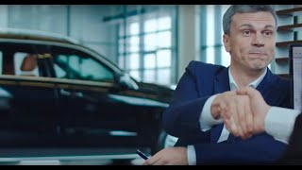

Slide 72
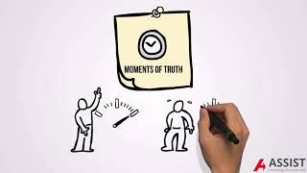

Slide 73
Forbes Article: Customer Experience Vs. Customer Service Vs. Customer Care

Slide 74
Customer Experience Vs. Customer Service
Read through the following:
Know the Difference between Customer Service and Customer Experience
Customer Service vs. Customer Experience: Here’s How They’re Different
Customer service vs. customer experience: Here’s the difference
In the student workbook, list the similarities and differences between customer experience and customer service. Discuss with other students or think about it on your own.

Slide 76
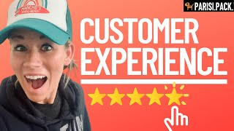

Slide 77
Improving the “customer experience”
Identify 1 company, business, or organization that you wouldn’t go back to.
Knowing what you know now, explain how you would change the customer experience that this company/business/organization provided. For additional supports, refer to the infographics provided on the next slide.
Discuss with other students or think about it on your own. Add your thoughts to your copy of the student workbook.

Slide 78
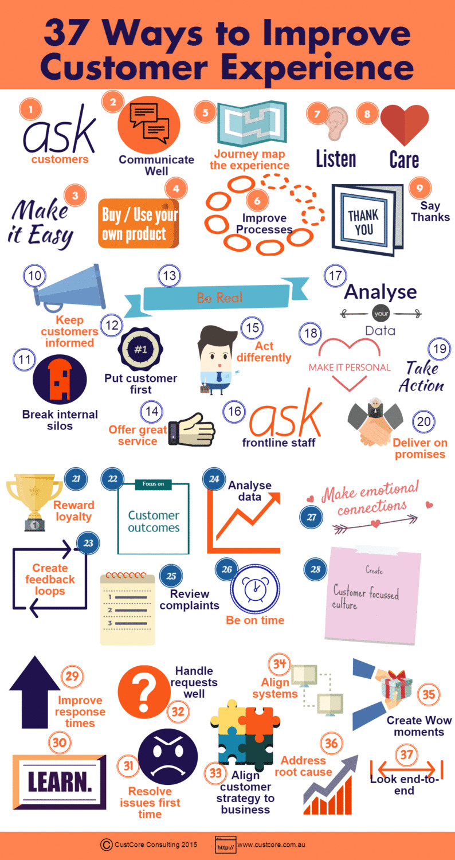
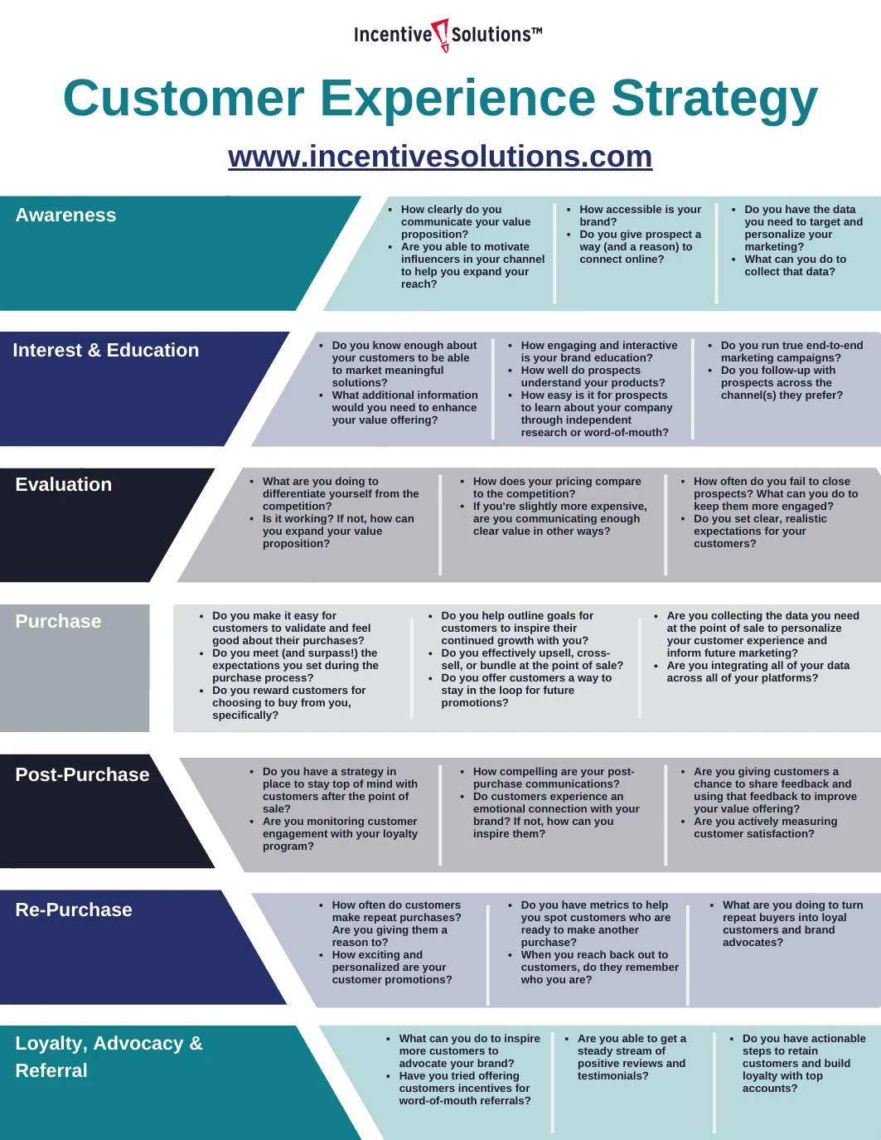
Notes:
Corporate Video – Dealing with an Angry Customer
Video: https://www.youtube.com/watch?v=T20hV4ynU7o&t=19s

Slide 79
Congratulations!
The Customer Service Certification is….

Slide 80
Lean Six Sigma
Extension Module
Make sure that you have your workbook for this module ready to record on.
Table of Contents

Slide 81
What is Lean Six Sigma?
As you watch the video on the following slide, write down how Lean Six Sigma connects to customer service and the overall customer experience.

Slide 83
Who uses Lean Six Sigma?
Explore the site link provided below to see which organizations are using Lean Six Sigma. Choose those that connect to the SHSM sector that you are in or are interested in and record them on the workbook.
Lean Six Sigma Success Stories by Industry

Slide 84
Why is Lean Six Sigma important to the customer experience?
Based on the video provided to the next slide and what you have learned so far about Lean Six Sigma, why do you think Lean Six Sigma is important to customer service? Write down your thoughts on the student workbook.

Slide 85
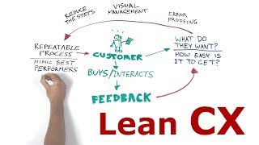

Slide 86
Why is earning a certification in Lean Six Sigma important?
Read the blog linked below and record the top 10 reasons why you should earn a certification in Lean Six Sigma.
TOP 10 REASONS TO GO FOR LEAN SIX SIGMA TRAINING AND CERTIFICATION

Slide 87
OVIN (Ontario Vehicle Innovation Network)
Extension Module
Make sure that you have your workbook for this module ready to record on.
Table of Contents

Slide 88
What is OVIN?
As you watch the video on the following slide and explore the OVIN site linked below, write down on your workbook what you have learned about OVIN.
OVIN Website

Slide 90
Minds On
The OVIN Spotlight Series highlights Ontario-based businesses and the impacts that they are making in the connected and autonomous vehicle industry.
As you watch each video, brainstorm how you think customer service and the customer experience connects to OVIN. Write these ideas on the student workbook.
OVIN Spotlight Series

Slide 91
Explore: Segments of the Sector
Ontario is a world-leading jurisdiction in the automotive and smart mobility sector, with a long history of manufacturing, world-class academic institutions, and a strong innovation ecosystem contributing to its success.
Read through the site linked below to learn more about the segments of the sector. On your workbook, list the 6 segments and briefly describe each.
Sector Overview

Slide 92
Explore: Emerging Automotive and Mobility Trends
The global automotive and mobility sector is experiencing a major transformation that is affecting the sector’s talent base and the future of work. These impacts have been further accelerated as a result of the global COVID-19 pandemic.
Read through the site linked below to learn more about the emerging automotive and mobility trends. On your workbook, list and briefly explain the 6 trends.
Emerging Automotive and Mobility Trends

Slide 93
Making Connections: The Customer Experience, OVIN, and your SHSM Sector
STEP 1: Choose an SHSM sector. For a full list of those offered in Ontario, click here. Record this on your workbook.
For example, a student is taking the grade 11 health care class (TPJ3M). They might choose to select the Health and Wellness SHSM sector.

Slide 94
Making Connections: The Customer Experience, OVIN, and your SHSM Sector
STEP 2: From the OVIN Emerging Automotive and Mobility Trends, choose from the following list the mobility and smart technology that you think connects to the SHSM sector you chose in STEP 1:
Connectivity
Autonomous driving
Shared mobility
Electrification
AI
Briefly explain how it connects to your SHSM sector. Record your choice and explanation on your workbook.
For example, the student who is taking TPJ3M and chose the Health and Wellness sector in step 1, might choose autonomous driving. They would then explain how autonomous driving connects to the Health and Wellness sector. They might talk about autonomous ambulances or drones that deliver organs for organ transplants.

Slide 95
Making Connections: The Customer Experience, OVIN, and your SHSM Sector
STEP 3: Describe how the mobility and smart technology that you chose in PART 2 could be used to create a better customer experience for your chosen SHSM sector. Record this on your workbook.
For example, the student who chose the Health and Wellness sector along with autonomous driving, will need to explain how this would create a better customer experience for an individual needing an ambulance to get to the hospital. Or how a drone could help provide an organ transplant recipient with a better customer experience.

Slide 96
Print Resources
Carlaw, P., & Deming, V. K. (1999). The big book of customer service training games: Quick, fun activities for training customer service reps, salespeople, and anyone else who deals with customers. McGraw-Hill.
Evenson, R. (2011). Customer service training 101: Quick and easy techniques that get great results. American Management Association. Second Edition.
Kinni, T. B. (2011). Be our guest: Perfecting the art of customer service. Disney Editions.
Notes:
https://www.zendesk.com/blog/customer-support-vs-customer-service/
https://www.investopedia.com/terms/c/customer-service.asp
https://beldingtraining.com/customer-service-pillars/
Bad Customer Service – movie clips montage
- https://www.youtube.com/watch?v=9oywp2qRRyc
Love Your Customer - https://www.youtube.com/watch?v=ojOqUjbGsgQ
LAST method: https://www.youtube.com/watch?v=dnpMqQnt8WY

Slide 97
Credits
Special thanks to all the people who made and released these awesome resources for free:
Presentation template by SlidesCarnival

